Slide 1

Literature Review & Secondary Data Analysis

Slide 2
Clarification
RM Module – part of PGradDip – Secondary Research Assignment
MA Year = Proposal + Dissertation
Reference Guides 8 & 10

Slide 3
Clarification
RM Module Assignment –
  2 parts – 6,000 word Literature review + 1,500 presentation
This IS NOT the Dissertation Proposal

Slide 4
Readings
Baker, M. J. (2000) ‘Writing a literature review’, The Marketing Review, Vol. 1, pp. 219-247.
Bolton, G. & Delderfield, R., 2018. Reflective practice: writing and professional development, London: SAGE.
Collis, J. and Hussey, R., (2021). Business research: A practical guide for undergraduate and postgraduate students. 5th ed., London: Palgrave Macmillan Higher Education
Creswell, J. (2002). Qualitative, Quantitative, and Mixed Methods Approaches. 2nd ed., Thousand Oaks, CA: Sage Publications
Cunliffe A. (2004) ‘On Becoming a Critically Reflexive Practitioner’, Journal of Management Education, 28, p.407
Saunders, M., Lewis, P. and Thornhill, A. (2009) Research Methods for Business Students. Pearson, New York

Slide 5
Research Design & Purpose
Secondary data analysis and review involves collecting and analyzing a vast array of information.
To help you stay focused, your first step should be to develop a statement of purpose – a detailed definition of the purpose of your research – and a research design.
Know why you are analysing this data?
What purpose is it serving for you?

Slide 6
Literature Review
The Literature Review is a summary of the major concepts, issues, and arguments related to the chosen topic. This information may be obtained from textbooks, academic journals, published reports, and conference proceedings and occasionally newspapers and magazine articles.

Slide 7
Literature Review…
is…a review of the literature
Not writer’s opinions
Not merely a list of what X found and Y found
A critical evaluation of previous theoretical, methodological and empirical research in the field of study
Needs to be your review, your interpretation of where the literature is at present, emerging gaps, unresolved debates, issues

Slide 8
3 Purposes of a Lit. Review
It brings together all relevant information on a topic
It provides an interpretation of what is known – there is a mis-placed assumption that the aim of the literature review is to impress readers with author’s knowledge of topic; it is not a laundry list (X noted, Y stated..)
It provides a critical account of the strengths and weaknesses of the field – omitted issues, quality of evidence, etc.?

Slide 9
Issues
LR deals with all currently available writings (i.e. secondary data) related to the chosen topic
Research project does not exist in isolation
Researcher must build upon previous work
Helps to generate research questions relevant to topic
Also involves discarding literature that is considered irrelevant
It will put your research project into context i.e. it will show how your topic fits into a particular field
Direction should be evident in the literature review

Slide 10
Issues
One should conclude the literature review with a summary and conclusions section which provides the link to the primary research.
This will also identify the ‘gap’ which exists in the current literature which the primary research will seek to answer.
By the end of the literature review the reader should be convinced of the need for the study
(Rudestam and Newton, 2001)

Slide 11
Lit. Review Process
Start at more general level
Provide a brief overview of key ideas
Summarise in brief, compare and
contrast work of key writers,
Narrow down to highlight most
relevant work
Provide a detailed account of the
findings of this work
Highlight issues where your research
will provide fresh insights
Lead the reader into subsequent sections
(Saunders et al., 1997)

Slide 12
Step 1
Start by reading relevant text books - unlikely to give you any in-depth material but will give you a quick look at some of the key issues in your area
Search databases – good quality journals
Initially, gather around 5-10 articles in your topic area
Read each article and produce a one page summary of the key issues – theories – theorists – models – etc.
A pattern should begin to emerge - theories - issues, etc.

Slide 13
Step 2
Start to type the literature review
Start sections on each of the key issues / theories identified
Type in the views of the theorists from the first articles reviewed
If in doubt – type in large tracts of material from each article – this can be edited later
After completing this stage – your LR should consist of a number of pages with a couple of paragraphs on each

Slide 14
Step 3
As you gather and review more material – you can insert relevant material, etc. onto the relevant page
You should have become better at sourcing only relevant material at this stage
A clearer pattern should begin to emerge, and at this stage, it should be possible to devise a draft table of contents for the LR.
Continue to gather material and insert it into appropriate headings in the table of contents

Slide 15
Step 4
As you gather more material – some new issues / theories / theorists may emerge - this may result in you adding new sections to your LR
You may also realise that some of the separate sections you originally identified really should be amalgamated into one section – perhaps as sub-sections
- As you read more and more material, it should become obvious when you have covered all the relevant issues / theories etc

Slide 16
Step 5
Your LR at this stage should consist of about 20 typed pages, divided into sections, each containing a series of paragraphs drawn from the reviewed literature. These paragraphs will probably be in no particular order - and will have no ‘linking’ narrative
Now the fun starts….. You now have to develop these ‘free floating’ paragraphs into a ‘story’
Examine each ‘paragraph’ i.e. look for similarities in the arguments, look for differences in the arguments

Slide 17
Step 6
Look for ‘development’ of the issues as you move from one theorist to the next. Your job is to construct a narrative that tells the story of the development of the theory in your chosen area - the theories, the issues, the theorists, what has been written about your area, what is important in your area
By bringing the material together in a logical format, you will become an implicit interpreter of connections between individual studies and strands of research, and an explicit commentator on the quality of individual studies and research strands.

Slide 18
Summary of Lit Review
Not a ‘compilation of facts’ (logical argument)
Specific and directly relevant literature
Concise, summarised material (avoid large or excessive use of quoting – reinforcement)
Avoid ‘padding’ your thesis
Role of table of contents in providing structure
Iterative process
Rely mostly on academic literature
Up to date literature (recent vs seminal work)
Thorough review required
(Brennan, 1998, p18-20)

Slide 19
The 4-S Strategy
Search
  Focused, comprehensive and premeditated
Select
  Academic literature, key authors, landmark studies
Synthesise
  Combine individual or different variables into LR
Structure
  Logical organisation of text, argument, headings…

Slide 20

Reading
Writing

Slide 21
Literature Sources
Academic journals - peer reviewed, referenced. Most of these can be accessed via the college databases e.g. Business Source Premier, Science Direct, Emerald fulltext, Infotrac, Academic source premier…….
Conference papers – theme based, current, access?
Textbooks – variety, for research purposes focus on texts by key authors. References? Collection of readings e.g. Issues in information systems
Semi-academic journals e.g. HBR, SMR, CMR
Professional publications e.g. Academy of Management; Journal of Marketing

Slide 22
Literature Sources
Government publications – statistical publications e.g. www.cso.ie www.oecd.org http://epp.eurostat.ec.europa.eu/portal/page/portal/eurostat/home/ http://www.imf.org/external/index.htm
Other theses
Search Engines e.g. http://scholar.google.com/
Business Magazines/Papers e.g. ww.businessweek.com
www.economist.com www.ireland.com www.ft.com www.irishtimes.com www.wsj.com www.fortune.com www.strategy-business.com www.mcKinseyquarterly.com www.businessworld.ie

Slide 23
Journals
Peer-reviewed
National and international
Authorship
Rankings - see http://www.harzing.com/jql.htm

Slide 24
Online Sources
Dissertations on-line - www.theses.com
British Library on-line theses – http://ethos.bl.uk/Home.do
E-journals / Publishers on-line
ITC

Slide 25
Analysis of
Literature Sources
General
knowledge
Specialised
knowledge
General encyclopaedias
General interest magazines and newspapers
Specialised magazines
Trade books
Government documents
Scholarly books
Academic journals
Less
authoritative
More
authoritative
[Ballinger, 1998]

Slide 26
Research Gap
A research proposal will explicitly state, the ‘research gap’. A literature review will summarise the existing research on a chosen topic and will provide a justification as to the gap’s existence. It will not however ‘jump in’ to this weakness in the literature, but will present the various facets of the debate and build up the platform upon which one’s own work can be presented.
At the end of the literature review, one should summarise the main arguments which have been developed in the review and refer to the ‘gaps’ which exist in the literature as it stands. This then becomes the basis for the research question and the research objectives.

Slide 27
Research Question
A useful starting point in the writing of research questions is to begin with one general research question which flows from your research idea. For example,
  What benefit do commercial organisations derive from sponsoring soccer clubs?
  Will the loss of mutuality status by building societies lead to them offering less attractive terms to savers and borrowers?
  What are the strategies that trade unions should adopt to ensure their viability in the future?

Slide 28
Research Objectives
One can use a research question(s) as a base from which to write a set of research objectives. Objectives are more broadly acceptable to the research community as evidence of the researcher’s clear sense of purpose and direction.
Research Question
What is the role of team briefing in manufacturing companies
Research Objectives
To understand why manufacturing organisations have introduced team-briefing schemes?
To what extent have the objectives of team-briefing have been met?
To determine the factors associated with effective team-briefing?

Slide 29
Research Question / Objectives
Research question:
  “To investigate the information flows of top managers in order to evaluate the validity of the concept of an information system for executives and develop guidelines for the design of future systems.”
Research objectives:
  To determine the characteristics of the communications networks of executives
  To investigate what information executives use and how do they add value to it
  To establish what communication channels executives use?
  To investigate how executives view computers and computerised information systems

Slide 30
Secondary Data
Secondary data analysis can be literally defined as “second-hand” analysis.
It is the analysis of data or information that was either gathered by someone else (e.g., researchers, institutions, other NGOs, etc.) or for some other purpose than the one currently being considered, or often a combination of the two (Cnossen 1997).
Data collected by a person or organization other than the users of the data

Slide 31
Writing Style
Write in the passive voice
The language and tone must be appropriate to an academic project
Direct quotes from articles should be used as sparingly as possible
Your job is to paraphrase the material you have reviewed - take the essence of the argument presented by the theorist – and write it in your own words
Do not ‘change’ the essence of the theorists argument - just paraphrase it!.

Slide 32
Writing Style Assistance
Dissertation Guidelines Document
  Basis for examination
General on-line assistance:
  The Internet Public Library [http://www.ipl.org/div/subject/]
  Purdue Online Writing Lab [http://owl.english.purdue.edu/owl/]
  Uni of Toronto [http://www.writing.utoronto.ca/advice]
  Many others

Slide 33
Purpose of Referencing
To attribute a quote
To justify a statement
To inform the reader of the information source
To argue for the reasonableness of your methods (as used by others)
To help interpret your results (vs findings)
To help build an argument
(Jankowicz, 2000)

Slide 34
Web Sources
Literature Reviews: An Overview for Graduate Students North Carolina State [9.39]
http://www.youtube.com/watch?v=t2d7y_r65HU
Writing the Literature Review: Step-by-Step Tutorial for Graduate Students – Part 1 [5.22] http://www.youtube.com/watch?v=2IUZWZX4OGI
Writing the Literature Review (Part 2): Step-by-Step Tutorial for Graduate Students – [7.40] http://www.youtube.com/watch?v=UoYpyY9n9YQ&feature=related
How to write a literature review Part 1 [9.59]
http://www.youtube.com/watch?v=xuJr0TVXy0o&feature=related
How to write a literature review Part 2 [9.26]
http://www.youtube.com/watch?v=uBn1w3rnvxc&feature=related
How to write a literature review Part 3 [5.38]
http://www.youtube.com/watch?v=OgjJBDGXAuQ&feature=related
Writing a dissertation (Uni of Leicester, 21.48]
http://www.youtube.com/watch?v=1hVNF_8S6Ok

Slide 35
Why Critique
Matthews and Ross (2010)
  Already known
  Different theories, methods
  Analytical frameworks used –for you?
  In context – policy
  Compare and contrast different sources and experts
  Learn the ‘language’ or vocabulary
  Find important issues or variables
  Think about/define research questions
  Inform discussion of findings
  Identify links in theory and practice
  Synthesis of relevant information so reader can understand

Slide 36
Evaluating Research
Step 1 Consider the Article as a Whole
Try to determine something about the purpose, audience and content of the paper before you start reading – in this regard, consider who is writing the article, what are his/her qualifications, what audience are they addressing, what is the article about and what sources are used by the author?

Slide 37
Evaluating Research
Step 2 Determine the Overall Purpose, Structure and Direction of the Article
Having examined the article as a whole, start reading … consider the purpose of the article (this should be in the introduction), the limits placed on the article, and the conclusion (this should only contain the author’s remarks to the reader).

Slide 38
Evaluating Research
Step 3 Read the Article but Pay Attention to the Writing and Presentation
Watch for not only what the authors says, but how it is said. This requires that you read the article to gain an understanding of how the author presents the evidence and how it is made to fit with the argument.

Slide 39
Evaluating Research
Step 4 Criticism and Evaluation of the Article
Initially, consider your personal reaction to the article, ask what the author is trying to say, who he or she are addressing and has it addressed a research gap
Then try to judge the worth of the article by comparing it to a standard article in that field.

Slide 40
Sexual harassment has many consequences. Adams, Kottke, and Padgitt (1983) found that some women students said they avoided taking a class or working with certain professors because of the risk of harassment. They also found that men and women students reacted differently. Their research was a survey of 1,000 men and women graduate and undergraduate students. Benson and Thomson's study in Social Problems (1982) lists many problems created by sexual harassment. In their excellent book, The Lecherous Professor, Dziech and Weiner (1990) give a long list of difficulties that victims have suffered.
The victims of sexual harassment suffer a range of consequences, from lowered self-esteem and loss of self-confidence to withdrawal from social interaction, changed career goals, and depression (Adams, Kottke, and Padgitt, 1983; Benson and Thomson, 1982; Dziech and Weiner, 1990). For example, Adams, Kottke, and Padgitt (1983) noted that 13 percent of women students said they avoided taking a class or working with certain professors because of the risk of harassment.
Good & Bad Example

Slide 41
Theory
‘Theory may be viewed as a system for ordering concepts in a way that produces understanding or insights [Zaltman et al., 1977, cited in Ghauri and Gronhaug, 2002]
‘Suppositions which explain, or seek to explain something’ [Blaxter, 2002, p. 205]
‘A set of interrelated constructs (concepts), definitions and propositions that presents a systematic view of phenomena by specifying relations among variables, with a purpose of explaining and predicting phenomena’ [Kerlinger, 1970, cited in Wallimam, 2001]

Slide 42
Defining Concepts and Developing a Conceptual Framework
Simplifies the research task
Discard literature not central to topic/question
Provide a ‘map’ of the field of study
Consider alternative frameworks - may have to modify, adapt or even replace the theoretical framework
Defining concepts
  Choosing a definition from the literature
  Help you understand and explain your subject matter

Slide 43
Defining Concepts and Developing a Conceptual Framework
Concepts
Frameworks
Building blocks of models and theories
Working definitions for chosen analyses
Chosen to be useful, not correct
Are more than a dictionary definition
Are analytical schemes
Simplify reality to make it easier to discuss, analyse or research
Simplify reality by selecting certain phenomenon or variables and suggesting certain relationships between them
Are judged in terms of utility, not correctness
Watson (1994), cited in Fisher (2007, p. 126, 133)

Slide 44
Theories
Ideas about how phenomena relate to each other
Ideas about how particular events or actions tend to lead to others or are brought about by them
Are generalisations
Are the inductive heart of scientific study
Watson (1994), cited in Fisher (2007, p. 126, 133)

Slide 45
Theoretical Framework
A conceptual model of how one theorises the relationships among the several factors that have been identified as important to the [research] problem
A collection of theories and models from the literature which underpins positivistic research study...it explains the research questions or hypotheses [idea or proposition that can be tested for association or causality using statistics].
  Sekaran, 1992

Slide 46
Benefits of Conceptual Frameworks
Modelling relationships between theories
Reducing theoretical data into statements of models
Explicating theories that influence the research
Providing theoretical bases to design, or interpret, research
Creating theoretical links between extant research, current theories, research design, interpretations of findings and conceptual conclusions

Slide 47
Developing a Framework
STEP 1: Identify and clarify concepts
STEP 2: Connections and relationships
between the concepts

Slide 48
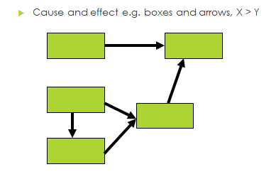
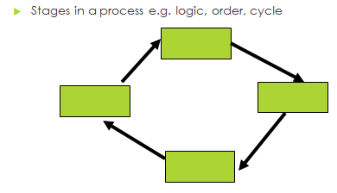
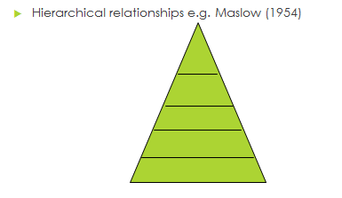
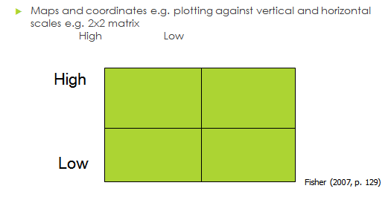
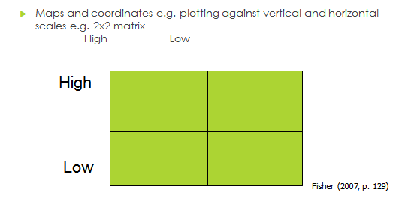
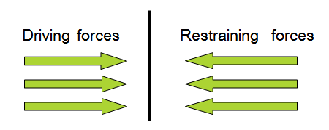

Slide 49
State your research Question?
Select 5 Articles
What is your research objectives?
What are each of the key Issues?
Is there a research Gap?
Define the concepts
Link the Relationships
Develop a theoretical framework

