Slide 1
Level 3 Foundation Certificate in People Practice
Business, Culture and Change in Context (3CO03)
Rhiannon Akers - September 2024

Slide 2
Agenda for today
9.30am – Introduction to the module.
10.45am – Break
11am – Analysing the business environment.
12pm – Lunch
12.45pm – Technology in the workplace.
1.45pm – Break
2pm – Organisational culture.

Slide 3
Learning outcomes
1. Understand the business environment in which the people profession operates, including the key issues that affect it.
2. Understand how people’s behaviour in the workplace affects and shapes culture.
3. Understand the importance of effective management of change.

Slide 4
Key Resources
Chapter 1 of ‘People Practice’.
CIPD Factsheets on Organisational Culture and Cultural Change, PESTLE, SWOT (available on CIPD website).

Slide 5
Key dates for the module
Face to face workshop 2 – 9.30am on Thursday 10th October.
Online tutorial - 11am on Thursday 24th October 2024.
Deadline for drafts – 11.59pm on Thursday 24th October 2024 (I can review and provide feedback on 50% of your work).
Deadline for final submission – 11.59pm on Monday 4th November 2024.

Slide 6
Assessment
Written answers to 9 questions (2500 words).
You will need to address each assessment criteria (AC) as noted in the assignment brief on Moodle.
Ensure you clearly address each one under a separate heading.
You can go +/-10% over/under the word count.
Always refer back to the question to ensure you are answering what is being asked.
Try to include references where possible.
Notes:
Go through assignment brief.

Slide 7
Learning outcome 1
1. Understand the business environment in which the people profession operates, including the key issues that affect it.

Slide 8
What are the goals of HRM function?
• Support organisation in achieving its objectives by developing and implementing HR strategies which are integrated with the Business strategy.
• Contribute to the development of a high performance culture • Ensure the organisation has the talented, skilled and engaged employees it needs.
• Maintain a positive employment relationship between management and employees (must feel trusted, valued and appreciated).
• Provide a satisfactory employee experience.
• Further the wellbeing of employees as major stakeholders.

Slide 9
Analysing the External Environment
• To inform strategy
• To remain competitive
• To ensure sustainable organisational performance
• Our responsibility to understand the external world
• Tools – PESTLE, SWOT, Porter’s 5 Forces

Slide 10

PESTLE

Slide 11
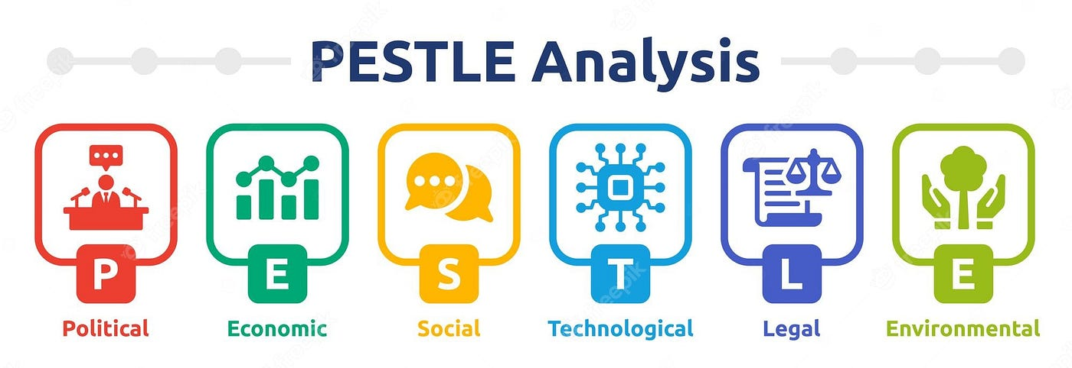
Notes:
Political - Tax policy, trade restrictions, political stability, Brexit
Economical - Economic growth or decline? Cost of living, working hours, unemployment
Social - Cultural norms, population growth, age, career attitudes
Technological - New technologies, rate of change, barriers to entry, 4th Industrial Revolution
Legal - Legislation changes, employment, imports and exports Legal
Environmental - Ecological and environmental issue

Slide 12
Examples of impact on HR
Example 1 – A social trend is the ageing population. Possible HR implications for the NHS – need to train staff in elderly patient care; increase number of staff in certain wards; offer flexible working opportunities to encourage older workers into the workforce/retain them.
Example 2 - Brexit (political factor) has resulted in less people migrating to this country which has already affected vacancy levels in some organisations. In the NHS this means finding alternative ways of filling those vacancies – for example by encouraging more men to go into the nursing profession

Slide 13
The main forces shaping HRM
Global pressures and globalisation.
Labour markets, patterns of employment and labour disputes.
Organisational flexibility, precarious work and regulation.
The legal and institutional framework.
Major global shocks for HRM.

Slide 14
UK and EU influences on HRM and employment relations
National minimum wage.
Equal pay/equal value.
TUPE and contracting-out.
Information and consultation.
Flexibility and security.
Working time directive.
Changes following Brexit.
(Marchington et al, 2020)

Slide 15
Major global shocks on HRM
Example – COVID19.
Major changes in the way we operate and how work patterns might change in the future.
Growth of remote working, increased use of technology and artificial intelligence.
Furlough schemes in different countries.
Rising unemployment and implications for the future of work.
Guides about safe work during pandemic.
(Marchington et al, 2020)

Slide 16
Factors influencing HRM
Product markets
Competitive pressures/positioning.
Direct and indirect customer pressures.
Predictability and uncertainty in market situation.
The question of multiple product markets.
(Marchington et al, 2020)

Slide 17
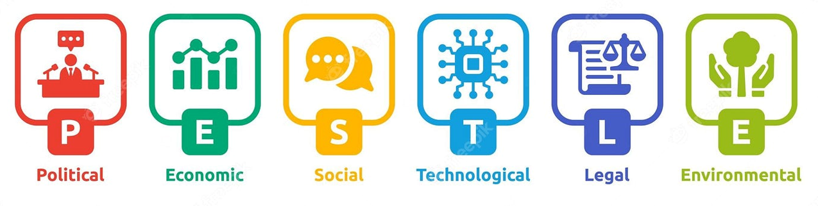
Group Activity
Complete a PESTLE analysis on an organisation of your choice.
Discuss and list the factors that are affecting or will affect the organisation.

Slide 18
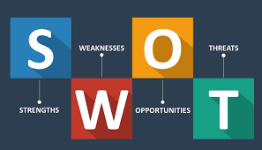
SWOT analysis
Strengths – Internal factors that
give the organisation a competitive advantage.
Weaknesses – Internal factors that place the organisation at a disadvantage.
Opportunities – External factors that the organisation could utilise to its’ advantage.
Threats – External factors that could pose challenges or risks to the organisation.
SWOT analysis is typically more focused on the immediate internal environment of the organisation.
Notes:
A SWOT analysis process generates information that is helpful in matching an organisation or group’s goals, programs, and capacities to the environment in which it operates. The ‘SWOT’ itself is only a data capture exercise - the analysis follows later.
Strengths: positive tangible and intangible attributes, internal to an organisation and within the organisation’s control
Weaknesses: internal factors within an organisation’s control that detract from the organisation’s ability to attain the desired goal. Which areas might the organisation improve?
Opportunities: external attractive factors that represent the reason for an organisation to exist and develop. What opportunities exist in the environment, which will propel the organisation? Identify them by their ‘time frames’.
Threats: external factors beyond the organisation’s control which could place the organisation mission or operation at risk. The organisation may benefit by having contingency plans to address them if they should occur. Classify them by their severity and probability of occurrence.
It's important to note the strengths and weaknesses are intrinsic value-creating skills or assets, or the lack of these, relative to competitive forces. Opportunities and threats are external factors which are not created by the organisation, but emerge as a result of the competitive dynamics caused by future gaps in the market. PESTLE analysis is used to look at opportunities and threats (external) elements.
Timeframe:
SWOT: Often used for shorter-term planning and addressing current issues or opportunities.
Application:
SWOT: Commonly used for business planning, project planning, and product development.
Focus on Change:
SWOT: More focused on the present situation and how it can be improved or leveraged.

Slide 19

SWOT analysis within an organisation
Notes:
Lecturer to play video

Slide 20
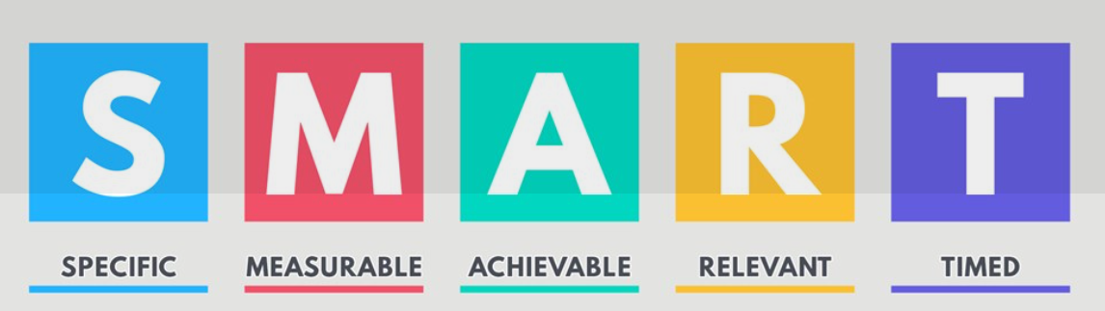
How to plan and achieve business goals

Slide 21
Why plan?
Provides direction and focus.
Enables measurement and progress.
Improves decision-making.
Increases motivation.
Facilitates resource allocation.
Enhances co-ordination.

Slide 22
Group Activity
1. Discuss the business goals of your organisation, or an organisation you are familiar with, and how this is communicated to employees.
2. Who are the main customers of your organisation, or an organisation you are familiar with?

Slide 23
How does HR impact the customer?
Employee satisfaction impacts customer satisfaction.
HR helps build customer-centric culture.
Employee data management.
Training and development.
Performance management.
Recruitment.
Internal customer service.
Notes:
Employee satisfaction impacts customer satisfaction: Happy, engaged employees are more likely to provide better customer service and experiences. HR plays a key role in ensuring employee satisfaction through proper management, training, and support.
HR helps build customer-centric culture: By recruiting, training, and developing employees with strong customer service skills and mindsets, HR contributes to creating a customer-focused organisational culture.
Employee data management: CRM systems used by HR can store and manage employee data in a similar way to customer data, allowing for better tracking of employee performance, skills, and development needs that ultimately impact customer interactions.
Training and development: HR is responsible for providing training that equips employees with the skills needed to serve customers effectively. This includes customer service training, product knowledge, and soft skills development.
Performance management: HR's role in evaluating and managing employee performance directly impacts the quality of service delivered to customers.
Recruitment: HR's efforts to attract and hire the right talent ensure that the organisation has employees capable of meeting customer needs and expectations.
Internal customer service: HR often serves as an internal service provider to employees, modeling good customer service practices within the organisation.

Slide 24
Hot topics for HR
Diversity and inclusion
Wellbeing
Flexibility
Impact of technology
Changing employee expectations mean that action in these areas will result in better employer brand (affects attraction/retention).
Notes:
All areas closely linked. Technology can heavily impact all 3 areas.
For example: AI can help you achieve your equality, diversity and inclusion (EDI) goals because it’s good at identifying patterns and processing large amounts of data quickly. It also enables you to gather, analyse and respond to biases resulting from people management processes efficiently. However, there is need for caution to ensure that AI is not the source of discrimination. There are specific guiding principles.

Slide 25
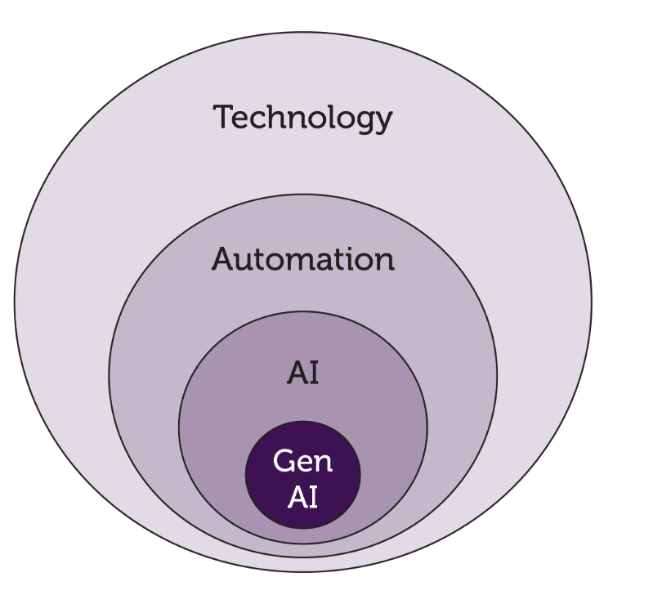
Technology
According to CIPD (2024), people professionals need to be aware of the range of technologies and how to use them responsibility to enhance their people practice.
Notes:
Technology
Technology is the application of knowledge or processes to achieve practical goals that are reproducible. This includes automation and other tools which aren’t necessarily about reducing human involvement. Examples include communication technologies like the internet and videoconferencing tools.
Automation
Automation is the use of technology to do tasks without (or with reduced) human assistance. AI, Robotic Process Automation (RPA) and even washing machines are examples of automation. RPA is used for repetitive tasks that people do on computers, like copying and pasting data between spreadsheets.
Artificial intelligence (AI)
AI is the automation of cognition, that is automating the collection, processing and interpretation of information.
Generative AI (GenAI)
GenAI is a type of AI that creates content from existing patterns of data such as text, video and audio. ChatGPT, Claude and Gemini are examples of generative AI tools that have been trained on vast amounts of text data to generate human-like responses. For examples of generative AI in HR, see our guide on preparing your organisation for AI use.

Slide 26
HR technologies
HR software (employee information system, human capital management solutions, HR management systems).
Business intelligence software.
Collaboration platforms.
Social networking platforms.
Generative AI tools.
Notes:
Business intelligence software (e.g. Power BI, Tableau, Looker) can help with reporting and sharing key people insights with business leaders.
Collaboration platforms (e.g. Teams, Zoom, Slack) can be useful for engaging with hybrid teams.
Social networking platforms like Glassdoor and Google Reviews can provide insight into what people think of your organisation, while LinkedIn can be useful for sourcing and connecting with candidates.
Generative AI tools like ChatGPT, Claude and Gemini can be useful for many things including brainstorming ideas and drafting text. Meanwhile AI-powered research tools like Consensus, Elicit and Semantic Scholar can support with evidence-based HR by helping you discover relevant literature quickly.

Slide 27
Technology
File sharing – Sensitive resources such as CVs, appraisal records or employee details can be shared instantly (Tebbs, 2018).
Video conferencing – HR Magazine found that over half of their readers said video calls had become their preferred communication method (Greedy, 2021).
How does your organisation, or an organisation your familiar with, utilise the above?
What are the advantages and disadvantages?
Notes:
Ask to discuss as a group.

Slide 28

File sharing
Advantages:
  Improved collaboration and accessibility.
  Enhanced security and compliance.
  Streamlined processes.
  Cost and time savings.
  Improved data management and retention.
Disadvantages:
  Security risks.
  Lack of control over data.
  Version control issues.
  Potential for data loss.
  Employee misuse.

Slide 29

Video conferencing
Advantages:
  Saves time and money.
  Increased engagement compared to audio calls.
  Enhanced collaboration.
  Flexibility for remote workers.
  Improved attendance.
  Reduced carbon footprint.
  Supports diverse teams.
  Boosts productivity.
Disadvantages:
  Security risks.
  Privacy concerns.
  Technical issues.
  Impersonal interactions.
  Distractions.
  Potential for misuse (both intentionally and unintentionally).

Slide 30
Technology – The fourth industrial revolution
2 views – pessimistic/optimistic
Likely – a time lag between jobs going and jobs being created.
Useful source – World Economic Forum - Fourth Industrial Revolution | World Economic Forum (weforum.org)
Notes:
The Fourth Industrial Revolution (4IR) refers to the current era of rapid technological advancement characterised by:
A fusion of technologies blurring the lines between physical, digital, and biological spheres.
Unprecedented speed of breakthroughs compared to previous industrial revolutions.
Disruption and transformation of nearly every industry across the world.

Slide 31
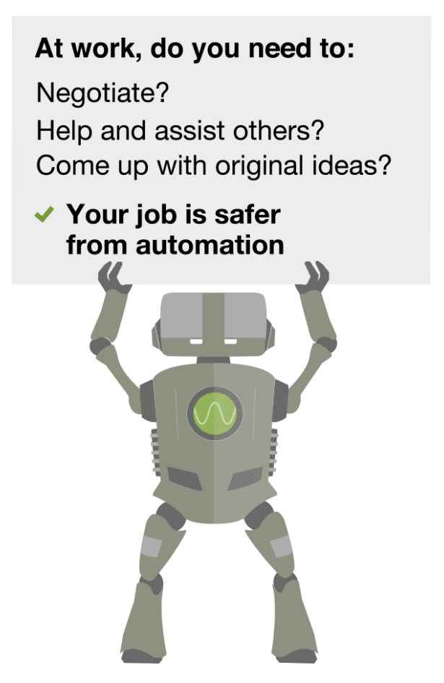
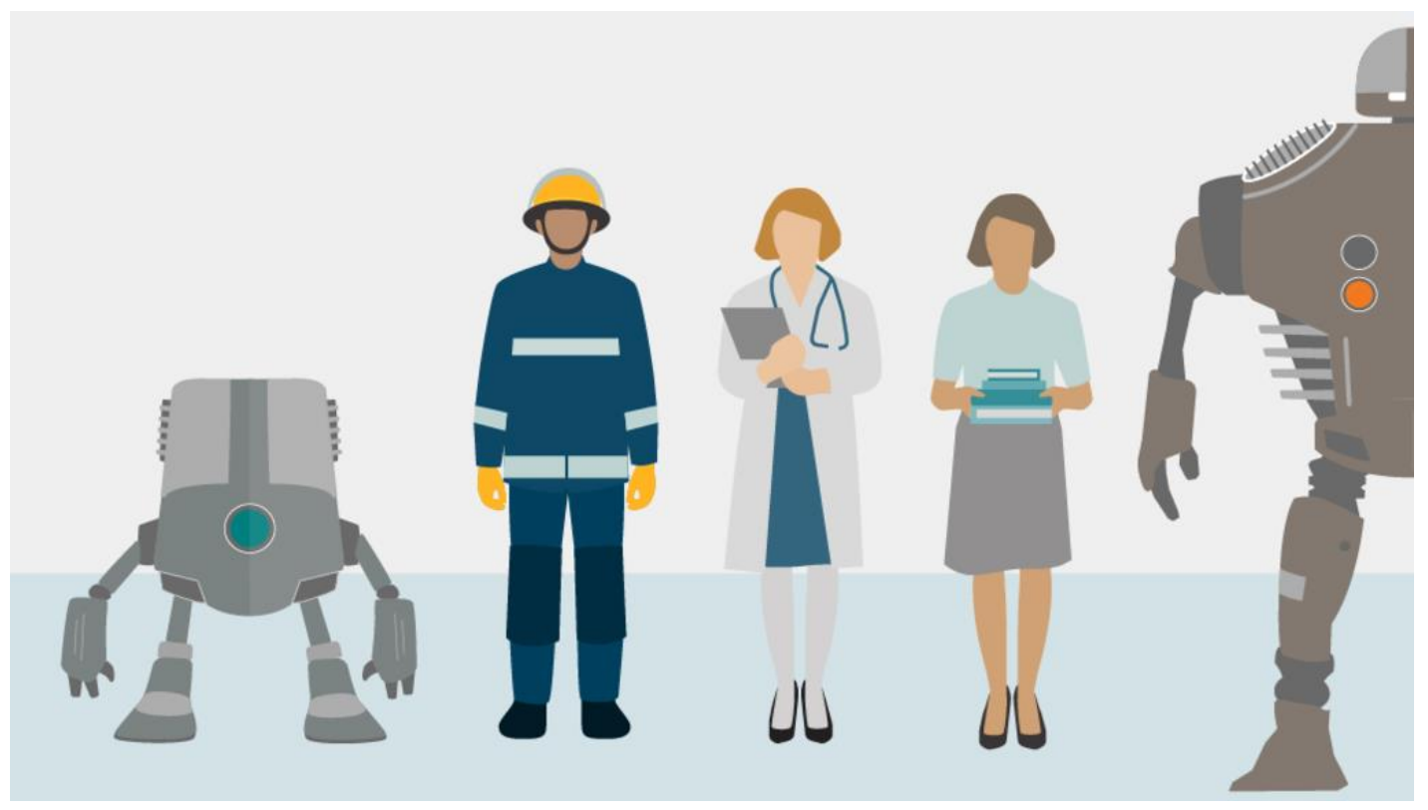
What makes a job susceptible to automation?
Will Robots Take My Job?

Slide 32
Learning outcomes
2. Understand how people’s behaviour in the workplace affects and shapes culture.

Slide 33
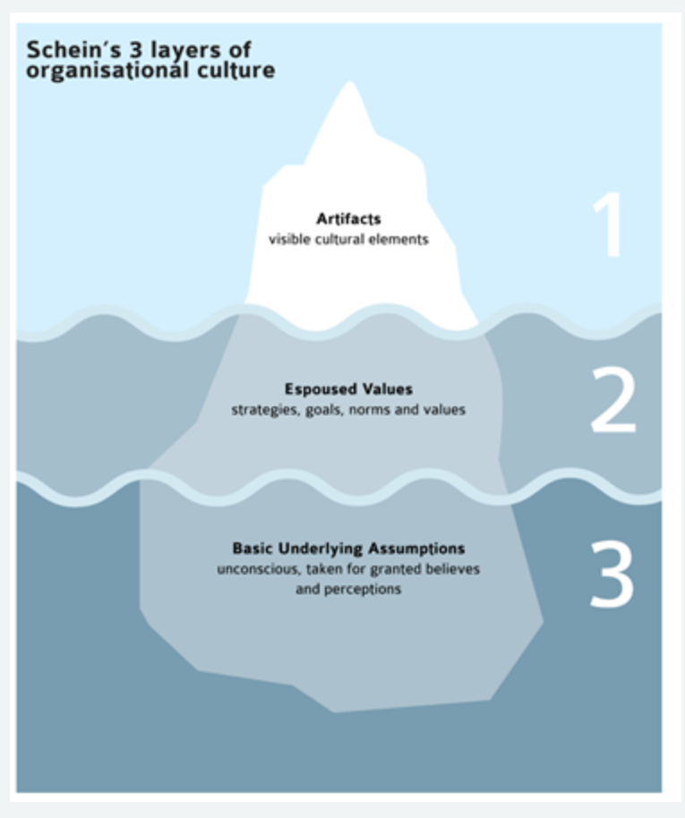
What is organisational culture? (CIPD, 2023)
The influential psychologist Edgar Schein described three levels of organisational culture:
artefacts that may reflect culture (for example, symbols and language)
norms and values about appropriate attitudes and behaviours (espoused or real)
underlying assumptions and beliefs (conscious or unconscious).

Slide 34
Culture definitions
Fincham and Rhodes (2005) ‘The set of beliefs, values and norms that represent the unique character of an organisation and provide the context for it’s actions’
Balogun and Johnson (2004) ‘the way we do things around here’
Molander and Winterton (1994) ‘The culture of an organisation is made of traditions, habits, ways of organising and patterns of relationships at work…’
Edgar Schein (1992) ‘A Pattern of shared basic assumptions that the group learned… that has worked well enough to be considered valid and therefore, to be taught to new members as the correct way to perceive, think and feel.’

Slide 35
Handy, 1993 – Sub-cultures
People Culture
Power Culture
Organisational Culture
Task Culture
Role Culture

Slide 36
Positive workplace culture
Employee Engagement: Employees are engaged and motivated to be productive and use skills to benefit the organisation
Competitive Advantage: A good culture fosters a good sustainable workforce who achieve goals and will support the organisational strategy. This creates an advantage over competitors. For example Apple- competitive advantage in innovation.
Embedded culture: Employees are all on the same page, there is support between employer and employee. Can attract the right talent when recruiting.

Slide 37
Question….
If culture has a positive impact on people’s behaviour in the workplace, how important is it to develop a positive culture?
How can HR professionals help ?

Slide 38
Fostering a positive organisational culture
Developing and promoting fair policies
Supporting the worker voice and viewpoint
Promoting and role modelling effective workplace values and behaviors
Upholding good and ethical practice.

Slide 39
Group activity
Your group will be allocated one of the following models to research and report back to the group.
  McKinsey 7-s
  Galbraith Star Model
  Burke Litwin Model

Slide 40
What have we learnt?
People practices support the achievement of business objectives.
Strategy can be affected by external, as well as internal factors.
Two key environmental analysis tools are PESTLE and SWOT.
There are both benefits and risk to improvements in technology.
Key issues for HR - wellbeing, flexibility/agility, diversity and inclusion, impact of technology, attraction and retention.
The importance of organisational culture and relevant models.

Slide 41
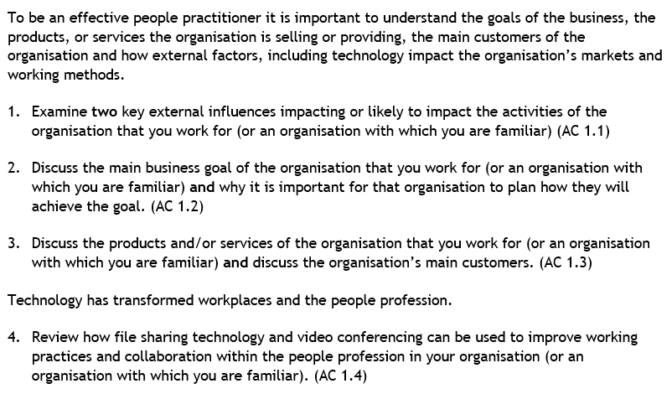
Assignment recap
Notes:
Break into groups and bullet point each question.
Remember you can use the

Slide 42
References
CIPD (2023) Organisational climate and culture. Available at: Organisational climate and culture | Factsheets | CIPD (Accessed: 18 September 2024).
CIPD (2024) Technology, AI and the future of work. Available at: Technology and the Future of Work | Factsheets | CIPD (Accessed: 18 September 2024)
Greedy, E. (2021) Employees prefer to communicate via video calls. Available at: HR Magazine - Employees prefer to communicate via video calls (Accessed: 18 September 2024)
Marchington, M., Wilkinson, A., Donnelly, R. and Kynighou, A. (2020) Human Resource Management at Work: The Definitive Guide. Sixth edition. London: Kogan Page.
Tebbs, A. (2018) How cloud technology is making HR more efficient. Available at: 39507 (peoplemanagement.co.uk) (Accessed: 18 September 2024)

