Slide 1

Effective Team Working
By Ebony Evans

Slide 2
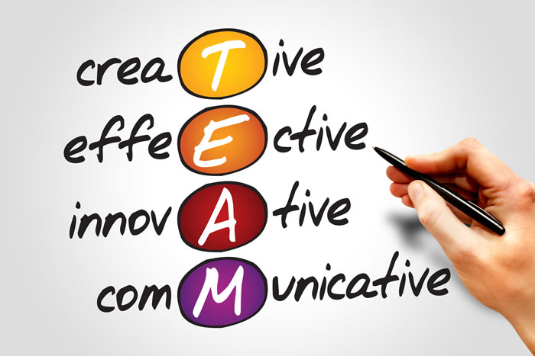
What makes the team effective?
“To work well together, the team members must have more than just team spirit… they need collaborative skills, for example; supporting one another and managing conflicts that occurs in the team in a way that it is constructive and not destructive” (Guirdham, M. 2002).
The components that create an effective team-working relationship are skills such as; effective listening skills and ensuring that everyone’s opinions are valued and respected with no judgement. Everyone in the team is committed to the same goal and inspire one another to achieve the best outcome and goal.
This photo shows you four words that are essential in an effective team.

Slide 3
“Teams are a question of balance.
What is needed is not well balanced
individuals but individuals that balance well
together”
Dr Meredith Belbin

Slide 4
Trust in teams
Why do we need trust in a team?
What does it take to form trust/a trusting relationship?
Trust is essential to an effective team, because it provides a sense of safety. When your team members feel safe with each other, they feel comfortable to open up, take appropriate risks, and expose vulnerabilities (mindtools,2018).
Steve and covey wrote this book “the speed of trust “ . They mention things that form a trusting relationship examples of there are. There must be honesty and clear communication. Another ways of gaining trust would be respecting your team members and clear guidelines and boundaries. You must be able to see the wrights and wrongs and also demonstrate respect to your team members. (Covey, S.M.R. 2006 )
How do trusting relationships differ from relationships that may lack trust?
Teamwork relies on a number of trust factors to be successful and productive. Colleagues who don’t have an established sense of trust with one another aren’t likely to create a strong communication or support system and might not be positioned to effectively collaborate or pull together important elements of the project necessary for success (Lisa McQuerrey. 2018).

Slide 5
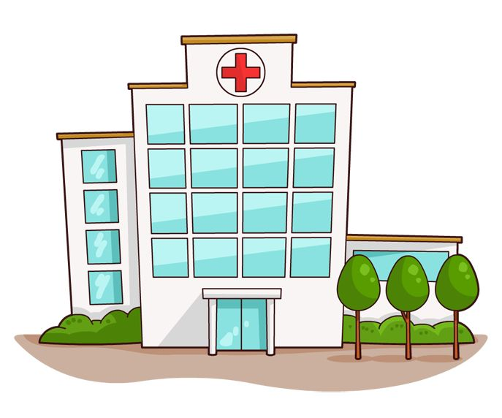
Example of Trust within a workplace environment
I currently work within a ward based environment working with patients and staff on the ward gaining there trust daily. One of the important stages of gaining trust is the initial interaction with the patients when they are admitted to our ward. I gain the patients trust by explain everything we are going to do throughout there stay in our ward. Patients also gain my trust when I show them I'm trust worth for example when it comes to carrying out personal care. Patients have never meet us but by the end of there stay they allow and trust us with most of there hygiene needs and personal belongings for example things that need to kept in a safe like money , jewellery or bank cards.

Slide 6

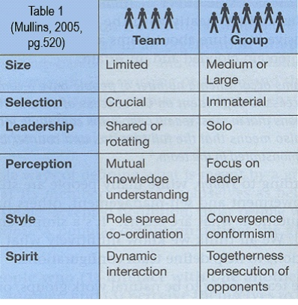
Groups vs Teams
The differences between “groups” and “teams”
Groups and teams are hard to differentiate due to the tendency of using the two words mutually in common language and literature. There are pros and cons to “teamworking” and “group working”. In a team there is more structure for example you would have a main leader delegating roles within there level of competence. While being within a group you are solo and do not have main leader to delegate. Another difference between teams and groups is the size, in a team you are limited to the amount of people however groups do not have limitation to their size (Laurie.Mullins 2005,pp 519-520).
Teams are more likely to be on a formal basis where as groups are informal. In a team, you have a set goal that you all strive to achieve success, however, the individuals in a team are dependant on the success of others. (Laurie.Mullins 2005,pp 519-520).
R. Meredith Belbin (2000)

Slide 7
Belbin team Roles.
Belbin has presented a model that concludes how teams interacted with each other during task’s. His model proposed nine points such as:
Resource investigator- They explores opportunities and have enthusiasm in doing so.
Team worker - co- operative, perceptive and diplomatic. Listens and averts friction.
Co-Ordinator- Mature, confident, identifies talent, Clarifies goals.
Plant- Creative, imaginative, free-thinking. With Generates ideas and solves difficult problems.
Monitor Evaluator- Sober, Strategic and discerning.
Specialist- The specialist provides knowledge and skills. And self-starting and is dedicated to it’s role.

Slide 8
Shaper- Challenging, Dynamic, they like pressure. They also drive and courage to overcome obstacles.
Implementer – Practical, reliable, efficient, Puts the idea into reality and organises work that needs to be done.
Completer Finisher- The finisher makes sure the goal is to the best it can be out polishes out any errors.
Organisations would be at an advantage if they followed Belbin's model when picking teams, making sure that each point can be preformed by one of the team members. Some of the roles are duel related that can be done by the same member of the team. Others points would need more skills set. The advantage of this is small companies can follow the model with a lower staffing group. (Meredith Belbin).

Slide 9
Examples of Belbin in my workplace.
An example of Belbin in my workplace would be the ward structure. For example you have different working levels where everyone is given different tasks striving for the same set goal. You have the different banding starting from six-two, Everyone has a different skill sets. The lower bands would take on multiply task as they would not have the skill sets to do the higher banding work.

Slide 10
Tuckman
Another Moodle that can be used by companies is Tuckman’s group development.
Forming-Starting the team
Storming- where you work out peoples skills.(personality’s)
Norming- where you start to realise where people can do this noticing peoples work and appreciating it.
Preforming- When team members are confident and motived to finish there set goal/task.
This model shows you four effective point of team working. By changing your approach by each stage, its important to identify when you are at each stage to be able to consider how to move on from each point. For example team meeting, reviews , feed back, This helps identify any concerns in induvial such as body language, behaviour change, lack of motivation. This helps you move on quicker to reach your goal in the most effective and creative way. ( study,2019)

Slide 11
References
Guirdham, M. Interactive Behaviour at Work. (2002). 3rd edn. Financial Times Prentice Hall.
Laurie J.Mullins. (2005) Management and Organisational Behaviour. 7th edn. University of Portsmouth.
Lisa McQuerrey. 2018. How Does Trust Affect Teamwork?. [ONLINE] Available at: https://yourbusiness.azcentral.com/trust-affect-teamwork-17383.html. [Accessed 7 May 2020].
Mind Tools. 2018. Building Trust Inside Your Team. [ONLINE] Available at: https://www.mindtools.com/pages/article/building-trust-team.htm. [Accessed 5 May 2020]
R. Meredith Bublin. Beyond The Team. (2000). Butterworth-Heinemann.
Covey, S.M.R. 2006, “The speed of trust: the one thing that changes everything” Simon & Schuster, New York; London.
Belbin, R. Meredith, Management Teams: Why They Succeed or Fail. Butterworth Heinemann, 3rd ed., 2010
study.com. 2019. norming stage of group development. [ONLINE] Available at: https://study.com/academy/lesson/norming-stage-of-group-develpment. [Accessed 14 May 2020].
belbin. 2019. Meredith Belbin. [ONLINE] Available at: https://www.belbin.com/about/belbin-team-roles/. [Accessed 4 May 2020]

