Slide 1

Digital Transformation in the Health Care Professions
BMHP6026
Component 2: Presentation
Student Name: Rafia Farooq
Student Number: 2325948
Lecturer Name: Joanne Davies
Smart Inhalers in Healthcare: A SWOT Analysis
Impact on Workforce and Patients/Service

Slide 2
Introduction
Digital transformation
Smart inhalers
SWOT analysis
Impact on work for and service users
Plan for Digital Health and Social Care
Recommendations
Conclusion

Slide 3

Digital Transformation in Health and social care
Digital transformation in health and social care means using technology instead of paper or face-to-face services. It includes online appointments, electronic records, connected systems, health apps, and data sharing (Health and Social Care Committee 2023).
Figure 1: Digital transformation in healthcare (source: Teo 2022, KeyReply)

Slide 4
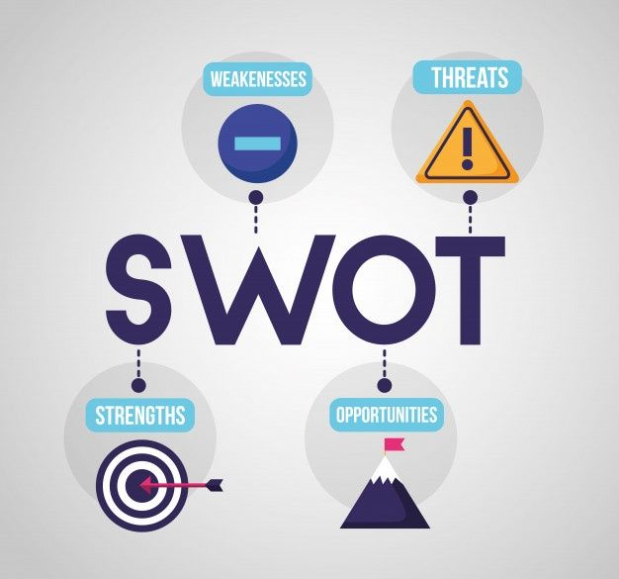
SWOT analysis
According to Care Learning (2025), SWOT analysis in healthcare is a strategic planning tool used to evaluate a healthcare organisation or service by identifying their Strengths, weaknesses, Opportunities. and Threats to support better decision-making and service improvement.
Figure 2: SWOT analysis business infographic template (no date)

Slide 5
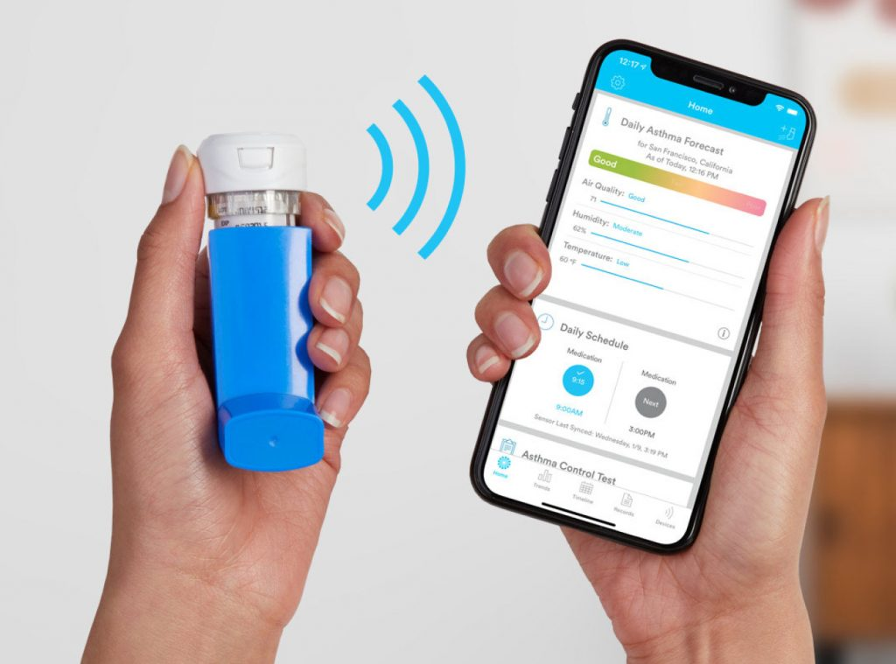
Smart Inhaler
Asthma is a chronic condition which affects the airways. 7.2 million people in UK suffer from asthma (Asthma + Lung UK, 2024).
What are Smart Inhalers?
Smart Inhalers are digital inhalers that monitor use and automatically send data to a smartphone or cloud system to help manage asthma and COPD more effectively (Chan et al., 2021).
Key Features (NICE, 2017).
Monitoring patient use
Bluetooth-based data transfer
Sharing data with patients and HCPs
Providing feedback
Figure 3: Smart inhaler monitoring system (Beauty Medical Devices, 2021)

Slide 6
Workforce
Strengths
Provides objective adherence data (Chan et al., 2021).
Enables remote monitoring and digital follow-ups
Helps prioritise high-risk patients especially children (NIHR Leicester Biomedical Research Centre, 2024).
Reduces emergency workload (Zabczyk and Blakey (2021).
Supports workforce upskilling in digital healthcare
Improves clinical decision-making.
Weaknesses (Borges do Nascimento et al., 2023).
Resistance to change among staff
Risk of data overload
Additional administrative tasks
Limited time for staff training
Challenges integrating new technology into existing workflows
Concerns about data security
Concerns about patient confidentiality
Threats (Hakizimana, Devani, and Gaillard, 2024).
Resistance to adopting new technology
Training and implementation costs
Increased reliance on digital systems
Opportunities (Asthma UK, 2017).
Expansion of remote clinics and virtual reviews
Fewer routine face-to-face appointments needed
Saves staff time and improves workload management
Multidisciplinary collaboration (pharmacists, nurses, GPs)

Slide 7
Patient service
Strengths (Chan et al., 2021; Kaplan et al., 2023)
Medication reminders improve adherence.
Early detection of worsening symptoms.
Fewer asthma/COPD exacerbations.
Reduced hospital admissions..
Better patient self-management and confidence.
Improved quality of life.
Weaknesses (Muruganantham, and Ramesh, 2025; Giebel et al., 2023).
Low digital literacy, particularly older adults.
Limited or no access to smartphones and the internet.
Poor inhaler technique.
Cost
Opportunities (NICE, 2026)
Preventative healthcare model
Population health monitoring
Personalised treatment plans
Education and empowerment
Integration with telehealth and AI prediction
Threats (Hakizimana, Devani, and Gaillard, 2024)
Digital inequality (elderly, low-income groups)
Data privacy and technical issues
Non-adherence to treatment plans
Over-reliance on technology

Slide 8
Plan for Digital Health and Social Care (Department of Health and Social Care and NHS England, 2022)
The UK's health and social care system needs digital transformation to be sustainable long-term. DHSC and NHS England are working together to achieve this by 2025, focusing on:
Preventing health issues from getting worse.
Tailoring care to individuals and reducing inequalities.
Enhancing service delivery and user experience.
Boosting overall performance.

Slide 9
Recommendations
(NICE, 2017) state that to ensure successful implementation of smart inhalers, healthcare organisations should provide comprehensive staff training programmes and offer patient education along with technical support.
Strong data protection policies must be in place to safeguard patient information, and non-digital alternatives should be available for patients who are unable or unwilling to use the technology (NICE, 2017).

Slide 10
Conclusion
Smart inhalers have the potential to significantly improve asthma and COPD management by enhancing medication adherence, monitoring inhaler use, and providing real-time data to support clinical decision-making. They can support more personalized care and better health outcomes.
However, successful implementation depends on addressing key challenges such as staff resistance, training needs, data security concerns, and integration into existing workflows. With clear governance, adequate support, and proper training, smart inhalers can become a valuable tool in advancing digital healthcare and improving patient care.

Slide 11
References
Asthma UK (2017). Smart asthma: Real‑world implementation of connected devices in the UK to reduce asthma attacks. Asthma UK. Available at: auk_smartasthma_feb2017.pdf (Accessed: 18 February 2026).
Asthma + Lung UK (2024) What is asthma? Available at: What is asthma? | Asthma + Lung UK (Accessed: 02 March 2026).
Beauty Medical Devices (2021) Why should asthma patients use smart inhalers? Beauty Medical Devices. Available at: WHY SHOULD ASTHMA PATIENTS USE SMART INHALERS? (Accessed: 07 February 2026).
Borges do Nascimento, I.J., Abdulazeem, H., Vasanthan, L.T., Martinez, E.Z., Zucoloto, M.L., Østengaard, L., Azzopardi-Muscat, N., Zapata, T. and Novillo-Ortiz, D. (2023). ‘Barriers and facilitators to utilizing digital health technologies by healthcare professionals,’ NPJ Digital Medicine, 6(1), p.161. Available at: doi: https://doi.org/10.1038/s41746-023-00899-4
Care Learning (2025) How to use a SWOT analysis in health and social care. Available at: How to Use a SWOT Analysis in Health and Social Care – Care Learning (Accessed: 07 February 2026).
Chan, A. H. Y., Pleasants, R. A., Dhand, R., Tilley, S. L., Schworer, S. A., Costello, R. W. and Merchant, R. (2021) ‘Digital inhalers for asthma or chronic obstructive pulmonary disease: a scientific perspective’, Pulmonary Therapy, 7(2), pp. 345–376. Available at: https://doi.org/10.1007/s41030-021-00167-4

Slide 12
References
Department of Health and Social Care and NHS England (2022) A plan for digital health and social care. Available at: A plan for digital health and social care - GOV.UK (Accessed: 23 February 2026).
Giebel, G.D., Speckemeier, C., Abels, C., Plescher, F., Börchers, K., Wasem, J., Blase, N. and Neusser, S. (2023) ‘Problems and barriers related to the use of digital health applications: scoping review’, Journal of Medical Internet Research, 25, p.e43808. Available at: Journal of Medical Internet Research - Problems and Barriers Related to the Use of Digital Health Applications: Scoping Review (Accessed: 06 February 2026).
Hakizimana, A., Devani, P. and Gaillard, E.A. (2024). Current technological advancement in asthma care. Expert Review of Respiratory Medicine, 18(7), pp.499–512. Available at: https://doi.org/10.1080/17476348.2024.2380067 (Accessed: 02 March 2026).
Health and Social Care Committee (2023) Digital transformation in the NHS: Eighth Report of Session 2022–23. UK Parliament. Available at: Digital transformation in the NHS - Health and Social Care Committee (Accessed: 02 March 2026).
Kaplan, A., Boivin, M., Bouchard, J., Kim, J., Hayes, S. and Licskai, C. (2023) ‘The emerging role of digital health in the management of asthma’, Therapeutic advances in chronic disease, 14, p.20406223231209329. Available at: doi: 10.1177/20406223231209329
Muruganantham, S. and Ramesh, S.L. (2025) ‘Soft mist, dry powder, and smart inhalers: comparative technologies and clinical impact on asthma and COPD management’, The Egyptian Journal of Bronchology, 19(1), p.109. Available at: https://doi.org/10.1186/s43168-025-00461-8

Slide 13
References
National Institute for Health and Care Excellence (NICE) (2026). Digital platforms recommended to help people manage their asthma. Available at: Digital platforms recommended to help people manage their asthma | NICE (Accessed: 18 February 2026).
National Institute for Health and Care Excellence (NICE) (2017) Smart inhaler for asthma: MedTech innovation briefing MIB90. Available at: Smartinhaler for asthma (Accessed: 07 February 2026).
NIHR Leicester Biomedical Research Centre (2024) UK First as new NHS study of digital ‘smart inhalers’ for children with asthma starts in Leicester [online]. Available at:UK First as new NHS study of digital ‘smart inhalers’ for children with asthma starts in Leicester - NIHR Leicester Biomedical Research Centre (Accessed: 08 February 2026).
Teo, P. (2022) The impact of digital transformation in healthcare: trends & examples. KeyReply. Available at: The Impact of Digital Transformation in Healthcare: Trends & Examples (Accessed: 02 March 2026).
Zabczyk, C. and Blakey, J.D. (2021) ‘The effect of connected “smart” inhalers on medication adherence’, Frontiers in medical technology, 3, p.657321. Available at: doi: 10.3389/fmedt.2021.657321

