Slide 1
Kirran Ali
Nasima Haydory
Mukta Uddin
Rezual Choudhury
dreamcreations39@gmail.com
haroonali100!

Slide 2
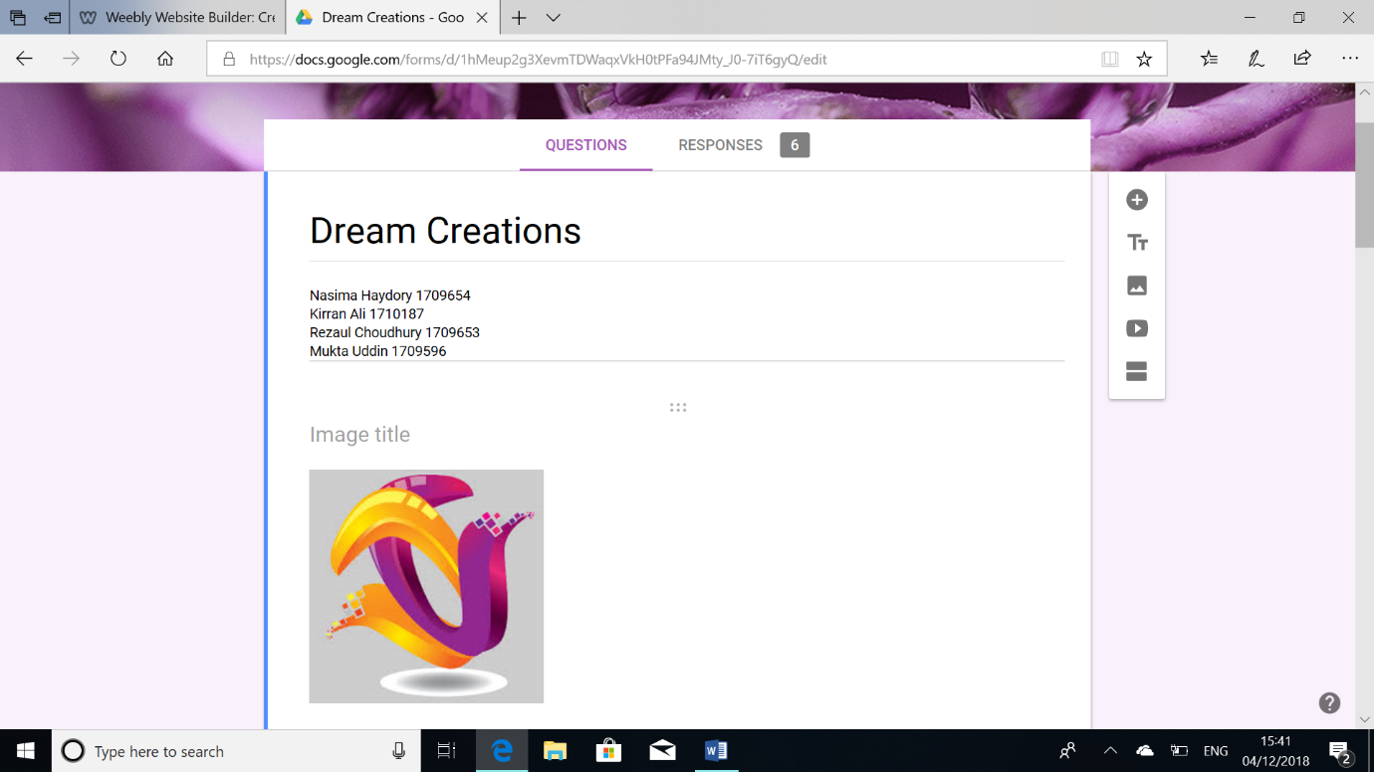
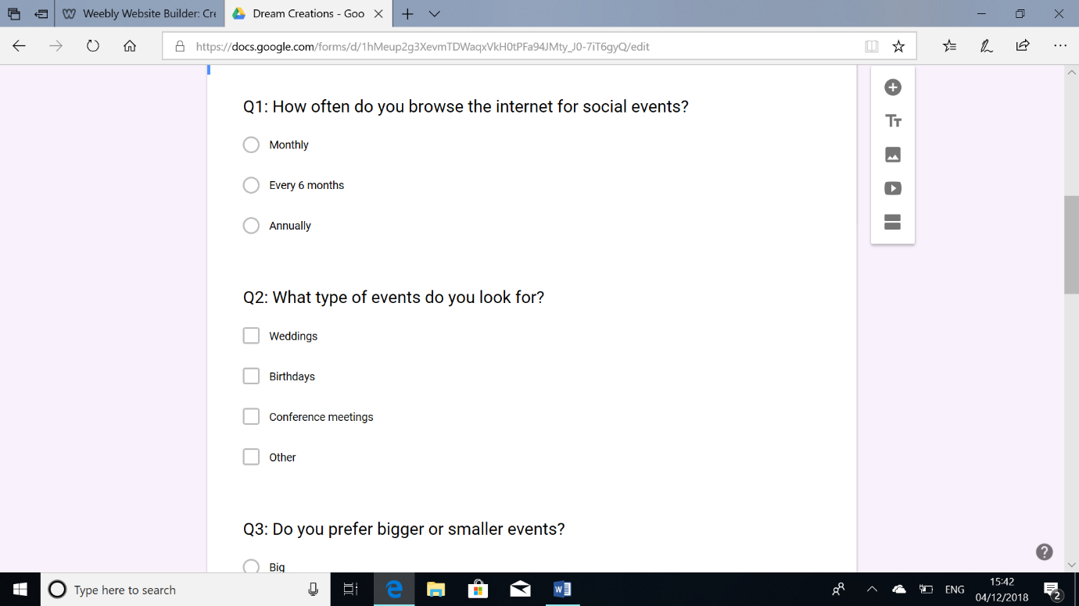
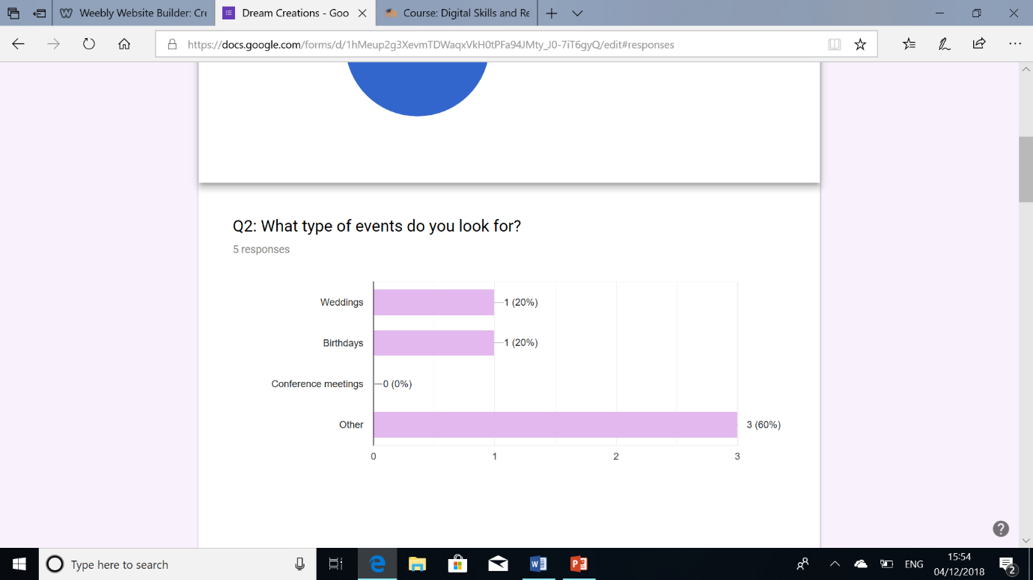
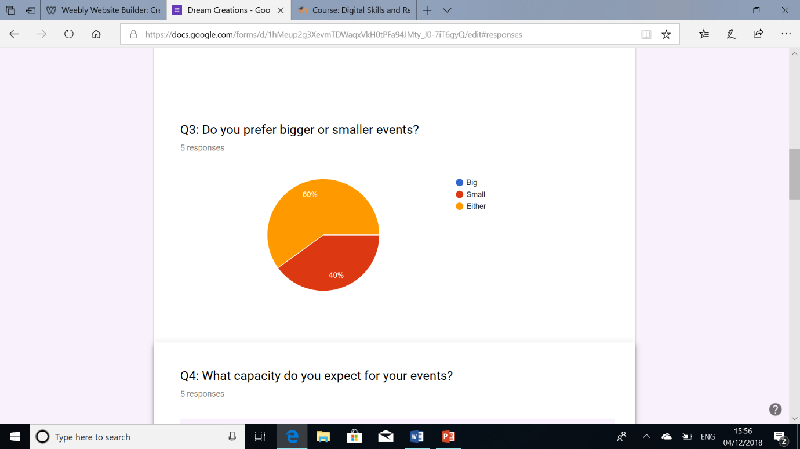

Slide 3
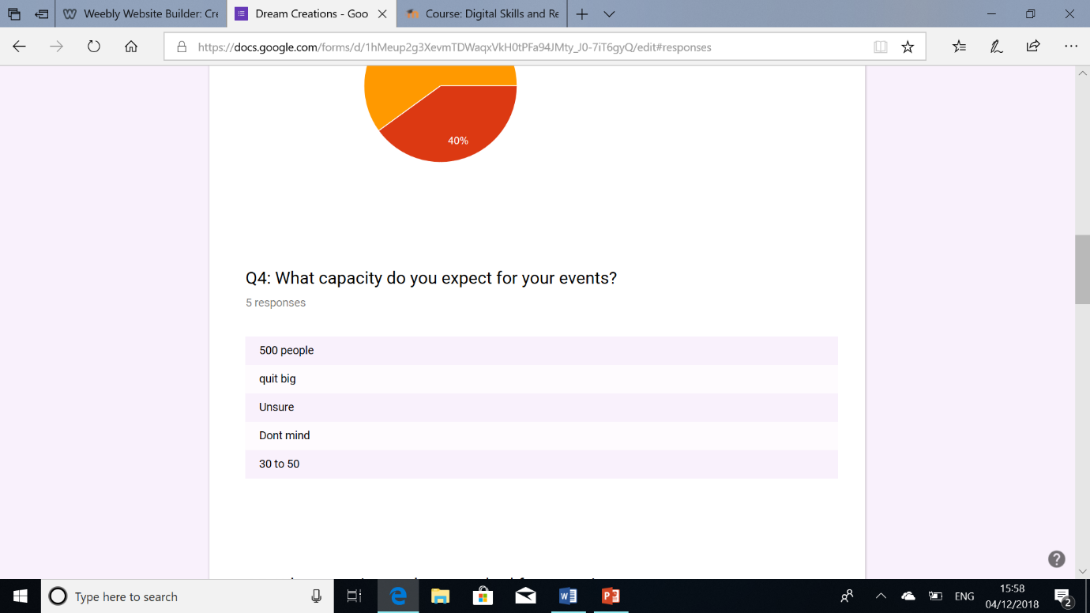
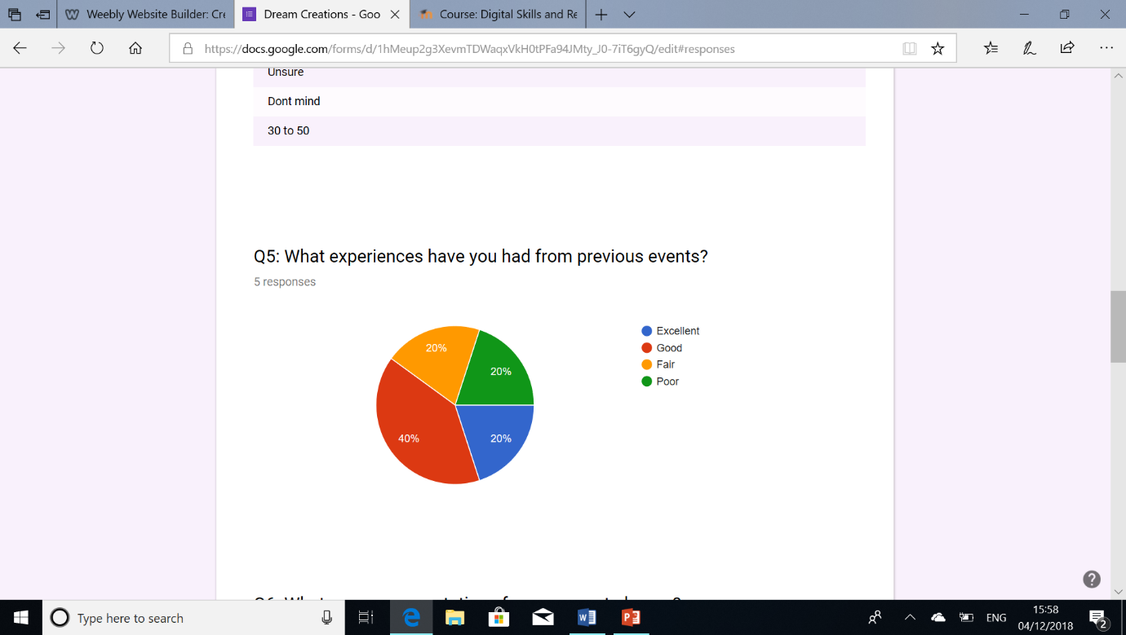
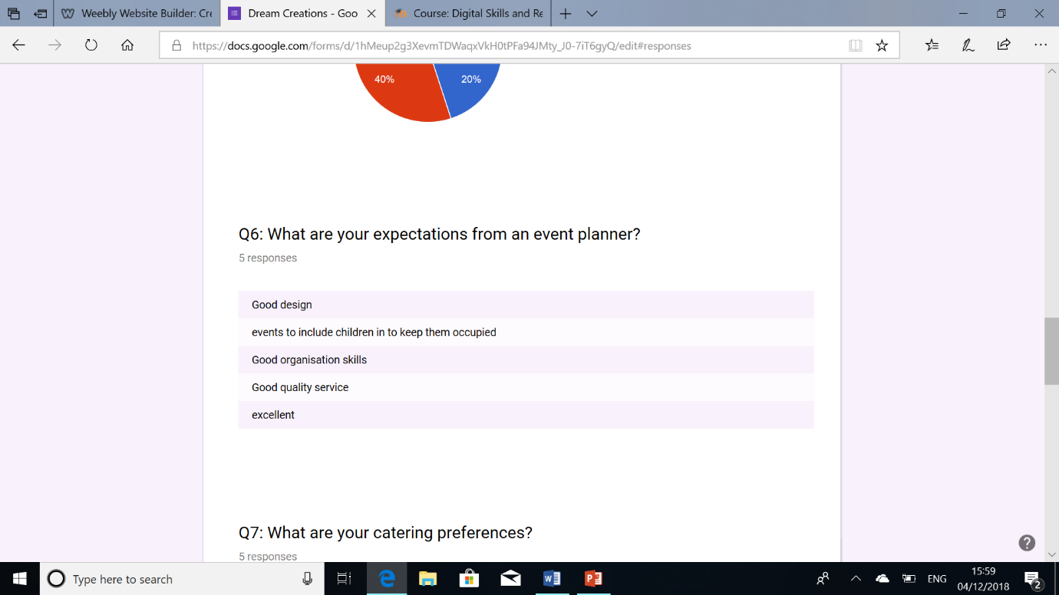
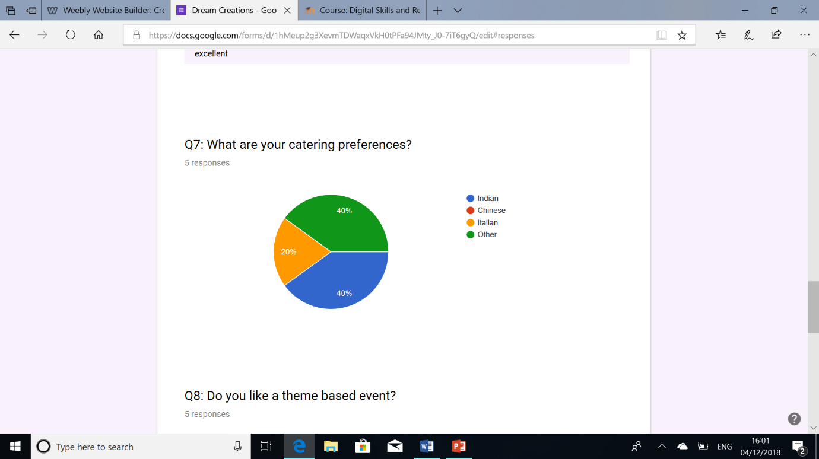

Slide 4
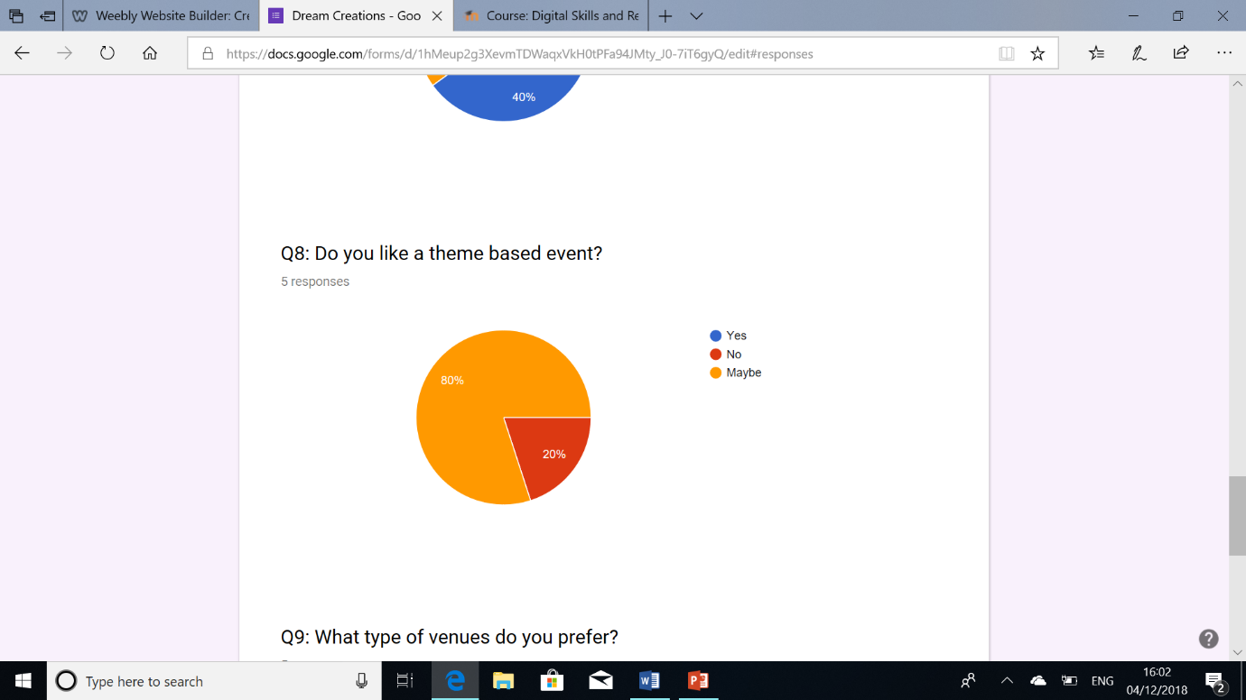
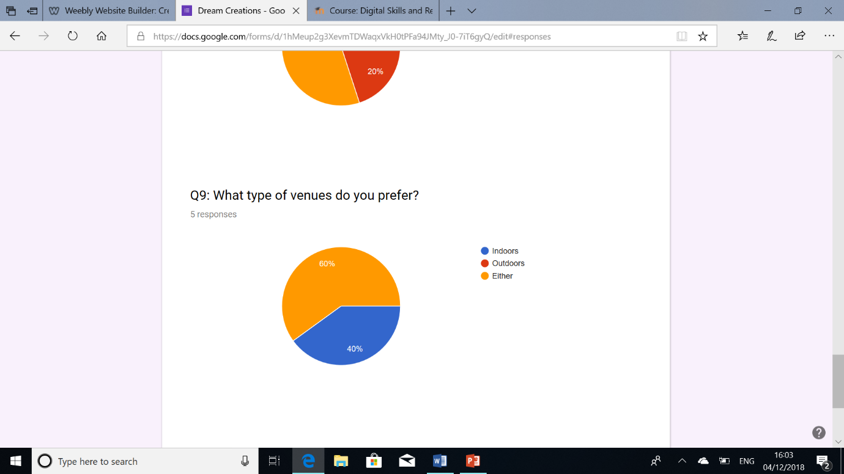
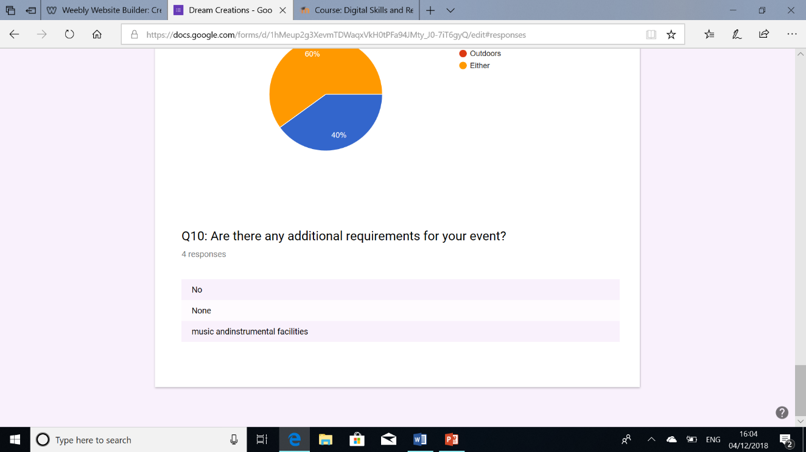

Slide 5
Contribution Audit for Business Plan.
Group members:
Nasima Haydory 1709654
Mukta Uddin 1709596
Kirran Ali 1710187
Rezaul Choudhury 1709653
Title: Business Plan
Start Date: 13th November 2018
End Date: 5th December 2018

Slide 6
6th November 2018 (week 1)
Nasima Haydory – logged into Moodle to gather information she needed for assignment 2.
Mukta Uddin- Mukta carried out the task of the questionnaire with the group.
Kirran Ali- I made preparation for the questionnaire.
Rezual Choudhury- he made the what’s app group for the group to communicate.

Slide 7
13th November 2018 (Week 2)
Nasima Haydory – Gathered all information from the group to start the questionnaire.
Mukta Uddin- opinions were given on what type of questions should we use in the questionnaire.
Kirran Ali- emailed names as well as email’s address to Nasima Haydory.
Rezual Choudhury- Rezual gave us ideas on the type of questions we should use for the questionnaire.

Slide 8
20th November 2018 (week 3)
Nasima Haydory- opinions were given on questions and the type of questions would suit us.
Mukta Uddin- informed Nasima Haydory about ideas given in the lecture, and started to consider making the questions.
Kirran Ali- gave opinions on questions.
Rezual Choudhury- no contribution towards questionnaire.

Slide 9
27th November 2018 (week 4)
Nasima Haydory- The questionnaire was sent to the group members for approval and a final check, Kirran Ali sent Nasima Haydory the list of emails that the questionnaire would be sent to.
Mukta Uddin- Gave positive feedback for the questionnaire.
Kirran Ali- approved for the questionnaire.
Rezual Choudhury- approved for the questionnaire.

Slide 10
5th December 2018 (week 5)
Nasima Haydory- Nasima had received responses for the questionnaire, after the responses were given she then took screenshots and added it to the PowerPoint, and Nasima will be submitting the questionnaire on Turnitin with the help of the lecturer.
Mukta Uddin- she will be submitting the questionnaire on Turnitin with the help of the lecturer.
Kirran Ali- I will also be submitting through Turnitin with the help of the lecturer.
Rezual Choudhury- He will also be submitting through Turnitin with the help of the lecturer.

