Slide 1


Academic Writing and Critical Thinking
Dr Jessica Clapham
MA TESOL Programme Director
Institute of Education and Humanities, Carmarthen campus.

Slide 2
An introduction to Academic Writing &
Q and A

Slide 3
ARE YOU … ( note in the chat)
2. How confident are you in your own writing?
3. How can you expand your thinking powers?
4. Do you have strategies for spelling and drafting?
5. Are there aspects of writing you avoid?
1. Proud of your achievements so far?
1b. What kind of writing do you do in your subject/life?

Slide 4
Agenda for today:
The parameters of Academic writing
Being critical and writing clearly
Lit review skills
The writing process
Signposting your writing
Syntax and grammar!
Buddy system

Slide 5
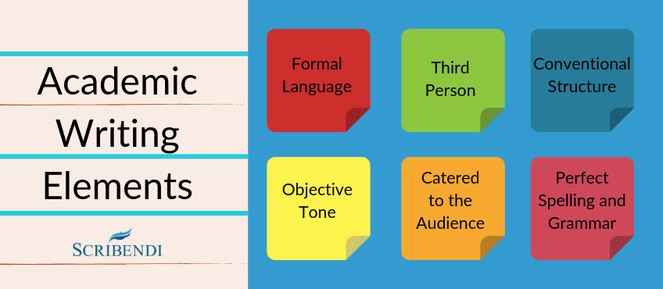
The features of academic writing

Slide 6
What is academic writing?
Academic writing is writing which communicates ideas, information and research to the wider academic community. It can be divided into two types: student academic writing, which is used as a form of assessment at university, as well as at schools as preparation for university study; and expert academic writing, which is writing that is intended for publication in an academic journal or book. Both types of academic writing (student and expert) are expected to adhere to the same standards, which can be difficult for students to master. The characteristics of academic writing which together distinguish it from other forms of writing are that it is:
structured
evidenced
critical
balanced
precise
objective
formal

Slide 7
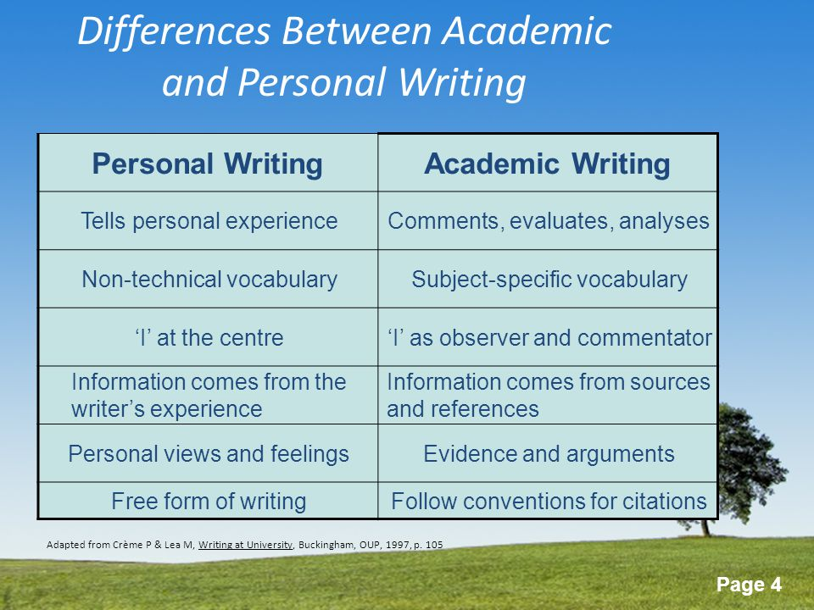
Comparing academic and personal writing styles

Slide 8
Criticality
What is the etymology of critical?
Etymology. From Latin criticus +‎ -al, from Ancient Greek κριτικός (kritikós, “of or for judging, able to discern”), from κρίνω (krínō, “I separate, judge”); also the root of crisis.
Criticism is about joining in a wider research debate with others you may never meet. Research is never perfect. It could always have been done differently or better. By joining in a critical debate, you can help to improve future research and understanding.
Blaxter, L. Hughes, C & Tight, M (1996)

Slide 9
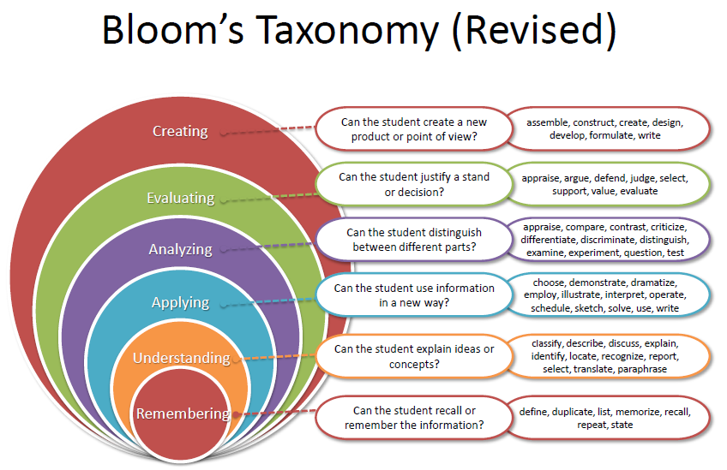
Bloom’s Taxonomy

Slide 10
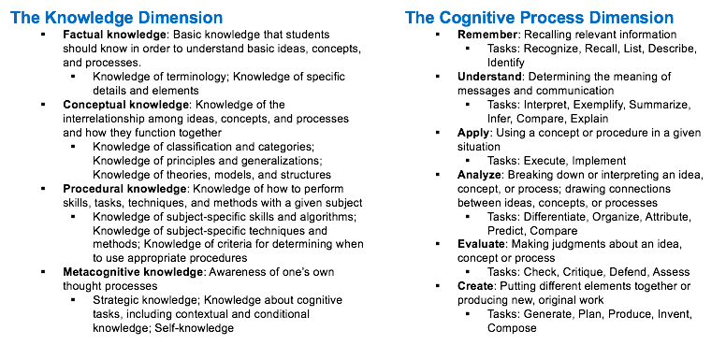
Using Bloom’s Taxonomy

Slide 11

Positionality

Slide 12
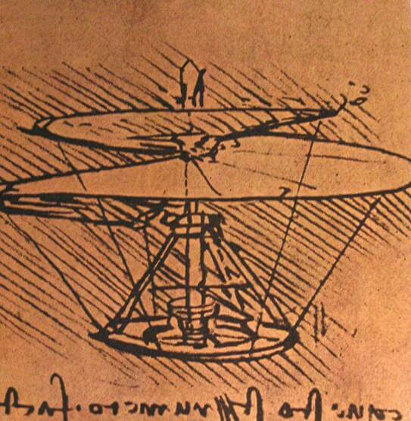
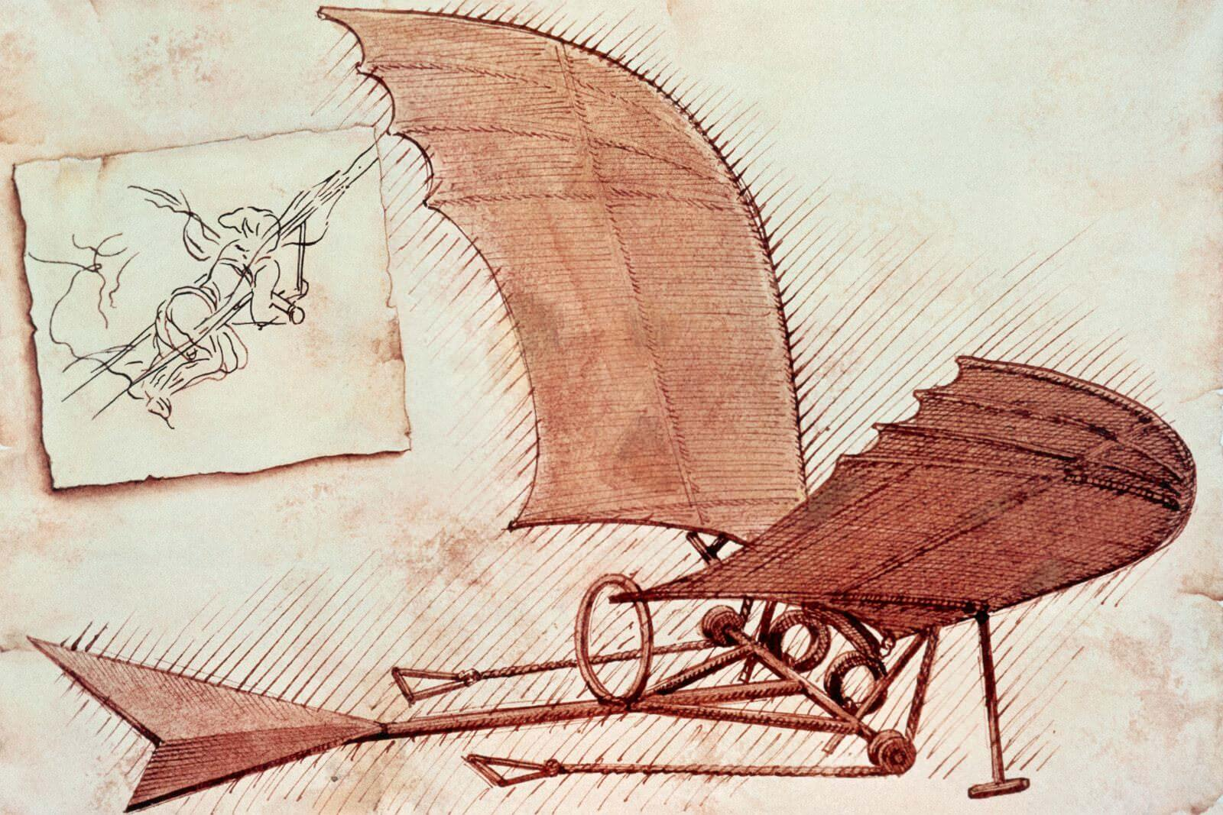
Is your idea clear?

Slide 13

Is your writing style clear?
When you write, you are writing for a reader.
Don’t strive to impress : go for clarity.
Take your reader through your story
Review the literature critically.
Develop a critical argument
Each paragraph should develop one idea with supporting evidence.

Slide 14
What’s missing?
In order to investigate Mandarin Chinese planning and policy in Cambodian local school context, one has to first start from the definitions of language Planning. It is generally believed in Language Planning and Policy (LPP) research area that “Language Planning” was raised by Einar Haugen who first introduced the term to the literature in 1959. While Haugen states that the term was first used by Weinreich “as the title of a seminar at Columbia University in 1957”. Haugen defines language planning as “the activity of preparing a normative orthography, grammar, and dictionary for the guidance of writers and speakers in a non-homogeneous speech community”.But later Haugen modified this definition himself by stating that the above activities are outcomes of language planning, “rather than language planning as a whole” defines the language planning as “the organized pursuit of solutions to language problems”. While simply uses language planning to refer to a solution to solve a language problem. As Rubin and Jernudd (1971) define the term in the introduction of the book Can language be planned? which became a milestone in the theory of LPP research…. Thesis draft.

Slide 15
Demistify writing
In order to investigate Mandarin Chinese planning and policy in Cambodian local school context, one has to first start from the definitions of language Planning. It is generally believed in Language Planning and Policy (LPP) research area that “Language Planning” was raised by Einar Haugen who first introduced the term to the literature in 1959. While Haugen (1965, p.188) states that the term was first used by Weinreich “as the title of a seminar at Columbia University in 1957”. In the article Planning for a Standard Language in Modern Norway published in 1959, Haugen defines language planning as “the activity of preparing a normative orthography, grammar, and dictionary for the guidance of writers and speakers in a non-homogeneous speech community” (Cooper, 1989, p.29; Liu, 2006, p.55). But later Haugen modified this definition himself by stating that the above activities are outcomes of language planning, “rather than language planning as a whole” (Cooper, 1989, p.29). Fishman (1973, p.23) defines the language planning as “the organized pursuit of solutions to language problems”. While Corson (1999, p.1) simply uses language planning to refer to a solution to solve a language problem. As Rubin and Jernudd (1971) define the term in the introduction of the book Can language be planned? which became a milestone in the theory of LPP research…

Slide 16
Demistifying writing
Being able to write accurate, clear English
Being clear about writing conventions
Assessment that builds confidence
Using a range of strategies to develop your own writing skills:
Shared writing, modelling the writing process – mind-mapping tools

Slide 17
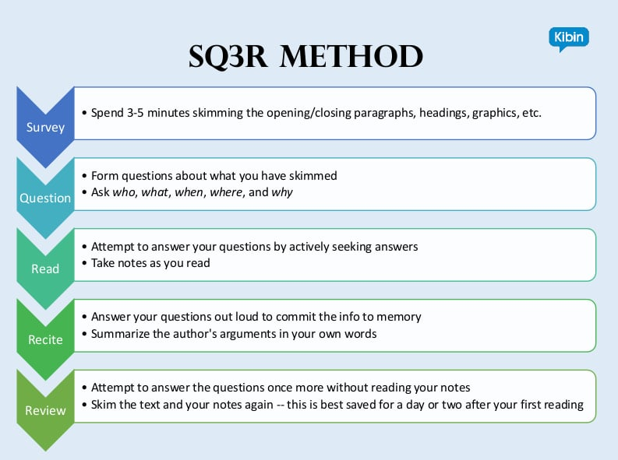
SQ3R Method

Slide 18
What makes a good research problem?
The Key Elements of a Dissertation Problem Statement:
Essentially, you want to establish (a) what the problem is, (b) that it matters, and (c) that it addresses a meaningful gap in the literature.
Give some brief background information. A few sentences to help the reader understand the context of the problem.
State the general research problem. This is one sentence that usually starts something like, “The general problem is…”
Establish relevancy. Here’s where you’ll cite research that supports that the general problem you just stated is relevant, current, and significant to the discipline.
Specific Problem Statement. This sentence should be worded similarly to your title and (future) purpose statement.
Conclusion and transition. Here, you’ll include a few sentences on the impacts of the problem on society or the relevant population, and transition to the next section.

Slide 19
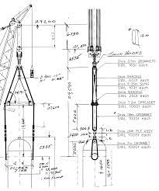
The design process….
This diagram was taken from Mammoet engineering showing a lifting device. It has a narrative of its own. Mammoet.com

Slide 20
Literature review
Review the literature critically.
Develop a critical argument. Don’t begin each paragraph with Smith Says…Clapham says…. Each paragraph should develop one IDEA with supporting evidence.
The literature review is not everything I know about…X
Explain and develop your own argument and position using quotations sparingly and judiciously
Try not to over use quotations; it is usually clearer if you cite and explain what authors say in your own words.

Slide 21
Finding the literature
Starting with what you know
Look for keywords
Note the journals from which the articles come
Follow up their reference lists
Look for articles which have cited these
Look for more recent articles by the same authors

Slide 22
Searching electronic databases
The Key is to be systematic
Write down your search terms AND how you have combined them
Decide in what order you will look at the list of articles generated (Default is relevance)
Be on the look out for articles you know about that don’t appear
  ask yourself: why not?
Several smaller, more specific, searches may be better than one big one

Slide 23
Next steps
Save your search!
Look at the titles of the articles you have found and reject any that are clearly irrelevant
Read the abstracts of the remainder
Ask yourself- Does this article definitely address my research question? (Yes/ No/ can’t be sure)
Keep notes
Skim the articles you have left

Slide 24
Evaluating the quality of studies
Rigour
Independence/ lack of bias
Ruling out other possible explanations for any changes

Slide 25
What research tells us about writing….
Good writing involves:
Modelling
Joint construction
Independent construction
‘Spoken language forms a constraint, a ceiling not only on the ability to comprehend but also on the ability to write, beyond which literacy cannot progress.’ Mayhill and Fisher, 2010
https://www.google.co.uk/books/edition/Using_Talk_to_Support_Writing/WxdTxzFFpVoC?hl=en&gbpv=1&dq=myhill+and+fisher+2010&pg=PP2&printsec=frontcover

Slide 26

Background theory: Systemic Functional Linguistics
Genre Analysis and Pedagogy
Focuses on how language makes meaning rather than on a set of rules (that often don’t seem to work)
Provides useful insights for supervisors supporting students
Research students have a clear view of what they are trying to achieve with a text. It provides a vocabulary for talking about structure
It provides a strategy for teaching structure

Slide 27
The writing process
Start
Study the title
Note the length and due date
First thoughts/organisation
encyclopaedias/specialised reference books/
use library facilities/subject indexes/bibliographies/online journals
take notes using cards
arrange note cards
make outline
write essay

Slide 28

Signposting

Slide 29
Signposting
Always make good use of signposting so that the reader knows where they are as they make their journey through the text. This includes subheadings, numbering of points, listing devices ( firstly, secondly etc) phrases signaling changes (e.g. Another point I would like to emphasize is) and numbering of sections.
Begin with a clear statement of where the text is going and end with a summary of what was said.

Slide 30
Manchester Phrase bank
Useful Phrases for Signalling Transitions
https://www.phrasebank.manchester.ac.uk/
Introducing a new topic or aspect of a topic
As regards X, ….
With respect to X,
With regard to X, ….
Regarding X, ….
As far as X is concerned, ….
Reintroducing a topic
As was pointed out in the introduction to this paper, ....
As was mentioned in the previous chapter, ....
As explained earlier, .... As described on the previous page, ....

Slide 31
Paragraphs
Short paragraphs add to the clarity of a piece of writing.
A paragraph should develop one point; new ideas or issues probably merit their own paragraphs.
Make sure that the paragraphs flow logically from one to the next. The reader should be able to see a logical progression of thought and follow the logic of your argument.

Slide 32
Syntax
.
Use short sentences.
More than 2 subsidiary clauses can be confusing!
If a sentence is three lines or more in length, it might be useful to split it.
Use short but precise words. This doesn’t mean that the style is simplistic.
Terminology and jargon should be explained where necessary.

Slide 33
Responding and being critical: assignment buddies!
One of the most helpful ways to develop your writing is to have a critical friend to respond to what you write.
Responding doesn’t mean criticizing negatively!
Being critical is not rubbishing someone else’s work.
Instead it is careful, considered, measured, even-handed and
( importantly) justified evaluation of their work.
Peer mentoring – watch this space ☺

Slide 34

Further details:
Dr Jessica Clapham SFHEA, FRSA.
ELT Lead,
Professional Doctorate & MA TESOL Course Director,
UWTSD,
Lampeter.
j.clapham@uwtsd.ac.uk
Associate Researcher ESRC Bilingualism Centre, Linguistics Department, Bangor University.
https://www.bangor.ac.uk/addysg/Staffpages/
Jclapham.php.en

Slide 35
Useful reading and resources
Dominic Wyse, 2007, The Good Writing Guide for Education Students, London, Sage.
Burns and Sinfield (2008) Essential Study Skills, London Sage
Ethos e-thesis online service : https://ethos.bl.uk/Home.do
Bloom’s taxonomy: https://tips.uark.edu/using-blooms-taxonomy/
SQ3R https://www.kibin.com/essay-writing-blog/wp-content/uploads/2018/03/SQ3R-Method.jpg
Problem purpose statements
https://www.beyondphdcoaching.com/dissertation/dissertation-problem-statement/

Slide 36
Research skills
Bell, J., (2005) Doing Your Research Project. 3rd ed. Open University Press, Buckingham.
Denscombe, M., (2007), The Good Research Guide, Open University Press, Milton Keynes
Oliver P., (2008), Writing your Thesis, London, Sage.
Punch, K. (2016) Developing Effective Research Proposals London: Sage
Punch, K. (2014) Introduction to Research Methods in Education London: Sage
Piantanida and Garman, (2009), The Qualitative Dissertation. Sage
Robson, C .(2011) Real World Research Oxford: Blackwell
Thomas, G., (2009) How to do your Research Project, Sage.
JJC update13.11.25 Dr Jessica Clapham

