Slide 1

NVH Analysis
Taylor Winter
Notes:
Good Afternoon,
Today, I'll discuss component harmonic resonance and its effects on mechanical systems, particularly test engines. This happens when a component vibrates excessively due to an external source that matches its natural frequency, leading to stress and damage. To avoid this, engineers use simulation tools and carefully select materials and geometries. I'll also cover accelerometers, which detect mechanical vibration and are crucial for identifying issues. We'll talk about their frequency range, sensitivity, accuracy, and environmental conditions. By the end, you'll understand the significance of precise vibration measurements in preventing damage.

Slide 2
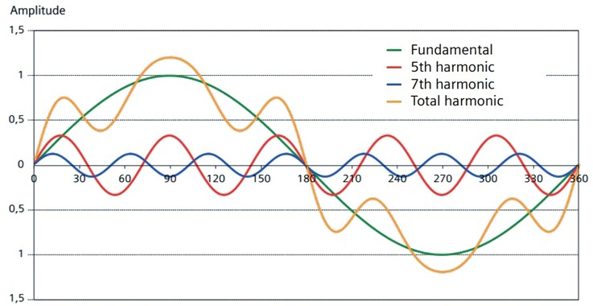
Component Harmonic Resonance
Figure 1: Component Harmonic Resonance
Notes:
Component harmonic resonance refers to a phenomenon in which certain mechanical components of a system vibrate excessively or experience large amplitude oscillations due to an external excitation source whose frequency matches the natural frequency of the component. In other words, the component vibrates at its resonant frequency, resulting in high stress and potential damage to the system.
In a test engine, some components that could be affected by harmonic resonance include the crankshaft, connecting rods, and pistons. These components are subjected to high forces and stresses, and their natural frequencies are influenced by their size, shape, and material properties.
For example, the crankshaft, which rotates at high speeds, is subjected to high inertial loads and centrifugal forces, which can cause it to vibrate at certain frequencies. If the frequency of the excitation source generated by the engine matches the natural frequency of the crankshaft, the crankshaft can resonate, leading to excessive vibration and potential damage to the system.
Similarly, the connecting rods, which connect the pistons to the crankshaft, can also vibrate at certain frequencies. If the frequency of the excitation source matches the natural frequency of the connecting rod, it can cause the rod to vibrate excessively, leading to fatigue and eventual failure.
Lastly, the pistons, which are responsible for converting the pressure generated by combustion into rotational motion, can also resonate at certain frequencies. If the frequency of the excitation source matches the natural frequency of the piston, it can cause it to vibrate excessively, leading to piston slap and other problems.
To prevent component harmonic resonance, designers and engineers need to carefully analyse the natural frequencies of the system and ensure that they are well separated from the excitation frequencies generated by the engine. This can be achieved through the use of advanced simulation tools, such as finite element analysis (FEA) and computational fluid dynamics (CFD), and through the careful selection of materials and geometries.

Slide 3
Mechanical Vibration
Selection criteria for measuring mechanical vibration:
Frequency range: The frequency range of interest should match the expected frequency range of the vibration
Sensitivity: The sensitivity of the sensor should be high enough to detect small changes in vibration
Accuracy: The accuracy of the sensor should be high enough to provide precise measurements
Environmental conditions: The sensor should be able to withstand the harsh conditions of the measurement environment, such as high temperatures, vibration, and electromagnetic interference
Notes:
Mechanical vibration can be measured using various sensors. The selection of the sensor depends on the frequency range of interest, sensitivity, accuracy, and the environmental conditions where the measurement is performed.
Mechanical vibration refers to the oscillatory motion of an object or system around its equilibrium position. It can be caused by various factors such as external forces, resonant frequencies, or unbalanced loads. To measure mechanical vibration, accelerometers are commonly used, which are sensors that detect acceleration in a specific direction.
The basic operation of an accelerometer is based on Newton's Second Law of Motion, which states that the force acting on an object is equal to the mass of the object multiplied by its acceleration. When a mass attached to a spring system is subjected to acceleration, a force is generated, causing the mass to move. The displacement of the mass is proportional to the acceleration, and this displacement is measured by a piezoelectric crystal or a strain gauge, which produces an electrical signal that can be analysed.
In a typical accelerometer, a mass is attached to a spring, which is fixed to a frame. When the frame experiences acceleration, the mass is displaced, causing a change in the distance between the mass and the frame. This displacement is detected by a piezoelectric crystal or a strain gauge, which generates an electrical signal proportional to the acceleration. The piezoelectric crystal or strain gauge converts the mechanical strain caused by the displacement of the mass into an electrical signal that can be further processed by other electronic devices or software.
Piezoelectric crystals are made of certain materials such as quartz, which generate an electric charge when subjected to mechanical stress. The displacement of the mass causes a strain on the crystal, generating an electric charge that is proportional to the acceleration. Strain gauges, on the other hand, are made of a material that changes its electrical resistance when subjected to mechanical stress. The displacement of the mass causes a change in the resistance of the strain gauge, generating an electrical signal that is proportional to the acceleration.
In summary, accelerometers are widely used to measure mechanical vibration. The basic operation of an accelerometer is based on Newton's Second Law of Motion, and it detects acceleration by measuring the displacement of a mass attached to a spring system. The displacement is measured by a piezoelectric crystal or a strain gauge, which generates an electrical signal that is proportional to the acceleration.
When selecting a sensor to measure mechanical vibration, there are several important criteria to consider to ensure accurate and reliable measurements. These selection criteria include:
The frequency range of interest should match the expected frequency range of the vibration. The sensor should be able to detect and measure vibration in the frequency range of interest. Different types of sensors have different frequency ranges, and it is important to select a sensor that is appropriate for the specific application. For example, if measuring vibration in a high-speed rotating machinery, a sensor with a high-frequency range would be needed.
The sensitivity of the sensor should be high enough to detect small changes in vibration. The sensor should be able to detect vibration amplitudes that are below the noise level. The sensitivity of the sensor is determined by its design and the type of transducer used. A higher sensitivity sensor is preferred to accurately measure low-amplitude vibration.
The accuracy of the sensor should be high enough to provide precise measurements. The accuracy of the sensor is affected by factors such as its calibration, measurement range, and stability over time. The sensor should be calibrated periodically to ensure accurate measurements. The accuracy of the sensor can be improved by selecting a higher precision transducer.
The sensor should be able to withstand the harsh conditions of the measurement environment, such as high temperatures, vibration, and electromagnetic interference. The sensor should be designed to operate in the specific environment, including the mounting configuration, temperature rating, and electrical isolation. For example, in a high-temperature environment, the sensor should be made of materials that can withstand the temperature, and in a high-vibration environment, the sensor should be mounted in a way that minimizes the effects of vibration.

Slide 4
Acoustic Air Pressure Waves
Selection criteria for measuring acoustic air pressure:
Frequency range: The frequency range of interest should match the expected frequency range of the sound waves
Sensitivity: The sensitivity of the sensor should be high enough to detect small changes in sound pressure
Accuracy: The accuracy of the sensor should be high enough to provide precise measurements
Directionality: The directional response of the microphone should match the directionality of the sound wave
Environmental conditions: The microphone should be able to withstand the harsh conditions of the measurement environment, such as high temperatures, vibration, and electromagnetic interference
Notes:
Acoustic air pressure waves can be measured using various sensors. The selection of the sensor depends on the frequency range of interest, sensitivity, accuracy, and the environmental conditions where the measurement is performed.
When we speak or produce any sound, it creates acoustic air pressure waves that travel through the air. These waves are essentially variations in air pressure that cause the air molecules to move back and forth. The magnitude and frequency of these waves determine the loudness and pitch of the sound.
A microphone is an electronic device that is commonly used to detect and measure these acoustic air pressure waves. It is a sensor that converts sound waves into electrical signals that can be further processed or analysed by other electronic devices or software.
The basic principle behind the operation of a microphone is the piezoelectric effect. The piezoelectric effect is a phenomenon in which certain materials, such as quartz crystals or ceramics, generate an electric charge when they are subjected to mechanical stress or pressure.
In a microphone, a diaphragm made of a piezoelectric material is placed in the path of the sound waves. When the sound waves hit the diaphragm, it vibrates, causing the material to generate an electrical charge. This charge is then converted into an electrical signal by the microphone's electronics, which can be amplified and analysed by other devices.
The movement of the diaphragm can be detected by different types of microphones, including dynamic, condenser, and ribbon microphones. Dynamic microphones work by using a coil and a magnet to generate the electrical signal, while condenser microphones use a charged plate and a diaphragm to create a capacitance that changes with the sound waves. Ribbon microphones use a thin metal ribbon to detect the movement of the air molecules.
In summary, a microphone is a vital tool for measuring and detecting acoustic air pressure waves. Its basic operation relies on the piezoelectric effect, which converts the movement of a diaphragm into an electrical signal that can be further processed or analysed.
When selecting a microphone to measure acoustic air pressure, there are several important criteria to consider to ensure accurate and reliable measurements. These selection criteria include:
The frequency range of interest should match the expected frequency range of the sound waves. Different types of microphones have different frequency responses, and it is important to select a microphone that is appropriate for the specific application. For example, if measuring speech, a microphone with a frequency response of 20 Hz to 20 kHz would be suitable.
The sensitivity of the microphone should be high enough to detect small changes in sound pressure. The microphone should be able to detect sound pressure levels that are below the noise level. The sensitivity of the microphone is determined by its design and the type of transducer used. A higher sensitivity microphone is preferred to accurately measure low-amplitude sound pressure.
The accuracy of the microphone should be high enough to provide precise measurements. The accuracy of the microphone is affected by factors such as its calibration, measurement range, and stability over time. The microphone should be calibrated periodically to ensure accurate measurements. The accuracy of the microphone can be improved by selecting a higher precision transducer.
The directional response of the microphone should match the directionality of the sound wave. Microphones have different directional responses, and it is important to select a microphone that has the appropriate directional response for the application. For example, if measuring sound pressure in a noisy environment, a directional microphone that reduces the pickup of background noise would be suitable.
The microphone should be able to withstand the harsh conditions of the measurement environment, such as high temperatures, vibration, and electromagnetic interference. The microphone should be designed to operate in the specific environment, including the mounting configuration, temperature rating, and electrical isolation. For example, in a high-temperature environment, the microphone should be made of materials that can withstand the temperature, and in a high-vibration environment, the microphone should be mounted in a way that minimizes the effects of vibration.

Slide 5
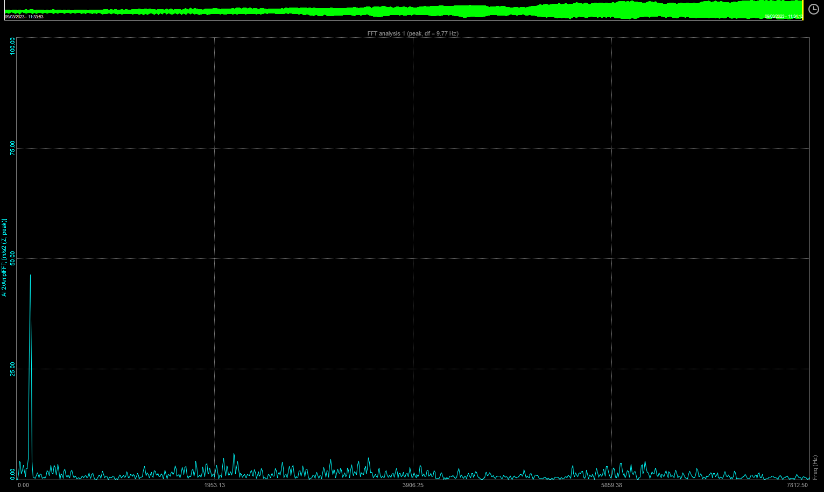
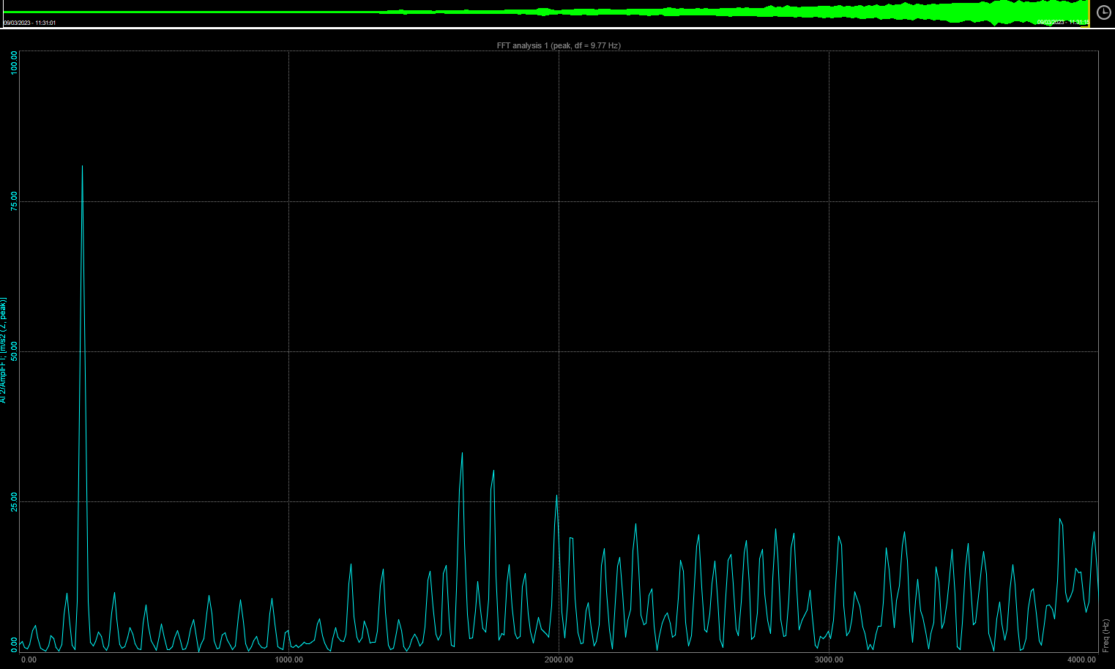
FFT Analysis
Figure 2: FFT Analysis 1 Cylinder
Figure 3: FFT Analysis 4 Cylinder
Notes:
The graphs above show the Fast Fourier Transform (FFT) analysis, which is a computational algorithm that efficiently implements a mathematical operation called the discrete-time Fourier transform. Figure 2 shows the FFT analysis for 1 cylinder, 4 cylinder results can be seen in figure 3. This analysis enables a determination of the amplitude of separate frequencies and the excitation of them. Essentially, the FFT analysis produces a diagram that represents the transformation of sound into sine and cosine waves.
As Instruments states, The human ear automatically and involuntarily performs a calculation that takes the intellect years of mathematical education to accomplish. In other words, the FFT analysis is a way to produce a diagram that replicates what the human ear naturally does when it transforms sound into sine and cosine waves. By breaking down a periodic waveform into a series of sine and cosine waves, the FFT analysis can convey information about different frequencies and their amplitudes. This type of analysis is commonly used to analyse data from a variety of observations, by plotting frequency against the amplitude of a sine wave (Instruments, 2015).
The FFT graphs provide valuable insight into the noise and vibration characteristics of an engine. The graphs show the frequency spectrum of the engine's noise, with the amplitude of each frequency component plotted against its frequency. The higher the amplitude at a certain frequency, the louder the engine will sound at that frequency.
In the case of the graphs provided, it is clear that the 4 cylinder engine produces much more noise than the 1 cylinder engine. This is not surprising as the 4 cylinder engine has more cylinders and therefore more moving parts, resulting in more noise and vibration. The FFT graphs show a higher amplitude of frequency components across a wider range of frequencies for the 4 cylinder engine compared to the 1 cylinder engine.
Additionally, the FFT graphs can help identify any specific frequency components that are causing excessive noise or vibration. This can be useful for pinpointing potential issues in the engine, such as a malfunctioning component or a resonance problem. By analysing the FFT graphs, engineers can make adjustments to the engine design or identify specific components that need to be replaced to reduce noise and vibration levels.

Slide 6
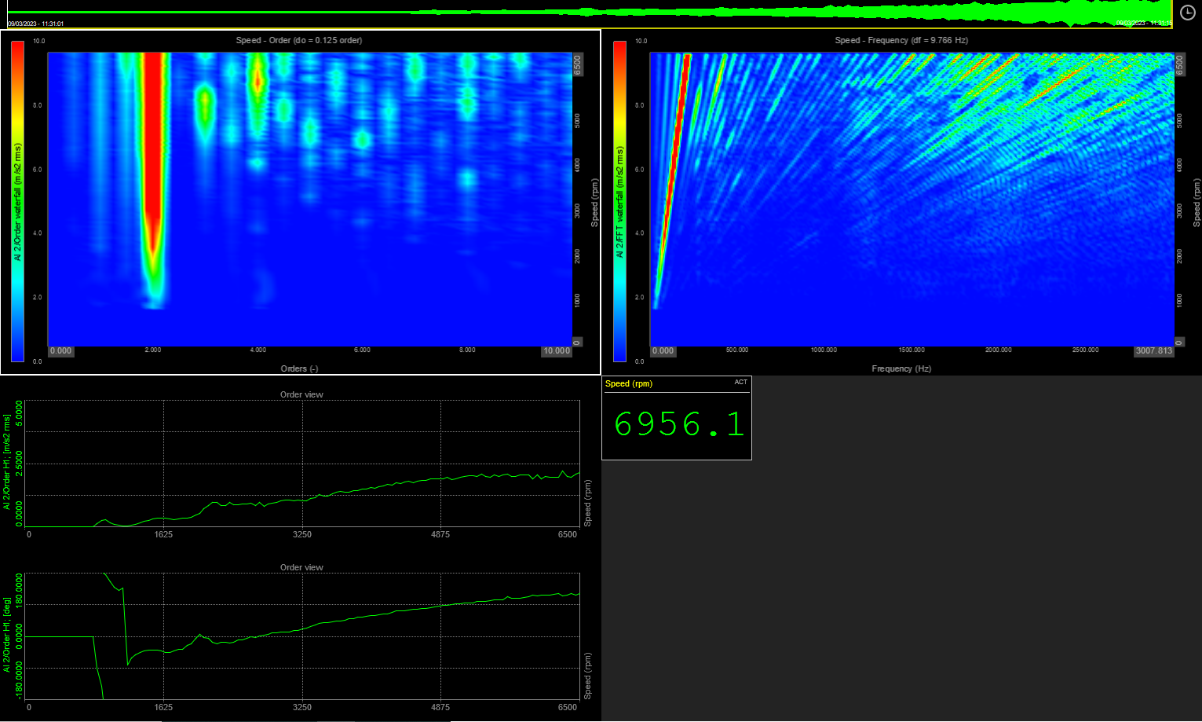
Order Lock Analysis: 4 Cylinder
Figure 4: Order Lock Analysis 4 Cylinder
Notes:
The graph on the left shows the results of an order lock analysis. The different orders of vibration present in the engine are shown, with orders 0.5, 1, 1.5, 2, 3, and 4 visible in the graph.
The order number is an indication of the frequency of the vibration, with order 1 representing the fundamental frequency of the engine, which is usually the frequency of the engine's rotation. In an order lock analysis, the order of 0.5 typically corresponds to the first harmonic of the engine's rotation frequency. The engine's rotation frequency can be expressed as a whole number multiple of the fundamental frequency, which is order 1. Therefore, an order of 0.5 in an order lock analysis indicates a vibration frequency that is half the fundamental frequency of the engine.
Order 2 is much more prominent than the other orders, suggesting that order two corresponds to the combustion stroke. The combustion stroke occurs when the air-fuel mixture is ignited, and the piston is pushed down, generating power. As the engine being analysed has four cylinders, each cylinder will complete one combustion stroke every two rotations of the crankshaft. Therefore, two combustion strokes will occur every four rotations of the crankshaft, corresponding to an order two vibration frequency.
An order of 1.5 typically corresponds to the third harmonic of the engine's rotation frequency. The engine's rotation frequency can be expressed as a whole number multiple of the fundamental frequency, which is order 1. Thus, an order of 1.5 in an order lock analysis indicates a vibration frequency that is one and a half times the fundamental frequency of the engine.
An order of 3 corresponds to the third harmonic of the engine's rotation frequency, meaning that the vibration frequency is three times the fundamental frequency (order 1) of the engine. The third harmonic vibration can be caused by various sources, such as unbalanced forces in the engine's rotating parts or the transmission system.
An order of 4 corresponds to the fourth harmonic of the engine's rotation frequency, meaning that the vibration frequency is four times the fundamental frequency (order 1) of the engine. Like the third harmonic (order 3), the fourth harmonic is weaker and less dominant than the lower order harmonics. However, it can still provide valuable information about the engine's behaviour and help diagnose issues such as misalignment or wear in the engine's components.

Slide 7
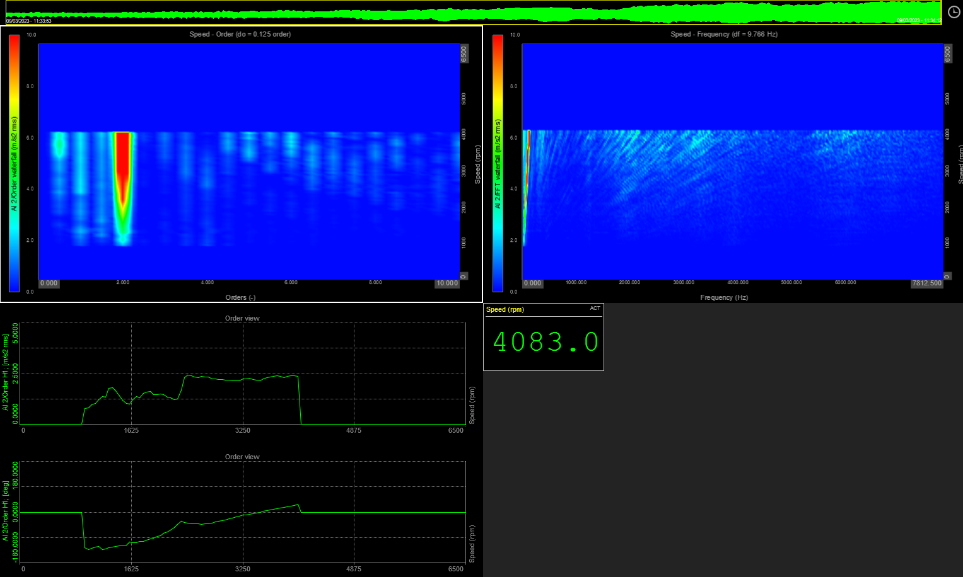
Order Lock Analysis: 1 Cylinder
Figure 5: Order Lock Analysis 1 Cylinder
Notes:
The graph on the left shows the results of an order lock analysis, a technique used to examine the vibration signals generated by the engine to identify the frequencies at which various engine components are vibrating. Similarly, the different orders of vibration present in the engine are shown, with orders 0.5, 1, 1.5, 2, 3, and 4 visible in the graph.
However, the orders are much less prominent than the 4 cylinder, this is because the 1 cylinder engine has fewer moving parts and a simpler design compared to the 4 cylinder engine, resulting in less vibration and noise. As a result, the vibration signals generated by the 1 cylinder engine have a lower amplitude and are less complex than those of the 4 cylinder engine, leading to fewer and less prominent orders in the order lock analysis.
Overall, the FFT analysis and the order lock analysis are powerful tools that can provide valuable insights into the noise and vibration characteristics of an engine. By analyzing the frequency components and orders present in the vibration signals generated by the engine, engineers can identify potential issues and make informed decisions regarding engine design, maintenance, and repair. These analyses can ultimately help reduce noise and vibration levels, improve engine performance, and enhance the driving experience for vehicle owners.

Slide 8
Comparison: 1 Cylinder vs 4 Cylinder
Notes:
The results of the order lock analysis for the 1 cylinder and 4 cylinder are quite different. The 4 cylinder has more moving parts and a more complex design than the 1 cylinder, resulting in more vibration and noise. This is reflected in the order lock analysis, where the orders are much more prominent in the 4 cylinder than in the 1 cylinder. In particular, order 2, which corresponds to the combustion stroke, is much more prominent in the 4 cylinder engine than in the 1 cylinder engine, as each cylinder in the 4 cylinder engine completes one combustion stroke every two rotations of the crankshaft, while the 1 cylinder engine only has one cylinder.
On the other hand, the orders in the 1 cylinder engine are much less prominent than those in the 4 cylinder engine, reflecting the fact that the 1 cylinder engine has fewer moving parts and a simpler design. The vibration signals generated by the 1 cylinder engine have a lower amplitude and are less complex than those of the 4 cylinder engine, leading to fewer and less prominent orders in the order lock analysis.

Slide 9
Conclusion
NVH can negatively impact the operation of a system, and if not addressed, can lead to significant damage
Damping is a possible may to mitigate this
Notes:
In summary, noise, vibration, and harshness (NVH) can negatively impact the operation of a system, and if not addressed, can lead to significant damage. One way to mitigate this is through damping, where components are mounted with bushings to absorb some of the vibration and protect the component. Increasing damping can help prevent harmonic resonance, vibration, and noise. Harmonic resonance is a major issue that affects the efficiency of a motor-drive system and can cause equipment or system damage. Early detection and correction are crucial to prevent these issues from occurring.
The Fast Fourier Transform (FFT) analysis is a powerful tool that enables engineers to gain valuable insight into the noise and vibration characteristics of an engine. By breaking down a periodic waveform into a series of sine and cosine waves, the FFT analysis can provide information about different frequencies and their amplitudes. The FFT graphs provided in this analysis clearly show the difference in noise and vibration levels between a 1 cylinder and 4 cylinder engine. Additionally, the order lock analysis provides further insight into the vibration frequencies and their sources. By analysing the FFT graphs and order lock analysis, engineers can identify potential issues in the engine, make adjustments to the engine design, or replace specific components to reduce noise and vibration levels. Overall, the FFT analysis and order lock analysis are important tools in the field of engineering, providing valuable information that can be used to improve engine performance and efficiency.

Slide 10
Bibliography
Instruments, D., 2015. Dataq Instruments. [Online]
Available at: https://www.dataq.com/data-acquisition/general-education-tutorials/fft-fast-fourier-transform-waveform-analysis.html
[Accessed 31 March 2022].
Asheef, M., 2020. LinkedIn. [Online]
Available at: https://www.linkedin.com/pulse/what-actually-harmonic-resonances-mohammed-asheef/
[Accessed 29 March 2023].

Slide 11

Thank you
Notes:
Thank you for listening.

