Slide 1

Menu Engineering
Student name : Elena Gavril
Student number : 2207241
Lecture name : Rohan Dubrey

Slide 2



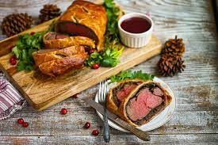
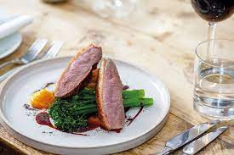

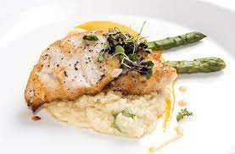
APPETIZERS
VALENTINES SPECIAL
Lobster Bisque With Croutons And Chives
Seared Scallops With Crispy Bacon And Pea Puree
Burrata With Heritage Tomatoes, Pesto, And Sourdough Toast
MAINS
Beef Wellington With Roasted Root Vegetables And Red Wine Sauce |28.00
Pan-seared Duck Breast With Cherry Sauce, Fondant Potatoes, And Buttered Green Beans | 22.50
Grilled Sea Bass With Saffron Risotto And Grilled Asparagus |24.50
Wild Mushroom And Truffle Risotto With Parmesan Shavings And Rocket Salad |18.00
We hope you and your loved one enjoy this special Valentine's Day menu at Hotel Trinity. Please let us know if you have any specific dietary restrictions or preferences, and our staff will be happy to assist you

Slide 3

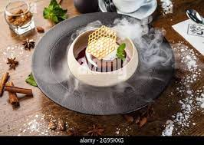
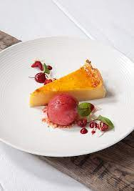
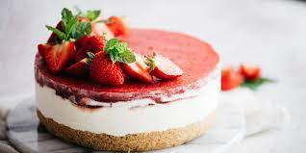
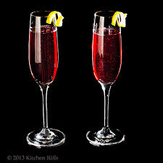

DESSERTS
DRINKS
Dark chocolate fondant with vanilla ice cream and raspberry coulis |9.50
Lemon tart with meringue and raspberry sorbet | 8.50
Strawberry cheesecake with whipped cream and berry compote | 7.50
Love Potion Cocktail (A sweet and fruity cocktail made with raspberry vodka, cranberry juice, pineapple juice, and a splash of grenadine. Served with a fresh raspberry garnish.) | 9.50
Chambord Kir Royale (A classic romantic drink made with Chambord black raspberry liqueur and champagne, garnished with a fresh raspberry.)|11.50
Velvet Valentine Martini (A decadent and rich cocktail made with vanilla vodka, Godiva chocolate liqueur, and a splash of cream. Served in a chilled martini glass with a chocolate-covered strawberry. ) | 10.50

Slide 4
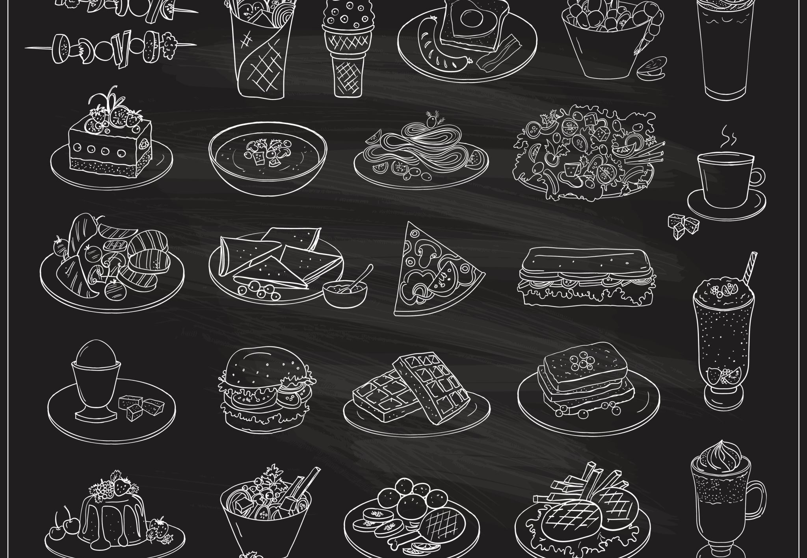
REFERENCES:
Brown, D.R., TotalBoox and TBX (2013) The Restaurant Manager’s Handbook: How to Set Up, Operate, and Manage a Financially Successful Food Service Operation. 4th edn. Atlantic Publishing Group.
Boussard, S. (2021) Food and Beverage Management in the Luxury Hotel Industry. New York: Business Expert Press.
Cousins, J., Foskett, D., and Pennington, A. (2011) Food and Beverage Management: For the Hospitality, Tourism and Event Industries. 3rd edn. Oxford: Goodfellow.
Davis, B., Lockwood, A., Pantelidis, I. and Alcott, P. (2018) Food and Beverage Management. 6th edn. London: Routledge.Johnston, R. (2012) Service operations management: improving service delivery. 4th edn. Harlow, England: Pearson.
Motarjemi, Y. and Lelieveld, H. (2014) Food safety management: a practical guide for the food industry. Amsterdam: Academic Press.
Valentine's Day Cocktail Recipes" by Town & Country, 12 Jan. 2021, Town & Country Magazine
Valentine's Day Dinner Ideas for a Romantic Night In" by Sienna Livermore, 29 Jan. 2021, Good Housekeeping
Zutshi, A. (2019) ‘How to Develop Well-Informed and Assured Teams to Embed Food Safety Compliance in the UK Catering and Hospitality Industry’, Perspectives in Public Health, 139(6), pp. 294–295.

