Slide 1
Computer Systems
Fundamentals
(ACCA4028)
Lecture - 7

Slide 2
Content
CPU
Instruction cycle
Interrupt
Types of Computer Architecture

Slide 3
CPU
The brain of a computer.
It processes instructions from programs and manages system operations.
Three major components
ALU - Arithmetic Logic Unit
CU - Control Unit
Registers/ Memory

Slide 4
Arithmetic and Logic Unit
Performing basic arithmetic operations
Addition, Subtraction, multiplication
Performing logical operations
AND, OR, and NOT
Managing the Operation Code (Opcode) and Operands

Slide 5
Arithmetic and Logic Unit
Operator: Specifies the operation to be performed (e.g., ADD, SUB, MUL, DIV).
Operand: The data on which the operation is performed (e.g., variables, memory addresses).
Opcode: The machine-level representation of an operation that the CPU can execute.
Example: In ADD A, B, ADD is the opcode, and A, B are the operands.

Slide 6
Control Unit
Critical component of the CPU responsible for directing operations.
Manage and coordinate the Fetching, Decoding and execution of instructions in the computer
Manages data flow between the ALU, registers, cache, and memory
Program Counter Management
Control Signal Generation and Synchronisation
Interrupt Handling

Slide 7
Registers
Registers are high-speed, small-sized memory locations inside the CPU used to store data temporarily during processing.
A register may hold
  a software instruction
  a storage address
  a single characters
  a bit sequence of a symbol

Slide 8
Registers
32-bit System must have a 32-bit register
Half Registers
Numbered or have specific names
High-speed working areas
Registers facilitate the movement between:
  RAM,
  the control unit and
  the arithmetic-logic unit (ALU).

Slide 9
Registers
Two Types:
General-Purpose Registers: Used for arithmetic, logic operations, and temporary data storage.
Special-Purpose Registers : Designed for specific control functions such as instruction execution, stack management, and condition flag handling.

Slide 10
Special-Purpose Registers
Not available to user programs
Used by CPU to control its operation(s)
Control program execution
Status Registers (Flags Register):
These registers provide information about the current state of the CPU. Examples of status flags include zero flag, carry flag, overflow flag, and others.

Slide 11
Special-Purpose Registers
Program counter (PC)
It contains the memory address of the next instruction to be fetched.
Instruction register (IR)
Holds the current instruction being executed.
Stack Pointer (SP)
The stack pointer points to the top of the stack in memory.

Slide 12
General Purpose Registers
  Data registers,
    data to be stored in the computer storage (e.g. RAM), or the data after a fetch from the computer storage.
    It acts like a buffer and holds anything that is copied from the memory ready for the processor to use it.
  Address registers, which contain memory addresses of data and instructions.

Slide 13
Timing and Control Unit (TCU)
Timing and Control Unit (TCU)
Generate the necessary control signals and manages the timing of various operations within the processor.
Ensures the proper sequencing of instructions and the coordination of data transfer between different sections of the processor.

Slide 14
I/O control
Input/Output Control manages communication between the processor and external devices using a serial communication protocol.

Slide 15
The Fetch-Execute Cycle
Instruction Decoder:
Decodes machine instructions fetched from memory.
Interprets the opcode to determine the operation and operands.
Generates control signals for data transfer, arithmetic, logic operations, and control flow.

Slide 16
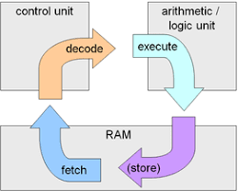
The Fetch-Execute Cycle
Machine Cycle Encoder:
The processor controls timing and sequencing of operations.
Determines the sequence of machine cycles required to execute an instruction.
Different instructions require different numbers and types of machine cycles.
Machine cycles include:
  Fetch Cycle (retrieve instruction from memory).
  Decode Cycle (interpret the instruction).
  Execute Cycle (perform the operation).

Slide 17
Interrupt
An interrupt in computing refers to a mechanism by which a processor can be temporarily halted or suspended to give attention to a specific event or condition that requires immediate attention.
Interrupts are crucial for handling real-time events and asynchronous tasks in a computer system.
Interrupt Service Routine (ISR):
An ISR is a specific code designed to handle a particular interrupt. When an interrupt occurs, the processor transfers control to the corresponding ISR to deal with the event.

Slide 18
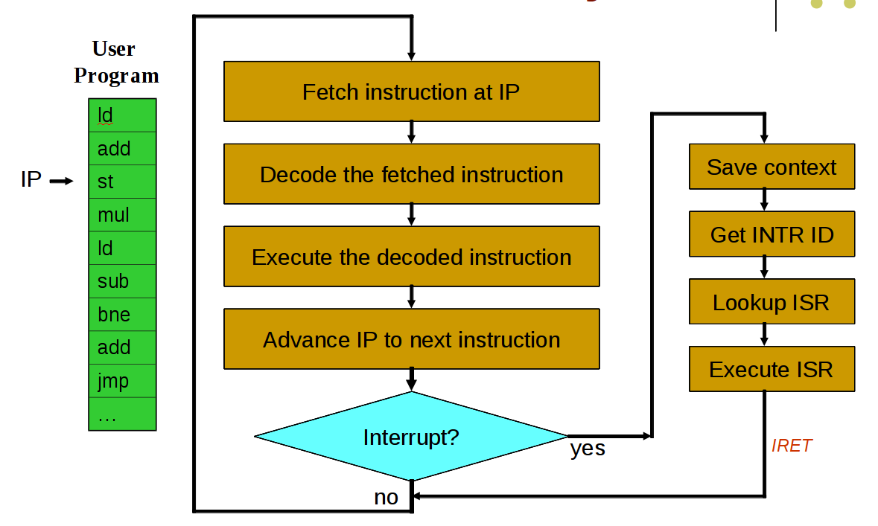
Interrupt

Slide 19
Interrupt
Interrupt Sources:
Hardware Interrupts: Generated by external devices to signal events like keyboard input, mouse movements, or data arriving at a communication port.
Software Interrupts: Invoked by software instructions or conditions, often used for system calls or to handle errors.
Exception Interrupts: Triggered by exceptional conditions such as division by zero, invalid memory access, or other error situations.

Slide 20
Interrupt
Interrupt Request (IRQ):
A signal generated by a device to request the attention of the processor.
Interrupt Controller:
In systems with multiple interrupt sources, an interrupt controller is used to prioritise and manage interrupt requests. It helps avoid conflicts when multiple devices seek attention simultaneously.
Maskable and Non-Maskable Interrupts:
Maskable Interrupts: Ignore or mask these interrupts based on its current state.
Non-Maskable Interrupts (NMI): cannot be ignored and usually indicate critical system conditions.

Slide 21
Interrupt
Interrupt Priority:
In systems with multiple interrupts, priority levels determine which interrupt is serviced first when multiple requests occur simultaneously.
Return from Interrupt (RTI):
After an ISR has completed its execution, a return from interrupt instruction (RTI) is used to resume normal program execution.

Slide 22
Main Types of architecture
Main Types of architecture
Von Neumann
Harvard

Slide 23
Von Neumann Architecture
Uses a single memory unit to store both data and instructions
Single bus for both instructions and data, known as the system bus.
Instructions are fetched, decoded, and executed sequentially
Used in PCs, laptops, and general-purpose processors.
Most common architecture used in modern computers.
Eg, ARM processor (until ARM 9)

Slide 24
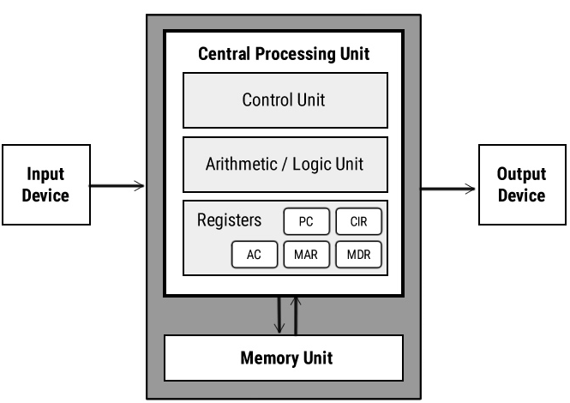
Von Neumann Architecture

Slide 25
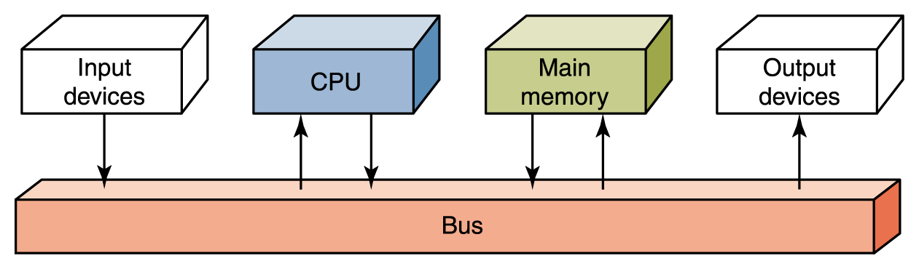
Flow of Information
Von Neumann architecture

Slide 26
Harvard Architecture
Uses separate memory units for data and instructions
Allows parallel access to both memory units, improving speed
Commonly used in microcontrollers and DSPs (Digital Signal Processors)
It is complex to design.
Eg: Arduino, PIC microcontrollers

Slide 27
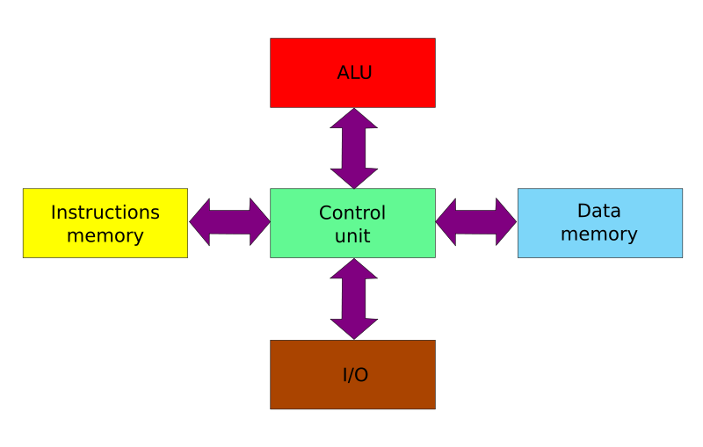
Harvard Architecture

Slide 28



Device Driver Software
A device driver software enables the operating system and a peripheral device to communicate with each other.
Generalized commands from the system software or an application
Unique programming commands that the device can understand
Personal Computer
Driver
Printer

Slide 29

Thank You

