Slide 1



Community Care and Development
Assessment Component 1
Viva Voce
Children and young people Mental Health Community and service provision
Student name: Olivette Mildred Cole
Student number: 2022097
Module code: BMHP6022
Lecturer : Jolly Nwankwo

Slide 2

Introduction: Define Community
Community is when a group of individuals come together to work as a team and build relationships, bonds, and different interests and identities. Community is also a way for people to share workload in certain environments, services, and even cultural activities (Conversational-leadership, 2023).
Nevertheless, communities are also known to be intricate and vibrant, and individual identities and allegiances may differ as time goes by, especially in different social circumstances.
(GOV, 2018)

Slide 3
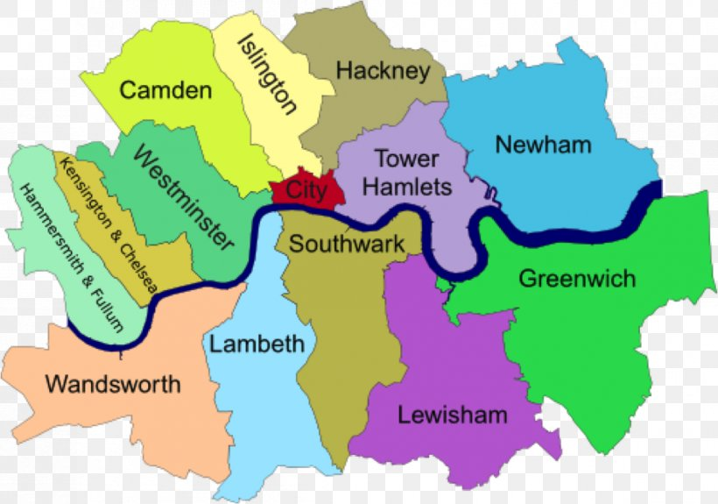
Location of community in Southwark
Southwark is a district of Central London
Area: covers 11 Square Miles
Population: 314,400 people live in Southwark
(Southwark Public Health, 2018)

Slide 4

Southwark Demography of Children & Young People
Southwark population under 20 years old- 68,542
18% of black people are black other, 6% black Caribbean, and 22% black African.
Southwark is rated 9th in London and 18th place in England against child poverty in low-income families
28% of children and young people in the Southwark community living in poverty compared to 24% in London and 19% in England.
(Morden Gov, 2023)

Slide 5
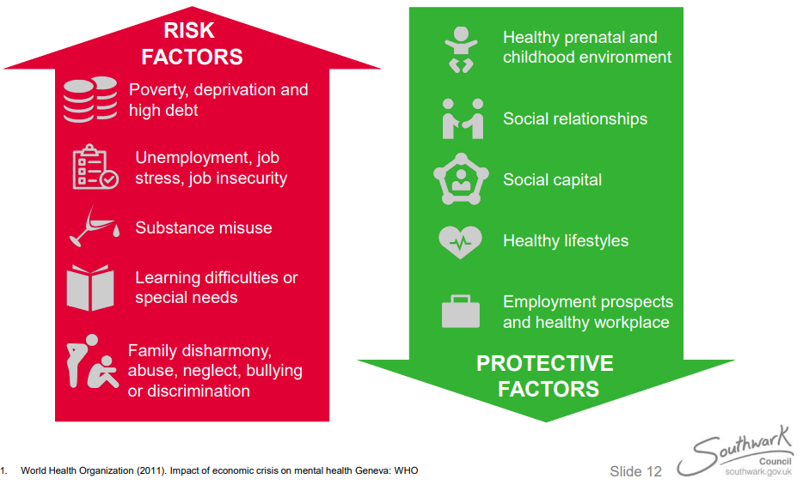
What are the health issue in Southwark?
High Prevalence of mental health illness within Southwark community
According to Southwark Community (2022):
There has been 13.4% high level of mental health issues reported this is down to a great number of the population in Southwark that’s reported depression and anxiety from 2014 to 2015 (more than the 11.7% London average).
High teenage pregnancy rates
Drug abuse
Alcohol misuse
HIV and acute sexually transmitted diseasesthat
(WHO, 2011)

Slide 6

The aim of the individual project
To promote awareness to increase individuals’ understanding of mental health as and to reduce stigma of mental health (WHO, 2023).
To Improve mental health access to everyone while reducing health inequalities as well as providing a healthier environment (Public Health England, 2018).
To be able to build evidence from community-based interventions that are known to impact positively on the Southwark community population’s mental health and wellbeing (Southwark Public Health, 2017).

Slide 7
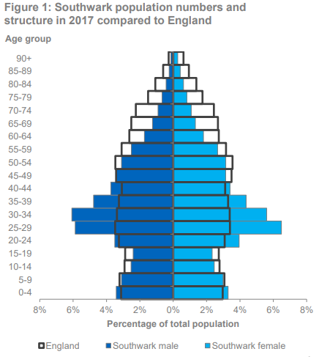
Gender and sexual orientation
Gender in 2021:
Males 149,020
Females 158,550
(ONS, 2023).
Sexual orientation in 2021:
4.5% are homosexual and lesbian
3.2% are bisexual and pansexual
(Southwark Public Health Division, 2023).
(ONS, 2018)

Slide 8
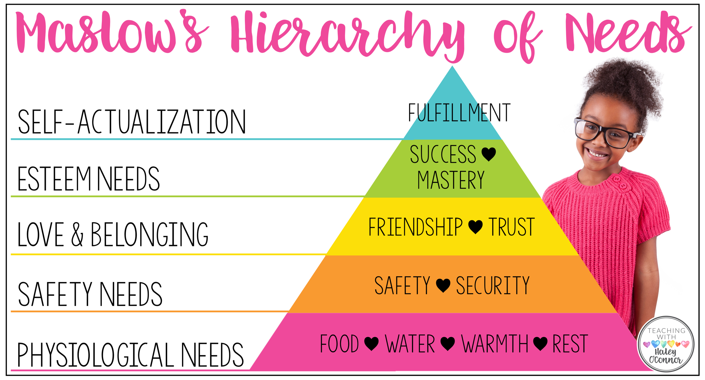
children and young people Health and Social Care needs
Needs assessment is done by the children’s service team, this helps to determine if a child or young people need extra support:
– CAMHS (Child and Adolescent Mental Health Service) Needs Assessment
– CYPHP (Children and Young People Health Partnership) Needs Assessment
– Neglect Needs Assessment
Needs of the family, children, and young people such as daycare for under 5s
Parenting assistance can come in the form of parenting workshops, study programs, guidance from family support workers, or even just practical household assistance along with access to children’s centers. Nonprofit groups may also offer support services.
(NHS, 2020).
(Teaching with Haley, 2023)

Slide 9

educational and employment needs children and young people’s
Young people's educational needs
According to Section 2 of the Education and Skills Act (2008), adolescents shall be permitted to pursue continuous study in a training centre, college, or school.
center
Children’s educational needs
According to the Early Years Foundation 2014, states care providers meet the educational needs of children which are:
ensuring that each child develops and is educated
Make certain that each child is kept safe and in good health.
Ascertain that each child possesses the information and comprehension necessary for them to begin school.
(Early Years Foundation, 2014)
Employment needs
Full-time work or volunteer work
Participate in a sponsored internship, traineeship, or apprenticeship.
(Child Law Advice, 2023)
(Bing, 2023)
Notes:
(Bing, 2023)

Slide 10
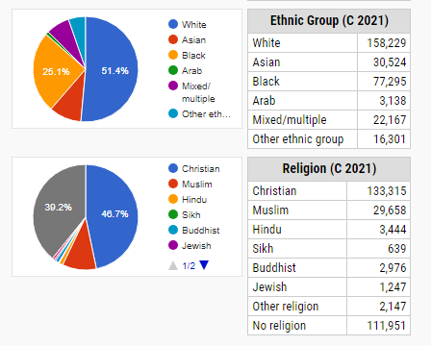
Impact of children and young people’s Health duing the pandemic on
Children and young people’s health was affected by the pandemic due to disruption to:
Disruption to schools
Social isolation
Health Anxiety
Family financial stability
The pandemic has played a great role in exposing children and young people to several health risk factors in developing mental health
(Kings College London, 2022).
Age Profile
Youngest population average in England.
In 2017, Southwark's median age was 33.1 years, which was over seven years lower than the national average and two years lower than the average for London
(Office for National Statistics, 2018).
(City Population, 2023)

Slide 11
Key Facts
Overcrowded:12%
Homeowner: Very low within Southwark
Households: One-quarter (27%) of Southwark households are socially rented from the council.
Disability:17.5%
Education: no qualification 18.08% and Apprenticeship 5.32%
Car ownership: 41.6%
Crime and homelessness: Southwark's crime rate as of 2023 is 31% greater than that of England, Wales, and Northern Ireland and 15% higher than that of London (Crime rate, 2023). 1 in 46 people are homeless (London news, 2023).
Languages: 76% English to be their main spoken language
Pay inequality: woman are paied 5.99% higher than males
Housing affordability: 25% in 2002 and 35% increased
(Southwark Council, 2023)

Slide 12
Policies and legislations
The Impact the Education and Skills Act 2008 legislation has on young people’s community is that its duties is to raise the percentage of youth enrolled in training and educational initiatives
(legislation, 2008).
The quality of education that young people get in schools is being improved by policies that have an influence on the youth community. By doing this, young people will be able to graduate from high school at the age of sixteen with a solid education and be ready for future study and the workforce (GOV, 2015).
NHS Long Term Plan 2019
Mental Health Act 1983
Equality Act 2014

Slide 13

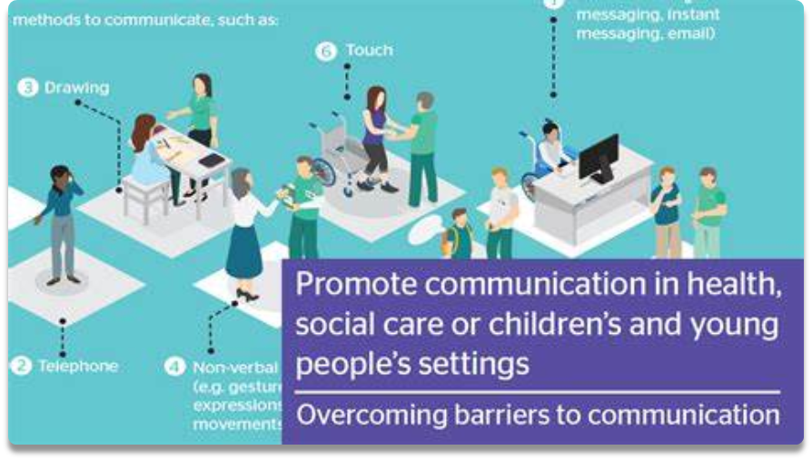

Existing means of communication of health and social care providers
Internal means of communication are:
External means of communication are:
Mental Health Awareness Week
Young Minds
Mental Health Crisis Text line
Digital technology communications when proving health information.
There are different ways to communicate effectively in relation to providing health care information such as:
health care apps
Websites
SMS text and emails
Hearing aids
Video calls and skype from doctors
(Skillsforcare, 2023)

Slide 14

Recommendation
Early intervention assistance for the mental health of children and adolescents
accessibility to specialised help
Clinical commissioning groups, which have often fallen short of national standards, are held accountable by NHS England and Improvement for significant measurements including spending, wait times, and accessibility rates.
Together, the health system and local government can encourage mental health and stop the emergence of new problems.
The Department of Education and the Department of Health and Social Care should collaborate alongside every educational institution to ensure they are provided with the resources necessary to implement a whole school strategy, such as:
-Digital self-help support available; -School counselling available to all children in need of the service; -Excellent guidelines for staff about best practises for the provision of the most suitable support in schools.
(Southwark public Health, 2018)

Slide 15
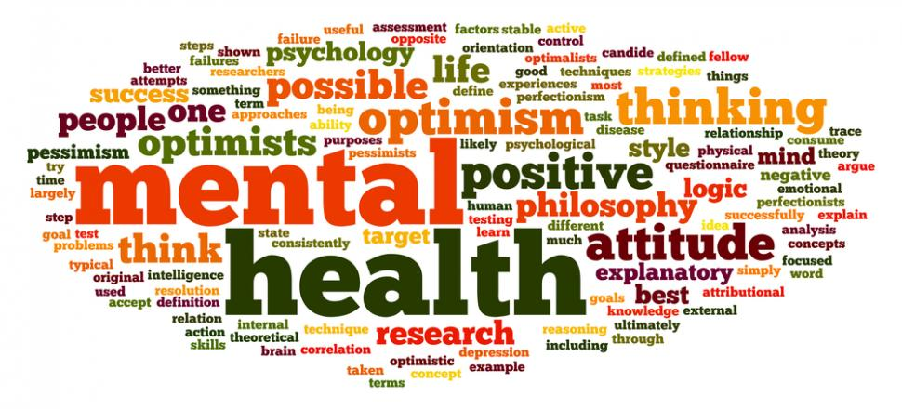
Conclusion
One of South East London's neighbourhoods with the greatest population growth is Southwark. By 2030, the population is expected to have increased by over 20%, or 60,000 more people (Southwark Public Health, 2023). Even if most of the Southwark population is young, not all of it is made up of kids and teenagers.
The main cause of it is that, in comparison to other places, there are more young individuals in their 20s and 30s and fewer adults 50 years of age and older. Both natural change, such as more births than deaths, and immigration from outside the borough are contributing to the population increase in our borough. With 10% of our population moving in each year, Southwark has one of the greatest population turnover rates in the nation., and 10% of our population moving out each year.

Slide 16

Reference
Bing (2023) Image of empowering workforce. Available at: https://www.bing.com/images/search?view=detailV2&ccid=rsHvmVfn&id=7FC4EBA84F5CE6AAA2B5ECD2C93574134A820732&thid (Accessed: 6 November 2023).
Child Law Advice (2023) educational needs. Available at: https://childlawadvice.org.uk/information-pages/child-employment/ (Accessed: 6 November 2023)
conversational Leadership (2023) What is a community?. Available at: https://conversational-leadership.net/community/#:~:text=A%20community%20is%20a%20group%20of%20people%20who,towards%20a%20common%20purpose%20about%20which%20they%20care. (Accessed: 17 October 2023)
City Population (2023) Aging population in Southwark. Avaliable at: https://www.citypopulation.de/en/uk/london/admin/southwark/E43000218__southwark/ (Accessed: 6 November 2023).
Crime rate (2023) What are the crime rates in southwark community?. Available at: https://crimerate.co.uk/london/southwark (Accessed: 6 November 2023).
Early years foundation (2014). educational needs and employment needs. Available at: https://www.gov.uk/government/publications/early-years-foundation-stage-framework--2 (Accessed: 6 November 2023).
Gov (2015) Policy for children and young people health care. Available at: https://www.gov.uk/government/publications/2010-to-2015-government-policy-young-people/2010-to-2015-government-policy-young-people#actions (Accessed: 6 November 2023).
Kings College London (2022). Impact of the pandemic on health. Available at: https://www.kcl.ac.uk/an-isolated-generation-the-impact-of-covid-19-on-children-and-young-people (Accessed: 6 November 20230.
Legislation (2008) Health and social care Act. Available at: https://www.legislation.gov.uk/ukpga/2008/14/contents (Accessed: 8 November 2023).
London News (2023) Homelessness in southwark community. Available at: https://londonnewsonline.co.uk/three-south-london-boroughs-in-top-10-highest-homeless-rate-in-country/#:~:text=The%20borough%E2%80%99s%20rate%20of%20homelessness%20%E2%80%93%20calculated%20by,Southwark%20the%20rate%20is%20one%20in%2046%20people (Accessed: 6 November 2023).
Morden Gov (2023) Southwark Demography of Children & Young People. Available at: file:///C:/Users/Student/Downloads/JSNA%20Factsheet%202018-19%20-%20Demography%2020180725%20(1).pdf (Accessed: 19 October 2023).
Office for National Statistics (2018) mid-year resident population estimates released June 2018. Available at: https://www.ons.gov.uk/datasets/TS077/editions/2021/versions/1 (Accessed: 25 October 2023).
Office for National Statistics (2023) Gender identity, England and Wales: Census 2021. Available at: https://www.ons.gov.uk/datasets/TS077/editions/2021/versions/1 (Accessed: 25 October 2023).
ONS (2023) Gender and sexual orientation in Southwark. Available at: https://www.ons.gov.uk/peoplepopulationandcommunity/culturalidentity/genderidentity/bulletins/genderidentityenglandandwales/census2021 (Accessed: 5 Novermber 2023).

Slide 17
ONS (2018) Gender and sexual orientation in Southwark. Available at: https://www.ons.gov.uk/peoplepopulationandcommunity/culturalidentity/genderidentity/bulletins/genderidentityenglandandwales/census2021 (Accessed: 5 Novermber 2023).
. Public Health England (2018)The aim of the project for individuals. Available at: https://www.gov.uk/government/publications/children-and-young-peoples-mental-health-government-response/the-governments-response-to-the-health-and-social-care-committee-report-children-and-young-peoples-mental-health. (Accessed: 21 October 2023).
/Southwark Community (2022) What are the health issues in Southwark?. Available at: https://moderngov.southwark.gov.uk/documents/s54956/Presentation%20Southwark%20Childrens%20Public%20Health. (Accessed: 17 October 2023).
Southwark Public Health (2017) The aim of the project for individuals. Available at: https://teachingwithhaley.com/2017/01/29/supporting-students-in-foster-care/ (Accessed: 21 October 2023).
Southwark Public Health (2018) Location of community in Southwark. Available at: https://www.citypopulation.de/en/uk/london/admin/southwark/E43000218__southwark/ (Accessed: 19 October 2023)
Southwark Public Health Division Children and Adults Department (2023) Gender and sexual orientation in Southwark. Available at: file:///C:/Users/Student/Downloads/JSNA%20Annual%20Report%202023.pdf (Accessed: 26 October 2023).
Southwark Public Health (2018) Location of community in Southwark. Available at: Gov (2018). Health matters: community-centred approaches for health and wellbeing. Available at: https://www.gov.uk/government/publications/health-matters-health-and-wellbeing-community-centred-approaches/health-matters-community-centred-approaches-for-health-and-wellbeing (Accessed: 5 November 2023)
Sothwark Council (2023) What are the key main issues affecting children and young people in the Southwark community. Available at: https://www.southwark.gov.uk/planning-and-building-control/planning-policy-and-guidance (Accessed: 7 November 2023).
Teaching with Haley (2023). Maslow's Hierarchy of Needs. Available at: https://teachingwithhaley.com/ (Accessed: 5 November 2023).
World Health Organisation (2023) The aim of the project for individuals. Available at: https://www.who.int/health-topics/mental-health#tab=tab_1 (Accessed: 20 October 2023).
World Health Organization (2011) Impact of economic crisis on mental health Geneva. Available at: https://www.who.int/news-room/fact-sheets/detail/mental-health-strengthening-our-response (Accessed: 17 October 2023)

