Slide 1
Gender
Becoming, performing and fluidity

Slide 2
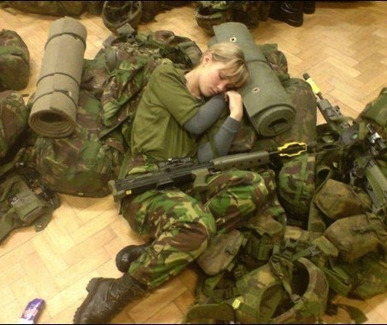
Gender studies
Explores social categories associated with different sexes
Analyses how category behaviours shape practice
Demonstrates how gender expectations create differences
Looks to determine the role culture plays in establishing gender expectations

Slide 3
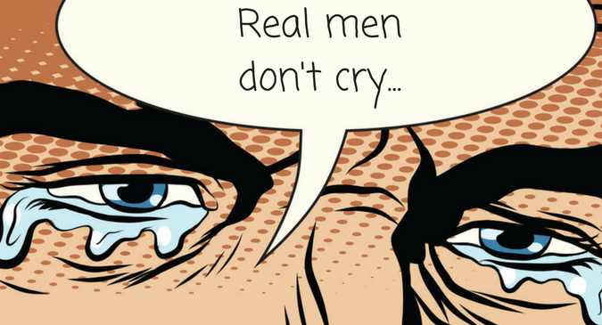
Masculinity is evident in
Socially expected practices, actions and behaviours that show masculinity
Masculinity is typically associated with ‘being a man’….but not exclusively
What activities and behaviours demonstrate one is ‘being masculine’?
Make a list.

Slide 4
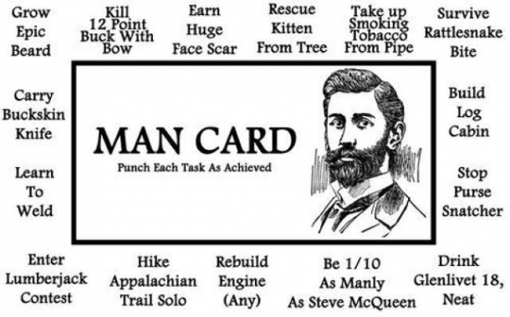
Masculinity is
Typically connected to protection, dominance, predatory behaviours (including sexual predation) and other violent acts….but not always, as the ethnographic record shows.
Which ethnographic examples challenge this stereotypical representation of masculine behaviour?

Slide 5

Similarly, femininity is evident in
Socially expected practices, actions and behaviours that show femininity.
Femininity is typically associated with ‘being a woman’….but not exclusively.
What activities and behaviours demonstrate one is ‘being feminine’?
Make a list.
Offer ethnographic examples that challenge this.

Slide 6
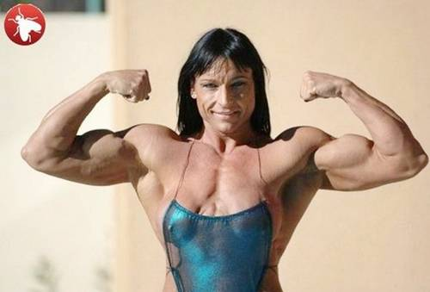
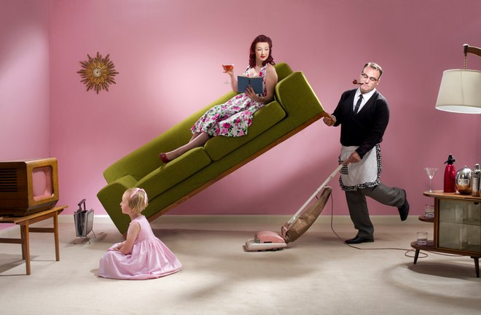
Establishing certain behaviours as correct sets up differences.
People must behave as expected to avoid being considered the opposite of social norms (e.g.: a feminine man)
Notes:
Differences have created inequality. In the case of Euro-American social structures, masculinity dominates thereby creating societies with inequality between the sexes, which has caused pain, anxiety, anger and consternation to many people who feel caught in these gender traps.
Others feel held, supported, safe and happy with clear divisions between sexes and their social roles.
The label for a male dominated society is patriarchy. Patriarchy means: A social system where men hold the power.

Slide 7
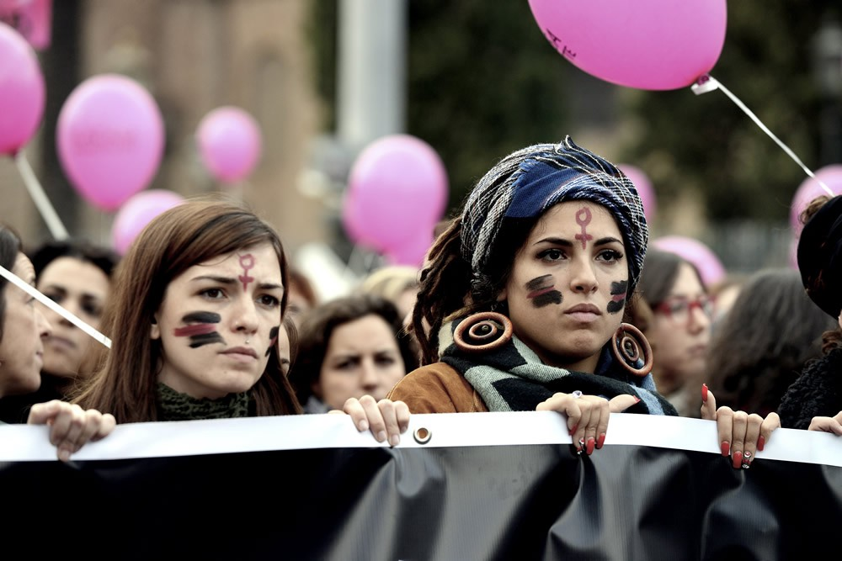
Is gender real or an illusion?
Exploring gender through Butler

Slide 8
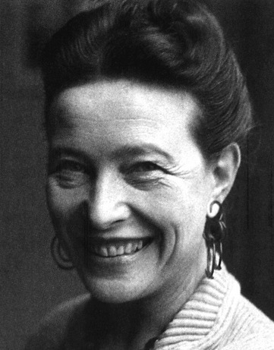
‘One is not born, but, rather, becomes a woman…’
On the first page of the article Butler (1988: 519, emphasis added) quotes Simone de Beauvoir, existentialist philosopher and feminist from early 1900s:

Slide 9
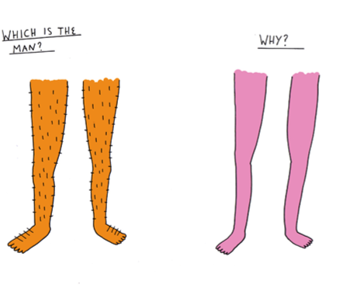
Butler maintains that:
Gender is an illusion and a belief. She states that gender is
Learned
Performed
Created and maintained through ‘acts’
Unstable and flexible
How does she explain this…

Slide 10
Butler’s notion of performativity.
Butler is critical of gender role play and goes so far as to say – despite biological diamorphism – that nothing is ‘given’ about a binary system (1988).
She asserts: social agents constitute reality (1988: 519)
Collectively we make the rules, and go on to teach each other how to perform in ways that fit our already constituted gender norms. This process perpetuates and validates gender differences.
‘Regardless of the pervasive character of patriarchy and the prevalence of sexual difference as an operative cultural distinction, there is nothing about a binary gender system that is given. As a corporeal field of cultural play, gender is a basically innovative affair, although it is quite clear that there are strict punishments for contesting the script by performing out of turn or through unwarranted improvisation’ (1988: 531)

Slide 11
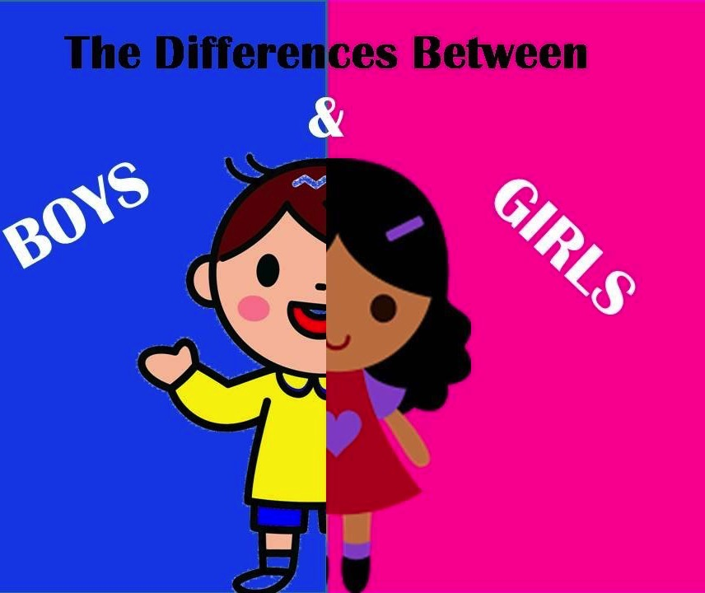
Learning how to be a girl/boy
Activity
What social methods are used to teach boys and girls how to be different?
Offer ethnographic examples to illustrate your answer.

Slide 12
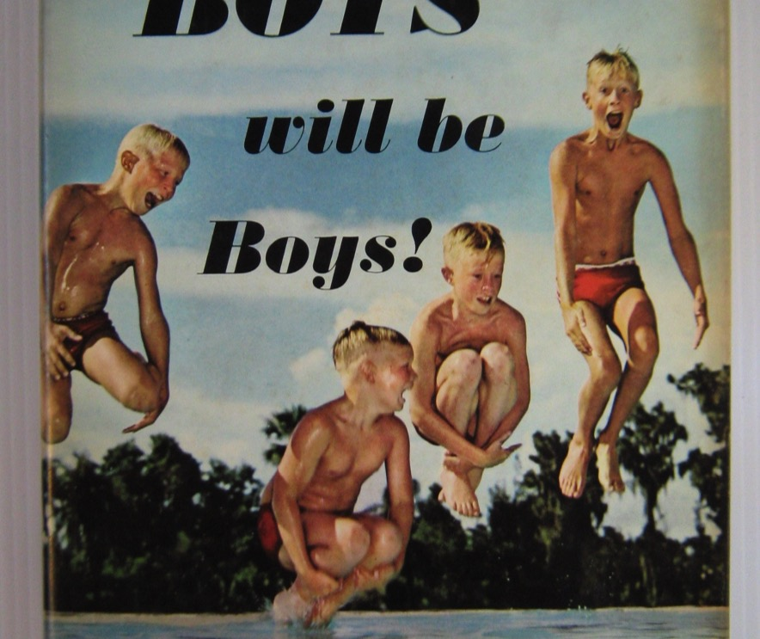
Performing gender identities
Activity
How do people ‘perform’ gender?
What are these constituting acts that Butler talks about?
Are you the sole source of your constituting acts?
What are the roles of: language, gesture, symbolic signs?

Slide 13
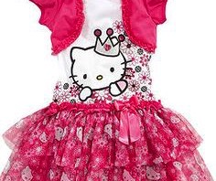
How bodies perform gender identity
‘Gender is instituted through the stylization of the body’(Butler 1988: 519).
Explain what you think Butler means.

Slide 14
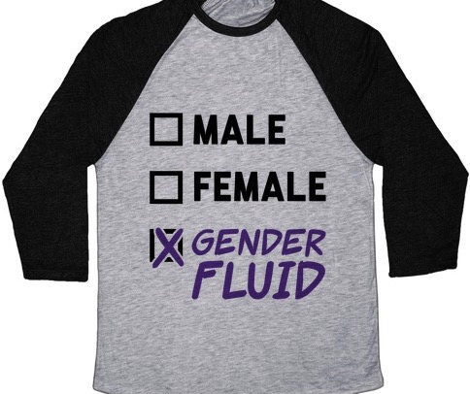
Gender identity is not stable (Butler 1988)
“If gender is instituted through acts which are internally discontinuous, then the appearance of substance is precisely that, a constructed identity, a performative accomplishment which the mundane social audience, including the actors themselves, come to believe and to perform in the mode of belief” (Butler 1988: 520).
Notes:
Butler breaks the relationship between gender identity and the ‘internal’ or biological determinism
Demonstrates that gender is performed
Gender is an illusion – an ‘appearance of substance’
Thus, it is constructed.

Slide 15

Social Audience
This constructed identity is something both the social audience and the agent ‘come to believe’.
Agents then ‘perform’ a ‘mode of belief’
Gender identity, therefore, is a ‘stylized identity’ which is performed over space and time, and it is not necessarily seamless.

Slide 16
Ok, so this is NOT about gender equality per se, but concerns how society persuades people to believe and act.
Thus, Butler shows that these ideas and methods become the norms through repetition. However, they are social constructs (made up by people) and are not biological (and then cannot be claimed to be natural)…therefore, they are not ‘right’ and can change.
Notes:
Butler asks what are the reified and naturalized conceptions of gender?
It is only through understanding how these are constituted that new modes of belief, new constitutive methods, can occur.
Repetition is important in performativity – how gender stability is instituted
Butler specifically uses the word ‘belief’ to indicate the construction of identity as a ‘compelling illusion’
Key point: the ‘gendered’ self does not exist before the act and it is not stable
Therefore: “gender identity is a performative accomplishment compelled by social sanction and taboo” (1988: 520).

Slide 17
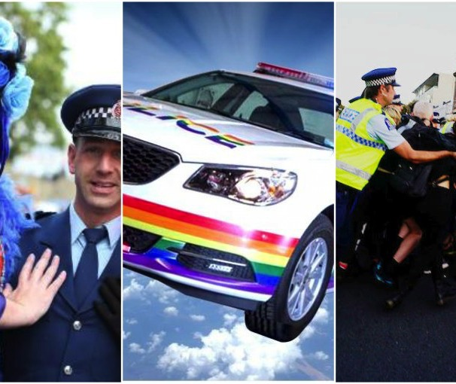
Agents and change
Examine the relationships between the act, the possibility of a different act, how the style can be broken. If subversive acts happen, can they be repeated and form a new norm?
What determines and shapes the social and cultural parameters of the act?
Notes:
The word ‘agent’ means ‘person’ who acts and has choices.
Acts are collective, not individualistic. The collective must embrace any changes.
The parameters:
What we wear
What we do
What we do in accordance with certain sanctions and proscriptions
Victor Turner: social action requires a performance which is repeated
The performance renders social laws explicit

Slide 18
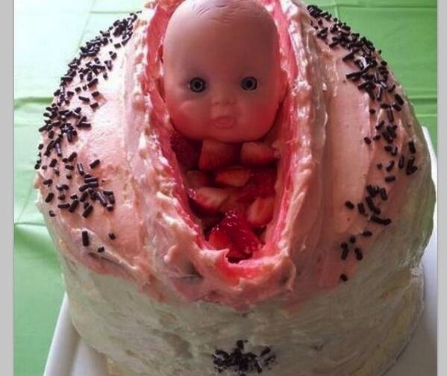
What Butler’s perspective does
By arguing gender is performed it becomes destabilised and there is the possibility that it can be contested.
It shows that being ‘woman’ (or any gender) is a historical situation? Rather than a ‘natural fact’.

Slide 19
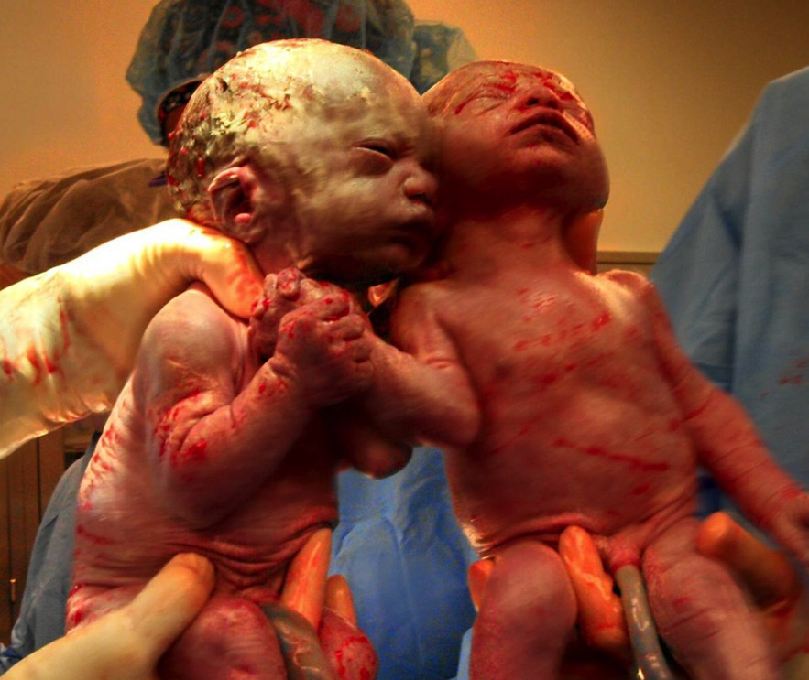
Gender and the Body
‘The body is not a self-identical or merely factic materiality; it is a materiality that bears meaning, if nothing else, and the manner of this bearing is fundamentally dramatic. By dramatic I mean only that the body is not merely matter but a continual and incessant materializing of possibilities. One is not simply a body, but, in some very key sense, one does one's body and, indeed, one does one's body differently from one's contemporaries and from one's embodied predecessors and successors as well’ (Butler 1988: 521).

Slide 20
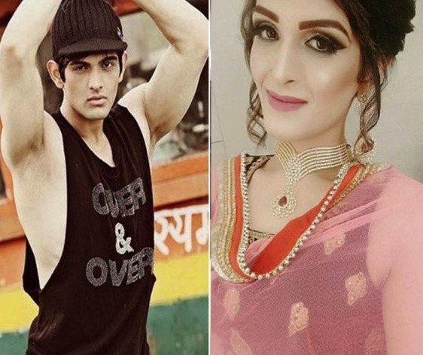
Gender becomes a strategy of survival
“To be female* …has no meaning, but to be a woman is to have become a woman, to compel the body to conform to an historical idea of 'woman,' to induce the body to become a cultural sign, to materialize oneself in obedience to an historically delimited possibility, and to do this as a sustained and repeated corporeal project. The notion of a 'project', however, suggests the originating force of a radical will, and because gender is a project which has cultural survival as its end, the term 'strategy' better suggests the situation of duress under which gender performance always and variously occurs” (Butler1988: 522).
*or ‘man’…but Butler is a feminist…so, yeah.

Slide 21
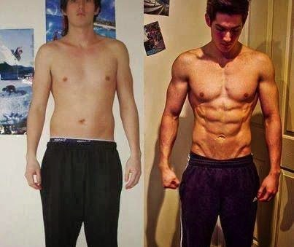
The body is transformed; gender comes into being
‘The body becomes its gender through a series of acts which are renewed, revised, and consolidated through time’ (Butler 1988: 523).
Bodies transform into his or her bodies
Bodies are known through gendered appearances.

Slide 22
Performing gender ‘naturalises’ it
‘Consider that there is a sedimentation of gender norms that produces the peculiar phenomenon of a natural sex, or a real woman, or any number of prevalent and compelling social fictions, and that this is a sedimentation that over time has produced a set of corporeal styles which, in reified form, appear as the natural configuration of bodies into sexes which exist in a binary relation to one another’ (Butler 1988: 524).

Slide 23
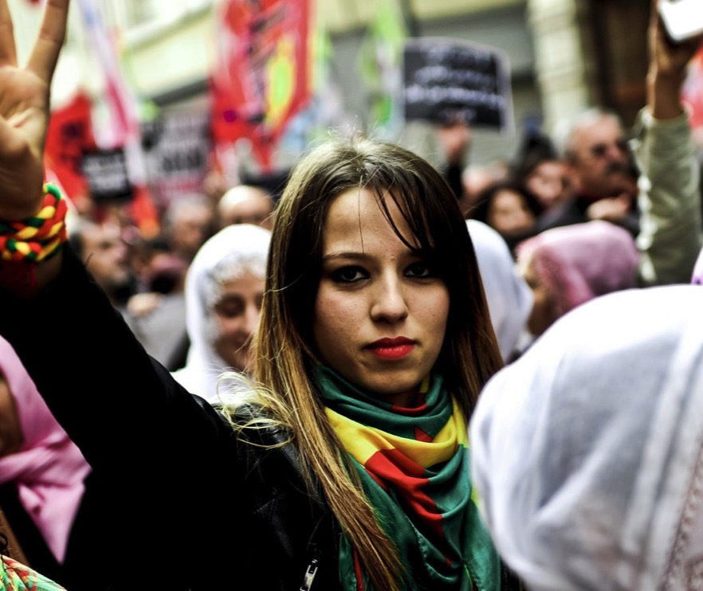
GENDER IS PERFORMATIVE
Gender is not passively scripted on the body. It is what is put on daily and incessantly, with anxiety and pleasure.
Gender is not determined by nature.
If it is mistaken for a natural or linguistic given, power is relinquished and can produce subversive performances of various kinds. (1988: 531)

Slide 24
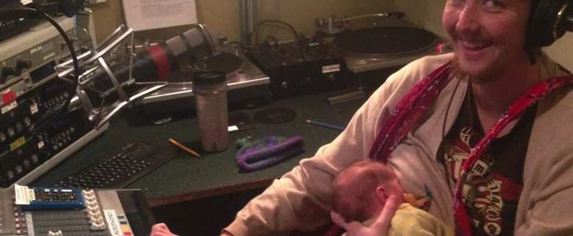
Gender: U

Slide 25
What about sexuality?
Is that also produced by culture?

Slide 26
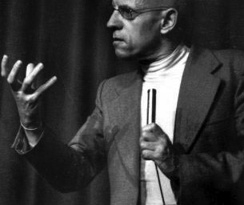

Foucault’s The History of Sexuality (1978)
People are utterly preoccupied with sex – not repressed - as is often presented. Our preoccupation makes us refer to it constantly. Foucault calls this ‘confession’ – we confess our sexuality by talking about it.
As a result we have an excess of sexual categories that organise sexuality and sexual identities.

Slide 27
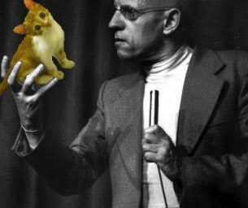
Obsession creates the ‘normal’
Rather than seeing sex as an art (as in, say, Japan), sex is seen as a science – with the truth to be found.
Seeking for truth produces the ‘normal’.
(All the categories contribute to this process)

Slide 28
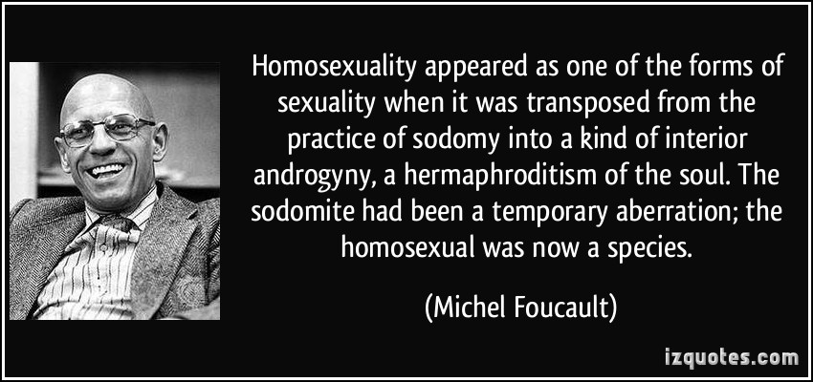
Homosexuality, according to Foucault (1978)
Naming creates a subject category.
But categories are not bounded around sexuality alone. They pervade and seep meaning into diverse areas, broadcasting effects across society.
Therefore by naming someone a homosexual you are not only talking about their sexual identity. You also reference more about preferences and behaviours.
Coming out was like confession (but confession failed to get rid of, rather it recreated).
Notes:
Addition to point 2: similarly if someone calls you a homosexual they have invented you. For Foucault, the invention of a type of person called ‘the homosexual’ made them their own species.

Slide 29
Being a sexual subject
The way sex is approached had turned it into a ‘thing’, almost invented it in a particular normalised form (constructivist).
Consequently, categories (e.g.: homosexuality) are inventions, constructed in discourse.
To be a subject, therefore, means taking a position in the ‘order’ of things.
Activity
Compare this to Butler’s ideas -
How does Butler think gendered subjects become themselves?
How does Foucault see sexual subjects as being invented?

Slide 30
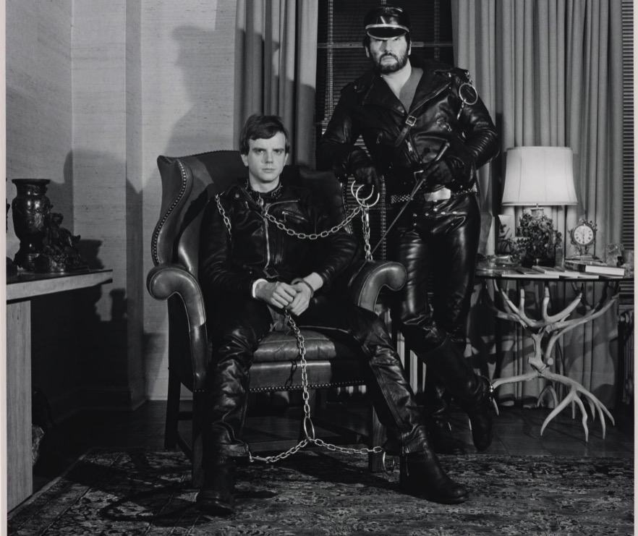
Power…is everywhere
Foucault (1978) was concerned with power and how it transmits, provokes, initiates and produces itself. Like Butler, he shows how words (and acts) do unpredictable things.
For Foucault (1978), every relationship had power dynamics.
Foucault (1978) also demonstrated that controlling and mediating desire was a significant aspect of sexuality.

Slide 31
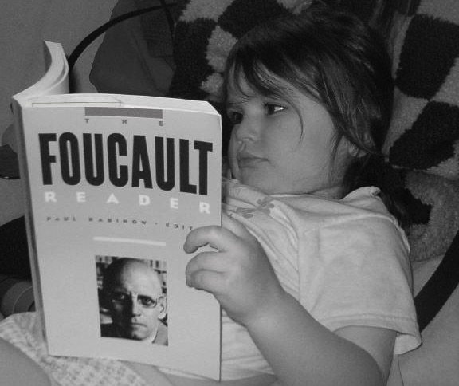
Summary of comparisons
Butler shows that people practise themselves.
Foucault shows that we bring subjects into being through making ‘categories’.
Both methods attend to the social power inherent in gender categorisation and the normalising of meanings.

Slide 32
Sex and Gender: natural, biology and culture
Many have fought for gender equality and a reconsideration of gender roles.
In doing so, any notion of ‘the natural’ has been destabilised thereby prompting wider discussions about equality, and calls for sexual orientation to be included in discussion.
However, if gender is socially constructed, can we say sexuality is too?
Is sexual orientation biological (to do with genetics)?

Slide 33
Sexual Orientation and Gender Identity
Sexual Orientation: The ‘inherent or immutable enduring emotional, romantic or sexual attraction’ (HRC.org 2018).
Gender Identity: ‘One’s innermost concept of self’ (HRC.org 2018) … this can be different from what is assigned at birth and is not based on bio-morphism.
Activity
Research sexual orientation
List variations and their meanings
Feedback to the group
https://www.hrc.org/resources/sexual-orientation-and-gender-identity-terminology-and-definitions

Slide 34

Living as a man and a woman

Slide 35
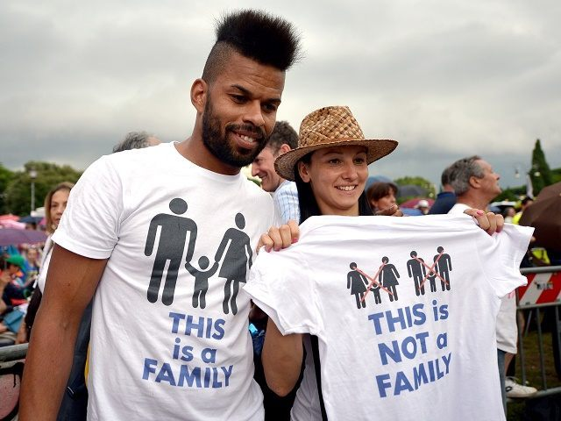
Biology? Sex and Gender Materially Linked…
Biological determinism: are biological essentialisms satisfactory explanations for sexual identities? In other words, is one born gay or hetero?
If biology determines one’s sexuality what role does culture play in this, if any?
Discussion - Is sexuality biological and genetically fixed?
Apply Butler and Foucault to your conclusion.

Slide 36
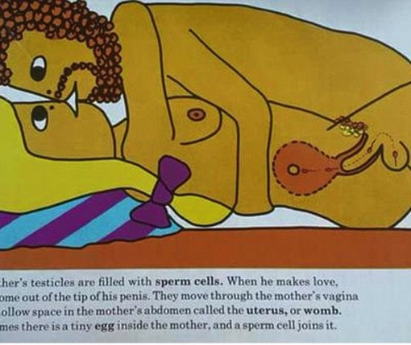
Biological determinism
(as cause of sexual orientation)
Despite any protestations, it is considered problematic to imagine that essentialism is helpful.
In addition, this kind of ‘speciesism’ is thought best avoided.
According to Graham (2016: 71), ‘species thinking undergirds the misguided notion that ‘homosexuals’ are a separate sexual population’ because it holds that non-reproductively functional sex is pathological. This is done by using biology as a measure.

Slide 37
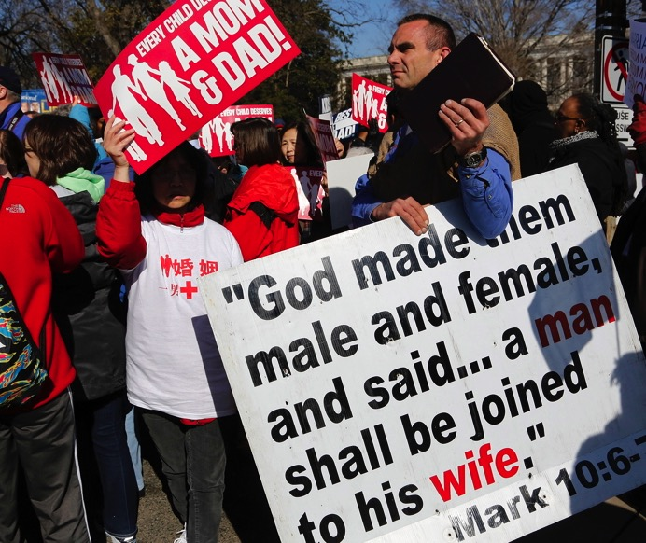
On the other hand…
Homosexuality as ‘natural’ (genetically produced) helps discredit attacks.
Or it can be presented as just another wonderful expression of life.
See pages 82-83 in Graham (2016)

Slide 38

Not Gay by Jane Ward
Article: Ward. J. 2016 ‘Dyke Methods: A Meditation on Queer Studies and the Gay Men Who Hate It’ WSQ 44 pp. 68-85
Challenges biological essentialism: ‘sexual arousal can be shaped by social and cultural circumstance’ (p80)
‘That’s not how dicks work’ (p80)

Slide 39


Gender stories and society
Alderman’s experiment in role reversal useful?
Atwood’s warning. Far fetched?

Slide 40
#metoo
The global dialogue on sexual harassment and abuse

Slide 41
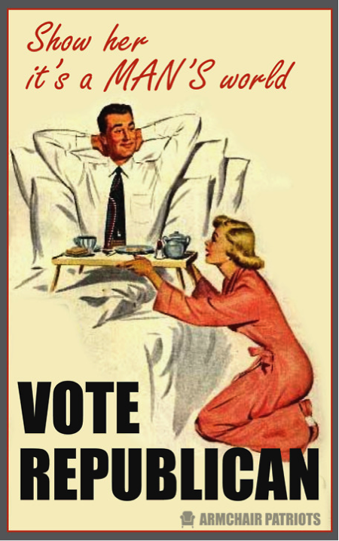
Patriarchy – the world where men are in charge
The ‘70s and ‘80s saw feminist scholars from multiple disciplines questioning the inequality that patriarchy creates
Patriarchy is the term used to describe that the hierarchical social system that gives men the power
The power of patriarchy concerns who makes decisions, who leads, who inherits and so on

Slide 42

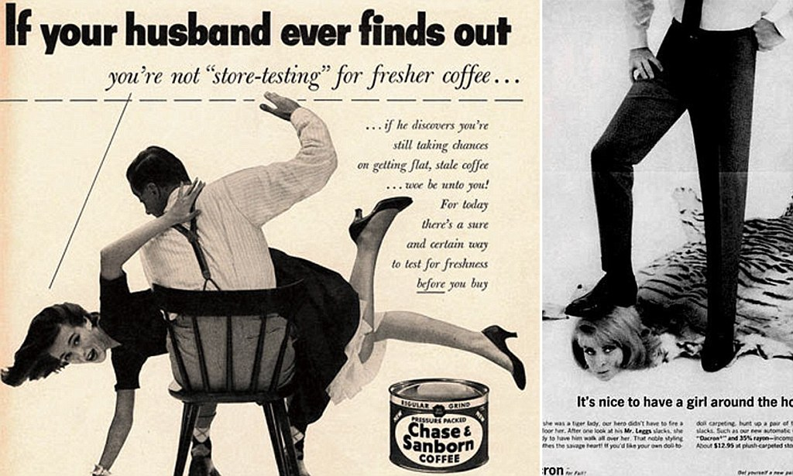
The last 40 years or so has seen vast strides towards equality in some areas of the world but…
Sexuality and violence are still conflated – typically by correlating male desire as associated with the ability
of men to control or dominate women. This promotes the notion that being a successful man means one must take.

Slide 43

2006 – mass healing via #metoo
Tarana Burke created #metoo in 2006
Tarana is an activist who says she created the movement to ‘radicalize the notion of mass healing for women of colour. To let them know they were heard’(CNN 2017)
N.B: sexual violence is not the exclusive domain of women. SurvivorsUK looks at male rape and sexual violence.

Slide 44

10 years later #metoo has
Used new platforms to spread the discussion (make it public)
Prompted renewed effort to denormalise sexual violence
Illustrated a systemic problem caused by power inequalities
Demonstrated the pervasiveness of these experiences
Raises questions around ‘what is sex?’ again

Slide 45

The whisper network goes public
Anna Babel explores #metoo using discourse analysis
Talking does things other than communicate. It creates outcomes
Sharing experiences
  Warns and protects
  Supports
  Creates bonds
‘Twitter Justice’ shows talking the private into the public forces indictment

Slide 46
#metoo is a statement and request
It doesn’t only say this is a hard cold world. It asks for the window to be shut, and the door too.
Now the stories belong to everyone, the discussions should create change.

Slide 47
A key theme concerns consent.
What is consent?

Slide 48

Can one ever give ‘real’ consent?
Philosopher Amia Sriniraska ‘Does anyone have the right to sex?’ (2018)
  Consent is more than rape prevention
  Argues that all work is sexualised
  She asks can workers ever consent when they can’t say no
  Calls for new models of consent to be constructed
Notes:
You can hear Amia talking on the question ‘what is a woman?’ here https://audioboom.com/posts/5450100-amia-srinivasan-on-what-is-a-woman

Slide 49
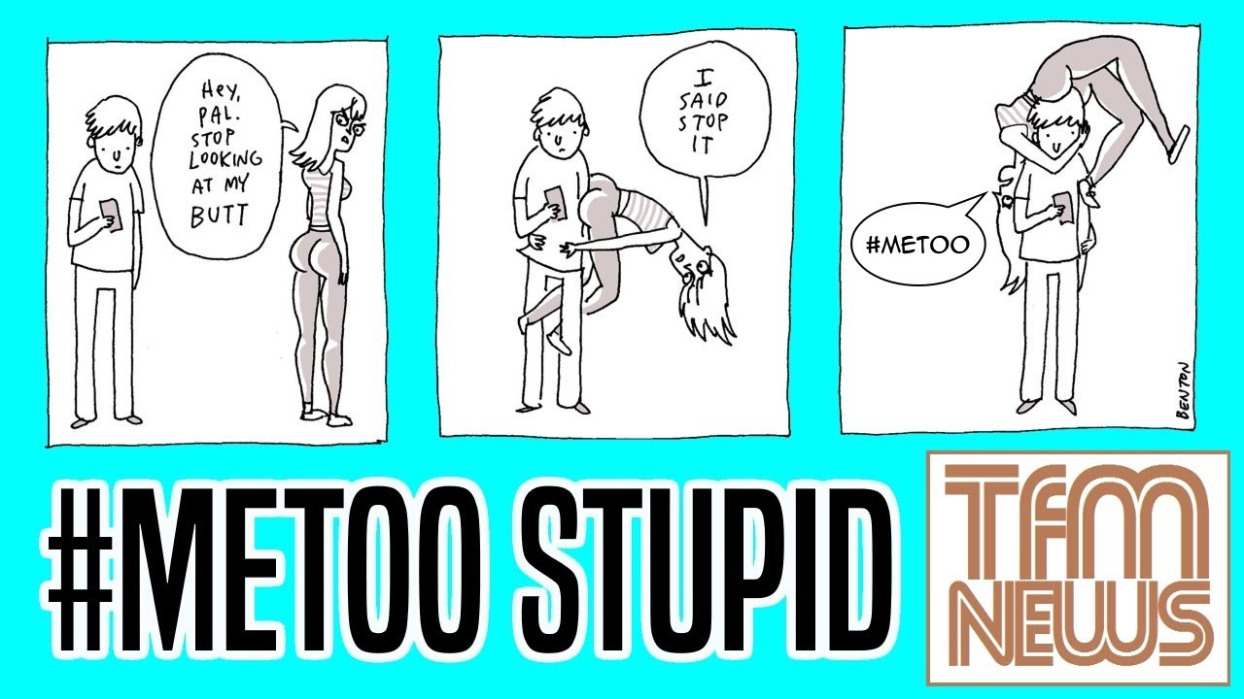
Other issues… ‘unwanted’ sexual attention

Slide 50
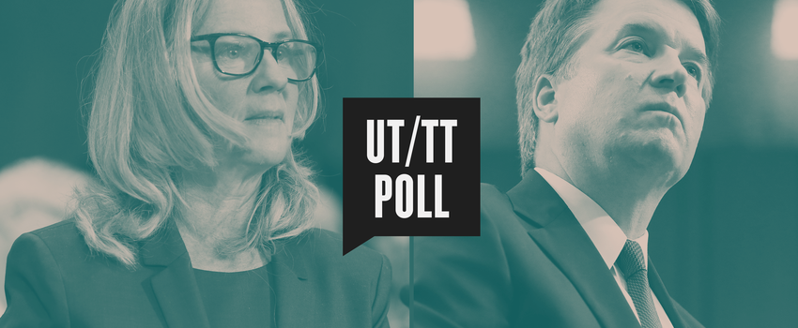
Burden of proof: he said/she said
Kavanagh, nominee for supreme court justice position accused of sexual abuse by Blasey Ford

Slide 51

‘Settler Sexuality’ or ‘Colonial Sex’
Kim Tallbear: A critical polyamorist wants us to talk about sex more. She says
  Sexuality has been shaped into a doer – done-to transaction. This is ‘settler’ sex born out of the culture of the settlers. She wants a new conversation that challenges hetero- and homo-normativity of white civilisation

Slide 52

Welcome to Hell

Slide 53
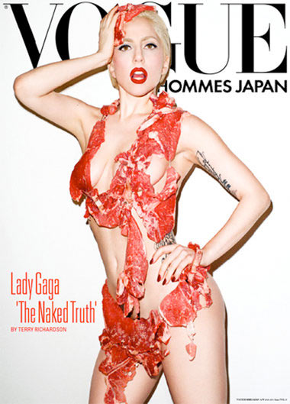
Cultural representations of women, sex and meat
Carol. J. Adams
and Lady Gaga
“I am not a piece of meat” Lady Gaga

Slide 54
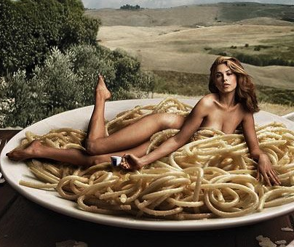


Carol Adams (1990)
Patriarchy conflates meat and sex. It depicts women as meat. There are correspondences between patriarchal ideas, violence and domination of animals.
Notes:
Adams makes links between female oppression with the oppression of animals in meat production. She sees correspondences between patriarchal ideas, violence and the domination of animals other than men.
She sees women and meat as objectified – where both could be seen as ‘persons’ – not for sale as objects. (Discussion: what might be the historical and ethnographic roots of associating men with meat?)
Therefore she sees connections between speciesism and sexism. Women are the other species in this case or put another way, sexism articulates the notion that women are not the same as men (no equality) and therefore can legitimately be dominated or simply used.
Speciesism: coined in 1973 by philospher Ryder, contests the validity and morality of human exceptionalism as speciesist.

Slide 55

The following 3 slides provide illustrations of advertisements that draw women’s bodies, sexuality and meat eating together explicitly – albeit for different purposes.

Slide 56


Slide 57
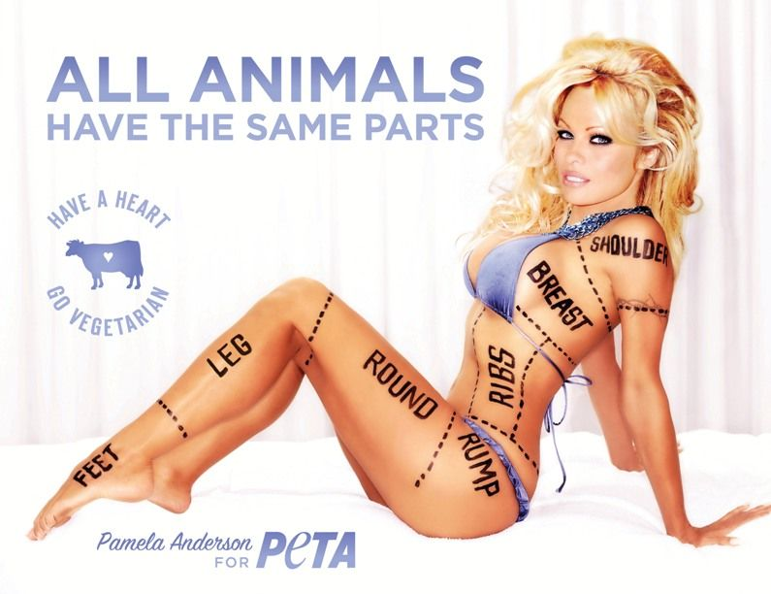
Notes:
Adam’s notes that non-human body parts are sometimes described using the same terms as human bodies parts when it transforms from the living being to a piece of meat. E.g: breast, thighs of a chicken…and so on.

Slide 58
Discussion: what might be the way men are associated with meat?
What might be the historical roots to this? Offer some ethnographic examples that support this.

Slide 59
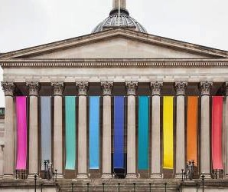
Research ‘methodologies’
Poststructuralism and postmodernist ideas have inspired new methods of approaching knowledge and knowledge making.
Gender theory aided in pushing this on by producing posthumanism and methods such as: queering and intersectionality

Slide 60
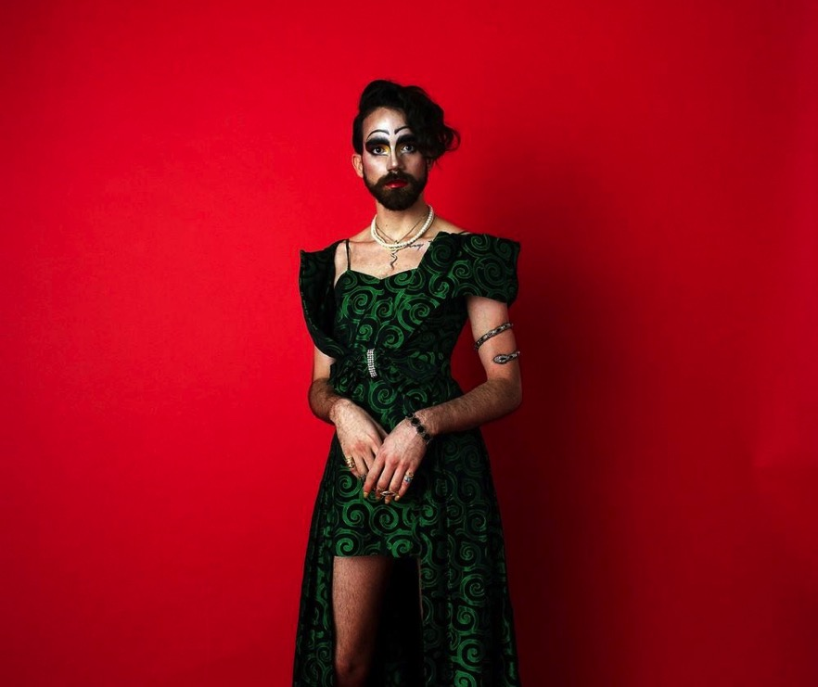
Queering, queer theory
Definition:
‘At its simplest queer theory is a critical enquiry into the alignments of sex, gender and desire that are in the service of normative forms of heterosexuality…that saturates social and cultural order’ (Graham 2016: 6).
It explores and interrogates how sex, gender and desire (s, g and d) are woven together and into the fabric of social life. It reveals even those things seemingly distant from s, g and d are interconnected.
It comes on the coattails of scholars such as Foucault and Butler and recognises ideas are constructs and performativity.

Slide 61
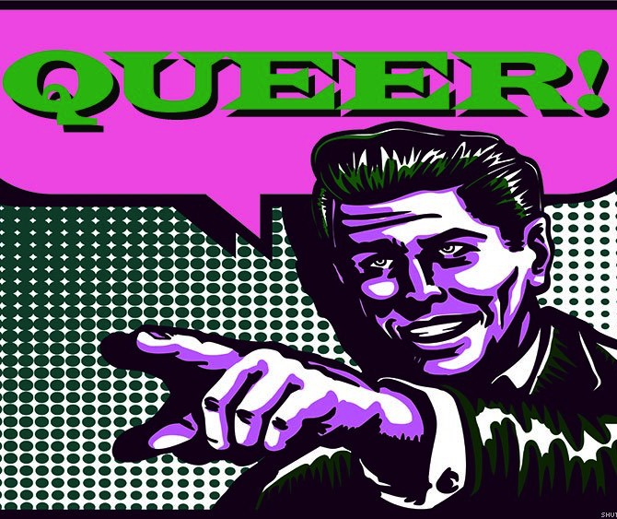
‘Queer’ – the word
Once used to describe homosexuals
Meant: odd, strange, unusual
It was an insult as much as a description
Its meaning relied on normativity within the social order
It was re-appropriated in the 1990s along with the use of the word ‘gay’.

Slide 62
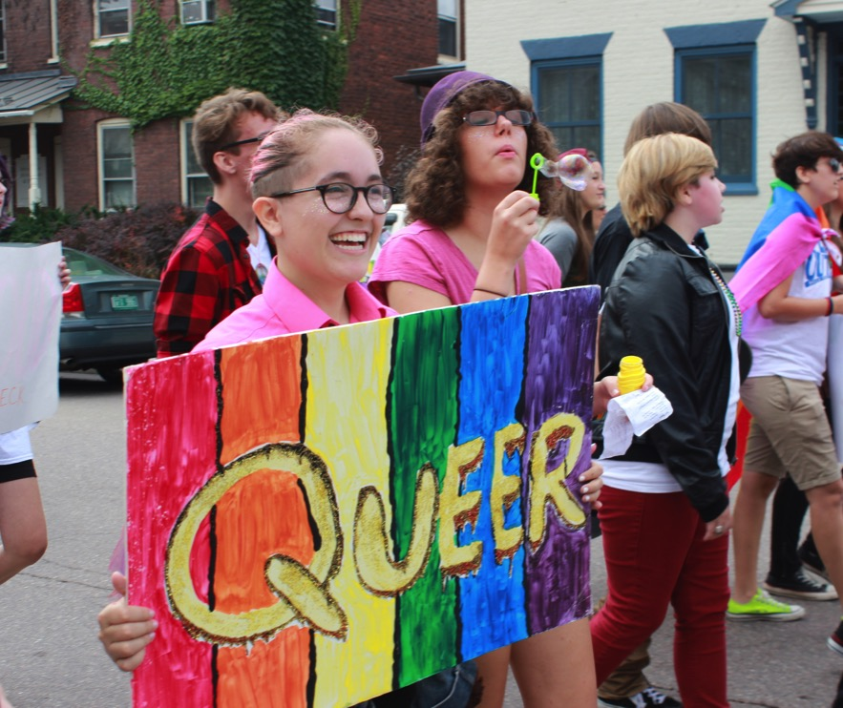
Anth approaches to Queer Theory:
Chiming with Foucault, it says categories are modern constructs. Using an Anthropological lens it shows that same-sex practices are not equitable with Euro-Americas ideas of homosexuality/bi/gayness. (Sambia?).
It tends to critically focus on Euro-American societies but does use ‘other kinds of commonsense’ (Graham 2016: 15) as counter examples.
It has been hugely influential, provoking social changes.

Slide 63
Intersectionality and Queer Research

Slide 64
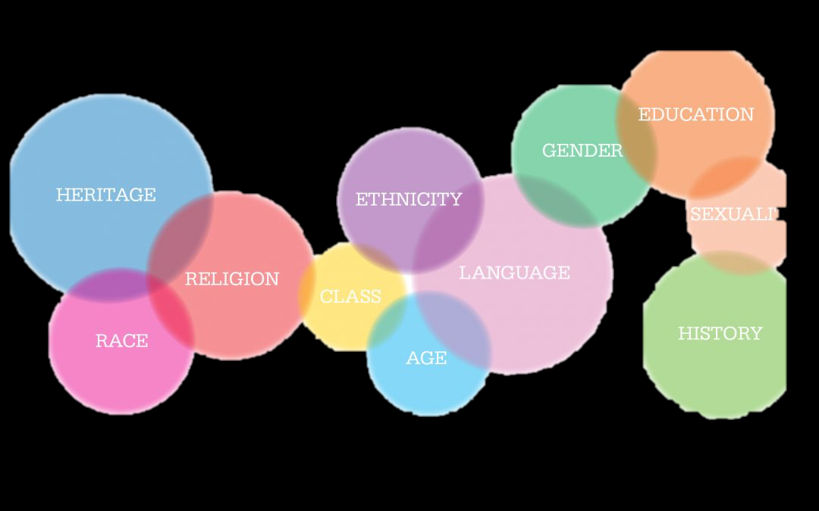
According to Fotopoulou (2012: 19) Intersectionality is
‘the systematic study of the ways in which differences such as race, gender, sexuality, class, ethnicity and other sociopolitical and cultural categories interrelate’.
Fotopoulou, A. 2012 Intersectionality Queer Studies and Hybridity: Methodological Frameworks for Social Research. Journal of International Women's Studies, 13(2), pp.19-32.

Slide 65
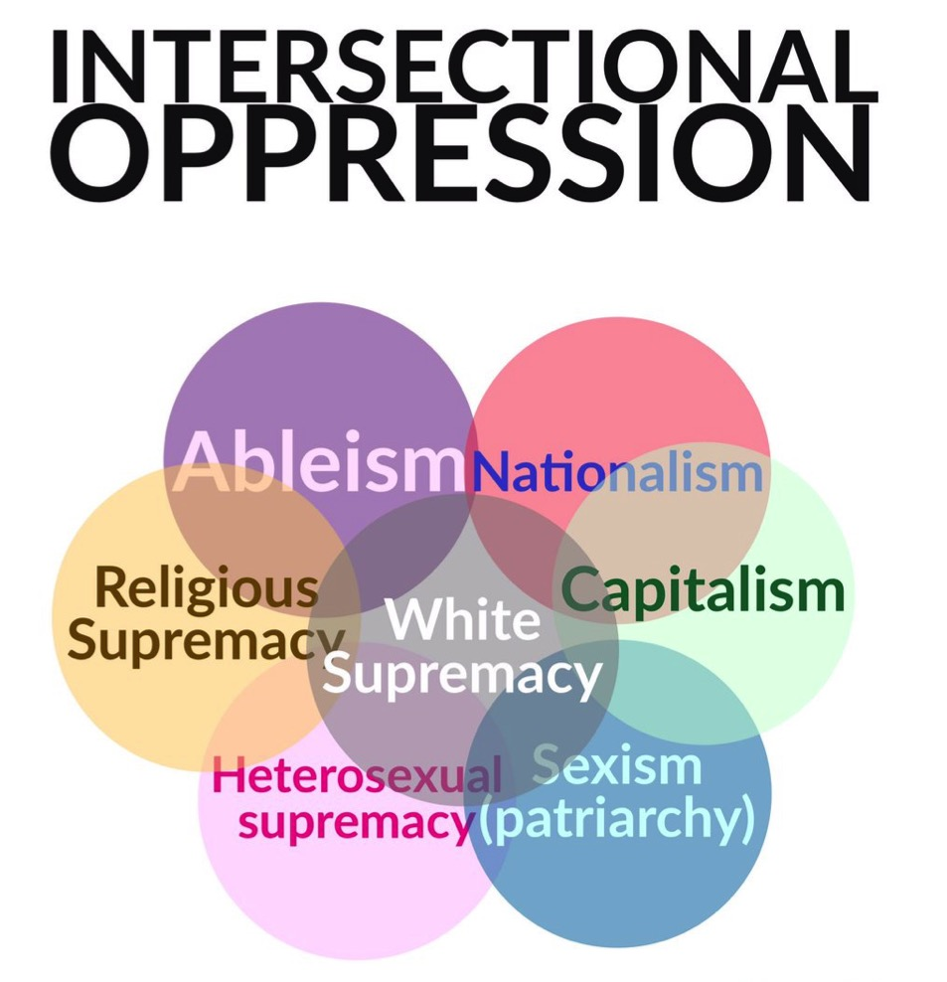
Intersectionality
Not a method as much as a focus that aims to demonstrate the multiplicity of factors impact oppressively on different lives.
It takes the deconstructive method of postmodernism and the challenge to categories of poststructuralism to demonstrate how life is lived as an 'inter-categorical complexity' (McCall 2005, cited in Fotopoulou 2012: 21)
Notes:
‘In this sense, it [intersectionality] is a working solution that makes visible the social and material consequences of the power systems relating to gender/race/class, but does so by employing methodologies compatible with the poststructuralist project of deconstructing categories, unmasking universalism, and exploring the dynamic and contradictory workings of power (Brah & Phoenix, 2004)’.(ibid: 21)
Because ‘categorical analysis cannot sufficiently reflect the heterogeneity of lived experience’ (ibid: 22).
‘Single person or single group narratives …commonly focus on one aspect of social life in order to minimize the complexity of the research process. If, for example, the identity of the group or person under analysis is that of lesbian, woman, middle class, only one respective dimension of the categories (or axes of analysis) sexuality, gender, class are reflected in the study’ (ibid 22).

Slide 66
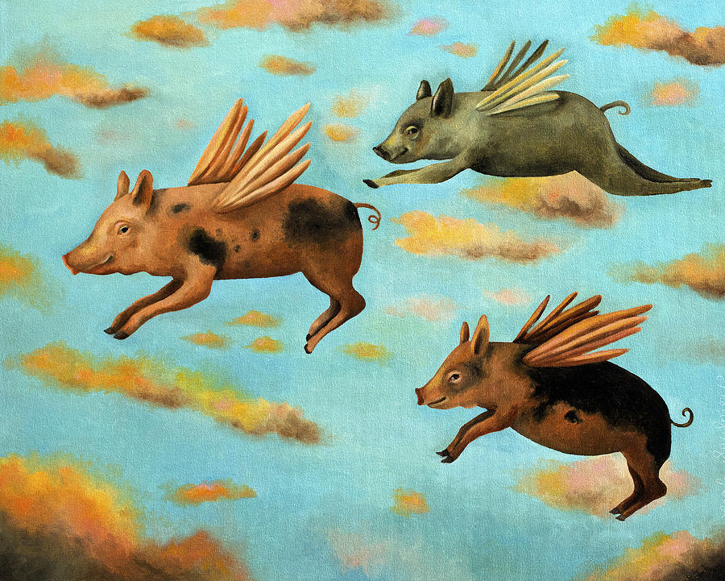
Weiss 2016 – What Queer Research is For
Weiss opens with a quote from Ingold about being a humanities scholar. He says:
To do anthropology, I venture, is to dream like an Ojibwa. As in a dream, it is continually to open up the world, rather than to seek closure. . . . It is the constant awareness of alternative ways of being. . . . Wherever we are, and whatever we may be doing, we are always aware that things might be done differently. It is as though there were a stranger at our heels, who turns out to be none other than ourselves.

Slide 67
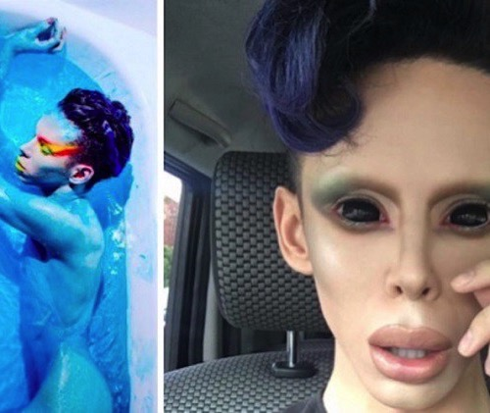
Weiss calls for
A continued move away from identities and towards possibilities.
She sees an opening for a ‘politics of desire’ (what do you want) and a reduction in the politics of privilege (or identity)
Queering asks us to consider what it is we are making of this world.
Vinny – genderless (androgynous) alien

Slide 68
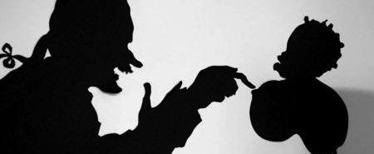
An example of queer (intersectional) research:
Kara Walker

Slide 69
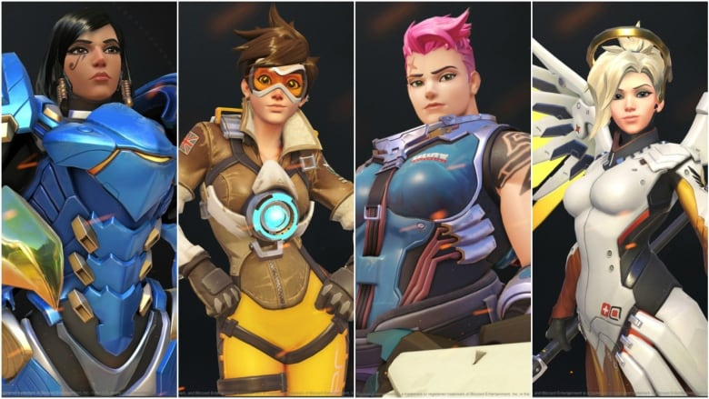
The cyborg post gender human
Cyborgs, hybridity and modifications:
transforming humans (transhumanism) by using technology

Slide 70

Defining Cyborgs
‘A cyborg is a cybernetic organism, a hybrid of machine and organism’ (Haraway 2016: 291)
‘A creature of the post-gender world’ (ibid: 292) that is both the future and the apocalypse.
People who want to trans-form (and improve) their bodies using technologies

Slide 71

Bodies and machines - Haraway
We are tangled with machines in medicine and war.
This confuses boundaries. (Haraway wants this confusion to be responsibly and pleasurably achieved (2016: 292).
She argues that gender categories have been part of the discourse of individuation. Cyborgs blend materialities and therefore challenge gender
Pacemaker before insertion

Slide 72
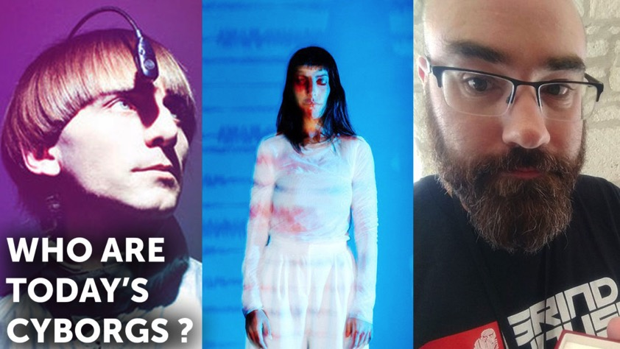
Cyborg pride: hacking bodies to become who you want to be
Fights for the rights of cyborgs
Uses the term ‘bodyhacking’
Works to have control over your own identity (and body) by using technology
  Example: Fertility is technologically controlled–other medical methods function similarly
Contests ‘nature’ as the best method of being
People who have grown up with technology ‘feel’ cyborg and find ways to make that materially real. (Cyborgism)
BdyHax 2018 conference

Slide 73
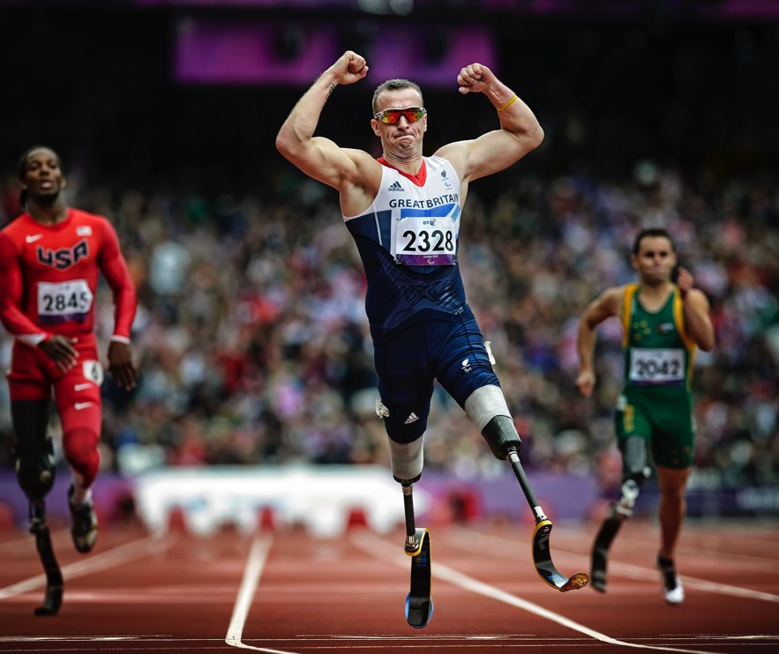
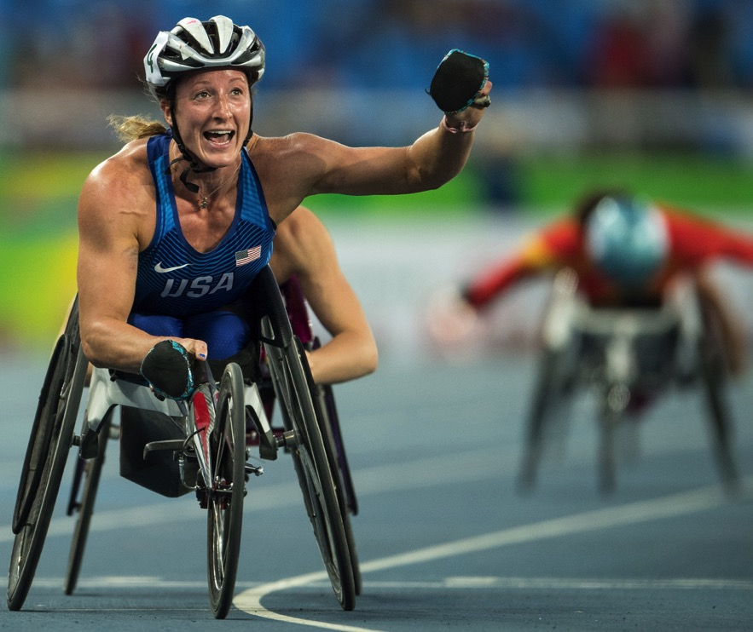
paralympics

Slide 74
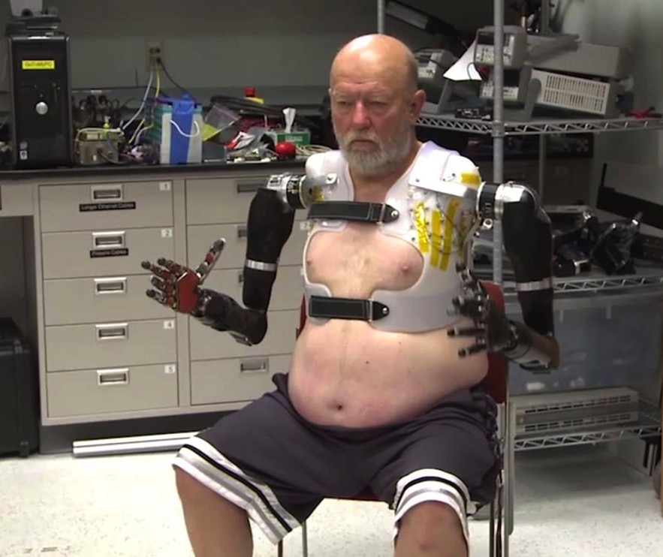
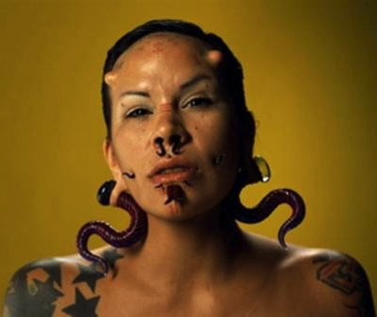
Plastics, modification, surgery
Amputee with cybernetic arms
https://ellelawsondigc335.wordpress.com/tag/plastic-surgery/

Slide 75
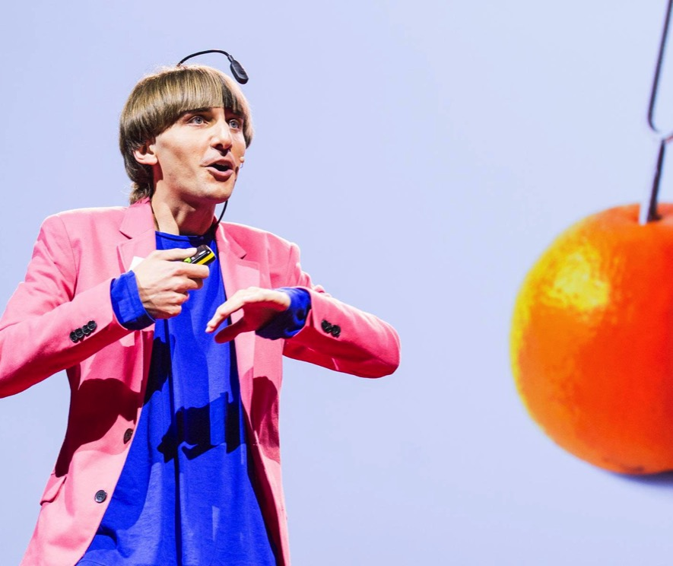
Neil Harbisson: a cybernetic organism
Identifies as an organism.
Has an antenna that augments his senses and connects to the Internet; the antenna is described as an organ (part of his body).
Neil listens to colours using the technology. Neil was born totally colour blind (monochrome).
Created the Cyborg Foundation in 2010 with Moon Ribas (a cyborg who has sensors in her skin that enable her to sense earthquakes. She claims to be connected to the planet) to help people become cyborg.
Video of TED talk, 2012

