Slide 1
MANAGEMENT PROCESS CHART

Slide 2
Sparkhill Management Company
SADIKUR 1711697
AAKASH 1711136
ANGURA 1712139
Notes:
Hello and Welcome to our meeting. We would like to thank Dorean, Denis and Suha for the invitation to present our project plan for the warehouse re- location from sparkhill to shirley.
We would like to show you our presentation how we intend do the re-location project plan.
This is our team at Sparkhill Management Company , Sadikur, Aakash and Angura. All our details are on the screen. We are based in Sparkhill Birmingham ,our office has state of the art facilities for project management programmes , we use the latest technologies to do project management for local companies.
If you need to contact us please contact us through skype or emails which are on our brochure and business cards sent to you .

Slide 3

OVERVIEW
Notes:
Paul Ranson who is your advisor has given us a brief on the project requirements you need. We are aware that your company is new to project management. So we will be using proven theories that benefits this project. One terminology will be using is based on prince two. Which we have learnt through our university[ UWSTD]. This technique reduces risk to project management programmes ,by using this framework we will be reducing risk on the relocation project.

Slide 4
DISCOVERY
INITIATION
DELIVERY
CLOSURE
REALISATION
THE PROJECT LIFE CYCLE
Notes:
Every project follows a natural life cycles as demonstrated in our chart, which are
Discovering the requirements needed and establishing the size and complexity of the project.
In the Initiation phase we will provide full blue print of the project.
If you agree to the Initiation phase then we will deliver and close the project.
After closing the project our team will come back and do a realization on the project.
For the success of the project this life cycle must be followed, so we can understand the scope of the project.

Slide 5

PROJECT MANAGER
User
SUHA
Specialist OMAR KING
Commercial
Doreen VENTIER
STEERING GROUP
SPONSOR
DENIS VENTIER
SPARKHILL MANAGEMENT COMPANY
Notes:
Working with Roberts 2011 approach. We feel that your project will need to be organize like the diagram that we produced for your company. So that decisions are made as a team effort and not implemented individually . So we purpose
Denis should be the project Sponsor because he should be the only person that sanctions all the decisions.
Doreen should be the commercial person that makes all the proposal on the business and finance .
Omar king should be the specialist , who argues on behalf of the person who would be using the building.

Slide 6
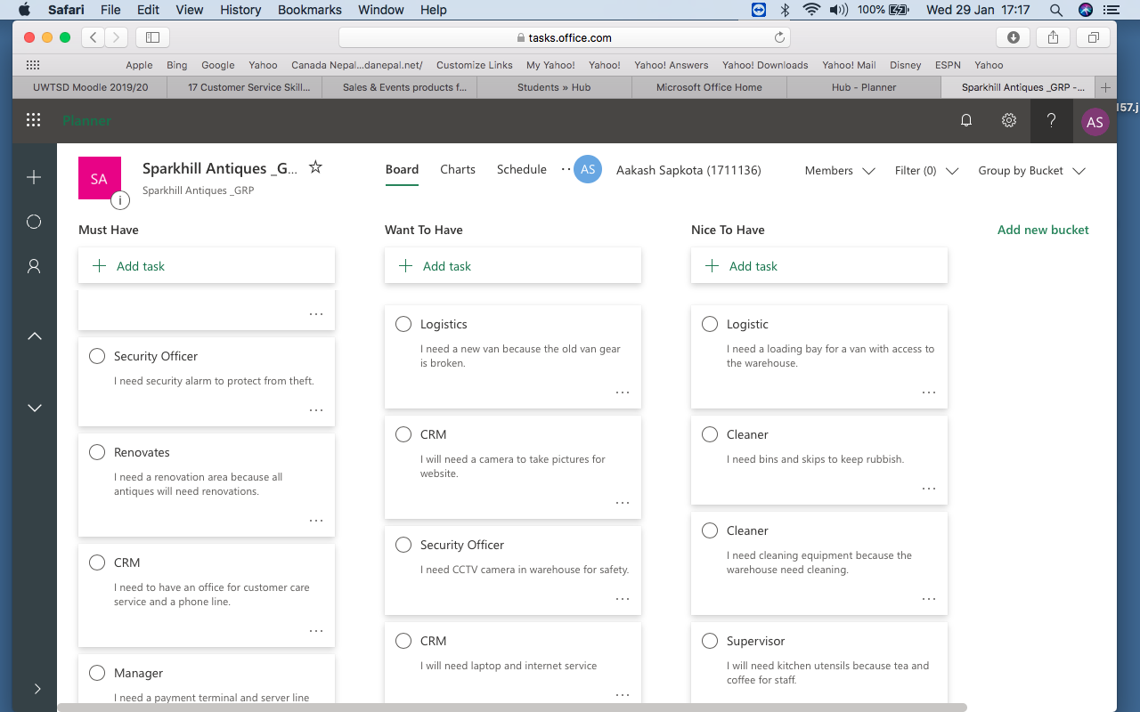
USER STORIES
Notes:
We have been using a technique called user stories to simplify the project . This technique is used to understand the requirements, the size and complexity of the project. This techniques also helps to bring out the problems of the project.
We created lots of user stories for the project. All the user stories that were produced are on the slide. They have been organized in order of Must have , want to have and Nice to have. This reduces time frames and project budgeting becomes easer . Your advisor Paul has briefed us on the project so we have used another technique called MOSCOW. This technique is to reduce the number of user stories to a minimum. This technique requires to ask many people as possible to work out what priorities to each story and then we can implement the most wanted tasks. We have taken all this down on brown paper and made an electronic version which will be email to you separately.

Slide 7
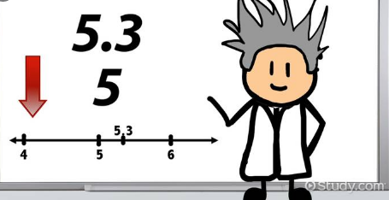
Estimate Using Product Project Technique
Notes:
We used a technique by Roberts 2011 . After prioritizing each task we then went through a process to estimate how long each task take to solve. The technique used was product project technique, coupled with the Delphi forum. this gives the best guess on how complex each task would be and what size. This involved haggling with many people as possible as we could to get the best average and then make a good estimate on tasks. This is called wisdom of the crowed by Dolton.

Slide 8
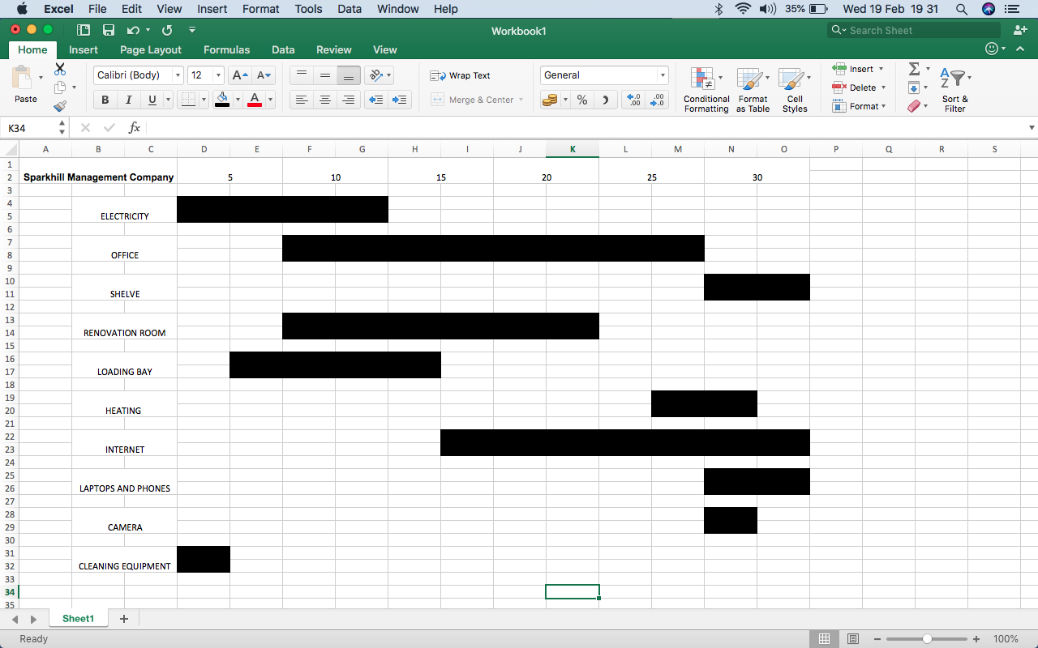
GANTT CHART
Notes:
On the screen is the Gantt chart that we produced it was designed by putting tasks on brown paper planning. This was designed by henry Gantt, This is a great way to show the development of the plan for your project. Top of the chart is a calendar with dates and the side shows the number task to be done. Each bar length represent the number of days. Where it is position indicates which point needs to be done.

Slide 9

COST AND TIME
Notes:
No project would be complete without giving the cost and time frame for the project .Based on all the planning and techniques used by us ,we have done an estimate for the project .please bare in mind this is an estimate not an actual price ,so the estimate could go up or down .
Our estimate
30,000 pound for the project
30 working days for the completion of the project
This estimate is based on all the user stories and the iron triangle theory .This is done by keeping quality and varying cost ,time and scope .
Varying any elements will an impact on the other two elements .

Slide 10
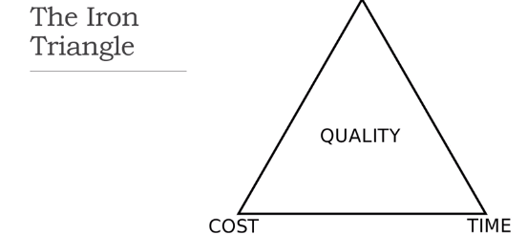

Slide 11
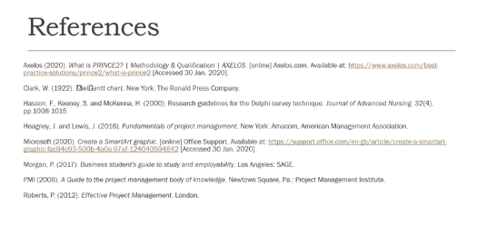
Notes:
This works was based on the reading on this page ,

Slide 12

Notes:
Thank you , and do you have any questions for us on the project that you would like to clarify.

