Slide 1
Coaching
Through
Small Sided Games

Slide 2
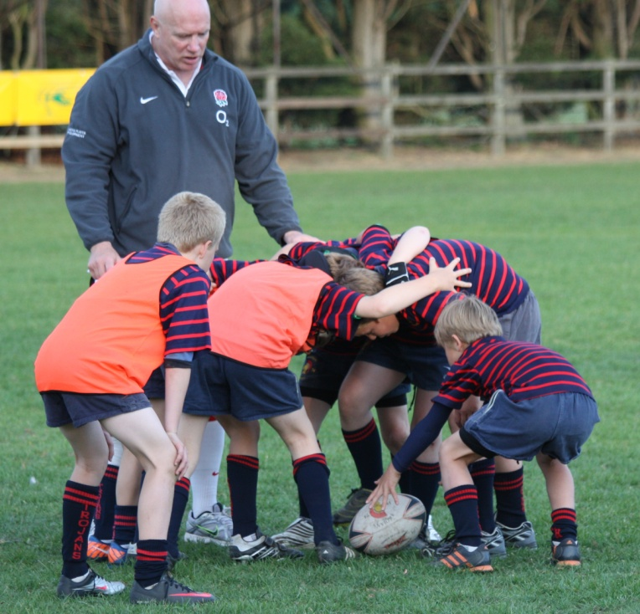
APES
Each coaching session should be:
Active.
Purposeful.
Enjoyable.
Safe.

Slide 3
Why Use Small Sided Games?
They are a coaching tool to:
guide players to discover and develop the game
increase motivation and more enjoyable for children
develop tactical awareness
improve individual skills
Develop Competence, Confidence, Connection, Character and Creativity!
Notes:
In the past, technique has often been over-emphasised within practice sessions. While technique is an important part of the overall skill, it has often been taught in isolation, without requiring players to think and apply the techniques to the situations required in the game. By using a game sense approach, players are challenged to think about what they are actually doing, and why. Players are taught to use the appropriate technique at the right time and place in the pressure situations of a game.
Game Sense has been shown to result in improved learning outcomes for students.
Game Sense places an emphasis on the play, where tactical and strategic problems are posed in a modified game environment, ultimately drawing upon players to make decisions.
It places the focus of a lesson on the student in a game situation where cognitive skills such as ‘tactics, decision-making and problem solving are critical...with isolated technique development utilised only when the player recognises the need for it’).

Slide 4
Critical Discussion
In the past, technique has often been over-emphasised within practice sessions.
While technique is an important part of the overall skill, it has often been taught in isolation, without requiring players to think and apply the techniques to the situations required in the game.
By using a game sense approach, players are challenged to think about what they are actually doing, and why. Players are taught to use the appropriate technique at the right time and place in the pressure situations of a game.
Game Sense has been shown to result in improved learning outcomes for students.
Game Sense places an emphasis on the play, where tactical and strategic problems are posed in a modified game environment, ultimately drawing upon players to make decisions.
It places the focus of a lesson on the student in a game situation where cognitive skills such as ‘tactics, decision-making and problem solving are critical...with isolated technique development utilized only when the player recognizes the need for it.

Slide 5
Learning Process
Interpret and apply what learnt to next experience
Have an experience
PLAN
DO
REVIEW
Analyse and reflect on it
Notes:
Talk through the learning cycle
“Do” is play the game, solving problems set by the coach through the conditions within the game
“Review” is prompted by coaches questioning players, raising awareness
“Plan” is part of players recognising they have solve the problem and adapting for the next play

Slide 6
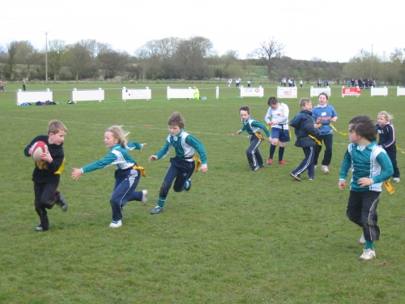
The “Games For Learning” Sequence
Warm Up
Game modification for skill development,
when needed
Game
Challenges
and
Questioning
Game Modification
Challenges
and
Questioning
Notes:
Coaching Through Small Sided Games (or Game Sense) is an approach to teaching that makes very effective use of active learning in that the students are learning though playing the games. In addition to this, ‘questioning is a powerful method of encouraging players to analyse their actions, both individually, and as a team’ (Goodman, 2001, p.7). Questions will generally relate to a particular tactical aspect.
Effective phrasing of questions can also help to guide the player to an answer, in the event that they are struggling with an activity. Age, experience and ability level of the players will affect the complexity of the questions used

Slide 7
Games Can Be ‘Modified’ By:
Varying the playing area in which the game takes place. Longer or shorter, narrower or wider, shape –e.g. funnel
Changing the starting space between attack and defence, closer, further away, wider
Varying the shape/positioning of the attack and defence, bunched, spread, single file, various groupings (2s, 3s, 4s)
Different starting positions – contesting the ball, sprint starts, lying down, back turned, kneeling, tackling
Introducing the ball in a variety of ways, pass, high ball, kick, roll, bounce
Dynamic starts (moving) to the game, no static situations, always moving
Varying the numbers playing – 7v5, 4v2, 3v2, 1v1, 2v2 etc.
Notes:
Games can be modified depending on the number of players, equipment available, training area, specific skills needing practice, level of pressure and fitness levels.

Slide 8
Developing Modified Games
What tactics and skills do you want to develop within the game?
What modifications/exaggerations can you make to emphasise these tactics and skills?
What will be the main problem for the players to solve?
What are the boundaries and safety rules?
What is the scoring system?
How do the players / ball(s) move?
How will the game restart after a tackle or after scoring?
What are some key questions you can ask to emphasise tactical aspects?
What progressions can you make?
Can I use two rugby balls to keep the continuity and tempo?

Slide 9
Using Differentiation In Small Sided Games
Giving each child an appropriate task or goal (within a game) tailored to their individual needs
Careful planning and grouping of children
Providing additional support (another coach working in the development area)
Divide players into small groups of players with similar needs
Players can be challenged appropriately so they achieve a good level of success
Notes:
if a coach sets the same task for a group of 15 players, at what level does s/he aim: the top, middle or lower level? By dividing a group of 15 into three groups of five or even five groups of three, based on similarity of need, the task becomes much less difficult. In a small group, with an appropriate task, participates can be challenged appropriately so they achieve a good level of success. If the coach teaches players how to change the task, they are then able to adjust it themselves, leaving the coach freed to give feedback.

Slide 10
Coaching Process In Small Sided Games
Observation and Analysis
Feedback
Listening
Demonstrations
Recreation
Play Live

Slide 11
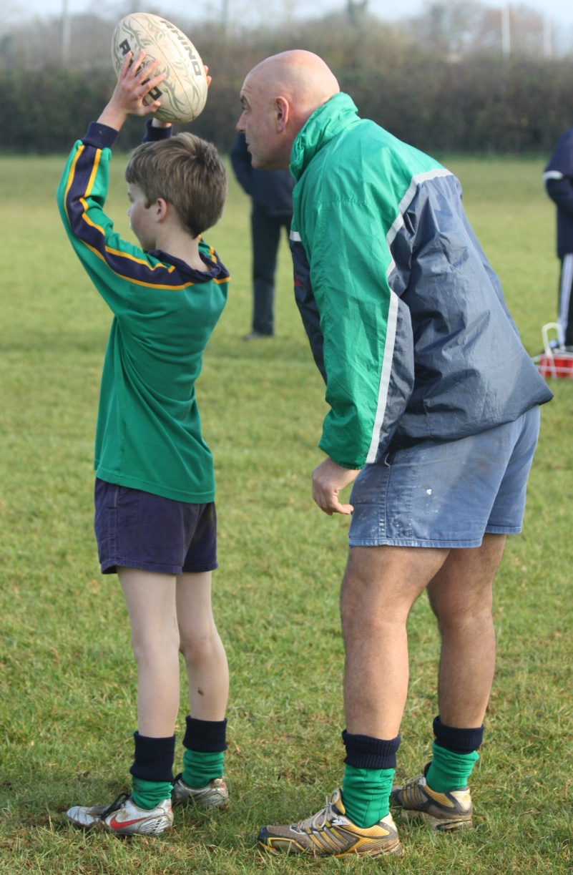
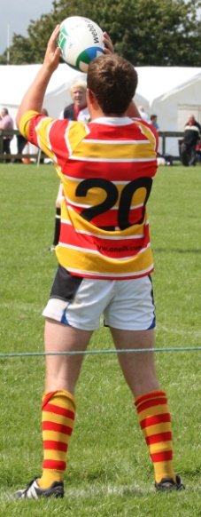
Key factors in Observation and Analysis
1. Focus on each key factor at a time
2. Observe action several times from different positions
4. Determine action:
Build on strengths, correct error or do nothing
3. Compare observation with correct template to find matches and mismatches

Slide 12
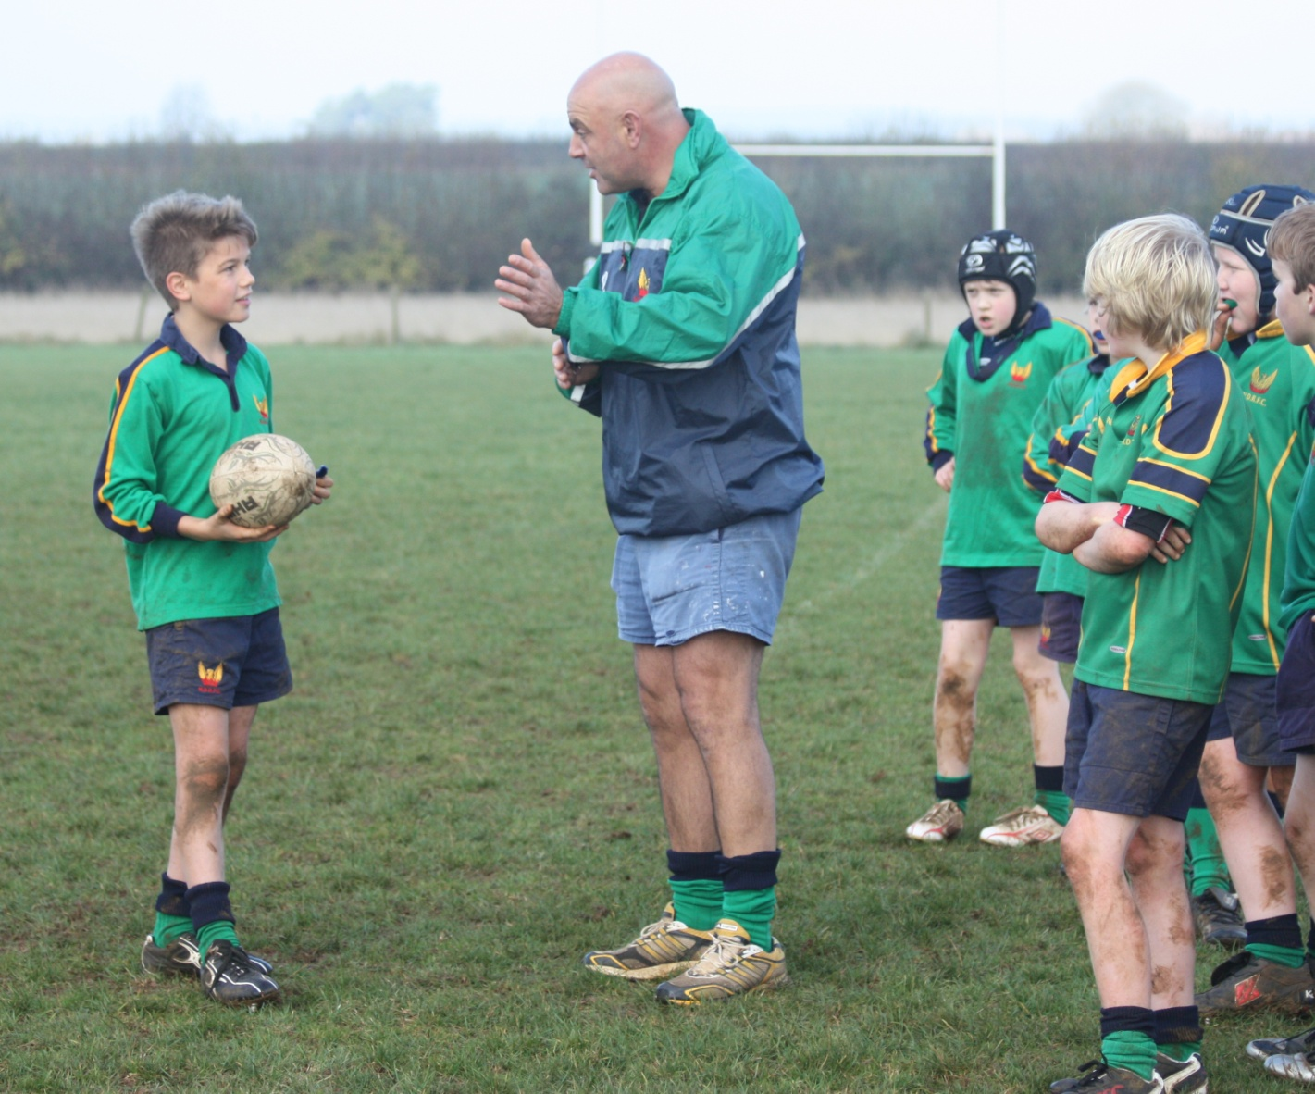
Key Factors - Providing Feedback
1. Ask questions to generate self-feedback
2. Limit information to
1 – 2 key points
3. Give specific and simple information
4. Keep it positive

Slide 13
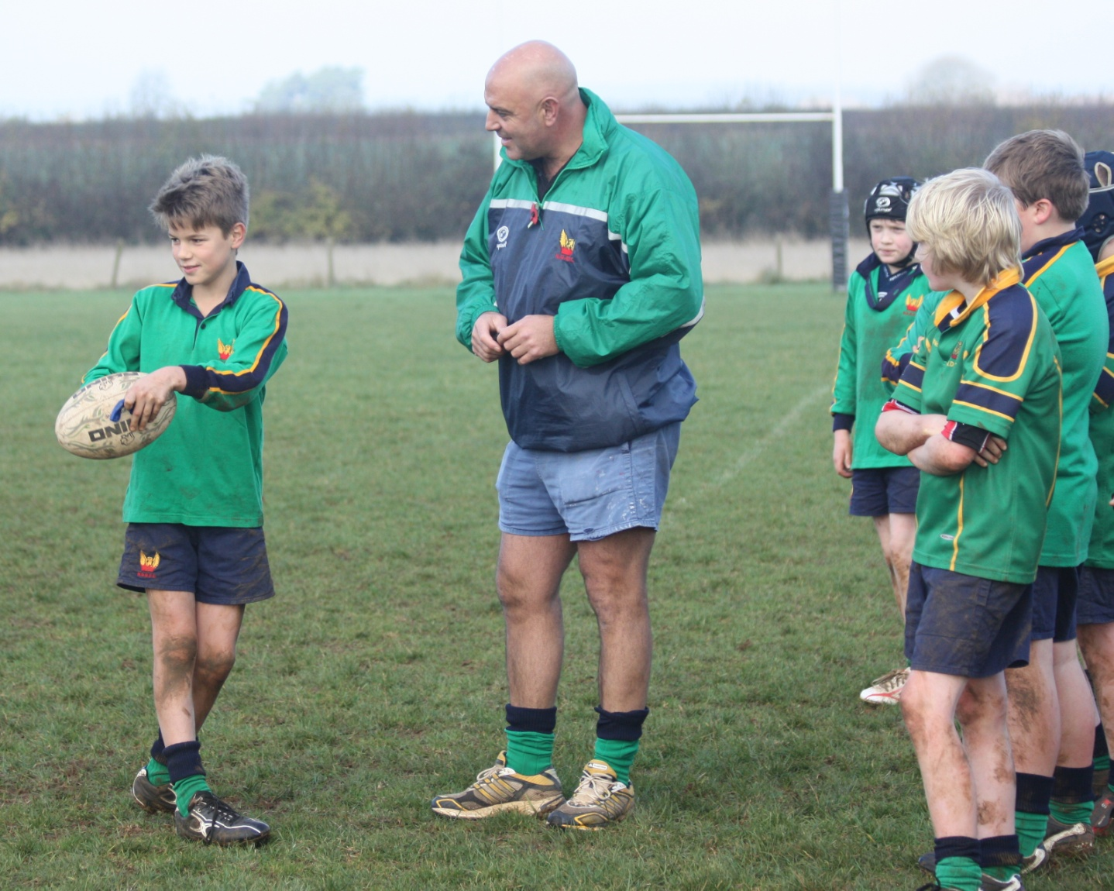
KEY FACTORS - Listening
1. Give 100% attention to the speaker, do not think about what you’ll do next
2. Give and maintain eye contact
3. Reinforce your interest through your body language
4. Never interrupt or finish someone’s sentence for them
Notes:
These slides should summarise the flip chart previously put together.

Slide 14
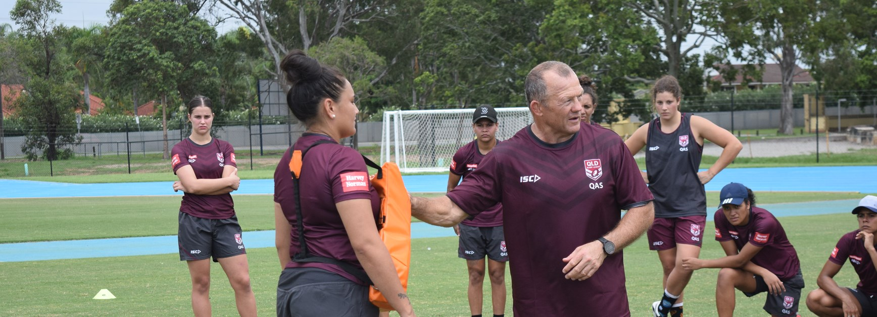
KEY FACTORS - Demonstrations
1. Focus of the Group
2. Ask Questions in relation to the demonstration.
4. Change position so participants can view from different positions.
3. Demonstration focusing on a few key points.

Slide 15
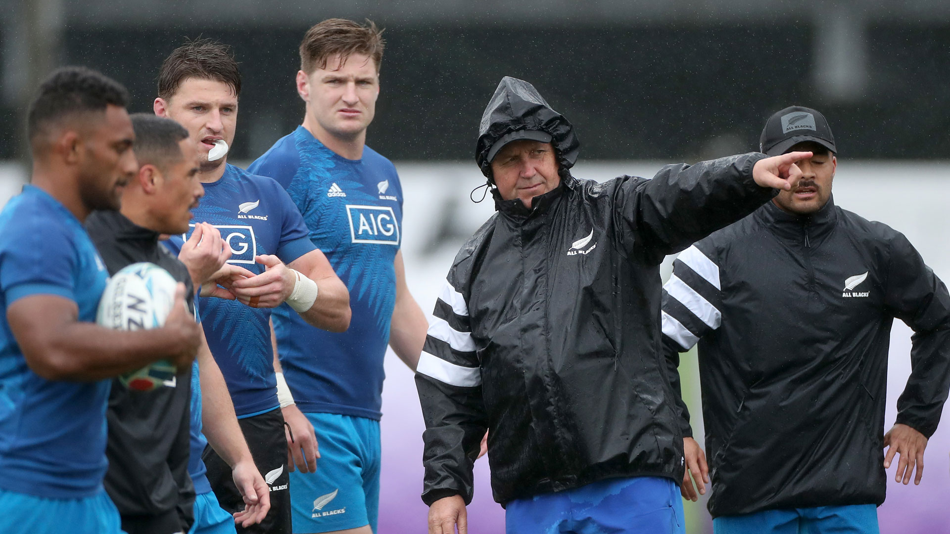
Key Factors - Recreation
1. Stop !! Freeze !! Go Back
2. Ask questions of options.
3. Conduct no pressure demonstration (Key Points).
4. Have another go and add defender constraints if required.

Slide 16
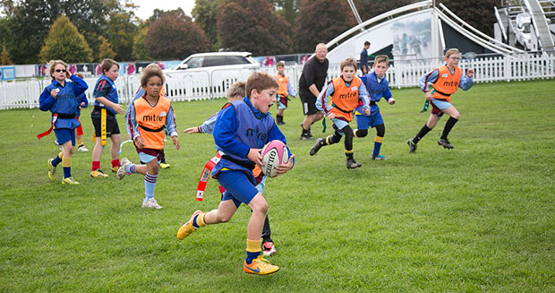
Key factors – Play Live
1. Let them Experience and Experiment
2. Can they solve the problem themselves?
4. Analyse – Do you see a change? Could they watch others with the coach from the side (Peer Learning).
3. Ask questions about key points (reminder)

