Slide 1
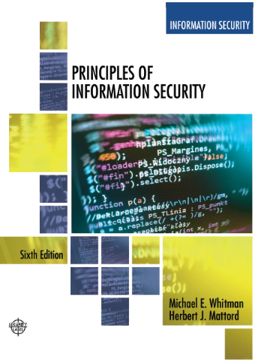
Information Security Maintenance
Lecture 12
Adapted Text
Lecturer: Assoc. Prof. Carlene Campbell
Email: carlene.campbell@uwtsd.ac.uk
Website: https://www.knowledgewithprofit.com/

Slide 2
Learning Objectives
Upon completion of this material, you should be able to:
  Discuss the need for ongoing maintenance of the information security program
  List the recommended security management models
  Define a model for a full maintenance program
  Identify the key factors involved in monitoring the external and internal environment
  Describe how planning, risk assessment, vulnerability assessment, and remediation tie into information security maintenance
  Explain how to build readiness and review procedures into information security maintenance
  Discuss digital forensics and describe how to manage it
  Describe the process of acquiring, analyzing, and maintaining potential evidentiary material
Notes:
Learning Objectives
Upon completion of this material you should be able to:
Discuss the need for the ongoing maintenance of the information security program
List the recommended security management models
Define a model for a full maintenance program
Identify the key factors involved in monitoring the external and internal environment
Describe how planning, risk assessment, vulnerability assessment, and remediation tie into information security maintenance
Explain how to build readiness and review procedures into information security maintenance
Define digital forensics, and describe the management of the digital forensics function
Describe the process of acquiring, analyzing, and maintaining potential evidentiary material

Slide 3
Introduction
Organizations should avoid overconfidence after improving their information security profile.
Organizational changes that may occur include:
  Acquisition of new assets, emergence of new vulnerabilities, shifting business priorities, partnerships form or dissolve, employee hire and turnover
If a program is not adequately adjusting, it may be necessary to begin the cycle again.
If an organization creates adjustable procedures and systems, the existing security improvement program can continue to work well.
Notes:
After successfully implementing and testing a new and improved information security profile, an organization may feel more confident about the level of protection it provides for its information assets.
New types of attacks such as viruses, worms, and denial-of-service attacks have been developed, and new variants of existing attacks have probably emerged as well. In addition, a host of other variables outside and inside the organization have most likely changed.
Introduction
Organizations should avoid overconfidence after improving their information security profile
Organizational changes that may occur include:
Acquisition of new assets; emergence of new vulnerabilities; shifting business priorities; partnerships form or dissolve; employee hire and turnover
If program is not adequately adjusting, may be necessary to begin cycle again
If organization creates adjustable procedures and systems, existing security improvement program can continue to work well

Slide 4
Security Management Maintenance Models
Management model must be adopted to manage and operate the ongoing security program.
Models are frameworks that structure the tasks of managing particular set of activities or business functions.
NIST SP 800-100 Information Security Handbook: A Guide for Managers
The Security Maintenance Model
Notes:
To manage and operate the ongoing security program, the information security community must adopt a management maintenance model. In general, management models are frameworks that structure the tasks of managing a particular set of activities or business functions.
This provides managerial guidance for establishing and implementing an information security program.
There are 13 areas of information security management presented
Provides for specific monitoring activities for each task.
Tasks should be done on an ongoing basis.
Not all issues are negative.
Information security governance
Agencies should monitor the status of their programs to ensure:
Ongoing information security activities are providing appropriate
Policies and procedures are current
Controls are accomplishing their intended purpose
System Development Life Cycle: the overall process of developing, implementing, and retiring information systems through a multistep process.
Awareness and training
Tracking system should capture key information on program activities.
Tracking compliance involves assessing the status of the program
Security policies must continue to evolve
Capital planning and investment control
Departments required to allocate funding toward highest-priority investments
Designed to facilitate the expenditure of agency funds
Interconnecting systems
The direct connection of two or more information systems for sharing data and other information resources
Can expose the participating organizations to risk
If one of the connected systems is compromised, interconnection could be used as conduit
Performance measures
Metrics should be used for monitoring the performance of information security controls
Six-phase iterative process
Security planning
One of the most crucial ongoing responsibilities in security management
Information technology contingency planning
Consists of a process for recovery and documentation of procedures
Security services and products acquisition
Incident response: incident response life cycle
Configuration (or change) management: manages the effects of changes in configurations, five-step process
The Security Maintenance Model
Designed to focus the organizational effort on maintaining systems
Recommended maintenance model based on five
subject areas:
External monitoring
Internal monitoring
Planning and risk assessment
Vulnerability assessment and remediation
Readiness and review
Security Management Models
To assist the information security community to manage and operate the ongoing security program, a management model must be adopted.
In general, management models are frameworks that structure the tasks of managing a particular set of activities or business functions.

Slide 5
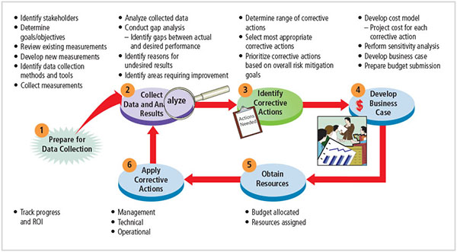
Information security measurement program implementation
Source: NIST SP 800-55 Rev. 1.
Notes:
Information security measurements should be used for monitoring the performance of information security controls and initiating performance improvements. This iterative process consists of six phases, as depicted in greatly simplified form in Figure 12-1. In reality, a process like this does not often proceed in such a direct fashion; instead, give and take is common as control objectives are balanced against the availability of resources.

Slide 6
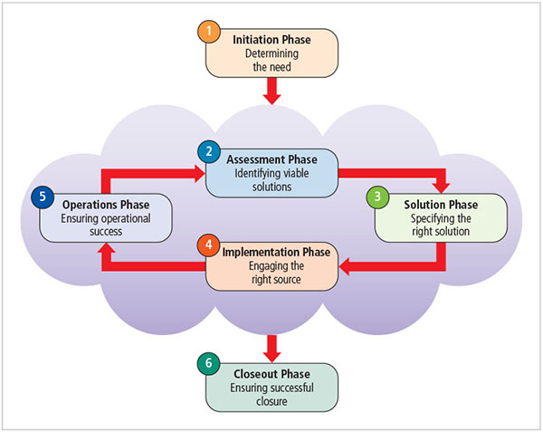
Conversion strategies
Source: NIST SP 800-35
Notes:
Just as the SDLC supports the development of products, the security services life cycle (SSLC) provides a framework to help decision makers organize and coordinate their security efforts from initiation to completion. Figure 12-2 depicts the SSLC for obtaining security services at a high level.

Slide 7
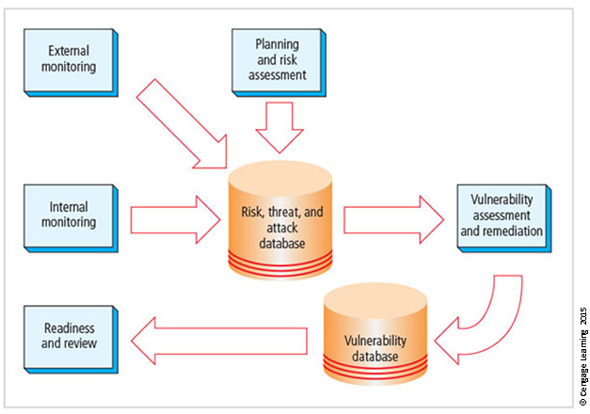
The maintenance model
Notes:
A Guide for Managers, deal with methods to manage and operate systems, a maintenance model is designed to focus the organization’s effort on maintaining systems.
The Figure illustrates an approach recommended for dealing with change caused by information security maintenance. The figure diagrams a full maintenance program and serves as a framework

Slide 8
Monitoring the External Environment
Objective to provide early awareness of new and emerging threats, threat agents, vulnerabilities, and attacks so the organization can mount an effective defense.
Entails collecting intelligence from data sources and giving that intelligence context and meaning for use by organizational decision makers.
Data sources
  Acquiring threat and vulnerability data is not difficult
  Turning data into information decision makers can use is the challenge
Notes:
The objective of the external monitoring domain within the maintenance model is to provide early awareness of new and emerging threats, threat agents, vulnerabilities, and attacks so the organization can mount an effective and timely defense.
External intelligence comes from vendors, computer emergency response teams (CERTs), public network sources, or membership sites
Regardless of where or how external monitoring data are collected must be analyzed in the context of the organization’s security environment to be useful
Monitoring, escalation, and incident response
Function of external monitoring process is to monitor activity, report results, and escalate warnings
Monitoring process has three primary deliverables:
Specific warning bulletins issued when developing threats and specific attacks pose measurable risk to the organization
Periodic summaries of external information
Detailed intelligence on highest risk warnings
Data collection and management
Over time, external monitoring processes should capture information about external environment in appropriate formats
External monitoring collects raw intelligence, filters for relevance, assigns a relative risk impact, and communicates to decision makers in time to make a difference
Primary goal is an informed awareness of state of organization’s networks, systems, and security defenses.
Internal monitoring accomplished by:
Inventorying network devices and channels, IT infrastructure and applications, and information security infrastructure elements
Leading the IT governance process
Real-time monitoring of IT activity
Monitoring the internal state of the organization’s networks and systems
Network characterization and inventory
Organizations should have/maintain carefully planned and fully populated inventory of network devices, communication channels, and computing devices
Once characteristics are identified, they must be carefully organized and stored using a mechanism (manual or automated) that allows timely retrieval and rapid integration of disparate facts
Making intrusion detection and prevention systems work
The most important value of raw intelligence provided by the intrusion detection system (IDS) is providing indicators of current or imminent vulnerabilities
Log files from IDS engines can be mined for information
Another IDS monitoring element is traffic analysis
Analyzing attack signatures from unsuccessful system attacks can identify weaknesses in various security efforts
Detecting differences
Difference analysis: procedure that compares current state of network segment against known previous state of same segment
Unexpected differences between the current state and the baseline state could indicate trouble
Monitoring the External Environment
Objective to provide early awareness of new and emerging threats, threat agents, vulnerabilities, and attacks so organization can mount an effective defense
Entails collecting intelligence from data sources and giving that intelligence context and meaning for use by organizational decision makers

Slide 9
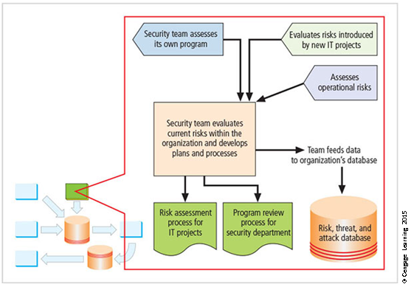
Planning and risk assessment
Notes:
Figure illustrates the relationships between the components of this maintenance domain. Note that there are two pivotal processes: the planning needed for information security programs and evaluation of current risks using operational risk assessment.

Slide 10
Knowledge Check Activity 1
The basic function of the external monitoring process is to maintain an informed awareness of the state of all the organization’s networks, information systems, and information security defenses.
True
False
Notes:
The basic function of the external monitoring process is to maintain an informed awareness of the state of all the organization’s networks, information systems, and information security defenses.
True
False
Answer: b. False
The steps to maintain an informed awareness of the state of all the organization’s networks, information systems, and information security defenses are internal monitoring. External monitoring is oriented to monitor activity, report results, and escalate warnings.

Slide 11
Vulnerability Assessment and Remediation
Primary goal: identification of specific, documented vulnerabilities and their timely remediation
Accomplished by:
  Using vulnerability assessment procedures
  Documenting background information and providing tested remediation procedures for vulnerabilities
  Tracking vulnerabilities from the time they are identified
  Communicating vulnerability information to owners of vulnerable systems
  Reporting on the status of vulnerabilities
  Ensuring that the proper level of management is involved
Notes:
The primary goal of the vulnerability assessment and remediation domain is to identify specific, documented vulnerabilities and remediate them in a timely fashion.
Process of identifying and documenting specific and provable flaws in the organization’s information asset environment.
Five following vulnerability assessment processes can help many organizations balance intrusiveness of vulnerability assessment with the need for a stable and effective production environment.
Penetration testing
A level beyond vulnerability testing
Is a set of security tests and evaluations that simulate attacks by a malicious external source (hacker)
Penetration test (pen test): usually performed periodically as part of a full security audit
Can be conducted one of two ways: black box or white box
Internet vulnerability assessment
Designed to find and document vulnerabilities present in an organization’s public network
Steps in the process include:
Planning, scheduling, and notification
Target selection
Test selection
Scanning
Analysis
Record keeping
Intranet vulnerability assessment
It is designed to find and document the selected vulnerabilities likely present on the internal network
Attackers are often internal members of the organization, affiliates of business partners, or automated attack vectors (such as viruses and worms)
This assessment is usually performed against critical internal devices with a known, high value by using selective penetration testing
Steps in the process are almost identical to the steps in the Internet vulnerability assessment
Platform security validation
It is designed to find and document vulnerabilities that may be present because misconfigured systems are in use within the organization
These misconfigured systems fail to comply with company policy or standards
Fortunately, automated measurement systems are available to help with the intensive process of validating the compliance of platform configuration with policy
Wireless vulnerability assessment
It is designed to find and document vulnerabilities that may be present in wireless local area networks of the organization
Since attackers from this direction are likely to take advantage of any flaw, assessment is usually performed against all publicly accessible areas using every possible wireless penetration testing approach
Documenting vulnerabilities
Vulnerability database should provide details about reported vulnerability as well as a link to the information assets
Low cost and ease of use make relational databases a realistic choice
Vulnerability database is an essential part of effective remediation
Remediating vulnerabilities
Objective is to repair flaw causing a vulnerability instance or remove the risk associated with vulnerability
As last resort, informed decision makers with proper authority can accept risk
Important to recognize that building relationships with those who control information assets is key to success
Success depends on the organization adopting team approach to remediation, in place of cross-organizational push and pull
Acceptance or transference of risk
In some instances, risk must be either simply acknowledged as part of the organization’s business process or transferred to another organization via insurance
Management must be assured that decisions made to accept risk or buy insurance were made by properly informed decision makers
Information security must make sure the right people make risk assumption decisions with complete knowledge of the impact of the decision
Threat removal
In some circumstances, threats can be removed without repairing vulnerability
Other vulnerabilities may be mitigated by inexpensive controls
Vulnerability repair
Best solution in most cases is to repair the vulnerability
Applying patch software or implementing a workaround often accomplishes this
Most common repair is the application of a software patch
Vulnerability Assessment and Remediation
Primary goal: identification of specific, documented vulnerabilities and their timely remediation
Accomplished by:
Using vulnerability assessment procedures
Documenting background information and providing tested remediation procedures for vulnerabilities
Tracking vulnerabilities from the time they are identified
Communicating vulnerability information to owners of vulnerable systems
Reporting on the status of vulnerabilities
Ensuring the proper level of management is involved

Slide 12
Vulnerability Assessment and Remediation (11 of 11)
Primary goal is to keep the information security program functioning as designed and continuously improving.
Accomplished by:
  Policy review
  Program review
  Rehearsals
Notes:
Readiness and Review
Primary goal is to keep information security program functioning as designed and continuously improving
Accomplished by:
Policy review
Program review
Rehearsals

Slide 13
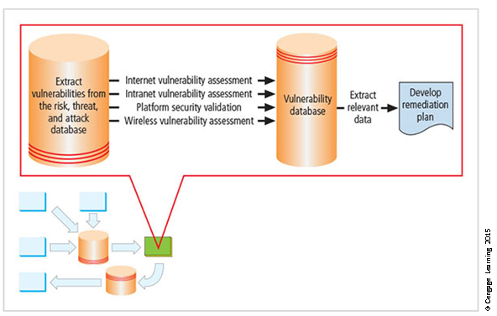
Vulnerability assessment and remediation
Notes:
Figure illustrates the process flow of the vulnerability assessment and remediation domain. Using the inventory of environment characteristics stored in the risk, threat, and attack database, the vulnerability assessment identifies and documents vulnerabilities. They are stored, tracked, and reported in the vulnerability database until they are remediated.
As shown in Figure, there are four common vulnerability assessment (VA) processes: Internet VA, intranet VA, platform security validation, and wireless VA. While the exact procedures associated with each can vary, these four processes can help many organizations balance the intrusiveness of vulnerability assessment with the need for a stable and effective production environment. Some organizations pursue a strategy of monthly vulnerability assessments that
involve all four processes. Others perform an Internet vulnerability assessment every week and rotate the other three processes on a monthly or quarterly basis. These choices depend on the quantity and quality of resources dedicated to vulnerability assessments.

Slide 14
Knowledge Check
The final process in the vulnerability assessment and remediation domain is the _____ phase.
Notes:
The final process in the vulnerability assessment and remediation domain is the _____ phase.
Answer: remediation
Remediation cannot be undertaken until all vulnerabilities are identified, categorized, classified and prioritized.

Slide 15
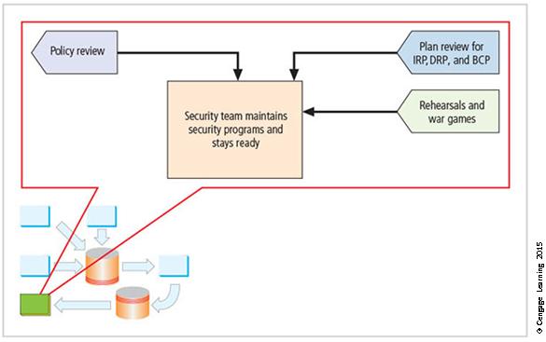
Readiness and review
Notes:
The relationships among the sectors of the readiness and review domain are shown in Figure.
As the diagram indicates, policy review is the primary initiator of this domain.
As policy is revised or current policy is confirmed, the planning elements are reviewed for compliance, the information security program is reviewed, and rehearsals are held to make sure all participants are capable of responding as needed.

Slide 16
Digital Forensics
Used to document what happened during attack on assets and how attack occurred
Based on the field of traditional forensics
Involves preservation, identification, extraction, documentation, and interpretation of digital media for evidentiary and/or root-cause analysis
Evidentiary material (EM): any item or information that applies to an organization’s legal or policy-based case
Notes:
Whether due to a character flaw, a need for vengeance, a profit motive, or simple curiosity, an employee or outsider may attack a physical asset or information asset. When the asset is the responsibility of the CISO, he or she is expected to understand how policies and laws require the matter to be managed and protected. To protect the organization and possibly assist law enforcement in an investigation, the CISO must document what happened and how an incident
occurred. This process is called digital forensics.
Used for two key purposes:
To investigate allegations of digital malfeasance
To perform root-cause analysis
Organization chooses one of two approaches:
Protect and forget (patch and proceed): defense of data and systems that house, use, and transmit it
Apprehend and prosecute (pursue and prosecute): identification and apprehension of responsible individuals, with additional attention to collection and preservation of potential EM that might support administrative or criminal prosecution
Digital Forensics
Used to document what happened during attack on assets and how attack occurred
Based on the field of traditional forensics
Involves preservation, identification, extraction, documentation, and interpretation of digital media for evidentiary and/or root cause analysis
Evidentiary material (EM): any item or information that applies to an organization’s legal or policy-based case

Slide 17
The Digital Forensics Team
Most organizations
  Cannot sustain a permanent digital forensics team
  Collect data and outsource analysis
Information security group personnel should be trained to understand and manage the forensics process to avoid contamination of potential EM.
Expertise can be obtained by training.
Notes:
This expertise can be obtained by sending staff members to a regional or national information security conference with a digital forensics track or to dedicated digital forensics training, as mentioned in lecture.
The organization should use caution in selecting training for the team or a specialist, as many forensics training programs begin with the analysis process and promote a specific tool rather than teaching management of the process.
The Digital Forensics Team
Most organizations
Cannot sustain a permanent digital forensics team
Collect data and outsource analysis
Information security group personnel should be trained to understand and manage the forensics process to avoid contamination of potential EM
Expertise can be obtained by training

Slide 18
Affidavits and Search Warrants
Affidavit
  Sworn testimony that certain facts are in the possession of the investigating officer; can be used to request a search warrant
  The facts, the items, and the place must be specified
When an approving authority signs the affidavit, it becomes a search warrant, giving permission to
  Search for evidentiary material (EM) at a specified location
  Seize specific items for official examination
Notes:
Most investigations begin with an allegation or an indication of an incident. Whether via the help desk, the organization’s sexual harassment reporting channels, or a direct report, someone alleges that a worker is performing actions explicitly prohibited by the organization or that make another worker uncomfortable in the workplace. The organization’s forensics team or other authorized entity must then request permission to examine digital media for potential EM. In law enforcement, the investigating agent would create an affidavit requesting permission to search for and confiscate related EM.
The affidavit summarizes the facts of the case, items relevant to the investigation, and the location of the event. When an approving authority signs the affidavit or creates a synopsis form based on the document, it becomes a search warrant. In corporate environments, the names of these documents may change, and in many cases written authorization may not be needed, but the process should be the same. Formal permission is obtained before an investigation occurs.
Affidavits and Search Warrants
Affidavit
Sworn testimony that certain facts are in the possession of the investigating officer; can be used to request a search warrant
The facts, the items, and the place must be specified
When an approving authority signs the affidavit it becomes a search warrant, giving permission to:
Search for EM at a specified location
Seize specific items for official examination

Slide 19
Digital Forensics Methodology
All investigations follow the same basic methodology
  Identify relevant EM
  Acquire (seize) the evidence without alteration or damage
  Take steps to assure that the evidence is at every step verifiably authentic and is unchanged from the time it was seized
  Analyze the data without risking modification or unauthorized access
  Report the findings to the proper authority
Notes:
In digital forensics, all investigations follow the same basic methodology once permission for search and seizure has been obtained:
Digital Forensics Methodology
All investigations follow the same basic methodology
Identify relevant EM
Acquire (seize) the evidence without alteration or damage
Take steps to assure that the evidence is at every step verifiably authentic and is unchanged from the time it was seized
Analyze the data without risking modification or unauthorized access
Report the findings to the proper authority

Slide 20
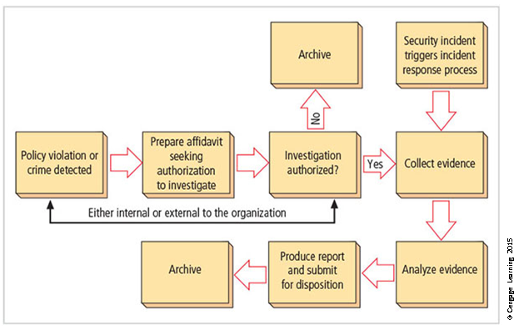
The digital forensics process
Notes:
This process is illustrated in Figure.
To support the selection and implementation of a methodology for forensics, the organization may want to seek legal advice or consult with local or state law enforcement.
Electronic Crime Scene Investigation: A Guide for First Responders, July 2001 (www.ncjrs.gov/pdffiles1/nij/187736.pdf )
First Responders Guide to Computer Forensics (https://resources.sei.cmu.edu/asset_files/Handbook/2005_002_001_14429.pdf )
First Responders Guide to Computer Forensics: Advanced Topics (http://resources.sei.cmu.edu/asset_files/handbook/2005_002_001_14432.pdf )
Searching and Seizing Computers and Obtaining Electronic Evidence in Criminal Investigations (www.justice.gov/criminal/cybercrime/docs/ssmanual2009.pdf )
Scientific Working Group on Digital Evidence: Best Practices for Computer Forensics (www.oas.org/juridico/spanish/cyb_best_pract.pdf ).

Slide 21
Evidentiary Procedures
Strong procedures for handling potential evidentiary material can minimize the probability of an organization losing a legal challenge.
Organizations should develop specific procedures, along with guidance for effective use.
The policy document should be supported by a procedures manual.
Notes:
The first component of the analysis phase is indexing. During indexing, many investigatory tools create an index of all text found on the drive, including data found in deleted files and in file slack space. This indexing is similar to that performed by Google Desktop or Windows Desktop Search tools. The index can then be used by the investigator to locate specific documents or document fragments. While indexing, the tools typically organize files into categories, such as documents, images, and executables. Unfortunately, like imaging, indexing is a time- and processor-consuming operation, and it could take days on images that are larger than 20 gigabytes.
In information security, most operations focus on policies—documents that provide managerial guidance for ongoing implementation and operations. In digital forensics, however, the focus is on procedures. When investigating digital malfeasance or performing root-cause analysis, keep in mind that the results and methods of the investigation may end up in criminal or civil court.
The policy document should be supported by a procedures manual and developed based on the documents discussed earlier, along with guidance from law enforcement or consultants. By creating and using these policies and procedures, an organization can best protect itself from challenges by employees who have been subject to unfavorable action from an investigation.
Evidentiary Procedures
Strong procedures for handling potential evidentiary material can minimize the probability of an organization’s losing a legal challenge
Organizations should develop specific procedures, along with guidance for effective use
Should be supported by a procedures manual

Slide 22
Summary
Maintenance of the information security program is essential
Security management models assist in planning for ongoing operations
It is necessary to monitor the external and internal environment
Planning and risk assessment are the essential parts of information security maintenance
Need to understand how vulnerability assessment and remediation tie into information security maintenance
Need to understand how to build readiness and review procedures into information security maintenance
Digital forensics and management of digital forensics function

