Slide 1
ECEY5004C
Iaith a Llythrennedd yn yr Oes Ddigidol
Hwiangerddi
ECEY5004
Language and Literacy in the Digital Age
Nursery Rhymes

Slide 2
Cynnwys
Contents
Hanes hwiangerddi;
Cysylltiadau diwylliannol;
Trafodaethau;
Ymchwil;
History of nursery rhymes;
Cultural links;
Discussions;
Research;

Slide 3
Cynnwys
Contents
Damcaniaeth;
Nodweddion hwiangerddi;
Cwestiynau;
Tasg grŵp.
Theory;
Features of nursery rhymes;
Questions;
Group task.

Slide 4
Cymwyseddau trosglwyddadwy lefel uwch
High-level transferable competencies
Trefnu a Chynllunio;
Ymchwilio a Chymryd nodiadau;
Cyfathrebu a Rhyngweithio;
Cyflwyno a Gwaith tîm.
Organisation and Planning;
Researching and Note taking;
Communication and Interaction;
Presenting and Teamwork.

Slide 5
Adnoddau
Resources
PP ar gyfer y ddarlith;
Hwiangerddi;
Ymchwil;
Gwefannau.
PP for the lecture;
Nursery rhymes;
Research;
Websites.

Slide 6
Rhaglen Ymarferydd Blynyddoedd Cynnar
Early Years Practitioner programme
Meini prawf y NOS a gyflawnwyd yn y ddarlith hon:
Core – K7, K8, K12, K13, K14, K17, K24, K26, K27
0401 – K56, K57, K58, K59, K60; P3, P4, P5, P7, P8
0403 – K60, K61, K62, K63, K64
0408 – K57, K59, K63, K66, K67
0409 – K60, K61, K62, K63, K64, K65, K66, K67, K68, K69, K70, K71, K72; P1, P19, P20, P22
The NOS criteria met in this lecture:
Core – K7, K8, K12, K13, K14, K17, K24, K26, K27
0401 – K56, K57, K58, K59, K60; P3, P4, P5, P7, P8
0403 – K60, K61, K62, K63, K64
0408 – K57, K59, K63, K66, K67
0409 – K60, K61, K62, K63, K64, K65, K66, K67, K68, K69, K70, K71, K72; P1, P19, P20, P22

Slide 7
Hwiangerddi - O ble?
Nursery rhymes - From where?
Rhieni;
Aelodau teulu arall;
Profiadau diwylliannol/
cymdeithasol;
Rhywle arall?
Parents;
Other family members;
Cultural/social experiences;
Anywhere else?
(Mullen, 2017)

Slide 8
Bach o hanes….
A little history…
Wedi cael eu hymadrodd i, a gan, blant am gannoedd o flynyddoedd;
Gwraidd rhan fwyaf o hwiangerddi yn adlewyrchu digwyddiadau hanesyddol;
Yn bwysig am ein hanes ac ein diwylliant.
Have been recited to, and by, children for hundreds of years;
Origins of most nursery rhymes reflect historical events;
Important for our history and culture.

Slide 9
Ydych chi’n cofio rhain?
Do you remember these?
Gee Ceffyl Bach;
Dacw Mam yn Dŵad;
Dau Gi Bach;
Mynd Drot Drot;
Mi Welais Jac y Do.
Ring-a-ring-o-roses;
Humpty Dumpty;
Baa baa black sheep;
Mary, Mary quite contrary.

Slide 10
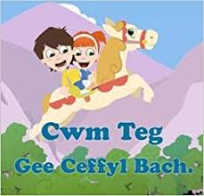
Gee ceffyl bach yn cario ni'n dau,
Dros y mynydd i hela cnau;
Dŵr yn yr afon a'r cerrig yn slic,
Cwympo ni'n dau,
Wel dyna i chi dric!

Slide 11
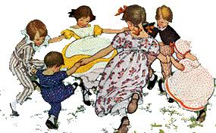
Ring-a-ring-o-rosies,
A pocketful of posies
Atishoo, atishoo,
We all fall down.

Slide 12
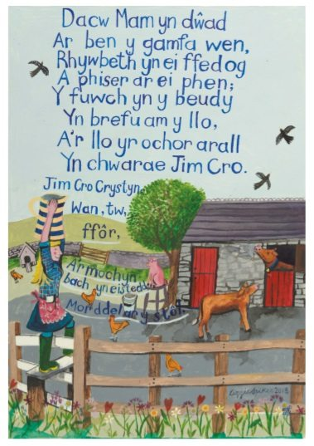

Slide 13
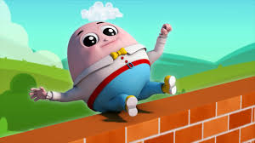
Humpty Dumpty sat on a wall,
Humpty Dumpty had a great fall.
All the king’s horses and all the king’s men,
Couldn’t put Humpty together again.

Slide 14
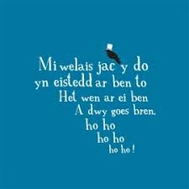

Slide 15
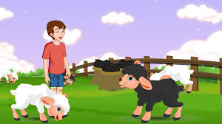
Baa baa black sheep,
Have you any wool?
Yes Sir, Yes Sir,
Three bags full –
One for the master,
And one for the dame.
And one for the little boy,
Who lives down the lane.

Slide 16
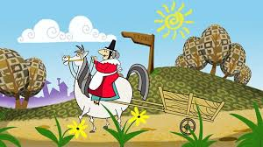
Mynd drot drot ar y gaseg wen,
Mynd drot drot i'r dref;
Mami'n dod nôl dros fryn a dôl,
A rhywbeth neis neis i de.
Teisen i Sil, banana i Bil,
A thamaid i'r gath a'r ci;
Afal mawr iach i Ben y gwas bach,
A rhywbeth neis neis i fi.

Slide 17
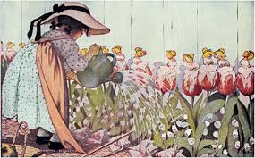
Mary, Mary quite contrary,
How does your garden grow?
With silver bells and cockle shells,
And pretty maids all in a row.

Slide 18
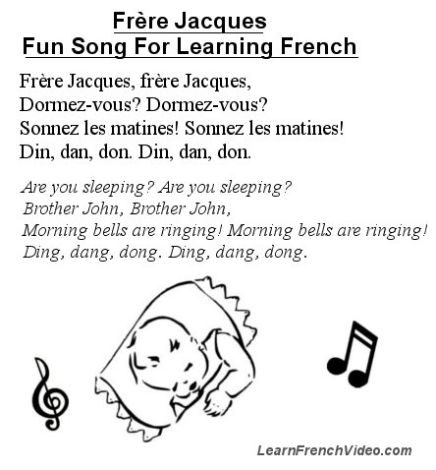
Ffrainc
France

Slide 19
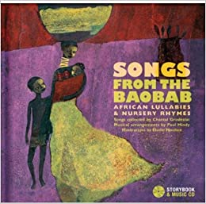
Affrica
Africa
Songs from the Baobab

Slide 20
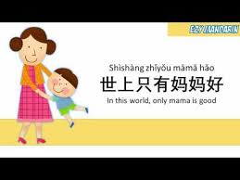
Mandarin Tsieineaidd
Chinese Mandarin
Shi Shang Zhi You Mama Hao

Slide 21
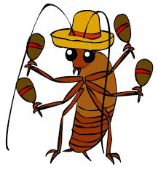
Amerig Lladin
Latin America
La Cucaracha

Slide 22
Barn heddiw...
Today’s thinking...
Hen ffasiwn;
Hynafol;
Consyrn;
Straeon tywyll;
Od;
Outdated;
Obsolete;
Concerns;
- Dark stories;
Bizarre;
(The Mail, 2018; Lee, 2017; Burton-Hill, 2015)

Slide 23
Barn heddiw...
Today’s thinking...
Dim gwerth addysgol;
Dim yn wleidyddol gywir;
Dim amser.
No educational value;
Not politically correct;
No time.
(The Mail, 2018; Lee, 2017; Burton-Hill, 2015)

Slide 24
Fodd bynnag...
However…
Bond corfforol;
Symudiadau rhythmig;
Cymdeithasoli trwy ganu;
Ystumiau a mynegiadau wynebol;
Physical bond;
Rhythmic movements;
Socialization by singing;
Gestures and facial expressions;
(Lee, 2017; Pourkalhor and Tavakoli, 2017)

Slide 25
Fodd bynnag...
However…
Dull effeithiol o ddysgu iaith/ail iaith;
Hybu canfyddiad clywedol;
Deall stori syml;
Hwylus – dysgu sut i chwarae gyda geiriau.
Effective way of learning language/second language;
Promotes auditory perception;
Understand simple story;
Fun – learn about wordplay.
(Lee, 2017; Pourkalhor and Tavakoli, 2017)

Slide 26
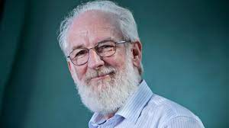
David Crystal
Ieithydd, academydd, awdur;
Chwarae â geiriau/iaith.
Linguist, academic and author;
Wordplay/language play.

Slide 27
David Crystal
Mae hwiangerddi yn:
Effeithiol;
Gweledol;
Cyffyrddol;
“coreograffi lleisiol-gweledol”.
(Crystal, 1998: 164)
Nursery rhymes are:
Effective;
Visual;
Tactile;
“vocal-visual choreography”.
(Crystal, 1998: 164)

Slide 28
David Crystal (2017: 69)
“Mae rhythm emphatig yn treiddio drwy'r rhyngweithio rhwng gofalwyr a phlant yn ystod y cyfnod o tua 6 i 18 mis. Meddyliwch am y gêmau sy'n cael eu chwarae – gêmau tician, gêmau clapio, gêmau siglo pen-glin, caneuon ailadrodd a llawer o hwiangerddi gweithgaredd. Mae gan bob un peth yn gyffredin: rhythm cryf, sydd fel arfer yn cael ei atgyfnerthu gan gyffwrdd a symudiad y corff."

Slide 29
David Crystal (2017: 69)
“Emphatic rhythm permeates the interactions between carers and children during the period from around 6 to 18 months. Think of the games that are played – tickling games, clapping games, knee-bobbing games, repetition songs and a lot of activity nursery rhymes. They all have one thing in common: a strong rhythm, usually reinforced by touch and body movement.”

Slide 30
David Crystal (2017)
Ynganiad;
Acenion;
Goslef;
Cyflymdra.
Pronunciation;
Accents;
Intonation;
Pace.
“It’s not what you say...It’s the way that you say it….”

Slide 31
Ewch amdani…
Have a go…
Dychmygwch eich bod yn byw mewn cyfnod cyn cyfryngau cyhoeddus;
Gofynnwyd i chi rhannu hanes Humpty Dumpty;
Imagine that you are living in an era before social media;
You are asked to share what has happened to Humpty Dumpty;

Slide 32
Ewch amdani…
Have a go…
Mewn grwpiau bach, adroddwch y newyddion fel pe bai chi’n:
darllenwr y newyddion;
plentyn 5 oed;
sloth;
Sion Corn;
sylwebydd pêl-droed;
David Attenborough;
A fedrwch meddwl am eraill?
In small groups, relay the news as if you were:
a newsreader;
a 5-year-old;
a sloth;
Father Christmas;
a football commentator;
David Attenborough;
Can you think of others?

Slide 33
Friedrich Froebel
Mae canu yn ffordd i gyfleu cariad a gofal mamol;
Gall ganu fod yn offeryn pedagogaidd;
Gall ganu rhigymau fod yn ddargludiad emosiynol.
Act of singing is a way to convey motherly love and care;
Singing can be a pedagogical tool;
Singing rhymes can be an emotional conduit.
(Dyke, 2017)

Slide 34
Sgiliau ieithyddol
Linguistic skills
Ymwybyddiaeth ffonolegol;
Sillafau;
Ffonemau;
Odl;
Phonological awareness;
Syllables;
Phonemes;
Rhyme;

Slide 35
Sgiliau ieithyddol
Linguistic skills
Ailadroddiad;
Cyflythreniad;
Onomatopeia;
Rhythm.
Repetition;
Alliteration;
Onomatopoeia;
Rhythm.

Slide 36
Ymwybyddiaeth ffonolegol
Phonological awareness
Y gallu i ddeall bod llythrennau'r wyddor yn cynrychioli ffonemau mewn lleferydd;
Rhagflaenydd pwysig wrth ddysgu darllen;
Yn gysylltiedig â darllen cynnar a sillafu llwyddiannus.
The ability to understand that letters of the alphabet represent phonemes in speech;
An important precursor in learning to read;
Linked to early reading and success with spelling.
(Saiegh-Haddad, 2019)

Slide 37
Gweithgareddau i hyrwryddo ymwybyddiaeth ffonolegol
Activities to promote phonological awareness
Tynnu sylw at ymwybyddiaeth ffonolegol mewn rhigymau, caneuon a straeon;
Cyfatebu lluniau â geiriau;
Cyfatebu geiriau â geiriau.
Highlight phonological awareness in rhymes, songs and stories;
Match pictures to words;
Match words to words.

Slide 38
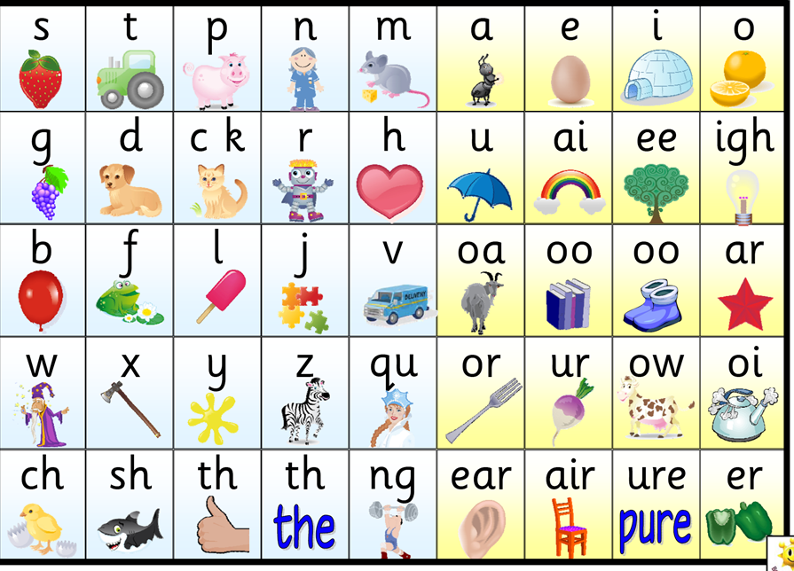
Ffonemau
Phonemes
What is a phoneme?

Slide 39
Sillafau & Rhythm
Syllables & Rhythm
Sillafau mewn hwiangerddi yn helpu llunio’u rhythm;
Yn ymgysylltu â gwrandawyr ac yn gwahodd ymatebion ar unwaith:
- Clapio dwylo;
- Neidio i fyny ac i lawr.
(Sayakhan et al., 2019)
Gweithgaredd cerddorol yn gwella caffaeliad sgiliau darllen.
(Linnavalli et al., 2012)
Syllables in nursery rhymes help make up their rhythm;
Engages listeners and invites immediate reactions:
Hand clapping;
Jumping up and down.
(Sayakhan et al., 2019)
Musical activity enhances acquisition of reading skills.
(Linnavalli et al., 2018)

Slide 40
Odl
Rhyme
Gwella’r cof (cofio geiriau);
Plant yn fwy tebygol o gofio union eiriau;
Cryfhau geirfa plant;
Galluogi plant i ragfynegi geiriau cyn iddynt gael eu dweud/darllen;
Plant ‘ar y blaen’ o rhan deall iaith a dysgu iaith.
Improves memory (word retention);
Children more likely to remember exact words;
Strengthens children’s vocabulary;
Enables children to predict words before they are said/read;
Gives children ‘an edge’ in language comprehension and language learning.
(Read et al., 2014)

Slide 41
Odl - Gweithgaredd
Rhyme - Activity
Yn yr amser a rhoddwyd gan eich darlithydd, gwnewch rhestr o eiriau sydd yn odli gyda ‘TI’
In the time given by your lecturer, make a list of words which rhyme with ‘RHYME’

Slide 42
Ailadrodd
Repetition
"... oherwydd yr iaith ailadroddus a natur ailadroddus eu defnydd, mae hwiangerddi yn benthyg eu hunain yn dda i weithredu fel driliau ieithyddol, heb y teimlad cysylltiedig o ddiflastod neu rwystredigaeth bosibl ac maent yn helpu i ddatblygiad awtomatig o ddefnydd iaith, ochr yn ochr ag arlwyo ar gyfer gwahanol arddulliau dysgu a deallusrwydd lluosog. Yn ogystal, maent yn cynnig digon o gyfleoedd i ailgylchu'r iaith drwy gynnig ystod eang o opsiynau ar gyfer datblygu gweithgareddau yn yr ystafell ddosbarth i gyd-fynd â nhw“
(Prosic-Santovac, 2015, p. 27).

Slide 43
Ailadrodd
Repetition
“…due to the repetitive language and the repetitive nature of their use, nursery rhymes lend themselves well to functioning as linguistic drills, without the accompanying feeling of potential boredom or frustration and they help in developing automaticity of language use, alongside catering for different learning styles and multiple intelligences. In addition, they provide ample opportunities for recycling the language by offering a wide range of options for developing classroom activities to accompany them”
(Prosic-Santovac, 2015, p. 27).

Slide 44
Ailadrodd – Trafodwch…
Repetition – Discuss…
Pam ydych chi'n meddwl bod awduron yn defnyddio ‘ailadrodd’ mewn llyfrau plant?
Ydych chi wedi sylwi ar enghreifftiau o ailadrodd mewn llyfrau rydych chi wedi'u darllen?
Pa wybodaeth bwysig yr oedd yr awdur yn tynnu eich sylw at?
Why do you think authors use repetition in children's books?
Have you noticed examples of repetition in books you have read?
What important information was the author drawing your attention to?

Slide 45
Cyflythreniad
Alliteration
Geiriau sy'n dechrau gyda'r un sain gychwynnol, e.e. clymau tafod;
Gallu cael effaith ar sgiliau ymwybyddiaeth ffonolegol;
Datblygu sensitifrwydd tuag at synau cychwynnol sy’n cael eu hailadrodd;
Gwella sgiliau gwrando.
Words that begin with the same initial sound, e.g. tongue twisters;
Can have an impact on phonological awareness skills;
Develops sensitivity towards repetition of initial sounds;
Enhances listening skills.
(Symmonds, 2020)

Slide 46
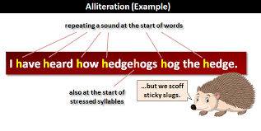
Cyflythreniad – Ewch amdani!
Alliteration – Have a go!
Gan ddefnyddio blaenlythyren eich enw cyntaf, ysgrifennwch enghraifft o gyflythreniad.
Using the initial of your first name, write your own example of alliteration.

Slide 47
Onomatopoeia
“ffurfiau ieithyddol sy'n dynwared synau o'r amgylchedd”
(Laing, 2019, t.4)
Helpu babanod i gysylltu synau lleferydd gyda ‘phethau’;
Geirfa gynnar yn cynnwys nifer uchel o eiriau onomatopoeig;
Rhan o leferydd tuag at blant;
Well gan fabanod Prydeinig geiriau onomatopoeig nag enwau (pethau).
“linguistic forms that imitate sounds from the environment”
(Laing, 2019, p.4)
Helps infants associate speech sounds with referents;
Early vocabulary consists of high number of onomatopoeic words;
Part of child-directed speech;
British babies fixate for longer on onomatopoeic words than nouns.

Slide 48
Gweithgaredd onomatopeia
Onomatopoeia activity
Match the noisy word on the left with a sentence on the right:
beep | I’m asking you politely to be quiet.
chuckle | It’s not that boring, is it?
clatter | A cat having a nap with its owner.
ding dong | The sound of money being made.
drip | The march of time sounds like this.
ker-ching | Is that thunder in the distance?
munch | A guitar being played, but badly.
purr | An angry motorist or a wake-up call.
rumble | Can you answer the door please?
shush | Dropping a dozen plates on the floor.
snore | Do up your coat-it’s cold outside.
tick tock | When something is quite funny.
twang | The sound of a healthy diet.
yawn | Sleeping like a baby.
zip | Turn off the tap properly to avoid this.

Slide 49
Estyn ‘Dysgu gweithredol a thrwy brofiad’ (2017)
Estyn ‘Active and experiential learning’ (2017)
Cyngor gan Llywodraeth Cymru;
Arfer effeithiol yn y Cyfnod Sylfaen – Blwyddyn 1 a Blwyddyn 2;
Cyflwyno llythrennedd a rhifedd.
Advice from Welsh Government;
Effective Foundation Phase practice – Year 1 and Year 2;
Delivery of literacy and numeracy.

Slide 50
Llafaredd (Estyn, 2017)
Oracy (Estyn, 2017)
Mewn mwyafrif o ysgolion:
Oedolion yn siarad yn rheolaidd gyda phlant sydd yn ymestyn eu dysgu.
Mewn rhai ysgolion:
Dim digon o gyfleoedd i blant siarad gydag oedolion am destunau sydd o ddiddordeb iddynt.
In most schools:
Adults talk regularly with children which extends their learning.
In some schools:
Not enough opportunities for children to talk to adults about topics which interest them.

Slide 51
Ysgrifennu (Estyn, 2017)
Writing (Estyn, 2017)
Mewn ¼ o ysgolion:
Plant yn cael cyfleoedd ystyrlon i ysgrifennu am ystod o bwrpasau.
Fodd bynnag:
Gorddibyniaeth ar ddysgu ffurfiol a defnydd o daflenni gwaith i sgaffaldio ysgrifennu plant.
In ¼ of schools:
Children have meaningful opportunities to write for a variety of purposes.
However:
Overreliance on formal teaching and use of worksheets to scaffold children’s writing.

Slide 52
Darllen (Estyn, 2017)
Reading (Estyn, 2017)
Mewn rhai ysgolion:
Mae plant yn cael llawer o gyfleoedd i ddarllen amrywiaeth o destunau.
Fodd bynnag:
Cynnydd darllen plant yn cael ei ‘niweidio’ wrth gadw at gynlluniau darllen.
In some schools:
Children are provided with numerous opportunities to read a variety of texts.
However:
Children’s progress in reading can be ‘adversely affected’ by having to adhere to reading schemes.

Slide 53
Estyn – ‘Dysgu gweithredol a thrwy brofiad’ (2017)
Estyn – ‘Active and experiential learning’ (2017)
Cyflwyniad o lythrennedd (a rhifedd) yn rhy strwythuredig a gormod o gyfarwyddyd oedolion;
Nid yw plant yn cael digon o gyfleoedd i gymryd rhan mewn dysgu gweithredol a phrofiadol;
Nid yw oedolion yn cynllunio'n effeithiol.
Delivery of literacy (and numeracy) is too structured and adult-directed;
Children do not have enough opportunities to participate in active and experiential learning;
Adults do not plan effectively.

Slide 54
I gloi….
To end…
“Reciting and singing nursery rhymes provides practice in different language areas and can help young learners to take the first steps to develop phonological awareness…Educators agree that a great deal of general evidence indicates that both early awareness of rhyme and nursery rhyme knowledge facilitate literacy acquisition”.
(Fleta, 2017: 37)
https://www.youtube.com/watch?v=0ySasQdLkso

Slide 55
Cyfeiriadau
References
Burton-Hill, C. (2015) The dark side of nursery rhymes. https://www.bbc.com/culture/article/20150610-the-dark-side-of-nursery-rhymes [Accessed: November 4 2020].
Crystal, D. (1998) Language Play. London: Penguin Books Ltd.
Crystal, D. (2017) Sounds Appealing: The passionate story of English Pronunciation. London: Profile Books Ltd.
Donaldson, G. (2015) Successful Futures. Cardiff: Welsh Government.
Dyke, J. (2017) A Froebelian approach: songs, rhymes and finger plays. Available at:https://www.froebel.org.uk/uploads/documents/FT-Songs-Rhymes-and-Finger-Plays-Pamphlet.pdf [Accessed: August 21 2024].
Estyn (2017) Active and experiential learning. Cardiff: Welsh Government.
Fleta, T. (2017) ‘The sounds of picturebooks for English language learning’,Children’s Literature in English Language Education Journal, 5(1), pp.21-43.
Laing, C. E. (2017) ‘A perceptual advantage for onomatopoeia in early word learning:
Evidence from eye-tracking’, Journal of Experimental Child Psychology, 161, pp. 32-45.
Laing, C. (2019) ‘A role for onomatopoeia in early language: evidence from phonological development’, Language and Cognition, 11(2), pp.173-187.

Slide 56
Cyfeiriadau
References
Lee, V. (2017) Children are no longer learning traditional nursery rhymes, and that’s sad news. https://inews.co.uk/inews-lifestyle/people/children-no-longer-learning-traditional-nursery-rhymes-thats-sad-news-101889 [Accessed: November 4 2020].
Linnavalli, T. et al. (2018) ‘Music playschool enhances children’s linguistic skills’, Scientific reports, 8(1), p.8767. [online]. Available at: https://www.nature.com/articles/s41598-018-27126-5.pdf [Accessed: August 21 2024].
Mullen, G. (2017) ‘More than words: Using nursery rhymes and songs to support domains of child development’, Journal of childhood studies, pp.42-53. [online]. Available at: https://journals.uvic.ca/index.php/jcs/article/view/17841 [Accessed: August 21 2024].
Phonic Books (2013) What is a phoneme? https://www.youtube.com/watch?v=dwFvD5Cv9n8 [Accessed: November 4 2020].
Pourkalhor, O. and Tavakoli, M. (2017) ‘Nursery Rhymes and Language Learning: Issues and Pedagogical Implications,’ International Journal of English Language & Translation Studies, 5, 1, pp.111-116.
Prosic-Santovac, D. (2015) ‘Making the match: Traditional nursery rhymes and teaching English to modern children’, CLELE journal, pp.25-48.
Read, K. et al. (2014) ‘The Seuss boost: Rhyme helps children retain words from shared storybook reading’, First Language, 34(4), pp.354-371.

Slide 57
Cyfeiriadau
References
Saiegh-Haddad, E. (2019) ‘What is phonological awareness in L2?’, Journal of Neurolinguistics, 50, pp.17-27. [online]. Available at: https://www.sciencedirect.com/science/article/pii/S0911604417300520?casa_token=jWByiIBl2_YAAAAA:IteJAcyFCpLrxZXu3awQhBqD5mFttB4W-xo9-jtPBW6wycxlrWpdgbGUqwnpsHRi-d5-wK2ivyM [Accessed: August 21 2024].
Sayakhan, N. I. (2019) ‘Nursery Rhymes as a Vehicle for Teaching English as a Foreign Language’, Journal of University of Raparin, 6(1), pp.44-55.
Symmonds, J.M. (2020) ‘Impact of Quality Shared Reading Experiences on the Phonological Awareness Skills of Preschoolers’. (Doctoral dissertation, The William Paterson University of New Jersey).
The Mail (2018) 'Political correctness gone mad': Readers gobsmacked at overhaul of traditional nursery rhymes. https://www.nwemail.co.uk/news/16426581.political-correctness-gone-mad-readers-gobsmacked-overhaul-traditional-nursery-rhymes/ [Accessed: November 4 2020].
Victoria State Government (2019) Examples to promote phonological awareness. https://www.education.vic.gov.au/school/teachers/teachingresources/discipline/english/literacy/readingviewing/Pages/litfocusphonologicalexample.aspx [Accessed: November 4 2020].
Welsh Government (2017) ‘ Foundation Phase Profile’. Cardiff: Welsh Government.

