Slide 1
Converting Research into Practice LCDB 7010
Week 5 – Coding &Qualitative Analysis
Notes:
Fill in the relevant information for the cohort

Slide 2
Session Plan
Review progress on your article (review and feedback)
  Siddartha, Magda, Yajing
Focus Group exercise ( completion )
Lecture & Discussion on Coding ( 11 - 12)
Jason Harcourt – AI guidelines and Academic Integrity – 2pm
Activity on coding manually Excel or Nvivo
( 2 – 4 pm)

Slide 3
Activities involved in qualitative analysis
■ categorisation;
■ recognising relationships and developing the categories you are using to facilitate this;
- recognising patterns/trends
■ developing and testing theories to reach conclusions.

Slide 4
Saldana – Coding Manual for Qualitative Research – Introduction to Codes

Slide 5
What is a code?
According to Saldana
  A code in qualitative inquiry is most often a word or short phrase that symbolically assigns a summative, salient, essence-capturing, and/or evocative attribute for a portion of language-based or visual data
In qualitative data analysis, a code is a researcher-generated construct that symbolizes or “translates” data (Vogt, Vogt, Gardner, & Haeffele, 2014, p. 13) and thus attributes interpreted meaning to each individual datum for later purposes of pattern detection, categorization, assertion or proposition development, theory building, and other analytic processes

Slide 6
Coding examples
I notice that the grand majority of homes have chain link fences in front of them. There are many dogs (mostly German shepherds) with signs on fences that say “Beware of the Dog.”
1 security

Slide 7
Example of several codes
1. He cares about me. He has never told me but he does.
2. He’s always been there for me, even when my parents were not. He’s one of the few things that I hold as a constant in my life. So it’s nice.
3. I really feel comfortable around him.
1 sense of self-worth
2 stability
3 “comfortable”

Slide 8
More examples…
1 My son, Barry, went through a really tough time about, probably started the end of fifth grade and went into sixth grade.
2 When he was growing up young in school he was a people-pleaser and his teachers loved him to death.
3 Two boys in particular that he chose to try to emulate, wouldn’t, were not very good for him.
4 They were very critical of him, they put him down all the time, and he kind of just took that and really kind of internalized it, I think, for a long time.
5 In that time period, in the fifth grade, early sixth grade, they really just kind of shunned him all together, and so his network as he knew it was gone.
1 middle-school hell
2 teacher’s pet
3 bad influences
4 teen angst (teenage worries and anxieties)
5 the lost boy

Slide 9
From codes to categories
data initially coded as classroom materials, computers, and textbooks were categorized under the major heading, Resources.
As their study continued, another major category emerged labelled
  Teacher Skills with the subcategories
  Instructional Skills and Management Skills.

Slide 10
.
Category: Teacher Skills
Subcategory 1: Instructional Skills
Code: PEDAGOGICAL
Code: SOCIO-EMOTIONAL
Code: STYLE/PERSONAL EXPRESSION
Code: TECHNICAL
Subcategory 2: Management Skills
Code: BEHAVIORIST TECHNIQUES
Code: GROUP MANAGEMENT
Code: SOCIO-EMOTIONAL
Code: STYLE (overlaps with instructional style)
Code: UNWRITTEN CURRICULUM
.

Slide 11
.
Category: Physical Oppression
Code: PUSHING
Code: FIGHTING
Code: SCRATCHING
Category: Verbal Oppression Code: NAME-CALLING
Code: THREATENING
Code: LAUGHING AT
.

Slide 12
.
Coding is not a precise science; it is primarily an interpretive act.
Also be aware that a code can sometimes summarize, distil, or condense data, not simply reduce them.
Madden (2010) notes that such analytic work does not diminish but “value adds” to the research story (p. 10).
.

Slide 13
Patterns !
A pattern can be characterized by:
  • similarity (things happen the same way)
  • difference (they happen in predictably different ways)
  • frequency (they happen often or seldom)
  • sequence (they happen in a certain order)
  • correspondence (they happen in relation to other activities or events)
  • causation (one appears to cause another) (p. 155)

Slide 14
From codes to theories

Slide 15
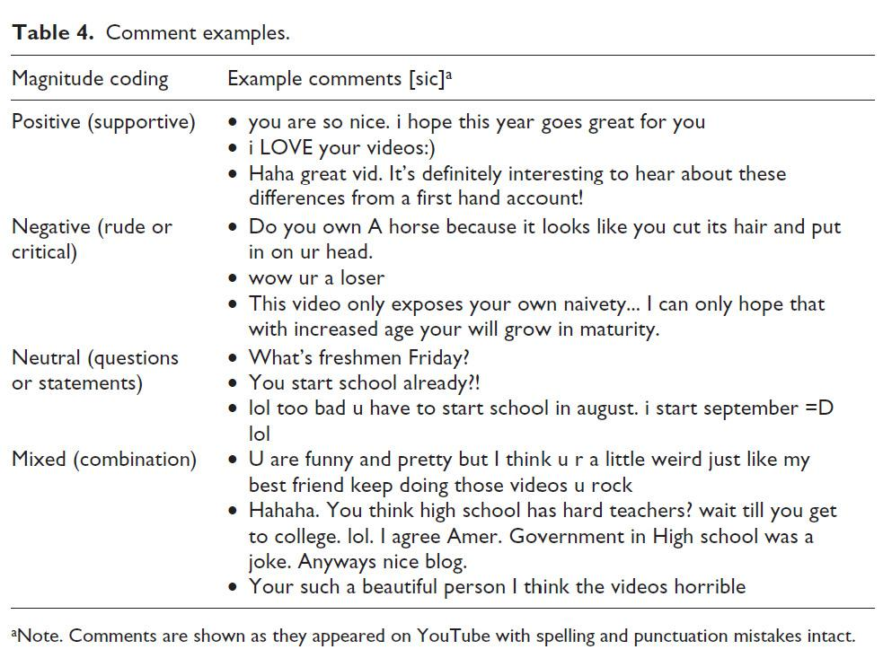
Coding examples
Sage journal examples
Snelson (2015) investigated school-related vlogging on YouTube.
One portion of her study examined viewer comments posted online about other young people’s vlogs. “Of the 3457 comments, 53% were coded as positive, 12% were coded as negative, 29% were coded as neutral, and 6% were coded as mixed” (p. 335).
The study “used comments as a reflective lens from the viewing audi­ence to help illuminate vlogger culture and perhaps suggest additional motivations for vlogging, such as positive attention or community interaction” (p. 328)

Slide 16
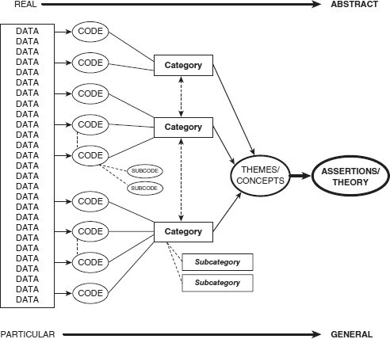
Coding, categorisation, themes/concepts

Slide 17
Coding techniques
Refer to Saldana (material uploaded)

Slide 18
Electronic coding
Using CAQDAS (computer assisted qualitative data analysis)
Eg:
  Atlasti (https://atlasti.com)
  Nvivo (https://www.qsrinternational.com/nvivo-qualitative-data-analysis-software/home)

Slide 19
Basis for Coding and NVivo in Action
https://www.youtube.com/watch?v=J-g1c7FriFE
https://www.youtube.com/watch?v=nzF48qLy2kg

Slide 20
Activity (group work)
Code and categorise your focus group discussion data manually OR
Use Excel OR Download Nvivo (free trail version)
Obtain a transcript of your choice to identify/develop codes and categories.

Slide 21
Remember next week’s FORUM Question!
.

