Slide 1

SAFEGUARDING PRACTICE REVIEW REPORT:
CASE STUDY : Child HN
Chosen Role: Social Worker
Name: Phumla Precious Gasa
Tutor: Gillian Weaver
Module: Protecting and Supporting Families in Health and Care (BMHP5021)
Student Number: 2236694

Slide 2
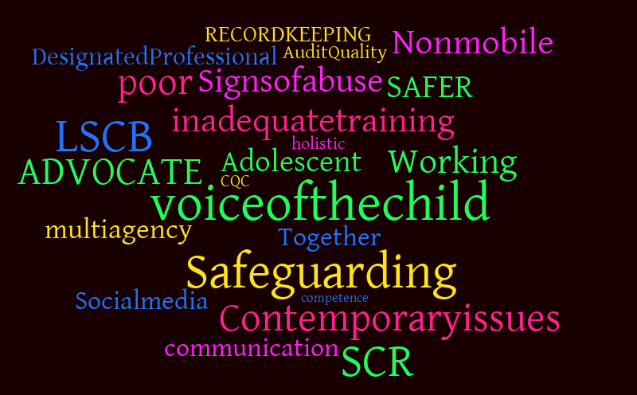
AIM:
*Introduction: Overview of the Statutory Framework
The primary aim is to evaluate the critical analysis of the Local Child Safeguarding Practice Review
(LCSPR) on Child HN who was diagnosed with Type 1 Diabetes and suffered a near fatal diabetic episode.
This report will focus on analysing:
Early Help (Well-being perceptions).
Accessing need and Providing help.
Multi-agency.
Organisational Responsibilities
ACE’s impact.
* Practice and Policy.
* Advantages and Disadvantages
* Recommendations
* Summary.
* References.
This Photo by Unknown Author is licensed under CC BY-NC-ND

Slide 3

INTRODUCTION:
This report will be analysing and proving a critical analysis of Child HN from a social worker perspective.
It will examine the effectiveness of early help, multi-agency working and professional practice in supporting Child HN and the family. It will also explore the impact of adverse childhood experiences and evaluates how statutory guidance informed, or failed to inform, or professional decision-making. (NSPCC, 2022).
Overview of the Statutory Framework. (NHS , 2025)
Working Together to Safeguarding Children

Slide 4
Accessing Child HN’s Need and Providing Help
(Birmingham Safeguarding Children Partnership, 2026)
EARLY HELP:
Accessing gaps such as: The early help assessment was not put into action when child HN moved. (UK Government, 2026).
Failure to recognise medical neglect as a safeguarding issue which was compounded by a cross- boarder move between Worcestershire to Herefordshire.
Healthcare professionals (social worker), needed to analyse child HN lived experiences and the capacity of child HN’s mother to manage his chronic illness.
Socioeconomic Barriers

Slide 5

MULTI-AGENCY
Stakeholders were not effective in communication sharing.
Inadequate information sharing between healthcare professionals and the social care teams.
Fragmented service delivery.
Delays in identifying risks .
(UK Government, 2026).

Slide 6
ACE’S IMPACT:
Family instability:
potential household dysfunction.
Poor Health Management:
A near miss incident due to mismanagement of daily diabetic management.
Behavioral challenges, By Child HN
lack of emotional regulation.
Trauma:
Lack of acceptance of life-threatening chronic illness.
Child HN’s mother exhaustion and stress due to family breakdown and lack of support for Child HN.
(ACE Hub Wales, 2026)

Slide 7

POLICY AND PRACTICES:
(Children Act, 1989)
Policy not effectively implemented.
Limited evidence of trauma –informed approach.
Systematic gaps placed the burden of care on the family without a multidisciplinary ongoing support.
No psychological support for Child HN to reduce the likelihood of depression and stress due to the diagnosis and family instability.

Slide 8
ADVANTAGES AND DISADVANTAGES
ADVANTAGES:
Recognition of safeguarding concerns however, recognition alone is insufficient without effective communication, action planning and coordination.
DISADVANTAGES:
Child HN’s mother’s concerns were not taken into consideration and Child HN’s holistic needs were not met.
Lack of communication between teams.
Delayed intervention
(NSPCC, 2023)

Slide 9
RECOMMENDATIONS:
A Trauma informed care plan should be implemented in practice to better support children and families like Child HN, who are affected by adverse childhood experiences and who have gone through traumatic life events.
Mandatory training for healthcare professionals should be increased incases to avoid gaps.
Professional input and consistent engagement between multi-agencies and families to improve outcomes.
An appointed Lead professional who will address high risk chronic medical cases to work together with hospital diabetic teams for child HN.
Local authorities and regular transfer meetings for children and families with complex care needs when they relocate to another county.
(CDC, 2024).

Slide 10
SUMMARY
Child HN’s case study demonstrated the consequences of delayed intervention therefore healthcare professionals and Multi-agency teams need to be proactive and implement preventative measures early to support families in crisis. (NSPCC, 2023).
Children with complex medical diagnosis such as diabetes should be prioritised immediately despite them presenting as responsible, as this may cause a lethal risk that would require more than a clinical management. (GOV.UK, 2021)
Recognition of safeguarding risks before they escalate to a crisis.
Multi-agency collaboration and a proactive approach.

Slide 11
REFERENCES:
ACE Hub Wales (2026) Adverse Childhood Experiences. Available at: https://acehubwales.com/
(Accessed: 20 February 2026).
2. Care Quality Commission (2025) Assessment Framework, Available at: https://www.cqc.org.uk/guidance-regulation/providers/assessment/assessment-framework (Accessed: 20 February 2026).
3. Centers for Disease Control and Prevention (CDC) (2023) Adverse Childhood Experiences (ACEs). Available at: https://www.cdc.gov/aces/
(Accessed: 20 February 2026).
4. CAYP Psychology (2025), Psychological Healthcare for Children. Adolescents and Young People Across UK, Professional and Effective Assessment, Therapy and Support Available at: https://www.cayp-psychology.com/ (Accessed 22 February 2026).
Children Act (1989) Available at: https://www.legislation.gov.uk/ukpga/1989/41/section/17 (Accessed: 20 February 2026)
6. Child Law Advice (2024) Child in Need Services. Available at: https://childlawadvice.org.uk/information-pages/child-in-need-services/
(Accessed: 20 February 2026).
7. NHS Health Research Authority (2025), UK Policy Framework for Health and Social Care Research. Available at: https://www.hra.nhs.uk/planning-and-improving-research/policies-standards-legislation/uk-policy-framework-health-social-care-research/uk-policy-framework-health-andsocial-care-research/ (Accessed 25 February 2026)

Slide 12
REFERENCES: CONTINUATION
8. HM Government (1989) Children Act 1989. Available at: https://www.legislation.gov.uk/ukpga/1989/41/section17
(Accessed: 20 February 2026).
9. Birmingham Safeguarding Children Partnership (2026) Early help Assessment and Our Family Plan. Available at: https://lspbirmingham.org.uk/working-with-children/early-help/early-help-assessment-and-our-family-plan (Accessed 20 February 2026)
10. NSPCC (2024) Safeguarding and Child Protection. Available at: https://learning.nspcc.org.uk/
(Accessed: 20 February 2026).
11. NHS Wales (2024) All Wales Traumatic Stress Quality Improvement Initiative.
Available at: https://traumaticstress.nhs.wales/
(Accessed: 20 February 2026).
12. Ace Hub (2022), Trauma-Informed Wales Framework. Available at: http://traumaframeworkcymru.com (Accessed: 20 February 2026).
13. Hampshire Safeguarding Children Partnership (2026), Child Protection Section 47 Enquiries Procedure and Strategy Discussions. Available at: https://hipprocedures.org.uk/ykyzo/assessing-need-and-providing-help/child-protection-section-47-enquiries-procedure-and-strategy-discussions (Accessed 25 February 2026).
14. UK Government , Working Together to Safeguard Children (2026), A Guide to Multi-Agency working to Help, Protect and promote the welfare of children. Available at: https://assets.publishing.service.gov.uk/media/69bb9be99c6ac6540dfd61f1/Working_together_to_safeguard_children_2026.pdf (Accessed 25 February 2026).

