Slide 1











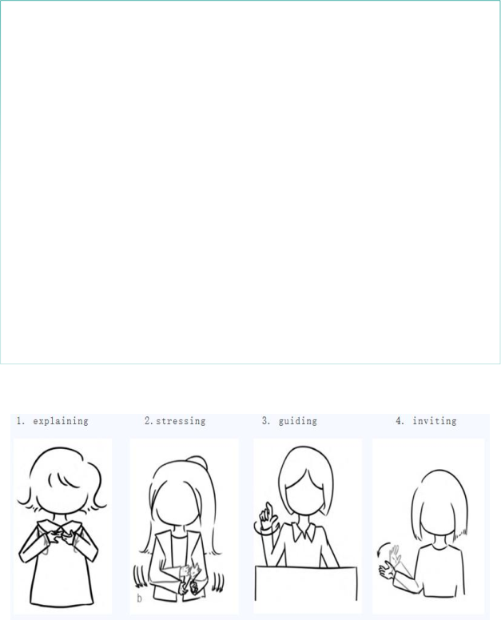

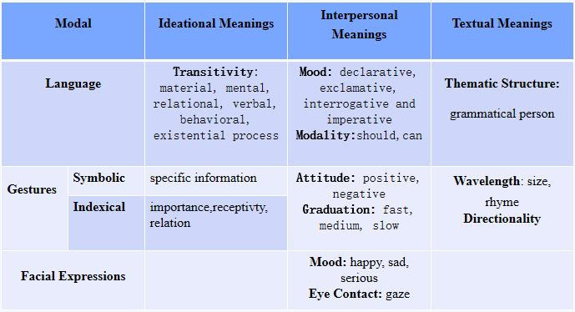



Introduction
Several studies indicate that teachers can improve the effectiveness of second or foreign language teaching when they use non-verbal symbols such as gestures and facial expressions
Research Questions
What gestures and facial expressions do teachers use to coordinate with  language to scaffold students’ discourse output?
Discussion 2--Facial Expressions
& ScaffoldingLanguage
Questioning or Modeling: seriousness+gaze
● Explaining: smile
(Jakonen & Evnitskaya, 2020). Moreover, the scaffolding language refers to discourses used
How teachers’ gestures and facial expressions and scaffolding language
Research Results (assumptions)
Teachers use the language modality the most frequently, with language scaffolding strategies including questioning, explanation, modeling, and feedback.
As for non-verbal modality, gesture is the most frequently used by teachers, combined with language functioning as explanation, emphasis, guidance and invitation.
Teachers have less variation in facial expressions, which usually is associated with explanation strategies to create a harmonious classroom atmosphere.
Conclusion (Assumptions)
by teachers to help students complete tasks in accordance with their zone of proximal development, including both verbal and non-verbal symbals (Tharp, Gallimore, 1988), which has been warmly discussed in the field of English language teaching. Taking the systemic functional multiodal discourse analysis as the analytical framework, this study explores how gestures, facial expressions and language work together to generate meaning, serving as
scaffolding. It is expected to provide implications for college English teachers on how to coordinate verbal and non-verbal resources to achieve effective classroom communication.
work together to gernerate meaning?
Research
Contexts
10 teachers in the comprehensive English course group of a university in China will be chosen as subjects
Research Methods & Analytical Framework
Research Method: qualitative analysis
Analytical Framework: Based on the theory of system-functional linguistics (Halliday, 1987), Lim (2017) proved the systemic functional multiodal discourse analysis framework,
● Videos (about 800mins) from subjects will be collected as the study’s data
Teachers are required to teach all in English and teaching content is related to textual explanation
Data
Anaysis
Corpus Processing: Screening the dialogue segments of teacher-student
interaction→Extracting the sequences of successful scaffolding
discourse→Using ELAN software to multimodal and multilevel annotation of
This poster shows the latest findings that how do college English
teachers coordinate verbal and non-verbal resources to achieve the effectiveness of classroom communication. Moreover, because gestures are second only to language in expressing connotative meanings (Muller, 2004), they are the most frequently used non-verbal modality, while non-verbal symbols such as facial expressions are easily overlooked. Finally, if teachers use gestures and facial expressions appropriately in the classroom, they achieve multimodal meaning coordination with language. Thus, they can successfully scaffold students, which is important for improving classroom efficiency.
elaborating teachers’ gestures from ideational, interpersonal and textual meanings. Based on teachers’ scaffolding strategies, gestures, and facial expressions in the
the framework, this study discusses the process of meaning coordination between language, video→Exporting the text format for data
gestures and facial expressions.
Date Analysis: the frequency counts of the 6 types of scaffolding strategies that
The multimodal discourse analytical framwork of teachers’ language, gestures and facial expressions in English language teaching
have been annotated→the frequency counts of gestures and facial expression
types→the analysis of meaning coordination between gestures and expressions
and scaffolding strategies based on the multimodal discourse analysis
framework.
Reference
Calor, S. M., Dekker, R., J.P.van Drie and Volman,M.L (2022). ‘Scaffolding small groups at the group level: Improving the scaffolding behavior of mathematics teachers during mathematical discussions’, Journal of the Learning Sciences, 3, pp. 369-407. DOI: 10.1080/10508406.2021.2024834
Dongying Li and Lian Zhang (2022). ‘Exploring teacher scaffolding in a CLIL-framed EFL intensive reading class: A classroom discourse analysis approach’, Language Teaching Research, 3, pp.333-360.https://doi.org/10.1177/1362168820903340
Jakonen,T., and Evnitskaya, N (2020). ‘Teacher smiles as an interactional and pedagogical resource in the classroom’, Journal of Pragmatics,163, pp. 18-31. https://doi.org/10.1016/j.pragma.2020.04.005
Lim, F.V (2017). ‘Analyzing the teachers’ use of gestures in the classroom: A systemic functional multimodal discourse analysis approach’, Social Semiotics, 1, pp.83-111. DOI: 10.1080/10350330.2017.1412168
Discussion 1--Gestures & Scaffolding
Language

Slide 2
Modality and Multimodal Learning
Modality: Linguistics--the ways language can express various relationships to reality or truth. Broadly speaking, modality refers to different channels or forms through which information is conveyed, including sounds, pictures, colors, actions. Language is just one of forms.(Huang Lihe, Zhang Delu,2019)
Multimodal Learning: teaching strategies and learning situations that involve multiple sensory systems simultaneously. Teachers can create materials for students with different learning styles such as auditory, visual, reading, and writing.

Slide 3
Scaffolding Language
The discourses used by teachers to help students complete tasks in accordance with their zone of proximal development, including both verbal and non-verbal symbols (Tharp, Gallimore, 1988)
Scaffolding Strategies: modeling, implicating, feeding back, instructing, questioning and explaining

Slide 4
Scaffolding Language
01 T:Why is it not easy for him to learn the language?
02 S: Because he couldn’t understand the serious book.
03 T: Because he didn’t have the...
04 S: Enough vocabulary.
05 T: Vocabulary and also...
06 S: Grammar.
07 T: Grammar. Okay, he didn’t know any grammar, and he had little vocabulary.

Slide 5
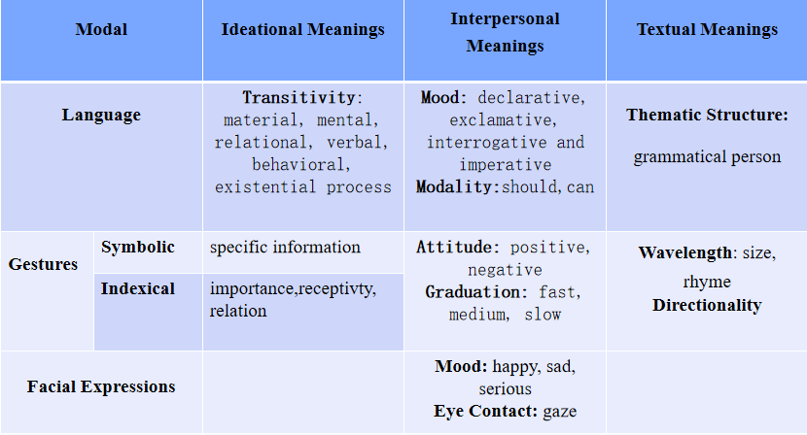
Multimodal Discourse Analysis Framework

Slide 6
Research Questions & Context
Research Questions:
1. What gestures and facial expressions do teachers use to coordinate with language to scaffold students’ discourse output?
2. How teachers’ gestures and facial expressions and scaffolding language work together to generate meaning?
Research Contexts:
10 teachers in the comprehensive English course group of a university in China will be chosen as subjects
Videos (about 800mins) from subjects will be collected as the study’s data
Teachers are required to teach all in English and teaching content is related to textual explanation

Slide 7
Data Analysis
Corpus Processing: Screening the dialogue segments of teacher-student interaction → Extracting the sequences of successful scaffolding discourse → Using ELAN software to multimodal and multilevel annotation of teachers’ scaffolding strategies, gestures, and facial expressions in the video → Exporting the text format for data
Date Analysis: the frequency counts of the 6 types of scaffolding strategies that have been annotated → the frequency counts of gestures and facial expression types → the analysis of meaning coordination between gestures and expressions and scaffolding strategies based on the multimodal discourse analysis framework.

Slide 8
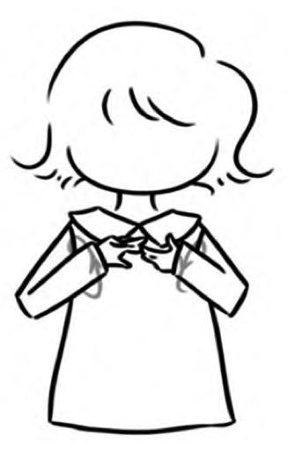

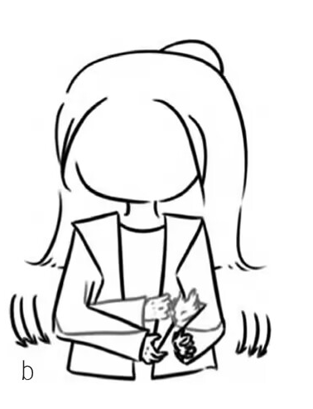

Gestures & Scaffolding Language
Explanation
Guidance
Emphasis
Invitation

Slide 9
Research Results (Assumptions)
Teachers use the language modality the most frequently, with language scaffolding strategies including questioning, explanation, modeling, and feedback.
As for non-verbal modality, gesture is the most frequently used by teachers, combined with language functioning as explanation, emphasis, guidance and invitation.
Teachers have less variation in facial expressions, which usually is associated with explanation strategies to create a harmonious classroom atmosphere.

Slide 10
Conclusion
This poster shows the latest findings that how do college English teachers coordinate verbal and non-verbal resources to achieve the effectiveness of classroom communication. Moreover, because gestures are second only to language in expressing connotative meanings (Muller, 2004), they are the most frequently used non-verbal modality, while non-verbal symbols such as facial expressions are easily overlooked. Finally, if teachers use gestures and facial expressions appropriately in the classroom, they achieve multimodal meaning coordination with language. Thus, they can successfully scaffold students, which is important for improving classroom efficiency.

Slide 11
References
Calor, S. M., Dekker, R., J. P. van Drie and Volman, M. L (2022). ‘Scaffolding small groups at the group level: Improving the scaffolding behavior of mathematics teachers during mathematical discussions’, Journal of the Learning Sciences, 3, pp. 369-407.
DOI: 10.1080/10508406.2021.2024834
Dongying Li and Lian Zhang (2022). ‘Exploring teacher scaffolding in a CLIL-framed EFL intensive reading class: A classroom discourse analysis approach’, Language Teaching Research,3,pp.333-360.
https://doi.org/10.1177/1362168820903340
Jakonen, T., and Evnitskaya, N (2020). ‘Teacher smiles as an interactional and pedagogical resource in the classroom’, Journal of Pragmatics,163, pp. 18-31. https://doi.org/10.1016/j.pragma.2020.04.005
Lim, F.V (2017). ‘Analyzing the teachers’ use of gestures in the classroom: A systemic functional multimodal discourse analysis approach’, Social Semiotics,1,pp.83-111.
DOI:10.1080/10350330.2017.1412168

Slide 12
Thanks for your attention！
Presenter: Yujie Wu

