Slide 1
Network Address Translation (NAT)

Slide 2
IPv4 Private Address Space
IPv4 address space is not big enough to uniquely address all the devices that must be connected to the Internet.
Network private addresses are described in RFC 1918 and are to designed to be used within an organization or site only.
Private addresses are not routed by Internet routers while public addresses are.
Private addresses can alleviate IPv4 scarcity, but because they aren’t routed by Internet devices, they first need to be translated.
NAT is process used to perform such translation.

Slide 3
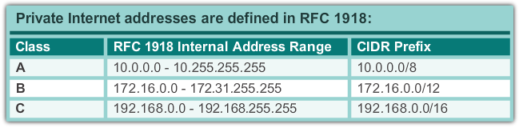
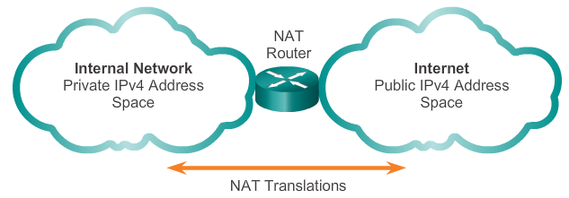
IPv4 Private Address Space

Slide 4
What is NAT?
NAT is a process used to translate network addresses.
NAT’s primary use is to conserve public IPv4 addresses.
NAT is usually implemented at border network devices, such as firewalls or routers.
NAT allows the networks to use private addresses internally, only translating to public addresses when needed.
Devices within the organization can be assigned private addresses and operate with locally unique addresses.
When traffic must be sent or received to or from other organizations or the Internet, the border router translates the addresses to a public and globally unique address.

Slide 5
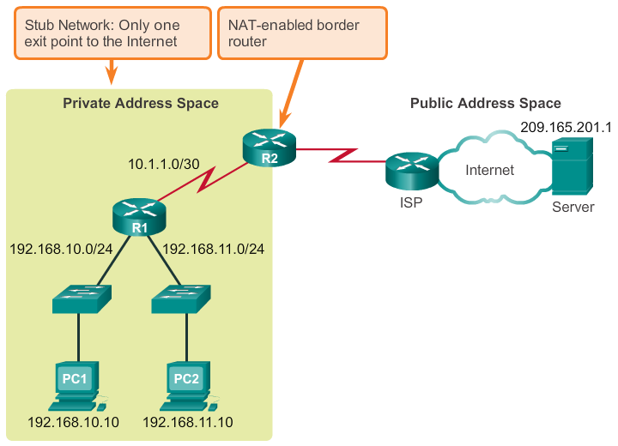
What is NAT? (cont.)

Slide 6
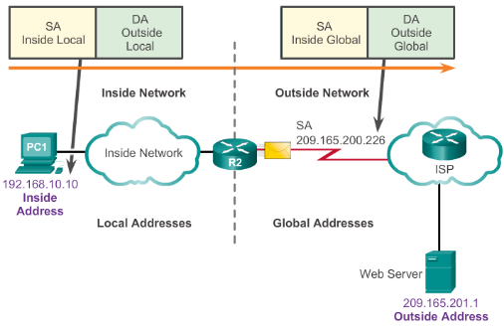
NAT Terminology
Inside network is the set of devices using private addresses
Outside network refers to all other networks
NAT includes four types of addresses:
  Inside local address
  Inside global address
  Outside local address
  Outside global address

Slide 7
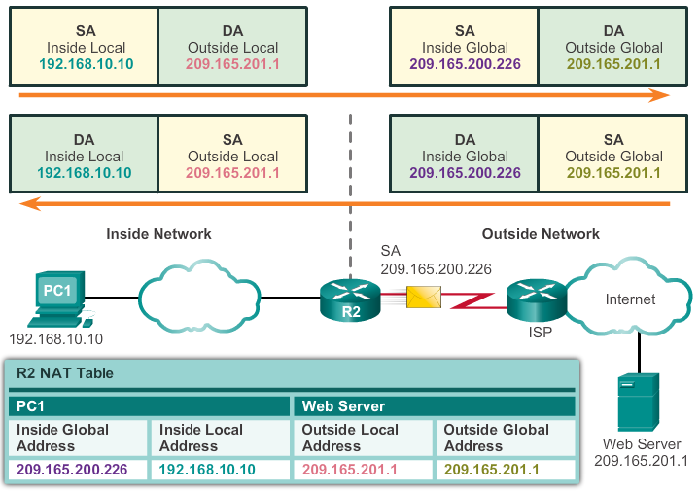
NAT Terminology (cont.)

Slide 8
Types of NAT
Static NAT
Static NAT uses a one-to-one mapping of local and global addresses.
These mappings are configured by the network administrator and remain constant.
Static NAT is particularly useful when servers hosted in the inside network must be accessible from the outside network.
A network administrator can SSH to a server in the inside network by pointing the SSH client to the proper inside global address.

Slide 9
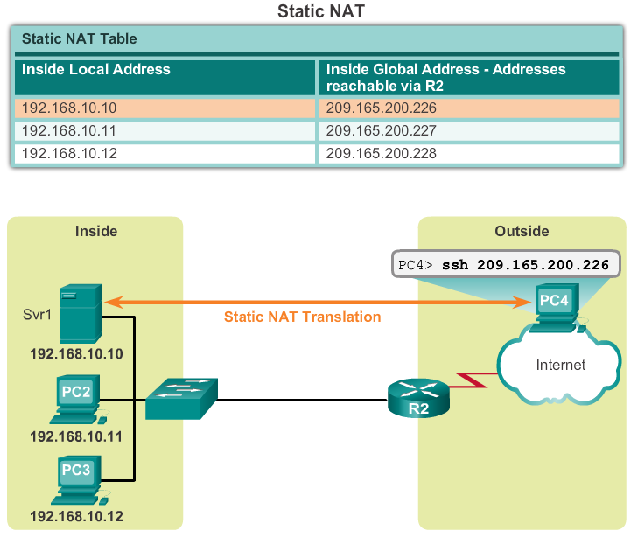
Types of NAT
Static NAT (cont.)

Slide 10
Dynamic NAT
Dynamic NAT uses a pool of public addresses and assigns them on a first-come, first-served basis.
When an inside device requests access to an outside network, dynamic NAT assigns an available public IPv4 address from the pool.
Dynamic NAT requires that enough public addresses are available to satisfy the total number of simultaneous user sessions.

Slide 11
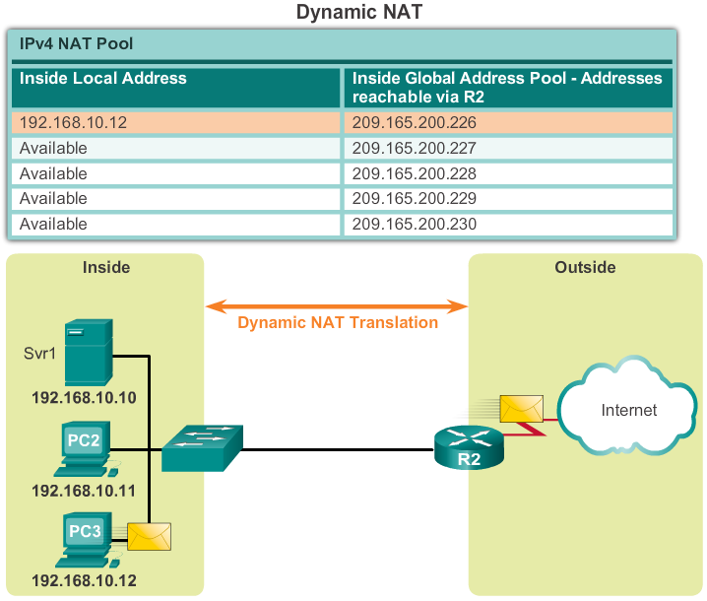
Types of NAT
Dynamic NAT (cont.)

Slide 12
Port Address Translation
Port Address Translation (PAT) maps multiple private IPv4 addresses to a single public IPv4 address or a few addresses.
PAT uses the pair source port and source IP address to keep track of what traffic belongs to what internal client.
PAT is also known as NAT overload.
By also using the port number, PAT forwards the response packets to the correct internal device.
The PAT process also validates that the incoming packets were requested, thus adding a degree of security to the session.

Slide 13
Comparing NAT and PAT
NAT translates IPv4 addresses on a 1:1 basis between private IPv4 addresses and public IPv4 addresses.
PAT modifies both the address and the port number.
NAT forwards incoming packets to their inside destination by referring to the incoming source IPv4 address provided by the host on the public network.
With PAT, there is generally only one or a very few publicly exposed IPv4 addresses.
PAT is able to translate protocols that do not use port numbers, such as ICMP; each one of these protocols is supported differently by PAT.

Slide 14
Benefits of NAT
Conserves the legally registered addressing scheme
Increases the flexibility of connections to the public network
Provides consistency for internal network addressing schemes
Provides network security

Slide 15
Disadvantages of NAT
Performance is degraded
End-to-end functionality is degraded
End-to-end IP traceability is lost
Tunneling is more complicated
Initiating TCP connections can be disrupted

Slide 16
Configuring NAT

Slide 17
Configuring Static NAT
There are two basic tasks to perform when configuring static NAT translations:
Create the mapping between the inside local and outside local addresses.
Define which interfaces belong to the inside network and which belong to the outside network.

Slide 18
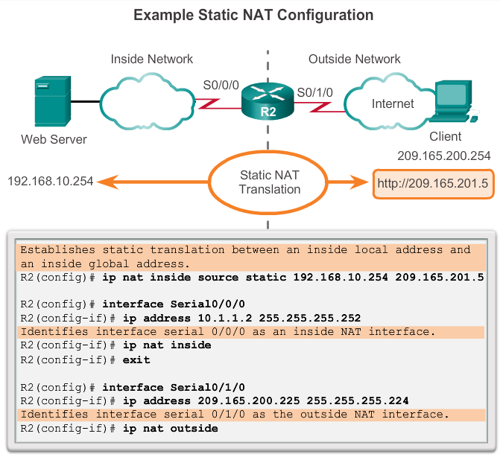
Configuring Static NAT

Slide 19
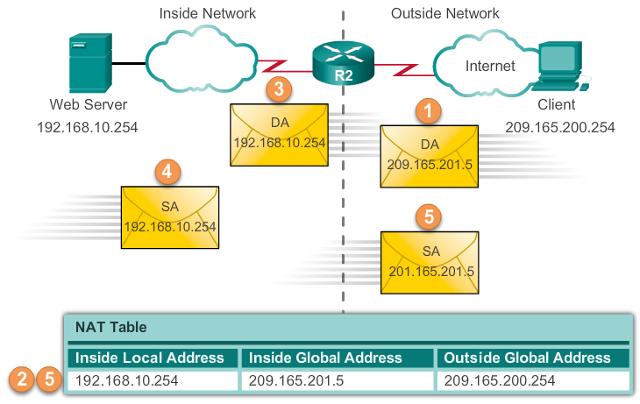
Analyzing Static NAT

Slide 20
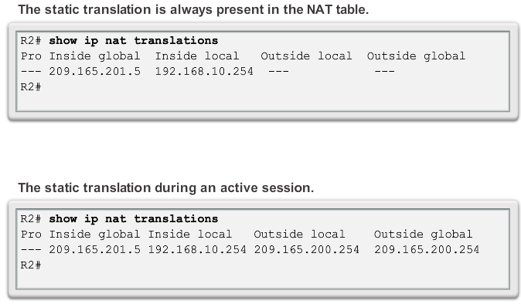
Verifying Static NAT

Slide 21
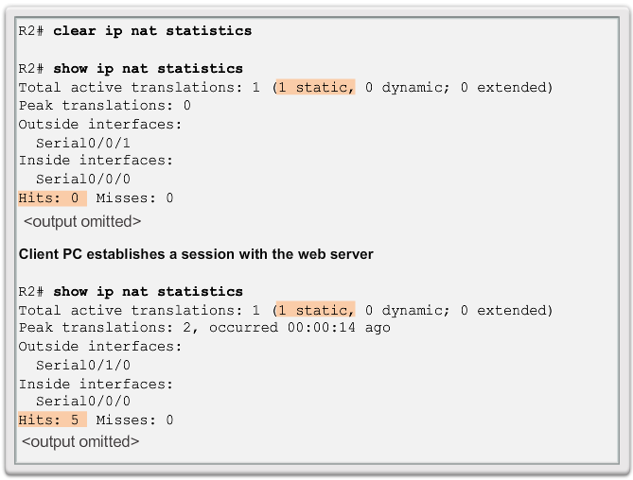
Verifying Static NAT (cont.)

Slide 22
Dynamic NAT Operation
The pool of public IPv4 addresses (inside global address pool) is available to any device on the inside network on a first-come, first-served basis.
With dynamic NAT, a single inside address is translated to a single outside address.
The pool must be large enough to accommodate all inside devices.
A device is unable to communicate to any external networks if no addresses are available in the pool.

Slide 23
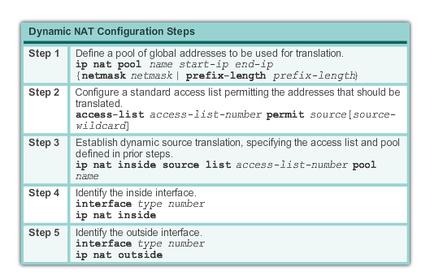
Configuring Dynamic NAT

Slide 24
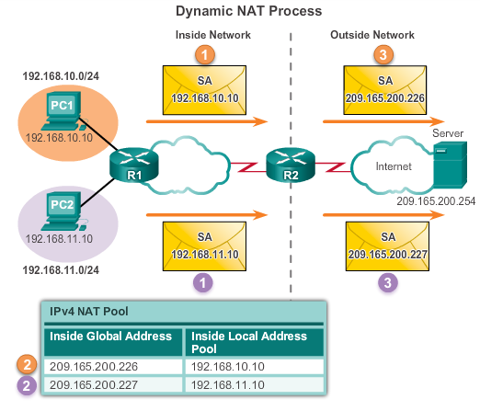
Analyzing Dynamic NAT

Slide 25
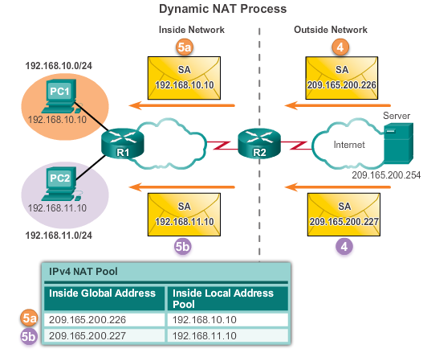
Analyzing Dynamic NAT

Slide 26
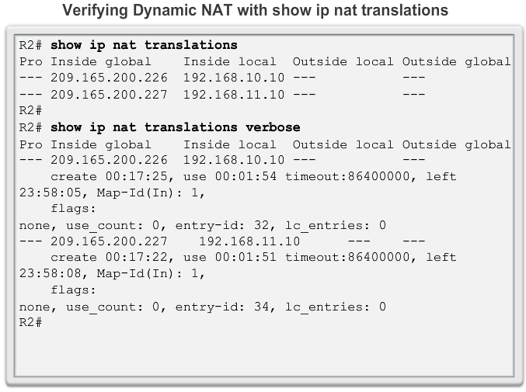
Verifying Dynamic NAT

Slide 27
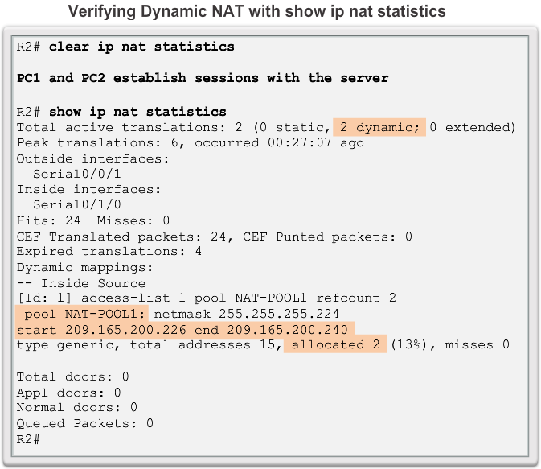
Verifying Dynamic NAT

Slide 28
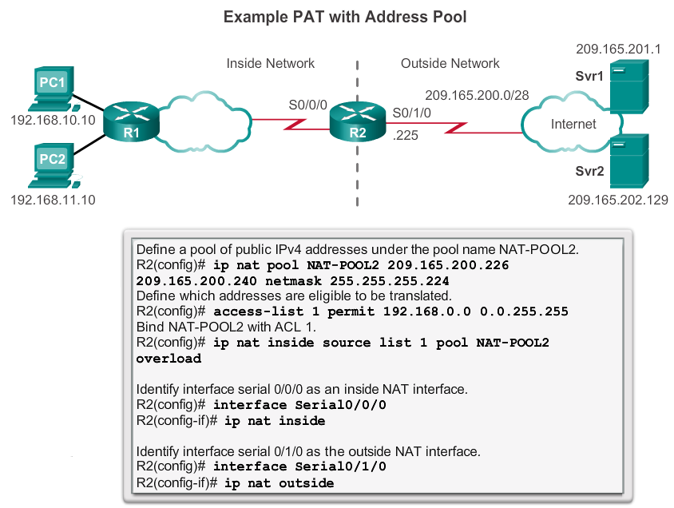
Configuring PAT: Address Pool

Slide 29
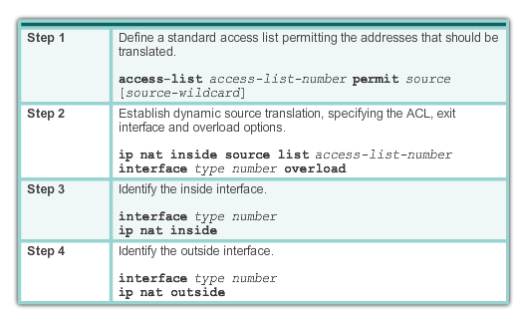
Configuring PAT: Single Address

Slide 30
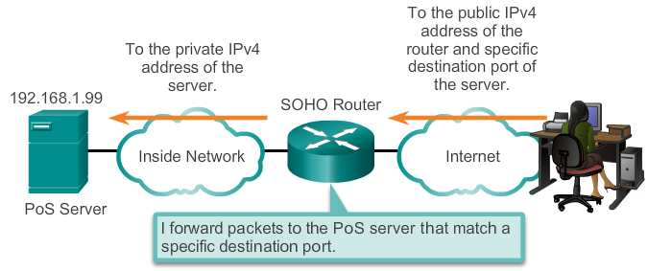
Port Forwarding
Port forwarding is the act of forwarding a network port from one network node to another.
A packet sent to the public IP address and port of a router can be forwarded to a private IP address and port in inside network.
Port forwarding is helpful in situations where servers have private addresses, not reachable from the outside networks.

Slide 31
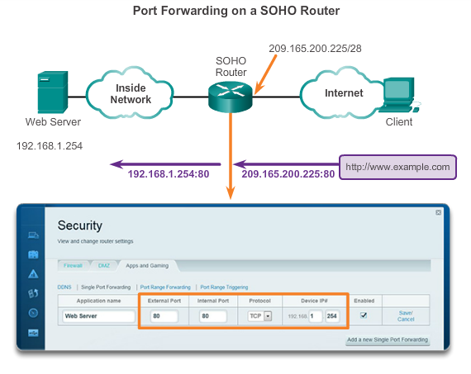
SOHO Example

Slide 32
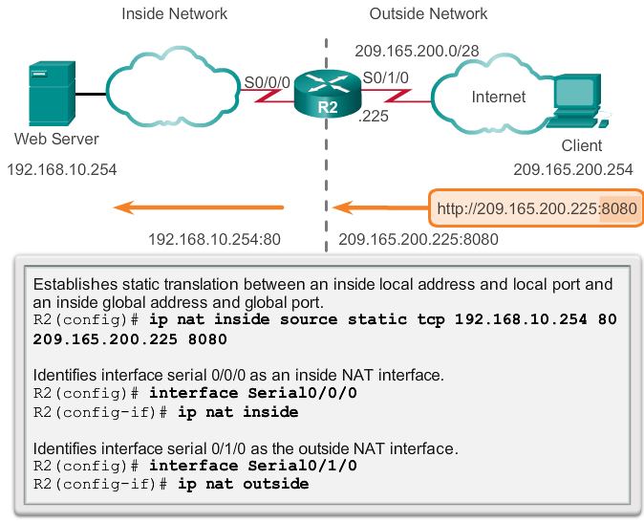
Configuring Port Forwarding with IOS
In IOS, Port forwarding is essentially a static NAT translation with a specified TCP or UDP port number.

Slide 33
Chapter 11: Summary
This chapter has outlined:
How NAT is used to help alleviate the depletion of the IPv4 address space.
NAT conserves public address space and saves considerable administrative overhead in managing adds, moves, and changes.
NAT for IPv4, including:
  NAT characteristics, terminology, and general operations
  Different types of NAT, including static NAT, dynamic NAT, and NAT with overloading
  Benefits and disadvantages of NAT
The configuration, verification, and analysis of static NAT, dynamic NAT, and NAT with overloading.

