Slide 1
LCHS4006 Psychology in Health and Social Care
Individual Presentation – Working with children in a social care setting
Chosen age group: 7-11 years
Student Name: Suma Begum
Student ID: 213484

Slide 2
Introduction
A lead volunteer who works in any women's refugee camp plays a vital role to support the children and create a learning environment.
It is also a key role to spend time with the children when their parents are out of the home.
The volunteers perform Creche activities that help to keep the children busy and help to educate them with effective approaches.
The presentation has been developed to present activities for 7-11 years old children in the refugee camp.
Notes:
A lead volunteer who works in any women's refugee camp plays a vital role to support the children and create a learning environment. It is also a key role to spend time with the children when their parents are out of the home. The volunteers perform Crèche activities that help to keep the children busy and help to educate them with effective approaches. The presentation has been developed to present activities for 7-11 years old children in the refugee camp.

Slide 3
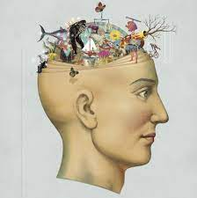
psychological theory
From the perspective of a women's refugee centre, psychological theories have a lot of influence on understanding the attitude
It impacts the thoughts of the children and practising relevant approaches to keep them in a learning environment (Williams and Conroy, 2022).
I will design the creche activities based on Vygotsky's Sociocultural Theory.
Notes:
From the perspective of a women's refugee centre, psychological theories have a lot of influence on understanding the attitude and thoughts of the children and practising relevant approaches to keep them in a learning environment (Williams and Conroy, 2022). I will design the creche activities based on Vygotsky's Sociocultural Theory.

Slide 4
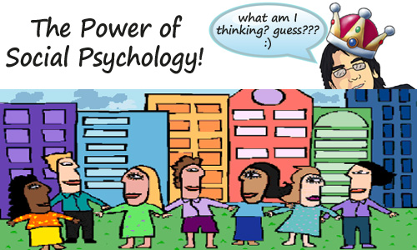
Vygotsky's Sociocultural Theory
Vygotsky's Sociocultural Theory has a lot of significance to influence the thoughts emotions and behaviours (Corcoran and Byrne, 2016).
Since, in a women's refugee centre, there are children from different cultures and societies.
So the variations have a lot of impacts on the learning process of the children.
Vygotsky's Sociocultural Theory says that parents, carers, peers, and the culture as a whole are responsible for the development of higher-order functions.
Notes:
Vygotsky's Sociocultural Theory is a learner centred- psychological theory where the teachers or supporters focus on the individual's skill and ability. The theory is also effective to identify the strengths and weaknesses of the learners properly. Vygotsky's Sociocultural Theory has a lot of significance to influence the thoughts emotions and behaviours (Corcoran and Byrne, 2016). Since, in a women's refugee centre, there are children from different cultures and societies. So the variations have a lot of impacts on the learning process of the children. Vygotsky's Sociocultural Theory says that parents, carers, peers, and the culture as a whole are responsible for the development of higher-order functions.

Slide 5
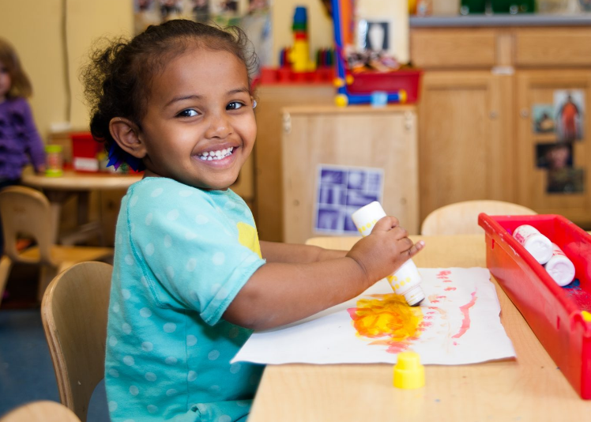
Two CrEche activities for 7 – 11 years
Drawing and painting: The volunteer can let the children run wild with paints and drawing tools.
Music, dancing, and singing: Singing and music largely help to develop the language of the children and improve their basic literacy skills (O’loughlin and O’loughlin, 2016).
Notes:
As a lead volunteer of the women's refugee centre, the staff has different Crèche activities to perform when the mothers are out attending a weekly support session. Here are two activities for children who are from 7 to 11.
Drawing and painting: The volunteer can let the children run wild with paints and drawing tools. This will allow the children to explore and experience their personal world. This also can introduce the children to different colours which is important for pre-writing skills (Evans and Kosec, 2012). The activity can help to keep the children calm and busy when their mom or parents are not available at home.
Music, dancing, and singing: Singing and music largely help to develop the language of the children and improve their basic literacy skills (O’loughlin and O’loughlin, 2016). At the same time, dancing can develop their strengths and ensure flexibility in the house. It also influences the children to live with a lot of freedom and without any cooperation of others. So the activity also can be effective for the volunteer for children who are from 7 to 11 years old.

Slide 6
Link With the theory
All the mentioned Crèche activities have a direct link with Vygotsky's Sociocultural Theory where the children are influenced by others when they draw and paint some specific and attractive pictures (Shuayb and Crul, 2020).
This is also influential for others to sing, dance and listen to the music of different cultures and languages.
So the theory is relevant to the activities in the context of the study.
Notes:
All the mentioned Crèche activities have a direct link with a social psychological theory where the children are influenced by others when they draw and paint some specific and attractive pictures (Shuayb and Crul, 2020). This is also influential for others to sing, dance and listen to the music of different cultures and languages. So the theory is relevant to the activities in the context of the study.

Slide 7
Conclusion
A lead volunteer of a refugee or social care centre plays different roles.
It is also an important role to spend time and perform Crèche activities with children of different ages.
This helps to develop the mental ability and ensure a learning environment in the care centre.
Notes:
A lead volunteer of a refugee or social care centre plays different roles. It is also an important role to spend time and perform Crèche activities with children of different ages. This helps to develop the mental ability and ensure a learning environment in the care centre.

Slide 8
References
Crawford, M. (2013). Social Pedagogy and Working with Children and Young People: Where Care and Education Meet. Australian Social Work, 66(3), pp.418–421. doi:https://doi.org/10.1080/0312407x.2013.809676.
Corcoran, M. and Byrne, M. (2016). Evaluating a primary care psychology service in Ireland: a survey of stakeholders and psychologists. Health & Social Care in the Community, 25(3), pp.1080–1089. doi:https://doi.org/10.1111/hsc.12410.
O’loughlin, M. and O’loughlin, S. (2016). Social work with children and families. Los Angeles: Learning Matters.
Shuayb, M. and Crul, M. (2020). Refuge 36 (2) Special Issue: Refugee Children, Status, and Educational Attainment: A Comparative Lens. Refuge: Canada’s Journal on Refugees, 36(2), pp.1–81. doi:https://doi.org/10.25071/1920-7336.40843.
Williams, S. and Conroy, D. (2022). A Student’s Guide to Placements in Health and Social Care Settings. Critical Publishing.

