Slide 1
HPHI5903: Cinema and War
Week 1: Key terms and Concepts

Slide 2
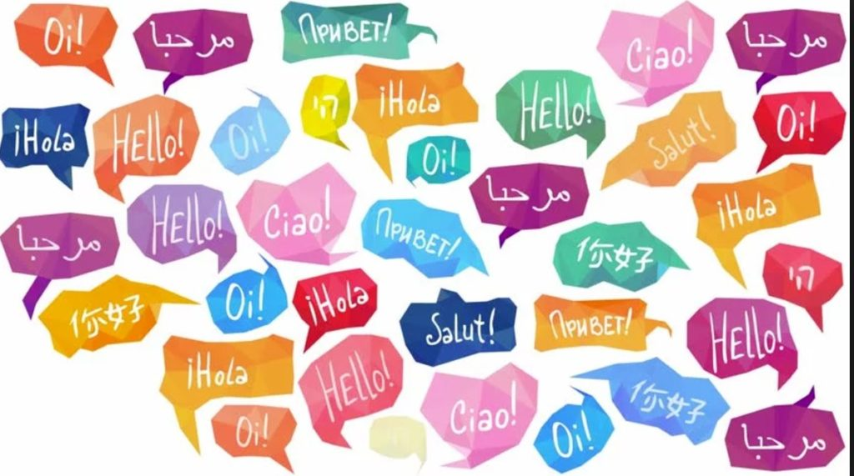
Lecturer : Robert Long

Slide 3
Films?
Can we all agree on ONE film we can all see / we have all seen – as a point of reference?
[preferably one that has claims to be historically accurate/factual?]

Slide 4
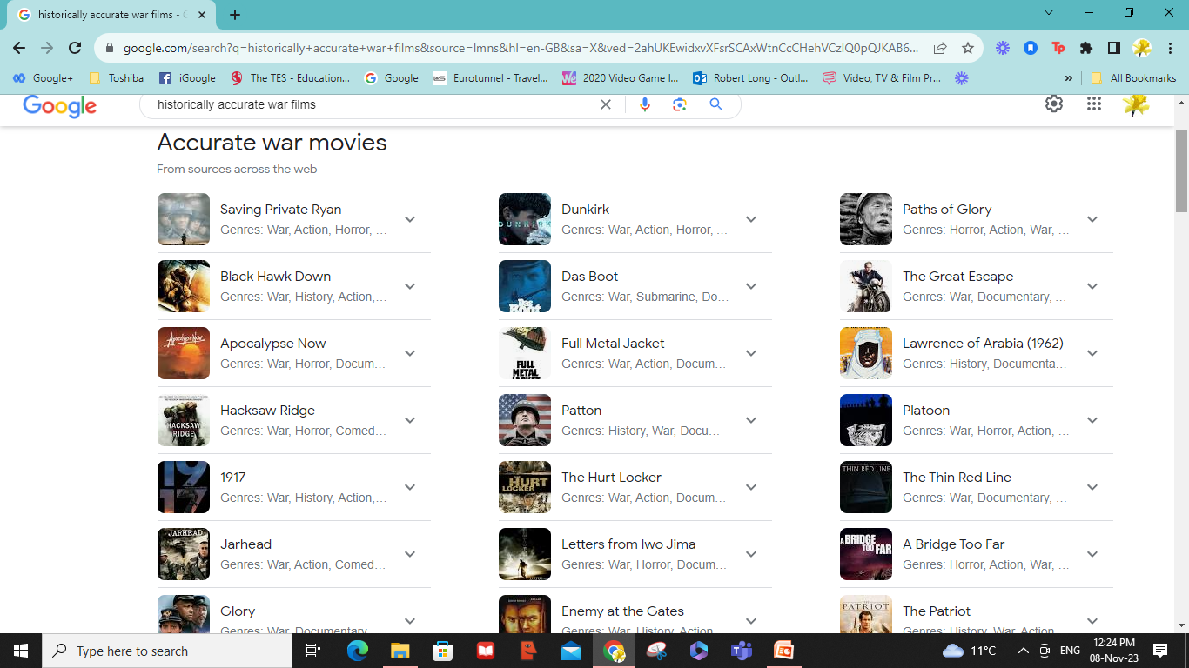

Slide 5
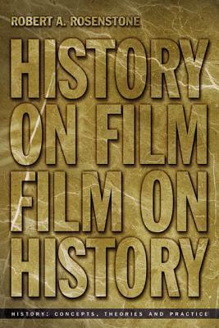
“Each day it becomes clearer to even the most academic of historians that the visual media are the chief conveyor of public history in our culture”
Rosenstone, Robert A. History on Film / Film on History. Routledge. Oxon. 2013. (P.15)

Slide 6
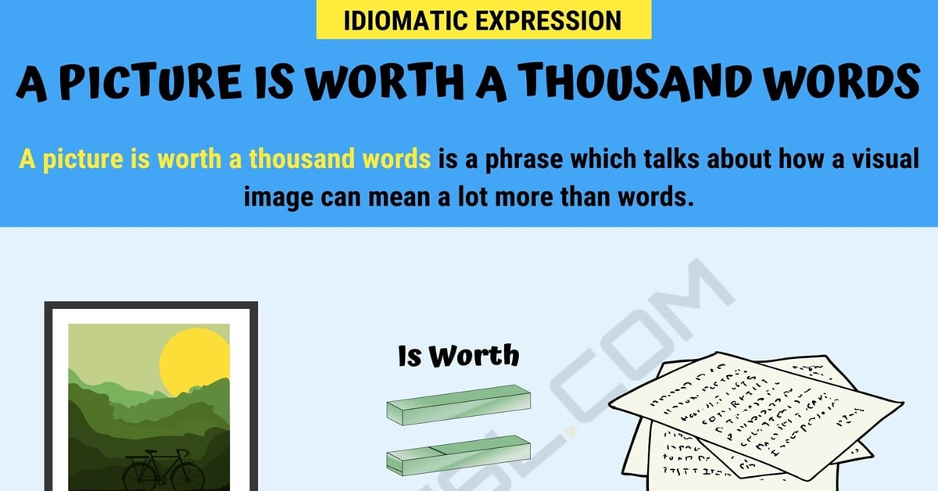
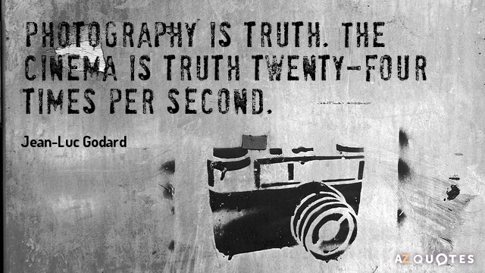

Slide 7

AIMS
To explore the history of cinema and the manner in which war has been represented in films

Slide 8
LEARNING OUTCOMES
Analyse films from different periods and which depict different historical conflicts
Discuss the problems and potentialities of using film as a media to understand, represent, and interpret the past
Understand aspects of film theory and scholarly literature on the techniques used by filmmakers to depict the past

Slide 9
Assessment 1:
Critical Analysis: 1,500 words (30%)
Assessment 2:
Essay: 3,500 words (70%)

Slide 10
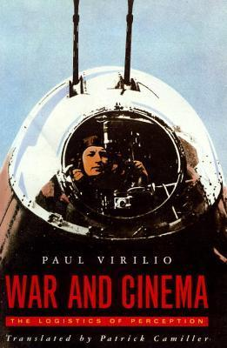
“ War can never break free from the magical spectacle because its very purpose is to produce that spectacle ”
Virilio, Paul. War and Cinema. Verso. London. 1984. P 5.

Slide 11
Cited in ‘Are You Talking To Me?: A Life Through Movies. Walsh, John. HarperCollins, 2003.Pp.9
JG Ballard, speculating about Hollywood’s influence on American attitudes to war…
“ Any dream that so endures…must draw its strength from the deepest survival instincts. The potent spectacle of bright light playing against a high wall taps into something hardwired in our brains – memories, perhaps, of the first dawn.”

Slide 12
135 years of cinema
1888
2023
“From the sychronized camera / machine-guns on the biplanes of World War One to the laser satellites of Star Wars, the technologies of cinema and warfare have developed a fatal interdependence”

Slide 13
Two ‘strands’ of study…
The symbiotic nature of war and cinema
(i.e. the ‘effect’ cinema had on how war was fought)
How war is represented in cinema

Slide 14
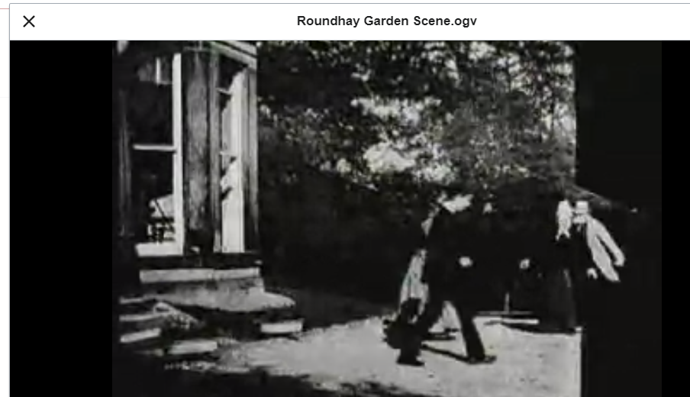
Roundhay Garden Scene is a short silent motion picture filmed by French inventor Louis Le Prince at Oakwood Grange in Roundhay, Leeds, in northern England on 14 October 1888

Slide 15
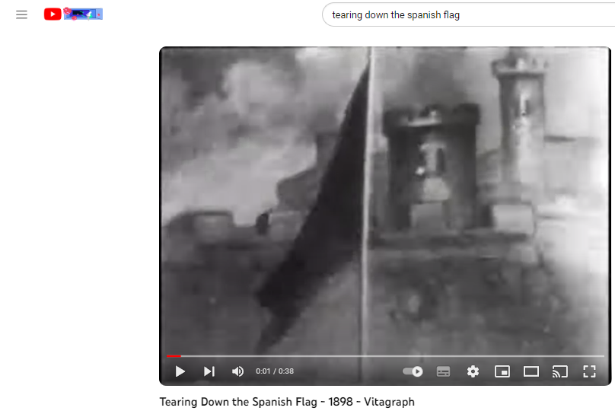
Tearing Down the Spanish Flag (1898)
R: J. Stuart Blackton. K: Albert E. Smith. P: Vitagraph Company of America. USA 1898
Filming Locations: Brooklyn, New York City

Slide 16
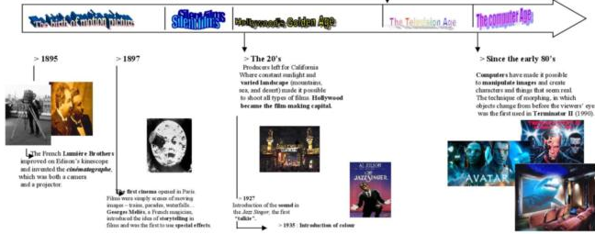

Slide 17
“The film was simply a close-up of Blackton’s hands pulling down a Spanish flag and replacing it with the American standard.
That was our very first dramatic picture and it is surprising how much dramatic effect it created… the people went wild.'”
https://traumundexzess.com/2013/08/29/title-16344623/

Slide 18
You can begin to think critically
…the problems and potentialities of using film as a media to understand, represent, and interpret the past

Slide 19
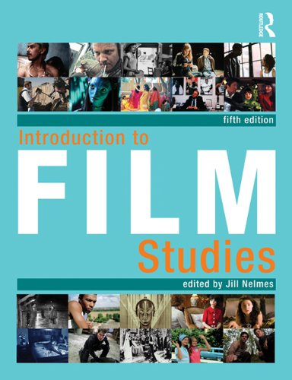
KEY CONCEPTS in FILM STUDIES

Slide 20
Institution : who controls the film?
Ideology: what ideas are being transmitted?
Narrative: What stories are being told using which characters...
Representation: Who/what/where/how/?
Language: How are technical and symbolic codes being manipulated for effect on…
Audiences: consider the ‘effect’ on audiences and who they are.

Slide 21

Institution

Slide 22
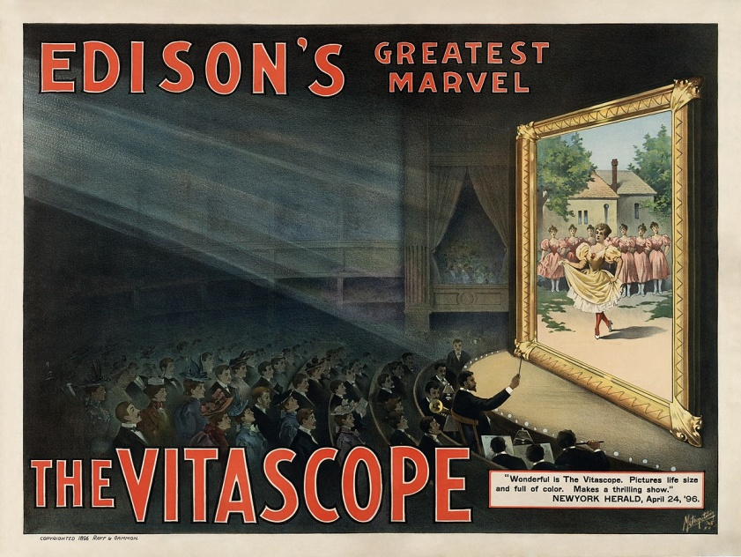
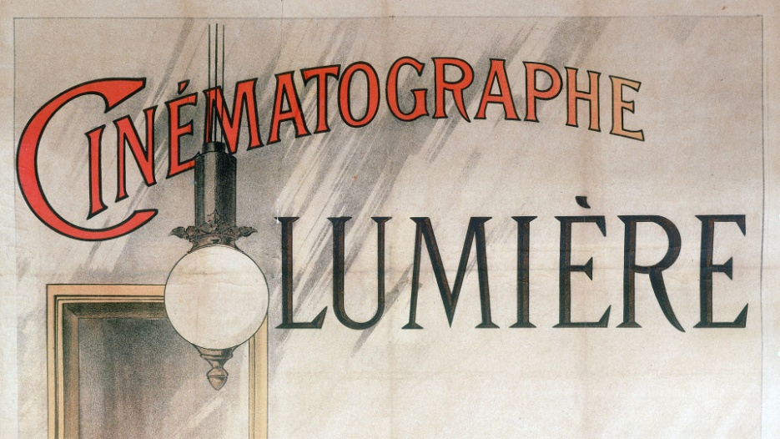
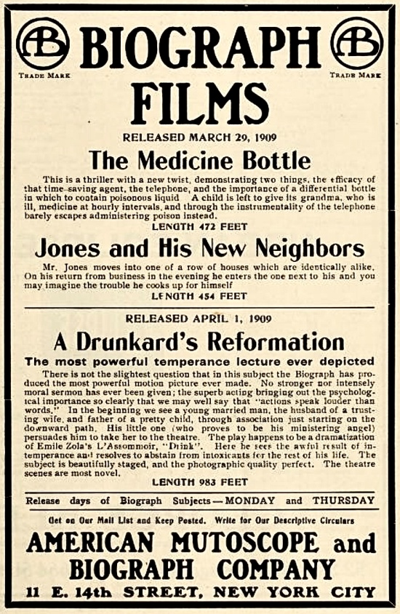
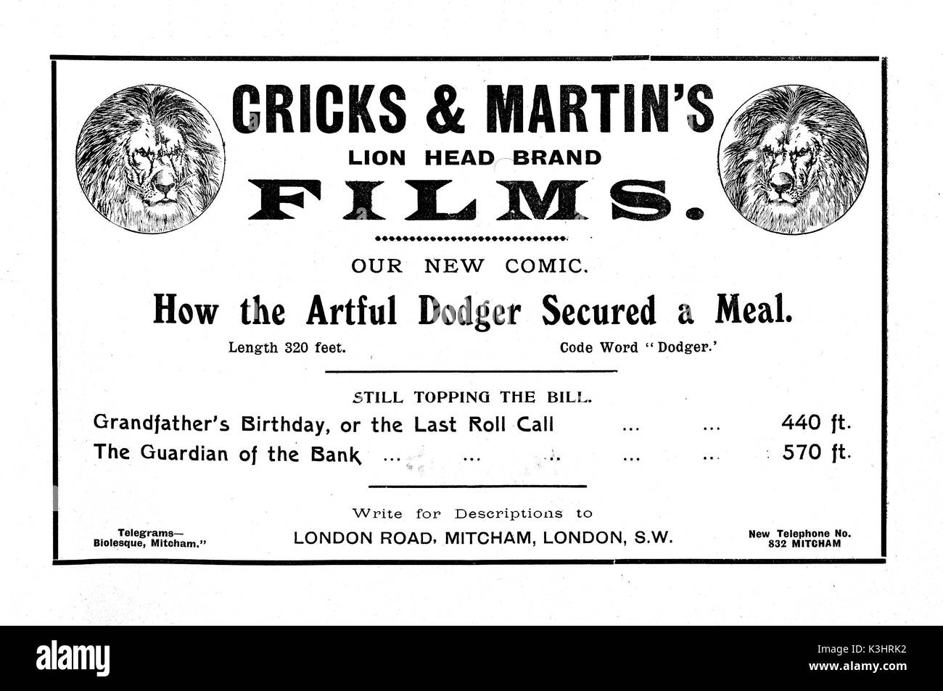
Institution : who controls the film?

Slide 24
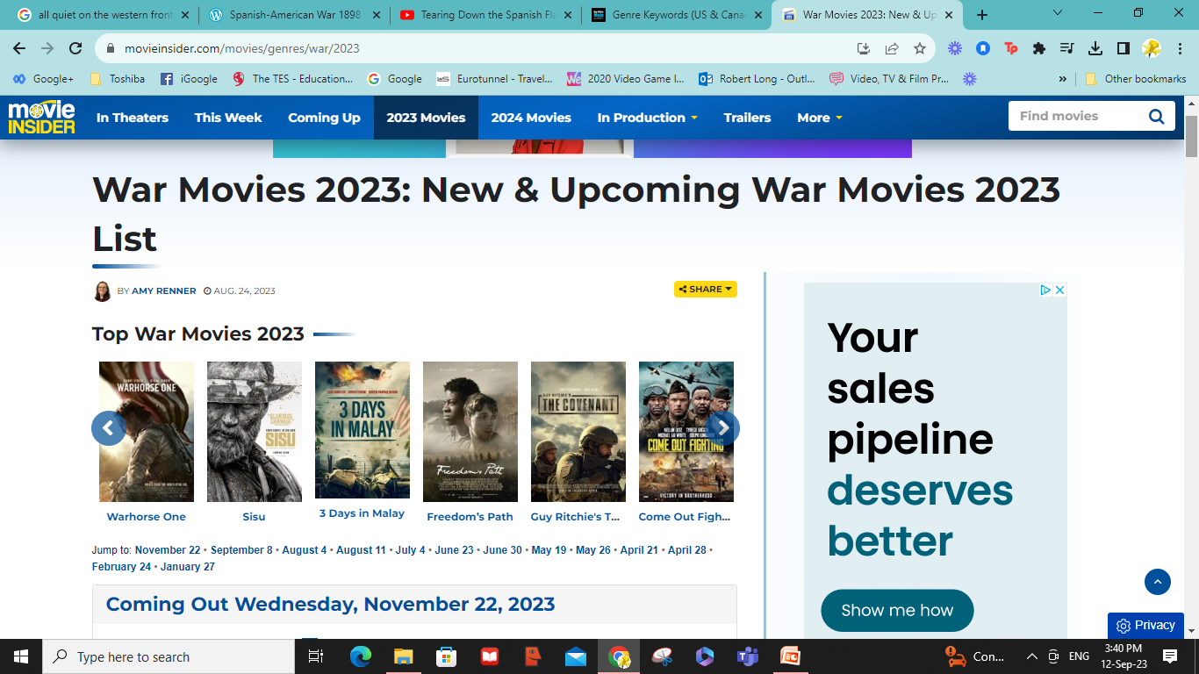

Slide 25
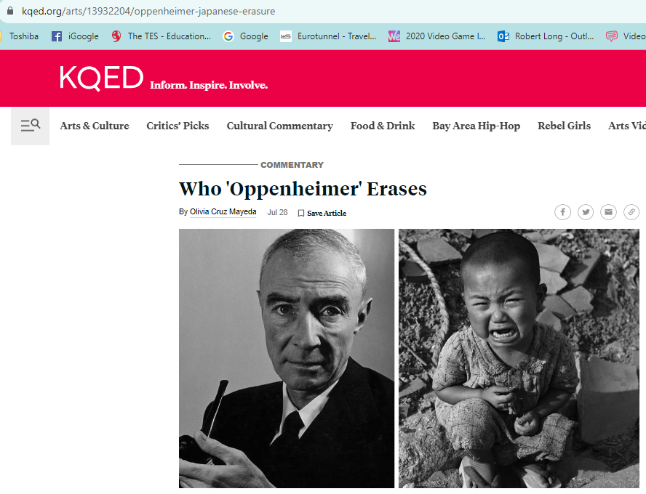
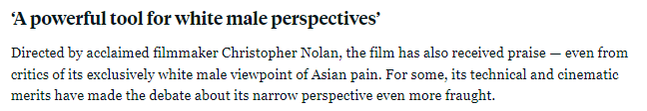

Slide 26
Ideology: what ideas are being transmitted?

Slide 27
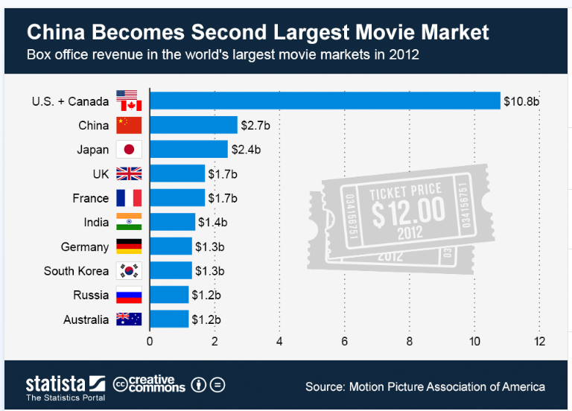


Slide 28

Global Audiences:
US dominance, US stories

Slide 29
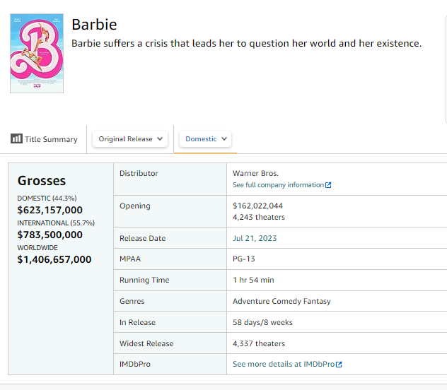

Slide 30
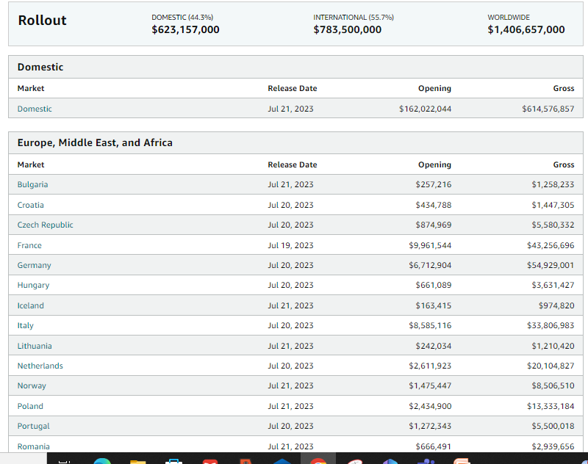

Slide 31
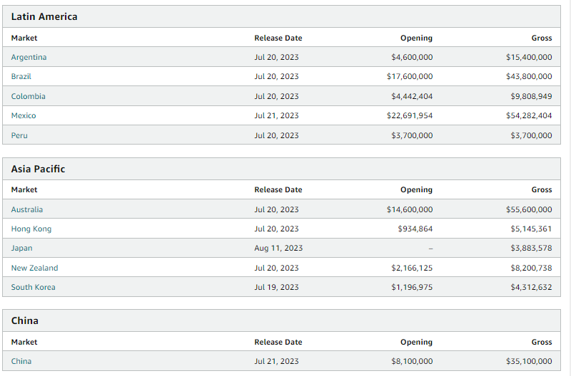

Slide 32
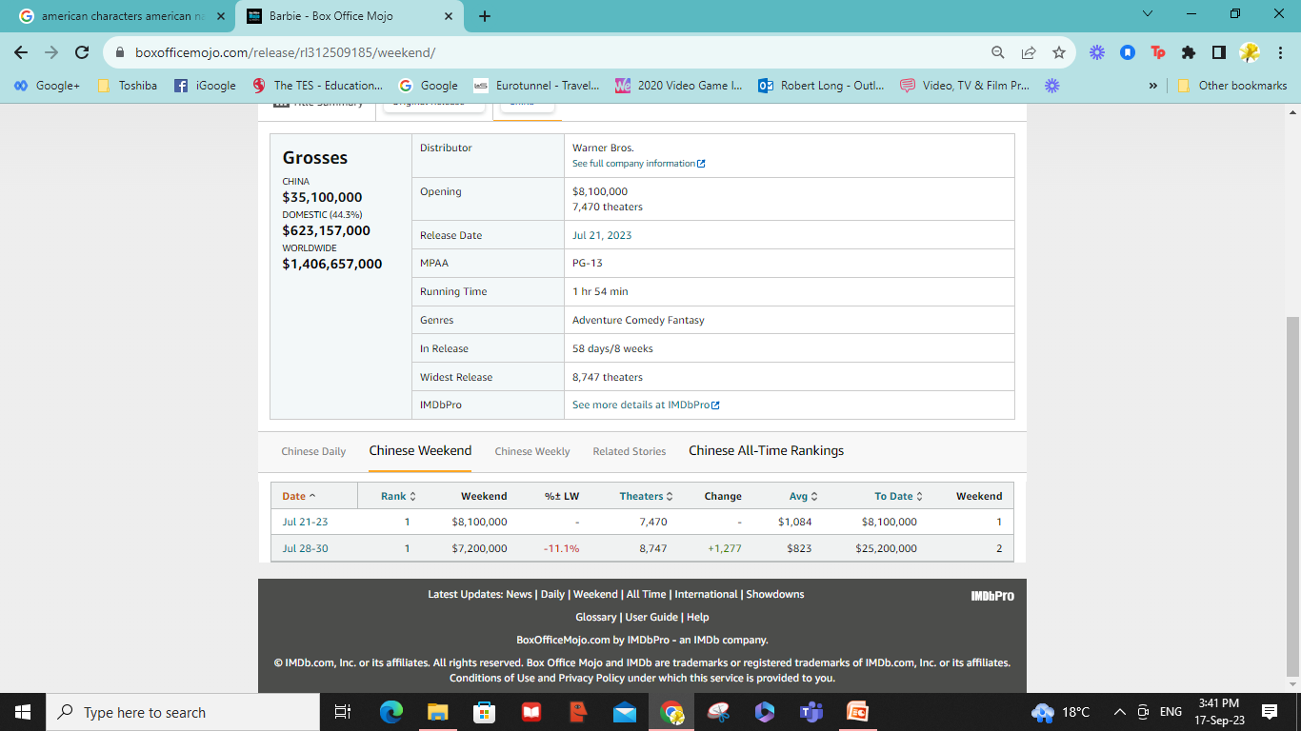

Slide 33
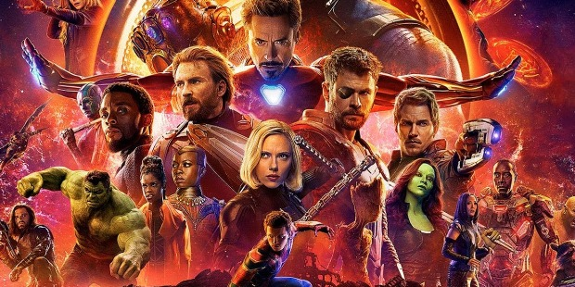
Decades of US cinema dominating global viewing

Slide 34
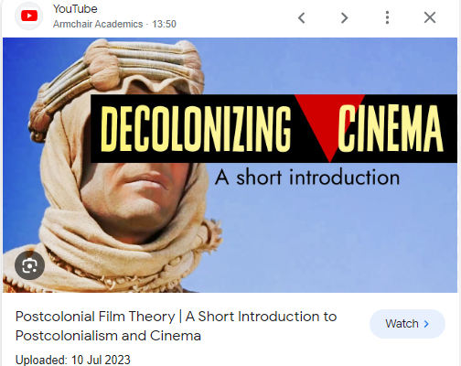
Post-colonial cinema
https://www.youtube.com/watch?app=desktop&v=ckA-rENK1Yg

Slide 35
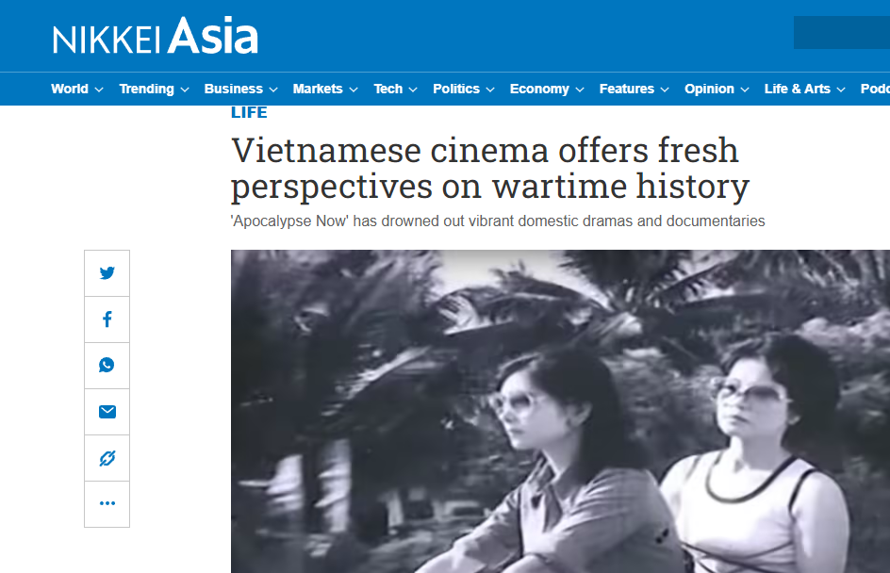
The Vietnam War

Slide 36

Audiences: consider the ‘effect’ on audiences and who they are.

Slide 37
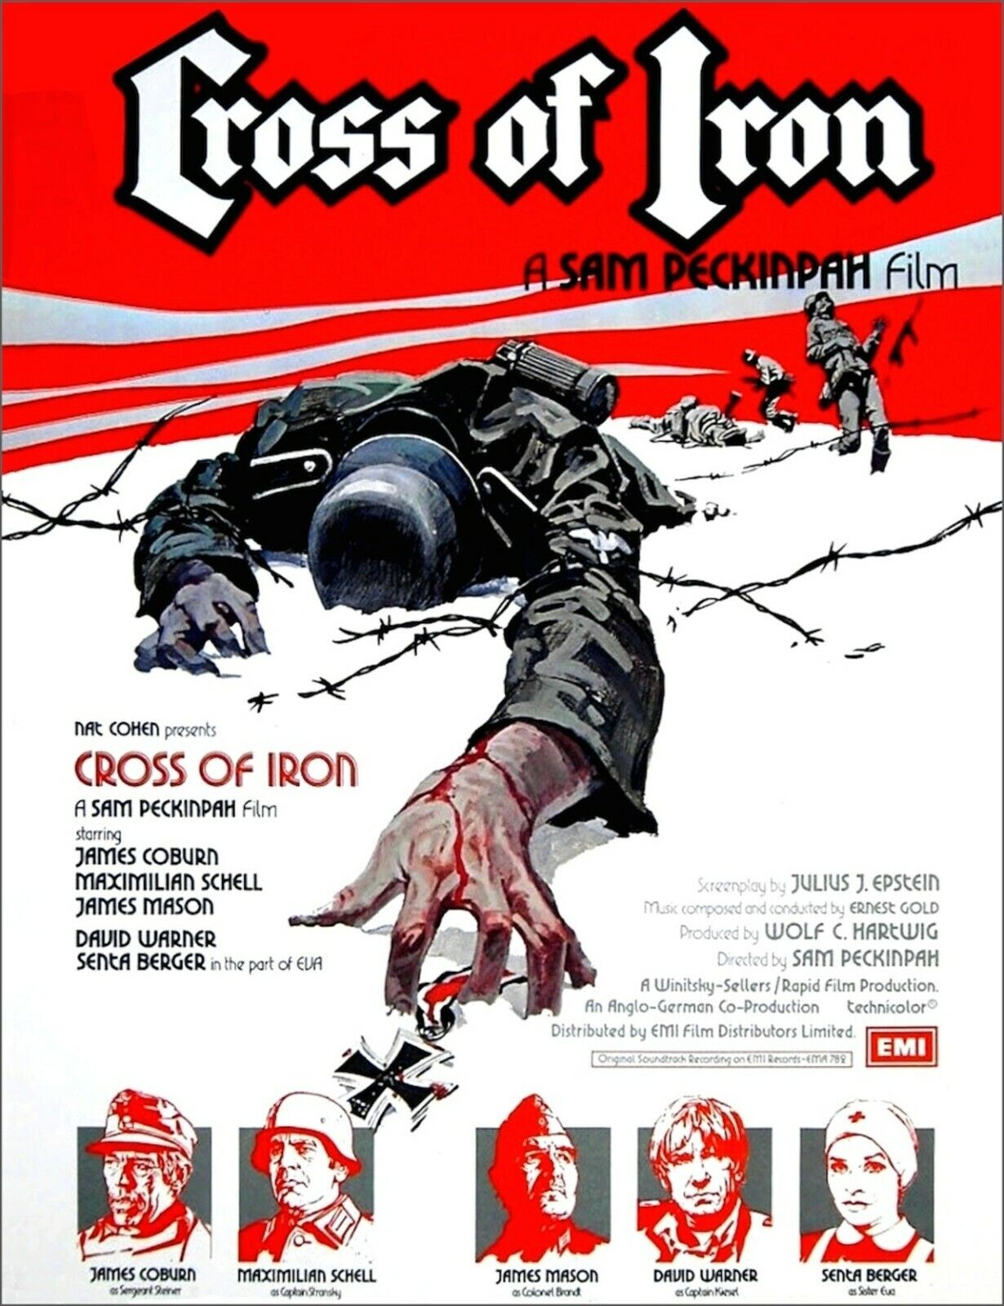
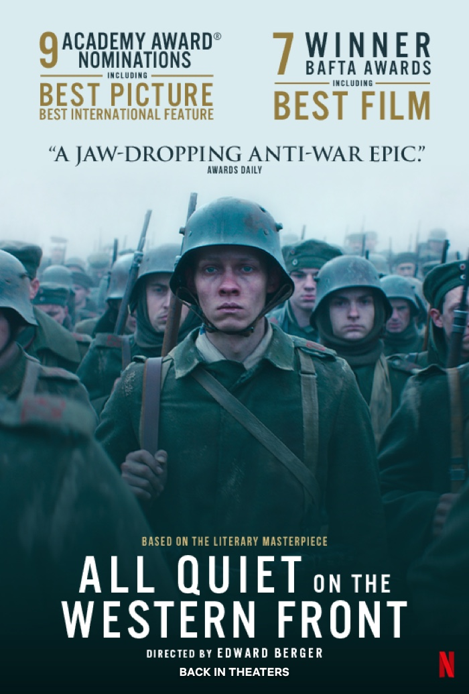
Narrative: What stories are being told using which characters...

Slide 38
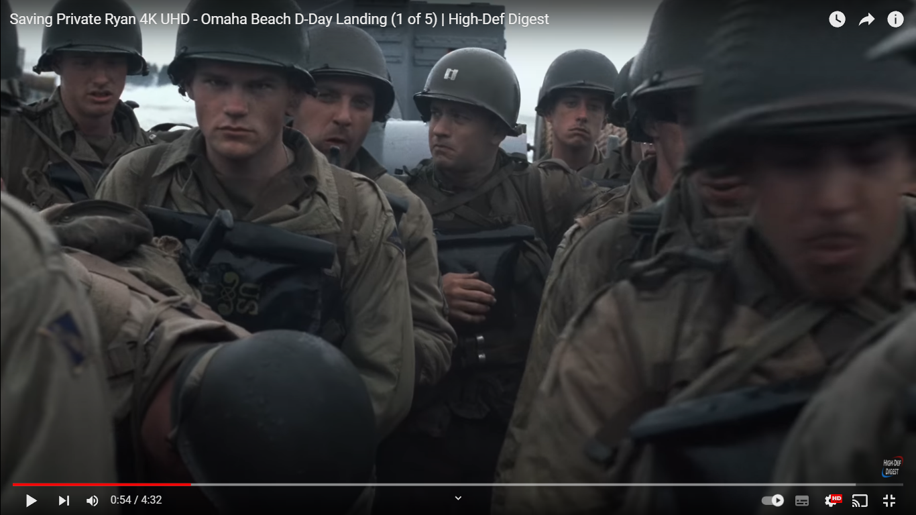
Representation: Who/what/where/how/?

Slide 39
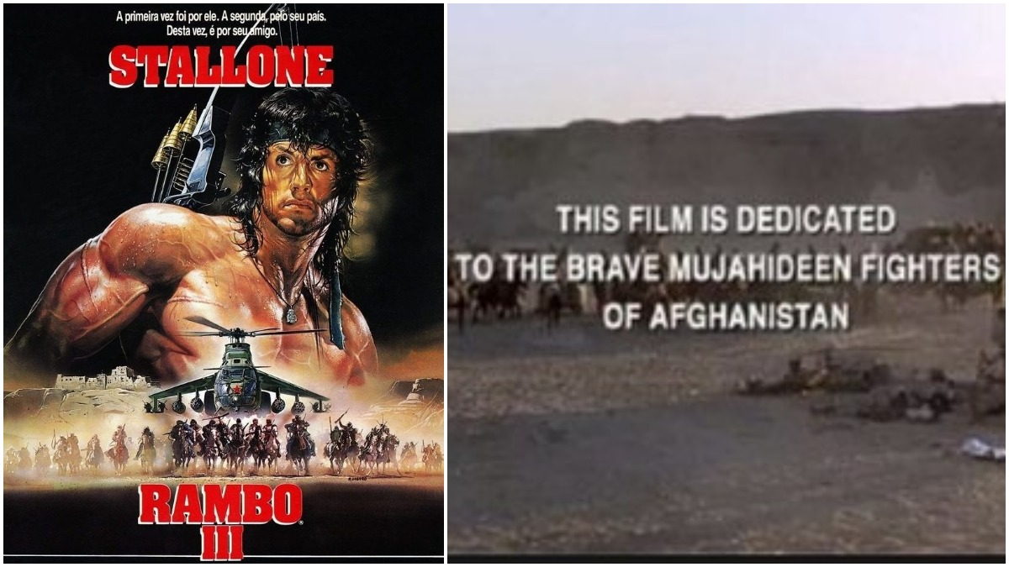
Rambo 3: A 1988 US film dedicated to ‘brave fighters’ trained by the CIA, who would later be labelled ‘terrorists’ and blow up the Twin Towers in New York in 2001

Slide 40
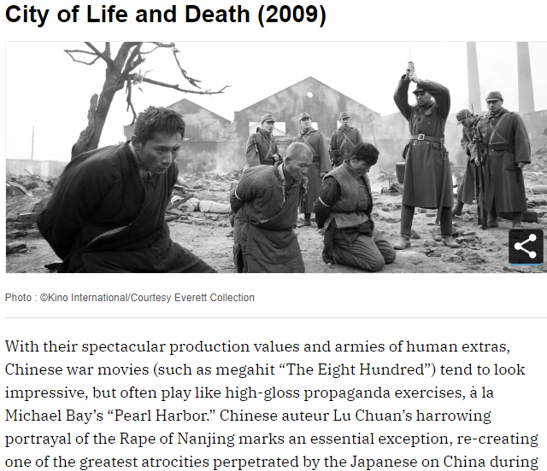
History Students
Representation: the when, the how, the which conflict, using which characters…

Slide 41

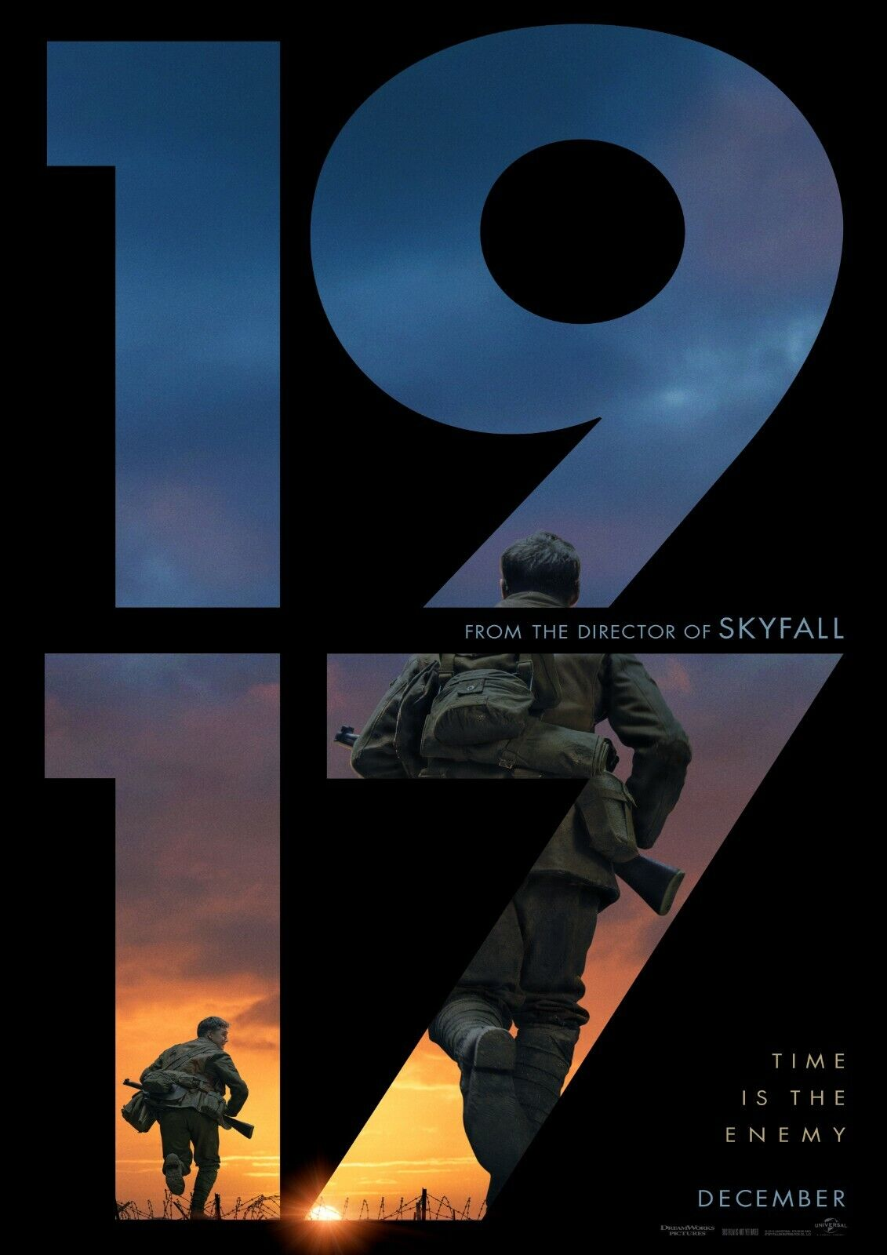

Slide 42
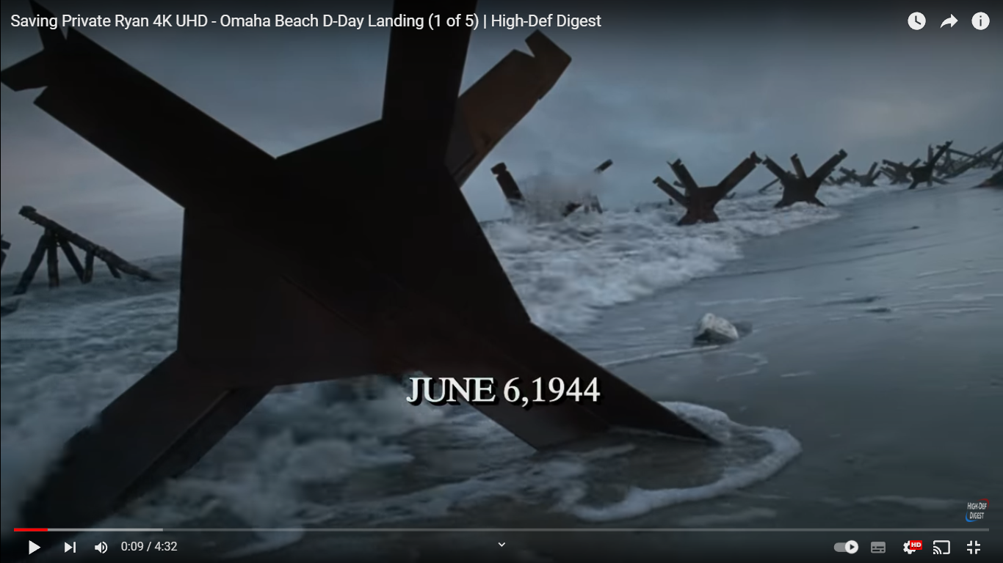
Language: How are technical and symbolic codes being manipulated for effect on audiences
https://www.youtube.com/watch?v=g_cCSWBo4cA

Slide 43
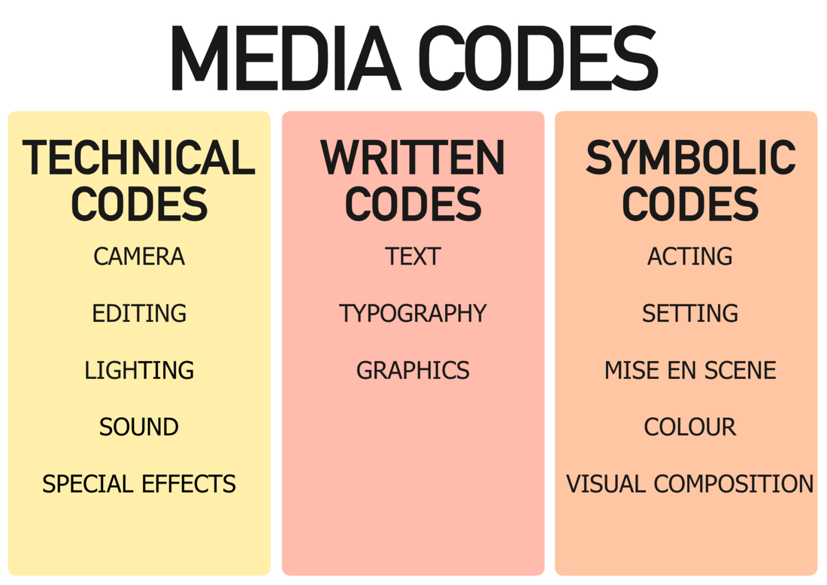

Slide 45
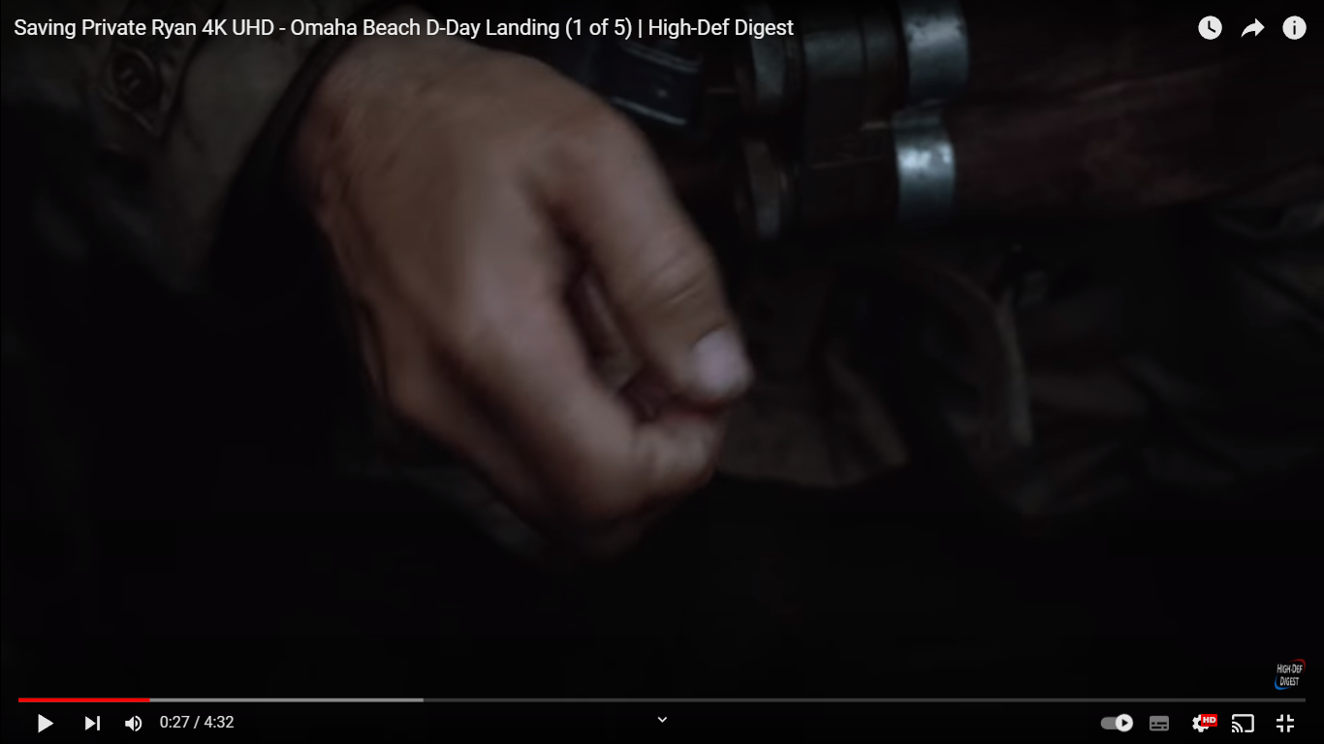

Slide 46
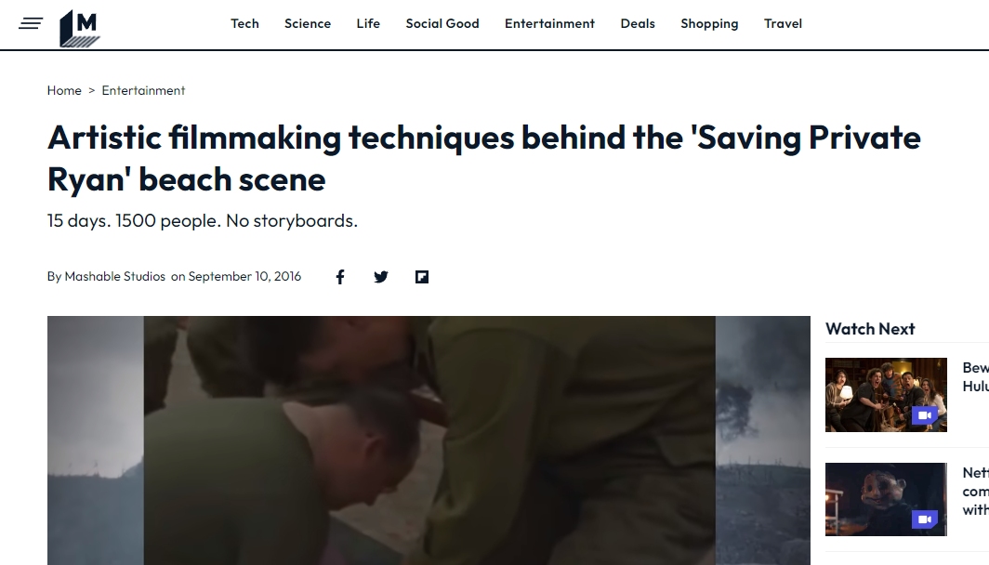
https://mashable.com/video/saving-private-ryan-art-of-the-scene

Slide 47
GENRE: Audiences can usually instantly understand the TYPE / CATEGORY of text through the use of certain codes and conventions

Slide 48
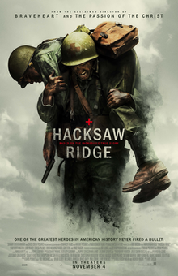
CODES are often physical / tangible (uniforms / weaponry etc.)
CONVENTIONS are often in the storylines (… someone is injured attacking the enemy / acts of heroism)

Slide 49
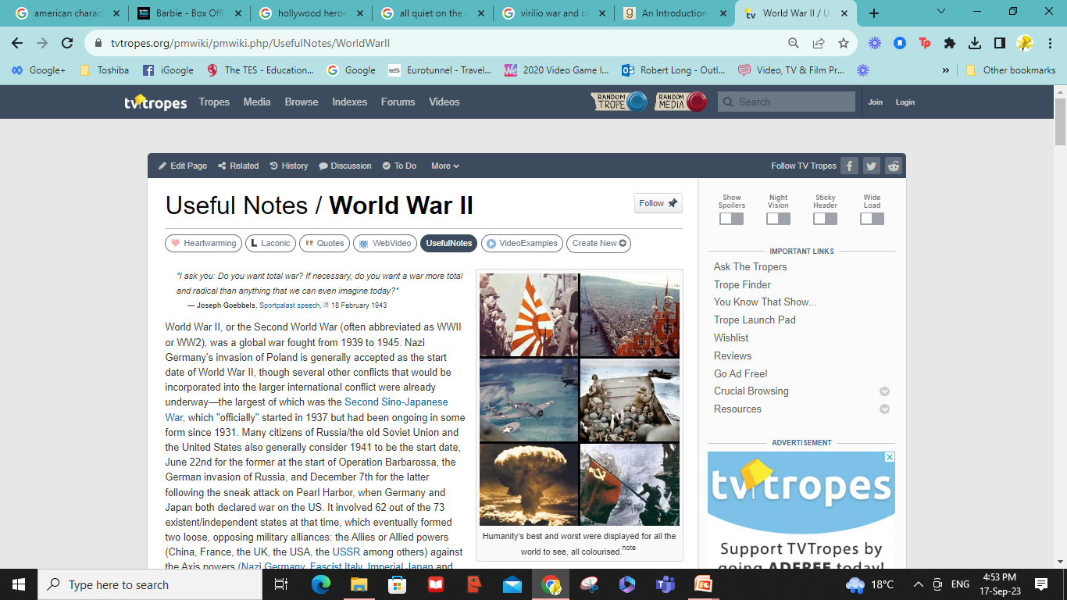

Slide 50
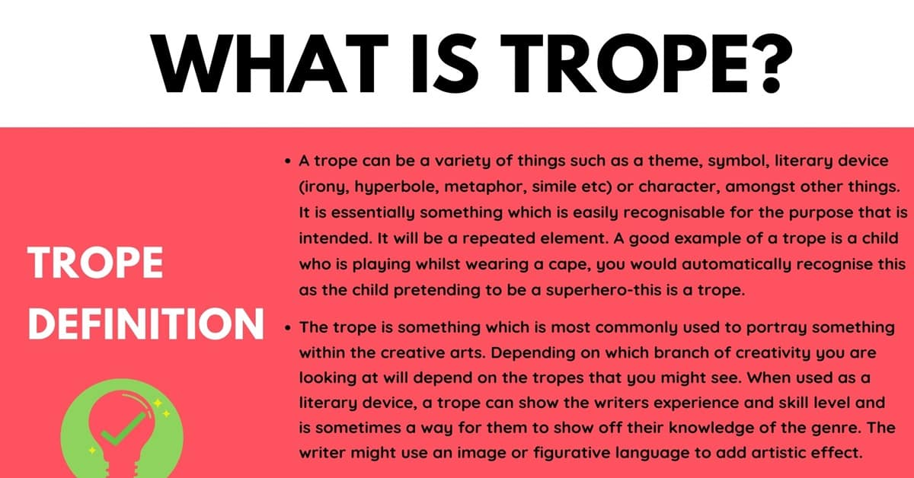

Slide 51
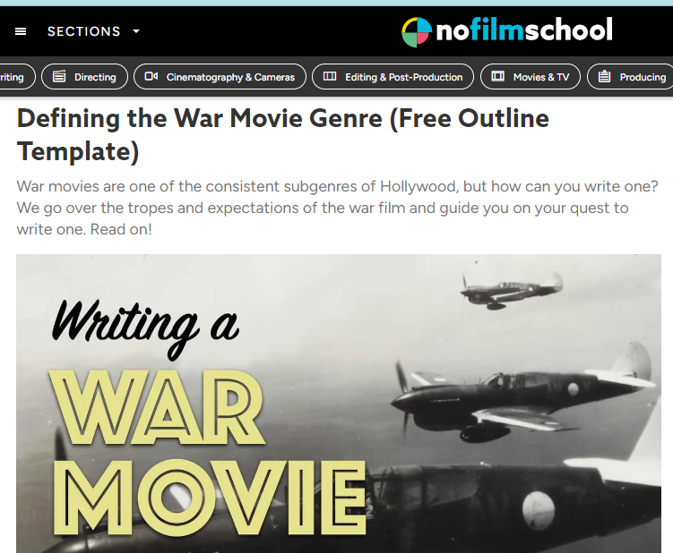
https://nofilmschool.com/war-movies

Slide 52
Institution : who controls the film?
Ideology: what ideas are being transmitted?
Narrative: What stories are being told using which characters...
Representation: Who/what/where/how/?
Language: How are technical and symbolic codes being manipulated for effect on…
Audiences: consider the ‘effect’ on audiences and who they are.
GENRE – the codes and conventions of the WAR film

Slide 53
Virilio, Paul. War and Cinema. Verso. London. 1984.

Slide 54
Rosenstone, Robert A. History on Film / Film on History. Routledge. Oxon. 2013.

Slide 55
Nelmes, Jill. Introduction to Film Studies. Routledge. London. 2012

Slide 56
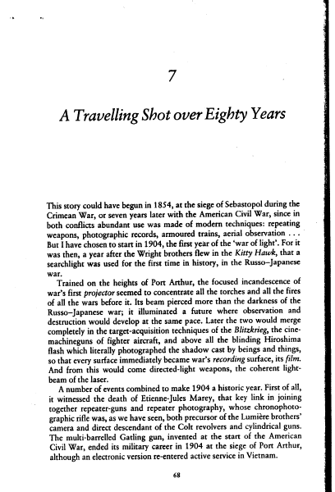
Virilio, Paul. War and Cinema. Verso. London. 1984.
Reading: Pages 68 to 89 for Session 2 (Chapter 7)

Slide 57
Rosenstone, Robert A. History on Film / Film on History. Routledge. Oxon. 2013.
Reading: Chapters 1 & 2

