Slide 1





Exceptional Care In The First 1000 Days
ECEY4005
2317112
3173

Slide 2
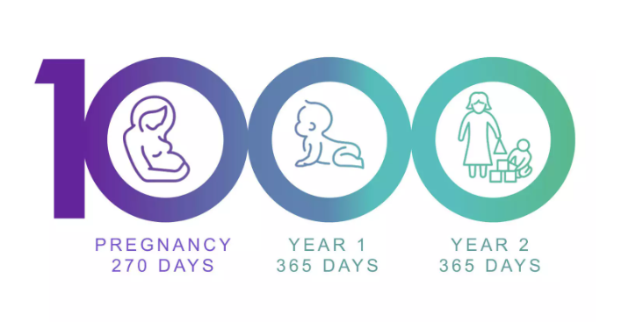
What is the first 1000 days?
ECEY4005
2317112
3173
According to Unicef (2013) the first 1000 days is the period of time from conception to around the age of two years old. During this time, a child’s health, growth and neurodevelopment are founded. The brain's growth is the most active from the last trimester in the pregnancy and within the first two years of life. At birth, an infant's brain develops the hippocampus and the visual and auditory areas, and in the first year of life the brain develops the language processing areas and the area that controls attention, inhibition and flexibility. It is therefore essential that during this time both mother and child are provided with the optimal nutrition as it has been shown that malnutrition can have an impact on the brain and reduce development.
Likhar and Patil (2022) agree that the first 1000 days are a significant time for a child’s development and that this can be impacted by how mothers and children are cared for and fed. During this time a child’s brain, every second, can make 1000 new neural connections. These connections, by the age of three years, are twice as active as that of an adult's brain and therefore provide the foundations for the child’s future.
(Source: LinkedIn, 2023)

Slide 3

Why is the first 1000 days important?
ECEY4005​
2317112​
3173
As stated by Likhar and Patil (2022), when children are provided with appropriate nutrition during the first 1000 days they are more likely to be born at a healthy weight, be less likely to develop a number of health conditions, such as obesity or diabetes, and they will also have a higher likelihood of becoming better learners and have less behavioural issues. The development of a child in the first 1000 days is placed into four stages, these stages are:
Nine months to zero months: pregnancy – During pregnancy, a healthy balanced diet will help aid to nourish the growing fetus, as well as prepare the mother's body for breastfeeding. Inadequate and excessive nutrition and weight during pregnancy can cause complications which can impact the mother and the child. The child’s development requires a range of vitamins and proteins as well as iron and folic acid, therefore it is essential to the child that the mother meets these needs by providing them.
Zero to six months: breastfeeding – Pediatricians recommend that newborns, until they are six months old, should be exclusively breastfed as breastmilk contains all the necessary nutrients required for a baby to grow and develop, as for a baby under size months of age breastmilk is a healthy and complete diet.
Six months to 12 months: introduction to solid food – From six months of age nutrient rich foods should be offered alongside breastmilk or formula, which provide the baby with the majority of their nourishment until they are 12 months old, to a baby as this will aid in healthy eating habits.
>12 months: transition to the family diet – A child’s growth slightly slows down when they are in their toddler years, although eating remains vastly important. Encouraging children to eat a variety of meals is essential. Children will often need a food type offered on more than one occasion and with different meals until it may be accepted.
Appropriate nutrition during the first 1000 days is essential for a child’s future health and can have impacts on their immune system, organ development and metabolism, therefore ensuring healthy nutrition during the first 1000 days is essential for the child to have the best start in life, so they are able to have the best possible outcome for their future.
(Source: Why Quality Counts, 2018)

Slide 4

What is exceptional care?
ECEY4005​
2317112​
3173
Brodie (2018) noted that early years practitioners are an extremely important part in children’s holistic care and development. Children should be provided with quality experiences within their setting, as children learn and develop holistically and the level and quality of care that is provided can impact their cognitive, physical, social and emotional, language and their overall development. To ensure children are being provided with quality care there must be practitioners in their setting that possess skills, which enable them to understand a child’s development, to therefore be able to understand and meet the needs of the children in their setting.
According to Brodie (2018), research indicates good practice and pedagogy already exists in early years settings. This research identified four key dimensions of pedagogy and stated five key quality conditions for practitioners working with children from birth to three years.
Four key dimensions:
Stable relationships and interactions with adults
Play based activities to allow children to lead their own learning
Communication and language support
Opportunities to be physically active
Five key conditions:
Knowledgeable and capable practitioners
A team of staff with low turnover
Effective staff development
Stimulating physical environments that are secure
Families that are engaged and involved
(Source: Worcester Early Years Centre, 2024)

Slide 5
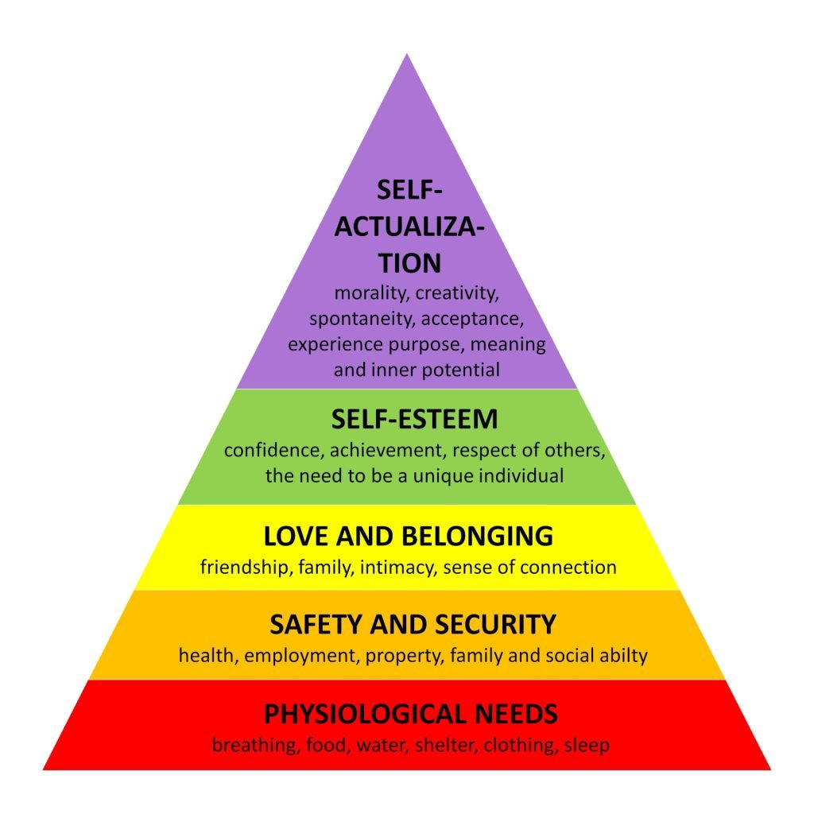
Why is exceptional care important?
ECEY4005​
2317112​
3173
Birth to 5 Matters (no date) state that during the early years a child’s future development is influenced by the experiences they encounter. Neurological connections are formed based on external stimulation from different experiences, through observation and interaction with other people. Therefore, a practitioner’s role is vital for a child’s development. It is essential for practitioners to provide support for a child’s development by being sensitive to their needs and skillful in their role to provide exceptional care to the child.
By providing children with a positive relationship, practitioners can support the child’s well-being and the development of their self-regulation. When there is a positive relationship with a child, the practitioner can be in tune with the child’s signals and respond consistently to meet their needs, which will help support their development (Birth to 5 Matters, no date).
Furthermore, Dunlap (2004) agrees that when a child’s basic needs are met their development is supported as meeting the basic needs of a child is vital for them as they are still growing compared to an adult. Without these essential needs being met children would not thrive and will not be able to develop to their full potential.
Dunlap (2004) discusses Maslow’s Hierarchy of Needs; Maslow maintained the idea that basic deficiency needs needed to be met before a child’s growth needs could be met. These basic deficiency needs include safety and security, physiological, love and belonging and self-esteem, all of which must be met before a child can grow and develop. It is therefore essential that practitioners ensure they provide children with exceptional care and meet these basic needs.
(Source: Simply Psychology, 2024)

Slide 6

What is the role of an early years practitioner in supporting children and families in the first 1000 days?
ECEY4005​
2317112​
3173
Wilson (2016) suggests that when early years practitioners support children and their families, they will support the child’s learning and development as children require healthy and positive relationships with their parent to develop. John Bowlby developed the attachment theory. His theory proposed that children need to develop a relationship with their primary carer, which is usually their mother, this provides a secure attachment. Without this relationship, the child will feel separation and loss, which will impact their learning and social and emotional development. When a child has a secure attachment with their primary carer, it provides them with a secure base where they can explore and learn.
Wilson (2016) adds that it is important for a practitioner to support children and their families to ensure the child has the best possible outcomes in life. By supporting children and their families, practitioners can build trust with the child’s parents, which enables the parents to share any concerns they may have. Practitioners are then able to either share ideas and support with parents and signpost parents to forms of intervention which can both support children to secure stable behaviour patterns.
(Source: PACEY, no date)

Slide 7
The importance of effective partnership working
ECEY4005​
2317112​
3173
Urie Bronfenbrenner has had a profound effect on the approaches to working with children and their families in early years settings. Bronfenbrenner used research studies and his own understanding of human development to influence policymakers regarding the importance of family support and early childhood education. Bronfenbrenner wanted to build on the understanding of human development in policies, research and practice and the current theorising and understanding of the importance of early childhood education and development are expressed by many of Bronfenbrenner’s views. Bronfenbrenner's theory involves the coalition between a developing child and the changing micro and macro conditions in which a child’s development is impacted and his theory can be applied in early years learning. The theory focuses on changes to micro conditions, such as family, friends and communities that surround the child and macro conditions, such as the cultural conditions in which they live (Hayes, O’Toole and Halpenny, 2017).
Hayes, O’Toole and Halpenny (2017) state that Bronfenbrenner’s ecological model of human development incorporates the development of the individual child within the environment. He characterised them into four systems: microsystem, mesosystem, exosystem and macrosystem. In the model the child is placed at the centre with microsystem being the next level. Microsystems are environmental factors that impact on the child’s daily life, this includes parents and siblings as well as other members of the family and practitioners and the setting the child is in. These factors can have a direct impact on a child’s life, it is therefore essential that practitioners and settings value exploration and good interactions with children, with a curriculum that is reflected by this to ensure children learn to explore and develop language skills.
The next level is called the mesosystem, which is the system of two or more settings which can impact the child, such as family and school. It shows how behaviour in one setting can be influenced by experiences in other settings. A connection between family and school is very important so that practitioners can gather a full understanding of the child and their lives outside of the setting. Following on from the mesosystem is the exosystem, which has less influences on the child’s life, these include quality of a parent's workplace, which may influence a parent's well-being, or a decision made by the manager of the setting the child is in. An example of this would be a decision made by an education policymaker, which the child is not involved with, although it can impact on the child’s experiences in education.
Lastly, macrosystems involve the influences that can impact a child that are at a cultural level, such as, sociocultural beliefs. Even though children are not directly involved with macrosystems they do have a great influence in the child’s life. The practitioner's role in the early years is important in leading and supporting children with their learning and development. Practitioners must develop good relationships with the child and their families to ensure the child receives the best start in life.

Slide 8
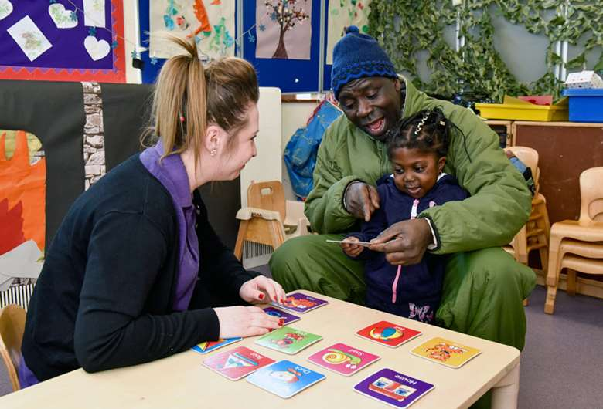
What are the challenges to providing high quality care?
ECEY4005​
2317112​
3173
According to Pite (2023), the ongoing challenges in the early years sector, regarding recruitment and retention, are a potential risk to the quality of early years provision, which is stated in Ofsted’s annual report. The report urges that the increasing use, in some settings, of agency staff and apprentices to retain staff to child ratios can impact the quality of care that the setting can provided the children in their care. This can impact on the children in the setting as they may not be provided with a key person, which could result in the staff member working with the child not being able to understand their needs.
These staffing issues are highlighted to be due to inadequate funding, resulting in low pay rates for staff working across the sector. To ensure that all children are provided with the best quality of care, it is essential that the government address the issue and make it an urgent priority.
Lee (no date) addresses the challenges of language barriers. It is stated that for non-English speaking parents an early years setting, where the primary language is English, may make them feel uncertain as the language and culture in that setting is different to theirs. The parent will have difficulties communicating to the practitioner daily about their child, which can make parents feel frustrated and rejected and may isolate themselves from the practitioner.
Lee (no date) states that a practitioner must ensure that they evaluate the parents' feelings and ensure they build a relationship with the parent. Practitioners can also share that they feel frustrated that they cannot speak the parents' language, this can show the parent equality and respect for their language and can help to keep the perception of the relationship as equals. It can also be helpful for parents for practitioners to link them with other parents who speak the same language as this can provide them with a support network outside of the setting.
(Source: Nursery World, 2016)

Slide 9
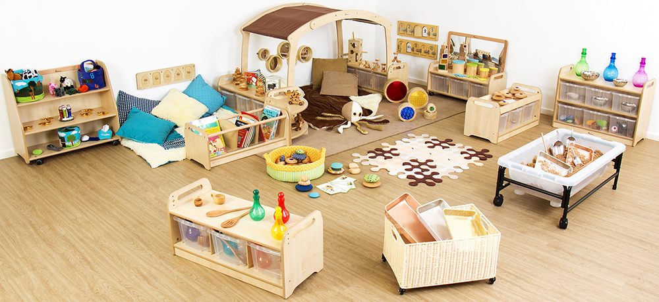
Enabling Environments
ECEY4005​
2317112​
3173
Hodgman (2011) suggests that an enabling environment should
support the six areas of learning of the Early Years Foundation
Stage. An enabling environment can be both indoor and outdoor
areas and must provide:
Space
Quality resources
Accessibility
Stability
Displays
Furthermore Hodgman (2011) states that an enabling environment
supports a child’s learning and development and will provide
children with:
Stimulation and challenges
Safety and emotional support
Reflective and focused learning
Support across all six areas of learning
Equality and support children to understand other's needs, religions and cultures
The ability to explore and experiment with the child’s interests at the centre
Encourage creativity and imagination
Encourage independence
(Source: tts, no date)

Slide 10
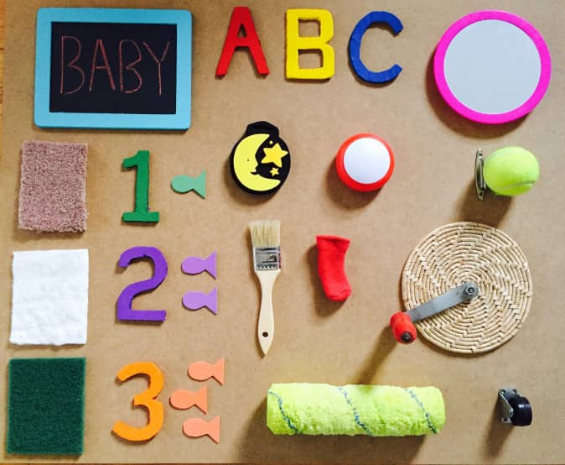
Sensory Play and Piaget's Theory
ECEY4005​
2317112​
3173
According to Hickey, Golden and Thomas (2018), Jean Piaget was a child psychologist in the 1960’s, he argued that between birth to two years children are in the sensorimotor development stage of their development. During the sensorimotor development stage children depend on their senses to gather information about the world around them. When children develop these skills, they gain sensory awareness and motor skills which create the earliest form of intelligence.
Additionally, Only About Children (2024) states that Piaget suggested that for children to guide their cognitive development, they need environmental stimuli and experiences. Piaget proposed that children absorb new knowledge through sensory play and store that knowledge for later reference.
Only About Children (2024) adds that sensory play has many benefits. Through exploration, curiosity, problem solving, and creativity sensory play encourages learning. It also aids in the building of nerve connections in the brain, which encourages language development and motor skills. Sensory play is important for children, and many different things can be used in sensory activities, nature being a good tool.
(Source: STEM Little Explorers, no date)

Slide 11
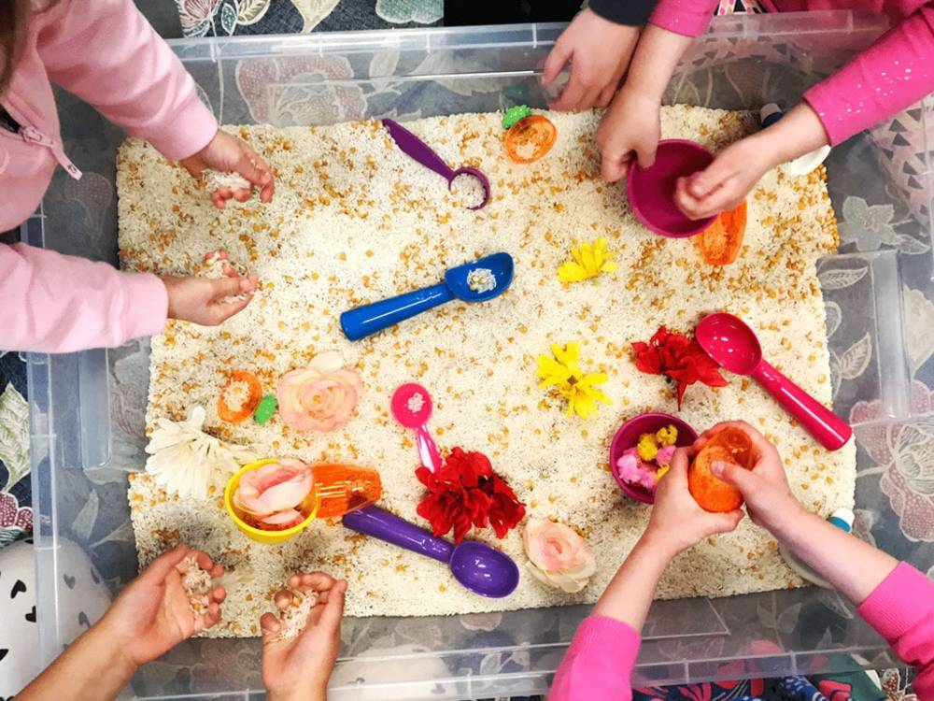

Sensory Play Ideas
ECEY4005​​
2317112​​
3173
Tactile Sensory Play
Tactile Play is when children explore and learn objects with their hands. Tactile play can help children learn about pressure, temperature, vibrations and much more (Only About Children, 2024).
Vestibular Sensory Play
Vestibular sensory play is when a child is hanging, jumping, swinging and rolling, which all contribute to a child’s balance development. The vestibular system is in the inner ear, and it controls the sense of balance and movement, so by a child getting their head into many different positions, it aids in strengthening the vestibular system (Only About Children, 2024).
Proprioception Sensory Play
Proprioception sensory play is when a child is pushing, pulling and jumping, which aids the child in developing spatial awareness of their body. Proprioception is the sense where children learn where their body is in space (Only About Children, 2024).
(Source: Tiney, no date)
Visual Sensory Play
Visual sensory play is where children are engaging with different colours, patterns or moving objects. This aids the child to develop their vision and sight (Only About Children, 2024).
Olfactory and Taste Sensory Play
Olfactory and taste sensory play is related to smell and taste. By engaging children in smell and taste activates it can help to develop these senses (Only About Children, 2024).
Auditory Sensory Play
Auditory sensory play is where a child explores with different sounds, which helps to develop their hearing (Only About Children, 2024).
(Source: Tiney, no date)

Slide 12
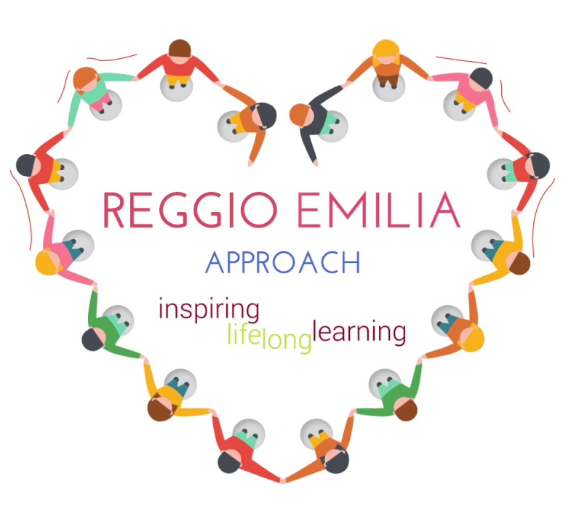
International Approaches – Reggio Emilia
ECEY4005​
2317112​
3173
Reggio Emilia is a small city in Northan Italy and their approach to early childhood education consists of a combination of engaging environments, artistic expression and long and short-term projects. The first schools in Reggio Emilia were started with the aim of honoring and educating all children and it is this initial aim that has developed into ongoing political conversations regarding the rights and values of children. The framework is created based on decisions that have been guided by the concept of ‘Image of the Child’. It is in this concept that children are rich in potential, strong, powerful, competent and connected to adults and other children. Children in Reggio Emilia are seen as active participants who can construct their own learning. An essential aspect of the image of the child is respect for children, as respect is more powerful than love as it acknowledges potential in the child (McNally, S and Slutsky, R, 2016).
Furthermore, McNally, S and Slutsky, R, (2016) state that Educators in Reggio Emilia are mindful of a child’s own sense of time, and they plan the children’s encounters at their pace. Reggio Emilia schools keep children with the same teachers for three-year cycles, as they believe that time cannot be measured with a clock or a calendar, this allows children to work at their own pace. The school environment in Reggio Emilia schools is another important factor in their learning, they are designed to give children an inviting space where they will stay and engage. All areas in the school will have identity and purpose and consist of natural light, healthy living plants, colour, transparency, comfortable furniture and functional flow.
(Source: St. Thomas' International School, no date)

Slide 13

ECEY4005​​
2317112​​
3173
International Approaches – Te Whariki
Te Whariki is a curriculum guideline for young children which was published by the New Zealand Ministry of Education and every early childhood service must follow the curriculum outlined in it to retain their license to care for and educate children. The Te Whariki curriculum includes experiences that a child would gain from being at home with parents and other family, such as well-being, a sense of belonging, explore through play and family activities (My ECE, 2023).
My ECE (2023) adds that to ensure these values are clear to early childhood educators Te Whariki is set out in four principles and five goals.
These principles are:
'Empowerment – Empowers the child to learn and grow'.
'Holistic Development – Reflects the holistic way children learn and grow'.
'Family and Community – The wider world of family and community is an integral aspect'.
'Relationships – Children learn through responsive and reciprocal relationships with people, places and things'.
The goals are:
'Well-being – Health and well-being of the child are nurtured and protected'.
'Belonging – Children and families feel a sense of belonging'.
'Contribution – Opportunitites for learning are equitable'.
'Communication – Languages and symbols of their own and other cultures are promoted and protected'.
'Exploration – The child learns through active exploration of the environment'.
(Source: Born Smart Parenting, 2017)

Slide 14
Reference List
Birth To 5 Matters (No Date) Child Development. Available at: https://birthto5matters.org.uk/child-development/ (Accessed: 13 January 2024).
Born Smart Parenting. (2017) Te Whariki and your child’s toybox!. Available at: https://bornsmartparenting.wordpress.com/2017/09/22/te-whariki-and-your-childs-toybox/ (Accessed: 20 January 2024).
Brodie, K. (2018) The Holistic Care and Development of Children from Birth to Three. Oxon: Routledge.
Dunlap, L, L. (2004) What All Children Need: Theory and Application. 2nd edn. Oxford: University Press of America Inc. 19(4)
Hayes, N., O'Toole, L. and Halpenny, A. M. (2017) Introducing Bronfrenbrenner: A Guide for Practitioners and Students in Early Years Education. Oxon: Routledge.
Hickey, K. Golden, T. Thomas, A. (2018) 'Sensory Play in Libraries: A Survey of Different Approaches', Children & Libraries: Chicago,16(3), 18-21.
Hodgman, L. (2011) Enabling environments in the early years: Making provision for high quality and challenging learning experiences in the early years settings. London: MA Education Ltd.
Lee, L. (no date) Working with non-English speaking families. Available at: https://www.teachingforchange.org/wp-content/uploads/2012/08/ec_nonenglishspeakingfamilies_english.pdf (Accessed: 19 January 2024).
Likhar, A. and Patil, M (2022) 'Importance of Maternal Nutrition in the First 1,000 Days of Life and Its Effects on Child Development: A Narrative Review', Cureus, 14(10), Available at: doi: 10.7759/cureus.30083
LinkedIn (2023). Early intervention to focus on the first 1000 days of a child's life. Available at: https://www.linkedin.com/pulse/early-intervention-focus-first-1000-days-childs-life-factories-qcqxf (Accessed: 17 January 2024).
McNally, S. and Slutsky, R. (2016) 'Key elements of the Reggio Emilia approach and how they are interconnected to create the highly regarded system of early years education', Early Child Development and Care, 187(12), 1925-1937.
My ECE. (2023) Te Whariki – What is this Early Childhood Curriculum?. Available at: https://www.myece.org.nz/te-whariki-curriculum/ (Accessed: 20 January 2024).
Nursery World (2016) Nursery Management: Working with parents - More than words. Available at: https://www.nurseryworld.co.uk/features/article/nursery-management-working-with-parents-more-than-words (Accessed: 19 January 2024).

Slide 15
Only About Children (2024) Exploring the benefits of sensory play for children. Available at: https://www.oac.edu.au/news-views/sensory-play/#:~:text=Piaget%20proposed%20that%20children%20need,to%20a%20child's%20brain%20development. (Accessed: 20 January 2024).
PACEY (no date) Supporting families. Available at: https://www.pacey.org.uk/working-in-childcare/spotlight-on/supporting-families/ (Accessed: 17 January 2024)
Pite, S. (2023) Ongoing early years staffing challenge highlighted in Ofsted's annual report. Available at: https://www.eyalliance.org.uk/news/2023/11/ongoing-early-years-staffing-challenge-highlighted-ofsted%E2%80%99s-annual-report (Accessed: 19 January 2024).
Simply Psychology (2024). Maslow's Hierarchy of Needs. Available at: https://www.simplypsychology.org/maslow.html (Accessed: 17 January 2024).
STEM Little Explorers (no date) Sensorimotor activities for children. Available at: https://www.stemlittleexplorers.com/en/sensorimotor-activities-children/ (Accessed: 20 January 2024).
St. Thomas' International School. (no date) Early Childhood. Available at: https://www.stthomass.com/en/early-childhood-2/ (Accessed: 20 January 2024).
Tiney (no date) 5 sensory play activities for childcare. Available at: https://www.tiney.co/blog/sensory-play/ (Accessed: 20 January 2024).
tts (no date) Inspiring early years environments. Available at: https://www.tts-group.co.uk/blog/2019/05/07/inspiring-early-years-environments.html (Accessed: 19 January 2024).
Unicef (2013) The first 1,000 days of life: The brain’s window of opportunity. Available at: https://www.unicef-irc.org/article/958-the-first-1000-days-of-life-the-brains-window-of-opportunity.html (Accessed: 31 December 2023).
Why Quality Counts (2018). How does nutrition affect the developing brain. Available at: https://wyqualitycounts.org/how-does-nutrition-affect-the-developing-brain/(Accessed: 17 January 2024).
Wilson, T. (2016) Working with parents, carers and families in the early years: the essential guide. Oxon: Routledge.
Worcester Early Years Centre (2024). Baby Care. Available at: https://www.worcestereyc.co.uk/baby-care.htm (Accessed: 17 January 2024).

