Slide 1
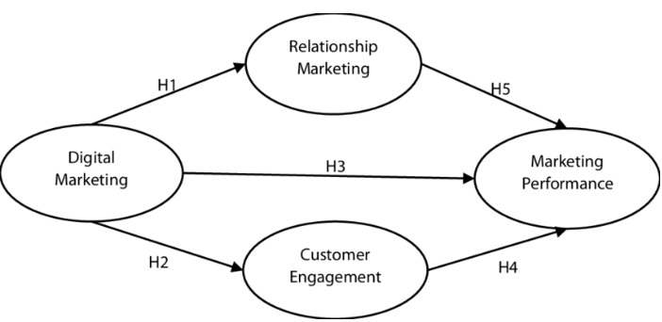
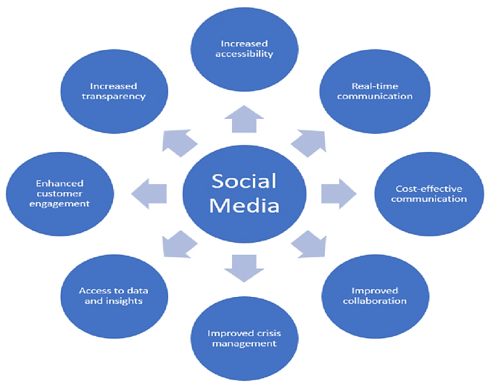
Effectiveness of Digital Marketing Strategy on Consumer Engagement in the UK Retail Sector: A Case Study of Marks & Spencer
Introduction
In the UK retail industry, digital marketing has emerged as a fundamental consumer attraction force. Marks and Spencer (M&S), which is one of the top retailers, has been tremendously investing in digital platforms including social media, personalised content, and integration of its online and offline channels to enhance consumer engagement (Gujrati and Uygun, 2020, p.325). There are however challenges of fulfilment, cybersecurity risks and digital exclusion. This paper critically reviews the effectiveness of the strategies M&S employs to boost engagement and loyalty.
Research Findings
4. Social Media Campaigns
TikTok and Instagram interactive campaigns increased popularity and engagement. User-generated content became a way of modernising the image of M&S, but trends are risky to enable a short-term engagement without operational follow-up (Marks & Spencer, 2025).
5. Barriers
Among the challenges there are cybersecurity threats, digital overload, fulfilment, and older customers being digitally excluded. These restrict the long-term interest of M&S (BBC, 2025).
Methodology
To examine the peer-reviewed journals, industry reports, and company publications (2018-2024) as secondary data, a Systematic Literature Review (SLR) was used. The process included:
Database(s): Scopus, SpringerLink, Web of Science, Google Scholar.
Keywords: digital marketing and consumer engagement and UK retail and social media marketing and personalisation.
Inclusion Criteria: Studies on digital marketing in the UK retail, consumer engagement and peer-reviewed/ industry reports (2018-2024).
Exclusion Criteria: Non-retail sector, non-English articles, before 2018.
Ethics: The secondary sources employed were only published publicly and the sources were cited well to ensure academic integrity.
This organised method was reliable, transparent and minimised bias in results.
Figure: Digital marketing influence on customer engagement
(Source: Safitri and Komaryatin, 2025)
1. Consumer Perceptions
The digital-first approach of M&S (Sparks loyalty programme, social-first campaigns, etc.) enhanced the brand relevance and interaction, especially with younger audiences. Trust was damaged though by fulfilment failures and a 2025 cyberattack (Seo, Han and Kim, 2022, p.3147).
2. Quality of Content and Customisation
Content, style quizzes, and specific offers built on AI enhanced the number of conversions and interactions (Anshari et al., 2019, pp.94). However, excessive targeting created privacy issues, whereas functional loopholes diminished long-term performance.
3. Omnichannel Integration
Store-digital links, app loyalty, and click-and-collect improved the level of convenience and engagement (Marks & Spencer, 2020). Nevertheless, the lack of homogeneity in logistics and cyber attacks exposed weak points.
Figure: The function of social media in communication and collaboration in business
(Source: Okonkwo and Awad, 2023)
Conclusion
The digital marketing practices of M&S, especially personalisation, omnichannel services and social media, promote consumer engagement to an important degree. Nevertheless, lasting success will be possible by improving the level of data protection, making the operations more resilient, and being more inclusive in the demographics.
References
Anshari, M., Almunawar, M.N., Lim, S.A. and Al-Mudimigh, A., (2019). Customer relationship management and big data enabled: Personalization & customization of services. Applied computing and informatics, 15(2), pp.94-101.
Safitri, D. and Komaryatin, N. (2025). Digital Marketing Influence on Marketing Performance: The Role of Customer Engagement and Relationship Marketing. Golden Ratio of Marketing and Applied Psychology of Business, 5(2), pp.316-331.
Okonkwo, I. and Awad, H.A. (2023). The role of social media in enhancing communication and collaboration in business. Journal of Digital Marketing and Communication, 3(1), pp.19-27.
Gujrati, R., and Uygun, H. (2020) ‘Digital marketing: changing consumer behaviour,’ International Journal of Forensic Engineering, 4(4), pp. 323-331.
BBC, (2025). Supplier to major supermarkets hit by cyber attack, BBC News. BBC. Available at: https://www.bbc.com/news/articles/czr88myp570o (Accessed: 19 September 2025).
Marks & Spencer, (2025). ‘ANYTHING BUT ORDINARY’: M&S LAUNCHES NEW CAMPAIGN TO SHOWCASE RESHAPED RANGES. Available at: https://corporate.marksandspencer.com/media/press-releases/anything-ordinary-ms-launches-new-campaign-showcase-reshaped-ranges (Accessed: 19 September 2025).
Marks & Spencer, (2025). MARKS & SPENCER ANNOUNCES NEW CUSTOMER INSIGHT PARTNERSHIP. Available at: https://corporate.marksandspencer.com/media/press-releases/marks-spencer-announces-new-customer-insight-partnership (Accessed: 19 September 2025).
Seo, S., Han, S. and Kim, D., (2022). D-CEWS: DEVS-based cyber-electronic warfare M&S framework for enhanced communication effectiveness analysis in battlefield. Sensors, 22(9), p.3147.

