Slide 1

FOOD AND BEVERAGE
MARRIOTT HOTEL

Slide 2
STUDENT NAME: Daniel Dogaru
STUDENT NUMBER :1816284
MODULE NAME:Food and Beverage Operations
MODULE CODE:M4X01918
LECTURER NAME:Jazz and Olu

Slide 3
TABLE OF CONTENT
Introduction
Main body
Conclusion
References

Slide 4
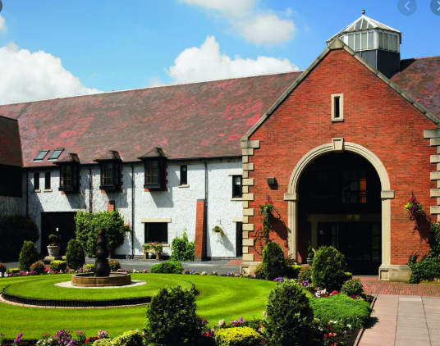
INTRODUCTION
Food and beverage is basically the sector which is mainly concerned with providing various services and thus comes under hospitality sector.
Forest of Arden Marriott hotels is predominately the hotel which is 6 Km from the Birmingham airport and NEC complex and thus provides various spacious rooms and leisure facilities.
This picture gives overview of history of Marriott forest of Arden, type of operations, F&B operations, menu and products, marketing strategy and health and hygiene within F&B.

Slide 5
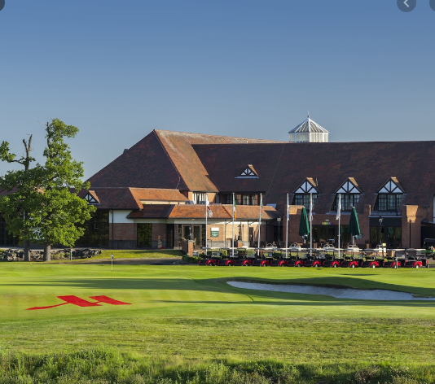
HISTORY OF MARRIOTT FOREST OF ARDEN
Forest of Arden Marriott hotel and country club is basically the country club as well as restaurant within England.
This is operated by the Marriott hotels and resorts and is mainly located 4 miles to east of the Birmingham International airport near Waewickshire.
This was mainly founded in the year 1970 as well as designed by the famous Donald Steel.
Initially, the forest of Arden has been a great place for carious championship courses and in the previous years was main site for numerous prestigious tournaments like European Tour events, British Masters etc.
Notes:
Since then, it has become one of the great place for various events and was later acquired by Hotel Marriott. The Arden was initially considered as the regular European Tour venue as well as hosted by British Masters as well as English open. This Forest of Arden Marriott hotel is one of the highly majestic place for various business as well as leisure events. This hotel was previously designed to offer various tournaments but later on in the year 2000, Hotel Marriott redesigned it and equipped it with various facilities like spa, travel and leisure etc.

Slide 6
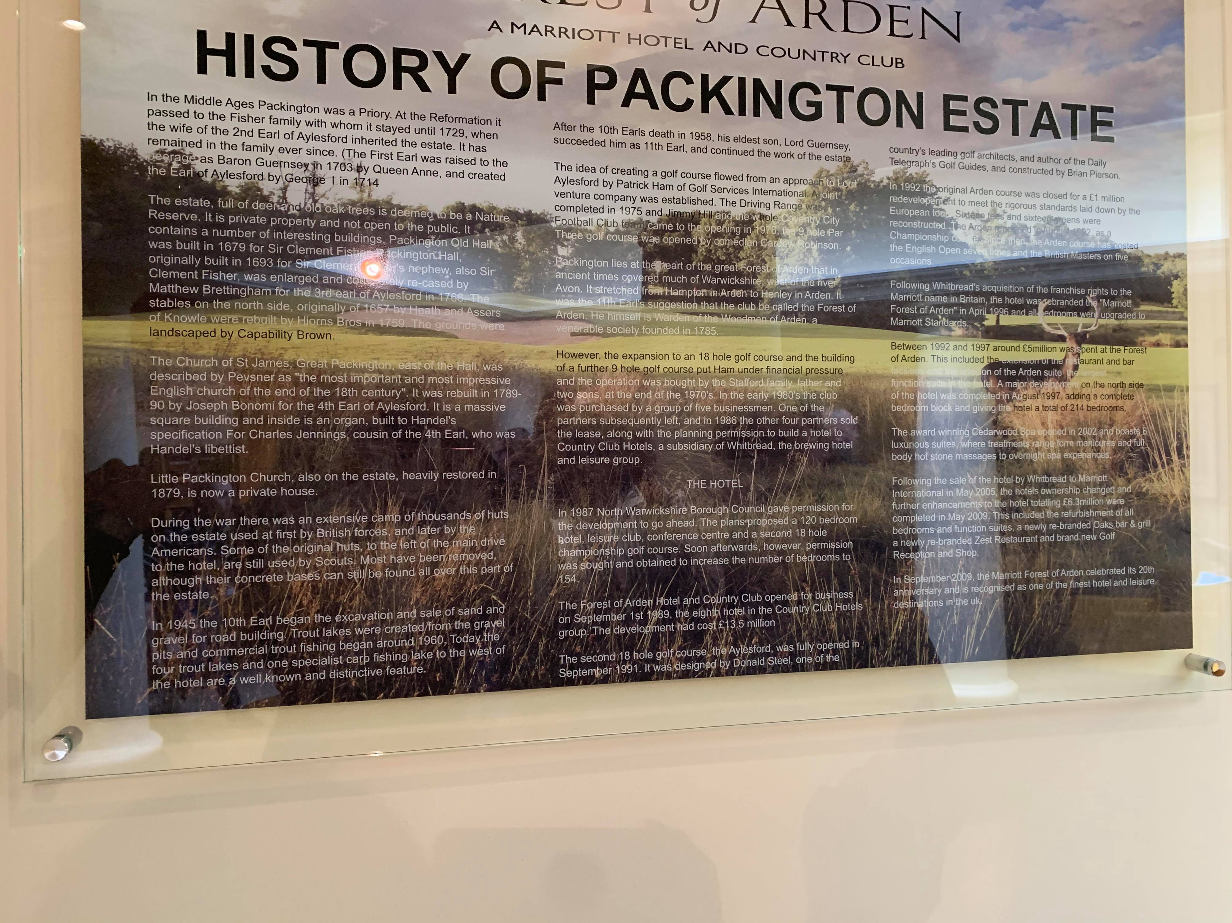
OPERATIONS
The Marriott forest of Arden is basically the hotel as well as country club which offers the rage of unforgettable experiences to their customers.
It is mainly set within the 10000 acres of the ancient woodland where especially deer roam free.
Centrally located beside the Solhihull within west Midlands this is mainly considered as one of the great hotel.
This hotel mainly provides a great services as well as products to their customers and have been known as one of the well-known and remarkable chain of Hotel Marriott.
Notes:
The forest of Arden Marriott hotel as well as country club is mainly 6 km from the Birmingham Airport as well as NEC complex and is mainly the home to various leisure facilities and products. This hotel mainly features cedarwood spam tennis court, fitness center as well as pool complex. There are specifically 18 meeting rooms as well as AA Rostte- awarded restaurant. These are the main operations of this hotel where it provides a range of services from a restaurant to the specialty spa. Besides this, guest also enjoys the terrace as well as food at Zest restaurant.

Slide 7
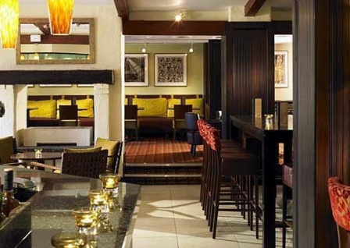
F&B OPERATIONS
The forest of Arden Marriott hotels basically provides a great restaurant to their customers which is equipped with great facilities as well as services.
It has a majestic and remarkable restaurant by the name Zest restaurant which is considered as the great place for enjoying the terrace view.
This restaurant mainly offers the terrace facility to their guests where customers can enjoy the great view of airport and outskirts of the country.
This restaurant is mainly equipped with numerous facilities like Wi-fi, great food etc.
Notes:
. Besides this, the restaurant also provides high-speed internet to their guests along with bar and free parking. This restaurant is mainly known for its great menu varieties and different food items. This restaurant is not only known for the delicious food but also have a separate space of bar where guests can enjoy the different drinks and cocktails of their choice. Along with this, the upper terrace of this restaurant is perfect place for hosting any party, event or business meeting and is generally the best place providing variety of facilities like flexible space as well as catering service.

Slide 8
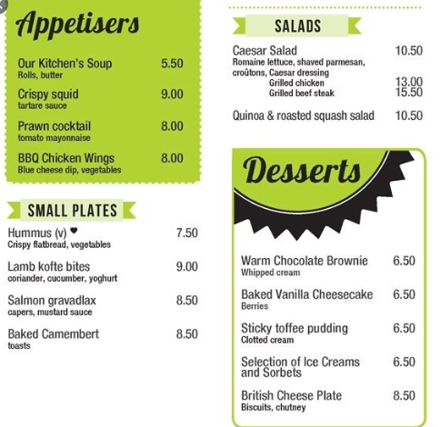
MENU AND PRODUCTS
The Zest restaurant of Forest of Arden Marriott hotel basically offers a range of menu selection and dishes to their customers.
This restaurant mainly provides a great blend of food and drinks to the customers and thus offers great breakfast, dinner and lunch to their guests.
Within the appetizers, this restaurant provides various cocktails as well as wines like Sparkling Wine, French Mail, Red wine etc.
In the starters, this restaurant provides healthy salad as well as fruit and berries to their guests.

Slide 9
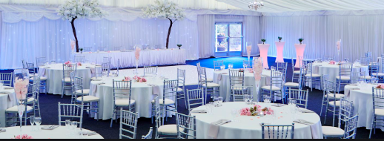
MARKETING STRATEGY
The marketing strategy of the Forest of Arden Marriott hotel is highly well-defined and structured.
This hotel mainly seek the support of both offline and online marketing channels for advertising its services and restaurants.
Within the online channel, company seek the support of social media for attracting the customers.
Within the social media, this hotel markets its products and services on various websites like Instagram, Twitter, Facebook etc.
Notes:
. Along with the social media, this hotel also markets its products and services through the use of television, radio etc. The marketing strategy of this hotel is mainly based on both offline and online activities. Within the offline activities, this hotel promotes their various aspects through word of mouth. The Forest of Arden Marriott hotel provides a great quality to their customers and thus provides well-through customer services by resolving their queries quickly, providing assistance to them, etc thus these loyal customer in turn suggest the hotel to their closed ones. In this, way hotel markets its products and services through offline means.

Slide 10
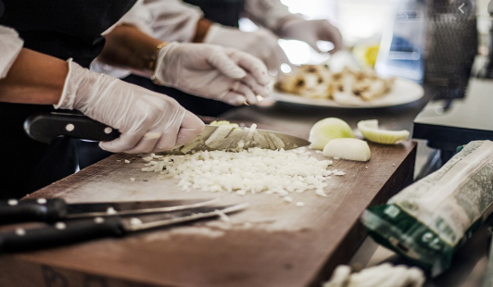
HEALTH AND HYGIENE WITHIN F&B
The restaurant and Forest of Arden Marriott hotel is highly concerned with hygiene and health of their guests and thus provides a great blend of organic and healthy food.
The chefs in restaurant of this hotel are highly trained as well as skilled to provide great customer services.
These chefs are the one who are experienced and thus follows the food hygiene standards and rules thoroughly.
These chefs maintains the hygiene within their kitchen by frequently cleaning the utensils with the safe dishwasher and maintaining a proper hygiene in kitchen.
Notes:
. Besides this, all the dishes that the restaurant and this hotel provides contains all the ingredients which are highly organic and of high quality. For example- meat based food items restaurant uses the chicken which is highly processed and free of germs. Along with this, the workers of the restaurant are provided with thorough training about various kitchen etiquette etc. The restaurant is mainly focused towards providing a great experience to customers thus in view of this, staff of the restaurant maintain a hygienic sitting environment for their customers by frequently cleaning the floors and tables. Thus, in this way this hotel provides a great customer service by emphasizing on health and hygienic.

Slide 11
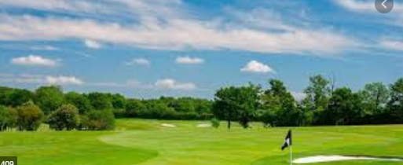
CONCLUSION
It has been summarized that the hospitality industry is mainly recognized by its quality services and products which they provide to the customers.
The major operations of the hotels are room services, restaurant, swimming pool, lodging services, etc.
Hotels are highly concerned with providing great customer services by focusing in health and hygiene and using various channels for promoting it.

Slide 12
REFERENCES
Barrows, C. and Robinson, M., 2018. Food and Beverage.
Weber, C., 2019. Operational Efficiency in the Food and Beverage Industry Through Sustainable Water Consumption.
Williams, S.N. and Nestle, M. eds., 2017. Big food: Critical perspectives on the global growth of the food and beverage industry. Routledge.
Giacalone, D. and Jaeger, S.R., 2019. Perceived situational appropriateness as a predictor of consumers' food and beverage choices. Frontiers in psychology.10. p.1743.
Chan, E.S. and Hon, A.H., 2020. Application of extended theory of planned behavior model to ecological behavior intentions in the food and beverage service industry. Journal of Foodservice Business Research.pp.1-23.
Weber, O. and Saunders-Hogberg, G., 2018. Water management and corporate social performance in the food and beverage industry. Journal of Cleaner Production.195. pp.963-977.
Del Chiappa, G., Martin, J.C. and Roman, C., 2016. Service quality of airports' food and beverage retailers. A fuzzy approach. Journal of air transport management.53.pp.105-113.
Bresciani, S., 2017. Open, networked and dynamic innovation in the food and beverage industry. British Food Journal.

Slide 13


