Slide 1
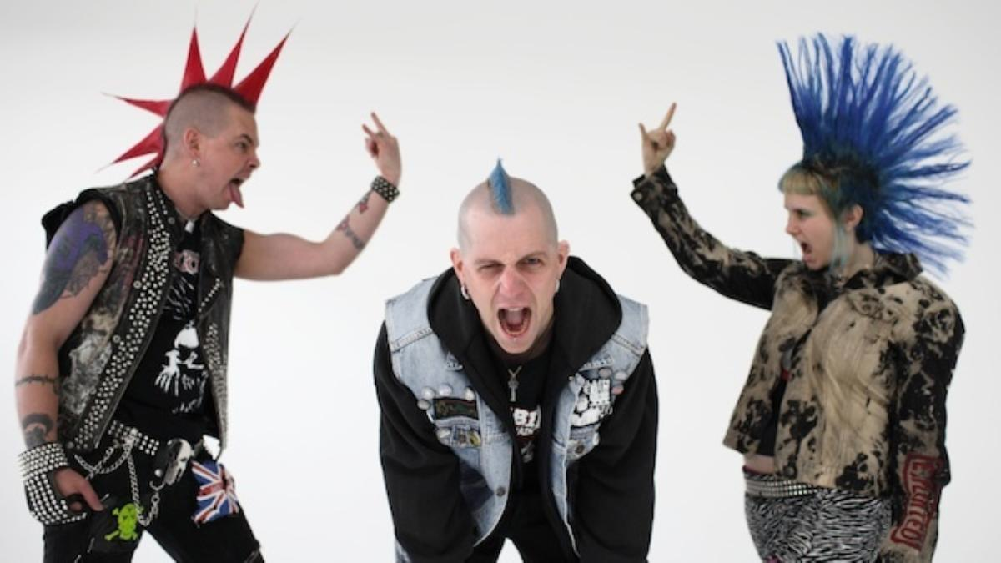

Slide 2
Last week:
Culture as a shared meaning, constructed by a society or community.
Introduction to representations of Wales from the last century.
Introduction to poly or trans creative approach to one text via Under Milk Wood.
Expectation of the familiar.

Slide 3
Woyzeck
Responses to the text.
What themes are apparent?
What types of character were in the excerpt?
What – if any - potential for performance did you envisage?
https://www.youtube.com/watch?v=gQYTk4GjgmM

Slide 4
Linking performance to people
‘What is the vital, dynamic core of the community that gives it its uniquely distinctive character? What really makes it tick?’
(Lewis, 1976:21)

Slide 5
A nice analogy
‘If communities can be thought of as houses, we are as concerned to discover what goes on in the bedroom, bathroom, kitchen as in the dining room and sitting room...’ (Lewis, 1976:19)
‘..spilling over to affect and be affected by what goes on elsewhere under the same roof.’ (Lewis, 1976:19)

Slide 6
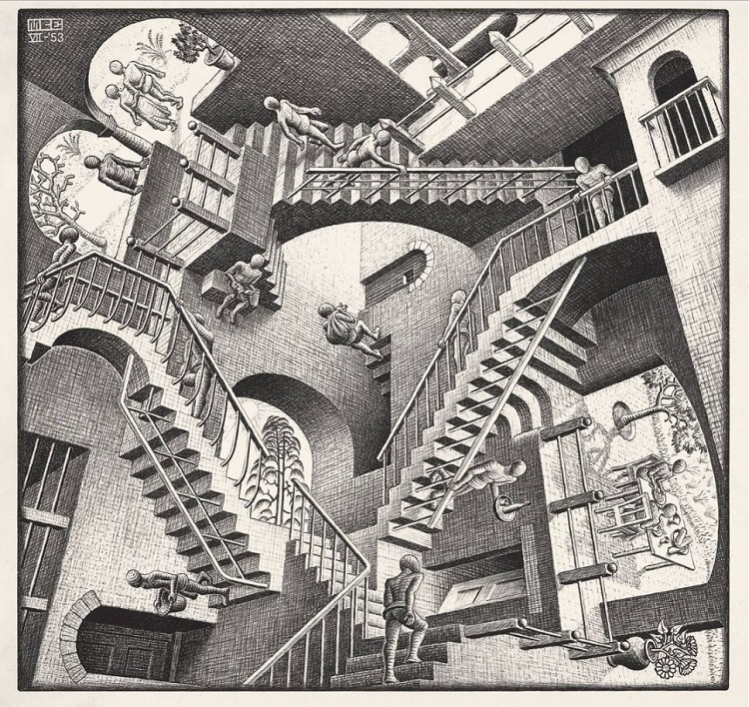

Slide 7
Cross-discipline description
‘Social life can thus be viewed as a kind of theatre, an image which, of course, has always appealed to dramatists and poets. From this perspective, we set out to discover the plot of the social drama which the members of a particular community are in effect engaged in presenting, the parts or ‘roles’ that its members assume, and their mutual interaction as the play proceeds.’ (Lewis, 1976:20)

Slide 8
Looking in
It has been recognised that the external viewer will see in a community that what s/he constructs, as no member of the community can be objective enough to explain the processes to the viewer.
‘Clifford Geertz also advised that once you know what view an anthropologist holds of himself, you can predict what he will say about the people he studies…’ (Lewis, 1976:365-6)

Slide 9
‘our language is a struggle to create our own voices’ (Maybin 2001:64, in Aly,2015:19)

Slide 10
‘The word in language is always half someone else’s. It becomes one’s own only when the speaker populates it with their own intentions. Prior to this moment of appropriation the word does not exist in a neutral and impersonal language (i.e. not in a dictionary) but rather it exists in other people’s mouths, concrete contexts, serving other people’s intentions. It is from there that one must take the word and make it one’s own. (Baktin 1981: 293 in Aly,2015:18).

Slide 11
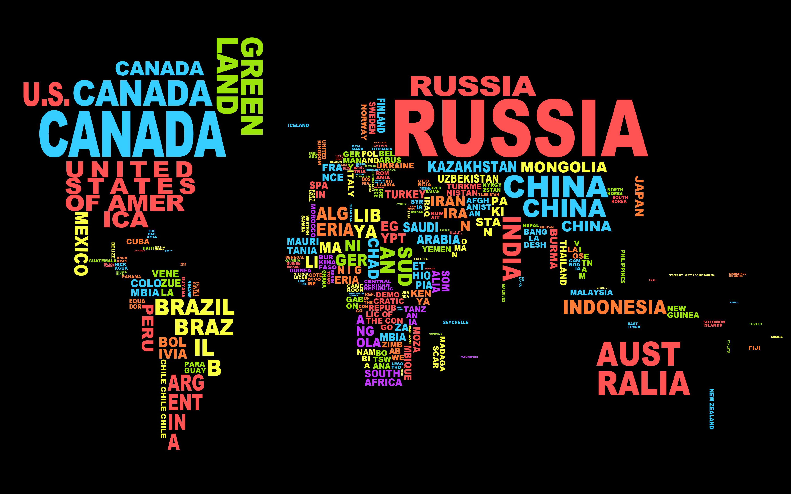

Slide 12
What words come to mind?
List 1
Identity
Narrative
Society
Culture
Ritual
History
Practice
List 2
Boundaries
Etiquette
Habits
Ceremonies
Cults
Gangs
Expectations
List 3
Community
Roots
Play
Authenticity
Folk
Belonging
Heritage
International
Representation
Traditional

Slide 13
Citing Butler, Aly establishes that ‘A “performative act” is one that brings into being or enacts that which it names’ (Butler 1993: 134).
This expresses positive recognition that, in describing ourselves or naming an act we identify it, but Butler conversely considers that the naming process also limits the act (‘regulates and constrains’).

Slide 14
Example
‘Butler turns to the pre-natal ultrasound scene in a hospital where a doctor or nurse announces ‘It’s a girl’. This speech act permanently transforms the foetus and has consequences way beyond physiological categorisations. Almost immediately a set of names, colours, dispositions and characteristics are brought to bear upon this yet-to-be-born human…’ (in Aly, 2015:17).

Slide 15
Dissonance?
Being something therefore not being something else.
Normative - Establishing, relating to, or deriving from a standard or norm, especially of behaviour.
https://en.oxforddictionaries.com/definition/normative

Slide 16
So far, so…?
How are ‘types’ represented at large? Media/ social media/ art/ performance/ language.
What and who were represented in:
The Glynn Vivian gallery
Dylan Thomas’ texts
Woyzeck
Lucy’s play

Slide 17
Subculture
A group of people who consciously define themselves as different to or apart from the culture to which they officially belong.
Dick Hebdige’s Subculture: the Meaning of Style (1979), argues that subcultures use style as a means of creating an identity.
Identity in this context amounts to a form of resistance because it is created in opposition to the hegemonic norms of the day.
(A Dictionary of Critical Theory, 2010)

Slide 18
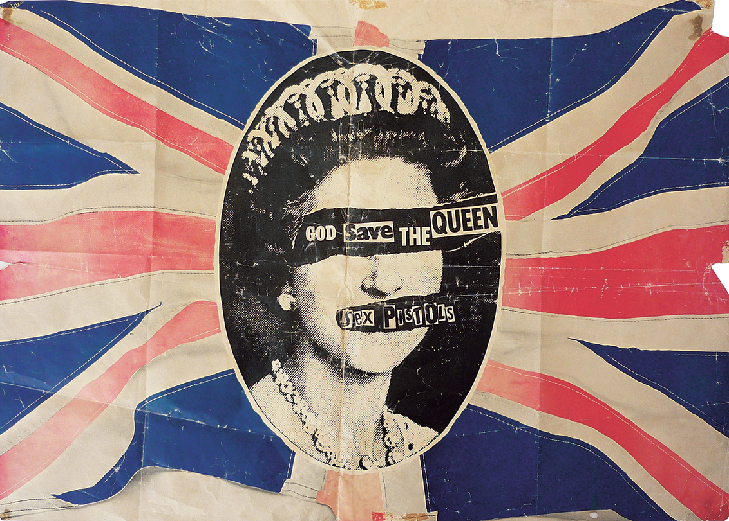

Slide 19
Punk
What is Punk?
What do you think the punk subculture was/did?
Does it matter today?

Slide 20
Punk
A mid to late 70’s movement – therefore an awareness of the ethos of the 1970’s is important in constructively criticizing the ideologies of punk.
Possibilities through lo-fi / non-expert creation – DIY approach to key artistic disciplines – music, fashion, art.
Remaining peripheral to cultural norms.
Both of these are anti-consumerist beliefs locating punk in opposition to social norms.

Slide 21
Punk
Was in -some cases- a response to middle class ideals of what was expected of a young person (job/army/ university) although criticism exists that some punks were rebellious rich kids pretending to be of a different class – a poseur in the true punk’s mind. (Goad).
A rejection of mass - and therefore popular- culture which was perceived as mainstream.
Freedom for individual expression.
Non-conformity in clothing.
Anarchy – a broad and changeable political stance or ideology which (mainly) rejects established power systems.

Slide 22
Punk reborn?
Post punk represented a move from the notional working class rage of the punk era into reinvention and recycling of avant garde artistic beliefs.
The ‘post-punks’ set forth in the belief that “radical content demands radical form” and made a point out of “the systematic ransacking of twentieth-century modernist art and literature”(White, in Sell, 2011)

Slide 23
Post Punk
‘Fragments of the post punk story have emerged here and there to go for the big picture and capture post-punk as what it was: a counter culture that was fragmented yet shared a common belief that music could and should change the world.’ (Reynolds,2006:3)

Slide 24
Mr and Mrs Clark
Is this a punk ethos in performance?
Smash it up (article –read please)
https://vimeo.com/130449475

Slide 25
Pretty Vacant
Punk spawned many copy groups who were often criticized for missing the point of the punk ethos.
During the 90’s art school groups such as Blur and Pulp were very popular.
Elastica ‘s Connection video shows a well polished ‘paired down, diy approach’ to Britpop music making.

Slide 26
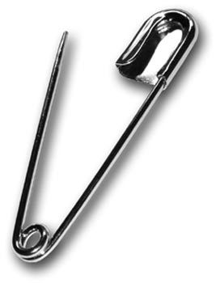
http://www.independent.co.uk/life-style/fashion/safety-pin-punk-relevant-diy-anarchy-alexander-mcqueen-vivienne-westwood-a7357661.html

Slide 27
Toby Mott book.
Some good descriptions of Punk era. In a book. With pictures. Published by Phaidon. Available for £16.85 on Amazon. How mainstream mass culture…
‘Everyone could do something. Also punk didn’t have that distinction between superstars like with Bowie or Led Zeppelin – everyone was on the same level. It wasn’t about worshipping a hero and conceiving a product, it was culture everyone participated in; whether you made the music, or made a fanzine or clothing.”

Slide 28
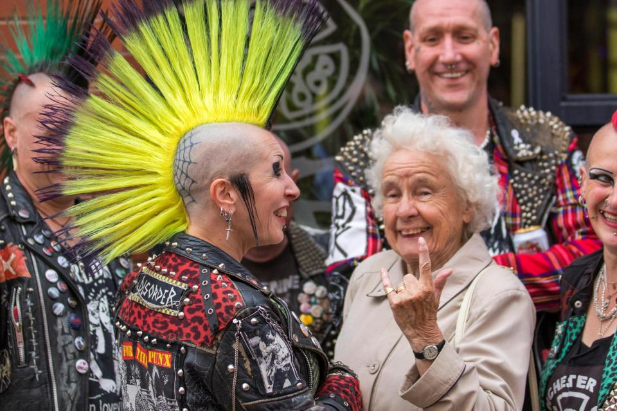

Slide 29
Toby Mott
“You look back to 1976 and 1977 and then jump forward to the New York Book Fair or Cultural Traffic and you see the connection between today’s zine culture and people doing stuff online. The draw is the idea that it’s autonomous and you take control by creating something that doesn’t rely on a major publisher or record company – that’s the link and why it’s still so current,” explains Toby. “I think the internet adds to that idea because it’s a gateway that’s open to everyone. There’s also been a resurgence in zine culture, where people want to make tactile things using paper and crude forms of reproduction.”

Slide 30
Guardian article
https://www.theguardian.com/culture/2014/mar/20/youth-subcultures-where-have-they-gone
This article from 2014 by Petridis outlines the power of the subculture to not only react to more established and mainstream ideas of culture, but – as mentioned in Mott - how digital creativity and democracy plays a significant part in defining how members of today’s societies want to be perceived.

Slide 31
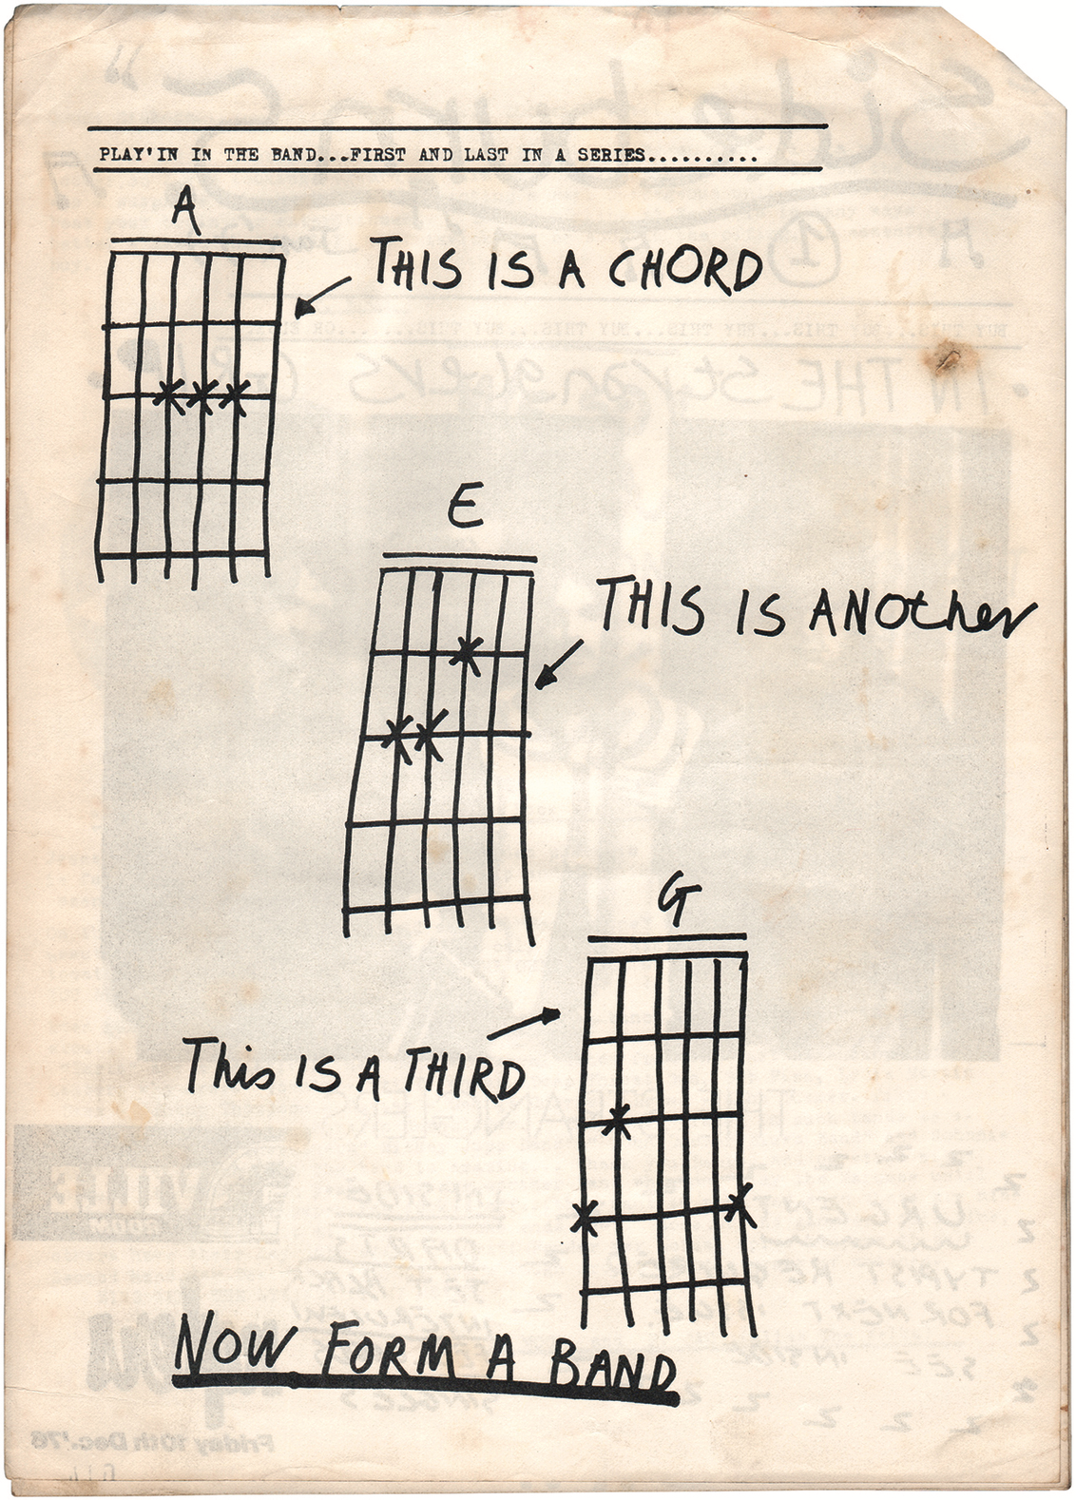

Slide 32
The end?
https://www.further.co.uk/blog/death-of-subculture-part-7-subculture-becoming-culture-neotribalism-whats-the-next-subculture/
Some highly interesting and relevant responses to questions of the continuing existence of the subculture.
“Subcultures are undoubtedly in decline. Subculture isn’t life and death anymore, it’s just having fun in the dressing-up box of history.” (Ian Fortnam)
“The internet changed everything. Why is there any need to go and meet anymore? Cyberspace is forming lots of subcultures” (Rich Berry)

Slide 33
The end?
‘Subculture doesn’t know its history.’
“Everything is now on shuffle. It’s the crippling debilitating side effect of too much choice. We scroll, listen to half a song, watch half a movie then flick. The internet and social is the cultural equivalent of channel hopping on a global scale.” (Russ Tucker)

Slide 34
Task: by Wednesday 07/02/18
Skim the Death of Subculture part 7 article (link in bibliography).
Search for ‘Subculture’ in the LRC catalogue, articles section.
Choose and read 1 article which discusses a subculture that appeals to you.
Make note of some of the ways that your chosen subculture identifies and defines itself by identifying traits in the article and (if necessary) a wider search.
Do you think your chosen subculture is dying out or staying strong?
You will present your findings in a 1-2 minute presentation.

Slide 35
Bibliography
Aly, R.M.K. 2015. Becoming Arab in London: Performativity and the undoing of identity. Pluto Press- London.
Death of Subculture part 7:
https://www.further.co.uk/blog/death-of-subculture-part-7-subculture-becoming-culture-neotribalism-whats-the-next-subculture/
Accessed 01/02/18
Escher image:
http://portugalconfidential.com/escher-art-lisbon/ Accessed 04/02/18
Goad: (this article is an outpouring of inflammatory rhetoric which some people may find disturbing but has value because of its punk style and apparently anti establishment / anti-everything stance)
http://www.jimgoad.net/goadabode/issue%202/undergnd.html Accessed 03/02/18
Lewis, I.M. 1976 Social Anthropology in Perspective: The relevance of Social Anthropology. Cambridge University Press: Cambridge.
Mott publication in Its Nice That:
https://www.itsnicethat.com/features/toby-mott-oh-so-pretty-punk-in-print-phaidon-111016 article

Slide 36
Bibliography
http://www.oxfordreference.com.ezproxy.uwtsd.ac.uk/view/10.1093/acref/9780199532919.001.0001/acref-9780199532919-e-677
Accessed 01/02/18
Word Map of world:
https://rf610.wordpress.com/2014/03/30/experiment-1-word-maps/
Reynold, S. 2006 Rip it up and Start Again. Faber and Faber: London. Available online at:https://books.google.co.uk/books?id=dK-F43T8V0wC&printsec=frontcover&dq=post+punk&hl=en&sa=X&ved=0ahUKEwjfwtuc147ZAhURLewKHcEJAj4Q6AEIKDAA#v=onepage&q=post%20punk&f=false
Accessed 04/02/18
Sell, M. 2011. Avant-garde performance and material exchange: vector of the radical. Palgrave Macmillan: Basingstoke.

