Slide 1


Session 3
Key challenges to supporting ALN learners:
Teacher expectancy, labelling and accountability

Slide 2
Core strand 3:
Key challenges that create barriers to supporting the needs of learners with ALN
Explore how the classroom environment may create barriers for learners with ALN and how this may be modified.
Explore how curriculum content and methods of delivery may create barriers for learners with ALN and how this may be modified.
Understand how assessment may create barriers for learners with ALN and how assessment for learning can be used to support learners with ALN.
Identify how attitudes of teachers, parents and learners could be a barrier to inclusive education.
Understand how the accountability and standards agenda within education may create barriers for learners.

Slide 3
Learning without limits
Teachers work with provisional outcomes.
Learners surprise us in what they know and do.
Relationships are at the heart of pedagogy.
There are important external influences on learning.
Teachers and leaders engage in ‘fixed ability thinking’.
CYP with additional learning needs / disability are particularly vulnerable to determinist beliefs about ability.

Slide 4
We need to see learning capacity as a product of the interplay of external and internal factors and states of mind. It resides in the collective as well as the individual.
Hart and Drummond 2013

Slide 5
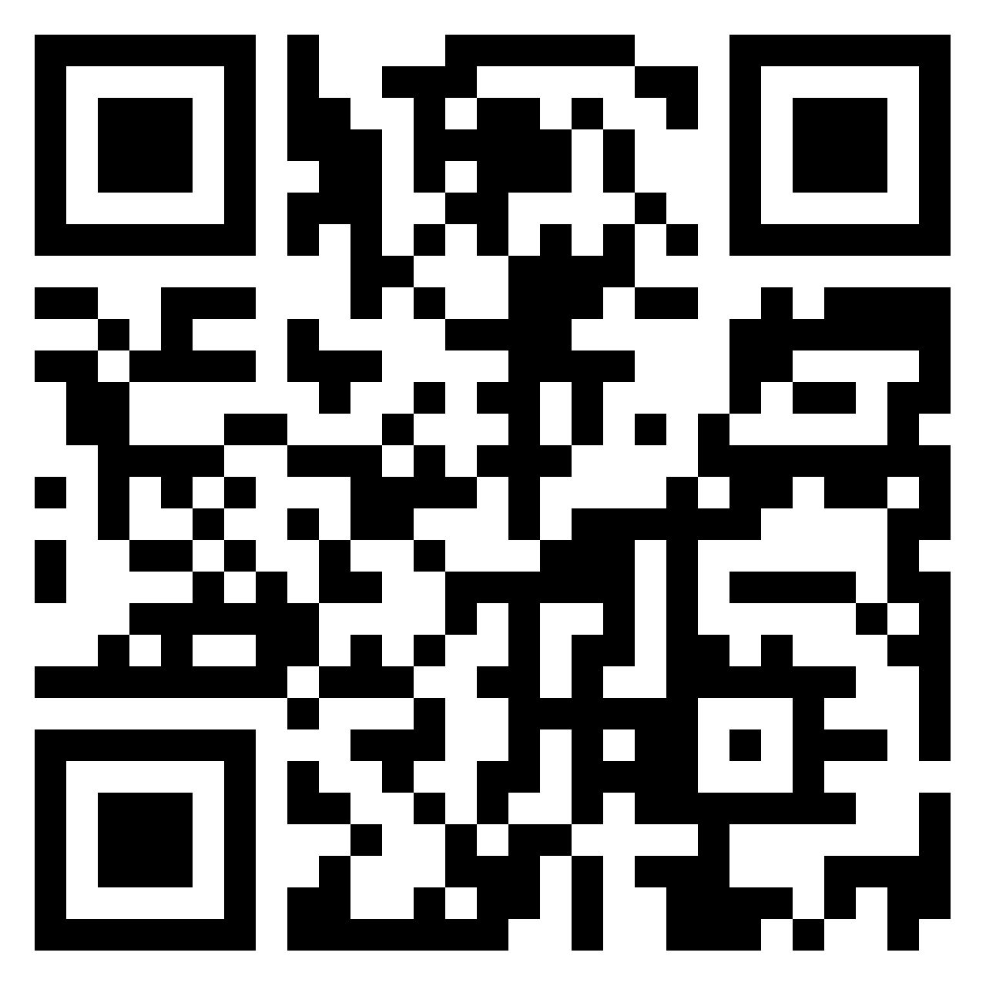
Activity 1
What labels do you use in your setting to describe CYP?
Brainstorm in your break-out rooms and add to Padlet.

Slide 6
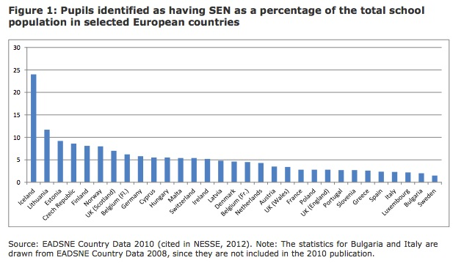

Slide 7
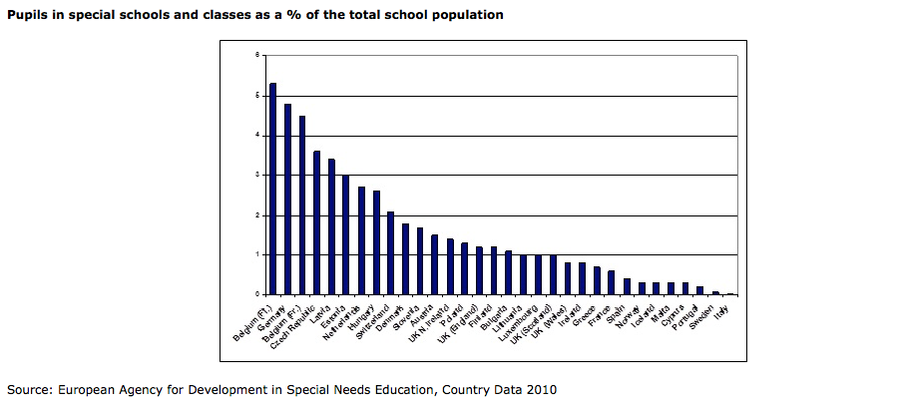

Slide 8
Impact of SEN classification
Greater recognition of SEN = greater inclusive education coverage (IEC).
Where proportion and range of SEN is large, IEC will be high.
Decisive connection between inclusion rate and general belief in importance of SEN.
However, stigma is very important issue.
Entrich 2021

Slide 9
Impact of structural issues within education systems
IEC less dependent on economic resources of a nation or policy commitment to inclusion.
IEC more dependent on extent of differentiation between schools within an education system.
Other factors:
External pressure that mainstream is for ‘average’ learner.
Effectiveness of existing special education system.

Slide 10
Finnish context
High level of inclusive education coverage.
High levels of SEN identification in early years – 30 % of pupils receive ‘part-time special education’.
‘Normalisation’ of learning support – little evidence of stigmatisation of some learners.
Finland has not bought in to competition culture and high-stakes testing.

Slide 11
Categories of need
Steady or decreasing numbers of ‘non-conditional’ disabilities eg. hearing, vision.
Sharp increase in ‘conditional disabilities’ eg. mental health.
Indicates that processes of identification and categorisation can change – especially if depends on judgement, policy design, resource allocation
Can be more or less recognition, and what is recognised can change.

Slide 12
Welsh context
Education system – high accountability, eg. school categorisation system, testing, differentiated schools.
Existing special education system.
Teacher belief – divergent views exist including non-belief in inclusion.
Discourse of low ability / high ability – grouping practices in schools
Tensions in new ALN Code / educational reform.
How will stakeholders respond? – unfolding picture.

Slide 13
Activity 2
Thinking about your setting, rate strength of impact on inclusion of the following: (1 = low impact; 10 = high impact)
Labelling
Testing
Teacher belief (eg. about learner capabilities)
Inclusive values
Stigma
Existing special education provision
School status
Discuss your ratings with your colleagues in break out rooms – explaining your reasons for each of your ratings.

