Slide 1



CIVIL SERVICES JOBS
Name: Ashfak Miah
Student ID: 2114741
Academic & Employability Skills
BMSW4001
Lecturer: Lizeta Demetriou

Slide 2
Overview
WHAT IS CIVIL SERVICE JOBS
HOW/WHERE YOU CAN APPLY FOR CIVIL SERVICE JOBS
WHAT REQUIREMENTS YOU NEED
SWOT STRENGTH & WEAKNESS
DEFINITIONS OF BEHAVIOURS
REFERENCE

Slide 3

What is Civil Service
The civil service is a collective term for a sector of government composed mainly of career civil servants hired on professional merit rather than appointed or elected, whose institutional tenure typically survives transitions of political leadership.
For example: you can apply for Admin, magistrates court, crown court, HMCTS & 10 DOWNING STREET AS PA
https://www.britannica.com/topic/civil-service/Conditions-of-service - (BY Edward Bridges, 1st Baron Bridges)
https://en.wikipedia.org/wiki/Civil_service - (According to the information on Wikipedia)

Slide 4
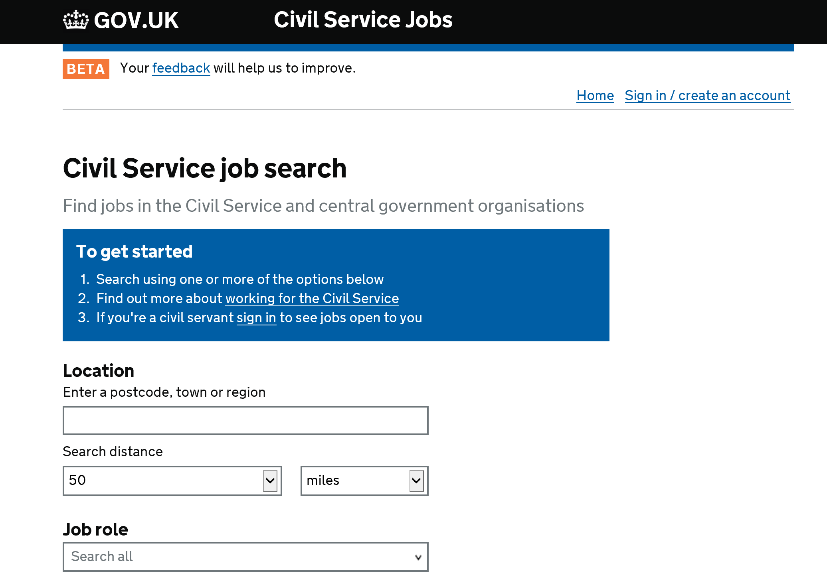
How/where you can apply for civil service jobs
You can go to the civil service jobs website.
https://www.civilservicejobs.service.gov.uk/csr/index.cgi - (All content is available under the Open Government Licence v3.0, except where otherwise stated)

Slide 5
DEFINITIONS OF BEHAVIOURS
Seeing the Big Picture
Changing and Improving
Making Effective Decisions
Leadership
Communicating and Influencing
Working Together
Developing Self and Others
Managing a Quality Service
Delivering at Pace
Delivering at Pace
Managing a Quality Service
Making Effective Decision
Communicating and Influencing
https://assets.publishing.service.gov.uk/government/uploads/system/uploads/attachment_data/file/717275/CS_Behaviours_2018.pdf - (2018, Success Profile Civil Service Behaviours, pg. 1-6)

Slide 6

WHAT REQUIREMENTS YOU NEED
Communication Skills
Personal Skills & Interpersonal Skills
IT Skills
Time Management

Slide 7

COMMUNICATION SKILLS
The ability to listen, process and interpret information and follow instructions.
Conflict handling and the ability to communicate effectively in difficult situations.
Understanding of business terms, especially terms specific to the role you are applying for.
Clear and well-structured preparation and presentation of written communication, for emails, letters, business reports etc. Writing skills will include strong word-processing skills.
https://www.skillsyouneed.com/general/graduate-employability-skills.html - (July 2011, SkillsYouNeed.com)

Slide 8

Personal Skills & Interpersonal Skills
Personal Skills
Interpersonal Skills
Maintaining an appropriate personal appearance and attitude.
Balancing your work and personal life effectively and finding time to relax.
Ability to define personal priorities and manage your time effectively.
Ability to compare and contrast theoretical models and relate them to practical and contemporary issues.
The ability to network, build rapport and gain the understanding of different people, colleagues, managers and bosses, clients, customers and the general public.
Group and team working skills – including the ability to participate and work with others in a positive, organised and collaborative way.
The ability to work alone and proactively, demonstrating good personal motivation and time management.
Problem solving and analysis skills, including systematic and logical reasoning, critical evaluation, appropriate interpretation and innovation and creativity.
To understand your weaknesses and be able to deal with criticism constructively.
https://www.skillsyouneed.com/general/graduate-employability-skills.html - (July 2011, SkillsYouNeed.com)

Slide 9

IT Skills
Ability to use Microsoft office
Have good knowledge od data entry
Security & Privacy
Email Clients
Search Engines
Computer Programming

Slide 10

Time Management
Excellent time keeping skills
Always willing to go above and beyond
Be reliable
Be able to adapt to chances within the business requirements

Slide 11

SWOT STRENGTH & WEAKNESS
STRENGTH
WEAKNESS
Confident
Adaptable
Efficient
Disciplined
Motivator
Learner
Problem solver
Team player
Responsible
Fear of losing your job
Job may not be permanent
Public complain about your customer
Making a lot of mistakes
Arguing with managements and other staff members
https://assets.publishing.service.gov.uk/government/uploads/system/uploads/attachment_data/file/717274/CS_Strengths_2018.pdf - (2018, Success Profile Civil Service Strengths Dictionary, pg. 1-6)

Slide 12


REFERENCE
https://www.britannica.com/topic/civil-service/Conditions-of-service - (BY Edward Bridges, 1st Baron Bridges)
https://en.wikipedia.org/wiki/Civil_service - (According to the information on Wikipedia)
https://www.civilservicejobs.service.gov.uk/csr/index.cgi - (All content is available under the Open Government Licence v3.0, except where otherwise stated)
https://assets.publishing.service.gov.uk/government/uploads/system/uploads/attachment_data/file/717275/CS_Behaviours_2018.pdf - (2018, Success Profile Civil Service Behaviours, pg. 1-6)
https://www.skillsyouneed.com/general/graduate-employability-skills.html - (July 2011, SkillsYouNeed.com)
https://www.skillsyouneed.com/general/graduate-employability-skills.html - (July 2011, SkillsYouNeed.com)
https://www.skillsyouneed.com/general/graduate-employability-skills.html - (July 2011, SkillsYouNeed.com)
https://assets.publishing.service.gov.uk/government/uploads/system/uploads/attachment_data/file/717274/CS_Strengths_2018.pdf - (2018, Success Profile Civil Service Strengths Dictionary, pg. 1-6)

