Slide 1


Social Media & Digital Marketing
Niche Marketing

Slide 2
Digital Marketing
Media forms overlap
Platforms
Owned Media
Websites
Mobile Sites – Apps
Review Sites
Social Media

Slide 3
Impacts & Strategies
Display Ads
Retargeting
Pay per click
Paid Adverts
Shares, Mentions, Reviews
Incentives
Influencers
Paid Influencers
Paid Content
Promotion
Data Gathering

Slide 4

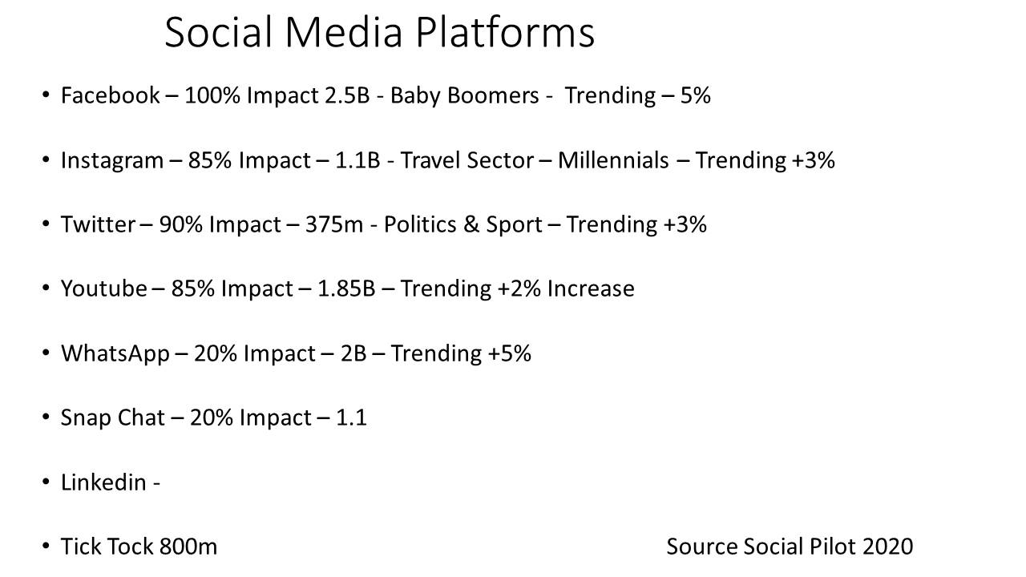

Slide 5
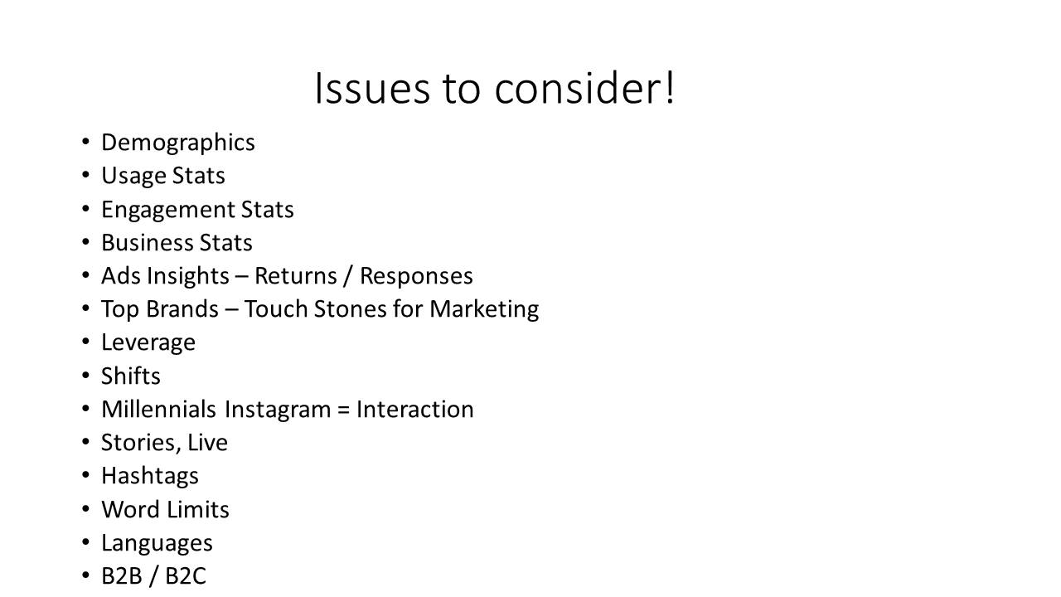

Slide 6


