Slide 1

BMHP6009 Assessment 1
May 2023
Euthanasia and End of Life
Presentation by
Carrie Jelfs -1912214
Isatou Jadama - 2014844
Zhasmina Georgieva - 2026746

Slide 2

Hello and Good Morning
I am Carrie and these are my colleagues Zhasmina and Isatou. Today we are presenting some key facts on Euthanasia and End of life care, the purpose it serves and the rights of euthanasia for some patients who are at the end of their lives.
Many patients come to stage in their lives where they will need palliative care and sometimes what is in the best interest for the patient is not always the case for legal reason. According to the NHS assisted suicide is an illegal act of purposely ending a person's life NHS (2020).
Guardian (2023).

Slide 3
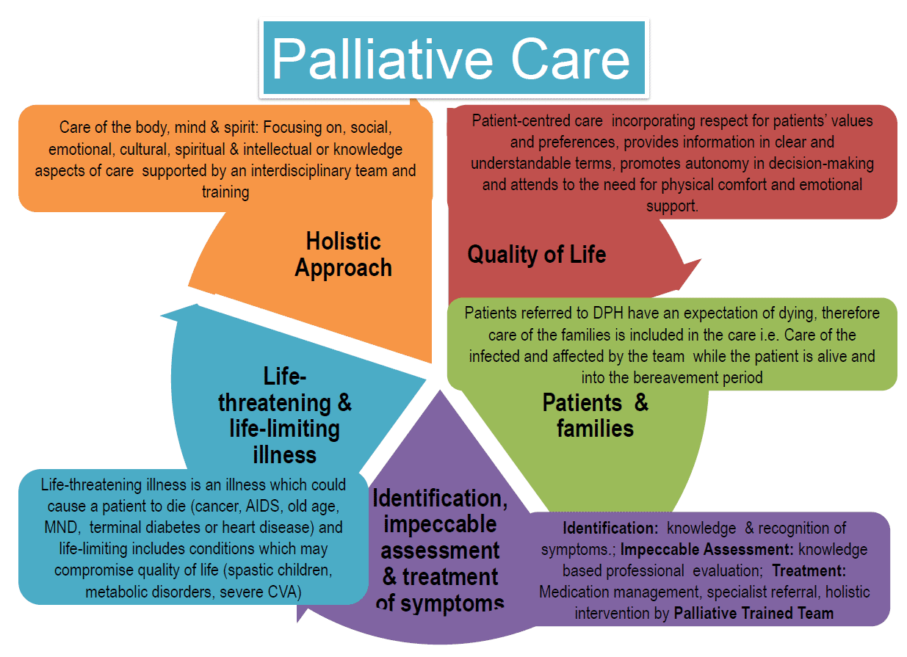
Care Settings
As we take through this presentation you will be able to Briefly imagine care settings for a patient at end of life. Some end-of-life patients can receive this at home, care home or hospital GOV (2019).
Palliative Care (2023).

Slide 4

End of life Defined
This define by ethic value and end of life experience, social values and most importantly the relationship with cardiac arrest - Haworth Press (2005).

Slide 5

Palliative Care
This is a particular type of care given in nursing, residential care homes and hospitals. In some cases, it can be delivered at home with family ()

Slide 6
Is End of life care for everyone?
During this slide I will talk about the gap between the needs and availability and the options and resources that are suitable for each person, and if in fact these aspects are suitable for everyone.
It is important to recognise a person's psychological well-being during this stage of their lives. Can a person recognise that they are dying and are they in immediate pain and suffering?
Hurst, & Mauron, A. (2017).
Hurst, & Mauron, A. (2017). ​

Slide 7

Arguments for euthanasia and assisted suicide
Autonomy and self-determination: it is contended that the Autonomy of individuals should encompass the ability to make choices regarding the termination of their lives (Young, Burgess, & Philip, 2019).
Mercy and compassion: it is believed that euthanasia and assisted suicide can alleviate the pain and distress (Haverkate et al., 2018)
Patient-centred care: it is argued that respecting patient autonomy and providing options for a hastened death can extend quality end-of-life care.
Notes:
Autonomy and self-determination: According to Young, Burgess, and Philip (2019), proponents of autonomy and self-determination in end-of-life decision-making argue that individuals should have the freedom to make choices about ending their lives, especially when faced with unbearable suffering. They emphasize the importance of respecting an individual's values, beliefs, and dignity when making such a profound decision. It is believed that granting individuals the authority to make decisions about their own lives and deaths can provide a sense of control and comfort, allowing them to minimize unnecessary agony.
b. Mercy and compassion: Haverkate et al. (2018) argued that it is believed that euthanasia and assisted suicide have the potential to alleviate the pain and distress experienced by terminally ill patients, enabling them to pass away peacefully and with dignity. Advocates further argue that legalizing these practices can establish necessary safeguards and regulations to ensure their ethical and responsible implementation, thereby protecting vulnerable individuals from potential abuse or coercion. They assert that by recognizing and respecting an individual's right to a self-determined death, society can foster compassion, empathy, and uphold the principles of autonomy and human rights.
c. Patient-centred care: it is argued that respecting patient autonomy and providing options for a hastened death can extend quality end-of-life care. Supporters of patient-centered care argue that allowing patients to have a say in their end-of-life choices, including the option of a hastened death, honors their values, preferences, and personal experiences. They contend that by prioritizing patient autonomy and tailoring care to their unique needs and desires, healthcare professionals can offer a comprehensive approach that encompasses physical, emotional, and spiritual well-being, ultimately enhancing the overall quality of end-of-life care.

Slide 8
Arguments for euthanasia and assisted suicide
Sanctity of life: it is believed that Chambaere et al. (2015) argue that the belief in the inherent value and sanctity of human life, considering it inviolable irrespective of the circumstances, is widely held. human life's inherent value and Sanctity, considering it inviolable regardless of the circumstances (Chambaere et al., 2015).
Slippery slope: there concerns about the potential for abuse and the erosion of safeguards once euthanasia and assisted suicide are legalized, potentially endangering vulnerable populations.
Palliative care alternatives: According to Quaghebeur et al. (2017), enhancing the availability of excellent palliative care and pain management can effectively alleviate the suffering experienced by individuals who are terminally ill.
Notes:
Arguments against euthanasia and assisted suicide
Sanctity of life: According to Chambaere et al. (2015), opponents of hastened death emphasize the inherent value and sanctity of human life, regarding it as inviolable irrespective of the circumstances. They argue that the sanctity of life is a universal and intrinsic principle that must be upheld to safeguard the inherent dignity and worth of every individual. Opponents believe that intentionally ending a human life, even in the presence of suffering, undermines the fundamental value of human existence and establishes a dangerous precedent that could potentially erode the sanctity of life in other contexts. Additionally, opponents advocate for prioritizing palliative care and enhancing pain management to meet the needs of terminally ill patients, with a focus on providing comfort, support, and compassionate care until natural death occurs.
b. Slippery slope: Critics express concerns about the potential for abuse and the erosion of safeguards once euthanasia and assisted suicide are legalized, potentially endangering vulnerable populations. Critics argue that legalizing euthanasia and assisted suicide could lead to a slippery slope, where the criteria for eligibility may gradually expand beyond the terminally ill, such as individuals with chronic illnesses or even those experiencing mental health challenges. They raise concerns about the potential for devaluing human life and the risk of vulnerable populations, such as the elderly or disabled individuals, facing coercion, neglect, or pressure to choose death over life due to societal and economic factors.
c. Palliative care alternatives: According to Quaghebeur et al. (2017 enhancing access to high-quality palliative care and pain management can effectively address the suffering experienced by terminally ill patients, eliminating the need for euthanasia or assisted suicide. Supporters of palliative care alternatives emphasize that by investing in comprehensive palliative care services, encompassing physical, emotional, and psychological support, patients can experience a significant reduction in pain and an improved quality of life. They underscore the importance of adopting a holistic approach that provides comfort, preserves dignity, and delivers compassionate care throughout the end-of-life journey. By prioritizing optimal support, patients can live their remaining days with dignity and support, rendering the option of hastened death unnecessary.

Slide 9
History of euthanasia and assisted suicide
Euthanasia and assisted suicide have a long history dating back to ancient civilizations (Trachtenberg, Manns, & Cuthbertson, 2019).
The development of modern medical technologies and advancements in end-of-life care have further complications
As societies grapple with the complexities of these issues, ongoing debates, and legal frameworks strive to strike a delicate balance between safeguarding individual rights(Radbruch et al., 2016).
Notes:
According to Trachtenberg, Manns, and Cuthbertson (2019), euthanasia and assisted suicide have a lengthy historical background that can be traced back to ancient civilizations. However, it was during the 19th and 20th centuries that debates surrounding these practices gained prominence, leading to extensive legal and ethical discussions that continue to shape contemporary discourse.
The advent of modern medical technologies and advancements in end-of-life care have further complicated these discussions, raising important questions about the limits of medical intervention, patient autonomy, and the responsibilities of healthcare professionals.
As societies grapple with the complexities of euthanasia and assisted suicide, ongoing debates and evolving legal frameworks aim to strike a delicate balance between protecting individual rights, ensuring ethical practices, and upholding the core principles of medical (Radbruch et al., 2016).

Slide 10

Recommendations for future
PRACTICE, POLICY OR RBaBase on our research and analysis, we recommend the following changes for future practice, policy, or research: 1. Enhance public awareness and education: there is a need for greater public awareness on the importance of end-of-life care and options available ,such as living wills and advance directives. Healthcare providers can play a vital role in educating empowering patients and their families to make informed decisions. 2. Increase access to palliative care: more resources and funding should be made available to expand palliative care services, particularly in underprivileged and rural areas 3. Development guidelines for the ethnical use of euthanasia and assisted suicide: there is a need for comprehensive guidelines on the ethnical use of euthanasia and assisted suicide. Such guidelines could help to ensure that these practices are only used where appropriate and in line with legal and ethical standards. 4. Promote and support research: further research should be conducted to better understand the needs and experiences of patients and families at the end-of-life research.
Notes:
Base on our research and analysis, we recommend the following changes for future practice, policy, or research:
Enhance public awareness and education: there is a need for greater public awareness on the importance of end-of-life care and options available ,such as living wills and advance directives. Healthcare providers can play a vital role
in educating empowering patients and their families to make informed decisions.
Increase access to palliative care: more resources and funding should be made available to expand palliative care services, particularly in underprivileged and rural areas
Development guidelines for the ethnical use of euthanasia and assisted suicide: there is a need for comprehensive guidelines on the ethnical use of euthanasia and assisted suicide. Such guidelines could help to ensure that these practices are only used where appropriate and in line with legal and ethnical standards.
Promote and support research: further research should be conducted to better understand the needs and experiences of patients and families at the end of life.
This can help to inform the development of more effective care policies and practices.
Encourage culturally- sensitive care : healthcare providers need to acknowledge that different cultures, religions, and beliefs may influences end –of –life decisions. Hence, there is a need to pay special attention to provide culturally- sensitive care to those approach in the end of their life.

Slide 11

Conclusion
In conclusion, end- of –life care is a crucial aspect of healthcare that aims to provide comfort and support for individuals and their families during the final stages of life. Palliative care is often used as a means of providing end-of-life care in a variety of settings such as hospitals, hospices, and care homes. However, the availability of end-of life care may not always meet the demand ,highlighting the need for improved planning and resources. In our presentation, we explored the controversial topic of euthanasia and assisted suicide. We provided definition and examined the current laws governing these practices in the UK. Additionally, we presented arguments for and against euthanasia and assisted suicide, drawn from extensive independent research. We have endeavored to present a balanced perspective by remaining objective and critical in our research and presentation. We recognize the sensitive nature of this topic and have taken care to remain respectful throughout. In view of the complex and multifaceted nature of the topic, we recommend further research, discussion, and ethical considerations .this will be essential for informing future policies and practices related to end-of- life care ,euthanasia, and assisted suicide. Furthermore, we recognize that there may be potential barriers to implementing our recommendations and suggest possible solutions to these, encouraging ongoing critical thinking and analysis.
Notes:
In conclusion, end- of –life care is a crucial aspect of healthcare that aims to provide comfort and support for individuals and their families during the final stages of life. Palliative care is often used as a means of providing end-of-life care in a variety of settings such as hospitals, hospices, and care homes. However, the availability of end-oflifecaremaynotalwaysmeetthedemand,highlighting theneedfor improved planning and resources. In our presentation, we explored the controversial topic of euthanasia and assisted suicide. We provided definition and examined the current laws governing these practices in the UK. Additionally, we presented arguments for and against euthanasia and assisted suicide, drawn from extensive independent research. We have endeavoured to present a balanced perspective by remaining objective and critical in our research and presentation. We recognize the sensitive nature of this topic and have taken care to remain respectful throughout. In view of the complex and multifaceted nature of the topic, we recommend further research, discussion, and ethical considerations .this will be essential for informing future policies and practices related to end-of- life care ,euthanasia, and assisted suicide. Furthermore, we recognize that there may be potential barriers to implementing our recommendations and suggest possible solutions to these, encouraging ongoing critical thinking and analysis.

Slide 12

References list
Beauchamp, T. L., & Davidson, J. E. (2020). Euthanasia and assisted suicide: Comparing legal frameworks in the United States, Canada, the Netherlands, and Belgium. Journal of Law, Medicine & Ethics, 48(3), 634-648.
Chambaere, K., Vander Stichele, R., Mortier, F., Cohen, J., Deliens, L., & Bernheim, J. L. (2015). Recent trends in euthanasia and other end-of-life practices in Belgium. New England Journal of Medicine, 372(12), 1179-1181.
Department of health and social care.(2018). End of life care. retrieved from https://www.gov.uk/government/publications/end-of-care--2.
Dignity in dying.(2021).campaigning for the right to die with dignity. Retrieved from https://www.dignityindying.org.uk/.
Haverkate, I., Onwuteaka-Philipsen, B. D., & van der Heide, A. (2018). Dutch criteria for physician-assisted dying in medical practice: A physician perspective. Journal of Medical Ethics, 44(9), 599-606.
Hospice UK.(2018).palliative care explained. Retrieved from https://www.hospiceuk.org/what-we-offer/care-and support/palliative-care-explained.
House of commons library.(2019). Assisted dying bill. Retrieved from https://commonslibrary.parliament.uk/research-briefings/sn07015/.
Macmillian Cancer Support.(2018). Palliative care and end of life. Retrieved from https://www.macmillian.org.uk/information-and -support/coping/at-the-end-of-life /palliative-care-and end-of –care.html.
National council for palliative care.(2019). Hospices and hospice care. Retrieved from https://www.ncpc.org.uk/about-us/hospices-and-hospice-care/.
National institute for health and care excellence (NICE).(2019). End of life care for adults. Retrieved from https://www.nice.org.uk/guideline/ng142.

Slide 13
References list
Quaghebeur, T., Dierickx, S., Deliens, L., & Cohen, J. (2017). Palliative care physicians' perspectives on euthanasia and physician-assisted suicide. Journal of Pain and Symptom Management, 54(3), 361-369.
Radbruch, L., Leget, C., Bahr, P., Müller-Busch, C., Ellershaw, J., de Conno, F., & Vanden Berghe, P. (2016). Euthanasia and physician-assisted suicide: A white paper from the European Association for Palliative Care. Palliative Medicine, 30(2), 104-116.
Trachtenberg, A. J., Manns, B., & Cuthbertson, B. H. (2019). Euthanasia and assisted dying practices around the world: A systematic review. Social Science & Medicine, 240, 112546.
Scalon, C.(2019). End-of-life care: what it is and who provides it. Medical News today, retrieved from https://www.medicalnewstoday.com/articles/323159.
Somerville, M. (2020). Death talk: The case against euthanasia and physician-assisted suicide. McGill-Queen's Press-MQUP.
Young, R., Burgess, M., & Philip, J. (2019). Legalising assisted dying: How implementation models impact outcomes. BMJ Supportive & Palliative Care, 9(3), 244-253.

Slide 14
Reference List
NHS (2020) Euthanasia and assisted suicide.
Available at: Euthanasia and assisted suicide (www.nhs.uk.
(Accessed 22nd June 2023).
Palliative Care Nursing (2023) Palliative Care.
Available https://www.pinterest.com/pin/271271577527150900/.
(Accessed 22nd June 2023).
GOV (2019) Palliative and end of life Care.
Available at: https://www.gov.uk/government/collections/palliative-and-end-of-life-care.
Accessed 23rd June 2023).
The Guardian (2023) Beware Mission creep Euthanasia laws.
Available at: https://www.theguardian.com/society/2016/jun/05/beware-mission-creep-of-euthanasia-laws.
(Accessed 22nd June 2023).

Slide 15

References
Journal of social work in end-of-life & palliative care. (2005). Haworth Press. 1(1).
Hurst, & Mauron, A. (2017). Assisted Suicide in Switzerland: Clarifying Liberties and Claims. Bioethics, 31(3), 199–208. https://doi.org/10.1111/bioe.12304.

