Slide 1
Reflective Report Assignment – M32937: Professional Review & Development
Olubukola Adegbite
Student Number: UP2291368

Slide 2
Table of Content
Reflection & Professional Development
Reflective theory to guide my reflection/presentation
Reflective Theory: Gibb’s Reflective Cycle
Evidence of Self – Awareness
Objective Evidence of Impact
Organisational Profile
Commitment to THREE Development Opportunities
My CPD Plans For Life-Long Learning
Conclusion

Slide 3
Reflection & Professional Development
Reflection refers to:
An intentional, experientially guided thought,
It involves self examination, criticality, and problem-solving,
That leads to insight, increased awareness, and/or new understanding (Anderson, 2020).

Slide 4

Reflection & Professional Development
Reflection is important in Professional development initiatives (Hommel, Fürstenau, and Mulder, 2023).
It is an integral part of both formal and informal learning which is a conscious effort and is centred on previous experiences (i.e., reactive learning).
Through professional development effort, reflection can lead to other outcomes at various levels, namely the individual level leading to self-development (Schön, 1983, 1987; Shulman, 1986), by gaining insights into the self and one’s own actions and thereby controlling, modifying, and further developing one’s action (double loop learning).

Slide 5
Reflective Theory used in this Presentation
I have selected Gibb’s reflective cycle in completing my reflective presentation.
Gibb’s reflective cycle is an established reflective model used by students and professional to review, reflect past learnings, experiences with a view to have new set of actions (Gibbs, 1988).
My previous learning both informal and formal learning (primary, secondary, university and professional trainings) has helped in shaping my world view and attitude to learning.
My view about learning is that learning is a continuum, this is particularly so I have moved from industry to academia.

Slide 6
Reason for choosing Gibb’s Reflective Cycle
I chose this model because it provides a systematic approach to reflection and also ensure that all aspect of the experience are well analysed
Also, it helps to recognise our strengths and weaknesses, promoting both personal and professional development (Gibb’s, 1988)

Slide 7
Reflective Theory: Gibb’s Reflective Cycle
Description
Background information of my trasitioning from industry to academia?
Action Plan
Plan I need to achieve going forward in my career development
Feelings
What were my thoughts and
feelings towards my career/professional development journey?
Conclusion
What did I learn from my self-awareness analysis in specific term?
• What were the professional goals/plan I need to achieve going forward?
Evaluation
The good moment and the challenging time in my career journey.
Analysis
What sense did I made from career development journey. What aspects of my career development plan and/or lifestyle that have
helped or hindered my intended
results/outcomes/progress?

Slide 8
My Reflection Using Gibb’s
Description- Transition from industry to Academia, this Involves completion of PGCert and Fellowhip of Higher Academy and starting my Doctor of Business Admnistration (DBA)
Feeling-lack of confident of my ability to succeed in academia, overwhelmed and unsured
Evaluation- access to training, professional development activities and positive feedback from students and colleagues contributed to my success on the other hand pressure to publish research and balance teaching responsibilities were overwhelming

Slide 9
Gibb’s Reflective Model
Analysis-The transition was a major change that necessitated development of new knowledge, perspective and approaches. In industry, it has been researched that professionals moving into academic roles may experience challenges related to identity and belonging within the academic community (Myers et al., 2024).
I was focused on practical applications and problem solving, but academic requires a more theoretical and research driven mindset
Conclusion- Looking back the transition from indusrtry to academia has been challenging yet rewarding experience. one of the significant moment of this journey has been opportunity to pursue my Doctor of Business Administration (DBA)

Slide 10
Gibb’s Reflective
Action Plan- Going forward, I will engage more with academic communities and embrace the principle of lifelong learning and professional development.
I will attend more training, and mentor new lecturers who have undergo the transition from industry to academic
I will also continue my DBA studies and ensure I get support from the University because this is an important step in my career progression and a way to enhance my contribution to academic field.

Slide 11
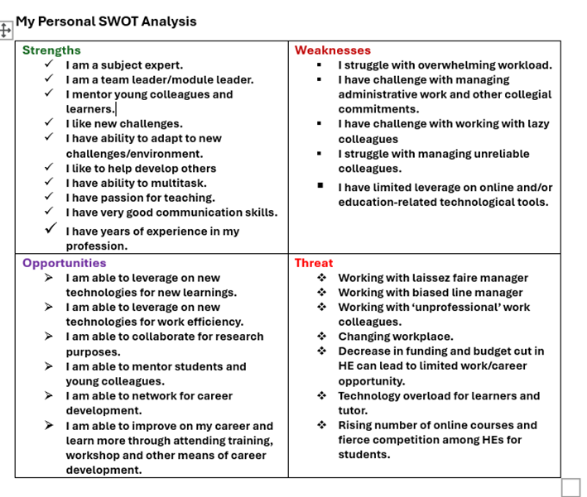
Evidence of Self – Awareness
My SWOT Analysis:

Slide 12
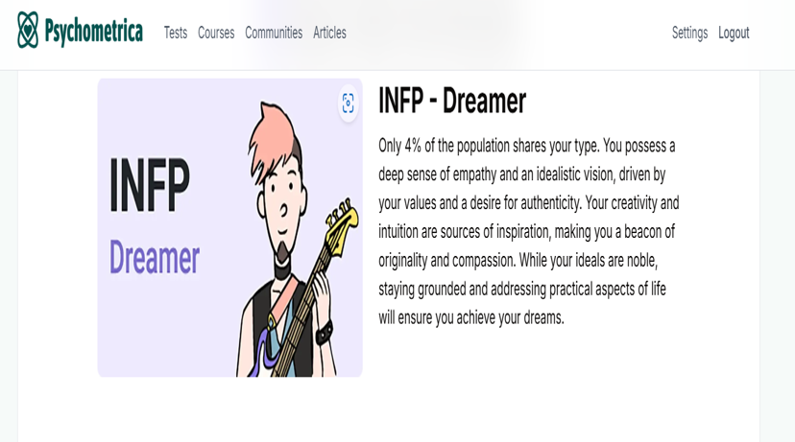
Evidence of Self - Awareness
My Psychometric test results - I:

Slide 13
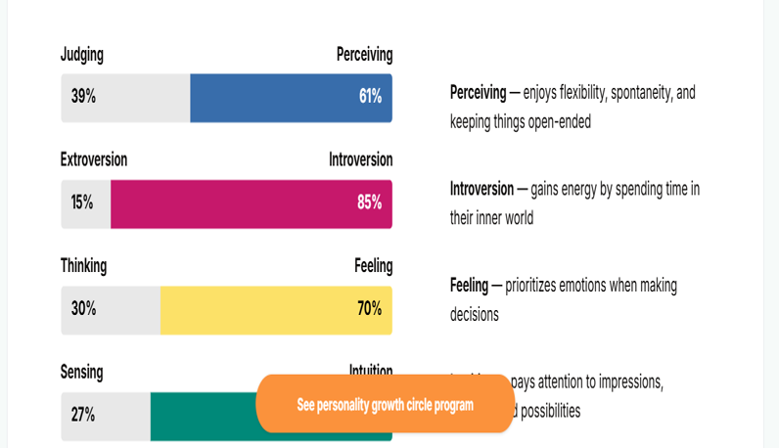
Evidence of Self - Awareness
My Psychometric test results - II:

Slide 14
Psychometric Test & Peer Feedback
The feedback I received from my psychometric test about my personality trait showed that I am a dreamer.
I agreed with this result as I often seen myself as proactive in my thinking, with belief that anything is possible to achieve if I put my mind to it. This certainly reflects my personality.
As I dreamer, I am creative, hands on, ambitious and could set a long-term goals. I impact and inspire my team and can reflect big-picture thinking. However, I need to be cautious lest I am perceived to be overbearing on team members. I also need to be moderate in my ambitious so that I do not push myself too hard.
I need to further leverage on my perceiving trait as it enables my flexibility and adaptability skills. In modern workplace, adaptability skills is fast becoming one of the most desirable skills.

Slide 15

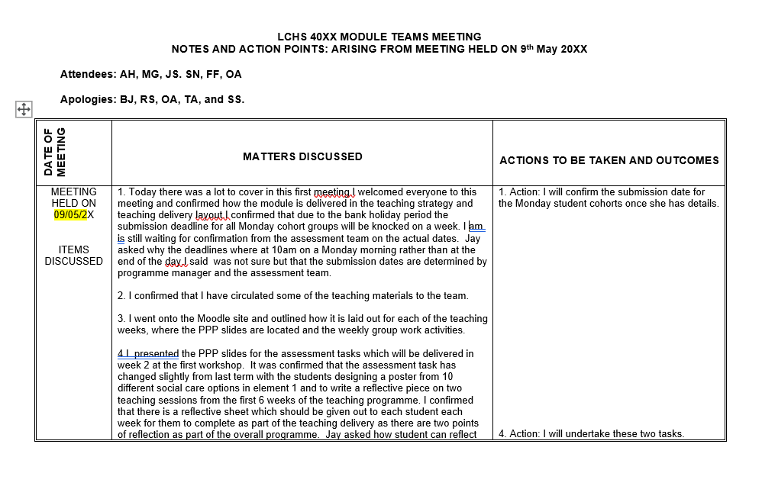
Objective Evidence of Impact
Objective evidence of impact at work, e.g. minutes of meetings:

Slide 16
Organisational Profile
Organisational profile: UK University.
Purpose: Transforming Lives through Education.
Strategy and Structure: Small size class, engaging lecturers, excellent student involvement, multi-campus settings.
Alignment of Personal Profile: I am a University Lecturer in the UK. I teach Business Management modules some of these are The Practice of management, Organisational Culture, Understanding Stakeholder Engagement, etc.,
Career Progression Goals: To start and complete my doctoral in Business Administration (DBA)

Slide 17
Commitment to THREE Development Opportunities
I am committed to three development opportunities that are linked to my professional career goals.
These development opportunities are channels of influence and support. They are:
LinkedIn learning – I intend to take several learning opportunities available on Linkedln for my career development.
Attend HE Webinars: I intend to take advantage of various teaching and research related webinar series as may be organised by my universities and other HE institutions.
I intend to attend HE conferences such as British Academy of Management (BAM), to increase in knowledge and best practices in my industry and among fellow professionals.

Slide 18
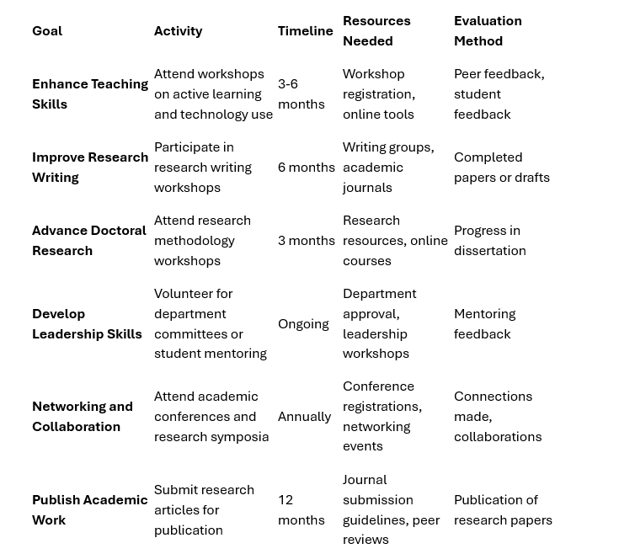
My CPD Plans For Life-Long Learning
My CPD plans to ensure life-long learning with integrated strategies to execute the plan.

Slide 19
Plans for Continue Development
Plans to ensure maximum impact for your continued development
I will ensure I review my plans monthly/quarterly to assess their execution and to stay on track
Professional Development Goals in the area of enhancing my teaching and pedagogical Skills
Continue to work on my doctoral studies by attending classes and completing assessments.
Academic Leadership and Mentorship
  .

Slide 20
Conclusion
In sum, in this presentation, I have reflected and applied Gibb’s reflective cycle on my learning and teaching career.
In the process of demonstrating understanding of self- awareness, I took a psychometric test and applied the SWOT analysis to myself.
The feedback I received from my psychometric test helped me in identifying the areas I need to improve upon, it also helped me of broadening my knowledge of my self-awareness.
In this presentation, I also went through my organisational profile, my commitment to development opportunities that are linked to my professional career goals. I also discussed my plans for life-long learning and my strategies to ensure maximum impact for your continued development.

Slide 21
Reference List
Anderson, J. (2020). Key Concepts in ELT: Reflection. ELT Journal, 74(4), 480–483, available @: https://doi.org/10.1093/elt/ccaa039, (Accessed on 29/03/2025).
Gibbs, G, 1988. Learning by Doing: A Guide to Teaching And Learning Methods. Further Education Unit. Oxford Polytechnic, Oxford.
Hommel, M., Fürstenau, B., & Mulder, R. H. (2023). Reflection at work – A conceptual model and the meaning of its components in the domain of VET teachers. Frontiers in Psychology, 13, 923888. available @: https://doi.org/10.3389/fpsyg.2022.923888, (Accessed on 29/03/2025)
Myers, F., Baxter, J., Selby‐Fell, H. and Pachón, A.M., (2024). ‘Navigating from industry to higher education: Practitioner transitions to academic life’. British Educational Research Journal.
Schön, D. (1983). The Reflective Practitioner: How Professionals Think in Action. New York: Basic Books.
Schön, D. (1987). Educating the Reflective Practitioner. Toward a New Design for Teaching and Learning in the Professions. San Francisco: Jossey-Bass.
Shulman, L. S. (1986). Those who understand: knowledge growth in teaching. Educ. Res. 15, 4–14. doi: 10.3102/0013189X015002004

