Slide 1
Critical Thinking

Slide 2
What is Critical Thinking?
It requires you to use your ability to reason. It is about being an active learner rather than a passive recipient of information.
Critical thinking is…
  the ability to think clearly and rationally, understanding the logical connection between ideas.
  the ability to engage in reflective and independent thinking.
Critical thinkers rigorously question ideas and assumptions rather than accepting them at face value.

Slide 3

The Skills We Need for Critical Thinking
observation, analysis, interpretation, reflection, evaluation, inference, explanation, problem solving, and decision making.
Think about a topic or issue in an objective and critical way.
Identify the different arguments there are in relation to a particular issue.
Evaluate a point of view to determine how strong or valid it is.
Recognise any weaknesses or negative points that there are in the evidence or argument.
Notice what implications there might be behind a statement or argument.
Provide structured reasoning and support for an argument that we wish to make.

Slide 4
think of something that someone has recently told you. Then ask yourself the following questions:
Who said it?
Someone you know? Someone in a position of authority or power? Does it matter who told you this?
What did they say?
Did they give facts or opinions? Did they provide all the facts? Did they leave anything out?
Where did they say it?
Was it in public or in private? Did other people have a chance to respond and provide an alternative account?

Slide 5
think of something that someone has recently told you. Then ask yourself the following questions:
When did they say it?
Was it before, during or after an important event? Is timing important?
Why did they say it?
Did they explain the reasoning behind their opinion? Were they trying to make someone look good or bad?
How did they say it?
Were they happy or sad, angry or indifferent? Did they write it or say it? Could you understand what was said?

Slide 6
How does Thinking Critically Apply to Writing.
Use this critical thought to enhance your writing through critical writing.
At level 4 most question titles asked you to “describe” or “discuss” on a certain topic area. Now (level 5 and 6) the expectation will be for you to critically evaluate or critically discuss.
Therefore if you “describe” or “discuss” then, in essence you are only partially answering the question.

Slide 7
Expectations at level 5 and 6.
Do not just be a photocopier.
Read, Read, Read.
Critique, Critique, Critique.

Slide 8
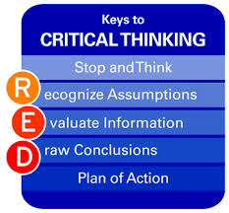
So… how can you start to write critically?
Read the article over several times: it will not always make sense the first time!
Get a feel for the content overall and then start breaking down each section.
A simple model

Slide 9
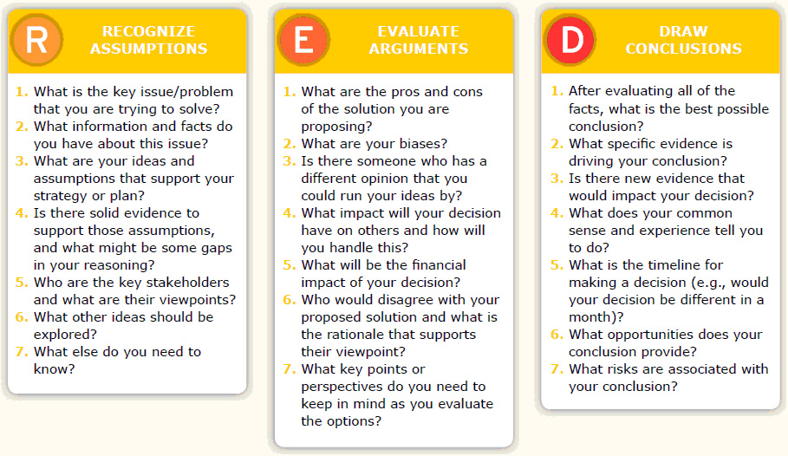
A more complex model:

Slide 10
So…… When we ask you to Critically Discuss / Critically Evaluate
It is using this critical thinking and is a vital skill for a Psychology student
  E.g. Not just ‘slating’ an article
  Highlight the positive too
  Present negative points in a constructive and professional way
    Imagine you’re reviewing papers for a journal – a paper has faults which you need to point out, but you also need to say how it could be better…
    You have to leave the author with the will to carry on!!
    Also remember that if the paper is published in a peer reviewed experts’ have agreed that the paper is good enough to be published. It doesn’t mean it’s perfect necessarily but does mean that it isn’t hopeless!!
    But also, some journals are better than others and more reputable ones have higher standards.

Slide 11
Other Things to Consider when Critically Writing
Assume Nothing.
  Write for an “intelligent idiot” – so YES, some description will be necessary.
Write in your own words – so you understand it.
Evaluate – Strengths and Limitations – Good points and points that could have been improved.
Use other sources to support your evaluation.
  For example – One limitation of Heaney’s (2011) research was the relatively low sample size of 11 participants, in an earlier study Walker (2009) had a sample size of 35 participants.
    EVIDENCE OF WIDER READING.

Slide 12
THE BIGGER PICTURE
Also consider the date of the theory / publication. For example, it’s all very well using modern neuroimaging techniques to question (or critique) cognitive psychology theory – but let’s not forget such techniques were around.
In addition, most researchers will be aware of limitations of their study, but try and consider “why” there are limitations before just labelling them as limitations

Slide 13
Finally.
Everyone can be critical! Being critical involves the ability to question - to ask 'why'. Children ask this all the time and so does everyone else.
Without our ability to criticise existing ideas and ways of doing things nothing would have ever changed! So, the first thing you need to know is that you can do it, in fact you are already doing 'it' and that it is good to be critical.
Therefore, be confident in your own interpretation.

