Slide 1

Level 7 Leading the Learning
“Successful Futures”
Session 1
Module 2 – SF Curriculum – October 2017

Slide 2
Thursday October 5th 2017
2-2.30 – Introduction to new Module
2.30-3 - Research Methods an introduction
3- 4 - Critiquing a research article
4-4.30- SWOT analysis

Slide 3
Learning Outcomes from this module
LEARNING OUTCOMES
Upon the successful completion of this module, the student should be able to demonstrate the ability to:
demonstrate systematic understanding of current thinking in the field of leading the learning in an educational setting
design, plan and implement strategies designed to improve their own practice and have a positive influence on the whole-school learning culture
carry out research to evaluate the impact of any changes on practice
make recommendations based on the results of the research to improve learning at a classroom and a whole school level.
This is all though the Successful Futures –Curriculum vehicle

Slide 4
Successful Futures Curriculum
››› Recommendation 2. The school curriculum should be designed to help all children and young people to develop in relation to clear and agreed purposes. The purposes should be constructed so that they can directly influence decisions about curriculum, pedagogy and assessment.

Slide 5
››› Recommendation 3. The purposes of the curriculum in Wales should be that children and young people develop as:
› ambitious, capable learners, ready to learn throughout their lives
› enterprising, creative contributors, ready to play a full part in life and work
› ethical, informed citizens of Wales and the world
› healthy, confident individuals, ready to lead fulfilling lives as valued members of society.

Slide 6
››› Recommendation 4. The curriculum 3–16 should be organised into Areas of Learning and Experience that establish the breadth of the curriculum. These areas should provide rich contexts for developing the four curriculum purposes, be internally coherent, employ distinctive ways of thinking, and have an identifiable core of disciplinary or instrumental knowledge.

Slide 7
››› Recommendation 5. The new national curriculum in Wales should have six Areas of Learning and Experience:
Expressive arts;
Health and well-being;
Humanities;
Languages, literacy and communication;
Mathematics and numeracy; and
Science and technology.

Slide 8

AoLE

Slide 9
››› Recommendations 6. Children and young people should have their learning developed across the curriculum through three Cross-curriculum Responsibilities that should be the responsibility of all teachers: literacy; numeracy; and digital competence.

Slide 10
›››7. A digital competence framework and an accompanying ‘Routes to Learning Digital Competence’ should be developed and be included as a Cross-curriculum Responsibility.
Recommendation 8. The expectations for the three Cross-curriculum Responsibilities and wider skills should be embedded within the Areas of Learning and Experience

Slide 11


Slide 12
Research Methods
See handout (Red)
PowerPoint 2 and 3

Slide 13
How to critique a research article

Slide 14
Critically reviewing education research literature
How do we critically evaluate research literature
  At the level of the article
  At the level of the field of interest
It’s all published so should it be the ‘final word’?
‘The literature review’

Slide 15
Critical and critical
‘well, I think it’s rubbish because I don’t agree; my year 3s / year7s would never respond like that’
‘I like it, I know the author is a professor and I agree that phonics is the way forward; it’s how I learnt after all’
Being academically critical ...

Slide 16
Your ‘voice’
You are the audience for educational research
Your considered opinion is valued in judging any educational research
You are able to undertake academically critical consideration

Slide 17
Evaluating a research article 1
Key Questions
Is it coherent?
Is it convincing?
Some starting points :
What are the aims and objectives of the research? (If not stated explicitly try and work it/them out.)
What research questions or hypothesis guide the study? (If not stated explicitly try and work it/them out.)
What is the context of the study?
What is the sample size and type – how selected? (Fair?)
Ethical issues – are ethical issues identified and explored? Are you satisfied with this aspect of the article? Why? Why not?
Notes:
As we progress through the module you will find the evaluative comments easier to make – based on your increasing knowledge of the field of research methods.

Slide 18
Evaluating a research article 2
What was the researcher’s role? (Participant, non-participant, professional researcher, teacher etc)
What data collection methods were used? What do you consider the strengths and weaknesses of the chosen methods?
Raw data – what raw data was collected?
Data management – how was the raw data organised for presentation in the article?
Analysis strategy – how was the data analysed? (Qualitative/quantitative/mixed method)

Slide 19
Evaluating a research article 3
What conclusions does the author come to?
What are the implications of the findings for teachers/educators?
What are the main point(s) of view presented in this article? (What argument(s) are the author/s putting forward?)
Are you convinced by the argument/s? (Explain your response: why/why not?)

Slide 20
‘Leaders views on the value of school based research’
Start to identify aspects of your research paper using the prompts
(Work in pairs if you wish)
Notes:
20 minutes or so – see slide 5 especially.

Slide 21


Slide 22
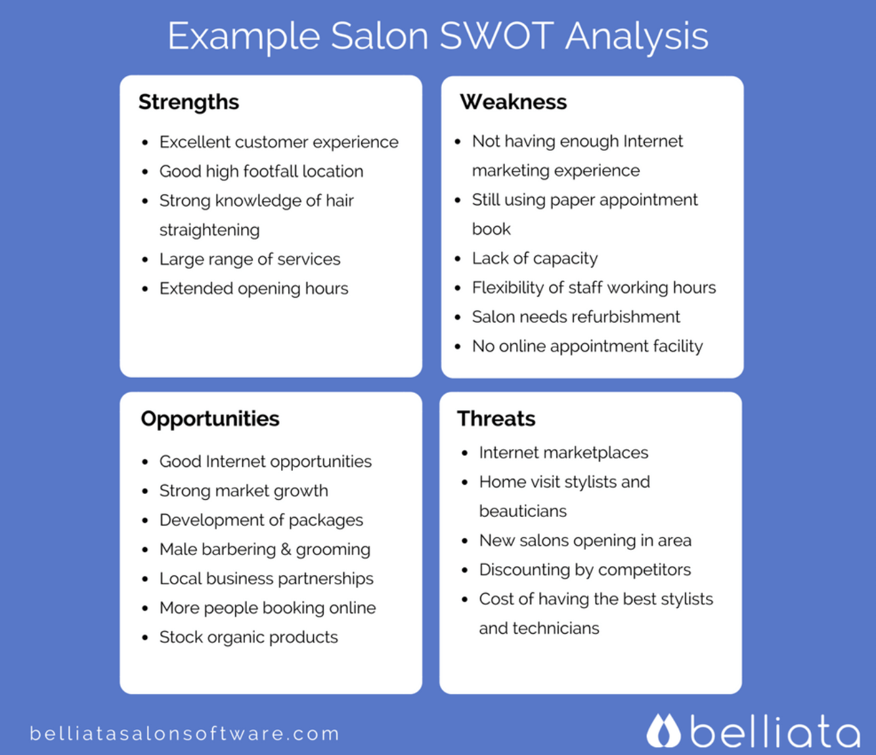

Slide 23
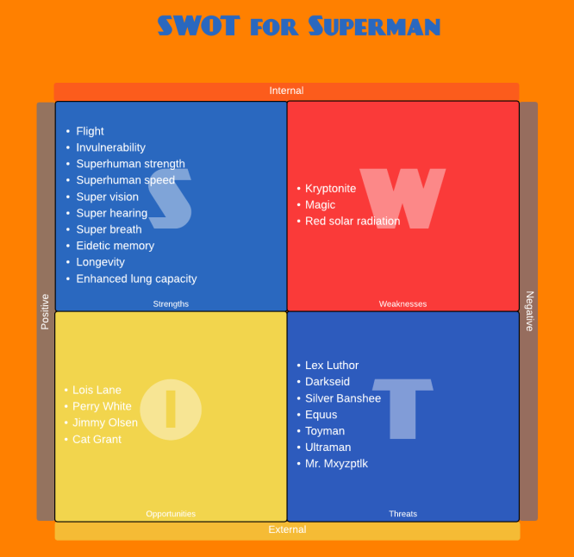

Slide 24
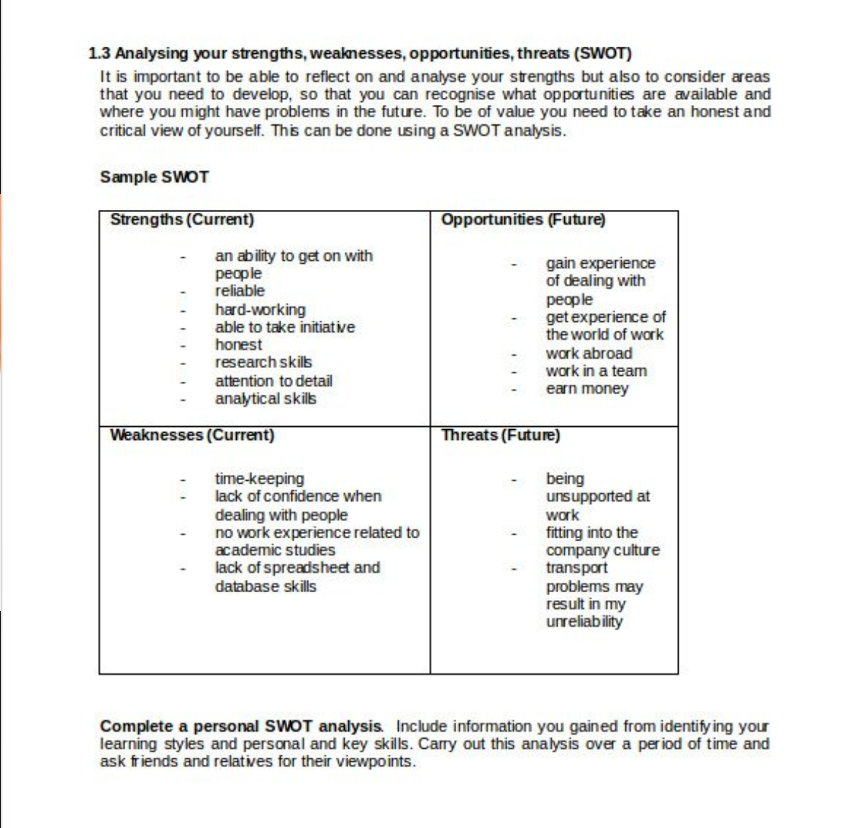

Slide 25
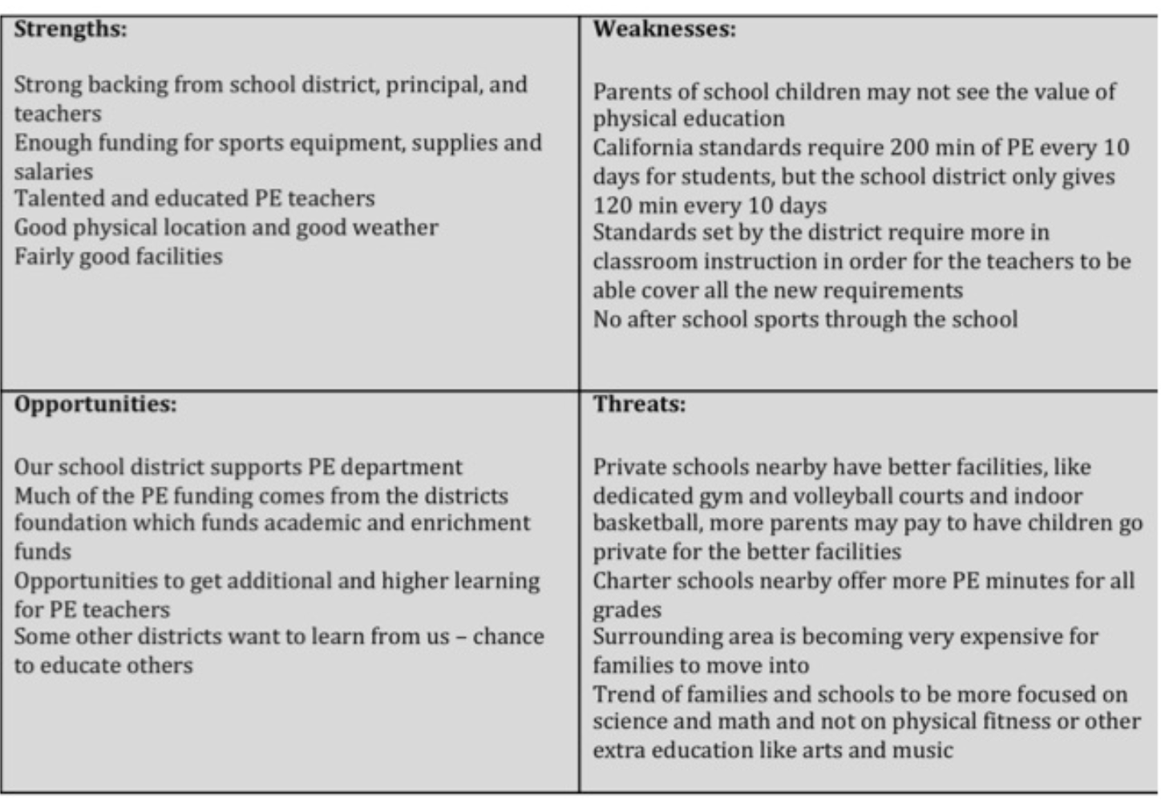

Slide 26
Use SWOT analysis tool to identify an area for research-focus SF Curriculum
Bring your ideas to session 2:
Area of focus
What research are you going to conduct
Questions to be answered

