Slide 1
Experiential Learning Theories

Slide 2
Experiential Learning Theory
Kolb 1984

Slide 3
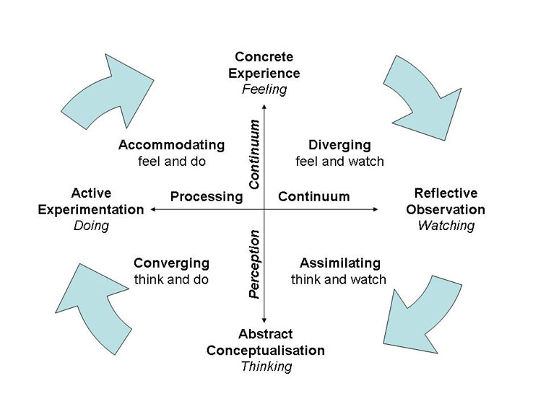
Experiential Learning Theory
Kolb 1984

Slide 4
Experiential Learning Theory
DIVERGING STYLE
These people are able to look at things from different perspectives.
They are sensitive.
They prefer to watch rather than do, tending to gather information and use imagination to solve problems.
They are best at viewing concrete situations from several different viewpoints.
Kolb called this style 'diverging' because these people perform better in situations that require ideas-generation, for example, brainstorming.
People with a diverging learning style have broad cultural interests and like to gather information.
They are interested in people, tend to be imaginative and emotional, and tend to be strong in the arts.
People with the diverging style prefer to work in groups, to listen with an open mind and to receive personal feedback.

Slide 5
Experiential Learning Theory
ASSIMILATING STYLE
The Assimilating learning preference involves a concise, logical approach.
Ideas and concepts are more important than people.
These people require good clear explanation rather than a practical opportunity. They excel at understanding wide-ranging information and organizing it in a clear, logical format.
People with an assimilating learning style are less focused on people and more interested in ideas and abstract concepts.
People with this style are more attracted to logically sound theories than approaches based on practical value.
This learning style is important for effectiveness in information and science careers. In formal learning situations, people with this style prefer readings, lectures, exploring analytical models, and having time to think things through.

Slide 6
Experiential Learning Theory
CONVERGING STYLE
People with a converging learning style can solve problems and will use their learning to find solutions to practical issues.
They prefer technical tasks, and are less concerned with people and interpersonal aspects.
People with a converging learning style are best at finding practical uses for ideas and theories.
They can solve problems and make decisions by finding solutions to questions and problems.
People with a converging learning style are more attracted to technical tasks and problems than social or interpersonal issues.
A converging learning style enables specialist and technology abilities.
People with a converging style like to experiment with new ideas, to simulate, and to work with practical applications.

Slide 7
Experiential Learning Theory
ACCOMODATING STYLE
The Accommodating learning style is 'hands-on,' and relies on intuition rather than logic.
These people use other people's analysis, and prefer to take a practical, experiential approach.
They are attracted to new challenges and experiences, and to carrying out plans.
They commonly act on 'gut' instinct rather than logical analysis.
People with an accommodating learning style will tend to rely on others for information than carry out their own analysis.
This learning style is prevalent within the general population.

Slide 8
Honey & Mumford (1986)

Slide 9
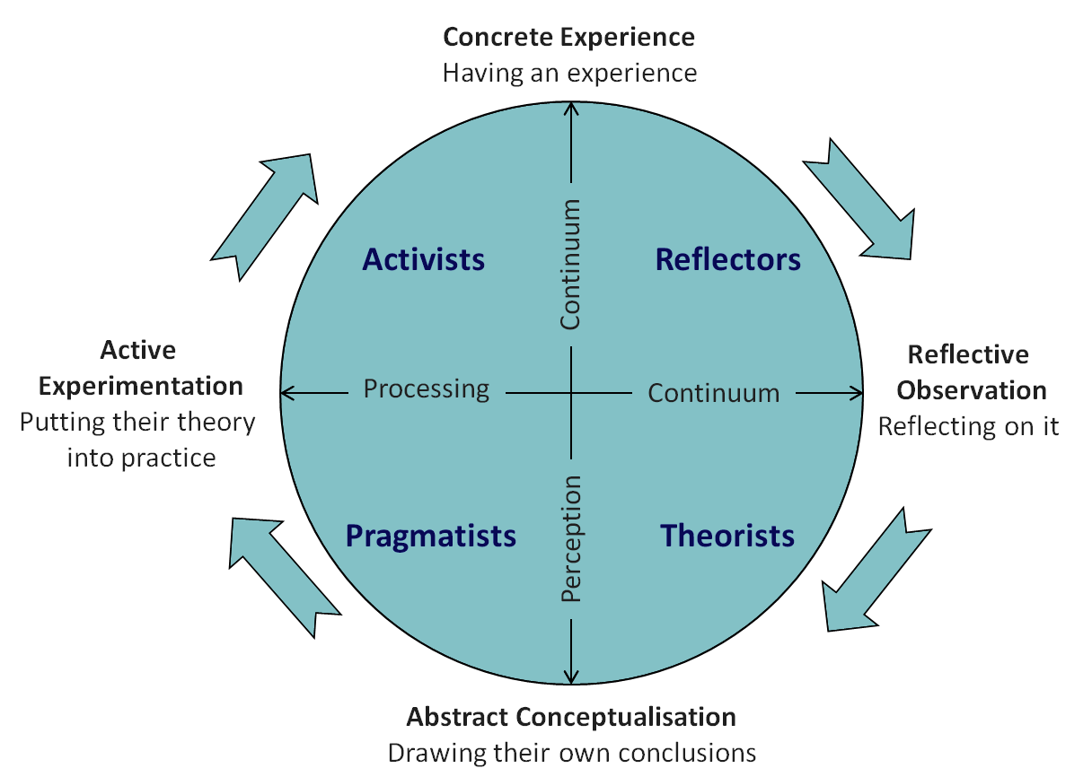
Honey & Mumford (1986)

Slide 10
In this model Mumford and Honey describe the learning styles as a continuum that learners move through over time.
However, over time, people usually come to prefer and rely on one, or more, style(s) above the others. As both teachers and Learners.
Research has shown that there is no evidence that one preference is better than another – indeed the diversity of our learning styles adds value to team work and organisational functioning.

Slide 11
Whilst Reading reflect upon your results of the questionnaire

Slide 12
The four key styles….

Slide 13
Honey & Mumford (1986)

Slide 14
Reflectors
These people learn by observing and thinking about what happened. They may avoid leaping in and prefer to watch from the side-lines.
Prefer to stand back and view experiences from a number of different perspectives, collecting data and taking the time to work towards an appropriate conclusion.
Suitable activities….
Paired discussions
Self analysis questionnaires
Personality questionnaires
Time alone to think
Observing activities
Feedback from others
Coaching
Interviews

Slide 15
Honey & Mumford (1986)

Slide 16
Theorists
These learners like to understand the theory behind the actions.
They need models, concepts and facts in order to engage in the learning process.
Prefer to analyse and synthesise, drawing new information into a systematic and logical 'theory'.
Suitable activities…
Models
Statistics
Stories
Quotes
Background information
Applying theories

Slide 17
Honey & Mumford (1986)

Slide 18
Pragmatists
These people need to be able to see how to put the learning into practice in the real world.
Abstract concepts and games are of limited use unless they can see a way to put the ideas into action in their lives.
Experimenters, trying out new ideas, theories and techniques to see if they work.
Suitable activities….
Time to think about how to apply learning in reality
Real life case studies
Problem solving
Discussion

Slide 19
Honey & Mumford (1986)

Slide 20
Activist
Activists are those people who learn by doing.
Activists need to get their hands dirty, to dive in with both feet first.
Have an open-minded approach to learning, involving themselves fully and without bias in new experiences.
Suitable activities..
Brainstorming
Problem solving
Group discussion
Puzzles
Competitions
Role-play

Slide 21

Try to build our own
experiential learning cycle
Try learning a new skill….
It can be anything from juggling to tying a knot.
Put what you have learnt into practice.
Try to deliberately create (facilitate) for yourself an experiential learning process that utilises different learning methods.

