Slide 1
Digital Skills &
Personal Branding
Online Session 6
CertHE Skills for the Workplace
BMSK4007

Slide 2
Overview
What is a personal brand?
What is personal branding?
How do I start to develop a personal brand?
How do I build a strategy to build my personal brand?
Self-directed learning

Slide 3


Slide 4
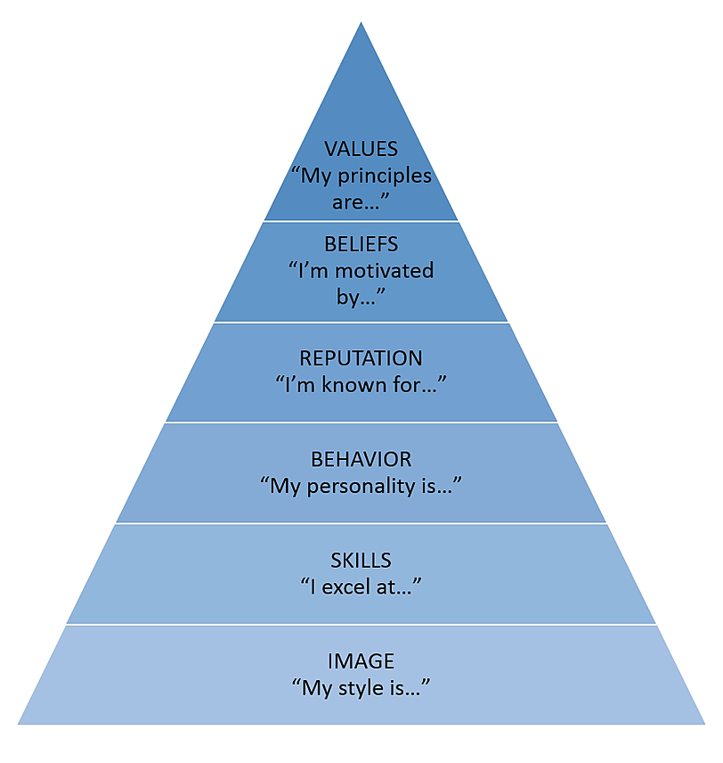
What is a personal brand?
Your personal brand states not what you are, but who you are:
Image
Skills
Behaviour
Reputation
Beliefs
Values
(Source: Me Inc., 2012, Branding and Positioning Career Advice)

Slide 5
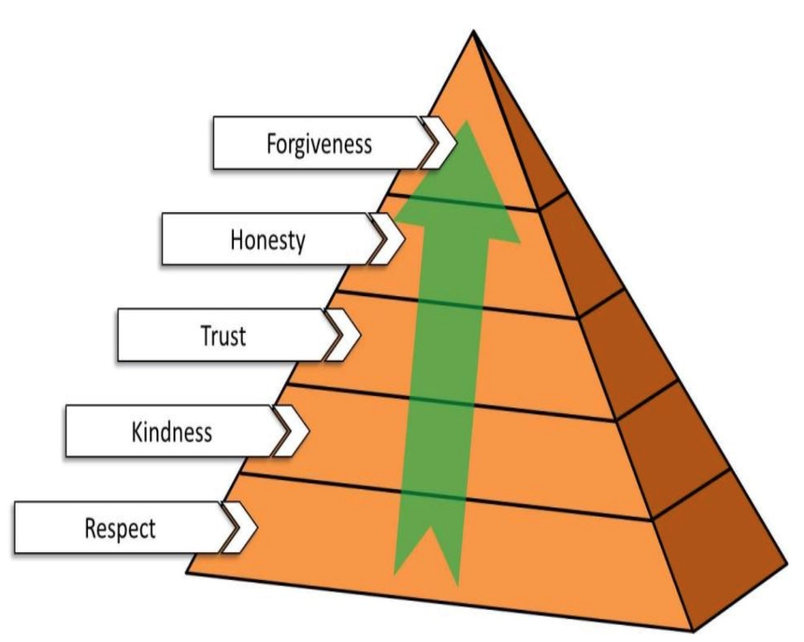
What is personal brand?
Personal branding is the consistent and uniform presentation of an individual.
It’s about being authentic and mindful of the impression that you make when you meet someone for the first time.
An everlasting impression is formed in the first four minutes. It can never be changed.
At the highest level, it’s your values that shine through.

Slide 6
Personal brand is all about who
You are

Slide 7
What is personal branding?
Personal branding is the strategy that an individual develops in order to deliver their personal brand.
Strategy involves:-
  Knowing where you are now?
  Where you want your brand to be?
  Understanding the driving forces.
  Understanding the resistances or blockages.

Slide 8



The arrow denotes the direction one is to take and what activities an individual must concentrate upon to get there
How we want to be perceived
How we are perceived now
The way to get to one’s goal
The resistances and blockages to be overcome along the way
Adapted from Lewin, K., 1947, Understanding the three stages of change
.

Slide 9
Metrics
In order to know where you are along the path towards developing your personal brand, it is necessary to develop metrics (to measure your progress);
Once you have developed some metrics it is possible to know where you are and whether you need to change course of speed up or slow down the processes.
Let’s look next at what metrics are and how we might design them.

Slide 10
Developing metrics
Maybe you want to be positioned for a new job in your firm or you want to be included in more of the important conversations that management is having.
What is it going to take for management to see you as a credible; and somebody that they ought to include in those conversations?
Maybe your plan is to speak up more in meetings. You might decide to raise your hand and offer an opinion.
Maybe you decide to participate in writing part of the company blog; adding your voice to the conversation.
Maybe you need to network internally, and to do it a little more strategically. You might aim to build influence with people who invite people to meetings.

Slide 11
Developing Metrics
When those things start happening and you see the results, then you know you're on the right path.
If your plan doesn't work, then you might decide to change direction or to try something else.
Always keeping your desired reputation (goal) in mind.
It's about building that brand incrementally and having an action plan.
Making a note of what you want; how often you do those things; and measuring their success is metrics.

Slide 12
Action planning
It’s important to create a clear strategic plan, with metrics, which is well defined:
Objectives, which are
Measurable,
Achievable,
Realistic and
Time based.

Slide 13
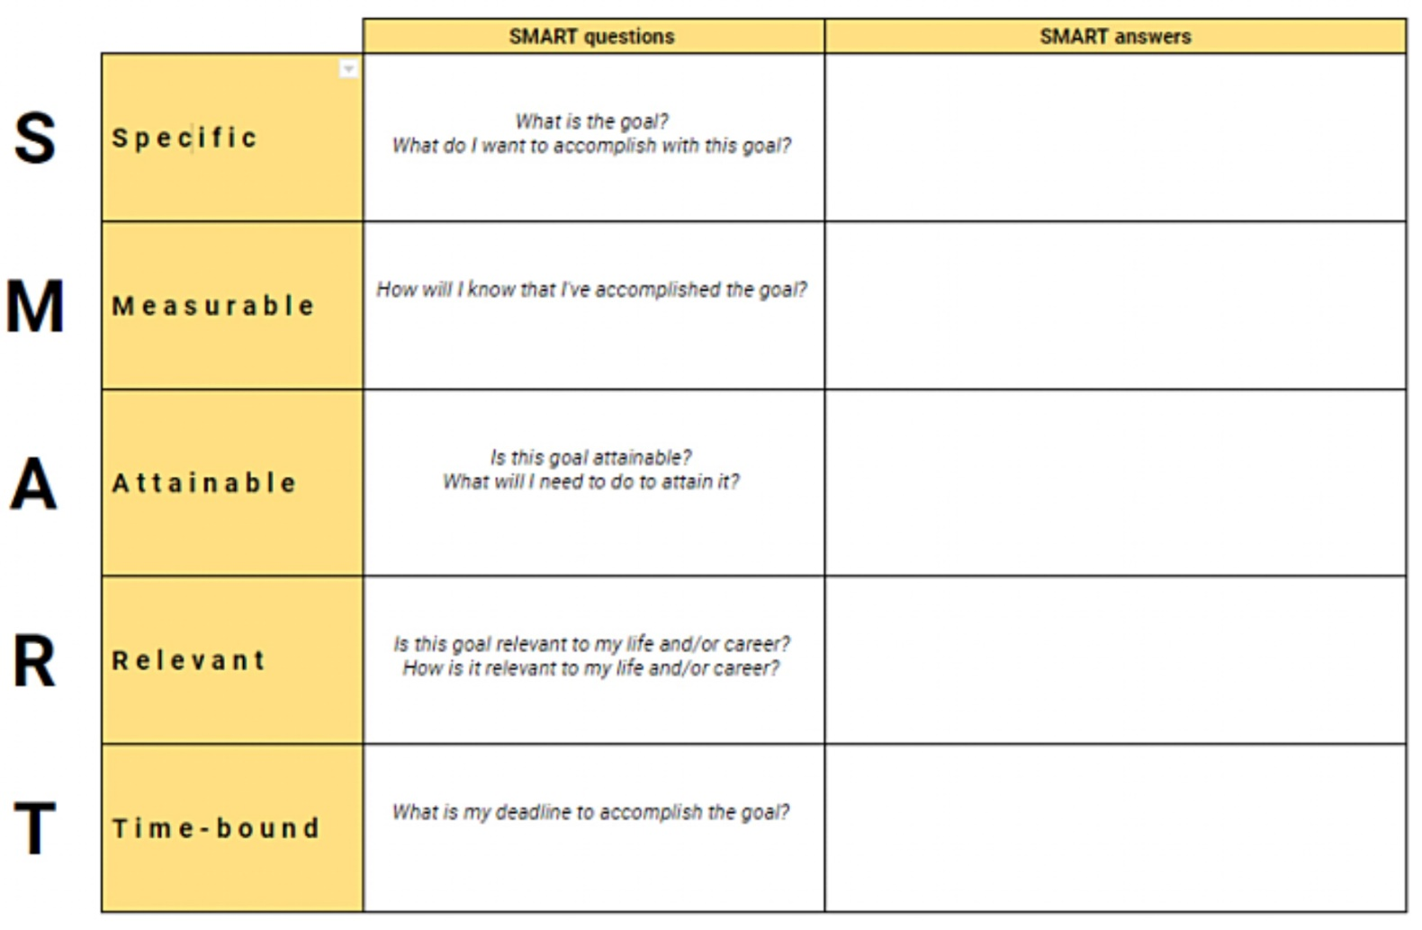
Action plan

Slide 14

Reflection
Let’s take 5 minutes to reflect upon in this session – what have you learnt?
Any key areas you want to research further?
What can help you with your assignment?
What can help you in your career?
Engage with your tutor on the topics

Slide 15
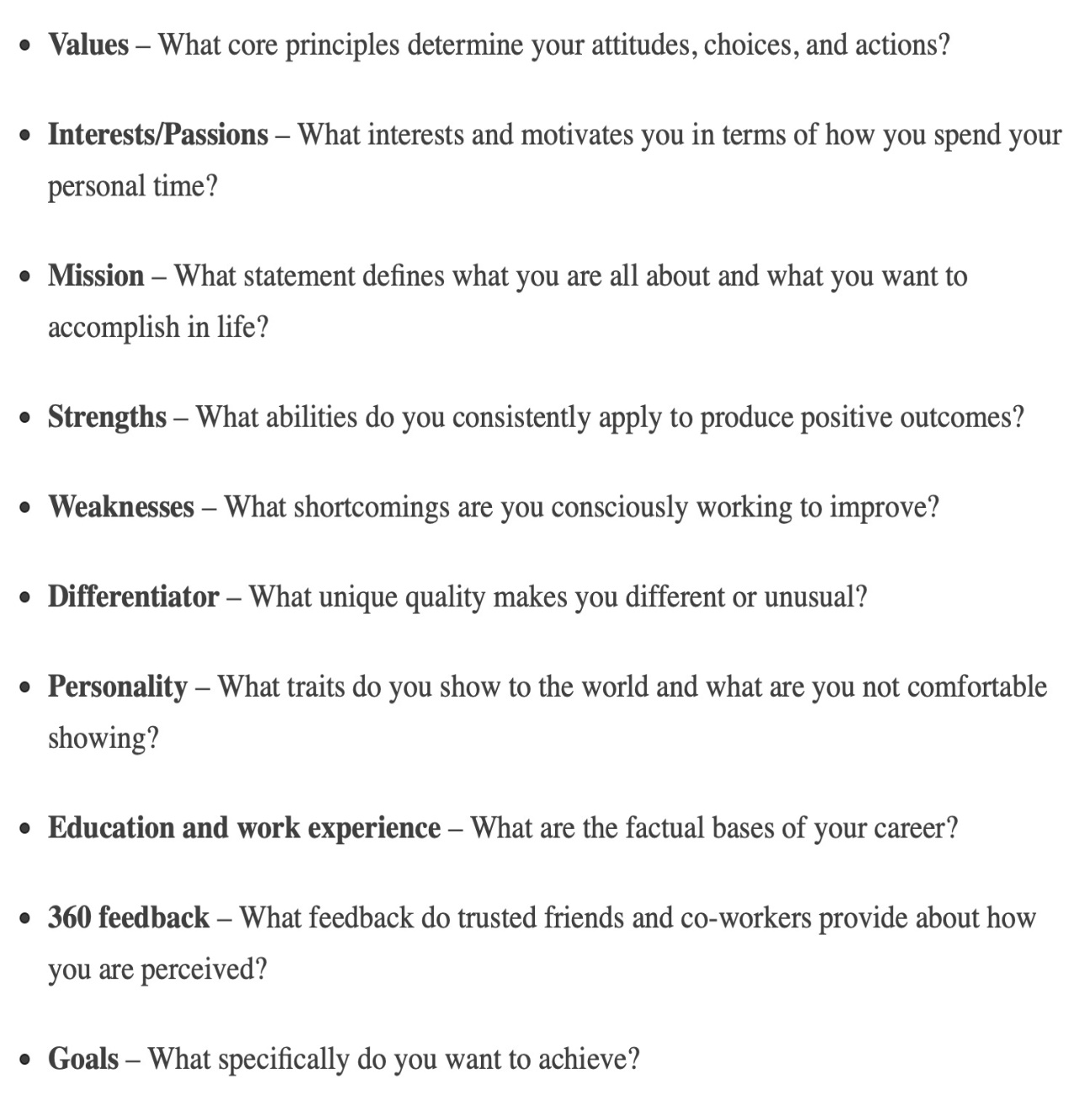
Before the next session
Use the headings shown on the right to produce a short evidence-based statement of your core principles.
Be prepared to present your statement orally at the next session, if requested.

Slide 16
References
Creating your Personal Brand https://www.linkedin.com/learning/creating-your-personal-brand/what-is-personal-branding?u=77966930 (accessed 21 Nov 20);
Lewin, K. (1947). Frontiers in Group Dynamics. Human Relations, 1(1), pp.5–41.
Me.inc. (2012). Branding and Positioning Career Advice https://incsights.files.wordpress.com/2012/10/personal-brand-pyramid.png
Arruda, W. and Dib, D. (2013). Ditch. Dare. Do! : 3D Personal Branding for Executive Success : 66 Ways to Become Influential, Indispensable, and Incredibly Happy at Work! New York: Tradesmark Press International.

