Slide 1
Student: Dominik Csaba David (2208146)
Module: Hospitality and Guest Services (BMIH4003)
Lecturer: Kathryn Flynn
Date: 06.02.2023
The role and importance of quality service, hospitality, and guest services within the hotel Industry

Slide 2
Table of content
Introduction to DoubleTree by Hilton
Consumers
Guest services and Facilities
Function and Role of Guest Services
Importance of Guest Expectations
Summary

Slide 3
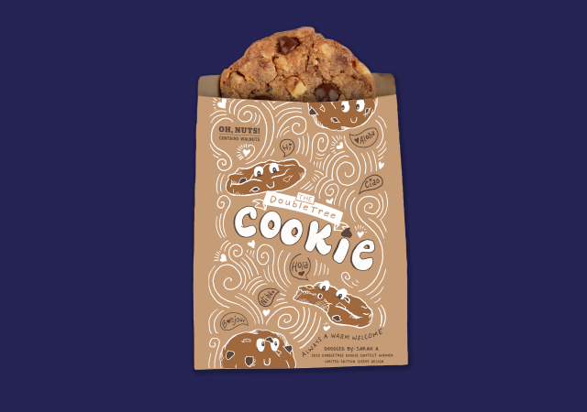
DoubleTree By Hilton
- The first DoubleTree hotel opened in 1969
- DoubleTree owned by Hilton worldwide
- More than 600 Resorts and Hotels all around 6 continents
- Pet Friendly
- Family friendly
- Signature warm cookie (Compton, 2020)

Slide 4
Main Consumers
Leisure
Business

Slide 5
Guest Services and Facilities
OFFERS
Spa facilities (vary by locations)
Hilton Honors loyalty program
Pet Friendly
Business services

Slide 6
Function and Role of Guest Services
Personalised attention and assistance
The 5 senses
Ensure the guest are comfortable with the stay and experience
High level of customer service
Emotional intelligence,: “Emotional intelligence (EI) helps employees regulate their emotions and display appropriate emotions, and hence should help hospitality workers provide outstanding service.”
(Miao, Humphrey and Qian, 2021)

Slide 7
Importance of Guest Expectations
Guest expectations play a crucial role in the hospitality industry as they help determine the level of satisfaction guests will have with their experience (Shoes For Crews Europe, 2019).
If clients begin with the wrong expectations, they will ultimately feel manipulated and dissatisfied. And the result is negative reviews, decreased consumer loyalty, and decreased revenue(Hallstrom, 2021).

Slide 8
Summary
- Organizations need functions to do tasks efficiently. Customer service helps customers address problems. Good customer service builds trust, loyalty, and business growth. Excellent customer service helps companies stand out and create long-term connections with customers.

Slide 9
References
Car rental Hilton for the stay. Available at: https://www.hilton.com/en/offers/car-rental/?cid=OH%2CMB%2COffersPgCarRental%2CMULTIPR%2CTile%2CHome%2CSingleLink%2Ci87077 (Accessed: February 6, 2023).
Compton, N.B. (2020) For the first time ever, Doubletree has released its iconic Chocolate chip cookie recipe, The Washington Post. WP Company. Available at: https://www.washingtonpost.com/travel/2020/04/09/first-time-ever-doubletree-has-released-its-iconic-chocolate-chip-cookie-recipe/ (Accessed: February 6, 2023).
Europe, E. (2022) Start a DoubleTree by Hilton franchise in 2023, Entrepreneur. Available at: https://www.entrepreneur.com/franchises/doubletreebyhilton/284273 (Accessed: February 6, 2023).
Europe, S.F.C. (2019) 2020 hotel guest expectations that all hotel staff need to be aware of, Shoes for Crews GB. Available at: https://www.sfceurope.com/uk/blog/2020-hotel-guest-expectations-that-all-hotel-staff-need-to-be-aware-of (Accessed: February 6, 2023).
Hallstrom, C. (2021) Customer expectations in hotels: How to make your guests happy every time, HermesThemes. Available at: https://www.hermesthemes.com/customer-expectations-hotels-make-guests-happy-every-time/ (Accessed: February 6, 2023).
Hyland, P. (2021) Top 10 largest hotel chains in the world: .TR, TOP 10 Largest Hotel Chains in the World | .TR. Tourism Review Media. Available at: https://www.tourism-review.com/top-10-world-largest-hotel-groups-news1988 (Accessed: February 7, 2023).
https://stories.hilton.com/food-beverage/doubletree-doodle-contest-winner-2023 (2023) https://stories-editor.hilton.com/wp-content/uploads/2023/01/DoubleTree-Doodle-Social-Media-Contest-Winning-Cookie-Sleeve.png?w=640&h=450&crop=1&q=75.
Lavanchy, D. (2018) Understanding the difference between business and Leisure Travellers, Geneva Business News | Actualités: Emploi, RH, économie, entreprises, Genève, Suisse. Available at: https://www.gbnews.ch/understanding-the-difference-between-business-and-leisure-travellers/ (Accessed: February 6, 2023).
Miao, C., Humphrey, R. and Qian, S. (1970) [pdf] emotional intelligence and job performance in the hospitality industry: A meta-analytic review: Semantic scholar, International Journal of Contemporary Hospitality Management. Available at: https://www.semanticscholar.org/paper/Emotional-intelligence-and-job-performance-in-the-a-Miao-Humphrey/764c28e99a7af9866d7bc484a85bd4817dd978aa (Accessed: February 6, 2023).
Miller, A. (2022) Hilton Hotels Honors Loyalty Program Review [in-depth], UpgradedPoints.com. Available at: https://upgradedpoints.com/travel/hotels/hilton-hhonors-loyalty-program/ (Accessed: February 6, 2023).
Tunstall, S. (2021) Can I bring my dog to DoubleTree by Hilton?, BringFido. Available at: https://www.bringfido.com/blog/doubletree-by-hilton-pet-policy/ (Accessed: February 7, 2023).

