Slide 1
Random Forests
A forest of decision trees
AKA Random Decision Forests

Slide 2
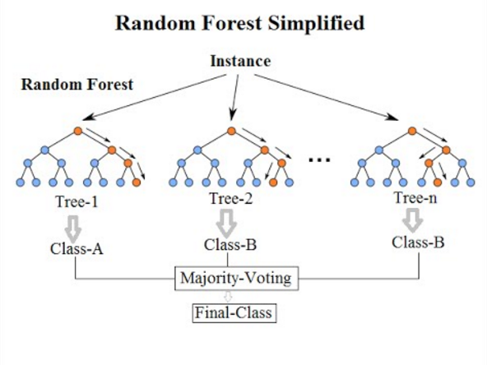
Random Forests
Venkata Jagannath - https://community.tibco.com/wiki/random-forest-template-tibco-spotfirer-wiki-page

Slide 3
Random Forests
A random forest is a collection of decision trees.
Like a decision tree, a random forest is a supervised ML method.
Whilst a decision tree uses the whole training dataset, and all the features, a random forest randomly selects samples and features to train multiple decision trees.

Slide 4
Random Forests
A random forest applies the general technique of bootstrap aggregating or bagging, i.e. bagging repeatedly (B times) selects a random sample with replacement of the training set and fits trees to these samples.
Random forests also use this bagging technique to select random features to train on.

Slide 5
Random Forests
Each tree has a vote and chooses the class.
The class receiving the most votes by a simple majority is the "winner" or predicted class.
This means that it is a type of ensemble learning algorithm.
They can be used for regression too (as can decision trees).
For regression problems the average output of each tree in the forest is used as the regressed value.
They are more black than white, so they don’t explain how they predicted a class.
They are less likely to be over-trained, unlike decision trees.
They reduce variance and do not increase bias.

Slide 6
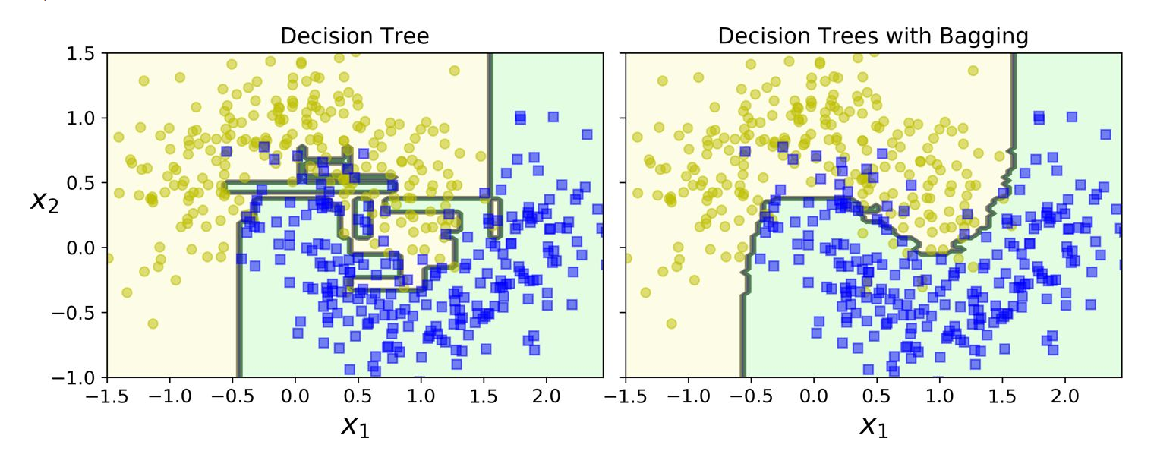
Random Forests
See how bagging reduces variance? The ensemble on the right has a comparable bias but a smaller variance (it makes roughly the same number of errors on the training set, but the decision boundary is less irregular). It generalises better.
Géron, Aurélien. Hands-On Machine Learning with Scikit-Learn, Keras, and TensorFlow (p. 194). O'Reilly Media. Kindle Edition.

