Slide 1
The Future of Work: AI and Human Collaboration in Hotel and Hospitality
Student name: Shah Mashuk Miah
Student ID: 1911285
Lecturer: Dr, Ernest Wavie

Slide 2
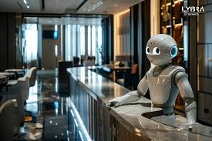
Introduction to AI in Hospitality
AI adoption in hotels grew rapidly post-pandemic, with 68% of global hotel chains using AI by 2023 (Deloitte, 2023).
Labor shortages affected over 1.5 million hospitality workers in the U.S. alone during the pandemic (BLS, 2022).
Rising guest demands for speed, customization, and efficiency accelerated AI investments across the sector.

Slide 3
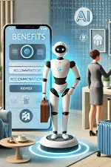
Benefits of Human-AI Collaboration
Research shows hybrid AI-human service models achieve 28% higher guest satisfaction compared to full automation (Accor, 2023).
AI handles repetitive tasks like booking and check-ins, allowing staff to focus on emotional guest interactions.
Human empathy and decision-making remain irreplaceable in handling complex guest requests and service recovery.

Slide 4

Changing Workforce Roles and Skills
AI shifts employee responsibilities to roles like Guest Experience Coordinators managing AI systems (Baum, 2022).
Marriott invested $15 million in digital literacy programs from 2020 to 2023 to prepare staff for AI adoption.
Hilton’s Digital Upskilling Initiative achieved an 89% employee satisfaction rate by supporting staff transitions.

Slide 5

Technostress and Workforce Resistance
58% of hospitality employees report moderate to high technostress when using AI systems (Robson et al., 2023).
Older staff are more vulnerable to anxiety over skill obsolescence caused by new technologies.
Labor unions like the Culinary Union in Las Vegas have opposed AI rollouts due to fears of job losses.

Slide 6

Guest Preferences and Acceptance of AI
78% of millennial travelers prefer AI-enabled services like mobile check-ins and digital concierge (Expedia, 2023).
Only 32% of baby boomers are willing to engage with AI services during their hotel stay (AARP, 2023).
Guest acceptance of AI varies across generations and regions, requiring hotels to balance technology with personal service.

Slide 7
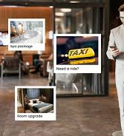
Ethical and Legal Risks of AI Adoption
73% of EU visitors express discomfort with biometric data collection like facial recognition (Costa & Costa, 2023).
Accor discontinued an AI recruitment tool in 2022 due to proven gender bias in candidate selection (Financial Times, 2022).
Hotels must comply with GDPR and the EU AI Act 2024, which classifies chatbots as high-risk systems needing human oversight.

Slide 8
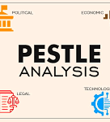
PESTLE Impact: Political, Economic, and Social Factors
Government AI policies and regulations influence technology adoption timelines and compliance costs.
MGM Resorts saves $45 million annually using AI-powered energy management systems (MGM, 2023).
However, 68% of independent hotels say AI is unaffordable, increasing the risk of market consolidation (AHLA, 2023).

Slide 9
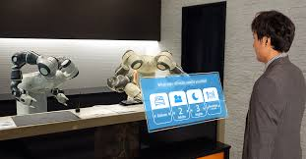
PESTLE Impact: Technological and Legal Challenges
High-quality AI requires reliable internet, cloud services, and digital infrastructure, which many regions lack.
Integrating AI with outdated hotel IT systems is costly and technically complex, limiting adoption.
The EU AI Act requires hotels to document AI performance and provide human oversight for high-risk applications.

Slide 10
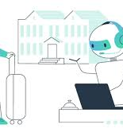
PESTLE Impact: Environmental Considerations
IHG reports a 30% reduction in energy consumption from AI-powered HVAC systems (IHG, 2023).
Training large language models like hotel chatbots carries a significant carbon footprint (Heikkilä, 2023).
Hotels must evaluate environmental trade-offs to ensure long-term sustainability in AI adoption.

Slide 11
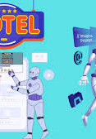
Digital Inequality for Small and Medium Hotels
Two-thirds of small hotel operators find AI adoption financially out of reach (AHLA, 2023).
Large hotel chains gain productivity while small businesses risk being left behind.
Industry partnerships and franchising models could help bridge the AI adoption gap for smaller hotels.

Slide 12
CONCLUSION
AI boosts efficiency but cannot replace the emotional intelligence of human staff in hospitality.
1
Successful hotels balance technology and human service, as seen in Marriott and Accor’s hybrid models.
2
Sustainable AI adoption requires workforce development, ethical governance, and environmental accountability.
3

Slide 13
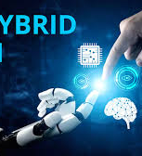
Recommendation: Adopt Hybrid Human-AI Models
Hybrid service models combining AI and human staff boost guest satisfaction by 28% (Accor, 2023).
AI handles administrative tasks, freeing staff for personalized guest care and complex requests.
Maintaining human interaction protects the relational value guests seek in hospitality experiences.

Slide 14
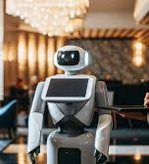
Recommendation: Invest in Workforce Upskilling
Training programs prepare staff to manage AI tools and adapt to new job roles effectively (Baum, 2022).
Marriott and Hilton’s employee training programs improved operational efficiency and staff satisfaction.
Change management strategies reduce employee resistance and maintain service quality during digital transformation.

Slide 15

Recommendation: Ensure Privacy and Environmental Responsibility
Hotels must clearly explain data usage and comply with privacy laws, such as GDPR, to build guest trust.
AI-powered solutions reduce operational costs but come with environmental trade-offs that must be measured.
Hotels should adopt energy-efficient AI models and sustainable operational practices to reduce carbon impact.

Slide 16
References
AARP, 2023. Travel Preferences by Generation: AARP Travel Survey. [online] Available at: https://www.aarp.org/research/ [Accessed 6 May 2025].
Accor (2023) Full-Year 2023 Results in Key Figures, Accor.com. Available at: https://group.accor.com/en/Actualites/2024/02/2023-full-year-results.
Baum, T., 2022. Sustainable human resource management in tourism and hospitality: A critical review. Tourism Management Perspectives, 42, p.100944.
Deloitte, 2023. The Future of Work in Hospitality: Insights on Automation and AI. [online] Available at: https://www2.deloitte.com [Accessed 6 May 2025].
European Commission, 2024. Artificial Intelligence Act: Regulation of high-risk AI systems. [online] Available at: https://digital-strategy.ec.europa.eu/en/policies/regulatory-framework-ai [Accessed 6 May 2025].
Expedia Group, 2023. Traveler Value Index 2023: Hospitality and Innovation Trends. [online] Available at: https://www.expediagroup.com/research [Accessed 6 May 2025].
Heikkilä, M. (2023) 'AI’s carbon footprint is bigger than you think,' MIT Technology Review, 5 December. https://www.technologyreview.com/2023/12/05/1084417/ais-carbon-footprint-is-bigger-than-you-think/.s
Ivanov, S., Webster, C. and Berezina, K., 2020. Adoption of robots and service automation by tourism and hospitality companies. Technological Forecasting and Social Change, 160, p.120252.
Koo, C., Yu, J. and Lee, J., 2021. Personalization and customization with AI in hotel services: A consumer perspective. Service Business, 15(3), pp.467–486.
Lu, Y., Wang, X. and Zhang, H., 2022. AI-driven dynamic pricing strategies in hotel management. Tourism Economics, 28(7), pp.1631-1649.
Murphy, H.C., Gretzel, U. and Pesonen, J., 2021. Marketing robot services in hospitality and tourism: the role of anthropomorphism and imaginative capability. Journal of Travel Research, 60(5), pp.1041-1056.
New York Post, 2024. AI to eliminate jobs, but also create new ones, says WEF report. [online] Available at: https://nypost.com/2024/01/23/ai-could-wipe-out-millions-of-jobs-but-also-create-new-ones-wef-report [Accessed 6 May 2025].
Park, S. and Allen, J., 2023. Longitudinal study of AI service acceptance in luxury hospitality. Journal of Hospitality and Tourism Technology, 14(3), pp.245-264.
PwC, 2024. Hospitality Directions: Technology Trends and Workforce 2024. [online] PricewaterhouseCoopers. Available at: https://www.pwc.com [Accessed 6 May 2025].
Robson, S., Lee, M. and Chan, K., 2023. Technostress in hospitality: The impact of AI tools on employee well-being. International Journal of Hospitality Management, 112, p.103156.

Slide 17
THANK YOU
ANY QUESTIONS

