Slide 1
Introduction to Christian Theology
Dr Angus M Slater

Slide 2
Assessment
Exams!

Slide 3
Re-cap

Slide 4

Redemption
The word ‘redemption’ is often used synonymously with ‘salvation’, although it has a more specific sense – of purchase.
But it isn’t just a purchase. It is much more significant than that – it is the term used when a slave can purchase their freedom.
So, in Jesus Christ, what God is doing isn’t reconciling himself to us, he is reconciling us to himself. However, there is something more to this – we aren’t just purchased out of slavery to run along on our own merry way again. Rather we are purchased to be slaves of God instead.

Slide 5
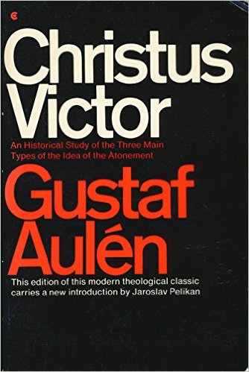
CHRISTUS VICTOR
This view utilises metaphors of God defeating the powers of death and evil. Early Christian art frequently portrays Christ harrowing hell and stood triumphant on the defeated corpses of the devil and the forces of death. It is a good way of showing the dramatic struggle between God and the forces of evil.
For many in the early church the metaphor was elaborated into a complex narrative of how, by dieing in human form, especially by being executed as a criminal, God in Jesus was able to trick the devil.
Taken to its extreme then the humanity of Jesus becomes a disguise or even a Trojan horse, which allows God to defeat the power of Satan, or to invalidate his claim upon humanity because he here claims a sinless one for hell, he thereby acts improperly and God is no longer honour bound to allow him to keep on claiming sinners for himself etc.

Slide 6
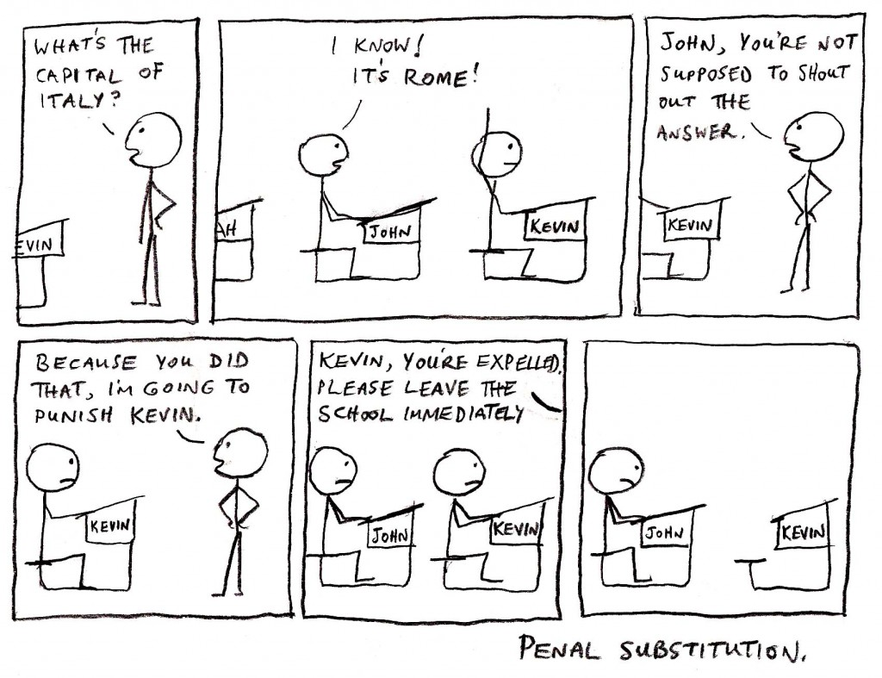
Penal Substitution

Slide 7
Moral Influence
For Abelard then, there is something problematic in the claim that God was required by some necessity outside of himself to insist on an appropriate payment of satisfaction before reconciliation can take place.
For Abelard no such necessity exists.
He claims instead that:
“Through this unique act of grace manifested to us in that his Son has taken upon himself our nature and preserved therein in teaching us by word and example even unto death – he has more fully bound us to himself by love; with the result that our hearts should be enkindled by such a gift of divine grace, and true charity should not now shrink from enduring anything for him... everyone becomes more righteous – by which we mean a greater lover of the Lord – after the Passion of Christ than before, since a realized gift inspires greater love than one which is only hoped for. Wherefore, our redemption through Christ‘s suffering is that deeper affection in us which not only frees us from slavery to sin, but also wins for us the true liberty of sons of God, so that we do all things out of love rather than fear”

Slide 8
Reading

Slide 9
Summary & Homework
Find a good explanation of one of the models of atonement online or in the library catalogue and post up a forum discussion.
Take the time to read posts by your classmates – this will function as revision for your EXAM!

Slide 11
Eschatology & Apocalypse
So Long, and Thanks for All the Fish…

Slide 12
Eschatology
Eschatology is that part of theology which engages with the parts of revelation that tell us about the “last things” – the last things of both ourselves and of the world as a whole.
This includes the end of an individual life, the end of the age, the end of the world and the nature of the Kingdom of God.
Broadly speaking, Christian eschatology is the study concerned with the ultimate destiny of the individual soul and the entire created order.
Εσχατος + λογος
last things + study

Slide 13
Apocalypse
ἀποκάλυψις
an uncovering
Connected to the notion of the Eschaton is that of an Apocalypse.
While the Eschaton is the general bringing about of the last things, an Apocalypse is seen as the means by which this occurs – generally a violent and disruptive uncovering of the nature of reality.
Apocalypticism is the belief in the coming of this disruption.

Slide 14
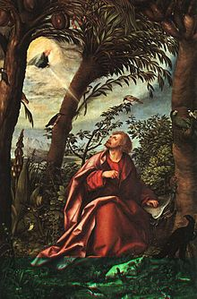
Apocalypse
When we talk about THE apocalypse, we generally mean one of two connected things:
The Apocalypse of St John of Patmos, AKA the Book of Revelation in the Bible – an uncovering of divine revelation
The Apocalypse described in the Apocalypse of John AKA the Book of Revelation – the series of events which violently brings about the end of the world

Slide 15
So, in what ways is eschatology essential for aspects of Christian doctrine we have discussed in this module?
Revelation? Trinity? Creation? Christology? Pneumatology?

Slide 16
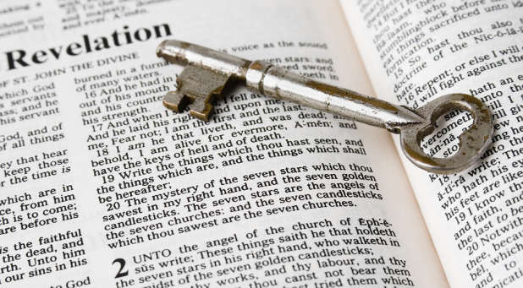
Eschatology and theology…
To put it all too briefly:
Revelation reveals what God is doing in the world, and shows that he is actually doing it. The eschaton is the full revelation of God in all his glory – as Paul puts it in the famous phrase of 1 Corinthians 13:12 –
“For now we see in a mirror, dimly, but then we will see face to face. Now I know only in part; then I will know fully, even as I have been fully known.”

Slide 17
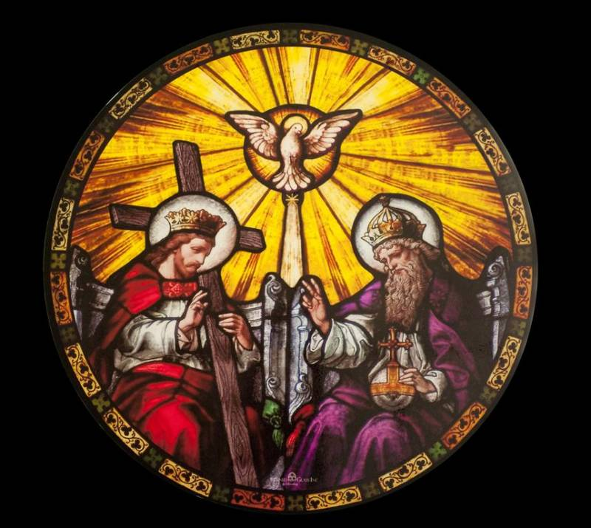
Eschatology and theology…
Trinity – ‘God will be all in all’ we will have a deeper participation within inner-triune relationality, which, nonetheless, does not undo our individuality or merge us into the same divine being.
Creation – eschatology is the restoration, not the destruction of creation.

Slide 18
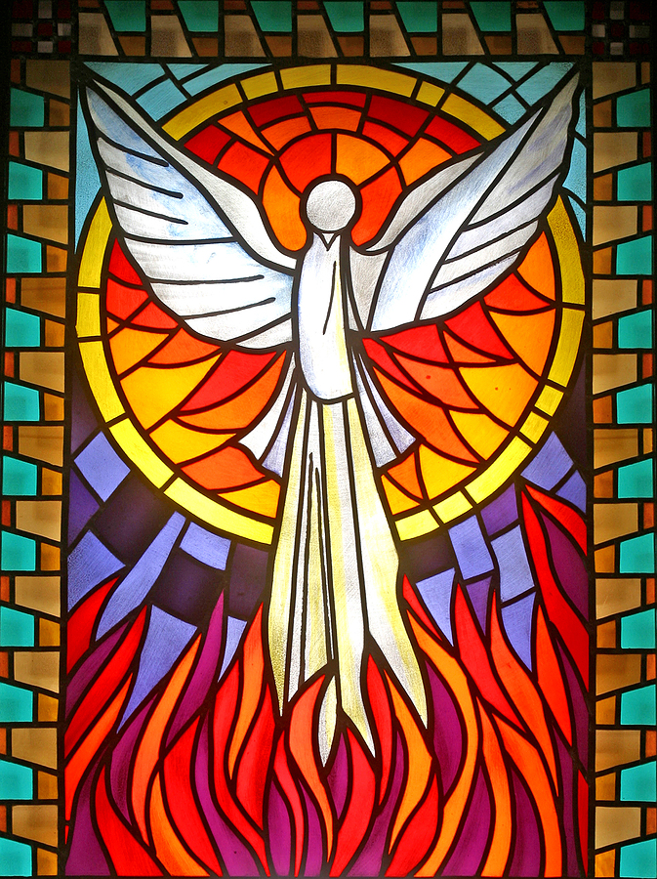
Eschatology and theology…
Christology- Christ isn’t just the revealer of God’s kingdom, he is ta eschata – he is the coming of the eschaton.
Pneumatology – The spirit is the first fruits of the kingdom – the guarantee that it is on its way, and the empowering presence which gives us the fortitude and patience to await it, rather than trying to impose it by our own power and our own swords.

Slide 19
So what is eschatology?

Slide 20
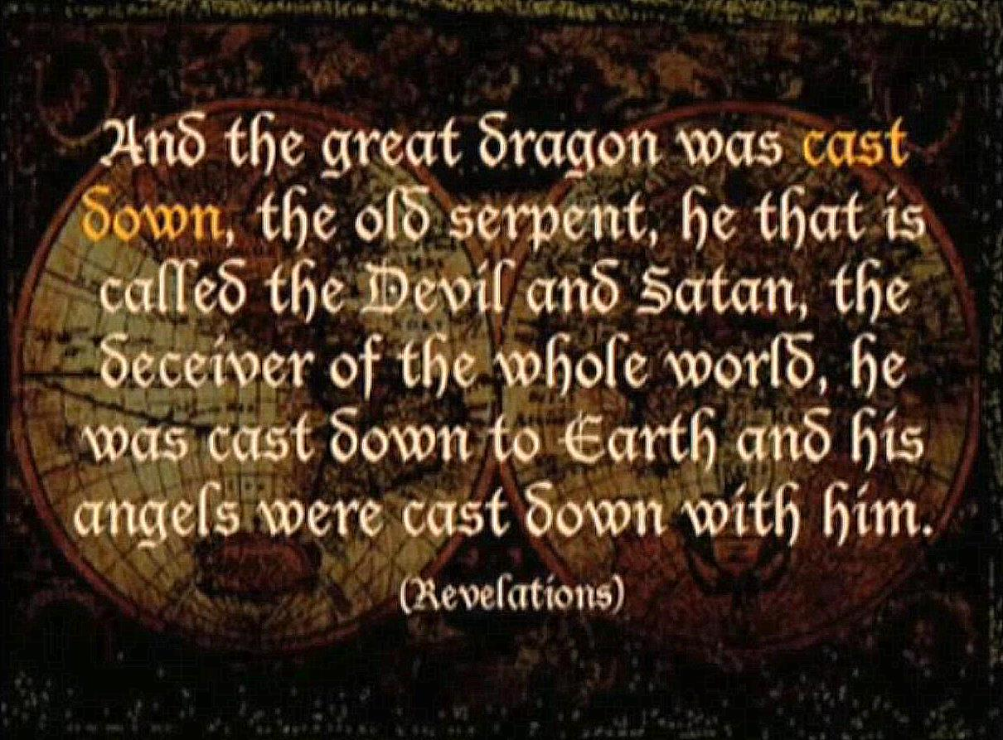
Attitudes to Eschatology
In popular culture the Christian view of the end-times has been portrayed, and perverted, into a coming Armageddon – a moment of utter vengeful destruction – the desolation of all creation – an event so unutterably terrifying that human response can only be one of fear and trembling.
However, for Christians, eschatology isn’t the prediction of complete annihilation – either of themselves or of God’s good creation – it is, rather, the ground and object of that great theological virtue – hope.

Slide 21
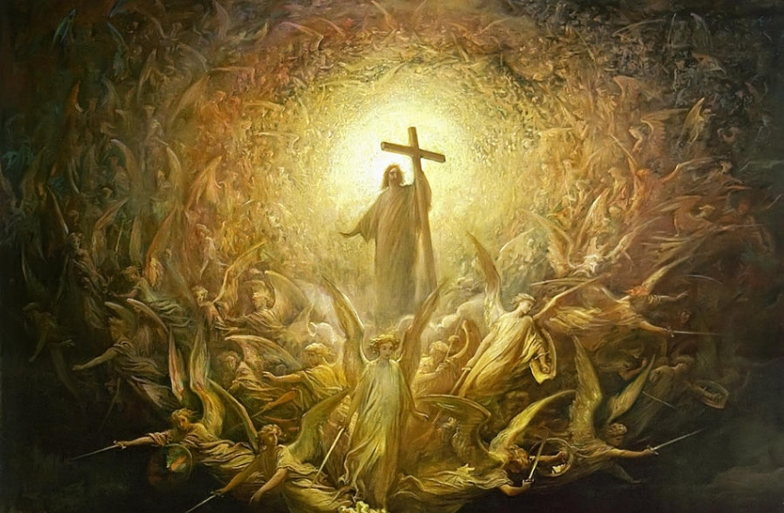
The “Kingdom of God”
The coming of the kingdom of God is central to Jesus’ teaching. Indeed, the urgency with which Jesus proclaimed this message is central to Christian theology.
The English phrase, ‘the kingdom of God’ is a useful and traditional translation of the greek phrase basileia tou theou – but the translation is inaccurate if it is taken to refer to a geographical location – as if what will arrive is a definite place where God rules

Slide 22
The “Kingdom of God”
Rather it is the kingship of God that is coming. The time is coming when God will realise his redemptive work; indeed, in a way, it is already here.
So, when Jesus claims ‘the kingdom of God is at hand’, what does he mean?
Well, he means that the rule of God is coming – the time of judgement is ‘at hand’ – God is about to, or is right now, establishing his rule once more.

Slide 23
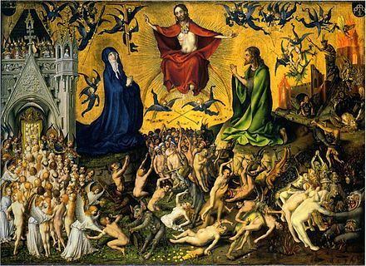
The “Kingdom of God”
So the coming of the kingdom of God is an all expansive doctrine – as one would expect from any theology whose final statement is ‘God will be all in all.’
It is a time when judgement and mercy meet, a time when creation will be renewed.
So, eschatology is both ‘already’ and ‘not yet’; it is both historic and cosmic; individual and communal; a continuation and a breach with what has gone before.

Slide 24
The “Kingdom of God”
The Kingdom of God is the culmination of the entire Christian story – from Creation, the Fall, Revelation, Incarnation, Crucifixion, Resurrection, Redemption, Salvation, Judgement, Eschaton, and Reconciliation with God.
Without the process of judgement and reconciliation, none of the earlier parts of the Christian story make sense or have meaning.
The doctrines surrounding the Eschaton bring together aspects of the Trinity, Creation, Christology, Pneumatology, and Ecclesiology.

Slide 26
Apocalypse…
The fun bit

Slide 27
The Book of Revelation
The Book of Revelation, often called simply Revelation or Apocalypse, is a book of the New Testament that occupies a central place in Christian eschatology.
Its title is derived from the first word of the text, (Greek: apokalypsis), meaning "unveiling" or "revelation”.
The Book of Revelation is the only apocalyptic document in the New Testament (although there are short apocalyptic passages in various places in the Gospels and the Epistles)

Slide 28
The Book of Revelation
The reason the Book of Revelation receives attention is not only for its eschatology, but also for its apocalypticism.
It doesn’t just tell us about the ‘last things’ but describes a vivid and shocking culmination of the end of the world.
Written about 65-95AD, it contains various things that have now entered our popular culture.

Slide 29
Revelation 6:1-17
And I saw when the Lamb opened one of the seals, and I heard, as it were the noise of thunder, one of the four beasts saying, Come and see.
² And I saw, and behold a white horse: and he that sat on him had a bow; and a crown was given unto him: and he went forth conquering, and to conquer.
³ And when he had opened the second seal, I heard the second beast say, Come and see.
⁴ And there went out another horse that was red: and power was given to him that sat thereon to take peace from the earth, and that they should kill one another: and there was given unto him a great sword.
⁵ And when he had opened the third seal, I heard the third beast say, Come and see. And I beheld, and lo a black horse; and he that sat on him had a pair of balances in his hand.
⁶ And I heard a voice in the midst of the four beasts say, A measure of wheat for a penny, and three measures of barley for a penny; and see thou hurt not the oil and the wine.
⁷ And when he had opened the fourth seal, I heard the voice of the fourth beast say, Come and see.
⁸ And I looked, and behold a pale horse: and his name that sat on him was Death, and Hell followed with him. And power was given unto them over the fourth part of the earth, to kill with sword, and with hunger, and with death, and with the beasts of the earth.

Slide 30
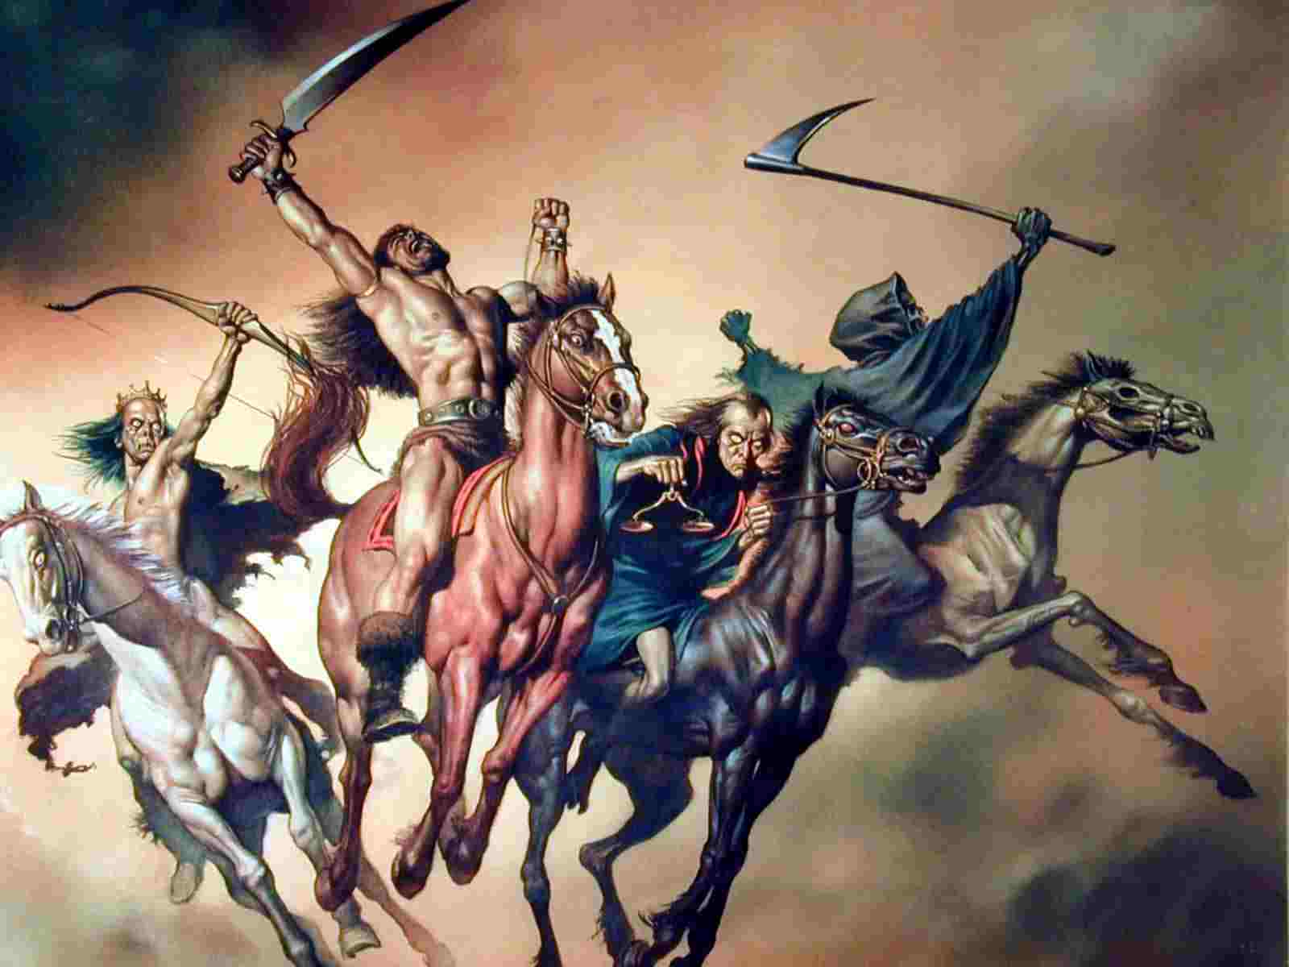
The Four Horsemen of the Apocalypse
The chapter tells of a book or scroll in God's right hand that is sealed with seven seals.
The Lamb of God opens the first four of the seven seals, which summons four beings that ride out on white, red, black, and pale horses.
The four riders are often seen as symbolizing Pestilence, War, Famine, and Death. The Christian
apocalyptic vision is that the Four Horsemen are to set a divine apocalypse upon the world as harbingers of the Last Judgment.

Slide 31
Revelation 12:1-6
A great sign appeared in heaven: a woman clothed with the sun, with the moon under her feet and a crown of twelve stars on her head.
² She was pregnant and cried out in pain as she was about to give birth.
³ Then another sign appeared in heaven: an enormous red dragon with seven heads and ten horns and seven crowns on its heads.
⁴ Its tail swept a third of the stars out of the sky and flung them to the earth. The dragon stood in front of the woman who was about to give birth, so that it might devour her child the moment he was born.
⁵ She gave birth to a son, a male child, who “will rule all the nations with an iron scepter.” And her child was snatched up to God and to his throne.
⁶ The woman fled into the wilderness to a place prepared for her by God, where she might be taken care of for 1,260 days.

Slide 32
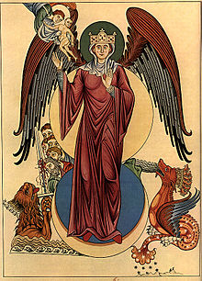
The Woman and Dragon
The woman, representing the Church or People of God, gives birth to the figure of Christ (note the identification of Mary and the Church) while being harassed by the Dragon, representing Satan, temptation, and Herod.

Slide 33
Revelation 12:7-9
⁷ Then war broke out in heaven. Michael and his angels fought against the dragon, and the dragon and his angels fought back.
⁸ But he was not strong enough, and they lost their place in heaven.
⁹ The great dragon was hurled down—that ancient serpent called the devil, or Satan, who leads the whole world astray. He was hurled to the earth, and his angels with him.

Slide 34
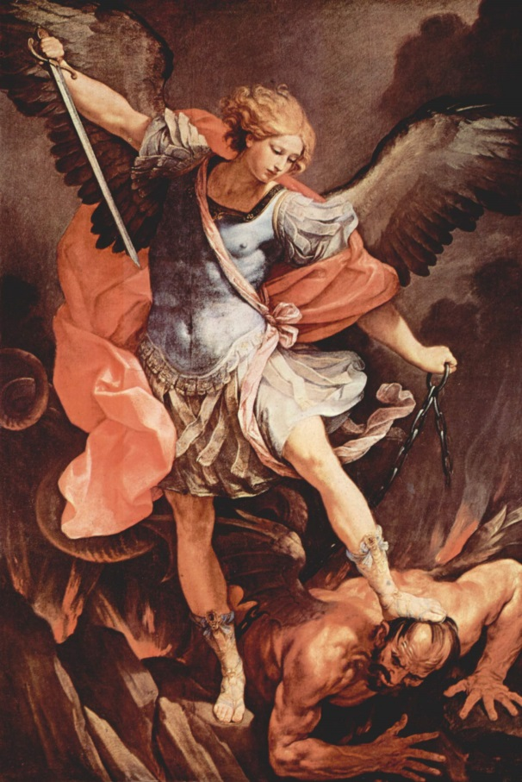
The War in Heaven
Satan, the Dragon, leads a third of the angels in rebellion against God.
This leads to a war in heaven between the forces of Satan and the Archangel Michael, which Satan loses.
He is cast out from Heaven and takes up his familiar place as the source of evil / temptation in Creation

Slide 35
Revelation 13:1-4
The dragon stood on the shore of the sea. And I saw a beast coming out of the sea. It had ten horns and seven heads, with ten crowns on its horns, and on each head a blasphemous name.
² The beast I saw resembled a leopard, but had feet like those of a bear and a mouth like that of a lion. The dragon gave the beast his power and his throne and great authority.
³ One of the heads of the beast seemed to have had a fatal wound, but the fatal wound had been healed. The whole world was filled with wonder and followed the beast.
⁴ People worshiped the dragon because he had given authority to the beast, and they also worshiped the beast and asked, “Who is like the beast? Who can wage war against it?”

Slide 36
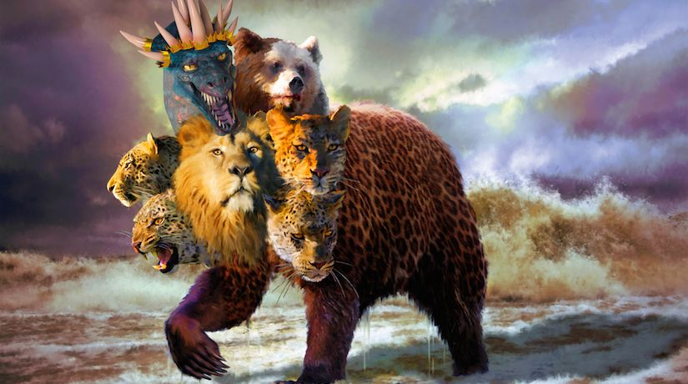
The Beast
This description draws many parallels with a vision in the Book of Daniel where four beasts symbolizing a succession of kingdoms come out of the sea in the forms of a lion, bear, leopard and a beast with ten horns
The Dragon here gives power to the Beast, often read as Satan empowering an Antichrist figure in order to deceive and tempt Christians in the last days.

Slide 37
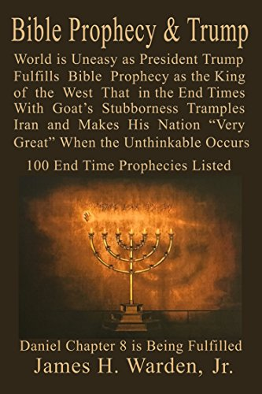
Revelation
All of this is pretty difficult to a) understand and b) know how it actually has any impact on living a Christian life.
However, a lot of people see the Book of Revelation as containing a roadmap for either the past, current, or future history of the world.
This can lead to a strong identification of things in Revelation with things that happen around us. E.g:

Slide 38
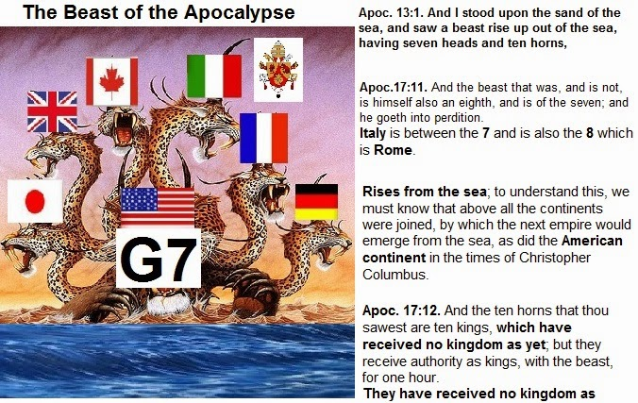

Slide 39
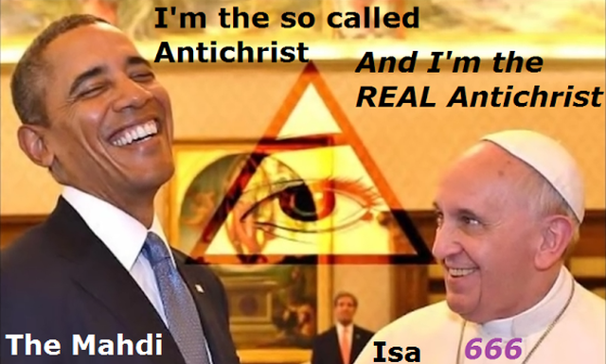

Slide 41
Reading
STEVENS, S., 2011. INTERPRETING
THE BOOK OF REVELATION.
Compass, 45(4), pp. 26-32.

