Slide 1

Terrorism
By Andrew James

Slide 2
Learning Outcomes
Be able to define Terrorism
Identify the different Terror Groups
Differentiate between the different motives of the Terror Groups
Could a country be a contributor to Terrorism?

Slide 3
What Emotions Does Terrorism Make You Feel?

Slide 4


Joining Instructions
Join at vevox.app
Or search Vevox in the app store
ID: 142-366-362

Slide 5
What Is The Definition Of Terrorism?
The Use or Threat of Action Which is Designed to Influence The Government, or an international Governmental Organisation or to Intimidate the Public. The Use or Threat Must Be Used for the Purpose of Advancing a Political, Religious, Racial or Ideological Cause. (Terrorism Act, 2000)
Notes:
What do you think is the definition of Terrorism?
Do you think there is a universal definition of Terrorism?
Well, there is not one universal definition of Terrorism, each nation state have their own definition and what they believe what Terrorism is.
On the slide is the UK’s definition of Terrorism, however according to the CPS (2022) there are specific actions that need to be included:
Serious Violence against a Person
Serious damage to Property
Endangering a Person’s Life (Other than that of the Person Committing the Action)
Creating A Serious risk to the health or Safety of the Public or a Section of the Public
Action Designed to Seriously Interfere With or Seriously to Disrupt an Electronic System

Slide 6
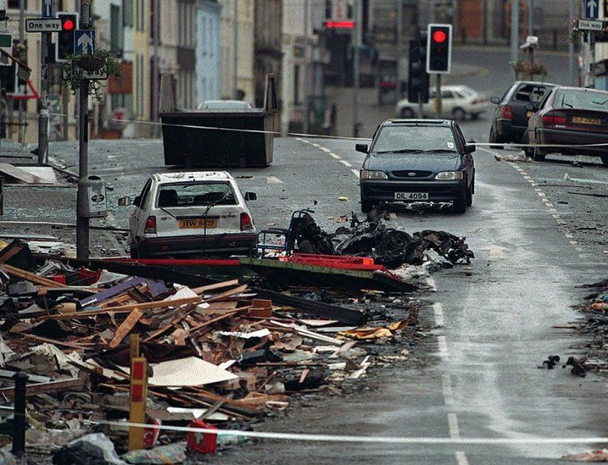
Irish Republican Army (IRA)
Created in 1969
Wants a Free State, independent from the UK
Main Tactics were Kidnapping, Murder and Bombing
Notable attacks are Omagh Bombing, Birmingham Pub Bombings
Notes:
Why do you think the IRA the was created?
Was a Reincarnation of a Previous group known as the IRA from the 1910s and 1920s. Created as a type of Civil Rights group to protect Catholic Republicans within Northern Ireland.
There were also different iterations of IRA, the most well-known was the Provisional IRA (PIRA)
What are the aim of the IRA?
The IRA want to create a Free State that is Independent from the UK. The UK has been involved in Ireland in one form another since the 1100s. Catholic-Republicans see themselves as true Irish whereas they see Protestant-Loyalist as British colonist (there ancestry coming from Scotland and England).
The Main tactics of the IRA were Kidnapping (to fund their activities), murder (protestants, police and soldiers) and bombing (both in Northern Ireland and the rest of the UK, mainly in England).
Many of the attacks that IRA committed in England was cause financial damage (intended to force the UK government to bend to their demands), they would warn the newspapers by giving them codes and that information be passed to the police with enough time for them to get people out before the bomb exploded.
There are stories that the IRA would make children lay the bombs (after a while they IRA would leave tags to warn the children that if they do not place the bomb they knew where they live).
Some of the most notable attacks committed by the IRA were Birmingham Pub Bombings in 1974, 21 and more than 200 were injured. The other notable attack was the Omagh Bombing in 1998, this attack killed 29 and injured about 300 (this attack was done by the Real IRA (A splinter group of the PIRA)). This image shows the aftermath of the Omagh Bombing.

Slide 7
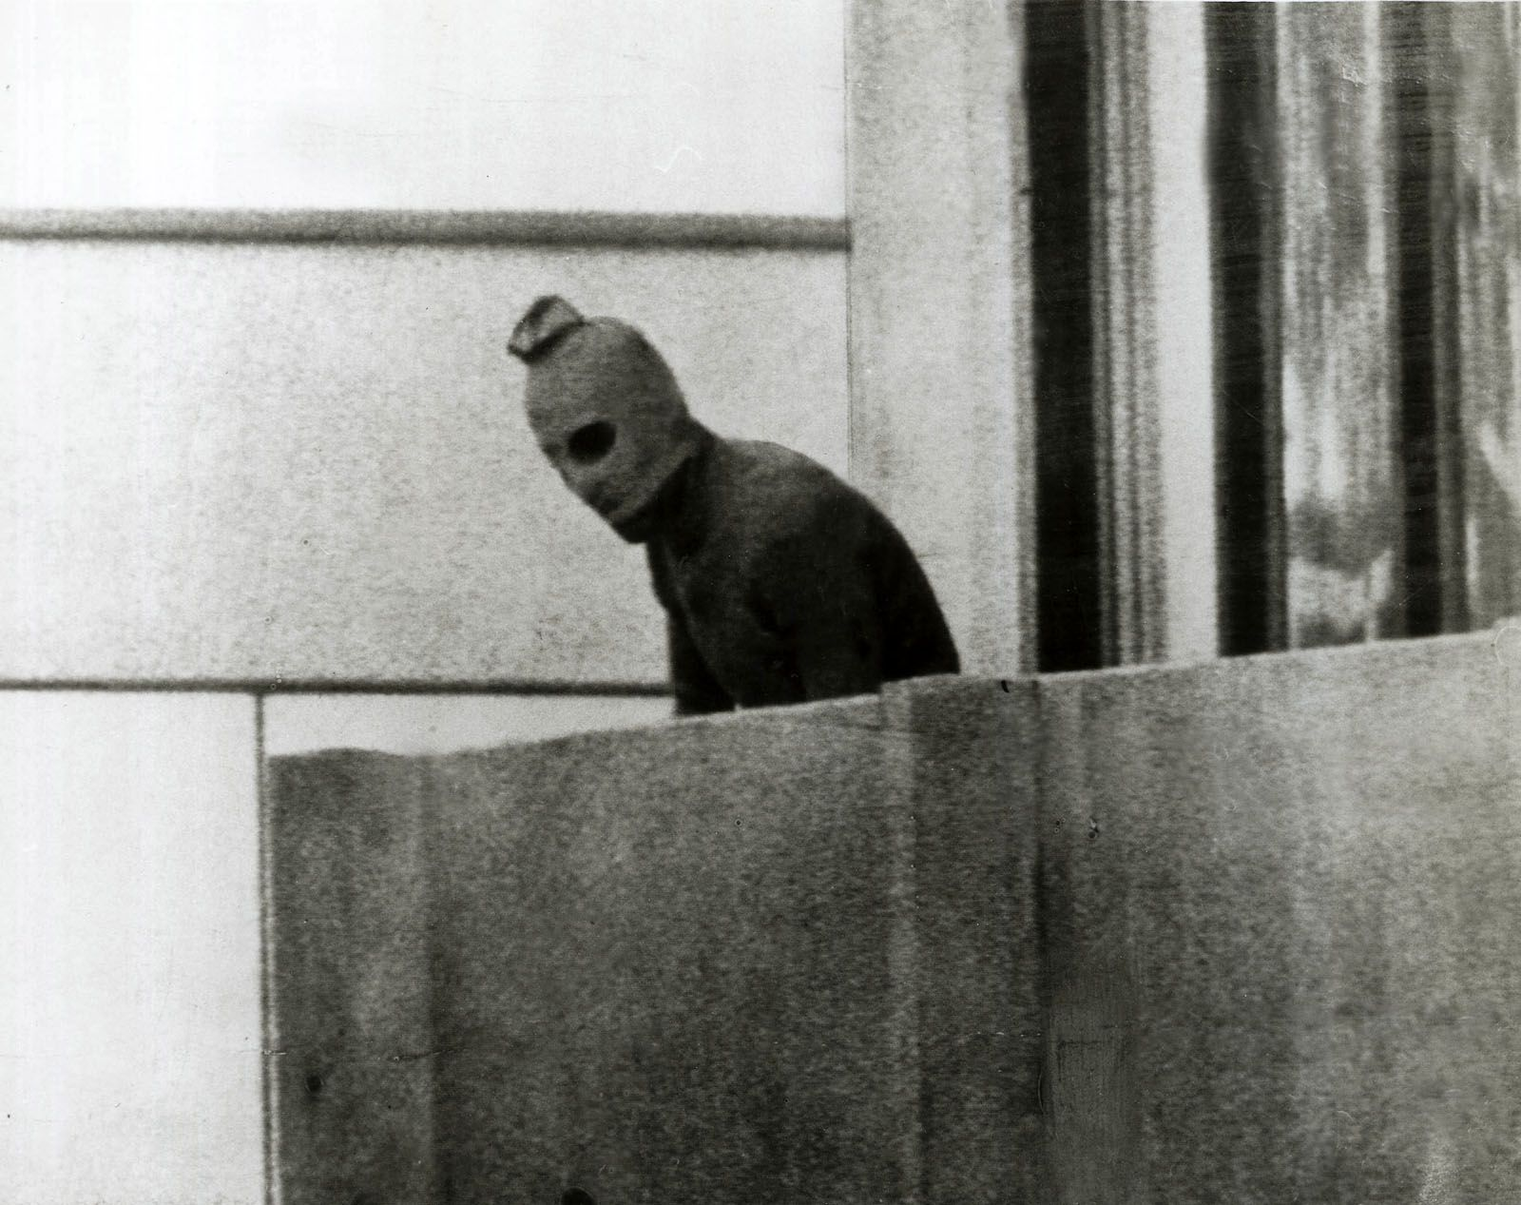
Palestine Liberation Organisation (PLO)
First founded in 1964
Wants to Create a Liberated Palestinian state within Israel
Became more known for its Terrorist Attacks
Notable Terror attacks include Munich Massacre and the Hijacking of Lufthansa Flight 181
Notes:
The PLO was first founded in 1964, it is an organisation that is made up of different groups that all have the aim of creating a Palestinian nation from territories that are currently within the nation of Israel.
Even though they have tried to achieve its goals politically they, the organisation became infamous for its terror attacks and its extremism.
Two most known Terror attacks were done by groups who made up the PLO, the first famous attack was the Munich massacre in 1972, this happened at the time of the Olympics and was committed by the Black September Organisation (17 people were killed, this include 11 of the hostages and 5 of the 8 terrorists), this attack led to the creation of number of Western countries Counter Terrorism Units. (The image is taken during the events)
The second well known attack was orchestrated by the Popular Front for the Liberation of Palestine, this is the hijacking of Lufthansa Flight 181 in 1977. The result of this attack was successful hostage rescue mission that rescued all the hostages on the plane and 4 of the crew (1 of crew had been killed by the terrorists), the rescue operation was executed by a German CT unit that was created after the Munich Massacre.

Slide 8
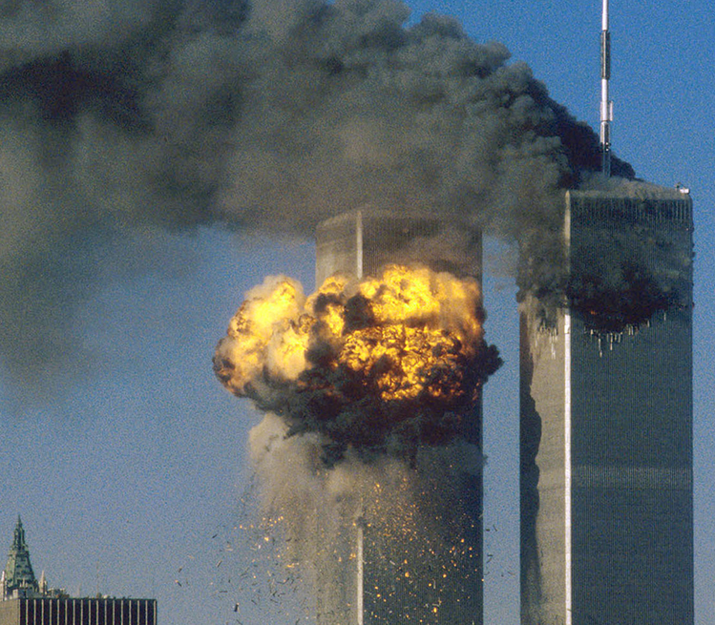
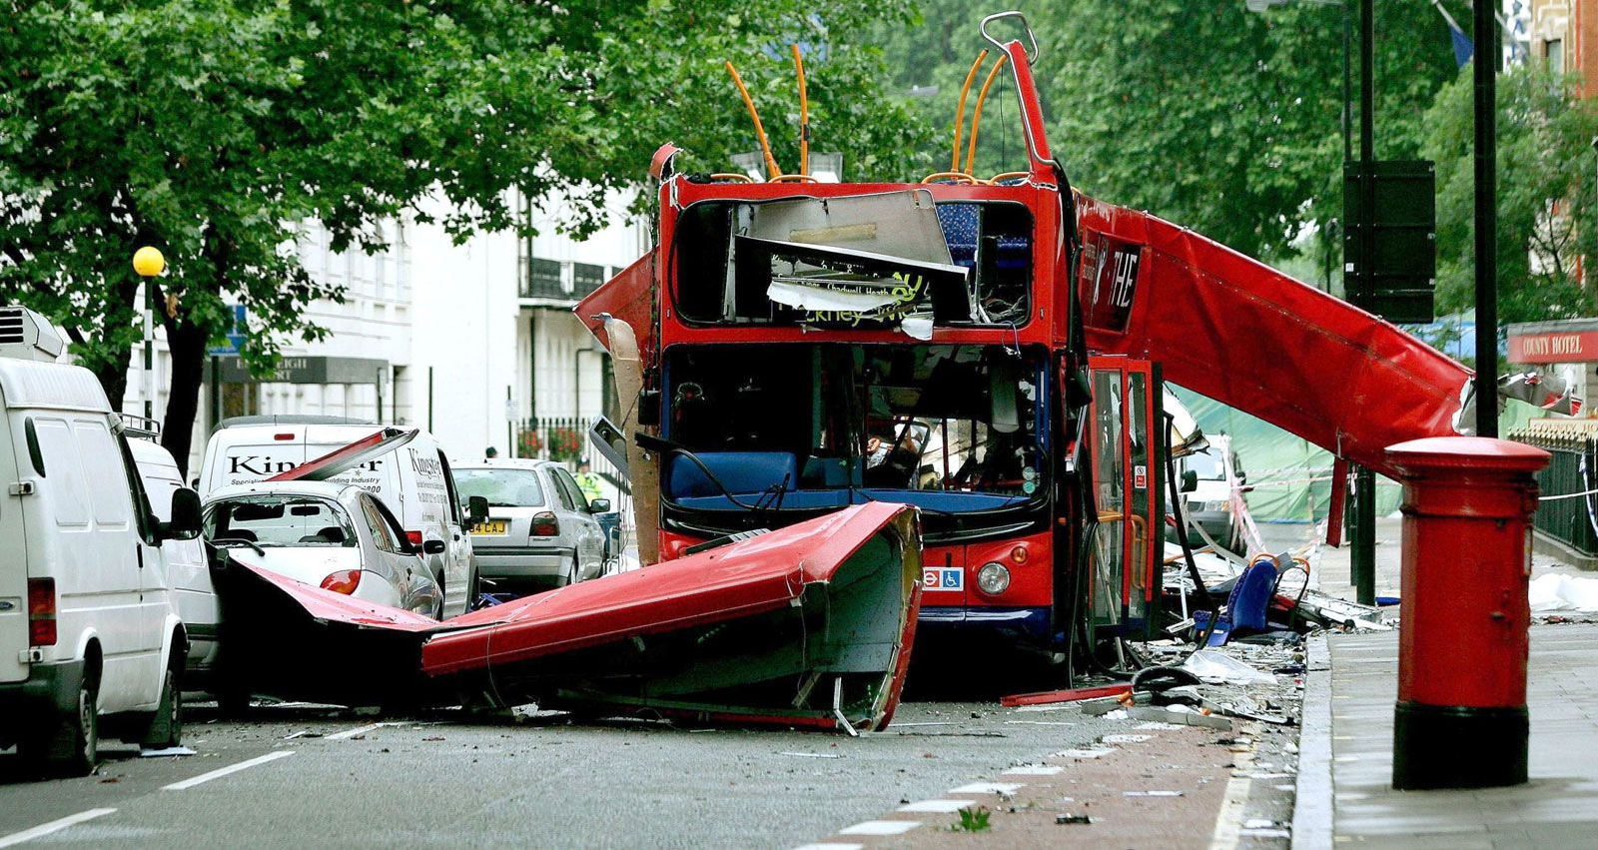
Al-Qaeda
Founded in Late 1990’s
Want to Form Islamist Governments in Muslim Countries
Operate across the Middle East and Africa, main was in Afghanistan
Known Attacks include 9/11 and 7/7
Notes:
Al-Qaeda was founded in the late 1990’s, however most its founders such as bin Laden gained experience during the Soviet invasion of Afghanistan in the 1980s.
Does anyone know what the literal translation of Al-Qaeda is?
The Base.
What do you think was one of the grievances of Al-Qaeda?
American soldiers being on Saudi Arabian territory during the Gulf War in 1991.
The group want to establish Islamic Governments in Muslim countries, they also want implement Shari’a law (Islamic law) in those countries.
Al-Qaeda was originally based in Afghanistan, but it has affiliates that operate across the Middle East (Such as Syria and Yemen) and Africa (one of the most notorious is Al-Shabaab in Somalia).
What do these nations all have in common?
There are currently ongoing conflicts in those countries (chaos breeds opportunities).
Two of Al-Qaeda well known attacks are 9/11, when two planes crashed into the Twin Towers in New York and one plane crashed into Pentagon building in Virginia (A fourth plane crashed into a field in Pennsylvania after the passengers subdue the hijackers). The result of this attack was that nearly 3,000 people were killed.
The second is 7/7, when four terrorists used suicide bombs to blow up three trains and a bus across London. 56 people were killed and 784 were injured.

Slide 9

Islamic State (IS)
Initially Created in 1999
Operated in Iraq and Syria
Wants to Create a Worldwide Islamic State
Paris Attack and Manchester Arena Bombing are Some of the Memorable Attacks
Notes:
IS was initially created in 1999 and had pledged allegiance to Al-Qaeda (similarly to Al-Shabaab in Somalia), by 2014 it split from Al-Qaeda (this was also around the same time it grew in prominence).
It was able to capture territory across large parts of Syria and Iraq in the 2010s. Even though they held this territory, they also have affiliates across the Middle East and Africa (like Al-Qaeda).
The goal of IS is to create a worldwide Islamic State that operated similarly to the Caliphates (Akin to an Empire) of the early middle ages. (This contrasts with Al-Qaeda who only focused on Islamic nations).
Some of the memorable attacks include Paris in 2015, when 9 terrorists with links to IS committed attacks across the city of Paris which led to the deaths of 130 people and 416 people were injured.
The second is the Manchester Arena Bombing the happened in 2017, a suicide bomber walked into the foyer of the arena and blew himself up killing 23 and injuring 1,017 other people.
How do you think an IS terror attack differs to Al-Qaeda’s?
IS are more spontaneous and require less planning (Lee Rigby murder as an example), whereas Al-Qaeda plan large bombing attacks (9/11 or 7/7).

Slide 10
Can Countries Be Involved In Terrorism?
The Opinion of Noam Chomsky is that Yes that Countries can be Involved in Terrorism
Russia Believes that the Bombing of Kerch Bridge was a Terror Attack
Notes:
Noam Chomsky believes that a nation state can be involved in terrorism, he uses the US as an example. He compares the bombing of Iraqi cities during the 2003 invasion to the similar tactics that Al-Qaeda used.
If we use the blitz in WW2 as an example, this will support Chomsky’s view as the objective of the bombing by the Germans was to demoralise the citizens of the UK so that they could force the UK government to make peace with the Germans. The same could be said by the retaliation of the Allies bombing German cities.
Another example that would support Chomsky’s view would be the current war between Russia and Ukraine, when Ukraine bombed the Kerch Bridge (which connects Crimea with Russia) Russia believed that was a terror attack. But we could also look at it in another point of view by the way that Russia bombs Ukrainian cities to strike fear into people and cause damage.

Slide 11

Q&A

