Slide 1

Professional Development Within Health & Social Care
Component 1 – Presentation
Nakeeda Price - 2509704

Slide 2
What is communication ?
Communication is the process of sharing information, ideas, thoughts, and feelings between individuals through verbal, non-verbal, written, and digital methods (Skills for Care, 2024).
Verbal communication (talking and active listening)
Non-verbal communication (facial expressions, gestures, body language and eye contact)
Written communication (patient records, reports, and emails)
Digital communication (electronic patient records and virtual consultations)
Good communication helps ensure that messages are clear and understood correctly.

Slide 3
Why is communication important in Health & Social care
Communication plays a vital role in health and social care because it:
It helps develop trust and strong relationships with patients and health care professionals
Encourages the delivery of person-centred care.
Enables professionals to identify and respond to patients’ needs and preferences.
Minimises the risk of misunderstandings and mistakes.
Enhances patient safety and the overall standard of care.
Effective communication helps build trust, supports person-centred care, reduces errors and improves patient safety (WHO, 2023; CQC, 2024).However ineffective communication can result in many different things such as errors, dissatisfaction and in some cases serious consequences for patients.

Slide 4
Relevance to professional practice
Health and social care professionals communicate with:
Patients and service users
Families and carers
Nurses, doctors, social workers, and other health care professionals
Third party organisations
Professional communication helps ensure the following :
That the information they are sharing is accurate and up to date
Effective care planning
Respect for confidentiality and dignity
The Care Quality Commission (CQC) identifies effective communication as a key component of high-quality care.

Slide 5
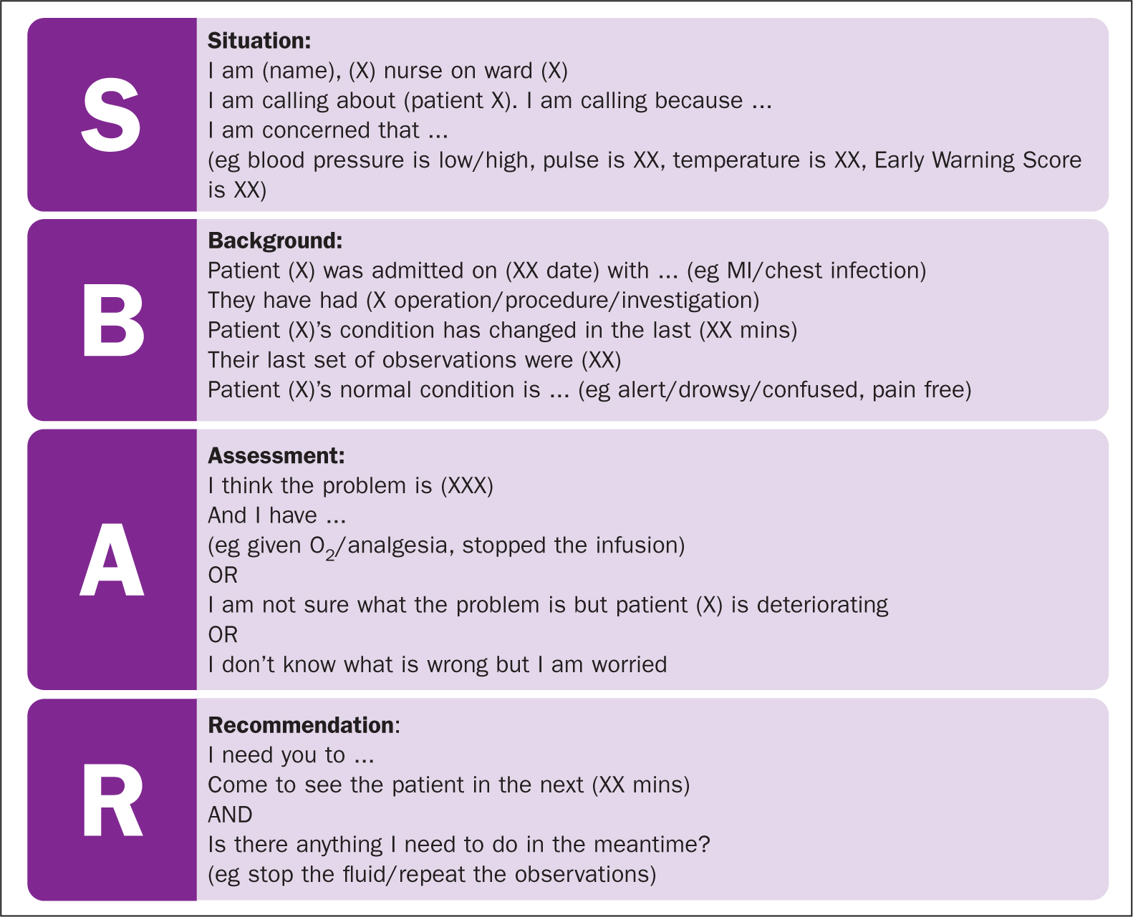
Communication Theory –The SBAR Model
SBAR – Situation , Background , Assessment , Recommendation
Why is it important in Health & Social Care ?
Enhances clear and effective communication among healthcare professionals.
Minimises the risk of miscommunication and mistakes.
Contributes to safer patient care and better outcomes.
Supports timely and informed clinical decision-making.
Helps ensure that essential information is communicated accurately during handovers, referrals, and emergency situations.
(Leonard et al., 2004).
The SBAR model is widely adopted across the NHS and other healthcare settings as a structured communication tool that promotes consistency, improves teamwork and enhances the quality of care provided to patients.(NHS England, 2023; Institute for Healthcare Improvement, 2022).

Slide 6
Practical Example- Applying SBAR in Practice
Scenario: Elderly Patient Showing Signs of Deterioration : A healthcare assistant notices that an elderly patient has become confused and is refusing medication . Using the SBAR model the healthcare assistant communicates concerns to the registered nurse.
S ( situation ) -The patient in Bed 5 is confused and has refused their medication this morning.
B ( Background)The patient has been admitted with a chest infection and has been taking antibiotics for three days.
A (Assessment)The patient appears more confused than yesterday and is not eating or drinking well.
R (Recommendation)Could you assess the patient as soon as possible and review their treatment plan?
Outcome:
The nurse carries out an assessment.
The patient's condition is reviewed promptly.
Appropriate interventions are implemented.
Communication is clear, concise, and effective.
Patient safety is improved.
This example demonstrates the use of SBAR to support effective communication and timely intervention in patient care (NHS England, 2023).

Slide 7
Conclusion !!
In conclusion, communication is a vital skill in health and social care supporting safe, effective and person-centred care. Effective communication improves patient safety & strengthens teamwork as it reduces errors (WHO, 2023; Leonard et al., 2004).
The SBAR model provides a structured way to share important information clearly and efficiently. In the practical example. It helped communicate concerns promptly leading to appropriate intervention and improved successful patient outcomes (NHS England, 2023).
The evidence from NHS England (2023) and Leonard, Graham and Bonacum (2004) it demonstrates that structured communication tools such as SBAR can improve teamwork, reduce communication errors, and ultimately enhance patient safety. As a future health and social care practitioner, I will use communication tools such as SBAR to support accurate information sharing and to deliver high-quality care.

Slide 8
Reference
Care Quality Commission (2024) How CQC monitors, inspects and regulates services. Available at: https://www.cqc.org.uk (Accessed: 21 June 2026).
Institute for Healthcare Improvement (2022) SBAR Toolkit. Available at: https://www.ihi.org (Accessed: 21 June 2026).
Leonard, M., Graham, S. and Bonacum, D. (2004) 'The human factor: the critical importance of effective teamwork and communication in providing safe care', Quality and Safety in Health Care, 13(Suppl 1), pp. i85–i90. (Accessed: 21 June 2026).
NHS England (2023) SBAR communication tool and patient safety guidance. Available at: https://www.england.nhs.uk (Accessed: 21 June 2026).
Skills for Care (2024) Communication skills in adult social care. Available at: https://www.skillsforcare.org.uk (Accessed: 21 June 2026).
World Health Organization (2023) Patient safety and effective communication. Available at: https://www.who.int (Accessed: 21 June 2026).

