Slide 1
10/03/25
<number>

Slide 2
Investigating Dr
Hart's Disappearance

Slide 3
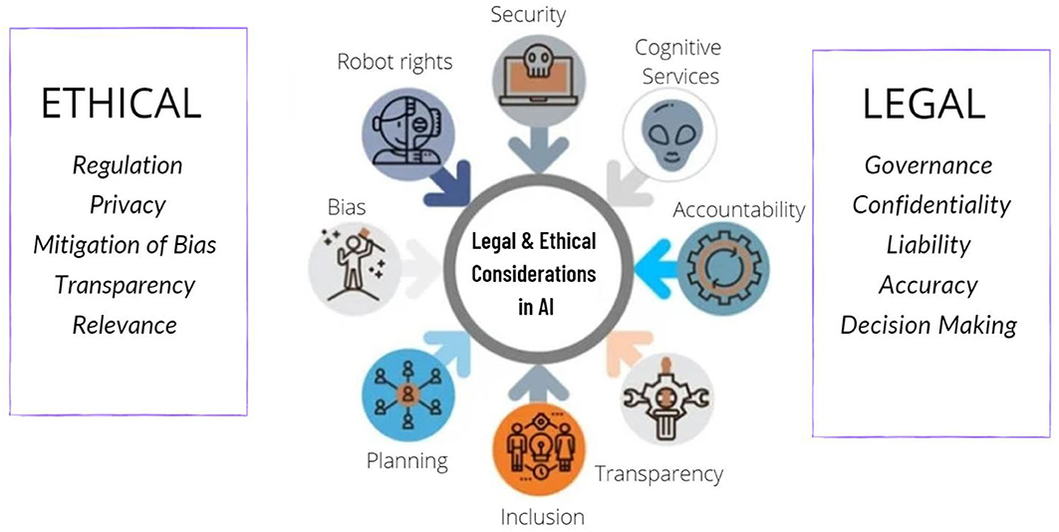
Introduction
Dr. Hart went missing under suspicious circumstances, as a renowned researcher on AI ethics and machine learning, sparking concerns about academic integrity, workplace safety and ethical AI development (Newman and Oak, 2020).
As a person involved in such controversial AI projects, her disappearance may be a result of institutional conflict or external pressure (Savchenko and Rosenfeld 2024).
10/03/25
<number>
Notes:
This presentation examines such evidence that workplace conflicts or ethical dilemmas might have played a part in her disappearance, considers potential motives in theory, and makes ethical and policy suggestions for protecting AI researchers from similar risks. To guarantee transparency and academic freedom in AI research (Volpe, 2016), these aspects must be understood.
<number>

Slide 4
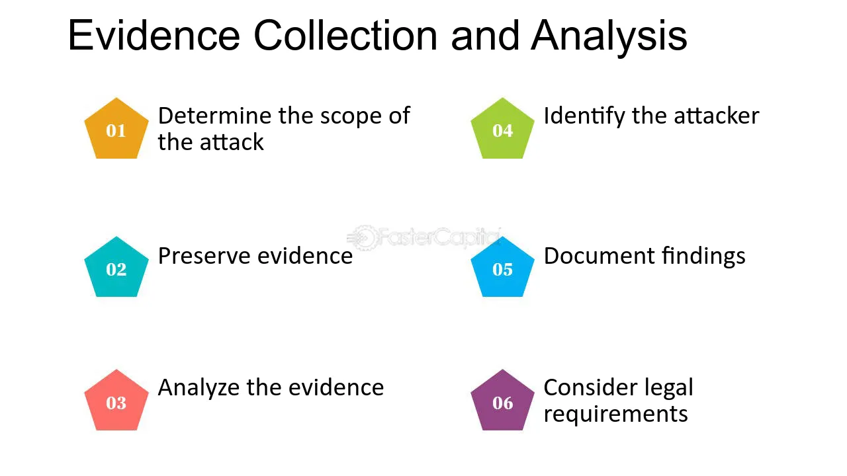
Key Evidence & Analysis
Workplace Conflicts & Academic Pressures
Work on the AI fairness and transparency by Dr Hart led her at odds with corporate sponsors and government agencies that benefited from unregulated uses of AI (Savchenko and Rosenfeld, 2024). She was reported to have been under pressure to adjust findings on bias with AI algorithms.
Ethical Dilemmas & AI Research
She applied her expertise to projects that would expose bias from AI driven surveillance and hiring systems, which might be seen as a threat to powerful stakeholders (Newman and Oak, 2020).
Her unwillingness to bargain with ethical standards in AI might have resulted in isolation from the academia or external threats (Volpe, 2016).
10/03/25
<number>
Notes:
Reliability of Evidence
However, both academic journals and media reports confirm ethical concerns with AI research (Miller and Brown, 2022), and such conflicts are often sensationalized in media reports (Miller and Brown, 2022).
According to some sources she quit or was forced to quit because of stress but others claim they were due to external threats or coercion (Newman and Oak, 2020).
<number>

Slide 5

Theories & Conclusions
Theory 1: Pressured to Work on Unethical Projects
Given that the technological level of cell phones is continually improving, Dr. Hart may have experienced institutional pressure to alter (or modify) her research findings from corporate or governmental perspectives (Savchenko and Rosenfeld, 2024).
In her research, she was very concerned about AI bias and ethics violations.
In a way, her refusal to cooperate may have cost her a career, or at least been ratted out (Newman and Oak, 2020).
10/03/25
<number>
Notes:
Theory 2: Workplace Safety & Psychological Stress
Academic environments can be highly competitive and politically charged, leading to mental stress and burnout (Volpe, 2016).
It is possible that Dr Hart’s disappearance was due to academic pressures, harassment, or career exhaustion (Miller and Brown, 2022016).
If she dared to publish how unethical AI was, she would likely be professionally isolated and prone to (security) risks.
Conclusion
While both theories are plausible, institutional pressure and ethical conflicts present a stronger case for Dr Hart’s disappearance.
<number>

Slide 6
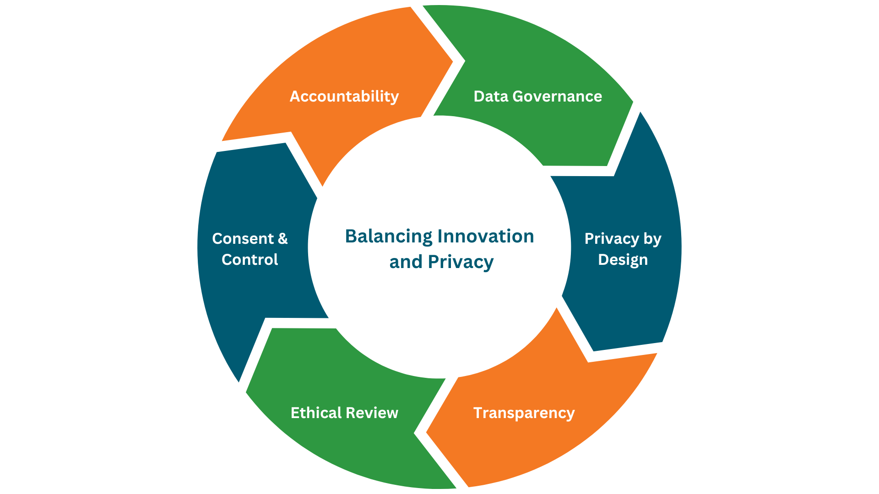
Recommendations & Ethical Considerations
To prevent similar cases, academia and AI research organizations must enforce stronger ethical guidelines and researcher protections (Newman and Oak, 2020).
Recommendations
Safe reporting: protecting AI researchers who can report ethical violations (Savchenko and Rosenfeld, 2024).
10/03/25
<number>
Notes:
Transparency in AI Research: Imposing independent review boards on corporate funded AI projects (Volpe, 2016).
Universities should provide resources to deal with burnout, harassment, and workplace conflict (Miller and Brown, 2022).
<number>

Slide 7
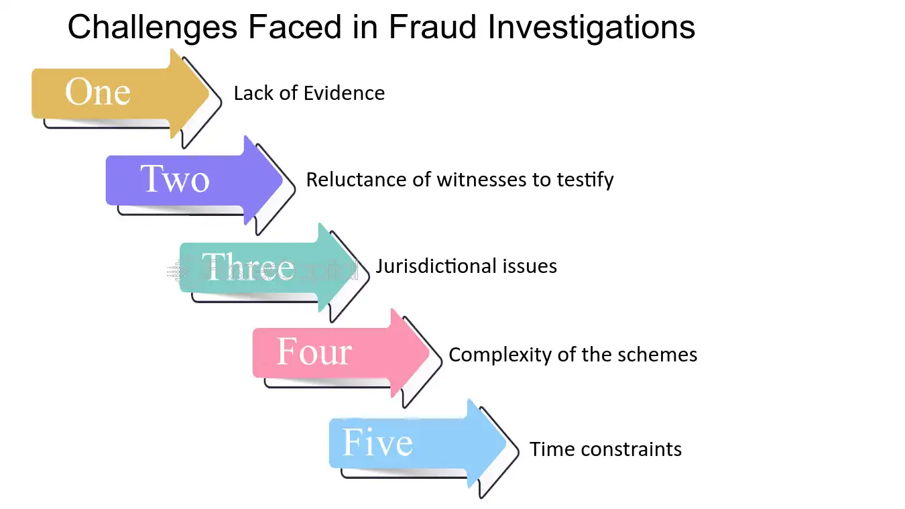
Reflection & Challenges
Challenges Faced During the Investigation
The Defects of Sensationalized Report: Sensationalized reports often exaggerated or distorted facts resulting in biased and inaccurate media reporting (Newman and Oak, 2020).
There’s a Lack of Direct Evidence: Given that many AI ethics cases involve hidden, corporate influences, verification is difficult (Savchenko and Rosenfeld 2024).
10/03/25
<number>
Notes:
Lessons Learned
Research: First it is critical thinking in research you should not be chasing for your answers or conclusions, but one should be analyzing various perspectives first before forming the conclusion (Miller and Brown, 2022).
Future policies should also protect AI Researchers by ensuring research integrity as well as ethical oversight (Volpe, 2016).
<number>

Slide 8
References
Newman, J.C. and Oak, R., (2020). Artificial Intelligence: Ethics in Practice. login Usenix Mag, 45(1).
Miller, D.W. and Brown, R.E., (2022). seven steps to setting up a neuroscience program at Universities in developing countries. In Neuroscience in the 21st Century: From Basic to Clinical (pp. 4537-4572). Cham: Springer International Publishing.
Savchenko, E. and Rosenfeld, A., (2024). Authorship Conflicts in Academia: An International Cross-Discipline Survey. arXiv preprint arXiv:2303.00386.
Volpe, M. R., (2016). Resolving Conflicts in Institutions of Higher Education: Challenges for Pracademics. Georgia State University Law Review, 32(3), pp.667–688.
10/03/25
<number>
Notes:
<number>

