Slide 1



Introduction to conveyancing
BMLW6003

Slide 2


Welcome to Conveyancing Practice!
Your module tutor is Siân Turvey
BA (Hons) F.CILEX GDL PGDip Legal Practice
Solicitor
Programme Manager for Law
Legal Advice Centre Manager
Institute of Management and Health Swansea
Property Law Specialist with over 18 years’ experience in the field

Slide 3

Aim of the module
To develop a broad and detailed understanding of Conveyancing and provide relevant underpinning knowledge and understanding towards the Legal Advice standards.

Slide 4

Learning Outcomes
Upon the successful completion of this module, the student should be able to:
Demonstrate a systematic understanding of conveyancing practice in relation to interests in land and the transfer of legal estates and how to take conveyancing instructions to prepare a contract for sale.
Systematically evaluate the complexities of title to land, leasing and easements and the transfer of title and the legal responsibilities in relation to funding and completion of property transactions.

Slide 5
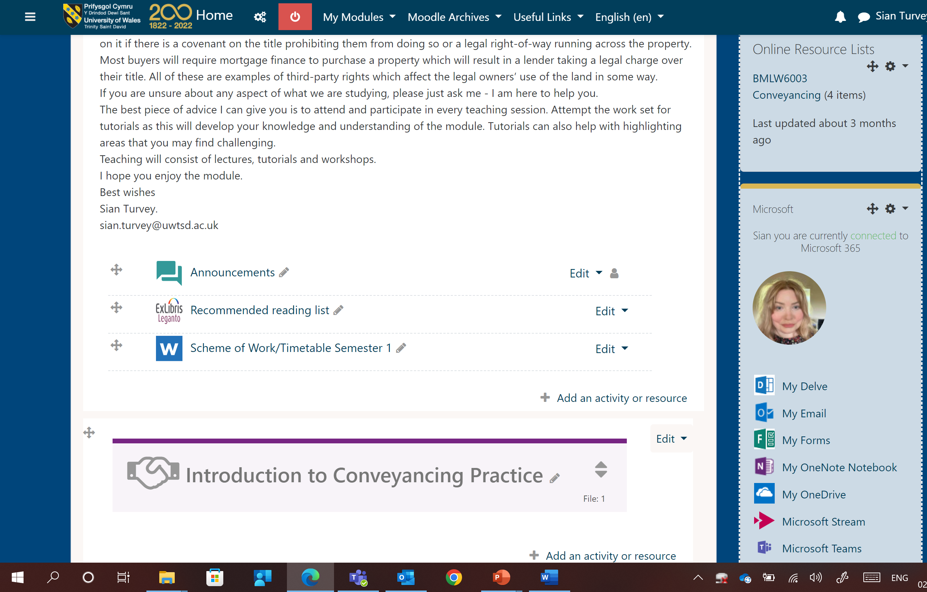
Indicative Content
Please see the Scheme of Work on Moodle

Slide 6
Assessment
One written assignment due in on 11th November 2022 by 23:59
One two-hour open book exam in January 2023

Slide 7


Introduction
Land and buildings come in all shapes and sizes, from flats and houses to fields, offices, factories, shops and even nuclear power plants.
No two properties are the same.
Property clients are also very varied: clients buy land and buildings for different reasons and a client who wants to occupy a house or business premises will have very different priorities from a client who wants to invest in or develop a property to raise income and a capital profit.
Some clients want outright ownership and are prepared to pay the purchase price up front, some clients only want the building for a limited period and prefer a pay as you go rental arrangement.

Slide 8
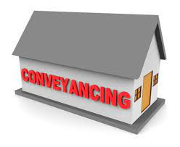
Whatever shape and size the property and regardless of how and why the client wants it, there are recognised procedures for buying, selling and leasing land and buildings in England and Wales which lawyers are expected to follow.
The process of transferring the ownership of a property is called ‘conveyancing’.

Slide 9
Conveyancing is procedural

Slide 10

Key elements
Two main milestones: -
Exchange of Contracts; and
Completion

Slide 11


Exchange of Contracts
Exchange is not compulsory, but is useful because it fixes the completion date and gives the buyer time between exchange of contracts and completion in order to make their final preparations.
Useful where the parties are agreed that conditions must be fulfilled before completion can take place.
The contract records the agreed terms and can be relied upon if anything goes wrong in the period between exchange of contracts and completion.
Not always necessary to have a gap in time. Exchange of contracts and completion can take place simultaneously, or the parties can agree to proceed straight to completion without an exchange of contracts.

Slide 12

Completion
Completion is the stage when the bulk of the purchase money is paid to the seller and the transfer deed is completed to transfer the property to the buyer.
Keys are handed over to the buyer.

Slide 13
Basic outline of a conveyancing transaction
Pre-contract stage
Exchange of Contracts
Pre-completion stage
Completion stage
Post-completion stage

Slide 14

When does the contract become legally binding?
It is important to realise that the parties are not bound to the transaction until contracts are exchanged.
Buyers sometimes have cause to complain when the seller pulls out of the transaction just before exchange of contracts, after the buyer has incurred considerable time and expense.
The obvious solution for this problem would be for the buyer to exchange contracts as soon as they make an offer so that, for example, they are not gazumped by a new buyer offering a higher price.

Slide 15
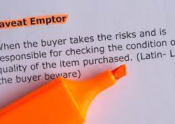
Caveat emptor
However, the buyer should not enter the contract until they have carried out numerous searches, enquiries and a survey of the property.
This is because of the principle of ‘caveat emptor’, which is a Latin phrase meaning ‘let the buyer beware’.
Caveat emptor means that the seller is not obliged to disclose information about the property, other than about limited matters of title, and would not be liable for any defects in the property which later come to light.
So, the onus is on the buyer to discover as much about the property as possible before exchanging contracts and committing to the purchase.

Slide 16

Pre-contract stage
Taking initial instructions.
Think about what information you will need to take from your client.
Let’s look at both the buyer’s and the seller’s perspectives.

Slide 17
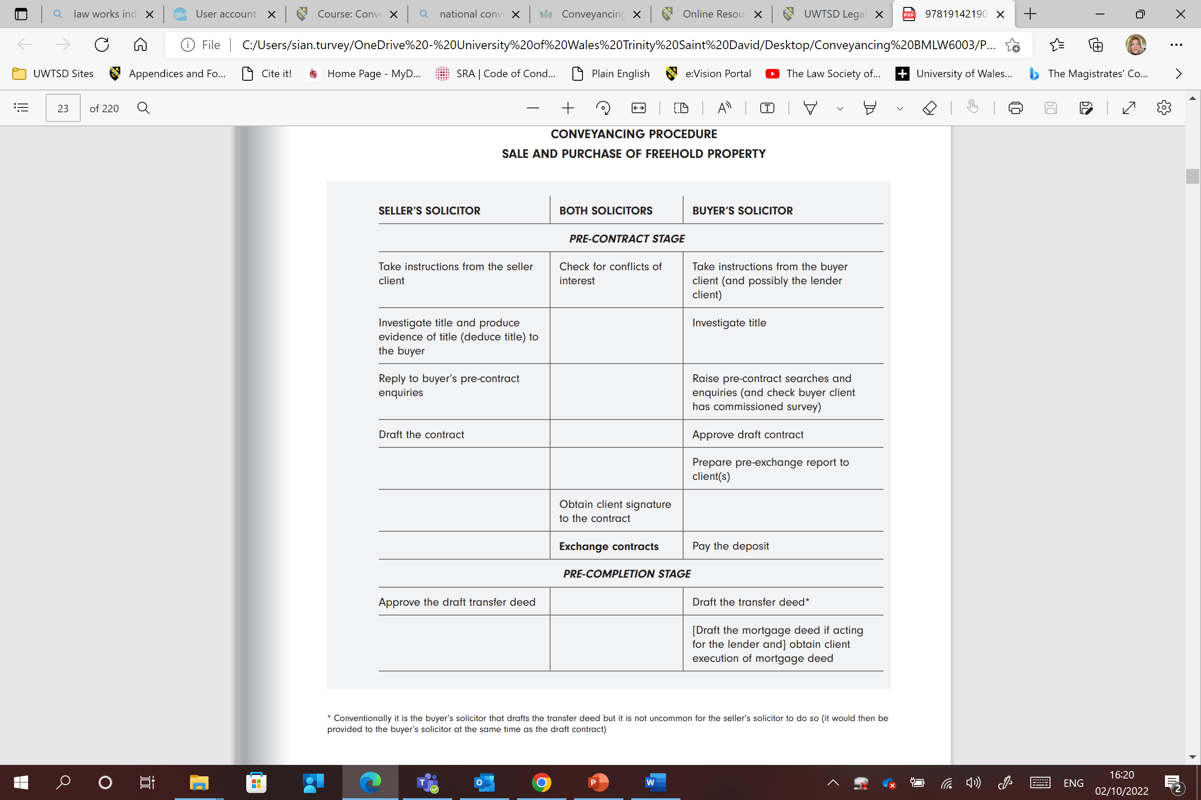
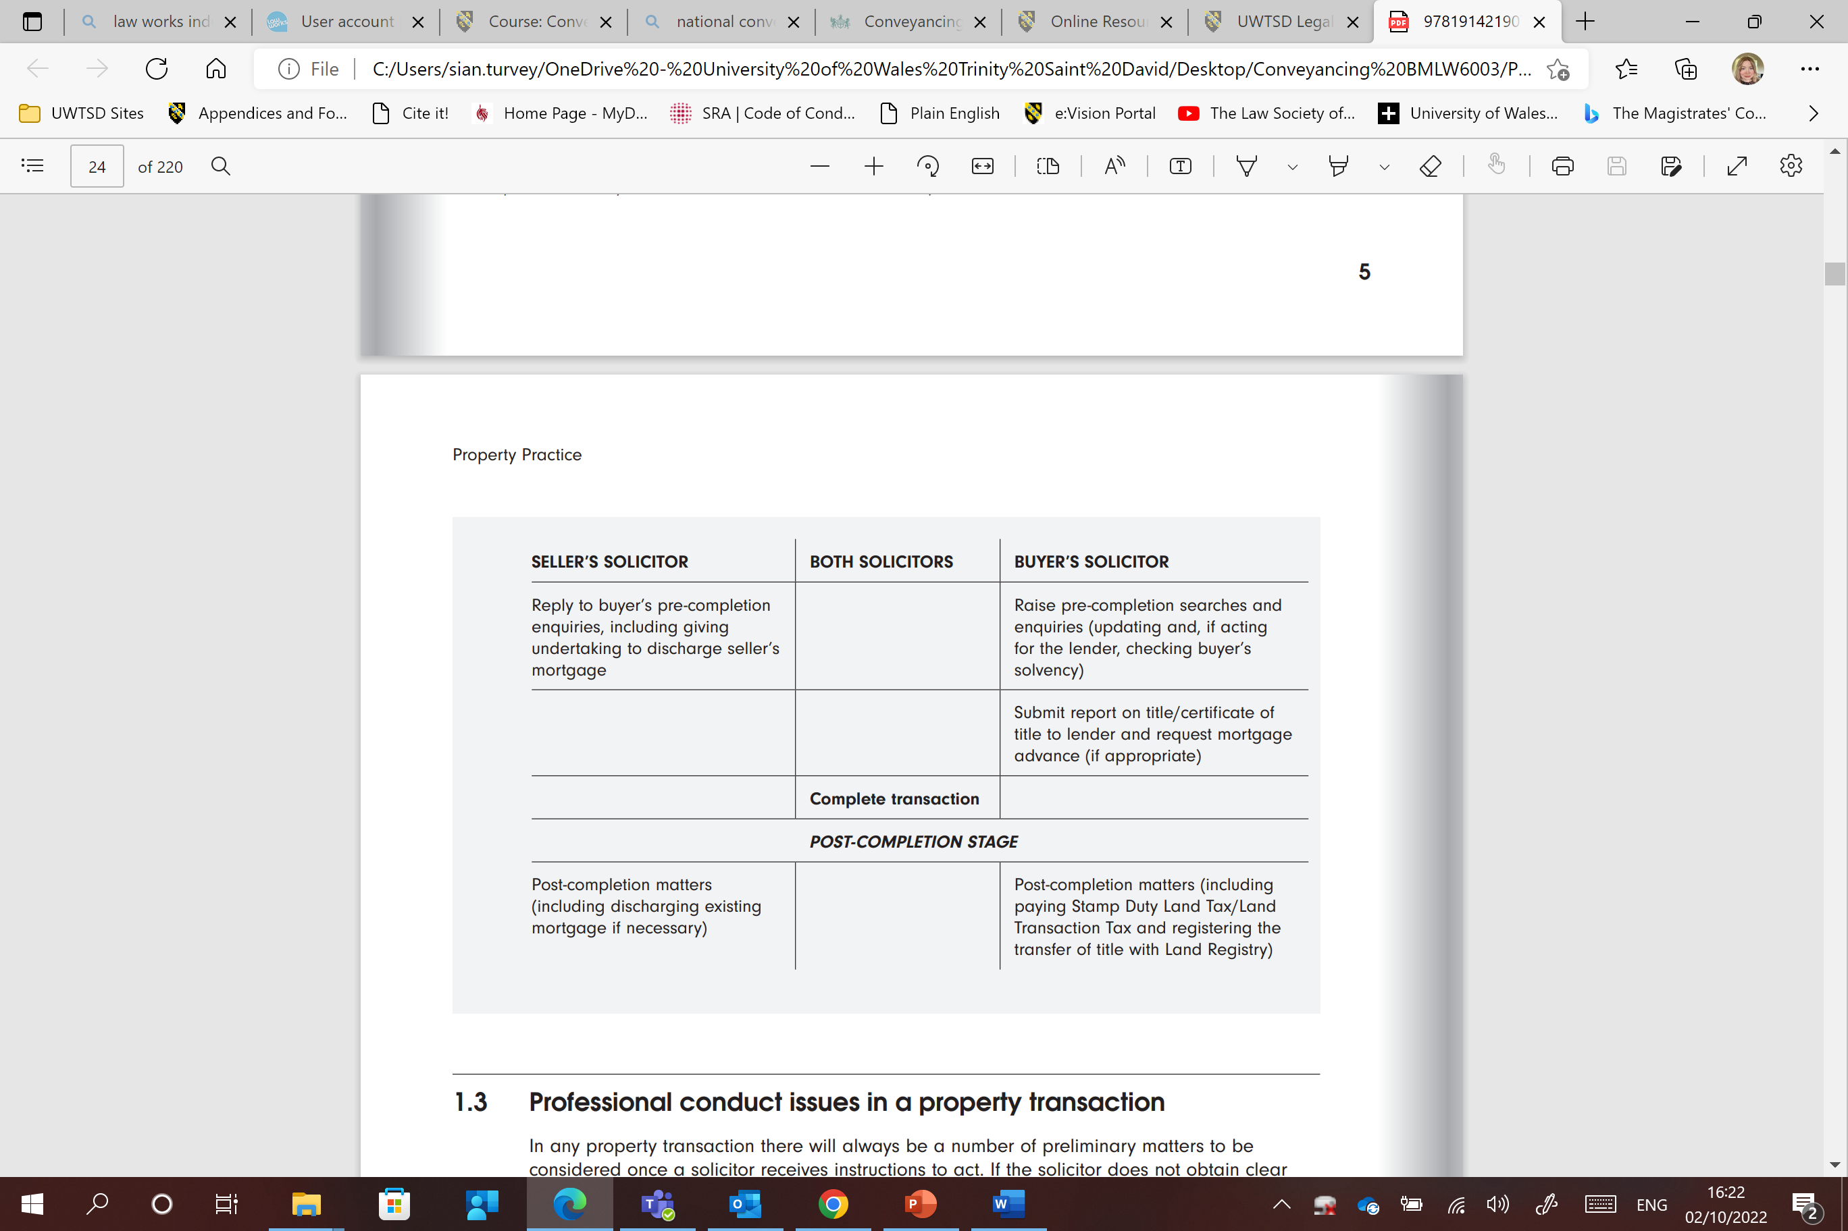
Conveyancing procedure

Slide 18
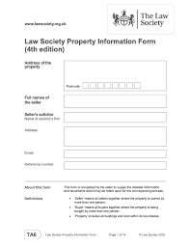
The Law Society Conveyancing Protocol
Applies to residential conveyancing only.
The current version of the Protocol was issued in 2019 and replaced earlier versions, the first of which was issued in 1990. A copy can be found on Moodle.
The Protocol is designed to standardise the residential conveyancing process.
It is a set of instructions to conveyancers as to how to carry out a residential sale and purchase and is accompanied by a series of standard documents issued under the ‘TransAction’ brand.
For example, where the Protocol is used, the form of standard pre-contract enquiries to the seller that the seller’s solicitor will ask their client to complete for a freehold property is called a Property Information Form (TA06).

Slide 19

All firms that undertake residential conveyancing and want to be members of The Law Society’s Conveyancing Quality Scheme (‘CQS’) are required to comply with the Protocol, a Client Service Charter and mandatory training and enforcement procedures.
Membership of the CQS is essential for any firm wanting to be on the panels of solicitors approved by the residential mortgage lenders to act for lenders where the buyer is taking out a mortgage.

Slide 20

Professional conduct issues
The first question should always be ‘Can we act on behalf of this client?’ and then ‘Can we carry out the client’s instructions?’.
For solicitors, the starting point and constant point of reference must be the professional conduct regulations laid down by the Solicitors Regulation Authority in the Code of Conduct for Solicitors.
A firm’s conduct will be governed by the Code of Conduct for Firms. Any breach of those regulations (collectively known as ‘The Code of Conduct’) may lead to disciplinary proceedings against the solicitor and/or the firm, and also a potential negligence claim.

Slide 21
Acting for buyer and seller
Can you think of any issues with acting for both parties?
Let’s look at the pros and cons.

Slide 22

Conflict of interest
Acting for buyer and seller is governed by paragraph 6.2 in The Code of Conduct which states that, subject to certain exceptions, a solicitor cannot act for both parties if there is a conflict of interest or a significant risk of such a conflict.
Acting for a buyer and a seller carries a high risk of conflict of interests where the land is being transferred for value.
This is particularly the case where the clients do not have equal bargaining power (eg an experienced developer and a first-time buyer) or where there has to be a negotiation on price

Slide 23
Exceptions
An exception set out in paragraph 6.2(a) allows a solicitor to act for more than one party, even if there is a conflict of interest, where the parties have a ‘substantially common interest’ in relation to the matter and provided that certain conditions are met.
However, the Law Society has stated that:
The SRA’s exception for circumstances where the two clients have a 'substantially common interest' does not apply to a property purchase. Although both clients will have a common interest in completing the sale, they also have different interests, since one is buying and one is selling.

Slide 24
Another exception set in paragraph 6.2(b) allows a solicitor to act even if there is a conflict of interest where the clients are competing for the same objective. The conditions for so acting are as for paragraph 6.2(a).
So, it might be possible, in theory, to act for two buyers who are competing against each other to buy a property, but this exception will not apply in a buyer and seller situation

Slide 25
Acting for joint buyers
It is usually acceptable to act for joint buyers, provided that the solicitor can comply with paragraph 6.2 in The Code of Conduct.
It may be necessary to advise residential buyers separately about how they want to hold the equitable interest in the property, particularly if they are not married or in a civil partnership

Slide 26
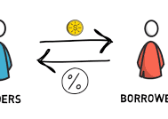
Acting for borrower and lender
Acting for more than one party in the same transaction is more common when the parties are the borrower and the lender.
Acting for a lender and borrower is possible unless, under paragraph 6.2 of The Code of Conduct, there is a conflict of interest or a significant risk of such a conflict.

Slide 27

Contract Races
Another situation that can cause difficulties for solicitors is where a seller client is selling a property using a marketing strategy known as a ‘contract race’.
A precontract package is sent to multiple buyers who then compete to be ready to exchange contracts first.
This is regarded as a legitimate selling technique, so long as all the prospective buyers know that they are engaged in a race.
However, problems arise when the seller instructs their solicitor that they do not want the prospective buyers to know.
Paragraph 1.4 of The Code of Conduct is relevant to this situation.

Slide 28
Important!
Where a solicitor acts for a seller of land, they must not mislead or attempt to mislead the buyers, either by their own acts or omissions, or by being complicit in the acts or omissions of others.
This means that the solicitor should inform all buyers immediately of the seller’s intention to deal with more than one buyer.
If the seller refuses to agree to such disclosure, the solicitor cannot disclose the contract race to the prospective buyers because they have a duty of confidentiality to the seller client under paragraph 6.3.
Instead, the solicitor should immediately stop acting in the matter.

Slide 29
Undertakings
An undertaking is a statement made by or on behalf of a solicitor, or the firm, to someone who reasonably places reliance on it, that the solicitor or firm will do something, cause something to be done, or will not do something.
Paragraph 1.3 deals with undertakings and says that solicitors should perform all undertakings, and do so within an agreed timescale.
Failure to honour an undertaking is professional misconduct so a solicitor should always ensure that anything they undertake to do is within their control.

Slide 30
Sources of finance
Think of how a buyer may fund a purchase.

Slide 31

Taxation
Look at the two property taxes charged in England and Wales
Go to Welsh Revenue Authority for Wales
Go to HMRC for England

Slide 32
Summary
A typical conveyancing transaction has two milestones, exchange of contracts and completion, and is broken down into three stages – pre-contract, pre-completion and post-completion.
The Law Society Conveyancing Protocol standardises the residential conveyancing procedure for those firms that adopt it.
A solicitor cannot usually act for more than one party in a property transaction if there is a conflict of interest or a significant risk of conflict of interest.
Acting for buyer and seller in the same transaction carries a high risk of conflict of interest.
It will often be possible to act for both buyer and lender in a residential transaction if the mortgage is on standard terms. In commercial property transactions, the lender will usually be separately represented.

Slide 33
A solicitor acting for more than one buyer in a contract race must comply with paragraphs 1.2 and 1.4 of The Code of Conduct.
Undertakings are frequently given in property transactions, but failure to comply with an undertaking constitutes professional misconduct
A buyer may obtain finance for the purchase from a bank, building society, employer or relative.
A buyer will usually choose from a repayment mortgage or an interest-only mortgage. The interest rate may be variable, fixed or track the base rate set by the Bank of England.
SDLT (England) and LTT (Wales) is charged on freehold transactions at different rates depending on the type of property and the purchase price and is payable by the buyer.

