Slide 1

Sue Hamer
Dissertation Hints & Tips

Slide 2


Slide 3
Yes, it will feel overwhelming at the beginning!
Do engage with your tutor and meet regularly
Meet with your tutor group colleagues
You are all aiming for the same goal so support one another!

Slide 4
Tips
Get your ethic form signed sooner rather than later
Don’t forget a consent form & participation sheet
Research question, aim and objectives
Each chapter requires an introduction and conclusion
Your literature review themes will provide structure when writing up your findings

Slide 5
What went well
Structured project plan with key dates
Having a 1-2-1 supportive tutor
Time to review each chapter and refine
Support from tutor group colleagues
Literature search documentation

Slide 6
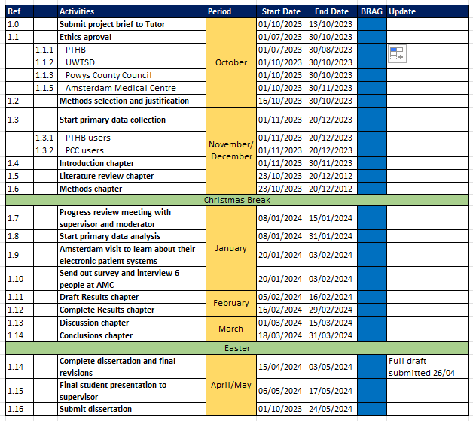
High Level Project Plan

Slide 7
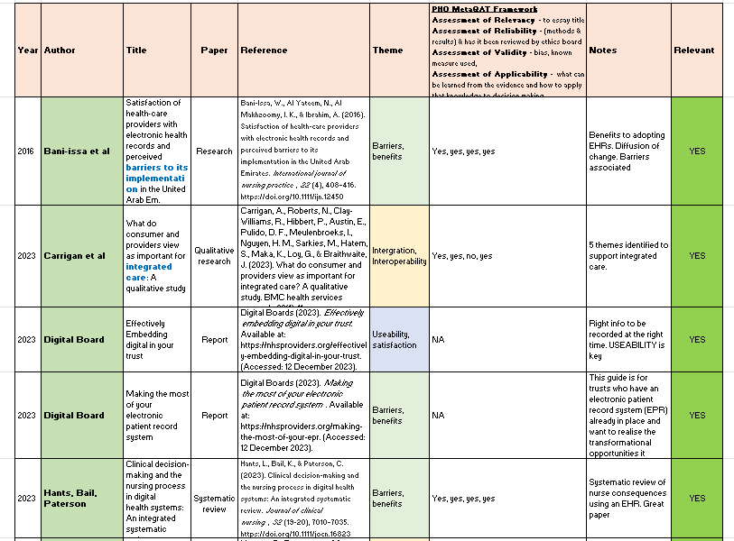
Literature Review Search

Slide 8

What was harder than expected
Literature Review
Keeping the word count under 16,500
The discussion section bringing the literature and results together
Getting people to complete the survey
Transcribing interviews & coding into themes

Slide 9
Final words
Keep it simple!
Amsterdam placement

Slide 10
⁠
⁠
Notes:
End Goal! Becoming a Master of Science in Digital Transformation!!

Slide 11

Q & A

