Slide 1
FOREIGN LANGUAGES AND CULTURAL AWARENESS – BMIH5003
Student Name: ZAHID LATIF
Student number: 2208182
Lecturer Name: HEIDI PROSSER
Assignment – Presentation
Recording-20231027_215110.webm

Slide 2

Diversity Hotel & Spa London
H
D
S
LONDON
(Noun Project, n.d).

Slide 3
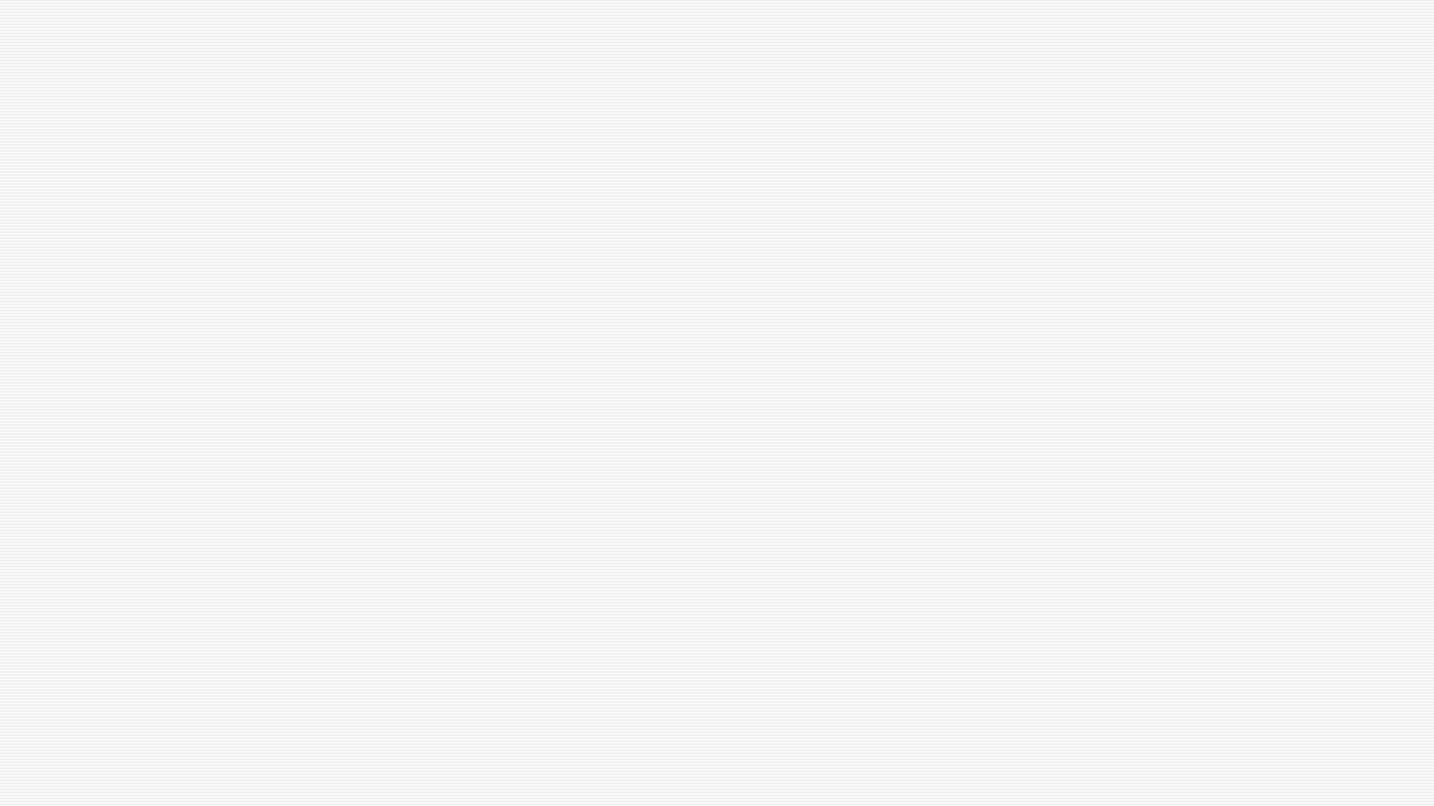

Benefits of multilingualism for hotel staff
Translation
Cultural gap (Hospitality Search International, 2023).

Slide 4
Importance of language awareness skills for hotel staff
Reading and comprehension skills
Good listening skills (EHL Insights, 2023).

Slide 5
Language: French
Where is it spoken? (Ministry for Europe and Foreign Affairs, 2023).
Is it hard to learn?
What is considered polite/impolite in a business context? (Coeli, 2023).

Slide 6
Examples
Greetings (Expatica, 2023).
First impressions (Today Translations, 2023).

Slide 7
References
Coeli, R. (2023) Language Institute – French Greetings, Gestures and Kisses Available at: https://www.reginacoeli.com/blog/french-greetings,-gestures-and-kisses.html#:~:text=The%20French%20do%20not%20just,encounter%20only%20lasts%20five%20minutes (Accessed: 24th October 2023).
EHL Insights (2023) Language skills for an international hotel management career Available at: https://hospitalityinsights.ehl.edu/key-language-skills-international-hotel-management-career (Accessed: 22nd October 2023).
Expatica (2023) French Etiquette and Manners available at: https://www.expatica.com/fr/living/integration/french-etiquette-101246/ (Accessed: 26 October 2023).
Hospitality Search International (2023) Benefits of Being Multilingual Available at: https://hospitalitysearch.co.uk/benefits-of-being-multilingual/#:~:text=There%20are%20all%20kinds%20of,when%20dealing%20with%20international%20clients (Accessed: 22nd October 2023).
Ministry for Europe and Foreign Affairs (2023) France Diplomacy – 10 good reasons to learn French Available at: https://www.diplomatie.gouv.fr/en/coming-to-france/studying-in-france/learning-french/article/10-good-reasons-for-learning (Accessed: 22nd October 2023).
Noun Project Inc. (n.d) Logo image Available at: https://thenounproject.com/icon/spa-163466/ (Accessed: 23rd October 2023).
Today Translations (2023) Doing Business in France Available at: https://www.todaytranslations.com/consultancy-services/business-culture-and-etiquette/doing-business-in-france/#:~:text=Eye%20contact%20is%20important%20as,your%20pockets%20at%20all%20times (Accessed: 24th October 2023).

