Slide 1
Managing in complex environments: Strategies, Insights and Solutions
MICE
SPBD 7006
Week 7 (Lecture 7)

Slide 2

Last week we talked about…
Leadership
  What it is
  What leaders are
  What they do
  Why it works (sometimes)
  How we can do it (a bit)

Slide 3

Today’s subjects…
Management
  What it is?
  The role of a manager?
  Theories of management?
  Relationship to leadership

Slide 4




Are you a “Good” boss?
Notes:
What makes a bad manager bad?

Slide 5
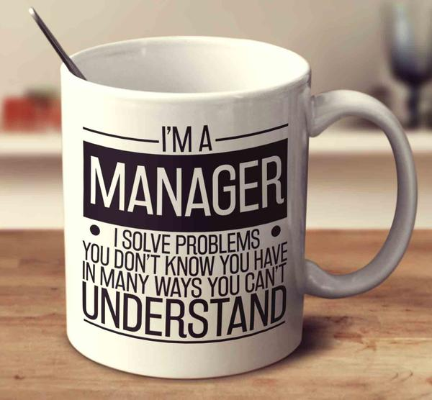
https://www.youtube.com/watch?v=GVTd0ecBHcM
Notes:
1:45 video. Bad boss, good boss

Slide 6

What makes a great manager?
Notes:
Whiteboard.
Think of a good boss that you’ve had, or a time when you were effective in managing yourself
What were they/ you like?
What did they/ you do?

Slide 7

Today’s BIG IDEA
Leadership and Management (L&M)
L&M can involve different activities and ways of thinking
Knowing the difference can help us to understand each one better
A breadth of skills will help us get better results
Who wants a half full toolbox?

Slide 8
This week we’ll discuss…
Management
  What it is
  The role of a manager
  Relationship to leadership

Slide 9

What do managers do?
(if anything)
Notes:
Get words, definitions of management and what it means to be a manager.

Slide 10

Management is Big & Complex
Notes:
One page of a search of “management” books in Amazon. More than 80,000 titles. Leadership gives 50,000.

Slide 11
A Warning
Management research is very rewarding, and not always rigorous
Two very respected sources (Minzberg and Kotter) based their findings on five and fifteen subjects only
Their analysis was based on common activities identified in “successful” managers
Notes:
Beware small data sets, especially small, diverse datasets
And also remember confirmation and matching bias – looking for common attributes is not proof. Remember Wason’s card test (do it now). Also remember survivor bias?
Both are from Harvard Business Review, which is a very interesting read, but not the most reliable academic journal as it tends to contain opinion pieces rather than peer reviewed research

Slide 12

Management is “making things happen”
Within structured organisations
Using hierarchies
Using systems and procedures
Directed towards a goal
Through the efforts of other people
Notes:
According to Mullins management is a formal construct, involving hierarchies and defined activities, using the effort of workers to reach a goal.
Do we agree with this definition? What is wrong with it?

Slide 13
Watson (1986) states that management is
Science
Magic
Politics
Art
Notes:
According to Watson:
Science – application of knowledge and skills
Art – use of natural talents, intuition and feel intelligence
Magic – no one really knows how it works, so we use ritual and force of personality i.e. engage in the rituals
Politics – understand the unwritten rules of the organisation to play the game
Is this a better description?

Slide 14
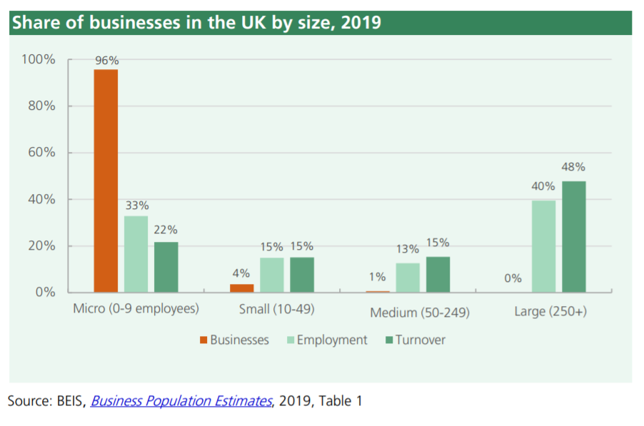
5.9 million private business in UK in 2019
Notes:
Henri Fayol at the turn of the 19th Century.

Slide 15
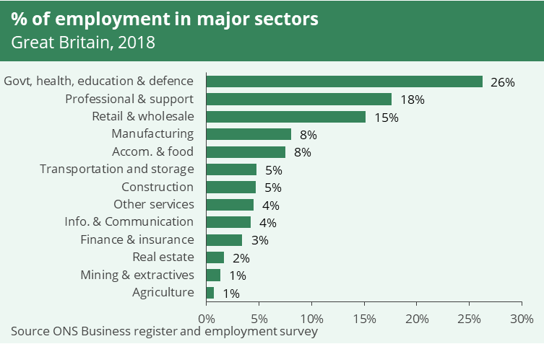
Notes:
The CMI also identifies the ill-preparedness of graduates for management jobs as a real concern for the industry. Their 21st Century Leaders 2018 report states that the UK economy needs 1.9 million new managers and that employers are struggling to fill roles. According to the report, 70% believe that management, enterprise and leadership modules should be built into all degree subjects to boost employability, while 66% of employers want to see graduates achieve professional qualifications as well as a degree.

Slide 16
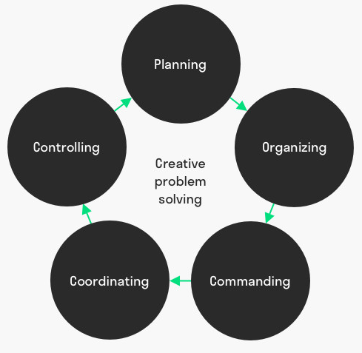
Traditionally managerial activities…
Planning
Organising
Command
Coordination
Control
Henri Fayol
Notes:
Henri Fayol at the turn of the 19th Century.
Planning (predicting the future and taking it into account)
Organising (obtaining and structuring resources)
Command (Obtaining effort from those resources)
Coordination (Aligning the effort in a common direction)
Control (Verifying results)
How about this description?

Slide 17
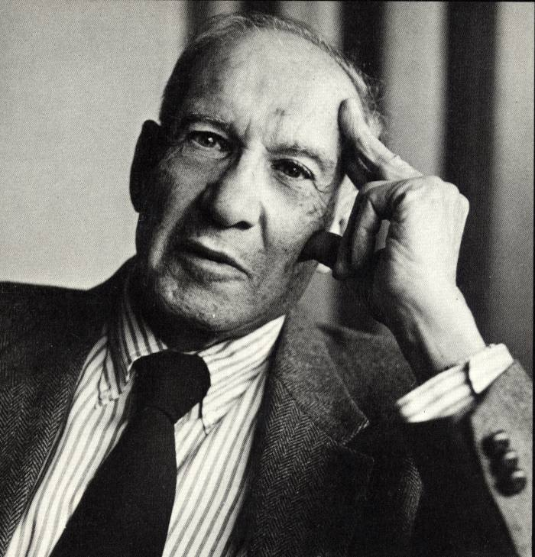
More recently…
Sets objectives
Organises
Motivates/ communicates
Measures
Develops people
Peter Drucker
Notes:
Drucker
Defined three main tasks:
Fulfil the organisational purpose
Maximise productivity
Manage broader impact (social)
Leading to five operations (slide)
These are not so different to Fayol’s activities. The only one without a clear mapping across is developing people – a more humanist approach to Fayol’s classical one

Slide 18
What is the difference between leadership and management?
?
https://www.youtube.com/watch?v=ktWBeqpSb9I
Notes:
Given those words, which would be leadership and which would be management? Is there any difference?

Slide 19
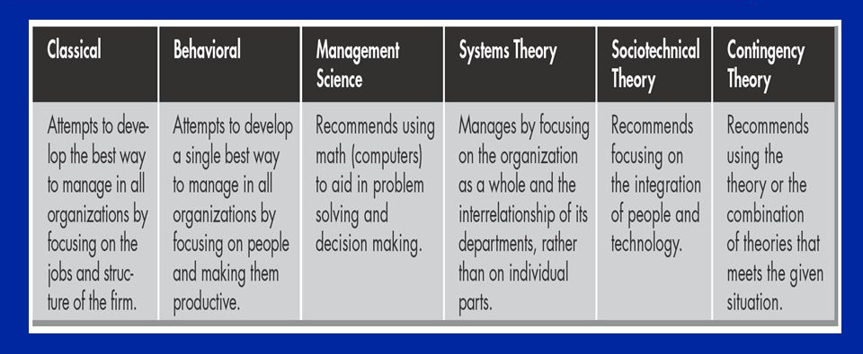
Management Theories – which is “best”?
Should you use any of these in your assignment? How?

Slide 20
According to the CMI
“Management style is the manner in which managers exercise their authority in the workplace and ensure that their objectives are achieved. It is about how managers plan and organise work in their area of responsibility and in particular about how they relate to, and deal with their colleagues, subordinates and team members. The key components of management and leadership style are attitudes and behaviours.”
So is management theory about what we do or about how we do it or both?
Notes:
Pull out the key points in this slide
What is wrong with this slide design

Slide 21


Slide 22
Theory X and Y of Management
(Douglas McGregor)
Management determined by manager’s assumptions about human nature.
Theory X - human beings have an inherent dislike of work and need to be controlled and directed to achieve objectives.
  Leads to autocratic and paternalistic management styles
  Could mean demotivation and low performance
Theory Y - work is a natural part of life from which people gain a sense of satisfaction. Workers motivated to give their best by respect and recognition.
  This leads to more consultative and participative management styles.
  Could mean motivated, high performing staff
Notes:
Ask students about how well the slide is designed
Too much text?

Slide 23
Blake & Morton’s Theory of Managerial Behaviour
Two drivers of managerial behaviour
concern for getting the job done
concern for the people involved
Managerial style is affected by their level of concern for these two factors
Impoverished management – little concern for either task or people. Involves only going through the motions, doing only enough to get by.
Authority-obedience – high levels of concern for task and low for people. Represents a controlling style, close to traditional ‘command and control’ approach, but runs risk of damaging human relationships.
Country club leadership – high levels of concern for people and low for task. This is seen as accommodating – may create a warm, friendly working environment but at the cost of getting the job done efficiently.
Team management – high levels of concern for both task and people. Most effective style with the potential for high achievement.
Middle of the road management – moderate level of concern for task and people. Achieves a balance between task and performance but is likely to perpetuate the status quo rather than achieve notable success.

Slide 24

THERE ARE MORE THEORIES
“Good management is crucial to driving growth and productivity, but many of today’s managers are simply not up to the job”
(CMI, 2014, p.16)

Slide 25
What is the difference between leadership Leadership & Management? (recap)
Leaders
Do the right things
Use influence
Managers
Do things right
Use authority
Create disruption
Create stability
Drive effectiveness
Drive efficiency
What is the difference between efficiency and effectiveness
Notes:
Lots of different opinions. Kent came up with some of these.
Efficiency vs effectiveness. Short discussion of this.
Efficient (adj.) – Performing or functioning in the best possible manner with the least waste of time and effort. The difference between effectiveness and efficiency can be summed up shortly, sweetly and succinctly – Being effective is about doing the right things, while being efficient is about doing things right.

Slide 26
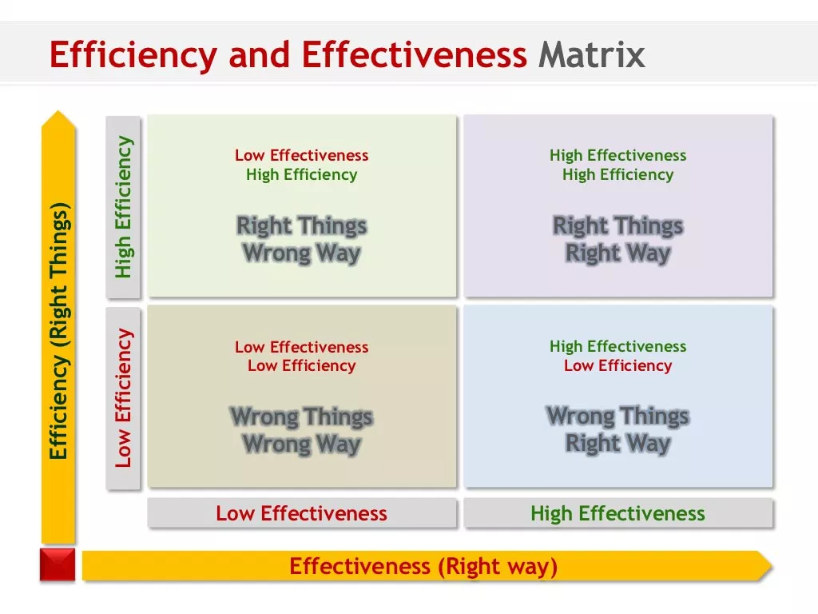

Slide 27
The two are not independent
Leadership
Management
Most
Effective
Notes:
We separate the two because it is useful to do so. Perhaps the most effective leaders are competent managers, and the most effective managers also lead.

Slide 28

Leadership vs Management
Transactional Leadership
    formal authority
    Clear goals
    Rewards and punishments
Transformational Leadership
    Values
    Vision
    Trust
    Loyalty
Notes:
A la Burns.
Bass suggest that this is achieved through organisational purpose, which trumps individual self interest by activating higher level needs.
Research indicates that optimal performance depends on both. Transformational does not work in isolation. Transactional leadership will get results up to a point. Combining the two is where true performance lies.

Slide 29
Situational Leadership
Telling
Delegating
Will
Y Axis
Selling
Participating
X Axis
Skill
Notes:
There are various versions of situational leadership, but they all have similar results.
The x axis is to do with the activity: could be ability of the subordinate or team, , level of structure of the task, readiness
The y axis is to do with the relationship: how subordinates will react, their motivation, willingness
A common way of referring to it is Skill and Will. (Hershey and Blanchard).
Situational leadership suggests different approaches based on where a person or individual falls on the grid. Moving to the left involves more direction, more instruction. Moving downwards involves more support and relationship building.
This theory is heavily linked to developing subordinates by guiding them through a curve from Telling to Selling.

Slide 30
Management Capabilities
Interpersonal Skills
Required Skill
Technical Skills
Seniority

Slide 31
Today’s subjects…
Management
  What it is?
  The role of a manager?
  Theories of management?
  Relationship to leadership

Slide 32


