Slide 1
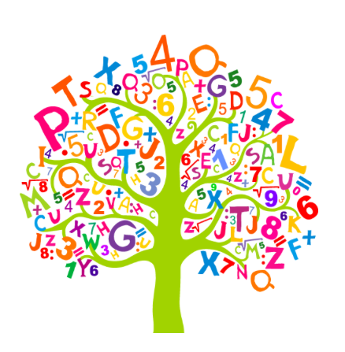
ECES5022C
Y Tri R
The Three Rs
Sesiwn 1 / Session 1

Slide 2

Beth yw’r Tri R?
What are the Three Rs?
This Photo by Unknown Author is licensed under CC BY

Slide 3
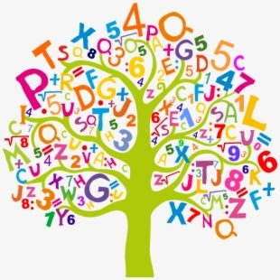
Amcan y Modiwl / Module Aims
Deall y ddeddfwriaeth, y polisi ac ymarfer sy'n ymwneud â datblygu sgiliau llythrennedd, rhifedd a digidol a dadansoddi rôl llythrennedd, rhifedd a sgiliau digidol wrth wella dysgu a chyflawniad gydol oes.
To understand the legislation, policy and practice related to the development of literacy, numeracy and digital skills and to analyse the role of literacy, numeracy and digital skills in enhancing learning and life-long achievement.

Slide 4

Deilliannau Dysgu Learning Outcomes
adnabod, dadansoddi a gwerthuso dulliau effeithiol o godi lefelau cyrhaeddiad mewn rhifedd a llythrennedd gan gynnwys defnyddio technolegau digidol;
identify, analyse and evaluate effective approaches to raising levels of achievement in numeracy and literacy including the use of digital technologies;

Slide 5

Deilliannau Dysgu Learning Outcomes
gwerthuso'r cysylltiadau rhwng sgiliau llythrennedd, rhifedd a chymhwysedd digidol a meysydd eraill y cwricwlwm.
evaluate the links between literacy, numeracy and digital competence skills and other curriculum areas.

Slide 6


Deilliannau Dysgu Learning Outcomes
Pam bod y deilliannau dysgu mor bwysig?
Cynnwys y dysgu
Meini prawf asesiad
Targedau o asesiadau Lefel 4?
Why are the learning outcomes so important?
Teaching content
Assessment criteria
Level 4 assessment targets?

Slide 7


Asesiad y Modiwl Module Assessment
Astudiaeth Achos o Ymarfer Effeithiol (4000 o eiriau +/- 10%)
Dyddiad Cyfwyno:
30/11/26 @ 23:59
Case Study of Effective Practice (4000 words +/- 10%)
Submission Deadline:
30/11/26 @ 23:59

Slide 8

Asesiad y Modiwl Module Assessment
Tasg: Cyflwynwch astudiaeth achos yn arddangos addysgu a dysgu traws-gwricwlaidd effeithiol ar gyfer datblygu sgiliau llythrennedd neu rifedd, a sgiliau cymhwysedd digidol, grŵp penodol o ddysgwyr.
Task: Present a case study highlighting effective cross-curricular teaching and learning for the development of literacy or numeracy skills, and digital competence skills, of a specific group of learners.

Slide 9

Astudiaeth Achos? Case Study?
Mae'r astudiaethau achos gorau yn dangos hanes llwyddiant, gan gynnwys y camau a gymerwyd a'r canlyniadau a gyflawnwyd:
arddangos eich ymchwil i arferion effeithiol
cynnwys trafodaeth ar strategaethau effeithiol
darparu enghreifftiau o'r byd go iawn
darparu arweiniad ar sail tystiolaeth ar gyfer ymarferwyr eraill
The best case studies show the story of success including the steps taken and the results achieved:
showcase your research of effective practices
include discussion of effective strategies
provide real world examples
provide evidence based guidance for other practitioners

Slide 10

Traws-gwricwlaidd? Cross-curricular?
Mae dysgu trawsgwricwlaidd yn cynnwys sefydlu patrymau gwybodaeth rhwng gwahanol bynciau academaidd.
Mae'n cynnig ffordd greadigol o ddatblygu gwybodaeth, dealltwriaeth a sgiliau ymarferol trwy astudio pynciau rhyng-gysylltiedig.
Mae sicrhau bod y cysylltiadau rhwng gwersi yn naturiol a heb eu gorfodi yn allweddol i strategaeth ddysgu drawsgwricwlaidd lwyddiannus.
Cross-curricular learning involves establishing patterns of information between different academic subjects.
It offers a creative way of developing knowledge, understanding and practical skills through a study of interconnected topics.
Making sure the links between lessons are natural and not forced is key to a successful cross-curricular learning strategy.

Slide 11
Traws-gwricwlaidd? Cross-curricular?
Trafodaeth grŵp
Trafodwch enghreifftiau o addysgu a dysgu traws-gwricwlaidd o'ch profiad chi / y grŵp
Beth yn union sy'n eu gwneud yn draws-gwricwlaidd?
Group discussion
Discuss examples of cross-curricular teaching and learning from your own / group's experience
How exactly are they cross-curricular? Be specific.

Slide 12

Sgiliau Llythrennedd? Literacy Skills?
Trawsieithu
Gwrando
Darllen
Siarad
Ysgrifennu
Datblygu hyfedredd mathemategol
Deall y system rif
Geometreg a mesur
Data
Fframwaith - Hwb (gov.wales)
Framework - Hwb (gov.wales)

Slide 13

Sgiliau Rhifedd? Numeracy Skills?
Translanguaging
Listening
Reading
Speaking
Writing
Developing mathematical proficiency
Understanding the number system
Geometry and measurement
Data
Fframwaith - Hwb (gov.wales)
Framework - Hwb (gov.wales)

Slide 14

Sgiliau Cymhwysedd Digidol? Digital Competence Skills?
Fframwaith Cymhwysedd Digidol - Hwb (gov.wales)
Rhan o Fframweithiau'r sgiliau trawsgwricwlaidd
Dinasyddiaeth
Rhyngweithio a Chydweithio
Cynhyrchu
Data a Meddwl Cyfrifiadurol
Digital Competence Framework - Hwb (gov.wales)
Part of the Cross-Curricular Skills Framework
Citizenship
Interacting and Collaborating
Producing
Data and Computational Thinking

Slide 15

Tasg Task
Gyda phartner:
Ysgogwch eich gwybodaeth flaenorol trwy restru o leiaf 5 stori y gellid eu defnyddio fel catalydd i gefnogi datblygiad a dealltwriaeth o sgiliau llythrennedd a rhifedd.
Sut y gellid gwella sgiliau cymhwysedd digidol trwy eich dewis o adnoddau.
With a partner:
Activate your prior knowledge by listing at least 5 stories that could be used as a catalyst to support the development and understanding of both literacy and numeracy skills.
How could digital competence skills be enhanced through your choice of resources.

Slide 16


Adborth Feedback
Rhannwch eich syniadau gyda gweddill y grŵp.
Sylwadau?
Cwestiynau?
Y peth gorau byddaf yn cymryd o’r sesiwn hon?
Share your thoughts with the rest of the group.
Comments?
Questions?
Top take-away from this session?

