Slide 1
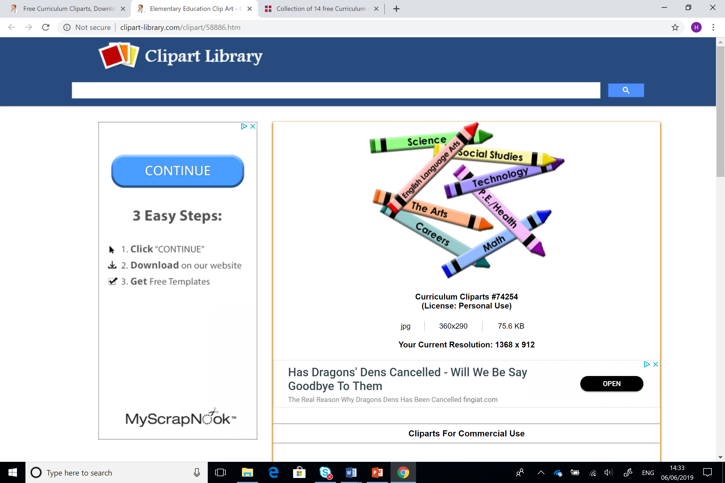
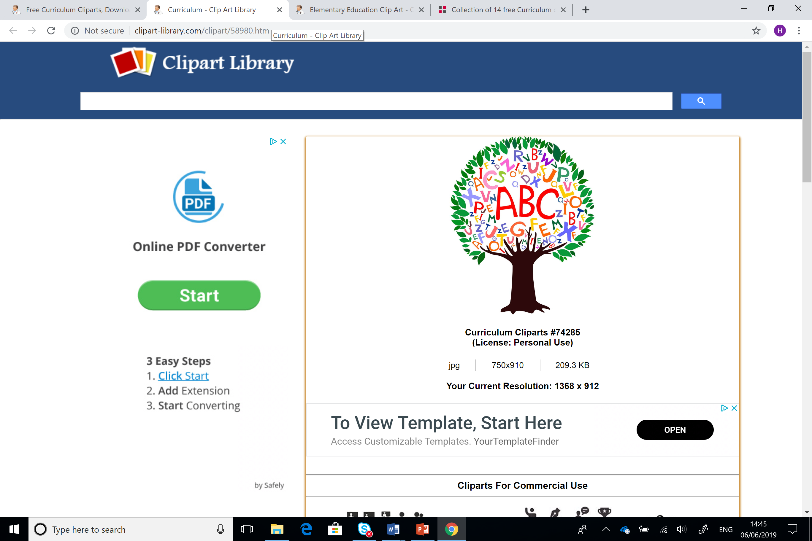
Astudiaethau Cwricwlwm ac Asesu
Curriculum and Assessment Studies
Sesiwn 4 / Session 4

Slide 2
Deilliannau Dysgu
Learning Outcomes
Dadansoddi'n feirniadol y cysyniadau sy'n gysylltiedig â theori ac ymarfer asesu'r cwricwlwm ac addysgol wrth ymestyn dealltwriaeth gysyniadol o addysg.
Critically analyse the concepts related to curriculum and educational assessment theory and practice in extending conceptual understanding of education.

Slide 3
Deilliannau Dysgu
Learning Outcomes
Trafod a dangos ymwybyddiaeth feirniadol o ffactorau athronyddol, cymdeithasegol, economaidd a phroffesiynol sy'n gysylltiedig â datblygu a chwricwlwm gweithredu.
Critically discuss and demonstrate critical awareness of philosophical, sociological, economic and professional factors associated with development & implementation curriculum.

Slide 4
Deilliannau Dysgu
Learning Outcomes
Dangos gwell dealltwriaeth o brif egwyddorion ac arferion asesu a gwerthuso o fewn cyd-destun addysgol a ddewiswyd.
Demonstrate an enhanced understanding of the main principles and practices of assessment and evaluation within a chosen educational context.

Slide 5

Beth yw cynllunio a pham ei fod yn bwysig?
What is planning and why is it important?
Penderfynu beth a sut i addysgu
Gosod nodau
Datblygu strategaethau
Amlinellu gweithgareddau i gwrdd a nodau
Rhan o broses sy’n bwydo dysgu, asesu, gwerthuso, ac adrodd nôl
Heb gynllunio mae cyfle i ddatblygu gwybodaeth, sgiliau a syniadau’n gallu cael eu colli
Deciding what and how to teach
Involves setting goals
Developing strategies
Outlining activities to meet goals
Part of a process that feeds into teaching, assessment, evaluation and reporting
Without planning opportunities to develop knowledge, skills and ideas can be missed

Slide 6
Beth sy’n dylanwadu ar gynllunio?
What influences planning
Polisiau a chanllawiau cenedlaethol
Gweledigaeth yr ysgol
Arsylwadau o ddysgu plant
National policies and guidance
School vision
Observations of children’s learning

Slide 7

Gwahanol fathau o gynllunio
Different types of planning
Tymor hir
Tymor canolig
Tymor byr
Sut fyddech chi yn diffinio’r termau yma?
Long-term
Mid-term
Short-term
How would you define these terms?

Slide 8

Deilliannau dysgu
Learning objectives
Yr hyn yr hoffai athrawon bod disgyblion wedi dysgu erbyn diwedd sesiwn
Gwybodaeth a dealltwriaeth, cysyniadau, sgiliau, gwerthoedd ac agweddau
Targedau CAMPUS - Cyraeddadwy, amser wedi'i bennu, mesuradwy, penodol, uchelgeisiol a synhwyrol
Disgyblion yn gallu cofnodi deilliannau dysgu
Nid oes rhaid rhannu deilliannau dysgu. Gellir annog y disgyblion i ddyfalu beth oeddynt ar ddiwedd y sesiwn
What teachers would like pupils to learn by the end of a session
Knowledge and understanding, concepts, skills, values and attitudes.
SMART – Specific, measurable, achievable, realistic, time-related
Pupils can record learning objectives
Teachers may choose not to share learning objectives but get the class to suggest what they were by the end of the lesson.

Slide 9

Dysgu ac addysgu
Learning and teaching
Aim to include a range of activities e.g.
Reading and writing
Investigations
Games
Debate
Listening
Discussing
Designing and making things
Drama
Art work
Composition and performance
Anelwch at gynnwys amrediad o weithgareddau e.e.
Darllen ac ysgrifennu
Ymchwiliadau
Gêmau
Dadl
Gwrando
Trafodaeth
Dylunio a gwneud pethau
Drama
Celf
Cyfansoddi a pherfformio

Slide 10

Dysgu ac addysgu
Learning and teaching
Nod sylfaenol addysg – annog dysgwyr annibynnol
Rhoi cyfle i blant gynllunio rhai gweithgareddau eu hunain
Rhoi ‘bwrdd cynllunio’ i ddisgyblion
Defnyddio ystod o ddeunydd gweledol
Tiwtora cyfoed
Tasgau a chwestiynau agored
Gadael i ddisgyblion ddefnyddio a rheoli adnoddau
Hunan-asesu ac asesu cyfoed
Fundamental aim of education – promote independent learning
Allow children opportunities to plan some activities themselves
Give children a ‘planning board’
Use a variety of visual prompts
Peer tutoring
Open-ended tasks and questions
Allow children to use and manage resources
Peer and self- assessment

Slide 11

‘If a child does not learn the way you teach, then teach him the way he learns’
(Chasty, 1997 cited in Grigg, 2015)

Slide 12
Model gynllunio gwersi Madeline Hunter
Madeline Hunter’s model of lesson planning
Creu diddordeb
Nod
Mewnbwn
Modelu
Sicrhau dealltwriaeth
Arwain ymarfer
Ymarfer annibynnol
Diweddglo
Anticipatory set
Objectives
Input
Model
Check for understanding
Guided practice
Independent practice
Closure

Slide 13
Strategaethau / Strategies
Logistical information – number of learners
Additional learning needs
Nature of groupings
Lesson timings
  Introduction – starter activity? (10 minutes)
  Main body (30 -40 minutes)
  Plenary (10 minutes)
Gwybodaeth logistaidd – nifer y ddysgwyr
Anghenion dysgu ychwanegol
Natur y grwpiau
Amseriadau
  Cyflwyniad – gweithgaredd dechreuol? (10 munud)
  Corff y wers (30 – 40 munud)
  Diweddglo (10 munud)

Slide 14
Amlinelliad gwers syml
Simple lesson outline
Amser / Time
Prif gorff y wers
Main body of lesson
Dechrau’r wers
Start of lesson
Diwedd y wers
End of lesson/
(Fautley & Savage, 2013)

Slide 15
Gweithgaredd gychwynnol
Starter activity
Dylai’r gweithgaredd gychwynnol gysylltu gyda’r gweithgaredd gyntaf
Dylai fod yn fyr
Dylent fod wedi eu gosod ar y bwrdd gwyn / y ddesg wrth i ddisgyblion gyrraedd
Pwrpas y weithgaredd yw i gael disgyblion i feddwl e.e. llun diddorol, gofyn tri cwestiwn ar destun ayb.
https://mikegershon.com/resources/
(Williams, 2016)
The starter should link to the first activity
Starters should be short
They should be on the IWB / desk as students enter the room
Starters should get students thinking e.g. an interesting picture, asking three questions on a topic etc.
https://mikegershon.com/resources/
(Williams, 2016)

Slide 16
Diweddglo
Plenary
Mae diweddglo yn atgyfnerthu’r dysgu
Rhowch gyfle i ddisgyblion egluro yr hyn maent wedi ei ddysgu
Defnyddiwch fyrddau gwyn bach, goleuadau traffig, tri chwestiwn sydd dal ganddynt am y testun
Angen digon o amser i’r rhan hyn
https://mikegershon.com/resources/
(Williams, 2016)
Plenaries check and reinforce learning
Give pupils opportunity to explain what they have learnt
Use mini white boards, traffic lights, three questions you still have on the topic
Give sufficient time for this part
https://mikegershon.com/resources/
(Williams, 2016)

Slide 17
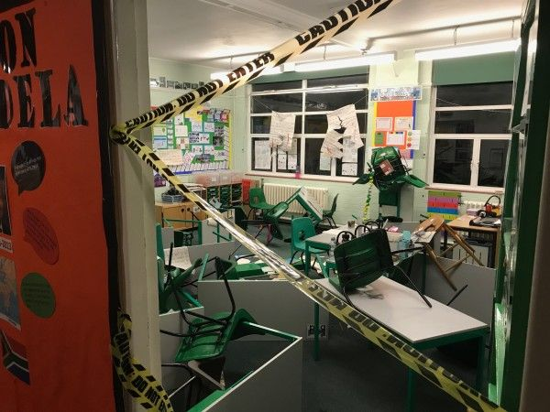

‘Some sessions may not start with teaching at all. The children might enter the room to find there are floury footprints everywhere and the bin has been turned over – what has happened?’
(Pie Corbett cited by Ward, 2012 in Grigg, 2015)

Slide 18

Rôl oedolion arall
Additional adults’ role
Sut fydd oedolion eraill yn cefnogi dysgu plant?
Ystyriwch y defnydd o gynorthwywyr dysgu, rhieni, gwirfoddolwyr ayb.
‘Model parthol’ (Vincent et al (2005) cited in Grigg, (2015)
How will other adults support children’s learning?
Consider learning support assistants, parents, voluntary helpers etc.
‘Zoning model’ (Vincent et al (2005) cited in Grigg, (2015)

Slide 19
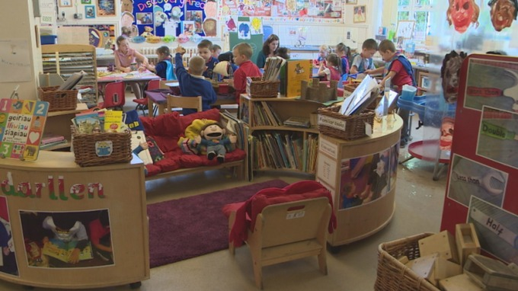
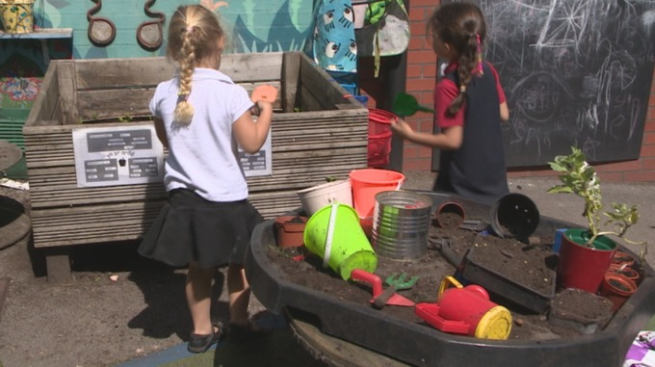
(Shelldrick, 2015)

Slide 20

Cwestiynu / Questioning
Strategaeth allweddol
Cynlluniwch gwestiynau i ofyn yn seiliedig ar y deilliannau dysgu a’r testun
Meddwl ar y cyd
Sustained shared thinking (Siraj – Blatchford et al, 2002 cited in Grigg, 2015)
‘Intentionality in planning and preparing higher-order questions, along with effective use of questioning strategies during instruction, can lead to higher student engagement and greater critical thinking ability in students.’ (Jenkens, 2017)
Byrddau gwyn bach
Pypedau
Key strategy
Plan questions to ask based on the learning objectives and subject coverage
Sustained shared thinking (Siraj – Blatchford et al, 2002 cited in Grigg, 2015)
‘Intentionality in planning and preparing higher-order questions, along with effective use of questioning strategies during instruction, can lead to higher student engagement and greater critical thinking ability in students.’ (Jenkens, 2017)
Mini white boards
Puppets

Slide 21
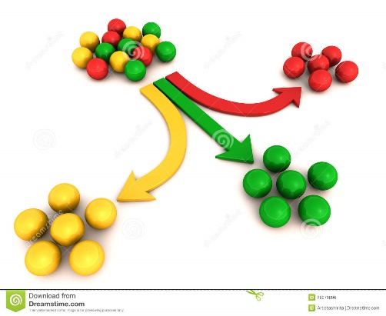
Gwahaniaethu / Differentiation
Work being planned at three different levels – lower, mid and higher
What could the problem be with this approach?
‘devising tasks so that they are well matched to pupils’ needs is a very demanding aspect of teaching (McNeil and Sammons, 2006 cited in Grigg, 2015)
Challenging all pupils
Gwaith yn cael ei gynllunio ar dri lefel gwahanol – is, canolig ac uwch
Beth allai’r broblem fod gyda’r ymagwedd yma?
‘devising tasks so that they are well matched to pupils’ needs is a very demanding aspect of teaching (McNeil and Sammons, 2006 cited in Grigg, 2015)
Herio pob disgybl

Slide 22


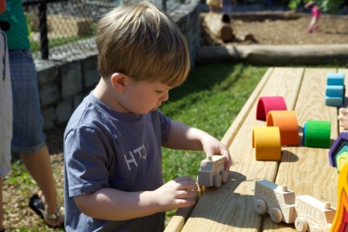
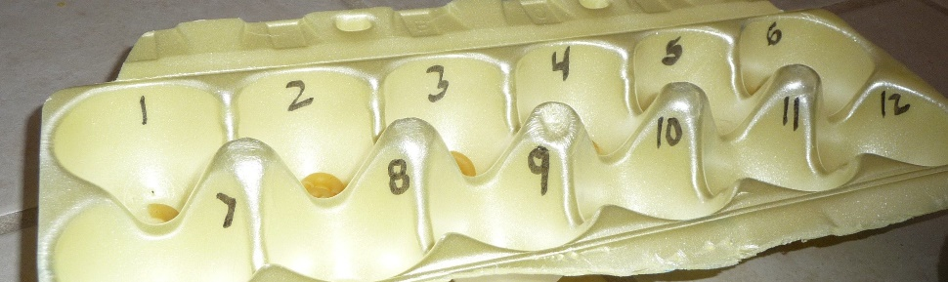
Adnoddau / Resources
Adnoddau yn cael ei defnyddio i gefnogi addysgu a dysgu
Adnoddau sylfaenol e.e. angen ystyried pensiliau, papur a rwber tra’n cynllunio
Cyfoeth o adnoddau ar gael i gefnogi cynllunio
Ystyriwch beth sydd ar gael.
Ydych chi wedi gweld defnydd effeithiol o adnoddau?
Resources are deployed to support teaching and learning
Basic resources e.g pencils, paper and rubbers should be considered in planning
Wealth of resources available to support planning
Consider what is available.
What effective use of resources have you seen?

Slide 23
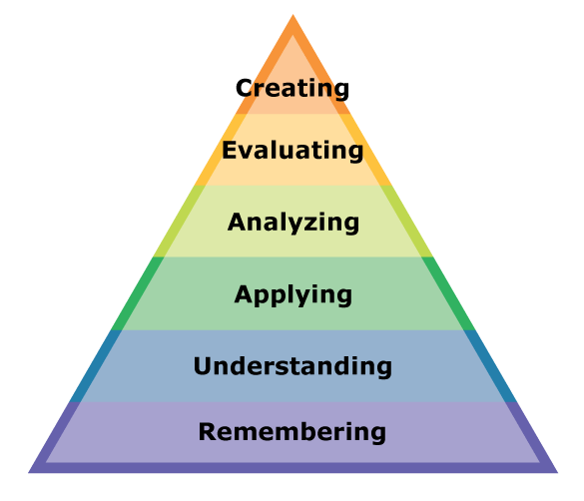
Un damcaniaeth wrth gynllunio gwersi
A theory behind lesson planning
Bloom’s Taxonomy –used as a base for planning
Remembering – what knowledge and skills are to be covered?
Understanding – What do I intend the pupils to understand?
Applying – What opportunities to use their knowledge? Reference to real–life contexts
Tacsonomeg Bloom – sylfaen cynllunio
Cofio – pa wybodaeth a sgiliau sydd angen cynnwys?
Deall – beth wyf yn bwriadu i ddisgyblion ddeall?
Cymhwyso – pa gyfleoedd sydd i ddisgyblion ddefnyddio eu gwybodaeth? Cyd destun bywyd go iawn

Slide 24
Dadansoddi – sut bydd disgyblion yn meddwl am y cynnwys? Alla i greu gweithgareddau lle maent yn crynhoi’r hyn maent wedi ei ddysgu?
Gwerthuso – beth alla i wneud i wirio cynnydd y disgyblion yn erbyn y deilliannau dysgu? Sut alla i annog y disgyblion i werthuso eu hunain a gweld gwerth y wers?
Creu – pa gyfleoedd sydd gan ddisgyblion i greu, cynllunio neu chyfuno syniadau?
Analysing – How will the pupils think about the content? Can I create activities in which they summarize what they have learnt?
Evaluating – what will I do to check the progress of pupils against the learning objectives? How will I encourage pupils to evaluate themselves and see the value of the lesson?
Creating – what opportunities will pupils have to create, plan or combine ideas?
https://mikegershon.com/resources/
(adapted from Anderson and Krathwohl, 2000 cited in Grigg, 2015)

Slide 25

Tasg / Task
Mewn parau edrychwch ar y cynllun gwers gwag ar Moodle
Ystyriwch wers y gallech chi ddysgu i fwlyddyn benodol
Llenwch cymaint o’r cynllun gwers â phosib
Ystyriwch unrhyw gwestiynau sydd gyda chi ynglyn â llenwi’r cynllun.
Os fyddwch yn gwneud hwn adref defnyddiwch y sianel TEAMS i holi cwestiynau?
In pairs, look at the blank lesson plan on Moodle
Consider a lesson that you could teach a particular year group.
Fill in as many parts of the lesson plan as you can
Consider any questions you have about filling in the lesson plan.
If completing this task at home use the TEAMS channel to ask any questions

Slide 26
Rhestr gyfeirnodi
Reference list
Cox, J. (2019) Thought Co: Here’s what you need to know about lesson plans. Available online: https://www.thoughtco.com/what-is-a-lesson-plan-2081359 (accessed 25/6/19)
Gershon, M. (2019) Free resources for teachers. Available online: https://mikegershon.com/resources/ (accessed 4/7/19)
Grigg, R. (2015) Becoming an outstanding primary school teacher. Routledge: London
Jenkens, J.(2017) Engagement: Not Just Hands-On but Minds-On. Delta Kappa Gamma Bulletin, 84(2), pp. 16-18,63. Available online: https://search-proquestcom.ezproxy.uwtsd.ac.uk/docview/2068975077?accountid=130472&rfr_id=info%3Axri%2Fsid%3Aprimo (accessed 25/6/19)
Shelldrick, T. (2015) ITV News Report: Foundation Phase is improving standards - but not closing poverty gap. Available online: https://www.itv.com/news/wales/2015-05-14/report-foundation-phase-is-improving-standards-but-not-tackling-poverty-gap/
Williams, S. (2016) Sharon Williams Educational. Available online: http://www.sharonwilliamseducational.co.uk/blog/lesson-planning-2-starters-and-plenaries-and-why-they-are-so-important-to-the-learning-process# (accessed 3/10/19)

