Slide 1



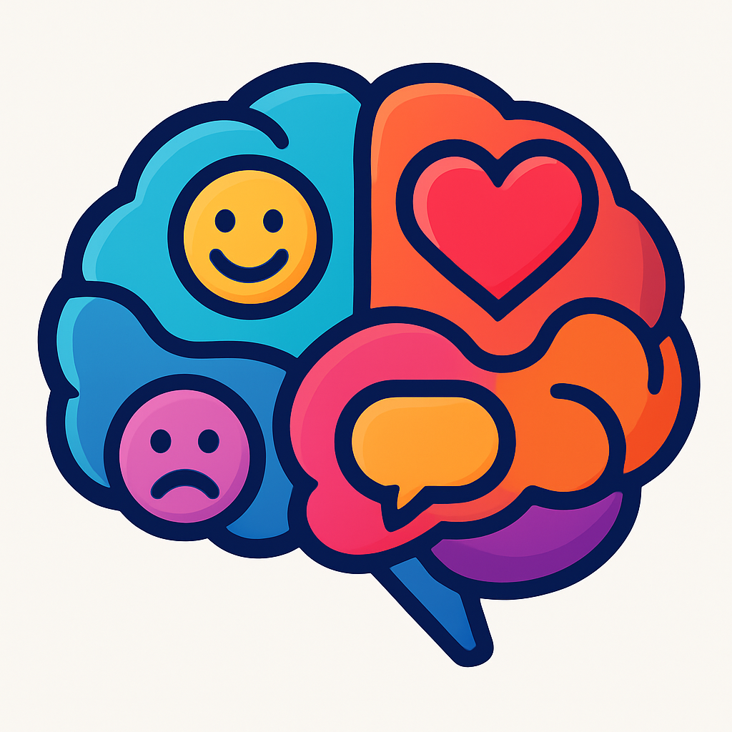


A SIMPLE GUIDE TO BUILDING EMOTIONAL INTELLIGENCE AS A STUDENT
Name and Student ID
Module: LCLM 5006 Developing Emotional Intelligence Skills
Assignment and Lecturer Name
Alin-Florin Iordache, 2330653
C1 Individual Poster Presentation, Abdallah Naser
Introduction
Method
How can someone develop emotional intelligence
Emotional intelligence (EI) is the ability to recognise, understand and manage our own emotions while responding effectively to others. In student life, emotions influence focus, motivation, teamwork and how we react to deadlines and feedback. When emotions are ignored, stress and impulsive reactions can reduce performance. Developing EI improves self control, communication and resilience, helping students make better academic decisions (Goleman, 1995).
Reviewed academic books and peer reviewed journal articles on emotional intelligence and mindfulness.
  Self awareness: notice triggers and name emotions accurately
  Self regulation: pause, breathe, choose a response not a reaction
  Motivation: set goals, track small wins, maintain discipline
  Empathy: listen for feelings and perspectives, not just words
  Social skills: communicate clearly, manage conflict, seek feedback
Based on emotional intelligence theory (Goleman, 1995).
Focused on key EI models (Goleman, Salovey and Mayer) and how emotions affect behaviour and performance.
Linked theory to student situations such as exams, deadlines, group work and feedback.
How I control emotions and develop mindfulness as a student
Selected practical strategies that can be applied daily to improve self awareness, self regulation and mindfulness (Salovey & Mayer, 1990).
  I plan my week to reduce last minute stress and overwhelm
  I use slow breathing when I feel pressure building
  I take short mindful breaks to reset focus
  I journal after difficult moments to identify patterns and triggers
  I use positive self talk after setbacks to protect motivation
  In group work, I practice active listening before responding
Mindfulness techniques help regulate emotional reactions and improve concentration (Kabat-Zinn, 2015).
References
Factors for success and actions
Objective
Goleman, D. (1995) Emotional Intelligence: Why It Can Matter More Than IQ. London: Bloomsbury Publishing.
Salovey, P. and Mayer, J.D. (1990) ‘Emotional intelligence’, Imagination, Cognition and Personality, 9(3), pp. 185–211.
Kabat-Zinn, J. (2015) Mindfulness for Beginners: Reclaiming the Present Moment – and Your Life. Boulder, CO: Sounds True.
Factors
Stress, time pressure, distractions, low confidence, fatigue, conflict in group work
Actions
Weekly timetable, start tasks early, mindfulness practice, ask lecturers for guidance, use study groups, protect sleep and routine, reflect on feedback instead of taking it personally
To explain how emotional intelligence can be developed, reflect on how I manage emotions and practise mindfulness as a student, and identify key factors for study success plus actions to overcome emotional intelligence challenges.
Developing emotional intelligence strengthens resilience, communication and long-term academic success.

