Slide 1
Physical Literacy
Llythrennedd Corfforol
BMOE4003
Notes:
Going to start by looking at the overall meaning of PL.
What does it mean?
Then we’ll begin to look one aspect of PL in particular – physical movement
Then – we’ll have a go- practical participation
Then before lunch we’ll zoom in on year year physical movement and we’ll look at what is known as fundamental movement skills
Physical literacy So what does it mean? Three key components
Monism and dualism Why is PL important Sensory integration
Intro to FMS What in modern society is impacting on this? Make a list
Specific FMS Mountain motor development
Practical bits to highlight monism approach …that engage emotional / physical & social
Key docs child matters, future gen act, don’t forget me

Slide 2
Amcanion / Objectives
Datblygu dealltwriaeth a gwerthfawrogiad o Lythrennedd Corfforol.
Cyswllt gyda’r traethawd
Cymryd rhan mewn gweithgareddau ymarferol.
Parodrwydd i rannu syniadau, barn a chwestiynau.
Develop an understanding and an appreciation of what is meant by Physical Literacy
Link with essay
Take part in some relevant practical activities
Be prepared to share ideas, opinions, thoughts & questions.
Notes:
Main focus for today is on Phys Lit & ensure you have sound understanding of this.

Slide 3
Draw your journey in life in terms of physical activities, adventure, exploring, motivation and confidence

Slide 4
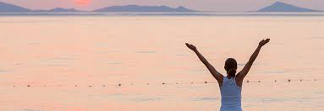
Physical Literacy
Physical literacy can be described as the motivation, confidence, physical competence, knowledge and understanding to value and
take responsibility for engagement in
physical activities for life.
(Whitehead, 2010, p. 11 ).
Notes:
PL is a concept.
PL is a phrase that means a culmination of things.
Physical literacy is a personal concept – it’s yours - you own your own Ph lit journey. And the hope then is that Ph L can be described as – read quote
This concept is not exclusive i.e. one person can’t ‘have’ PL and then another person can have PL – everyone has possession of their very own physical literacy.
Every individual has own level of physical and emotional dimensions.
PL is developed through engaging with a range of experiences and opportunities.

Slide 5
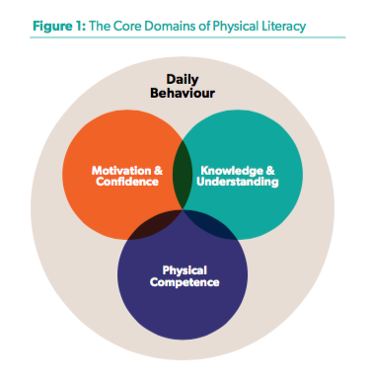
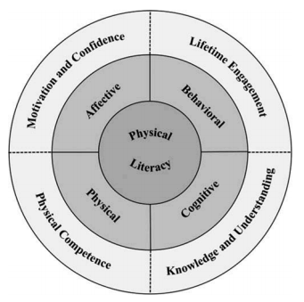
“to value and take responsibility for engagement in physical activities for life.”
(Healthy Active Living and Obesity Research Group, 2016)
(Robinson & Randall, 2016)
Notes:
So as you can see here - Physical activity or movement - is an element that is developed within physical literacy – as well as …quote
So PL is a Holistic concept –
it involves the ability of the body to move competently /
It engaging the brain to think - cognitively /
It has impacts our behavious and desire which can be influenced with social aspects /
and finally pl also refers to one’s motivation be that an emotional influence or a self-esteem or confidence aspect.
It about our physical interaction with the world that we are a part of.
So PL is quite expansive – it include a lot of elements. So when you hear someone talk about physical literacy – all these elements are considered.

Slide 6
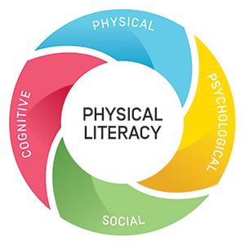
Notes:
Fundamental movement skills focuses on progressing physical skills only – whereas phys literacy also considers the affective and cognitive elements.
So you don’t teach Phys Lit – it’s a disposition – it’s a way of life – it’s a way of being.
Variety of elements contribute towards one physical literacy and it’ unique to every individual.
It is something that evolves with time & experiences provided or participated in
PL has many parts and to be successful in ones’ PL journey – those parts to be considered at the same time - holistic

Slide 7
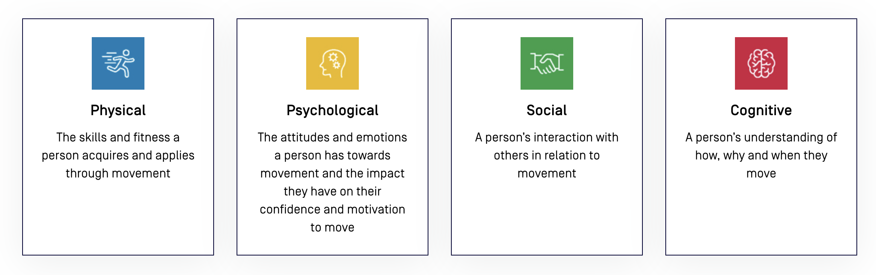
Australian Sports Commission (2019)

Slide 8
Link with Assignment
Part 1 : Essay. March 7th, 2025
Essay Title
Change the Story: Evaluate how children’s physical literacy can be developed by adventurous affordances.
Notes:
So within your essay you will need to show good / very good / excellent understanding of what
(i) Knowledge and understanding of phys lit & this from a child’s perspective & this child’s perspective could be from your past life when you were a child in primary school. (ii)Demonstrate then how this knowledge about physical literacy actually then relates to young children? What are the arguments, debate, justifications & again supported by literature. (300 words)
Include a short description of your school experiences as a child that supported your physical literacy. You can also mention additional organised outdoor, adventurous or sport activities where you might have participated and their benefits. Identify the teaching and facilitation styles of your teachers/group leaders at that time. Important: anonymise all information; do not provide names of schools and use only one initial for persons, or give and specify that names are fictional. Please only include a narrative of experiences you feel comfortable sharing and allow you to evidence your learning throughout the module with your proposal and analysis.
Explain the positive elements of your lived experiences and the relevant gaps or challenges you identify now as a professional in training. Contextualise within your areas of work (physical ed, outdoor ed). Connect your analysis with relevant theories, models and current data that reflect the relevance of your argument.
4. (i)knowledge and understanding of adventurous activities – value / impact etc
5. Propose a change in the story: describe and justify your recommendations in facilitation/teaching, planning, organising and delivery. Include an adventurous learning perspective in your proposal and introduce alternatives for applying new or enhanced relevant affordances in the learning experience that apply to the context you described
6. Clearly identify the benefits of your proposed approach,(& so for the purpose of this essay is needs to be outdoors and adventurous) and mention how specific learning or developmental goals would be impacted positively by the changes, connected to relevant theories, models and frameworks. What role does outdoor adventurous experiences have on this disposition. Inc concepts and theories & provide sound judgements – all supported by literature! (300 words)
7. Highlight the expected results in the disposition of a healthy physical literacy tujectory in life. what could we expect to see? Affectively / cognitively / physically / emotionally / socially … & how may this knowledge inform professional delivery / teaching?& explain how this reflection benefits your future practice as an educator (outdoor ed or physical ed) (400 words)
Share your learning throughout your reflective and creation process and why??
So today – focus on Phys Lit & ensure you have sound understanding of this.

Slide 9
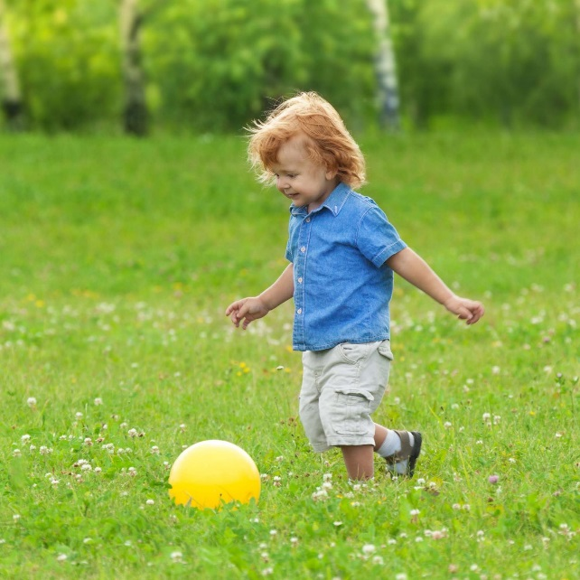
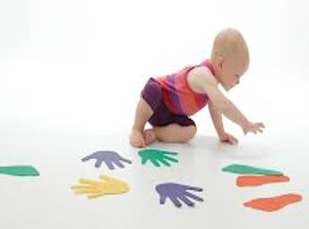
Pam mae Llythrennedd Corfforol yn bwysig o flynyddoedd cynnar?
Why is it important to develop positive experiences of being physical from early years?
Notes:
Ph Lit is important also because by it’s nature of the phrase ‘literacy’ = means that everyone can achieve this attribute at their own level.
Holistic education as a means of developing the whole child at their pace / level – attempting to develop mental, physical and emotional attributes that may then promote participation in physical pursuits throughout life. (Whitehead, 2010, p. 8).
It should be seen as a journey i.e. it’s not something that just happens at 3yrs age or 10 or 20 or 30 etc … it continues concept - to build on experiences over and over – extentialism = & by building on experiences gained prior to each step this then can influence the connectivity that occurs between neurons – by either (i) consolidating previous links / pathways with recent experiences – by making these links stronger and (ii)by developing earlier pathway & re-engaging with these in order to make stronger (iii) and beginning completely new pathways.
Scientific evidence is now available demonstrating the activity in the brain when the body moves.… & some researchers now believe that the development of cognitive concepts depends on embodied interaction with the world – Burkitt (1999) as cited in Whitehead Chapt 3
We come to realise more of our potential and our capabilities (mental & Physical) – which some call ‘embodied nature’.

Slide 10
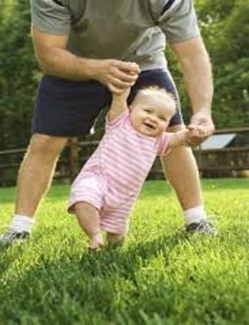
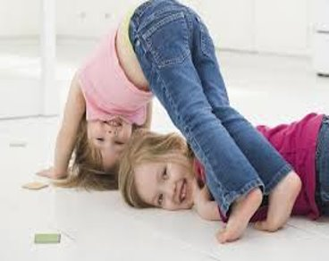
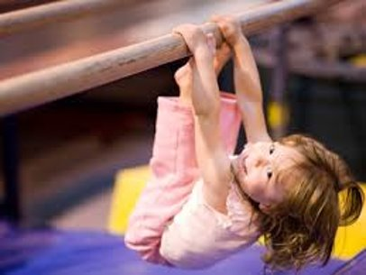
Notes:
Neurons!!! & phatways in the brain!!!
Physical Literacy – so from our pre- reading task - we can accept that our bodies and minds are one and that the path to achieve good PL within human race is to develop understanding of this key concept. ​ PL is all encompassing – develops conscious functionality, physical and mental. That you feel good
Within the concept of PL there are numerous elements. physical competence forms a key element of physical literacy. So now we now what aspects are included in PL were now going to look at how important it is to get the beginning of the PL journey right.
We will gain an understanding about how is physical competence developed
Understand the importance of movement in early childhood
How does movement underpin child development and physical competence ​
As a Human Being - we are wired for movement - physical development integral to psychological and social development. ​
You the individual - All different all equal - Whatever your personal story, we must try to seek to embody behaviours and beliefs that demo. a value for healthy behaviour. This isn’t exclusive to top athletes – do what is in your power (gardening/walking dog/cycling – walk on the beach). All of us can do this even if you don’t ‘yet’ (a powerful word for Dweck - Growth Mindset)
just starting to feel confident within our own journey & do what we can is important start. ​
​
Y bod dynol​
Chi’r unigolyn​
Agwedd cynhwysol a sensitifrwydd at anghenion unigol​
Cynllunio profiadau o ansawdd uchel​
Llythrennedd Corfforol​

Slide 11
Gweithgaredd / Class activity
Cwdyn ffa (coch, melyn, glas, gwyrdd)
Rhannau o’r corff
Danfon a derbyn
Symud
Bean bag each
Body parts
Send & receive
Movement
Notes:
Who did you have in your lives during the early years helping you to master the basic movements ? Look back at your journey plan.

Slide 12
In pairs or three’s
In 2025 … what is stopping young children form from being active?
What aspects of life is impacting physical activity in a negative way?
Notes:
Lack of parks
Safety to wander alone
Tech parenent into their gadjets …
- our society has changed – quite dramatically since the industrial revolution. The increase in the number and variety of baby gadgets available & where we once upon a time would walk everywhere … make a list …what modern influences do you think is hindering children from being active? What aspects of the way of life we now know is impacting of physical activity in a negative way ! …. Lets hear your suggestions …MAKE A LIST

Slide 13
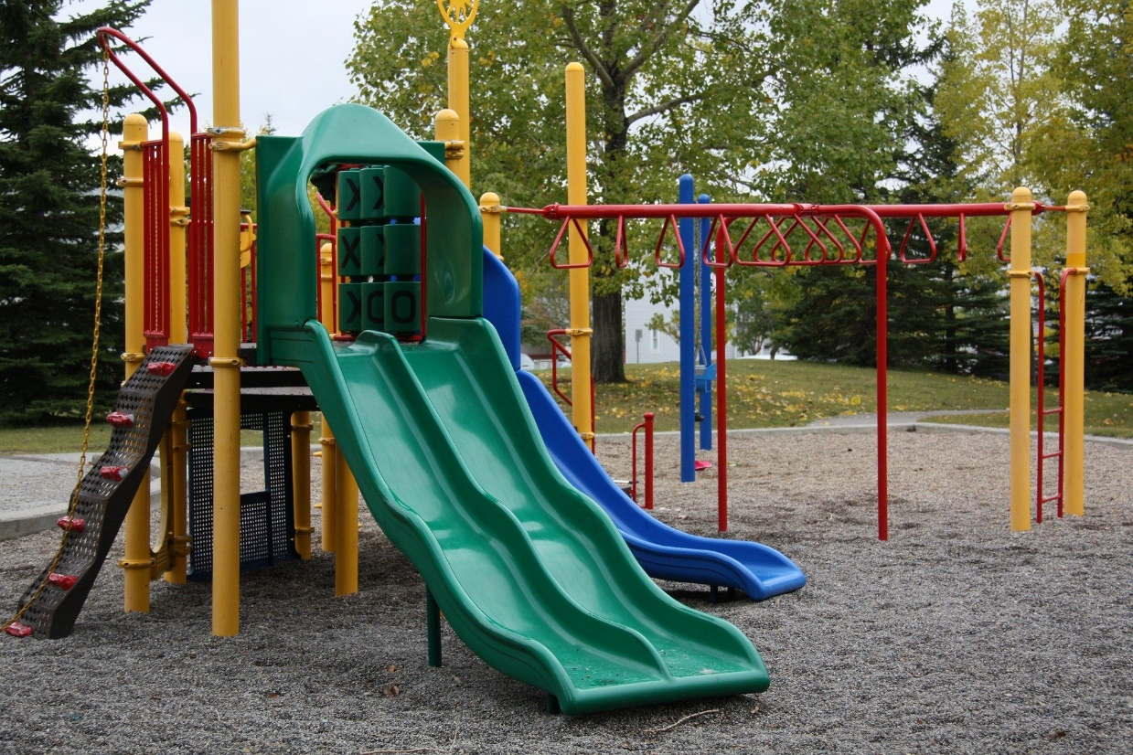
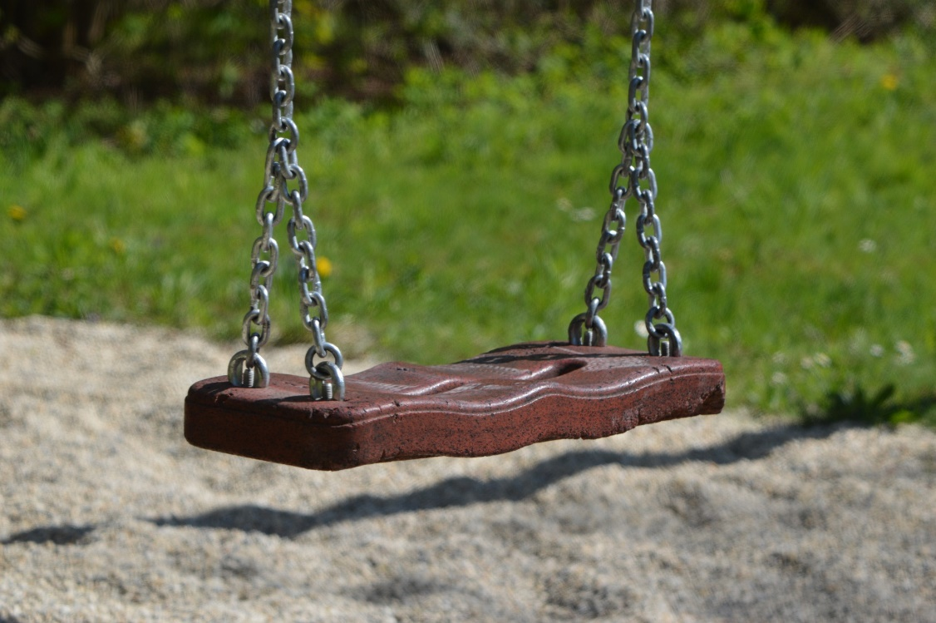
Notes:
playgrounds are often empty …& in recent years - the ever increasing developments in tech and the loss of green spaces available for children to play in both urban and rural areas have inevitably meant that children spend more of their leisure time on electronic games –
Gallahue, Ozmon and Goodway (2012)
By middle childhood children who are less competent in motor skills will most likely self select out of physical activity when given a choice or engage at lower level if required to do the physical activity such as in a physical education class – Those children who start with a low motor competence will then drive low physical activity levels, which then minimizes a child’s opportunities to improve motor competence and this may mean that they remain inactive throughout life

Slide 14
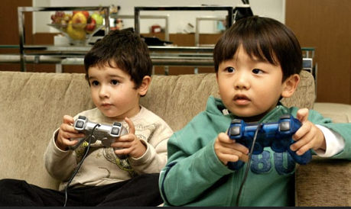
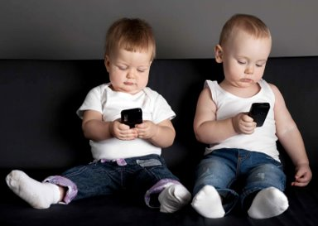
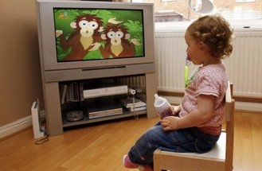
Modern Impact on Physical Activity
Notes:
More and more families both parents are busy working parents and so for convenience – children are driven to school ALSO some parental fears of children being hurt by traffic or being snatched by strangers has increased with highly publicized cases in the press & on TV – resulting children are growing up with reduced opportunities for physical and free play. (Wainwright, ) An introduction to Primary Physical Education – edited by Gerald Griggs. Routledge.
Ken Robinsion (2010) ‘Our children are living most intensely stimulating period in the history of the earth’ – as they are be-searched with information from computers / web pages / i Phones / androids / apps / I pads/ advertising on Radio / TV / Inernet all have 100’s and thousands of channels / web pages. technology has also meant that very young children are now fixed watching a screen … TV / iPad / Sky / Video games / children are getting less sensory integration through lack of movement​ -

Slide 15
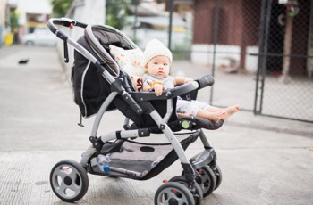
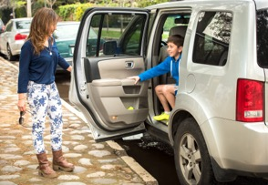
Modern Impact on Physical Activity
Notes:
Increased time in buggies and baby carriers – i.e, a baby may be in a car seat, bouncy chair or buggy for much of the day, with little chance for movement, and due to the seat design the baby is supported and has no need to develop core stability and balance. The baby can only interact with its immediate surroundings – opportunities to explore the world are extremely limited. The consequences of this are becoming evident in our schools, with young children unable to sit properly on chairs and lacking the strength and stability which is required in order to develop fine motor control. JCB analogy here.
Balance - as referred to earlier is a ciritcal aspect to child development in terms of sitting, walking upright – it provides good core strength – so this should develop in early childhood – but as we’ve eluded to already – modern ways of living in hindering this either through using buggies, pushchairs, car seats!!! Etc etc

Slide 16
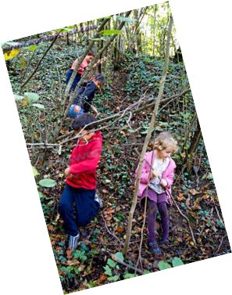
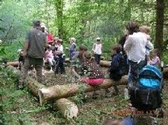
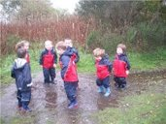
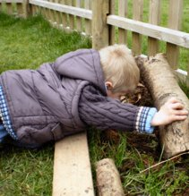
Notes:
Physical Competence impacts on life long physical activity (Stodden et al 2008, Goodway and Branta 2003) on a very basic level – when looking for clues – do you remember seeing a child sitting poorly ar a table – twisting legs around the chair legs and being slumped of the table – poor core stability poor core balance – physical competence develops these essential areas of the body to ensure that postural behaviour – which is related to the balance family - is strong and firm (Goddard Blythe 2005)
So at times – to the untrained eye children can be seen as a disruptive child – but we are beginning to realise how important and influential physical movement actually is – not only physically but to the brain & general feelings towards improving one’s well being. So a child needs to move to learn but also that child needs to learn how to move - Ouvry (2003)
High quality play – to develop and improve one’s muscle tone/balance and core stability needs to be happening all the time

Slide 17
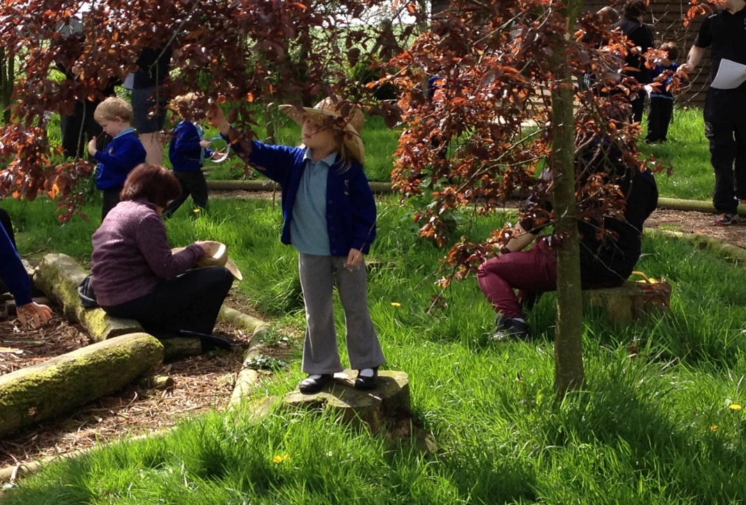
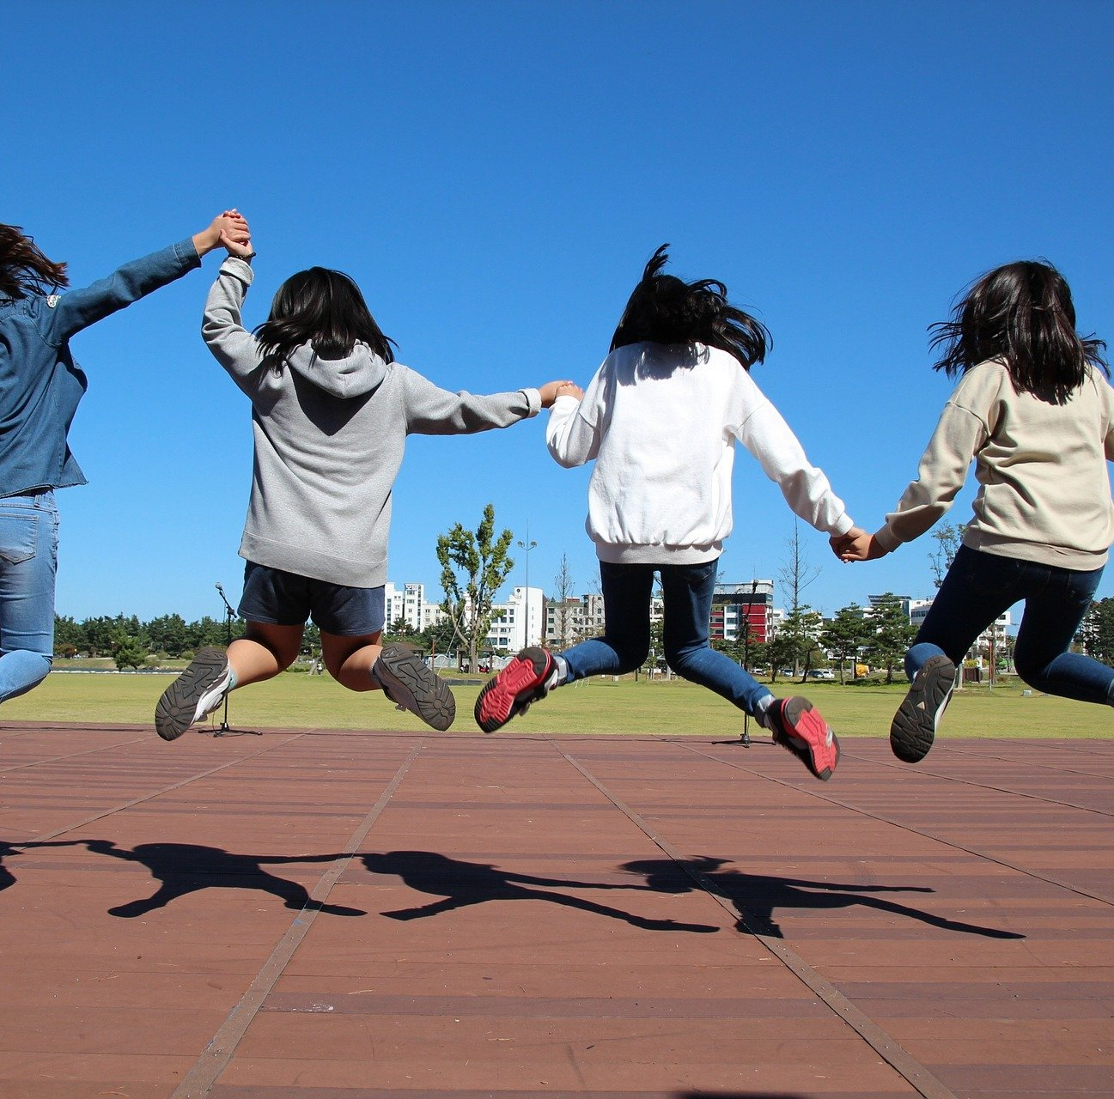
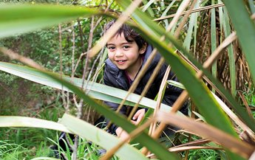
Fundamental Movement Skills
(FMS)
Notes:
Yes - physical activity is found within PL – BUT - PL isn’t only physical activity. Being able to distinguish what contributes towards Phys lit will help you to understanding the concept of PL.
This is a concept that has gained prominence in recent years and it has influenced developments of new proposed curriculum being statutory Sept 2022 - Physical literacy – will be aim of physical education.
Some definitions of physical literacy focus solely on developing physical competencies such as fundamental movements skills (FMS) such as motor development, running, speed. BUT - PL means much more than this. When we are leading an outdoor advenutours activity at school or at a center – this knowledge can make us aware of the need to provide high quality experience that contribute positively towards children’s physical literacy journey. & by being outdoors could be an ingredient towards supporting a healthy physical literacy disposition.

Slide 18
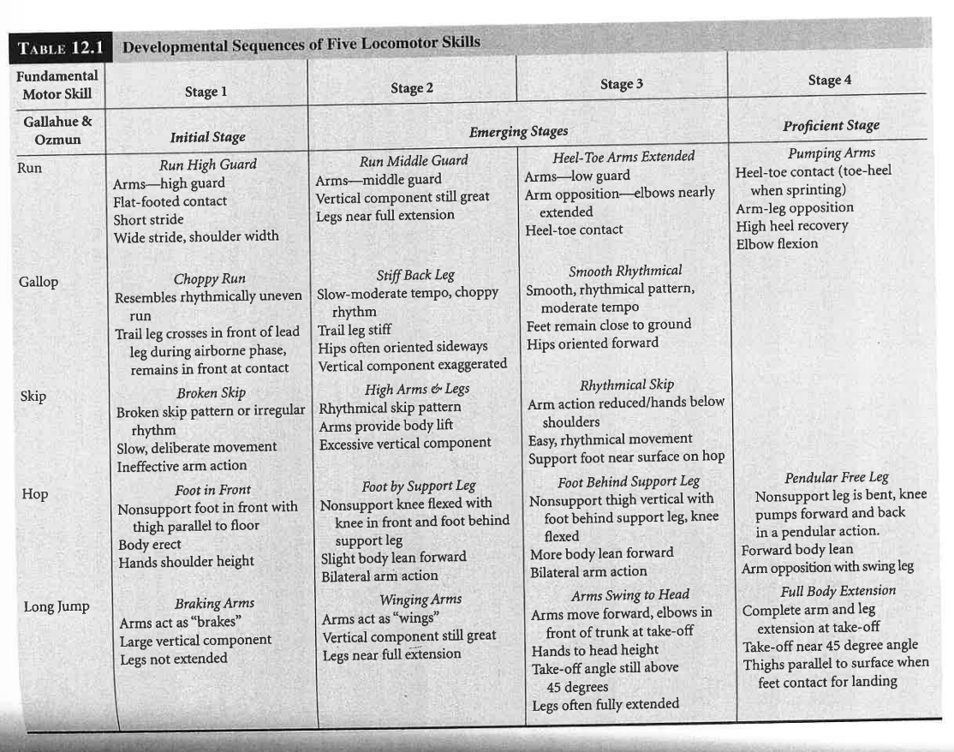
Tag!
Notes:
Gallahue (2012) mapped out what Fundamental movement skills are along the spectrum stages – knowing how the physical should look like for 3 – 19 yrs olds would help us make sure we have quality movements from our children. In the early years - the development of balance is particularly important – children need to develop good gravitational awareness in order to be able to sit, walk, run and move with competence.
The postural control is supported by visual and motor systems. The training of these systems takes place gradually over at least seven years – but also continues beyond puberty (Goddard Blythe, 2005). If these are under stimulated and lack range of experiences to mature the pathways within the neurons to process motor control – this then would mean that the child’s ‘vestibular system’ (part of the ear that processes direction / gravity / the way that’s up!) etc immature vestibular – which can then be attributed to specific learning difficulties such as Dyslexia and Dyspraxia – problems of attention, language impairment and emotional problems (Blythe 2005)
Locomotor is one domain that’s included within suite of fundamental motor skills … & is thought to be quite important and a key ingredient in the overall success of one’s physical literacy journey … Catch – tails play indoors and then outdoors

Slide 19
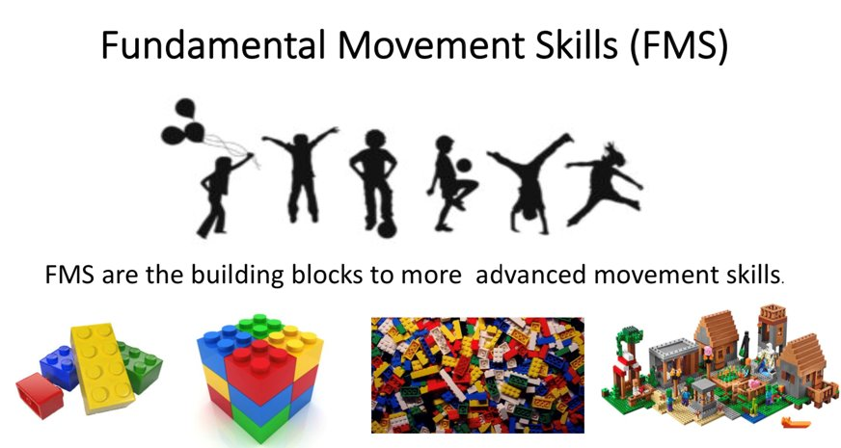
Notes:
Stodden and colleagues (2008) highlights the importance of FMS to engagement in lifelong physical activity. Then there is also a dynamic relationship between how good one is with physical activity and one’s motor skills. A key element to the success of one’s physical Lit journey it physical competence – this aspect seems to underpin the general success to the concept.
So motor skills / competence is referred to as FMS – which include general body movements but also object control i.e. how well someone can use tools – so couple of weeks ago we were tying knotts / you may be canoe, belay, walking sticks, bike, surf board, racket, ball, net,
Now an underlying common misconception is that children “naturally” learn FMS – however this is not true, many children do not reach proficient level is these skills and then they don’t demo the motor skills needed to be able to apply these skills to range of sports, outdoor provisions, games – this then can impact across childhood & adolescence (Goodway & Branta 2003)

Slide 20
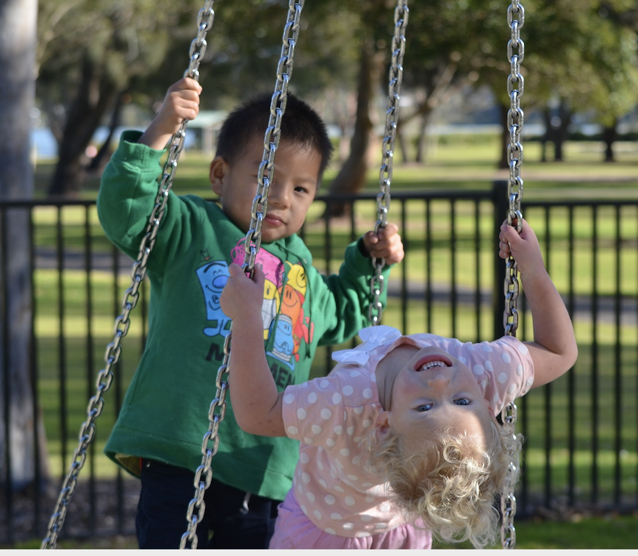
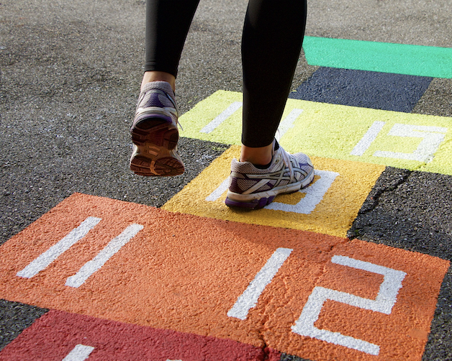
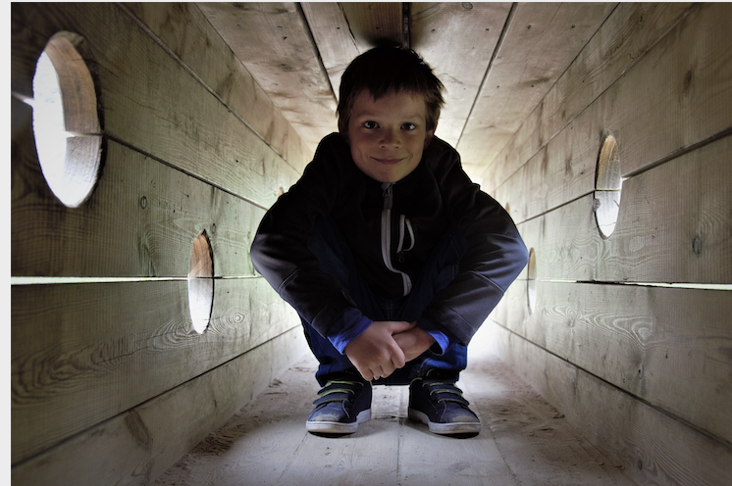
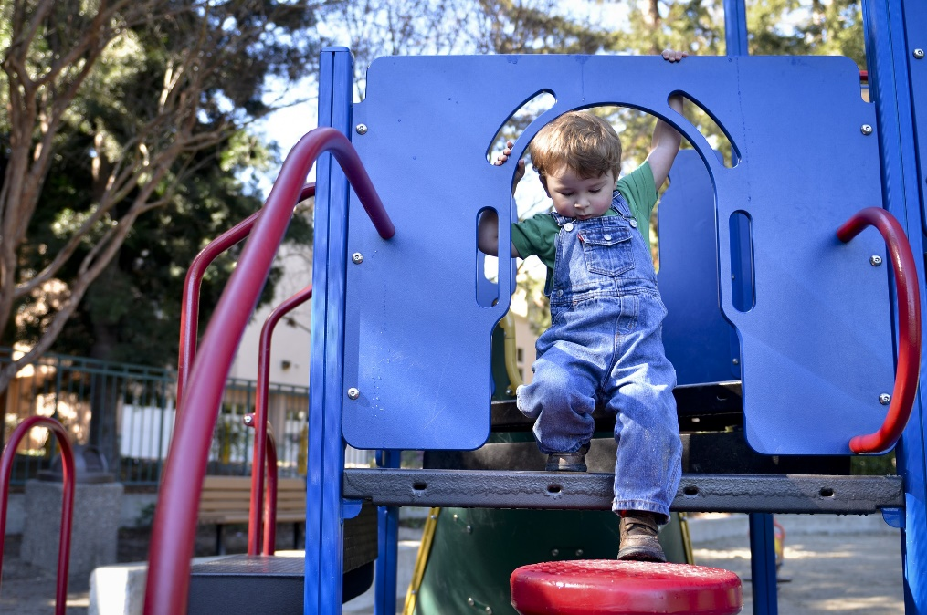
Fundamental
Motor Skills
Notes:
Children need rich movement experiences involving crawling, climbing, swinging, balancing, & inverting the body i.e. log rolls, rolling around bar, to ensure maturation of the systems required throughout life.
Furthermore, combine motor and sensory experiences in early childhood means that the neurons interconnect to form sensory and motor processes (Ayres, 2005) e.g. avoiding natural obsticles jumping over, stepping across, feeling your way around a woodland - which would encourage children to use variety of bodily skills (Fjortoft, 2004). Providing these range of high levels of movement experiences outdoor will also promote positive feelings of wellness by negotiating rough surfaces and differences in landscapes will be dynamic natural environment to develop physical competence.

Slide 21
Sensory integration – food for the brain (Ayres 2005)
“Higher intellectual functions will develop after the age of 7, and they will develop better if the sensorimotor functions are well developed. The 3rd – 7th years are a critical period for sensory integration” (Ayres, 2005 p.24)
Notes:
Jane Ayres (2005) also highlights this in her book and she emphasies the sooner the better outcome will be later on in life if the brain has been exposed to vast range of sensory experiences – physical, visual, touch, spatially, vocally. by providing young learner the opportunity to explore their surroundings in multiple ways – this improves their sensory integration.
So by integrating numerous systems from an early age – this improves concentration and general ability. If you then include the outdoors with this element you can only imagine the explosion of activity within a young brain. Either through – contious movements or Reflexes in preparation for movement ie jumping over / hoping into out of / dodging trees etc
Use the bean bag again & repeat.
Then include – walking, jogging, skipping, jumping & hopping whilst using the bean bag.

Slide 22
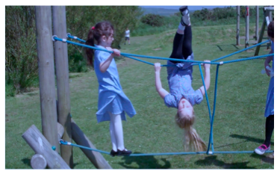
Sensorimotor components that influence learning.
Body awareness
Motor planning
Perception of movement
Fine motor control
Touch
Visual skills
Language processing
Notes:
These all contribute towards the concept of PL. So PL is about developing the brain,i.e. language processing development - senses – visual skills. touch and …physical development – through body movements – fine and gross motor control to become skillful and confident in a range of movement.
Improving these – or getting a better awareness of these ‘sensorimotor components’ influence a child’s general whole body awareness and then if their perception of movement is good in a range of activities this will then mean that their physical competence will improve. As well as their physical confidence!!
So – we need to expose children to things such as Catching / throwing / jump / skip / crawl / strike / catch / climbing / Body awareness – elements such as - behind the body / & to the side / over / under
Language – prepositions – in front / under / over / through
Ymwybyddiaeth corfforol​ / Cynllunio motor ​ / ‘Perception of movement’​ / Sgiliau cain ​ / Cyffwrdd ​
/ Sgiliau Gweledol ​ / Prosesi Iaith ​

Slide 23
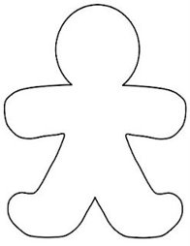
Cognitive - brain
Physical – body movements
Social – with others
Notes:
Draw a stick man or a biscuit like this …
As we listen to this brief video – write down all the physical movements you see & you hear them talk about – write them on the person’s body. PHYSICAL - Core stability tummy time / Hop jump skip / jump / hop / throw / catch /
You could also categorise other comments
COGNITIVE - Active brain / deve focus/ social / problem solving / creative minds (on the head)
SOCIAL – confident / active play / better mental health – (around the outside of the body)
PHYSICALLY - Helath y body – stronger bones (on the body)

Slide 24
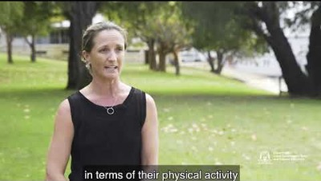
https://youtu.be/yaF0CaNuUIc
Notes:
In watching this video Make notes of all the different ways of moving you see & direction & use of equipment & social interaction with others
Developing high quality movement / inclusivity – within natural endowment – offering challenge (increased difficulty) – differentiating for individual needs allowing access (simplifying)​
​
ANSWERS:
​Fine motor need gross motor - POSTURE is key -
Use of space – ‘space bubble’, moving in space ​ Defnydd gwagle – ‘swigen’, symud yn y gofod​
Gross motor skill development - Travel – ​
walk/run/skip/gallop/jump/cr awling/ jump and land/ leaping hopping / jumping / balance shape - straight-star- cup angry+happy cat / log roll​
Datblygu sgiliau echddygol bras Trafeilio ​
cerdded/rhedeg/sgipio/​ cropian / nedio a glanio/llamu / hercian neidio/ cydbwyso / siâp – syth –seren – cwpan – cath hapus+blin​
/rôl bocyff​
Increase sophistication – Following/mirroring/ moving independently / create sequences - chasing games​
Cynyddu soffistigeiddrwydd –​Dilyn / drychweddu / symud yn annibynnol - creu dilyniant​
Sending/receiving/​ manipulating​ - Carry / toss / catch / dribble /roll/ trap/ strike / throw​
Gyrru / derbyn / trafod​ - Cludo / tafliad / dal / driblo rhowlio / trapio/ taro/taflu​
​

Slide 25
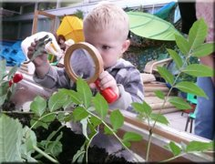
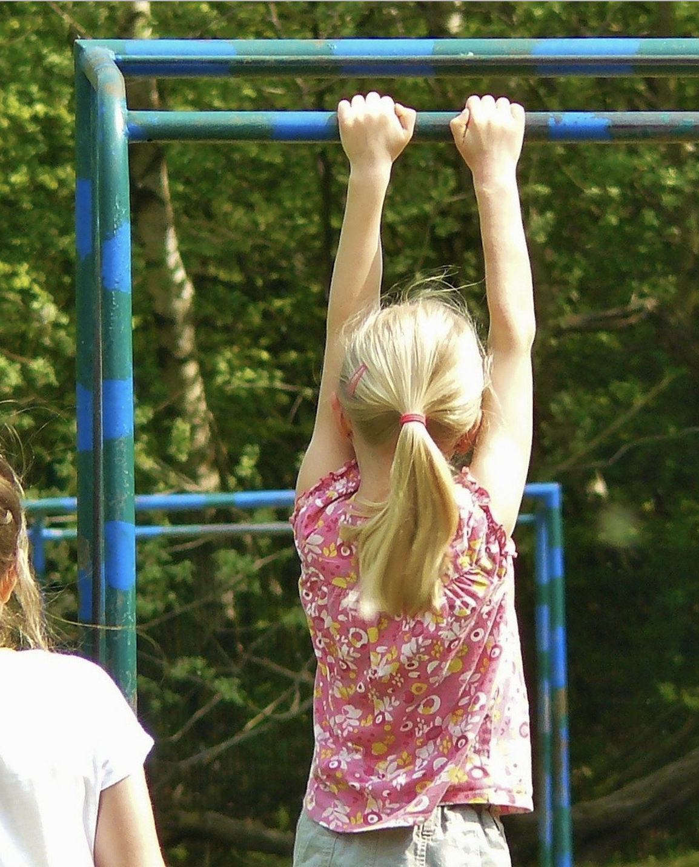
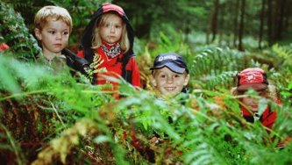
Notes:
Gallahue, Ozmun and Goodway (2012) Children who are more skilled are also more likely to perceive themselves as competent and gain intrinsic pleasure from participating in games / outdoor activities / sport.
COMBINATION motor and sensory experiences in early childhood means that the neurons interconnect to form sensory and motor processes (Ayres, 2005) e.g. avoiding/ side stepping natural obsticles jumping over, stepping across, feeling your way around a woodland - which would encourage children to use variety of bodily skills (Fjortoft, 2004).
Providing a range of high levels of movement experiences outdoor will also promote positive feelings of wellness by negotiating rough surfaces and differences in landscapes will be dynamic natural environment to develop physical competence.

Slide 26
Beth mae Ll Corff yn golygu i chi – yn eich bywyd?
What does PhL mean to you – in your life?
Llythrennedd Corfforol
Notes:
Fundamental movement skills focuses on progressing physical skills only – whereas phys literacy also considers the affective and cognitive elements.
So you don’t teach Phys Lit – it’s a disposition – it’s a way of life – it’s a way of being.
Variety of elements contribute towards one physical literacy and it’ unique to every individual.
It is something that evolves with time & experiences provided or participated in – so in thi moment in time what does being phiscially literalte mean to you.
write what 9 words or short phrases you think of when you hear physical literacy …. Could be things from the social domain, psychological domain – how we feel,
Now rank 1 to 9
Write your top 3 on paper and
Dojio!! Pairs discuss your top three with one other in the group – justify why they are your top three!!

Slide 27
Post 7 yrs old
(Reminder re essay…) upon your individual experiences during this time of your life & … what aspects of physical literacy was promoted so that you would have a positive disposition towards physical literacy & healthy lifestyle?
Notes:
To further compound this effect … by middle childhood 6yrs – 9yrs children then begin to possess the cognitive / brains ability to accurately assess their actual motor competence – compared to same-age peers. They know if they are good or bad compared to others! This then may result is a negative spiral of disengagement and bit by bit the child would engage less and may influence future engagement with Physical activity.

Slide 28
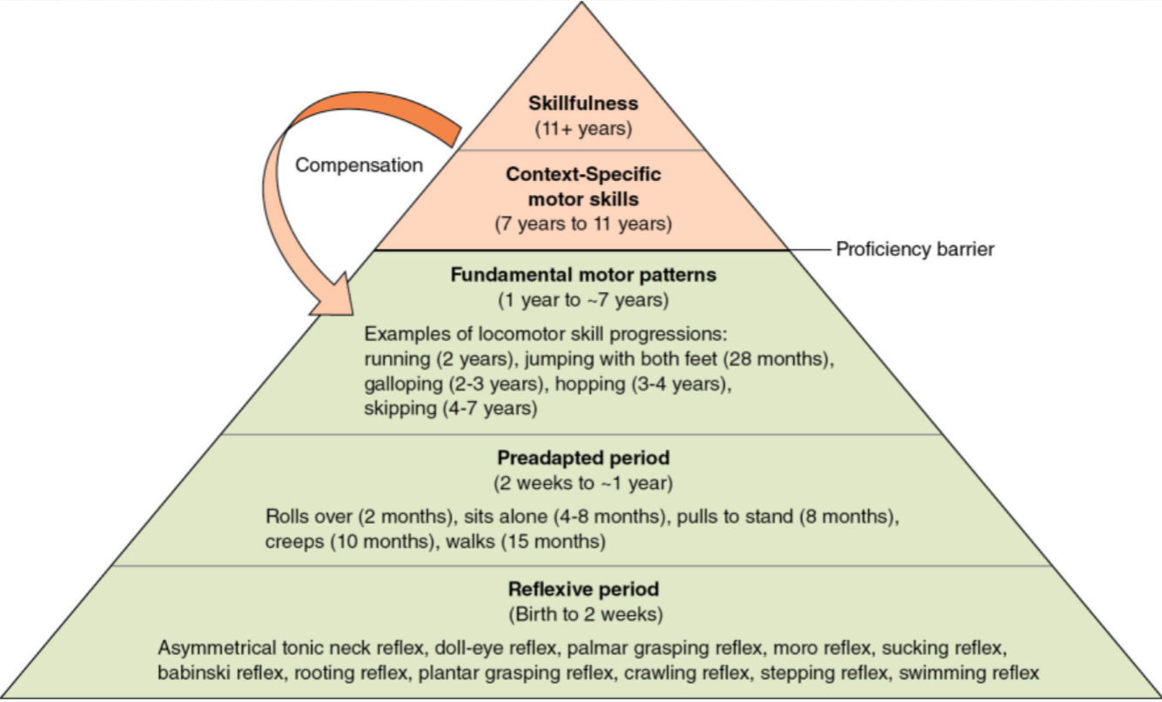
Mountain of motor development (Metcalfe 2002)
Notes:
So from a very young age children need to be supported / scaffolded to experience a range of movements that engage the whole body i.e. inverting the body is important aspect so that the vestibular section of the ear is developed – which also helps with balance and letting your brain know what / where is up!!
Thus higher levels of perceived motor competence and actual motor competence will drive higher levels of physical activity – which in turn will give children greater opportunities to become more competent!!! (read off some of their moodle contributions in Denises module!!!)
So these are then seen as positive interactions which will support upward spiral of engagement throughout one’s life - or so it is hoped.

Slide 29
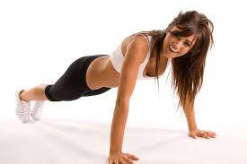
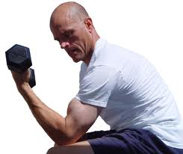
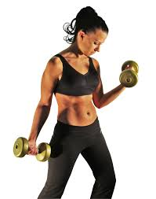
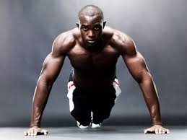
Dualism
Notes:
Unforuntaely there are things in our modern society that is impacting on one’s ability to flourish in a healthy way in terms of you’re their physical literacy journey.
Monism & dualism – chapter 3 on moodle “What is physical literacy and how does it impact on physical education?” Whitehead …
What is constantly fighting against the concept of PL & its’ holistic approach to life – is this however is a dualist approach - which views humans as two divisible parts – mind and body. The philosophy of dualism dates back to the work Descartes in 1972 who claimed then that at root we were cognitive beings.
Dualism / duality – means that we view ourselves as humans having two separate entities – that the mind and body don’t relate to each other. & This has been a prominent way of thinking on modern society for many years. With the mind influencing the body. I am not saying that in these images that these are bad for us and is incorrect – but some images are created specifically to influence & to sell a product – and that to be fulfilled and happy in life this is how you must look – to have your body conditioned etc etc. & this dualist vision is further emphasised or made obvious / promoted because of our use of social media platforms / twitter / facbook / Instagram.
So - It’s not just about being fit and sport / & it’s not about I’m going to diet the body …these thoughts need to be brought together and that actually one impacts the other – naturally so!
SO this is one vision that we’ve been bomdarded with for many year now - we are existing in a dualist world – e.g. Pressure of body image – Kim Kardashian – awful pressure on the young ​- she may do this to her physique but she may smoke daily / drink vast amount of alchohol / she may not have ample amount of sleep / she may eat milk shakes /
So physical literacy as a concept - moves away from this dualist approach – instead it alignes itself with the monism way of life which means it’s a holistic approach that refers to physical motor movement and emotion and learning and social well being.

Slide 30
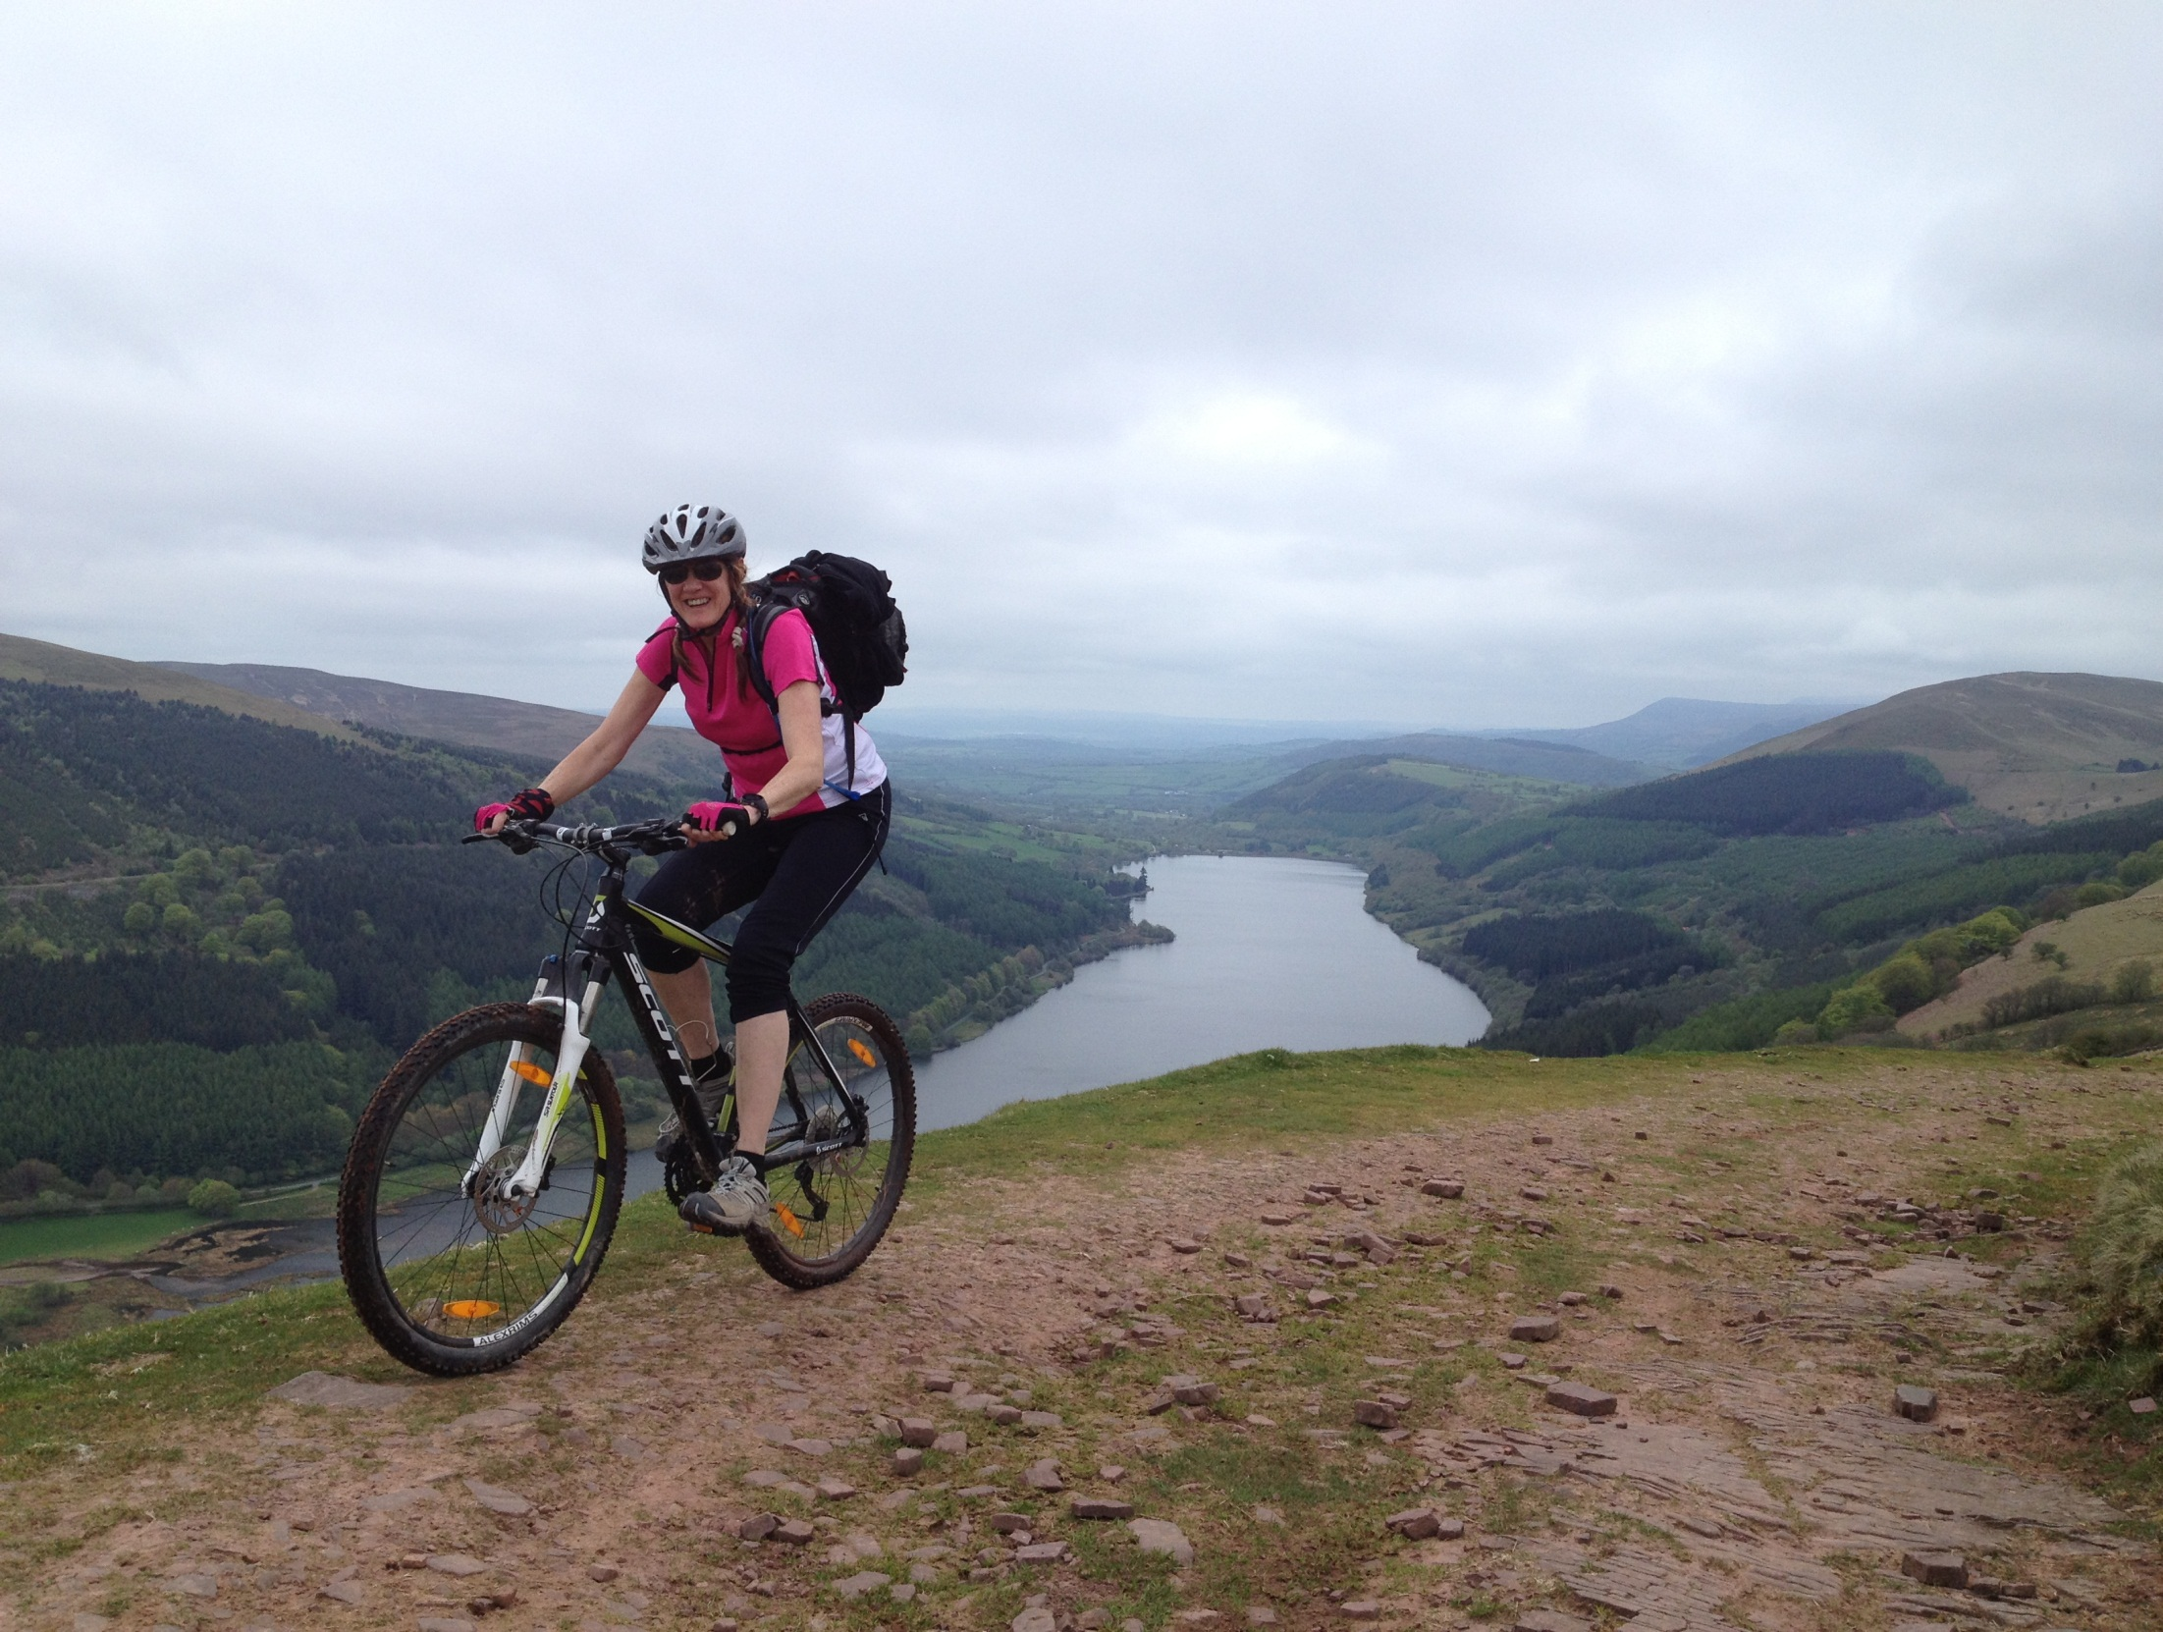
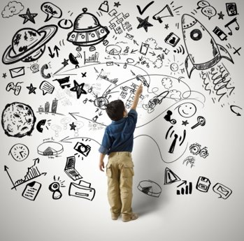
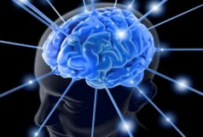
Monism
Notes:
Monism is a theory or doctrine that denies the existence of duality – Therefore, monism promotes the mind & the body alongside each other and that we as humans work as one entity i.e. they are seen as two different parts but of the same entity. Interlinking of parts.
In monism the physical brain and the abstract concepts of the mind e.g. theological – spiritual, emotional, mental are all as one.
& Because see ourselves as one entity - our mind doesn’t over burden our body and that it attempts to work as one.
However, in the world – the dualist within us fights this & many see psychological / mental and behavioural elements as separate entities to our physical elements. But with Covid-19 people have realized actually my mental wellbeing can be impacted by my physical engagement. & vice versa
SO PL embraces Monism & that every interaction provides new experiences and knowledge about the world PL therefore means that we do not deal the body and the mind as separate bits – but instead they are integrated naturally –
When we appreciate the full scope of what physical literacy entails – we see that developing as many Neural pathways within the brain is key ingredient – & that children’s wellbeing is considered hand in hand.
So – as future people potentially going into this world of work – we can promote the vision and importance of so that everyone’s PL journey grows and progress throughout life?

Slide 31
Ymarferol /Practical
Ymwybyddiaeth corff ac arddodiadau
Locomotor ac arddodiadau
Rheoli offer ac arddodiadau
Mewn parau creu gêm a dysgwch pâr arall
Body awareness
& prepositions
Locomotor
& prepositions
Object control
& prepositions
In pairs create a game & teach another pair
Notes:
Post 7yrs old children need to be able to control a range of movements confidently by themselves and with others & being inside and out!
Body awareness – in personal space / in shared space / body balances / shapes / how to use different body parts. All postural behaviour comes from balance (Blythe, 2005)
Locomotor –
Different ways of traveling - skipping / galloping / jumping – leaping, hoping, jumping like hop-scotch / walking / running – IN, AROUND, OVER, UNDER, THROUGH
Different directions of traveling – forwards sideways and backwards – IN, AROUND, OVER, UNDER, THROUGH
Directional pathways – straight / diagonal / zig zag / meandering / winding / twisting & as above
Different levels when traveling - high medium low
Different speed when traveling - fast medium slow
Object control - large and small objects / pull & push / throw & catch / kick and receive / stike / hold, grab, thread through, also bend / stretch / lift / carry / place /
Also with objects / loose parts you can explore prepositions
indoors –
In /on – mat / hoop / dot /
around - dots / hoops / mats / parachute
over – bench / table / mats /crawl over parachute
under – table / parachute
Through – hoops / crawl through tube
Outside
In/on – log / leaf / stepping-stones / puddle / mud / climb up to
Around – tree trunks /
Over – logs / sticks / puddles / mud / climb over
Under – branches / crawl
Through - crawl through willow
If we take physical literacy as a disposition – a way of being then the experiences that we have to promote this are crucial. Therefore, the environment & how we interact with it is extremely important.
Body awareness – in personal space / in shared space / body balances / shapes / how to use different body parts
Locomotor –
Different ways of traveling
Different directions of traveling
Different levels when traveling and
Different speed when traveling
Object control - large and small objects / pull & push / throw & catch / kick and receive / stike / hold, grab, thread through,

Slide 32
Foundational Movement Skills/ Competencies
Foundation Movement | Fundamental Sports Skills
Squat | Vertical Jump, sprint, hop, dodge, side gallop
Lunge | Sprint run, skip, hop, dodge, kick, static balance, catch, side gallop
Push Up | Overarm throw, strike
Pull Up | Throw, catch, strike
Hinge | Vertical jump, overarm throw, kick, dodge
Rotation | Sprint run, overarm throw, kick
Brace | Static balance, overarm throw, kick, sprint run, dodge
(Tompsett, Burkett & McKean, 2014)
Notes:
Understand what the foundational skills are – here is another variation of the same theme.
Physical competence impacts on life long physical activity (Stodden et al. 2008) and (Goodway and Branta, 2003)
So how are you moving differently outdoors in a natural environment? It’s more dynamic – as there is slightly more challenge than man made / & / or indoor environment.
Natural outdoor environment provides loose parts / unevan floors / smells and atmosphere ever changing / light & shade
Man made is always the same – predictable -

Slide 33
Post 13yrs
Notes:
It’s this – not a care in the world – with others – no barriers – no judging – being physical – social – with nature and adventure – adrelanine
BUT possibly some would be unable to engage because they haven’t been exposed to these experiences / feelings / environment to that point in their physical literacy journey.
So when we. Teach children we’ll need to be aware of this point.
Then as young child grows to be a teenager – how can their physical journeys be promoted? …

Slide 34
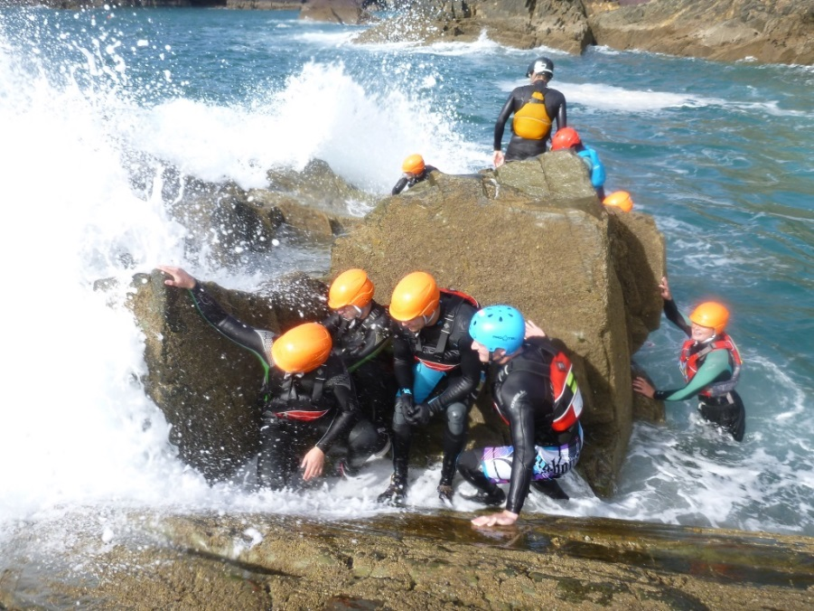
Post 13yrs
Notes:
Ensuring they have a range of physical experiences being taught in different settings – would be a good place to start!
(I)Continue motivation – exciting curriculum
(ii)Confidence – in the teaching environment & range of activities provided
(iii)Cognitive engagement – problem solving – be part of the planning programe/provision
(iv)Continue dev competence – by ensuring range of movements and skills being taught / provided
To support their natural dispositions to have a healthy / wholesome way of living. Encourage children to take more responsibility for their own learning and that we appreciate that environmental opportunities / families – significant others / and physical competencies AND MORE support the philosophy of what is known as physical literacy.

Slide 35
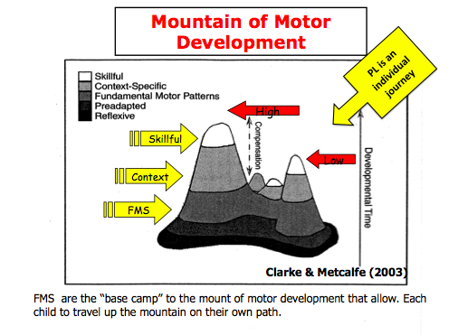
Notes:
FMS plays a role in the broader aspect of phys lit as a way of developing the physical competence element of phys lit. by developing locomotor and manipulative aspects of FMS and dev them in various settings & various contexts etc this then helps to develop the physical competence aspect of phys lit. (Definitions ….a systematic review 2016)
Talk about the mountain of motor development. …. One interesting point to make on this topic is that one’s motor competence (FMS) changes over time and also one’s physical activity can change with time.
Revisit our physical activity journey map & add in areas where you can see a potential ‘mountain’.

Slide 36
Link with Assignment
Part 1 : Essay. March 7th, 2025
Evaluate how children’s physical literacy can be developed by adventurous affordances.
Cat 1 : 30/100: read & reference, read & reference etc – Start with what’s on Moodle page & Leganto.
Notes:
So within your essay you will need to show good / very good / excellent understanding of what
(i) Knowledge and understanding of phys lit & this from a child’s perspective. (ii)Demonstrate then how this knowledge about physical literacy actually then relates to young children? What are the arguments, debate, justifications & again supported by literature. (300 words)
2. (i)knowledge and understanding of adventurous activities – value / impact etc
(ii) Your knowledge and und of how adv & physical literacy have on each other? what role does outdoor adventurous experiences have on this disposition. Inc concepts and theories & provide sound judgements – all supported by literature! (300 words)
3. (i)so what?.... If the above is all done well – what could we expect to see? Affectively / cognitively / physically …now & how may this knowledge inform professional delivery / teaching? (400 words)

Slide 37

Erthygl / Article
‘What is Physical Literacy, Really?’ (Jurbala (2015)
Rhannu ‘top tips’ sut i ddarllen erthygl (dosbarth)
Op. A : Rhannwch un/cwpwl o bwyntiau diddorol o’r erthygl (partner).
Op. B : Darllenwch paragraph o’r ‘Conclusion’ Pa eiriau sy’n bwysig?
Rhowch gynnig ar gyferinodi’r erthygl mewn testun ac rhestr ddarllen.
Share top tips how to read article (whole class)
Op. A : Share one/couple of interesting points from the article (partner).
Op. B : Read paragraph from conclusion & highlight key words
Have a go referencing this source in text & reading list
Notes:
Top tips how to read article
Read findings & conclusion 1st
Write synopsis of article in own words
By reading or by using tech put in key words in search tab from the article
Highlight key sentences
Include into reference list to avoid having to troll through again to try to find
Highlight potential ‘gem’ quotes & have a go at referencing
Highlight potential sections to paraphrase & have a go at referencing
Look at reference list supplied with articles for further reading options within similar field of research
Page 375 & conclusion section 379 & 380

Slide 38
Developing Physical Literacy in the Outdoors
Notes:
What does being outdoors add to the activity?
Feeling of exposure. - teimlo’n agored
Journey element – elfen o deithio i gyrraedd
Sense of play no physical bounderies – chwaraeus dim rhwystr amlwg o ran ymchwilion yn y gofod
Requires development of the skill in a slightly more tricky environment – floor uneven / wind /
Angen datblygu’r sgil mewn awyrgylch ychydig mwy heriol – llawr anwastad / gwynt
Accidental development or planned? Spontaneous? Adventurous!
Sense of ownership of the game / activity – created or adapted / decision making
Revisit our physical activity journey map & add in areas where as an adult you’ve engaged with physical activities in the outdoors? Swimming in the sea? Horse riding?

Slide 39
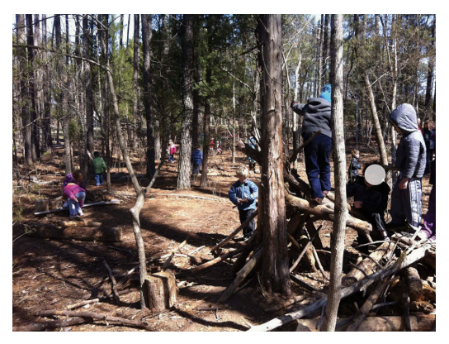
Notes:
Children enjoyed collecting sticks and logs in the natural zone. These stick-pile settings promoted hiding, Here we see a look-out and children balancing, as well as dramatic and constructive play opportunities. The ‘woods’ setting provide abundant natural and manufactured loose materials that inspired diverse spectrums of cognitive play and challenging behaviors.
Research shows that learning in a natural environment incorporates increased levels of physical activity helping significantly to children achieving their recommended daily activity levels (Mygind, 2007). the opposite ‘Nature – deficit Disorder’ can diminish use of the senses, attention difficulties and you could have higher rates of physical and emotional illness – Louv, 2005.
AND it’s not just physical health that is improved – contact with nature is also needed to maintain mental health Louv (2005) who’s research suggests that nature impacts positively on children’s concentration, reduced levels of stress and aggression.

Slide 40
Life long journey of Physical Literacy
Notes:
We now know that starting this with very young child toddler is important as some of the most significant years of cognitive development happens from when a child is born up to the age of 7yrs old.
It is important therefore that young children and their physical progression are developed in a meaningful and inclusive way.
BUT we are also aware that doing this is easier said than done in our modern society – as this can have a negative impact on this progression not just environment (digital) by physical (stranger danger & removal of parks)

Slide 41
OAE & PE
What can we do to encourage people to engage positively in their physical literacy journey?
Notes:
encouraging pupils to take more responsibility for their own learning
We need to ensure that when we lead outdoor activity that we consider the development of the whole person
Social
Physical
Emotional
High quality inclusive experiences that have scope for variations of engagement – opportunities for differentiation I offered atomacially
Positive environment – encouraging – rewarding – fulfilling
Furthermore the opportunities provided need to be inclusive, exciting, mentally stimulating as well as physical.

Slide 42
Crynhoi / Summary
Dealltwriaeth da a gwerthfawrogiad o Lythrennedd Corfforol.
Cyswllt gyda’r traethawd
Wythnos nesaf – byddwn yn astudio sut mae amgylchedd yn medru dylanwadu ymhellach ar lythrennedd corfforol person.
Cymrwch ofal o’ch hun yn feddyliol, corfforol ac yn emosiynol.
Now you have a very good understanding and appreciation of what is meant by Physical Literacy
Link with essay
Next week we’ll look at how an environment can influence one’s Physical Literacy journey.
Take care of yourselves mentally, physically and emotionally.
Notes:
NEXT WEEK we’ll look at how can adventurous activities contribute to this disposition.
As a result of today – have a go at writing about PH Lit and your understanding of it and what it possibly means to you as an adult?

Slide 43
Mind - Body – Emotion for Life
Your primary job is to take care of yourself. You’ve got to decide to make your health and wellbeing your priority
Notes:
It is through physical ‘embodiment’ that humans create themselves as they interact with their surroundings. (Whitehead, 2010, p.26).
Embodied = shaped by aspects of the entire body - features of cognition include high level mental constructs and performance on various cognitive tasks.
Embodiment – expression of something tangible / quality / feeling
One possible answer to this – could be to ensure that children can engage with confidence in a range of movements - & by doing so we can draw upon the concept of – fundamental movement skills. So to ensure that children can have physical embodiment with further supports their physical literacy we need to give them the necessary skills.
Some direct teaching will be needed and some modelling and sharing between and also some space for the child to explore and to have ownership of what it is they are learning (stages of which we’ll look at in much more detail further on in this module).

Slide 44
Rhestr Cyfeirnodi / Reference List
Ayres, J. (2005) Sensory Integration and the Child. Los Angeles: Western Psychological Services.
Australian Sports Commission, (2019) Australian Sports Commission: Physical Literacy,. Available at, https://www.sportaus.gov.au/physical_literacy. Accessed on: January 25th, 2025.
Blythe, G. (2005) The Well Balanced Child. Gloucestershire. Hawthorn Press.
Clark, J.E., & Metcalfe, J.S. (2002). ‘The mountain of motor development: A metaphor. In J.E. Clark & J.H. Humphrey (Eds.), Motor development: Research and reviews’. National Association of Sport and Physical Education. Vol. 2, pp. 163–190.
Dyson B. and Casey A. (2016) Cooperative Learning in Physical Education and Physcial Activity: A practical introduction. London Routledge​

Slide 45
Rhestr Cyfeirnodi / Reference List
Fjortoft, I. (2001) ‘The Natural Environment as a Playground for Children: The Impact of Outdoor Play Activities in Pre-Primary School Children’. Early Childhood Education Journal, 29(2), pp. 111-117.
Gallahue, D. L., Ozmun, J. C., & Goodway, J. D. (2011). Understanding motor development: Infants, children, adolescents, adults (7th ed.). New York: McGraw Hill Higher Education.
Goodway, J. D., & Branta, C. F. (2003). Influence of a motor skill intervention on fundamental motor skill development of disadvantaged preschool children. Research Quarterly for Exercise and Sport, 74(1), pp 36–46.
Jurbala, P. (2015) ‘What is Physical Literacy, Really?’ Quest, 67(4), pp367-383

Slide 46
Rhestr Cyfeirnodi / Reference List
Robinson, D. B., & Randall, L. (2016). Marking physical literacy or missing the mark on physical literacy? A conceptual critique of Canada’s physical literacy assessment instruments. Measurement in Physical Education and Exercise Science. doi:10.1080/1091367x.2016.1249793
Stodden, D. F., Goodway, J. D., Langendorfer, S. J., Roberton, M. A., Rudisill, M. E., Garcia, C., & Garcia, L. E. (2008). A developmental perspective on the role of motor skill competence in physical activity: An emergent relationship. Quest, 60(2), pp. 290–306.
Whitehead, M. (2010) Physical Literacy: Throughout the lifecourse. Oxon. Routledge​

