Slide 1
Group Project
Coronation Firework

Slide 2
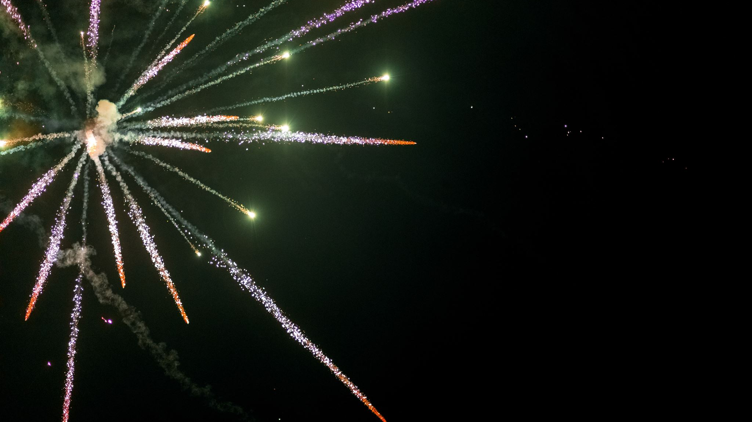
Requirements
A centrepiece firework is required for the conclusion of the coronation of His Majesty King Charles III.
The fireworks shall display a patriotic theme
They are to be fired from within the grounds of Buckingham Palace, with a portion of the effects occurring on and above the roof of the palace from the audience’s point of view
The audience will be located in front of Buckingham Palace around the Victoria Memorial, down The Mall, on surrounding roads and park land.
A duration of at least 30 seconds is required (excluding any time to effect) though up to two minutes is desirable
The materials budget for the fireworks display is £10,000
The display shall not break any legal limitations/regulations
‘Fall-Out’ (airborne display debris) shall be assessed and any associated safety issues addressed
Logistics and safety plans will be required
Environmental effects are to be considered and documented (disposal, site contamination, air pollution, etc.)
The following information may be useful!

Slide 3
Lesson Plan

Slide 4
Teams
Team 1
Team 2
Team 3

Slide 5
Team Roles and Responsibilities, Manufacture and Processing
Determine the production requirements
Propose process and commissioning trials
Conduct process trade off studies
Propose a manufacturing process
Construct a process flow
Understand where in that flow the critical features are created
Conduct a PFMEA
Understand the noises and controls in the process and the handshake through the flow
Raise the process control plan
Certify the manufacturing process

Slide 6
Team Roles and Responsibilities, T&E
Analyses the test requirements and specifies tests and trials appropriate to the stage of maturity of the design.
Compatibility testing.
Creates the trials specifications, plans and risk assessments,
Creates the trials procedures and conducts the trial to it.
Delivers advanced trials reports and final trials report
Conducts the Lesson Learned review post trials.
Three areas of trials to concentrate on in this project.
Performance, qualification and process

Slide 7
Team Roles and Responsibilities, B&D
Design for De mil. (Ensuring designs can be taken apart when they do malfunction so some forensic work can be undertaken)
X-Ray and NDT techniques.
Determining the waste streams in prototype and series manufacture and specifying the means of disposal.
Understanding the environmental aspects of disposal techniques.
Understanding the functionality of the device in order to render it safe and dispose of it. (Including in the case of malfunction)

Slide 8
Team Roles and Responsibilities, Safety
Understand the safety requirements of the design in use.
Conduct risk assessments for prototype manufacture, Series manufacture, use (in trials and in operation,
Occupational safety of prototype and series manufacture
Equipment safety legislation.
Prepare the basis of safety for series production including licensing and storage aspects.
Toxicity and environmental impact in function and manufacture.

Slide 9
Team Roles and Responsibilities, R&D
Takes in the requirements for the device and prioritises them.
Develops the functional map and the functional flow.
With trials and test engineer develops a series of trials to assess competing designs.
Proposes design options and highlights design tradeoffs.
Conducts DFMEA analysis etc. to determine design critical performance features (Safety critical feature)
Certifies design for trials understanding the limitations of use
Specifies qualification (Environmental) testing
Write process instructions to make prototypes and conducts risk assessment for the process (With Safety Representatives)
Interprets test data, (safety and performance)

Slide 10
Presentation
Role
TR&D | Understanding and analysis of customer requirements | Understanding of design deliverables | Critical analysis of design trade off and selection of appropriate design | Proposal of designs for trials | Contribution to manufacturing e.g. identification of critical design features | Contribution to process instructions, PCP, Care points
Total mark =
Manufacturing | Understanding and analysis of manufacturing requirements | Understanding of process deliverables | Critical analysis of process trade-offs and selection of appropriate designs form manufacture | Proposals for manufacturing verification trials | Identification of critical process steps | Development of the process control plan
Total mark =
Safety | Understanding of the safety requirements for the area selected | Understanding of the legal safety deliverables | Identification of the key hazards in the selected area of operation | Critical analysis of the key hazards | Description of the mitigation required to be included in procedures | Development of the basis of safety
Total mark =
Test and Evaluation | Understanding of the test and evaluation Requirements for the area selected | Understanding of the test deliverables | Identification of trials and test techniques appropriate to the design phase selected | Critical analysis of trials data. Go no go decisions | Feedback into the design process | Presentation of trials data.
Total mark =
Breakdown and Disposal | Understanding of the breakdown and disposal Requirements for the area selected | Understanding the deliverables for design for disposal in test and production arenas | Identification of candidate disposal techniques for article and explosive disposal | Critical analysis of disposal design data | Feedback into the design process | Preparation of the waste stream management plan
Total mark =

Slide 11
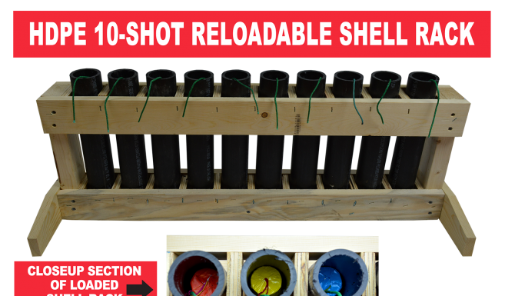
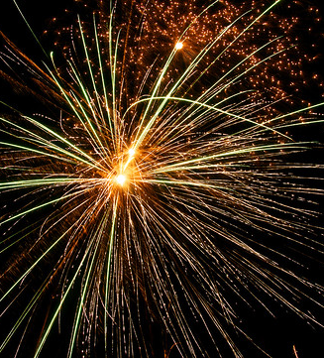
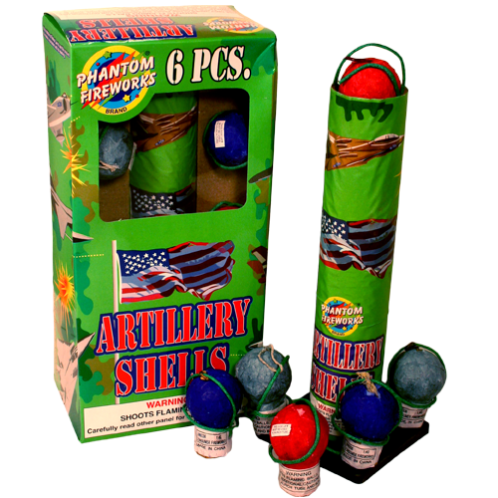
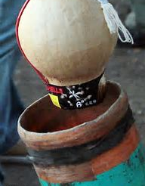
Types of fireworks. No1 Mortars.
A mortar tube uses a lifting charge to launch a shell which is ignited and burst at a predetermined burst height
The shells can contain simple stars or complex displays which show as multiple breaks (Usually up to three)
The shells can vary in size anywhere from an inch or so to the size of a football.
They can be deployed either singly or, more usually, from racks sequencing several shots.

Slide 12
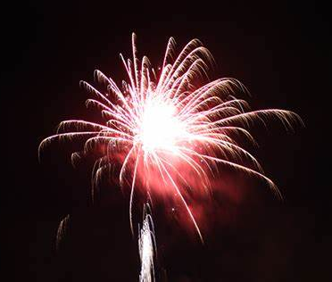
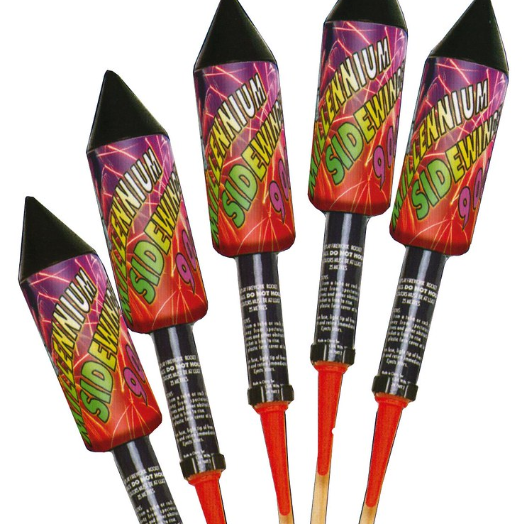
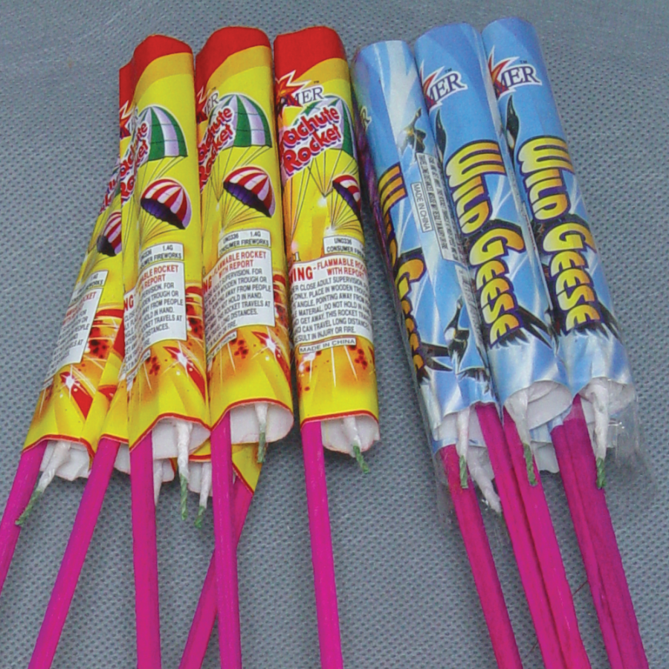
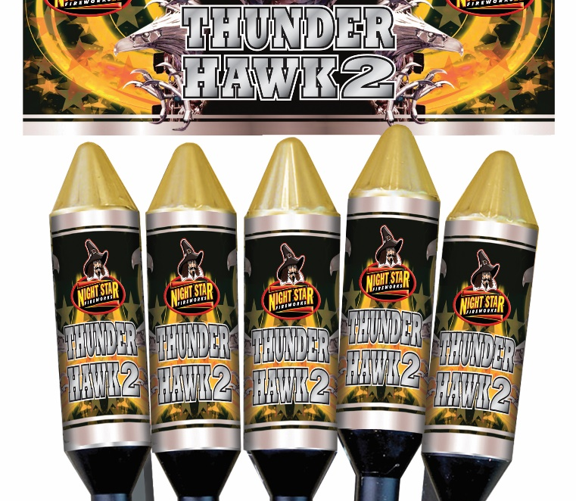
Types of fireworks. No2 Rockets.
Rockets, as the name suggests, use a rocket motor to propel the display skywards
They normally have three parts. The display shell, the motor and a stabilizing stick
They are normally fired in salvoes but can be deployed singly
The effect may be retarded on a parachute

Slide 13
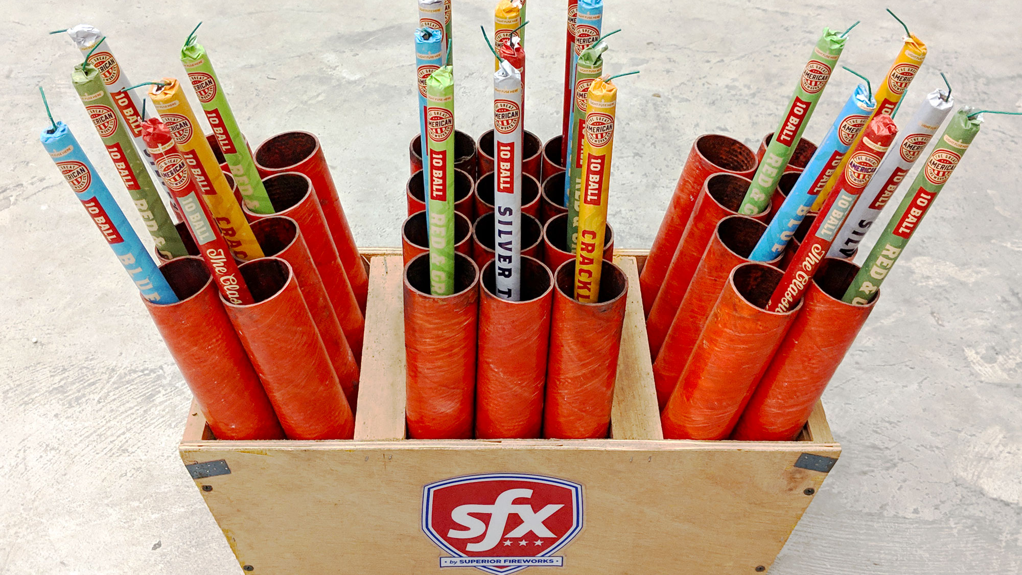
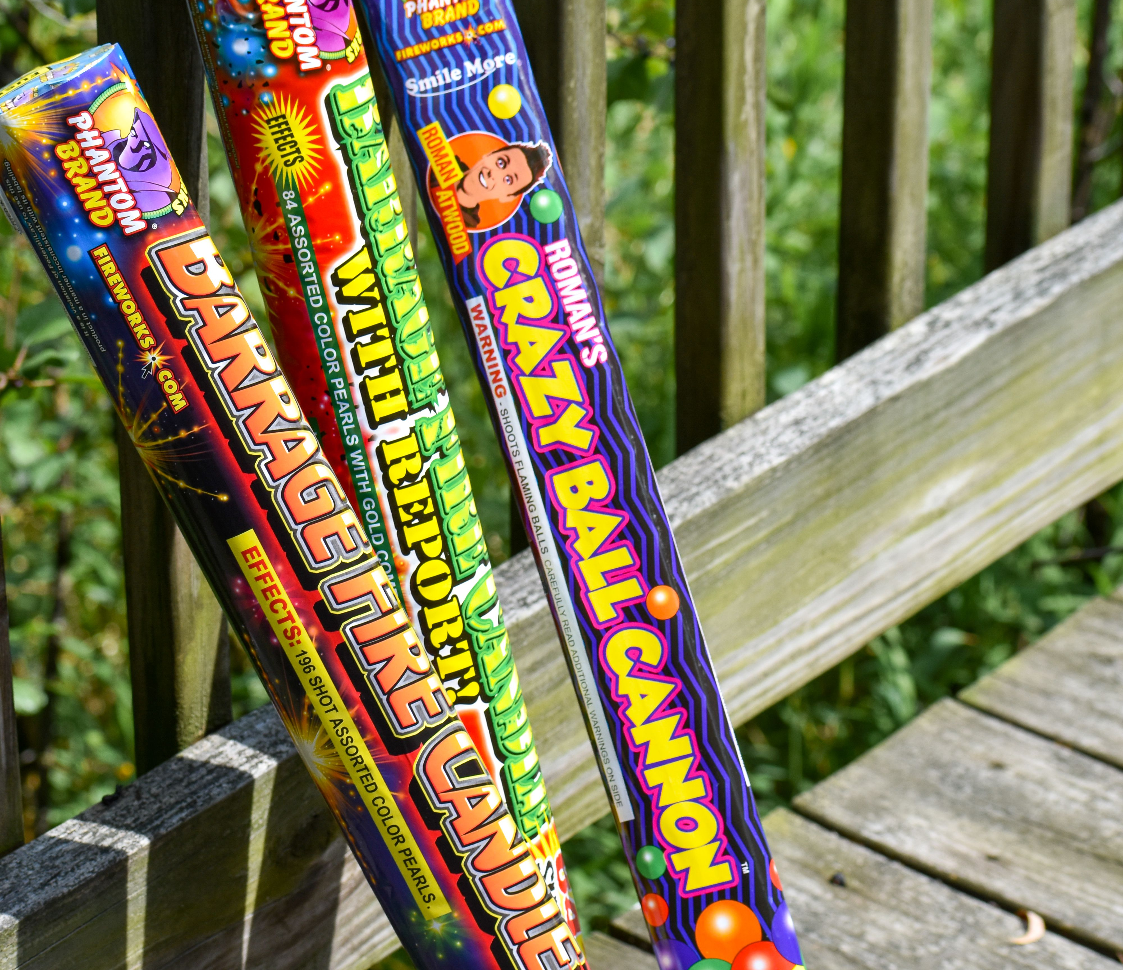
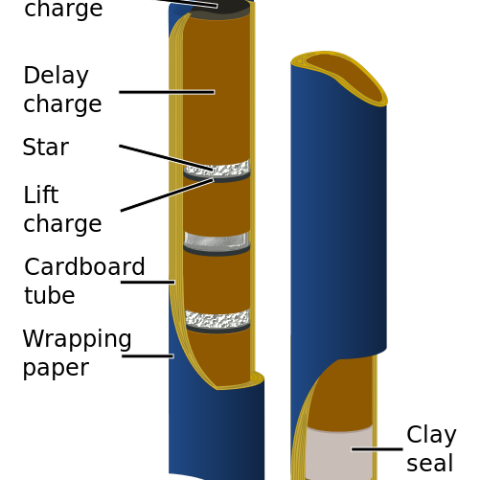
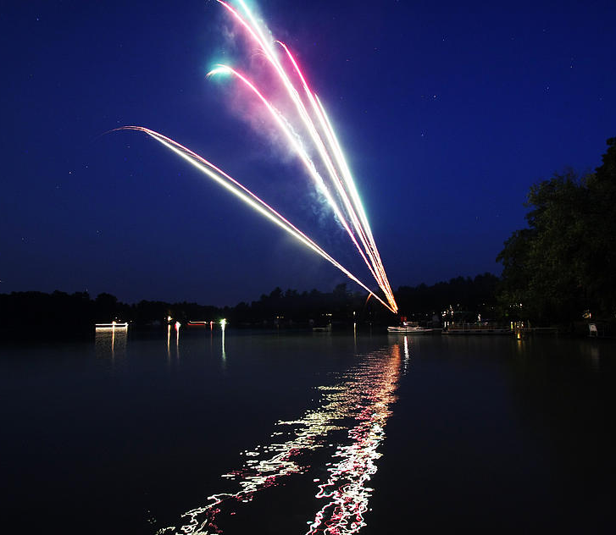
Types of fireworks. No3 Roman Candles
Roman Candles use lift charges to fire stars. Airburst and crackle effects skywards.
A static display is maintained between ejections.
Each subsequent effect rises higher due to the longer length of tube allowed for acceleration.

Slide 14
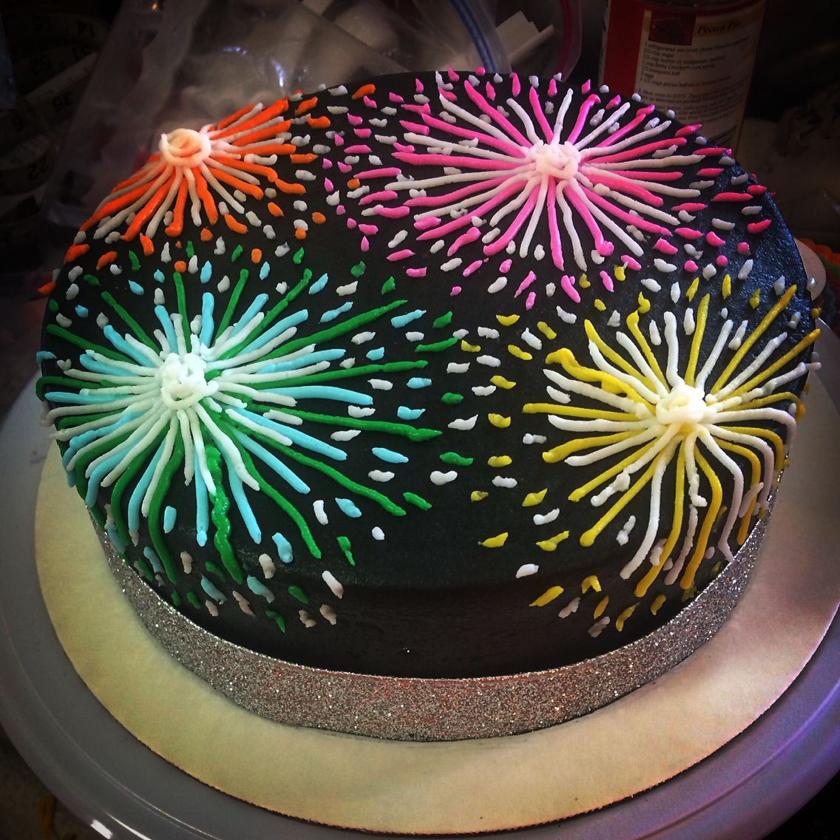
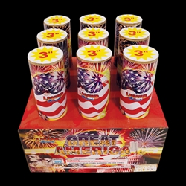
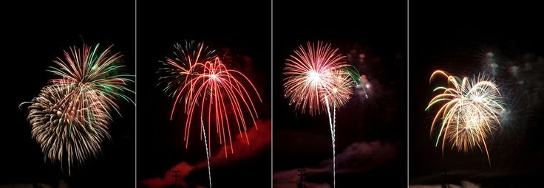
Types of fireworks. No4 Cakes
A firework cake is a series of tubes that have been fused together in one box for a chain reaction of shots and effects.
Typically a cake will be square or rectangular in shape.
Cakes are very popular for backyard shows, as they only require you to light them one time and have multiple shots and effects.

Slide 15
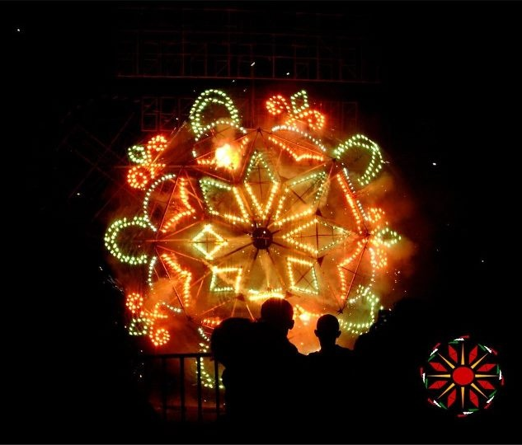
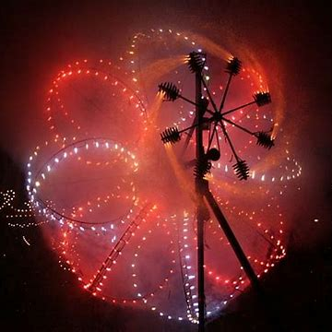
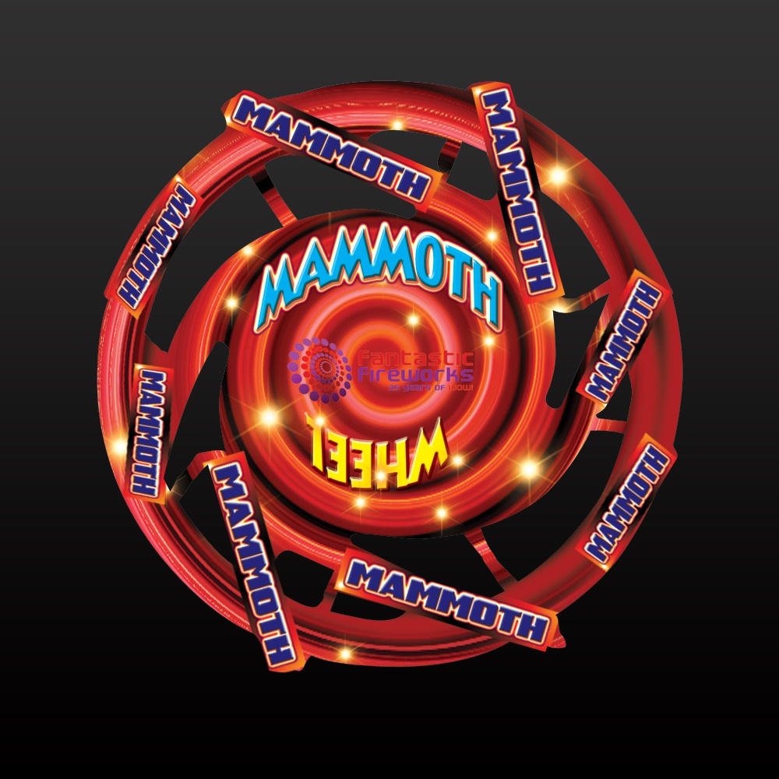
Types of fireworks. No5 Wheels
Wheels cam be small (A few inches in diameter) or huge!
Larger effects use rockets as drivers, some with sparkle effects and lances (Static flares) for colour.

Slide 16
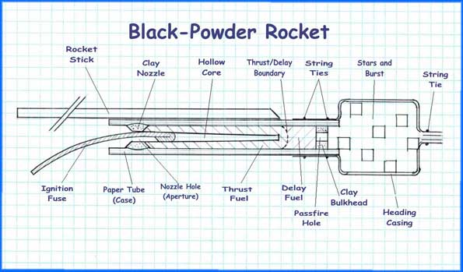
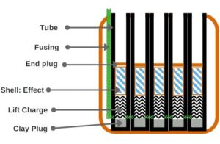
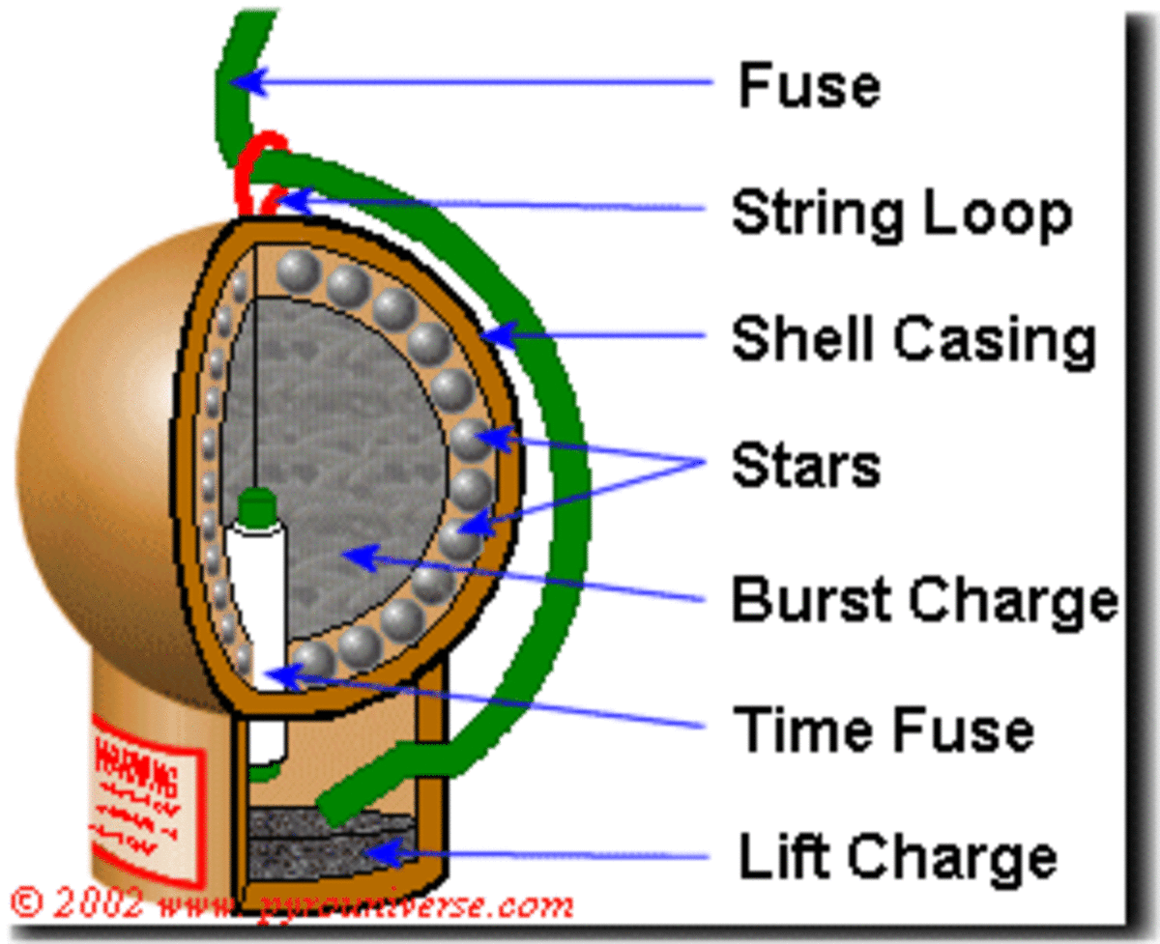
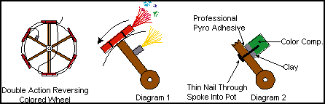
Drawings

